Slide 1




What does fair business taxation look like in a digital world?
Chair: Hamish Sandison
Labour Business
#ciotifsdebates #lab18

Slide 2
What does fair business taxation look like in a digital world?
Labour Party Conference fringe event 2018
Helen Miller
@HelenMiller_IFS

Slide 3
What does ‘fair’ mean when applied to business?
Concepts of ‘fair share’ apply more naturally to people
    87% of tax is handed to government by business, but all taxes are ultimately paid by people
    Corporate tax comes from the incomes of shareholders, workers &/or consumers
      Taxing large companies is not synonymous with taxing rich people
    How else to judge a corporate tax system ?
    Does tax give some firms a competitive advantage?
      Are digital companies being advantaged by lower tax rates?
    How does corporate tax distort where firms choose to locate profits and real activities?

Slide 4

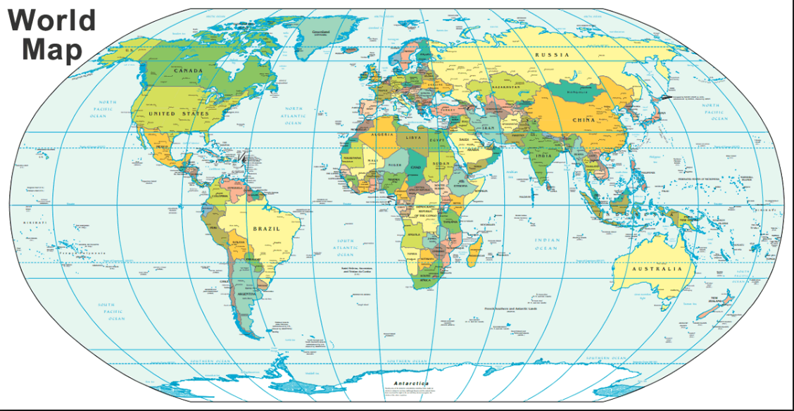






Corporate tax is quite simple ...
Allocation of corporate tax receipts is hard
Allocation based on users is really hard
Parent company
Production subsidiary
Intellectual property
Customers

Slide 5
Where do we go from here?
Everyone agrees the current system has problems
    No single ‘right’ answer to the question of where value was created; harder with digital
    Firms have incentives to shift profits & activities (can create real distortions) & governments have incentives to compete
But fairness doesn’t offer a criteria that helps allocate corporate tax
    Taxes based on residence of HQ, location of subsidiaries, where value is created, location of consumers could all be argued to be fair
A practical way forward is to try to reduce distortions (including to competition)
    Keep adding patches (to general system & specifically for digital)
      But don’t expect that to lead to a surge in UK tax revenues or fix all competition issues
    Or move to a system that has fewer problems
      Destination based corporate tax has merits: consumers are less mobile than businesses, investments or profits; removes incentives for firms shift activities and for governments to compete

Slide 6
What does fair business taxation look like in a digital world?
Anneliese Dodds MP
Shadow Financial Secretary to the Treasury
#ciotifsdebates #lab18

Slide 7
What does “Fair Business Taxation” look like in a digital world?
Glyn Fullelove
Chair of Technical Committee & Deputy President CIOT

Slide 8
Agenda
What is Fair Taxation?
Corporation Tax - A debate within a debate
UK Proposals
Can CT deliver?
Is it really a tax problem – or another sort of problem?

Slide 9
What is Fair Taxation?
Clear rules with certainty of treatment
Everything that should be taxed is taxed
No double taxation
No unwarranted advantages for a particular group of taxpayers
  Concern that companies get tax breaks or “deals” that individuals can’t
Same treatment for taxpayers in the same situation
  Concern that global digital businesses have advantages over
    Traditional businesses
    Domestic business
Probably not a complete list, and fairness is not the only consideration – complexity and practicality also play a part.

Slide 10
Corporation Tax
A Debate Within a Debate
“Amazon halved corporation tax bill despite UK profits tripling”
The Guardian, 3rd August 2018
I
“Mr Corbyn…called for the BBC to be funded through a “digital licence fee” on global tech giants…” The Times, 23rd August 2018
“Higher VAT for online would “save high street”” The Times 18th August 2018

Slide 11
Corporation Tax on Digital Companies
A perception of unfairness
Why:
  Avoidance?
  Base Erosion and Profit Shifting?
  Mismatch between tax and value creation?
What’s been done, what’s still to be done
This discussion is now within a context of a much wider debate on how digitalisation is affecting our lives and “traditional” businesses
Tax only one element
Monopolies?

Slide 12
Avoidance
What is it ; my definition of “traditional” tax avoidance - taking a position to reduce your tax using an interpretation of law you knew would be contested
Definitely unfair…but
Since the 2008 Crash, “traditional” tax avoidance has practically disappeared from the large corporate landscape in the UK
Government action (Banking Code, GAAR), Reputational Risk, Greater scrutiny and transparency
HMRC have greater powers (follower notices)

Slide 13
Base Erosion and Profit Shifting
Moving profits from high tax to low tax jurisdictions or making them disappear altogether (hybrid instruments)
Looks like tax avoidance – but this was stuff governments signed off on, or actively promoted – so no challenges from the authorities/courts
Quite a wide spread – you could include incentives such as patent boxes
Unfair because it gives one group of taxpayers – MNC’s – advantages others don’t have
Since 2013 –international action and hundreds of pages of UK legislation to combat BEPS
US Tax reform (1.1.18) also stops worst of BEPS for US MNC’s

Slide 14
Remaining CT Issues
Despite all these measures, and others around greater transparency, still concerns
Probably some lag between measures and results being recognised
But also sense that all profits made in UK not necessarily taxed in UK
Digital companies where users and user data are fundamental to the business model
Is that accounted for and taxed?

Slide 15

UK Proposals
March position paper update

Slide 16
Corporate Tax and the digital economy: position paper update
UK government “embraces” the changes brought about by digitalisation
Welcomes the important contribution made by the UK’s fast-growing digital tech sector
Notes employment of 1.5 million and investment of £6.8 billion (compares to 24,000 employed in the fishing industry)
Development of certain business models challenges the understanding of where value is created

Slide 17
The Government’s updated view
There are fundamental concerns about how the international tax rules apply to digital business
The key problem is the failure to take account of user-created value
The participation and engagement of users is important in value creation for certain business models
The preferred solution to this challenge is reform of the international tax framework through the OECD inclusive framework to reflect the value of user participation
The position paper considers how user participation creates value; an approach for incorporating this value into international tax rules
There is a need to consider interim measures

Slide 18
The UK’s view of user participation
Four channels
  User generated content – a platform populated by users’ posts, where revenue is generated from advertising (do they mean Facebook?)
  Depth of Engagement – sustained engagement leads to user-tailored platforms, and valuable data generation
  Network effects – interactions with other users – ratings, aggregations of searches – relevant to various types of platforms including intermediaries
  Contribution to brand – users creating “trust mechanism” for other users

Slide 19
Further considerations
Customers and users are different
A transactional relationship is not deep and interactive…
Data can be of significant value…
..but mere collection of data does not mean user created value is being generated

Slide 20
Longer Term Reform
Will take time to put in place because
Use OECD treaty principles
User created value should be recognised
User created value is realised within “residual profit”
Reward user created value through a percentage share of residual profit
Specify levels or bands – may vary from business model to business model – but how are those levels set?
Needs a deep understanding of, for example, why vendors advertise on Facebook and other platforms
Allocation to jurisdiction needs to take account of different “user-values”

Slide 21
Interim Measures
An interim measure would be a tax on the revenues of digital business deriving significant value from UK user participation
Three possible ways to determine scope:
Define the channels through which users create value and impose tax on relevant revenue
Objectively define categories of business, then tax revenues – social media platforms, search engines, online marketplaces
Define revenues – online advertising/facilitation of third party transactions and tax that (Closest to EU approach)
Revenues that relate to users in the UK – but could vary according to business model

Slide 22
Wider Considerations
User location – frequent crossing of borders?
Protecting start-ups and promoting growth and innovation:
  High de minimis threshold
  Set at appropriate level, recognising that tax will be applied to businesses with differing profit margins
  Safe harbour mechanisms to protect businesses with low margins or loss-makers
  Link to an imputed balance sheet strength measure?
A work in progress

Slide 23
The Wider Debate
The use of personal data
News and Fake News – platforms or publishers?
Property values and taxation
Consumers choosing the tech solution

Slide 24
Do we need other taxes?
CT is only a small part of the overall tax take
Are we asking too much of it?
Are digital profits so “intangible” we will never be happy we are taxing them properly?
Digital infrastructure use taxes?
Delivery taxes?
How do other taxes promote innovation and employment?

Slide 25
Is it a tax problem at all?
Margins made by some digital companies very high
Monopoly profits are hard to properly allocate for tax – they break all the rules
Regulation not tax?

Slide 26
What does fair business taxation look like in a digital world?
Hamish Sandison Labour Business (Chair) @HamishSandison
Anneliese Dodds MP Shadow Financial Secretary to the Treasury @AnnelieseDodds
Glyn Fullelove Chartered Institute of Taxation @CIOTNews
Helen Miller Institute for Fiscal Studies @HelenMiller_IFS
#ciotifsdebates #lab18

