Slide 1
A career in tax

Slide 2


What is tax?
Driven by politics and is often a hot topic
Funds society
Doctors, Police, Hospital

Slide 3


Why work in tax?
Problem-solving
Constantly changing
Person-focused

Slide 4

My career
My background
First tax job – getting ATT
Current role
My qualifications
My current and former clients
My “thing(s) I wish I knew then that I know now” nugget

Slide 5

Benefits of a career in tax

Slide 6















Where I can work?
Professional Services
Business and Industry
Government

Slide 7
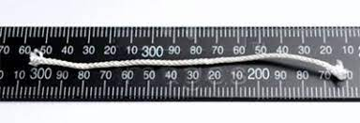
How much could I earn?
Practice | London | Regions
Partner | £100,000 to £2.5 million | £85,000 to £1million
Director | £90,000 to £200,000 | £75,000 to £150,000
Senior Manager | £60,000 to £100,000 | £50,000 to £80,000
Manager | £55,000 to £75,000 | £40,000 to £53,000
Assistant Manager | £42,000 to £55,000 | £32,000 to £40,000
Tax Senior | £32,000 to £45,000 | £25,000 to £35,000
Tax Assistant | £25,000 to £35,000 | £18,000 to £27,000
Information from Georgiana Head Recruitment Ltd
Information from Georgiana Head Recruitment Ltd (2021) .

Slide 8


Where do I start?
Association of Taxation Technicians (ATT)
The leading professional body for qualified taxation technicians who provide UK tax compliance services and related activities
The leading professional body concerned solely with taxation. Members have the practicing title of ‘Chartered Tax Adviser’

Slide 9

Routes in to studying
School leaver Programme
Graduate Programme
Apprenticeship Programme
Self Study

Slide 10

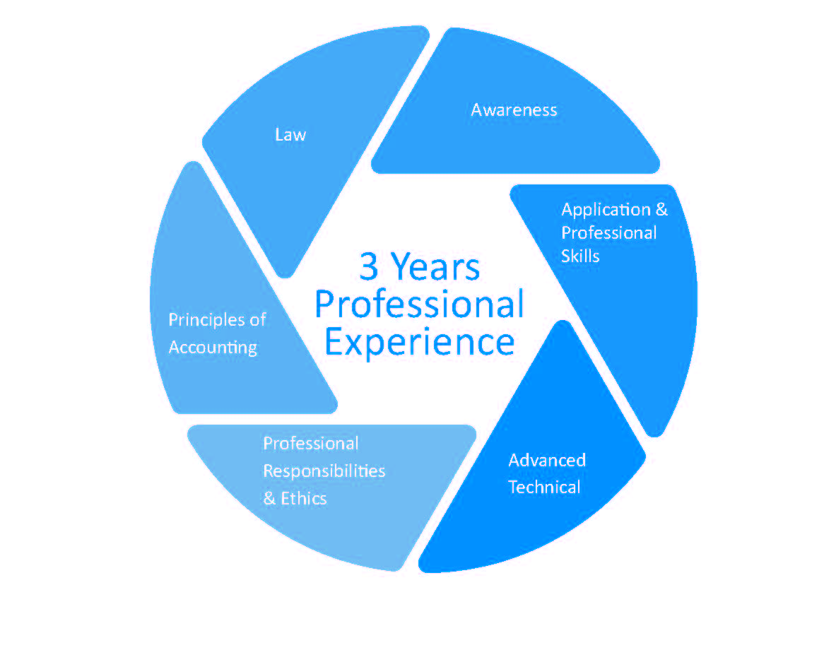
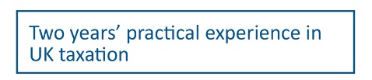
How do I start?

Slide 11
Exemptions
You may be eligible to apply for exemptions from some of our examinations if you hold certain professional qualifications. For example:
Based on the AAT qualification, you might be eligible to apply for the following exemption(s):
Examination | Criteria
Principles of Accounting: Computer Based Examination | AAT Level 4 exam qualified
The full list of exemptions is available on our websites. www.att.org.uk and www.tax.org.uk

Slide 12

Entry Requirements
To be eligible to register as a student you must be at least 16 years old with a reasonable standard of English and Mathematics
To be eligible to register as a student you must be at least 16 years old with a reasonable standard of English and Mathematics. If you don’t already have a tax qualification, we strongly recommend studying for the Tax Pathway which includes ATT examinations.

Slide 13
… or try something in advance!
Foundation qualifications:
Personal tax
Business tax
VAT compliance
Transfer pricing
Each qualification is split into four modules of learning and testing. You can work through these at your own pace. Once you have passed the four modules you then have to complete the Final Certificate Examination. All the material is online and can be sat at any time.
https://www.att.org.uk/qualification-navigator

Slide 14

Member benefits
Recognised as a Tax Professional
Letters after your name
Monthly publications
Yearly publications
Access to our Branch Network for CPD and
networking opportunities
Members Support Service
Discounts on tax related products and
services

Slide 15
Tax impacts you even if you decide against it as a career
Student loans
The main way of repaying loans taken out since 1998 is via the tax system, so you will deal with both the Student Loans Company (SLC) and HM Revenue & Customs (HMRC) when you leave or finish your studies and start paying back what you owe. https://www.taxguideforstudents.org.uk/student-loans
Part time work
Many students work part-time. Students on an apprenticeship will also be earning while they are on their course. It is important that you understand what income you can earn before you start paying tax and National Insurance contributions, what your payslip shows you and, if you have overpaid tax, how you obtain a refund.
https://www.taxguideforstudents.org.uk/tax-essentials
Going abroad
If you are going to be working and earning income whilst you are abroad you will need to notify HMRC and consider your UK tax situation (for example, whether you are due a UK tax refund or need to complete a tax return)
https://www.taxguideforstudents.org.uk/going-abroad

Slide 16


Want to know more?
Website: www.att.org.uk
Email: Info@att.org.uk
Telephone: 020 7340 0551
Website: www.tax.org.uk
Email: Info@tax.org.uk
Telephone: 020 7340 0550
For more information on tax go to:
www.taxguideforstudents.org.uk

