Slide 1


Supporting the learning journey of tax trainees
At Kaplan we’re here to help you realise your goals
Andy Fitzsimmons
Kaplan ATT & CTA Commercial Manager

Slide 2
Contents
Kaplan’s course offering and course footprint
Kaplan’s learning resources and support
Continuous innovation at Kaplan

Slide 3
Set yourself plans to succeed now and Kaplan’s tax training courses will guide and support you to achieve your goals.

Slide 4
Kaplan’s course offering
We offer a comprehensive suite of ATT and CTA courses to all available exam sittings. This enables us to support the following programmes for our clients and students:
- ATT
- CTA
- ATT/CTA
- ACA CTA
We provide both fee paying and apprenticeship options as part of our delivery.

Slide 5
Kaplan’s ATT and CTA course footprint
We offer classroom courses at our Birmingham, Bristol, Leeds, London, Manchester, Newcastle, Reading and Southampton centres.
In addition we also offer a full suite of Live Online courses in the daytime and the evening for those students who are unable to attend a physical location.
For dates and course specifics please visit:
https://kaplan.co.uk/courses/att
https://kaplan.co.uk/courses/cta

Slide 6


Kaplan learning resources
When you enrol on a Kaplan course it provides you with access to a wealth of learning resources
Our interactive learning portal MyKaplan acts as the spine of our courses and provides access to additional learning resources that complement both our Classroom and Live Online delivery:
Electronic versions of study materials, including access to an e-reader
Guidance to structure self-directed learning and homework
Live Online recordings of the full course for all students

Slide 7

Kaplan learning resources cont’d
We also provide:
Video tutorials covering tricky topic areas
Video walkthroughs of exam questions
Online quizzes
Professionally marked practice exams throughout tuition and revision courses providing detailed feedback to learners about how to continuously improve

Slide 8

Kaplan Support
Our dedicated tax tutors are specialists in their field and will support our learners throughout their studies with regular contact between course dates as well as during class.
In addition, our Academic Support team is on hand to answer student technical questions and queries 362 days a year including evenings and weekends via email, live chat and request a call back.
Talent coaches assigned to each Apprentice provide coaching support and guidance to both the learner and their employer throughout their apprenticeship.
The learning experience we provide means that Kaplan’s pass rates are consistently above National pass rates for both ATT and CTA exams.

Slide 9

Kaplan continuous innovation
In 2022 we launched our Tax Apprenticeships Plus offering in collaboration with our partners at Mercia Group.
This new offering adds a series of practical tax related on demand modules that:
Contextualise technical study towards exams
Further develop the skills and behaviours needed by a tax professional
Build the confidence needed to apply technical skills in the workplace with success

Slide 10
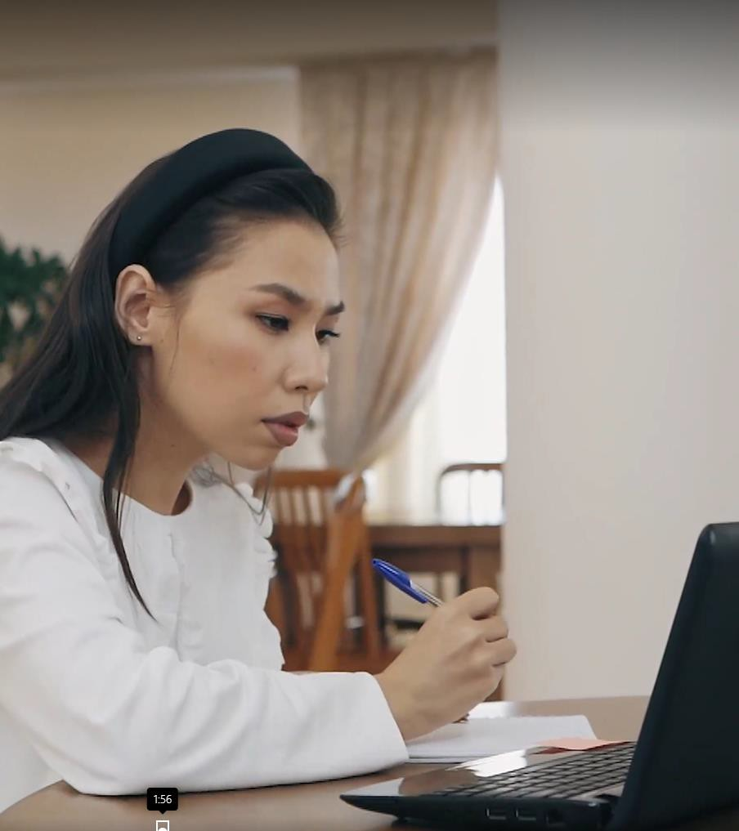
Kaplan continuous innovation
In 2022 we also launched our ATT and CTA Classroom Live Streamed courses which combine Kaplan’s high quality in-classroom experience with the flexibility to study from wherever our students want to.
Our students log in to live classroom sessions via Zoom and are able to see both their tutor and those students sitting in the actual classroom, making it feel like you are physically there.
Learners are able to listen to the questions asked both in class and online, and contribute to the conversation themselves.
We’re really excited about the learning experience this innovation can provide to our learners.

Slide 11
Thank you for your time

Slide 12


Thank you.
Want to know more?
Please contact our Kaplan Client Service team: clientservices@kaplan.co.uk
0161 259 7400
Website: www.att.org.uk Email: Info@att.org.uk Telephone: 020 7340 0551
Website: www.tax.org.uk Email: Info@tax.org.uk Telephone: 020 7340 0550
Twitter.com/ourATT www.linkedin.com/groups?gid
=3930317
Twitter.com/CIOTnews www.linkedin.com/groups?gi d=108458

