Slide 1


Attract and recruit the best talent in tax
Deloitte LLP: approach to attraction, selection and recruitment
Amelia Chapman: Tax and Legal Recruitment Manager
Jenny Catlin: Head of Professional Education

Slide 2
Contents
About Deloitte
Early Careers Recruitment - overview
Deloitte’s Early Career Programmes
Attraction and Career Paths
Attraction and Events
Selection Process
Questions

Slide 3
About Deloitte
Deloitte UK is a leading professional services firm committed to making an impact for our clients, our people and for society. We have over 20,000 people across the UK, providing Audit, Risk Advisory, Tax, Consulting and Financial Advisory services to public and private clients across multiple industries.
Bringing purpose to life for our people
Living our purpose with clients
An Impact that matters for society
The role of business in helping respond to society’s biggest challenges has never been more important. We are committed to playing a leading role in building trust in business, driving more inclusive and sustainable growth, and enhancing skills, education and inclusion for all.
Richard Houston, CEO, Deloitte UK and Deloitte North and South Europe
Annual Report 2020
Notes:
MKF to present

Slide 4

Deloitte Early Careers Recruitment
On average Deloitte recruits c.350 full time student hires into the Tax and Legal practice every year.
Graduates comprise the majority of our early careers recruits but we also have a well established school leaver programme, known as our BrightStart Programme.
We also have early work experience programmes, for both university and college students which act as feeders for our Graduate and School Leaver programmes.
The majority undertake a Professional Qualification with CIOT – either as part of the Joint Programme (ACA/CTA) or Tax Pathway (ATT/CTA).
Our qualifications are embedded into the Level 7 or Level 4 Apprenticeship Accounting / Tax Apprenticeship Standards

Slide 5

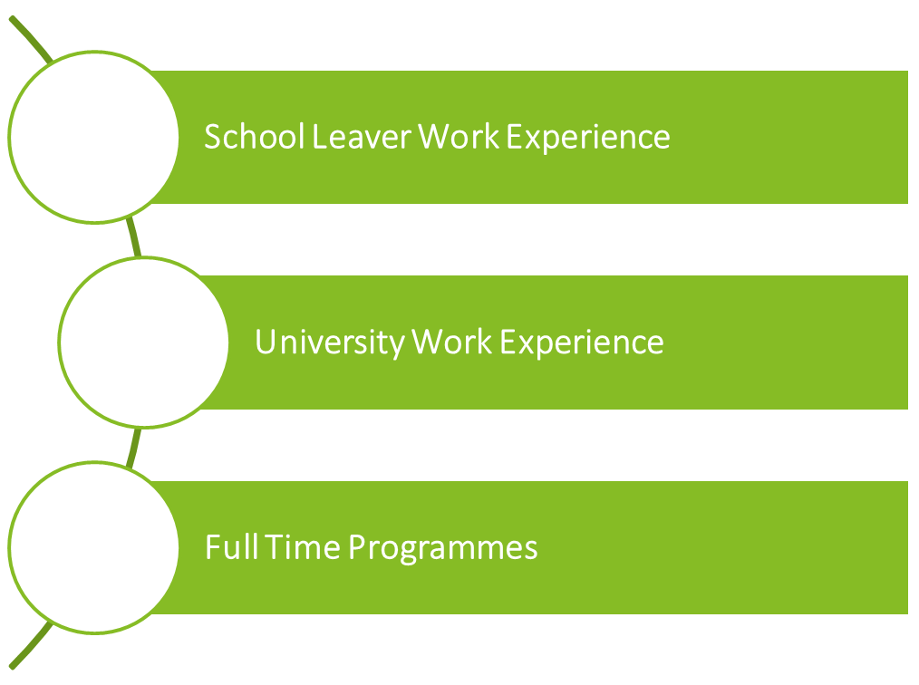
Deloitte Early Careers Programmes

Slide 6
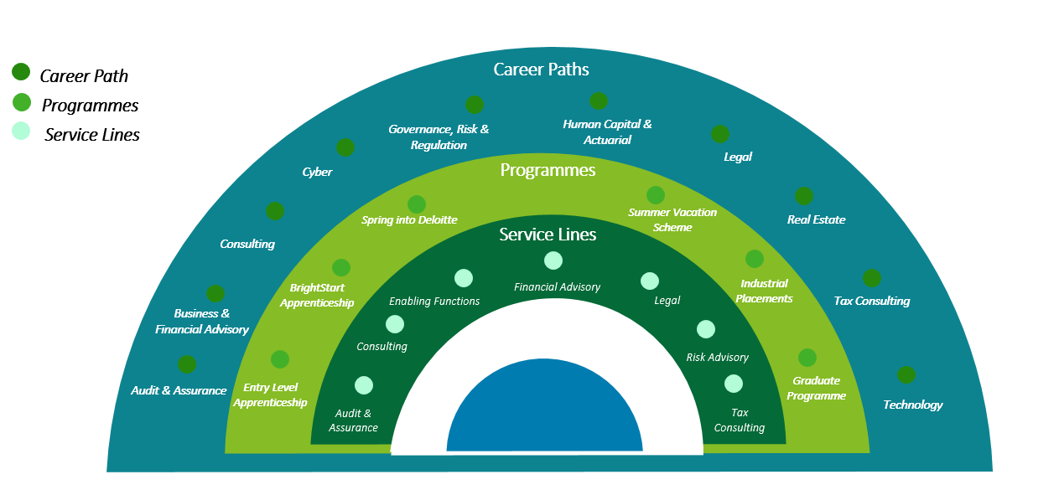
Attraction & Career Paths

Slide 7

Attraction & Events
Job Boards
Digital Media
University Events
Schools Events

Slide 8

Selection
Our Four Stage Recruitment Process
Apply Online
Immersive Online Assessment
Job Simulation
Final Assessment
For more information on our process, visit our assessment page on deloitte.co.uk/earlycareers

Slide 9

Thank you for your time
Any questions?

