Slide 1



Attract and recruit the best talent in tax
How to attract tax candidates in a competitive market place.
Georgiana Head
Director – Georgiana Head Recruitment

Slide 2

Contents
Who am I?
Why is it a difficult market place?
How to differentiate your offering.
What works in advertising campaigns
Thinking outside the box

Slide 3
Why is there an issue attracting Tax Staff?
The Great Resignation
Not enough tax professionals to go around
Changing labour market for tax
HMRC and in-house increased governance
Increase in salaries

Slide 4
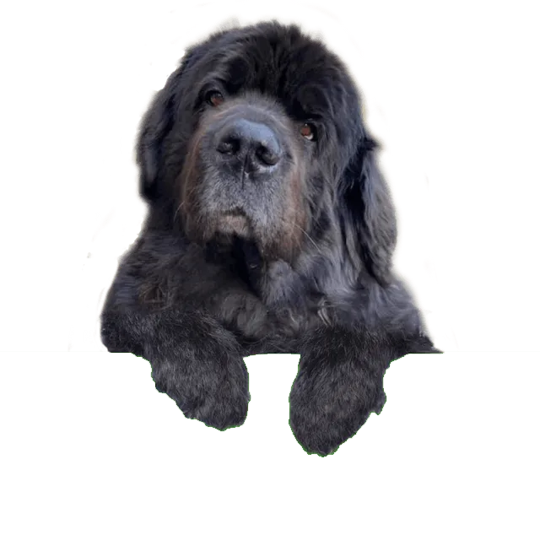
How to differentiate your offering
What is your USP?
What are you known for?
What do you want to be known for?
Remote working
Can you be location ‘agnostic’?
What flexibility can you offer?
Rewrite you job spec.
v

Slide 5

What works in Advertising Campaigns
Colour
Animals
Specific locations
Remote working
A salary
Best response ever – Linklaters advert

Slide 6
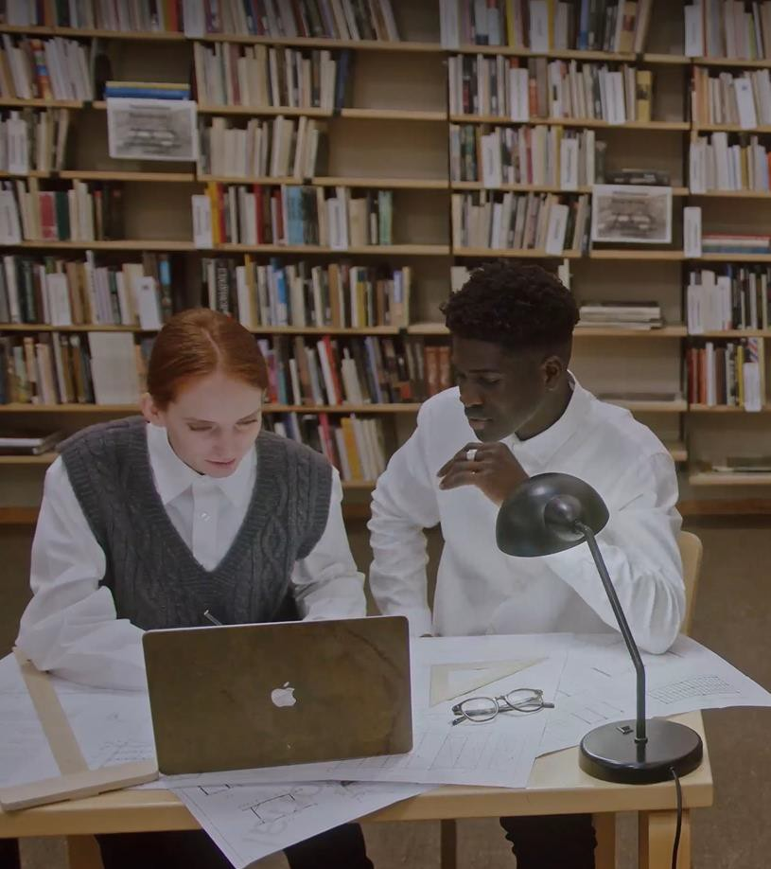
Thinking Outside the Box
Can the role be done as a job share?
Could you retrain someone from another jurisdiction?
Or can it be remote worked overseas by a UK hire?
Don’t use Blue

Slide 7



Thank you.
Want to know more?
What are you going to do differently in your advertising?
Email Georgiana Head at
Georgiana@ghrtax.com
Website: www.att.org.uk Email: Info@att.org.uk Telephone: 020 7340 0551
Website: www.tax.org.uk Email: Info@tax.org.uk Telephone: 020 7340 0550
Twitter.com/ourATT www.linkedin.com/groups?gid
=3930317
Twitter.com/CIOTnews www.linkedin.com/groups?gi d=108458

