Slide 1


The Chartered Tax Adviser Qualification Skills for the Future

Slide 2

Our aim is to ensure that CTA remains fit for purpose and attractive to students and employers into the future. We recognise we might need to adjust the qualification to ensure it tests the skills that the tax advisers of the future need in a way that is also future focused. These slides are to prompt you, as stakeholders, to think about some key questions. We will be holding meetings with the main providers of our students, but we are keen to hear from any interested members or employers, no matter their size or the number of trainees they put forward for CTA.

Slide 3
CTA Now – a reminder of current arrangements

Slide 4
The stated purpose of the CTA exam is to establish that exam candidates (our students) are capable of giving the very high standard of taxation advice expected of a Chartered Tax Adviser. This involves evidencing knowledge of a wide range of tax issues and demonstrating, in areas of tax chosen by them, in-depth competence and the ability to give concise and relevant written advice which is comprehensive, technically correct and commercially sound.

Slide 5
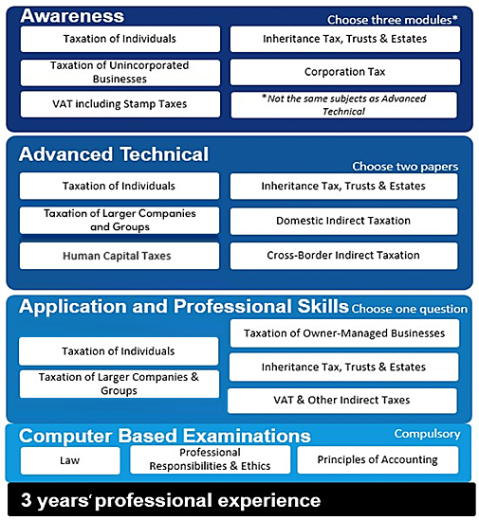
Tax exams sat in test centres CBE’s available on demand 24/7 or in test centres Breadth of technical knowledge tested via Awareness, depth of technical knowledge tested via two Advanced Technical papers. Awareness modules taken cannot be the same as the Advanced Technical papers taken. The Application and Professional Skills paper tests the higher skills expected of a CTA by way of a tax-based case study.

Slide 6
The tax exams are held twice a year and require attendance at a test centre where candidates type their answers and access legislation online. There is a choice of two legislation products. Candidates with particular medical circumstances are supported as required and those meeting a threshold may sit out of the test centre in an approved location, with an invigilator. Certain limited exemptions are available for qualified accountants or solicitors. Those studying for the Association of Tax Technicians (ATT) qualification can combine this route with CTA and register for the Tax Pathway. They will have a choice of sitting a third ATT paper or the CTA Awareness paper.

Slide 7
Joint Programmes with the ICAEW and ICAS For those who are on training contracts with ICAEW or ICAS, there is the option to register as a Joint Programme (JP) student with CIOT and choose one of three routes: Taxation of Larger Companies and Groups; or Taxation of Owner Managed Businesses ; or Indirect Tax (available for ICAEW JP students only) They will take one fewer exam for ICAEW and ICAS and two fewer for CIOT, than candidates for each qualification separately. This saves on both time and cost and is the fastest route to qualifying in both accountancy and tax to a highly respected level.

Slide 8
Current support available to CTA students Student area on our website which includes:
Past tax exam papers, scripts and suggested answers
Guidance as to how the Application and Professional Skills exam is marked
Guidance videos for using the exam software
Exam Skills & Focus Day webinars ahead of the exams at nominal cost
Sample CBEs, Tutorial Video and Guidance on Success
Provision for alternative arrangements
Tax Adviser magazine
Access to the Branch network with many free events
Tutorial bodies provide all other support to students.

Slide 9
Our four questions are: 1. Does the CTA qualification provide your tax trainees with the required skills to be a tax adviser as well as the appropriate breadth and depth of knowledge? Can you give us the reason/s for your answer? 2. Are there other ways you would like your tax trainees’ skills to be assessed by CIOT?

Slide 10
3. Do you use the Joint Programmes with the ICAEW and/or ICAS, if so, can you provide feedback? If you have actively chosen not to use the Joint Programme, can you give us the reason for this decision? 4. How do you expect the knowledge and skills required by your tax trainees to change, if at all, in the next five years?

Slide 11
Next Steps This is the start of a review process that will take some months. We would be grateful for your feedback on the questions we ask on slides 9 and 10. Please send your feedback to rbaxter@ciot.org.uk by 15 March 2024.

Slide 12



www.tax.org.uk
Find CIOT
On and

