Slide 1


Support the learning journey of tax trainees
Learning in partnership
Amber Cottrell
Head of Learning Content

Slide 2
Contents
Tripartite relationship
Tolley support
Tax is special

Slide 3
Tripartite relationship
Learner
Employer
Tolley
Notes:
The three parties need to work together to ensure learners successfully reach their individual potential
Learners need to be supported as they balance the needs of work, study and family. Learners need support from both Tolley and the Employer to achieve this.
Support needs to be in the form of encouragement and understanding of the commitments the learners have made and ensuring that they are achievable – eg checking with the learners as to their study programme and how it fits with their work commitments. Learners who complete and submit their practice and mock exams are far more likely to pass than those who don’t. An employer who ensures that work and study complement each other is more likely to have successful learners.

Slide 4
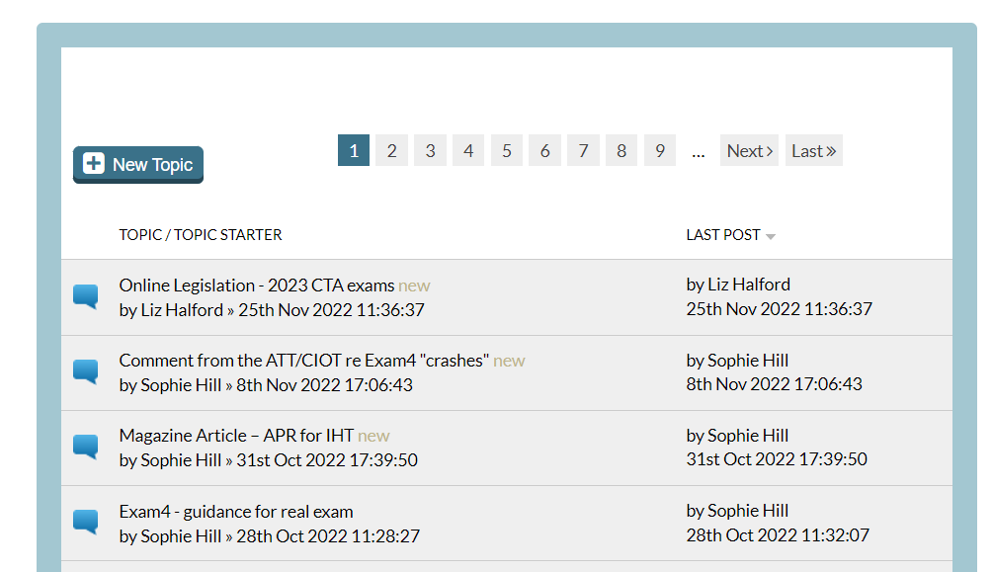

Tolley support
T.O.M.
Forums
Notes:
Tolley Onscreen Mock (TOM) system – mirrors Exam4 software to ensure that when Tolley learners complete their practice and mock exams they are in an exact replica of the environment they will need to use for the real exams
Learner forums – learners can post queries on our various learner forums, other learners may join in the conversation, all queries will also receive a response from a tax qualified tutor
Technical queries email – if learners prefer they can send technical queries to our technical mailbox where a tax-qualified tutor will respond

Slide 5
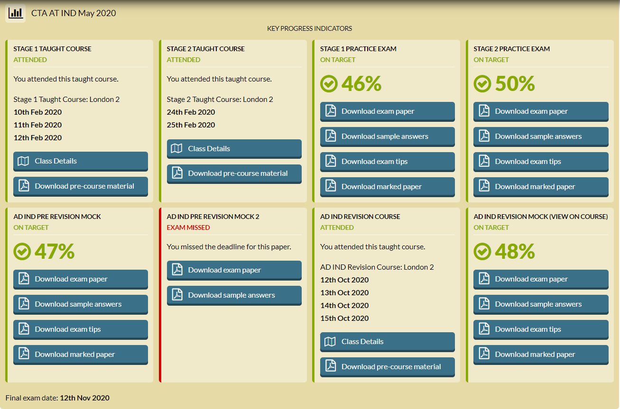
Tolley support
Notes:
My progress tab on the virtual learning environment enables both learners and employers to see in real time learner attendance and results of practice and mock exams. This is a detailed level view which is also the learner view, training managers can also see a higher level view of all their learners across the whole employer and also by training manager within a firm

Slide 6
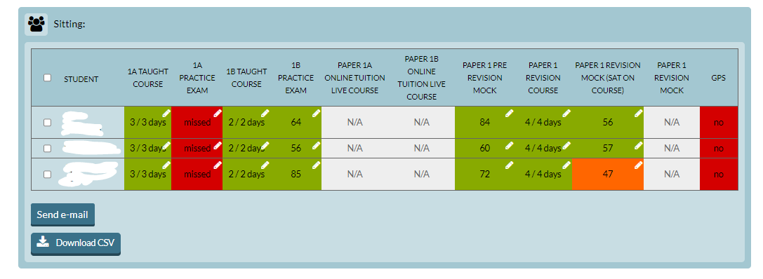
Tolley support
Notes:
This shows a training manager view of learner progress for one training manager within an employer – green is good, red is bad and orange is a warning

Slide 7
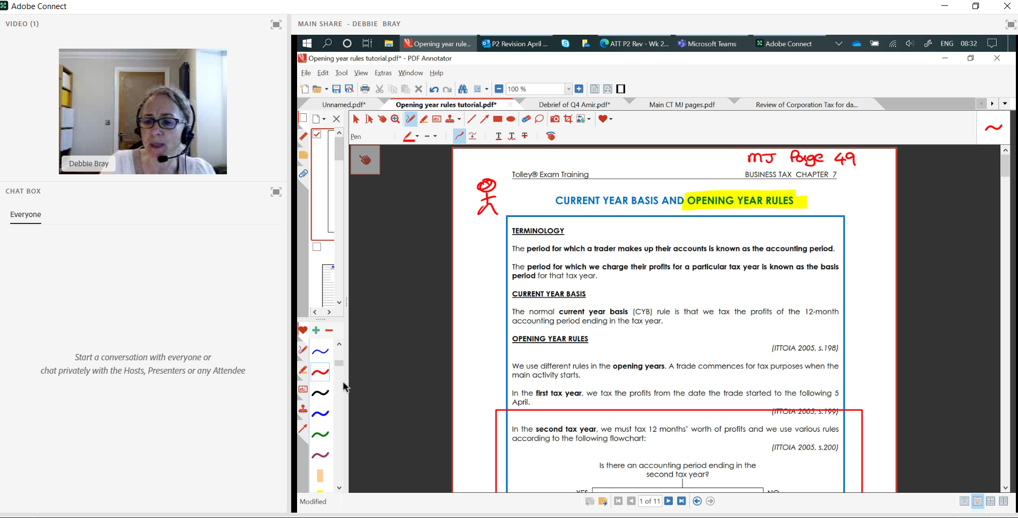
Tolley support
Link to an ATT Paper 2 tutorial – https://lexisnexis.adobeconnect.com/p8yk8snka61t/
Notes:
We use Adobe Classroom Connect as our software provider to deliver online classes. It enables learners and tutors to connect in a safe environment specifically designed for education.
This is an example of a short tutorial offered after an online class for those struggling with opening year rules – approx. 25 minutes. The recording is then made available to everyone – eg if they couldn’t stay after class it is still accessible.
A normal online class would also have a chatbox for learners to ask questions and also virtual polls and quizzes to test understanding. Often we have more interaction in an online classroom than in a physical classroom.
In most online classes there will be both a lead tutor and a support tutor. The lead tutor delivers the course and the support tutor (who is equally qualified) answers queries in the chatbox.

Slide 8
Tolley support
Safeguarding
Advice on navigating the qualifications
Notes:
Safeguarding is of critical importance to us – we have a safeguarding team responsible for responding to and managing any safeguarding referrals. All staff are also trained in safeguarding.
As a specialist tax provider all of our staff are able to give advice on the timing of exams, combinations of papers, which qualification is right for you

Slide 9
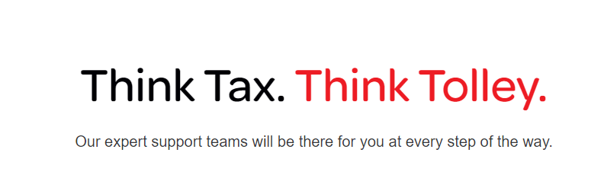

Slide 10

Thank you for your time

