Slide 1


The Generations Game
- should we change how we tax inheritance?
Introduction
John Cullinane, Tax Policy Director, Chartered Institute of Taxation
Twitter: #ciotifsdebates

Slide 2
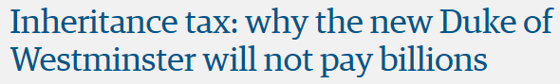

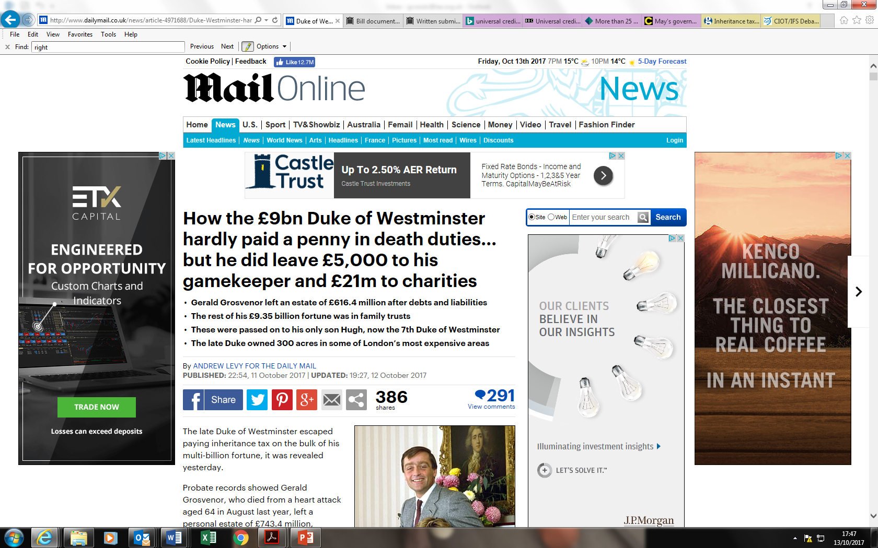

Slide 3
The Generations Game
- should we change how we tax inheritance?
In the Chair
Paul Johnson, Director of the Institute for Fiscal Studies
@PJTheEconomist
Twitter: #ciotifsdebates

Slide 4
The generations game – should we change how we tax inheritances?
Emma Chamberlain Barrister
Pump Court Tax Chambers
October 2017

Slide 5
THE HISTORY
  Estate duty introduced in 1894 (at 1 to 8%), initially to tax a person’s estate at death and then to catch gifts made in 7 years before death.
  Criticised as voluntary but no spouse exemption introduced until 1972 –even then limited to £15,000. Top rate- 80%
  Capital transfer tax replaced estate duty in 1974. The aim, said Denis Healey, “was to make the estate duty not a voluntary tax but a compulsory tax”. By 1979 it had raised 38% less in real terms.
  CTT based upon the premise that all gifts of property whether made inter vivos or on death should be cumulated together and progressive rates of tax applied to ever increasing cumulative total
  “Cradle to the grave tax”. Passing property on death was merely the final gift. Loss to donor concept. Rates of 75% over £2m

Slide 6
THE HISTORY
  From 1979 the Conservatives made steady erosion into some basic principles of CTT. 10 year cumulation – 1981. 1988 – flat rate: 40%
  1986 -PETS. Lifetime gift to individual is tax free if survives 7 years. Return to estate duty position so introduction of ROB provisions
  1992 – extension of 100% relief to business property and farmland
  2006 – fundamental changes to the taxation of trusts.20% tax
  Oct 2007 - introduction of transferable nil rate band; NRB= £325K
  April 2012 – reduced rate of tax of 36% if 10% or more of death estate goes to charity
  2017 – introduction of residential nil rate band - £100-175K on death but not available on estates of +2.2m or if issue do not take house

Slide 7
Reliefs – general policy is a flat high rate with lots of reliefs and exemptions – favours “the healthy, wealthy and well advised”
  Spouse/civil partner exemption – costs £4bn
  APR and BPR - costs just over £1bn and under review; business sold immediately after death can pass free of IHT and CGT.
  PETS -– will you survive 7 years? Can you afford to make lifetime gifts?
  CGT - no CGT on death and assets in death estate rebased to MV
  Foreign doms – no IHT on foreign situated property. Easy to achieve by inserting a foreign company above the UK assets. After [15 tax years] -deemed domiciled and taxed on worldwide estate but trusts set up before this by foreign doms are still generally protected from IHT. “Excluded property trusts”

Slide 8
Arbitrary?
  Regime for foreign doms is still very generous – albeit cut down from 2017 in relation to residential property
  Do not sell your business before death and lose BPR and pay CGT.
  Has the donor married a younger spouse/civil partner to whom property can be left on revocable life interest with the life interest then ended shortly after donor’s death – property can then pass tax free to the next generation provided spouse/civil partner survives 7 years
  Do you have a decent Will or is it a mess?

Slide 9
What do other countries do? Rates, reliefs, scope of tax and its tail
  Pakistan, India, Sweden, Australia, China, Russia, Israel, New Zealand, Canada, Middle East countries – no tax on death
  Italy – 4% over £1m on transfers to spouse and issue; other - 8%
  Switzerland – nothing at federal level but most cantons tax gifts to those other than spouse or issue albeit at very low rates
  France – spouse exemption on death since 2007; E100k per child per parent – rates of up to 45%. Some business reliefs; gifts within last 15 years taken into account. Use of usufructs
  Spain – no spouse exemption; variable allowances between regions. Tax depends on relationship with the deceased; relief for main home; limited reliefs for family owned businesses

Slide 10
What do other countries do? Rates, reliefs, scope of tax and its tail
  Portugal - no IHT from 2004 but stamp duty at 10% unless estate passes to spouse or children
  Germany – E500K exemption to spouses and E400K to each child; progressive rates between 7% and 50% depending on relationship with deceased; business reliefs but minimum period of ownership required by transferee so no immediate sale on death; allowances given every ten years; family home relief on death if not sold. Long tail if German resident citizen leaves Germany of up to 10 years
  USA - $5.45m NRB ($10.9 per couple); spouse exemption; no business reliefs; 40% maximum rate. Indefinite tail while still a US citizen

Slide 11
The options – radical reform
  Wholesale reform with the introduction of a comprehensive donee based tax similar to Ireland. Rate of tax on transfers of wealth is governed not by the value of the donor’s estate but by how much wealth the donee has inherited or been given during his lifetime from all sources.
  Argument is that it encourages more equal distribution of inherited wealth and wealth to be spread more widely.
  BUT significant administrative and compliance costs in a donee based Irish system
  Tax an inheritance as income of donee?

Slide 12
The options – more limited reform
  More limited reforms e.g. 20% tax rate; higher NRB; longer run off on lifetime gifts say to 15 not 7 years; higher rates of tax on trusts
  Changes to BPR/APR so that:
  transferee has to retain the business or farmland for a minimum length of time; e.g. five years
  reduce 100% exemption to 50%;
  correct anomalies about the relief. E.g. on investment assets held within the trading business
  Cap it e.g. at £5m/10m BUT
  Powerful vested interests with legitimate concerns about a dry tax

Slide 13
The options- change to BPR and APR
  Administrative issues – e.g. costs of valuation if relief not 100% or cap introduced
  A cap could penalise efficient businesses and lead to avoidance. e.g through fragmentation; trusts
  No CGT uplift on death in relation to business/farmland to the extent it qualifies for relief.
  CGT paid on later sale or lifetime gift Leads to less distortion - at present CGT is payable on a lifetime gift along with IHT if donor dies within 7 years compared with no CGT or IHT if the business is transferred on death

Slide 14
More radical options but within the existing system
  Return to CTT; abolition of spouse exemption; no CGT rebasing on anything along with IHT
  Should relationship of donee to the donor affect the rate of tax payable at death?
  Should some assets such as real estate be taxed differently?

Slide 15
Abolish IHT: CGT on death
  Abolition of IHT altogether – too many vested interests. Raises relatively little revenue.
  Replace with CGT. CGT no longer forgiven on death and instead death is occasion of a deemed disposal that triggers CGT except on transfers between spouses when treated as no gain no loss transfer.
  Advantage is that all the machinery and reliefs to collect CGT are already present.
  People pay tax on an actual gain so more comprehensible and fairer.
  Does not tax transfers of wealth as such but the gain: this can be seen as unfair in that it does not redistribute wealth – different rationale. Rates are currently lower – 20% on gain not 40% on value

Slide 16
The options – CGT on death
  Need to put a limit on main residence relief to stop people upsizing before death
  What about businesses? Death could be treated as a no gain no loss transfer on transfers of qualifying businesses and farmland so the gain is not taxed until an actual sale or voluntary lifetime gift- i.e. a rollover provision.
  Would it raise money – transfers of cash would not be taxed at all on death but if a donor has cash he is likely to give it away anyway under the current regime. He may have paid CGT on an earlier sale
  Would need to impose CGT on lifetime gifts to trusts

Slide 17
The options – CGT on death
  Emigration – no tax at all after 6 years? Or sliding scale up to 10?
  Immigration – rebasing on a foreigner becoming UK resident otherwise gains accruing when non-resident would be taxed. Would there be a 15 year rule as at present so only after 15 years would they pay CGT on foreign assets and this would include transfers on death?
  How are trusts taxed as they do not die and may hold assets indefinitely?
  What is the connecting factor: the trust, the beneficiary or the settlor?
  Impose a CGT charge every ten years on the trust credited against the tax due on final sale? Rather arbitrary

Slide 18
Conclusions
Needs political consensus – otherwise people just wait for a change of government
Can we afford not to tax transfers of capital and wealth more efficiently however unpopular?
Global consensus on how to tax transfers of wealth would help

Slide 19
Gift and inheritance tax in Ireland
Kieran Twomey
Twomey Moran
Private Client Tax Advisers

Slide 20
The Irish system
Ireland has an “acquisitions tax” – Capital Acquisitions Tax (“CAT”)
Introduced in 1976 but not copied from the UK
CAT comprises a gift tax and an inheritance tax
The recipient pays the tax – not the estate
Each recipient has a lifetime tax free amount
The tax is a single rate of 33%
Tax residence determines the charge not domicile (since 1999)

Slide 21
The Irish system – continued
Tax free thresholds are:
Transfers to a discretionary trust are taxed on appointment from the trust
Discretionary trust tax – 6% initial and 1% annual
We have
  Business property relief (copied from the UK relief) (90%)
  Agricultural relief (90%)
  Dwelling house exemption (100%)
 | EUR | Relationship
Class A | 310,000 | Child
Class B | 32,500 | Brother/sister, nephew/niece, grandchild
Class C | 16,250 | All other

Slide 22
2008 - 2017
Two main changes
In 2008, the tax rate was 20%
  In 2017, it is 33% (+65%)
In 2008, the Class A tax free threshold was €521K
  In 2017, it is €310K

Slide 23
Examples
 | € ‘0€’0 0000 | € ‘000
Parents – estate with 3 children | 2,000 | 4,000
CAT @ 33% for each child | 118 | 338
Total tax of family | 354 | 1,014
Tax as % of estate | 18% | 25%
‘000
‘000
UK IHT would be | 540 | 1,340
Tax as a % of estate | 27% | 34%

Slide 24
The key differences
 | UK | Ireland
Basis of charge | Domicile | Residence
Taxed on | Estate | Recipient
Tax free | £325k | €310k (per child)
Tax rate | 40% | 33%
Gift tax | None | Full
Discretionary trusts | Advantages | No advantage

Slide 25
Planning
No magic solutions

Slide 26
The “stats”
CAT yield is currently €431million
5 year projections are €450m – €534m
The €431m is split
  Inheritance tax 91/92%
  Gift tax 8/9%
CAT represents 0.88% of expected tax yield in 2017

Slide 27
The “stats” (cont’d)
The number of taxpayers who paid CAT is 20,000 per annum
In 2016, CAT was collected
2016 | 19,898 cases
2015 | 22,451 cases
2014 | 19,441 cases
Group A – €310,000 | 164m
Group B – €32,500 | 195m
Group C – €16,250 | 73m

Slide 28
How many pay CAT?
Total Irish taxpayers in 2016 = 2.4 million
Total who pay CAT = 20,000 cases
= 0.8% of taxpayers

Slide 29
Our policy?
2009 Commission on Taxation Recommendation
  Reduce business/agricultural relief to 75% (from 90%)
  Monetary cap of €3m on business/agricultural relief
Programme for Government
  We will increase the Class threshold to €500K

Slide 30
The Irish Public Mood
No public outcry
No lobbying
Not on the agenda?

Slide 31
Thank you.

Slide 32
The Generations Game
- should we change how we tax inheritance?
Panel Discussion and Q & A
Panellists:
Emma Chamberlain OBE, Barrister at Pump Court Tax Chambers
Kieran Twomey, Founding Director, Twomey Moran, and Council Member, Irish Tax Institute
Chair: Paul Johnson, Director of the Institute for Fiscal Studies
Twitter: #ciotifsdebates

Slide 33
The Generations Game
- should we change how we tax inheritance?
Close
Please join us for drinks and nibbles in the Benjamin Franklin room
Twitter: #ciotifsdebates

