Slide 1
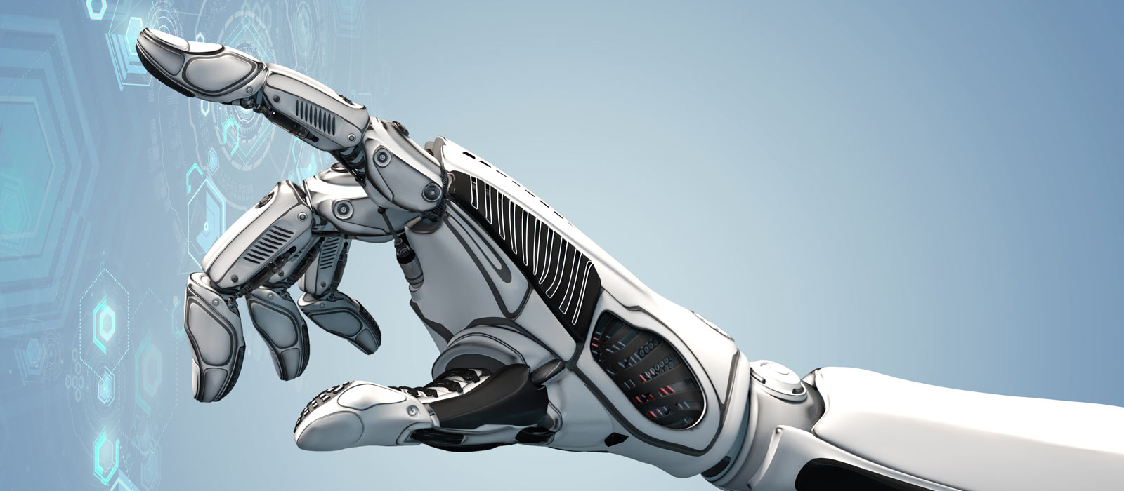
The role of Artificial Intelligence
Diego Calvanese
Faculty of Computer Science
Free University of Bozen-Bolzano
Fit for Digital Bozen/Bolzano
23/10/2019

Slide 2
AI is everywhere
Notes:
- Speech recognition, “interpretation”, and synthesis in portable devices
- Facial recognition
- Recommendation systems
- Self-driving vehicles
- Support in decision-making based on data analysis
- Language translation

Slide 3

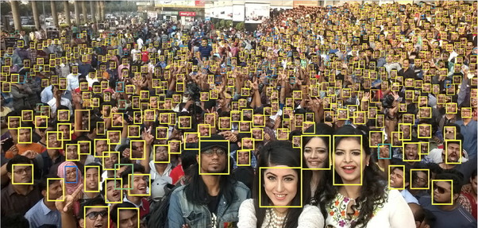


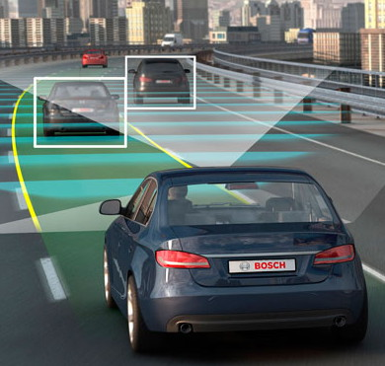



AI is everywhere
Notes:
- Speech recognition, “interpretation”, and synthesis in portable devices
- Facial recognition
- Recommendation systems
- Self-driving vehicles
- Support in decision-making based on data analysis
- Language translation

Slide 4
AI and the job market
Robots have automated routine jobs, but so far, new jobs have been created to replace old ones.
With AI, we are facing a completely new situation:
Humans need to compete with machines that
can outperform them in almost anything.
Economic growth is decoupled from job creation.
AI creates a “Winner-takes-all” environment.
Many jobs are at high risk of automation in the next 10-15 years.
https://willrobotstakemyjob.com/
Notes:
LinkedIn Emerging Jobs Report https://venturebeat.com/2018/03/13/it-could-be-time-to-make-your-move-into-the-ai-job-market/

Slide 5

AI in decision making
Selection of job applicants
Performance evaluation
Predictive models for crime
College admission
…
“In all these domains availability of big data and application of AI techniques may increase inequality, bias, und unfair treatment.”
Cathy O’Neil. 20116

Slide 6

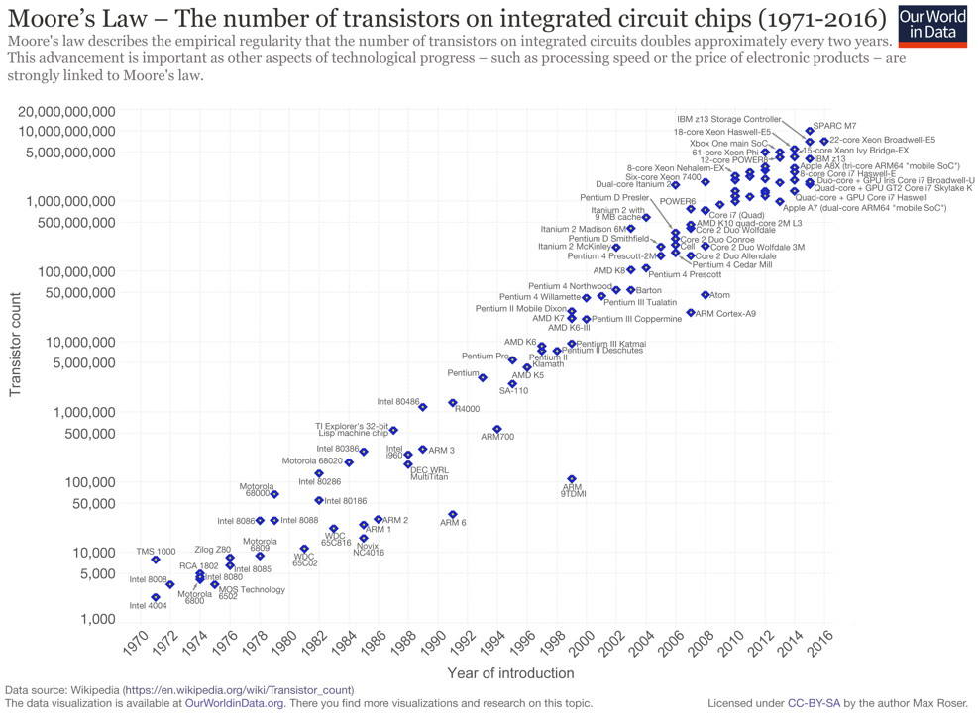
What made the recent progress in AI possible?
The underlying technology has been developed over 50 years ago: quantitative (mostly statistical analysis) approach relying on machine learning
What changed is the scale at which machine learning can now be applied:
  greatly increased computing power – Moore’s Law and “the cloud”
  availability of enormous amounts of data
Also: development of new statistical techniques – deep learning.
Turing Award 2018 to Y. Bengio, G. Hinton, Y. LeCun

Slide 7
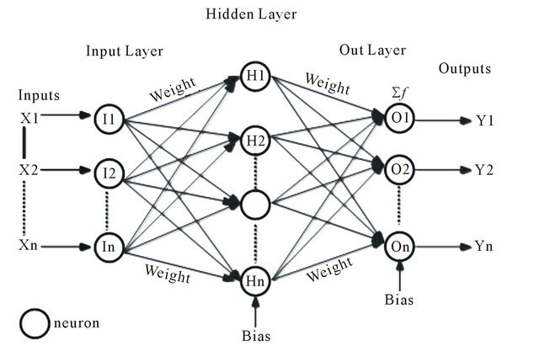

Machine/deep learning – A toy example
The aim is to capture the input/output behaviour of a system through a suitable function.
Example: recognition of a digit written in a 28x28 matrix of pixels
  784 inputs, one for each pixel
  10 binary outputs, each one signaling a digit
Function represented through weights
on connections between nodes.
A node becomes active if the input signal
is above a threshold.
Learning task is to determine the weights
that provide the correct output.

Slide 8
Machine/deep learning in the ”real world”
Online systems: face recognition, natural language understanding, online translation, autonomous vehicles, ...
Inputs: come come from the various types of “sensors”
Outputs: recognition of a face, natural language text, actions, ...
Offline sytems: decision making, profiling, classification, ...
Input: data about the new case/situation to be analyzed
Output: decision taken, classification

Slide 9
The role of data
There are different approaches with which AI systems learn the input/output behaviour:
Unsupervised learning
Supervised learning
Reinforcement learning
In all cases, we need huge amounts of data for training.

Slide 10
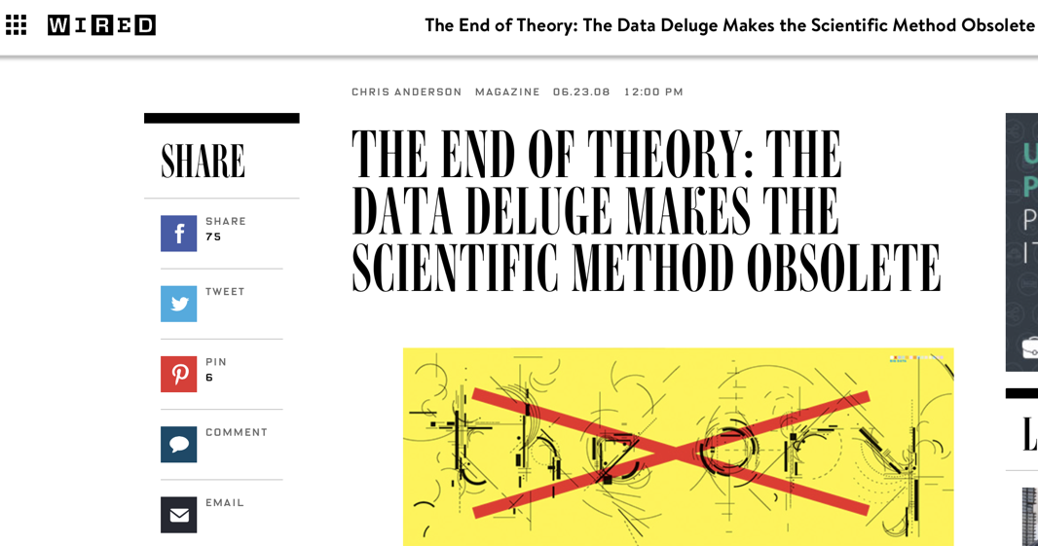
Is data all we need?

Slide 11
We have to be careful with data
Notes:
- Speech recognition, “interpretation”, and synthesis in portable devices
- Facial recognition
- Recommendation systems
- Self-driving vehicles
- Support in decision-making based on data analysis
- Language translation

Slide 12
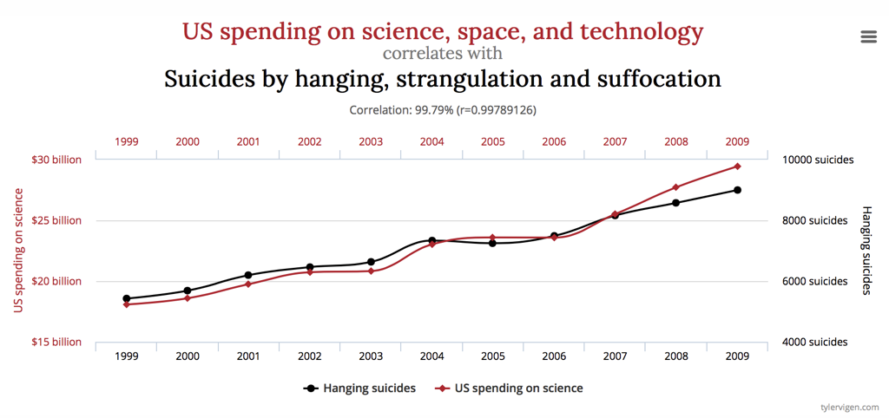
Causality vs. correlation

Slide 13
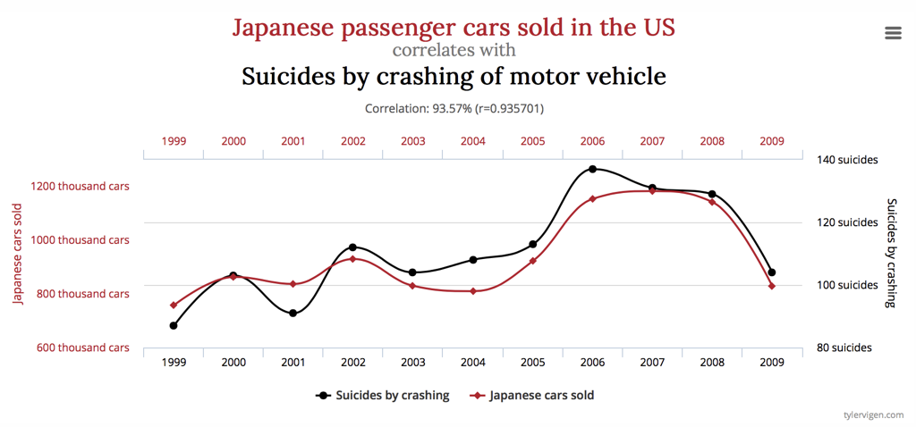
Causality vs. correlation

Slide 14
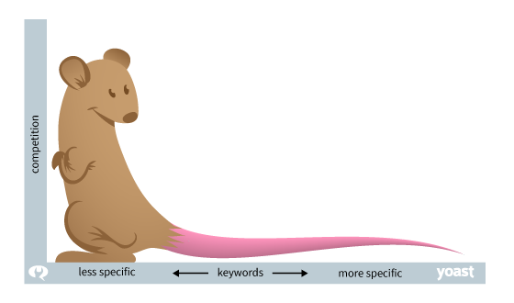
A problem with big data: the long tail
There are situations where big data do not help.
Long tail phenomenon:
Rare events play an important role.
  British National Corpus (10⁸ words): 1,7% occur ≤ 10 times.
  Search traffic on the Web: 70% is on keywords with ≤ 10 monthly occurrences [Hitwise]
To take this into account, we need to abstract and apply general principles, i.e., make use of knowledge.
Notes:
Si consideri il British National Corpus
100 millioni di parole inglesi scritte/parlate, da un gran numero di sorgenti
la maggior parte delle parole occorrono spesso
0.5% delle parole occorrono solo una volta
1.7% delle parole occorrono al più 10 volte
Quindi, leggendo un testo c'è una buona probabilità di incontrare una parola rara.

Slide 15
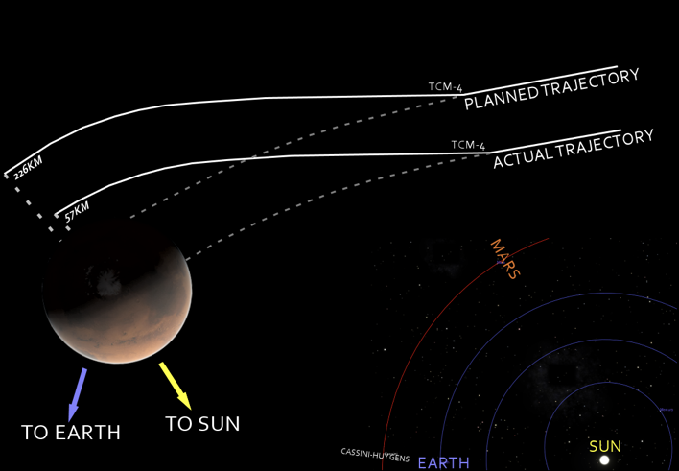
The meaning is important, not just the data
Mars Climate Orbiter (1999)
Probe sent to Mars
Cost of mission: 327M €
Probe got lost when entering Mars orbit.
Problem: different teams of engineers used different measurement units.

Slide 16
Ask Alexa!
Chi è Diomede?
“È un personaggio della mitologia greca, che si è distinto come guerriero nella guerra di -BIP-.”
Alexa has only a syntactic understanding of the terms about which she provides answers.
She lacks knowledge, i.e., an explicit model of the data.

Slide 17
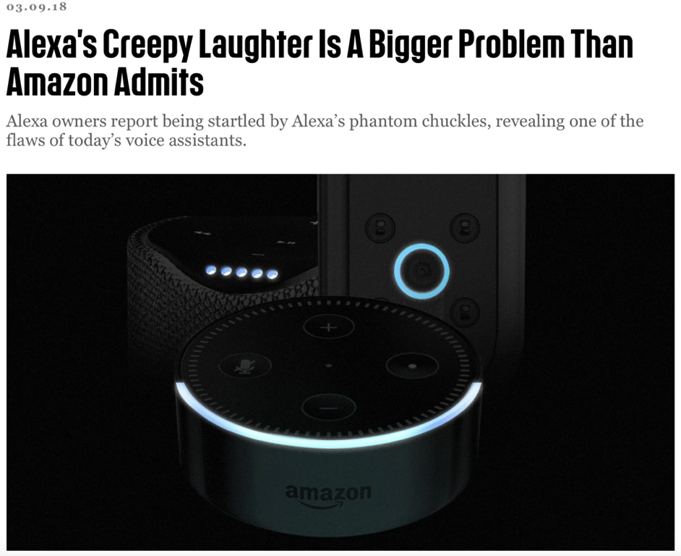
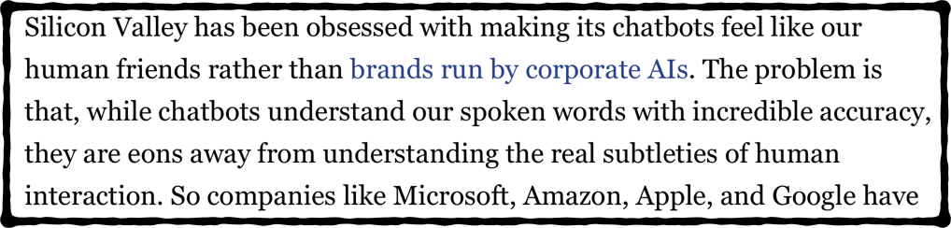

Slide 18
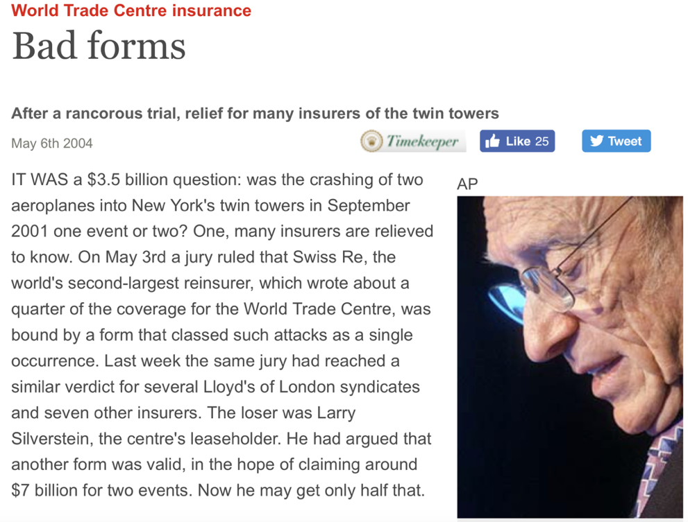
Having the wrong model can cost a lot!
It was a $3.5 billion question:
was the crashing of two aeroplanes into New York’s twin towers in September 2001 one event or two?
Thanks to Giancarlo Guizzardi for this nice example!

Slide 19
We need more than data
Notes:
- Speech recognition, “interpretation”, and synthesis in portable devices
- Facial recognition
- Self-driving vehicles
- Support in decision-making based on data analysis
- Language translation
- Recommendations

Slide 20
Not only data, but also knowledge
We humans constantly use background knowledge in our daily life.
Knowledge involves data, but data alone is not sufficient.
Knowledge is represented and stored as symbolic expressions.
The expressions are manipulated according to some general logic based rules, to derive new symbolic expressions that form new knowledge.
Knowledge Representation Hypothesis
Achieving intelligent behavior requires to store and to manipulate symbolic knowledge.
Notes:
And we typically under-estimate how much knowledge is actually required.

Slide 21
Where do the data come from?
Public administrations collect and own
lots of data!
But to exploit data, it needs to be integrated
available in a single place
represented in the same formats, both logically and conceptually
cleaned and reconciled
Models are key! – KR in AI deals with models
models of the data, to understand what it is about
models of the processes, to understand how data should and actually is used

Slide 22
Thanks for your attention

