Slide 1
EHO enrolment for U18 Umpires

Slide 2
Why is this section important?
This is a step by step guide on how to enrol U18 umpires to the EHO, via the GMS
It allows process to be slick for both players, umpires or individuals who do both roles within the game

Slide 3
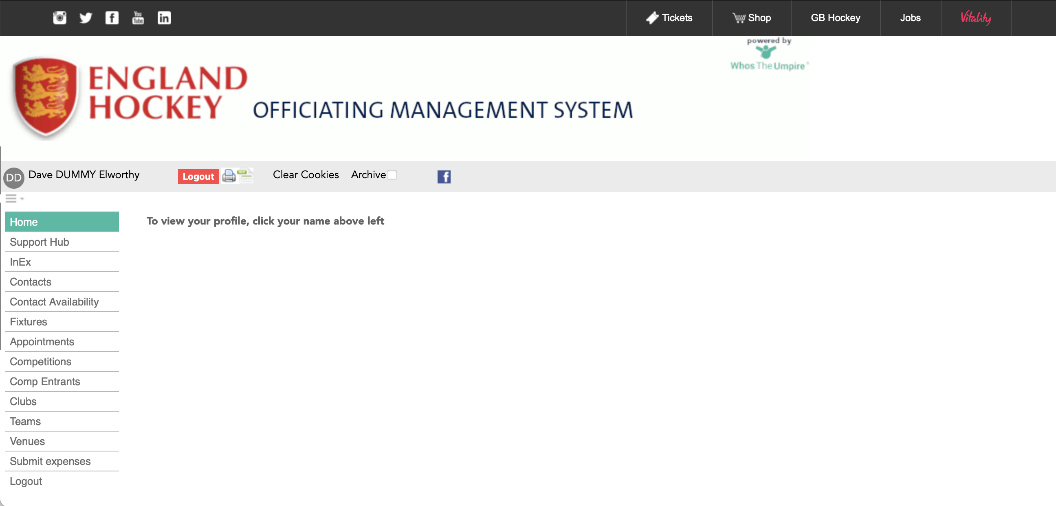
The Home Screen

Slide 4
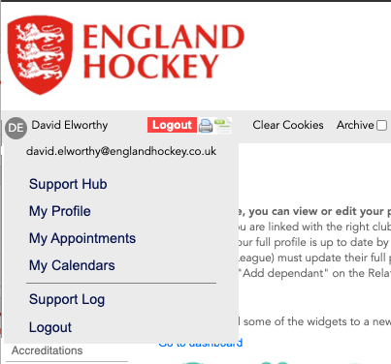
Adding your child / U18 to GMS
Click on your initials to
bring up the menu
Click on Cost My Profile

Slide 5
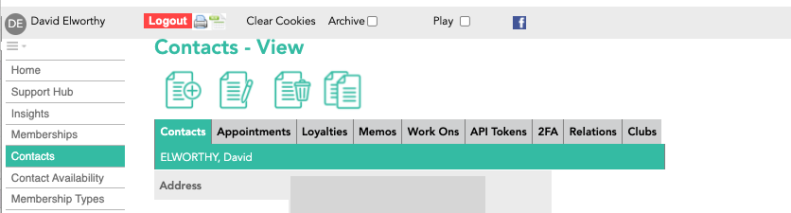
Adding your child / U18 to GMS
Click on Relations

Slide 6
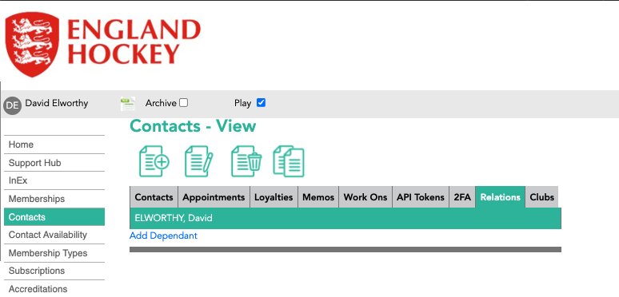
Adding your child / U18 to GMS
Click on “Add Dependant”

Slide 7
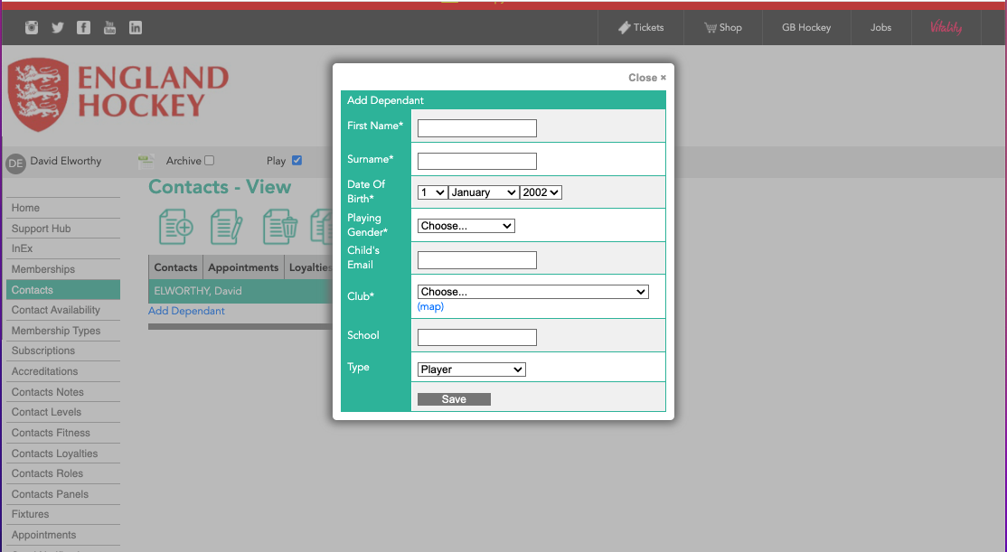
Adding your child / U18 to GMS
Complete the enrolment screen as required.
Choose “Player, Umpire or “Player & Umpire” here
Then click SAVE

Slide 8
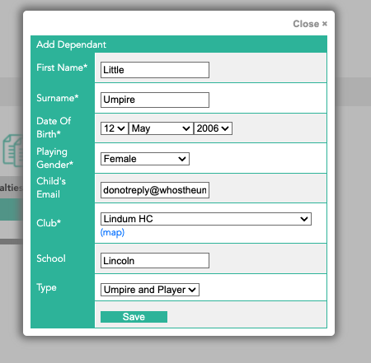
Example of completed Enrolment form

Slide 9
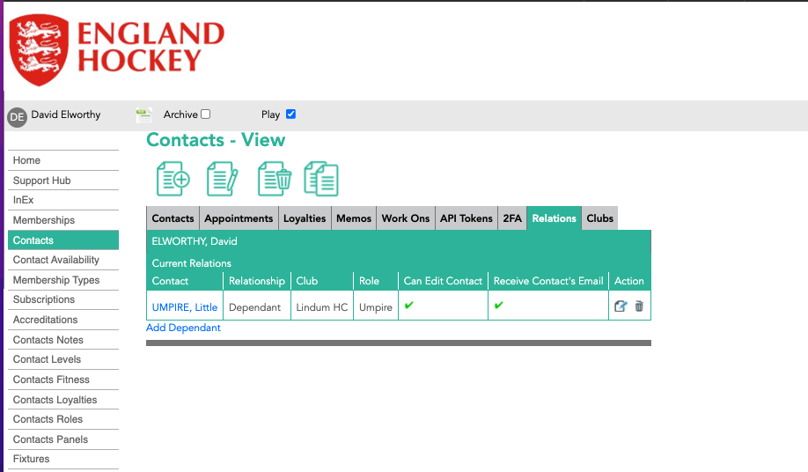
Completed Enrolment
If you have selected Umpire, then the system will automatically create the membership of the EHO for your U18 and ensure they are available on team sheets if umpiring in the Adult Leagues.

Slide 10
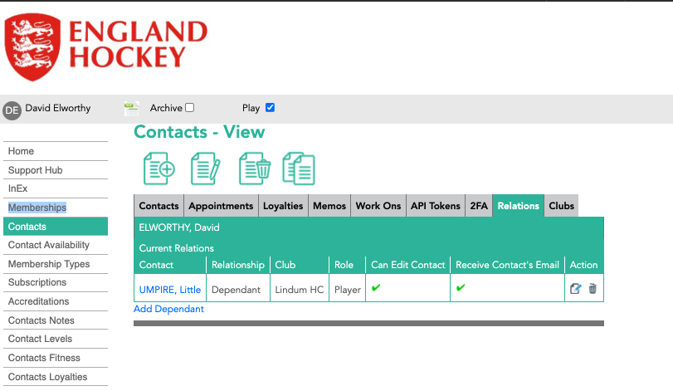
2. Adding Umpiring to an existing profile
Click the “Edit” button (looks like a piece of paper & pen)

Slide 11
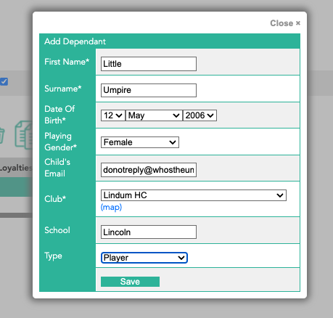
2. Adding Umpiring to an existing profile
Change the “type” from “Player” to either:
Umpire
Player
Umpire and Player
Then Press SAVE

Slide 12
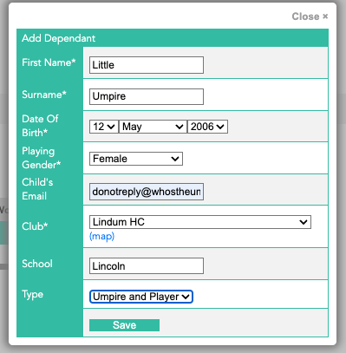
2. Adding Umpiring to an existing profile

Slide 13
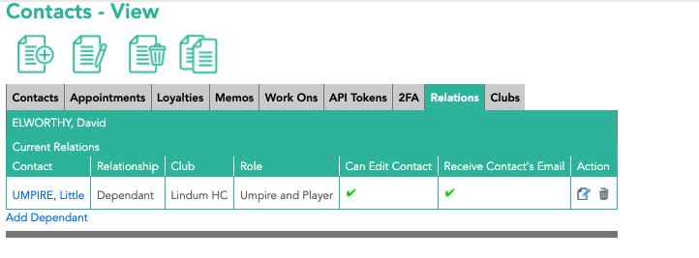
2. Adding Umpiring to an existing profile
This will show once you’ve pressed save so it shows the change has been made successfully

Slide 14
Thank You
More information is available here: www.englandhockey.co.uk/deliver/gms

