Slide 1

AGM 2023
6 July 2022 @ 7:30pm

Slide 2
1. Welcome and Introductions
AGM Chair: Chris Reece – Chair, North West Hockey Ltd
Welcome:
Member Clubs, County Representatives and Legacy Members
Non member Clubs who play in the NW hockey League
England Hockey Observer and IT Support (Harriet Tebbs)
North West Hockey Board and Management Committee Chairs and members
2. Apologies for Absence and confirmation of quorum

Slide 3


Agenda
Welcome and Introductions
Apologies for absence and confirmation of quorum
Chair’s Opening remarks
Announcement of postholder elections
Minutes of the last AGM held on 7th July 2022
Review of North West Hockey Ltd 2022-23
North West Hockey Ltd Financial Report 2022-23
Resolutions to be voted on at the meeting
Appointed Umpire Fees (Information)
Update on the Adult League Structure 2023-24
Any Other Business
Use the chat function

Slide 4

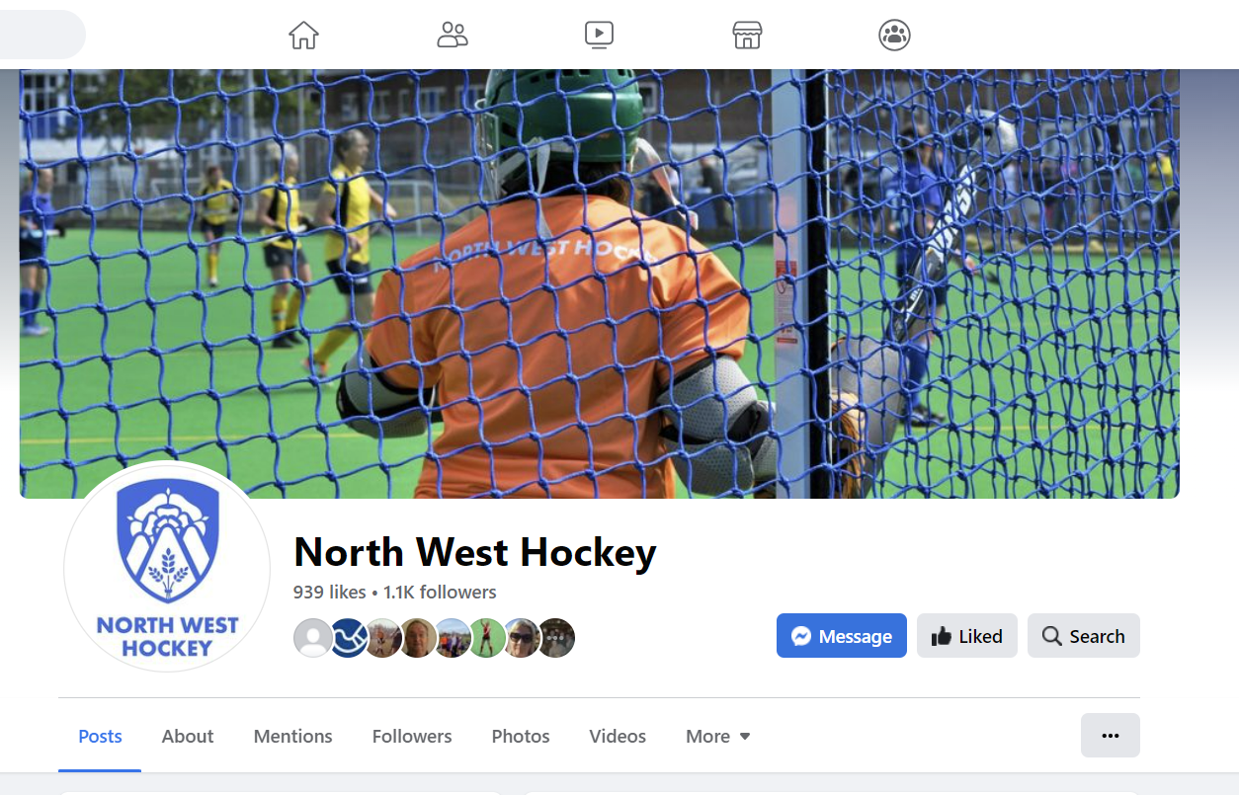
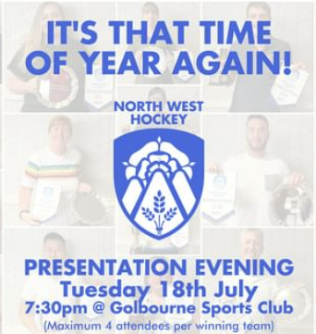
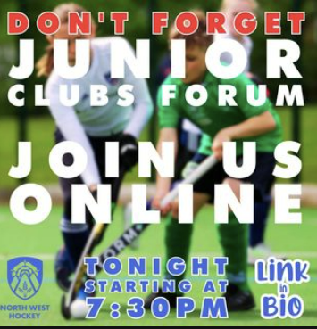
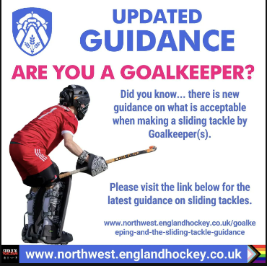
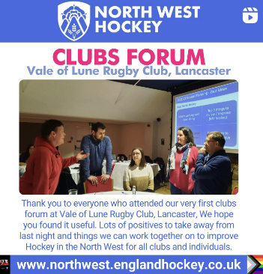
3. Chair’s Remarks
Year 2 completed since bringing together the NW hockey family
New structure and core NW roles and responsibilities 'bedding in' well
NW team working with 7 other Areas to continue to develop the new structures and shared approach to running hockey across all areas
Extended delivery to include NW500 (masters) and junior indoor
Developing NW Hockey Social Media
Delivered by an incredible community of people who #MakeHockeyHappen

Slide 5
North West Hockey Structure
Directors
Finance Director | Vice Chair | Chair | Operations Director | Governance Director
Committee Chairs
Adult Hockey | Junior Hockey | Officiating | Masters Hockey | Discipline
New Role 2022-23
Social Media Lead
Committees
Adult Leagues & Competitions | Junior Leagues & Competitions | Umpiring & Officiating | Masters Hockey | Discipline

Slide 6


Developing our Strategy for North West Hockey
Working with our Clubs
Developing our Strategy for NW Hockey is a priority for 2023-24
Our 2022-23 NW Clubs Forums have fed in ideas and inputs to help shape key priorities
Next step is to review the soon to be launched new EH Strategy for hockey and align NW Strategic themes
Update for Clubs in 2023-24 at our forums
Develop
Grow
Promote
Equality, Diversity and Inclusion

Slide 7
3. Chair’s Remarks
Thank you to everyone who has made hockey happen during the 2022-23 season from all those who have participated and enjoyed all we offer
- Adult Competitions – Junior Competition – Master Hockey – Officiating
- the Governance of NW hockey including Discipline
- our committees and volunteers delivering all aspect of hockey
- our Clubs and all their volunteers
- our Counties and all their volunteers
- our NW and Club officials and umpires
- and our players and supporters

Slide 8
4. Announcement of election results
Following the online ballot the following are duly elected:
Leighan Bleasdale – Governance Director
Niall Riley – Finance Director
VACANCY – Adult League and Competitions Chair
Tony Taig – Masters Chair
Annette Badger – Officiating Chair
VACANCY – Junior Competition and League Chair

Slide 9
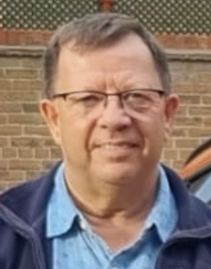
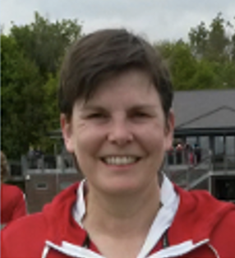
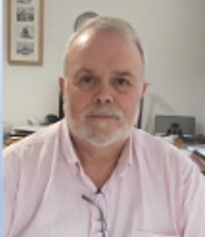
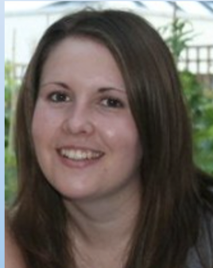
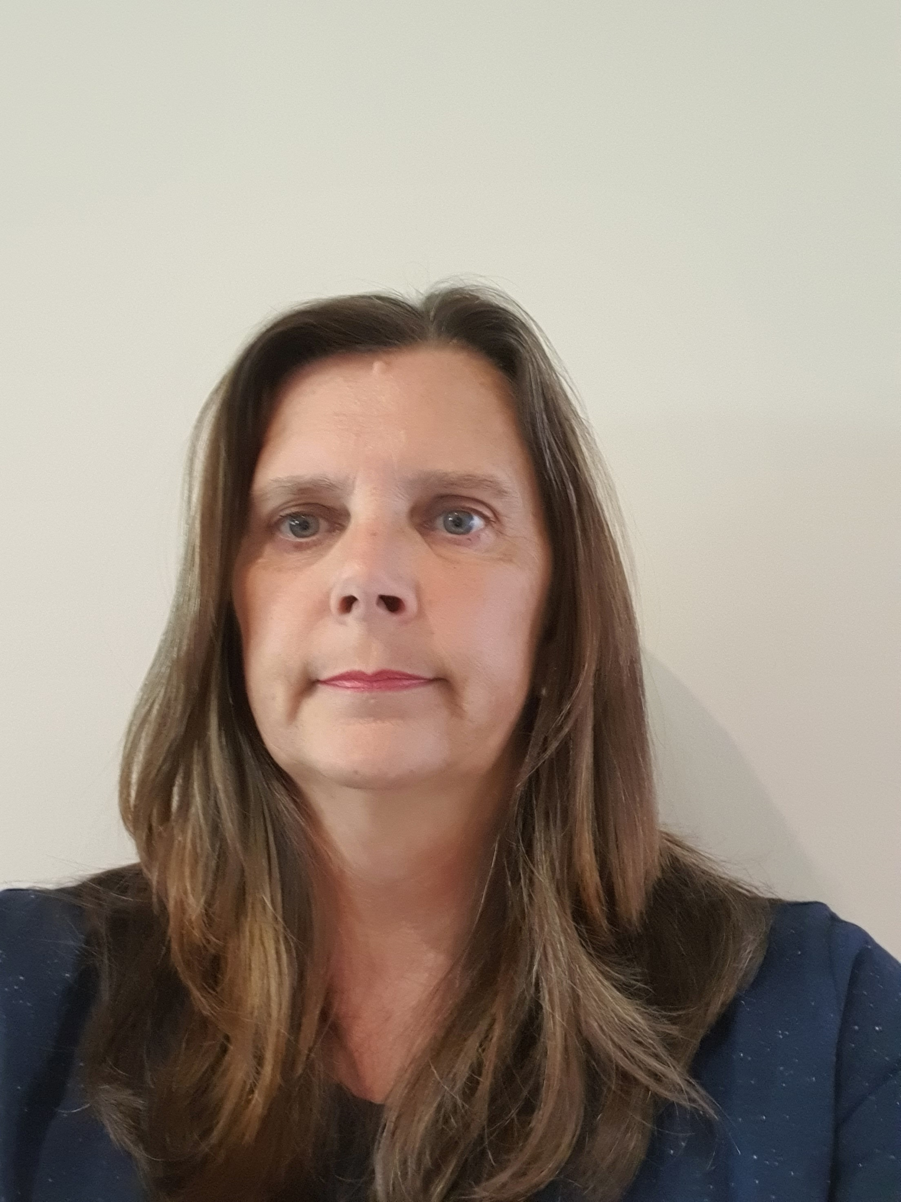
2023-24 North West Hockey Board
Board: Directors
Chair | Vice Chair | Finance Director | Governance Director | Operations Director
Chris Reece | Shelagh Everett | Niall Riley | Leighan Bleasdale | Wendy McDowall
The Announcement of Postholder elections - North West Directors

Slide 10
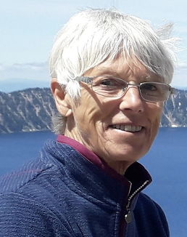
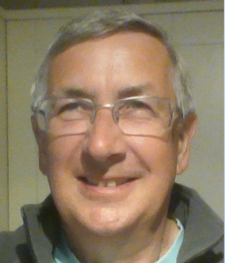
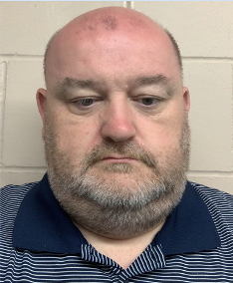
2023-24 North West Committee Chairs
Committee Chairs
Adult League & Comps | Junior League & Comps | Officiating | Masters | Discipline ADA Appointed Position
Vacant | Vacant | Annette Badger | Tony Taig | Peter McInulty

Slide 11

5. Minutes of the last AGM – 7th July 2022
Any matters of accuracy
5.1 Approval as a true and accurate record of the meeting
  Proposed / Seconded - VOTE
5.2 Matters arising (not covered by the Agenda)

Slide 12
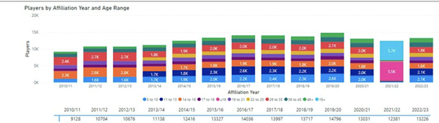
6. Review of 2022-23 - snapshot of NW Hockey
13,226 NW players registered with EH by clubs through the affiliation process
24% player numbers growth (2550) in 10 years since London 2012
44% (5800) of player are Under 16’s
6964 (52.6%) female players: 6262 (47.4%) male players
At Under 16 the gender split is 3100 (53%) female: 2700 (47%) male players
409 Adult NW League Teams and 48 Junior NW League Teams (+ EHL teams)
~4,500 NW adult NW league matches per season (fewer forfeited than 2021-2022)
Discipline: 40 red Card / MMO incidents

Slide 13
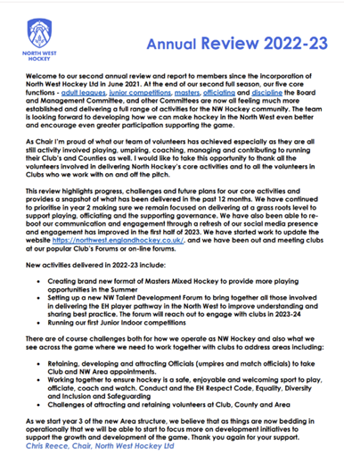
6. Review of North West Hockey 2023-24
Summary Annual Report circulated with Calling Notice
Key Highlights and Overview
Questions
Review of 2022-23
Use the chat function

Slide 14
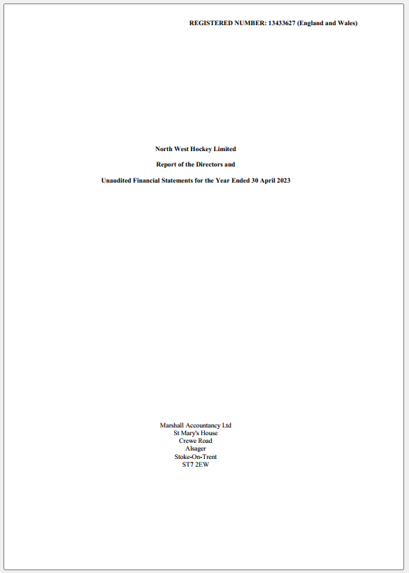
7. North West Hockey Ltd Financial Report
Annual Accounts circulated with Calling Notice
Niall Riley, Finance Director to share key highlights and overview
Followed by Questions
Use the chat function

Slide 15
7. North West Hockey Ltd Annual Accounts
The Company’s Annual Accounts were included with the information pack and have been independently scrutinised
These accounts for the first time include Masters Tournaments and other 2022 Summer activities
The highlights are: -
  Turnover £66,892
  Operating Costs £57,743
  Surplus on the year £9,149
  Ring-fenced Reserves from dissolved associations - £111,899
    In 2022-23, we received £2,247 in additional funds from dissolved associations.
The accounts have been approved by the Board and submitted to Companies House and HMRC
  We are exempt from Corporation Tax; however, tax is payable on Interest received on the Reserves

Slide 16
7. Financial Report
Membership Subscriptions and Fees for 2023-24
2022-23 has given us a sound financial base. This will enable us to support hockey development in the Northwest and to reduce the cost of hockey for member clubs in the coming season.
Therefore, for 2023-24 we are proposing: -
  A 30% reduction in Area Membership Subscription from £25.00 per Team to £17.50 per Team
  A 30% reduction in Adult League Entry Fee from £15.00 per Team to £10.50 per Team
  - Please note - as in 2022-23, this includes Development Teams
  Maintain the Appointed Umpire Fee at 2022-23 charge of £26.50 per Umpire per Game
  Use approximately 10% of Reserves to support development in all areas such as Junior and Adult Leagues, Talent Academies, Masters and Umpire development.
  To review all charges at the end of 2023-24 and amend charges accordingly
  Where possible, at year end, re-invest surpluses into the Reserves

Slide 17
8. Resolutions
8.1 Proposed Club Membership Subscription Fees for 2023-24
North West Hockey Ltd propose that: -
For full voting Member Clubs that the annual Subscription for 2023-24 for membership of North West Hockey Ltd shall be £17.50 per senior team (a 30% reduction on 2022-23)
For Counties and other Organisations, Subscriptions for 2023-24 shall be set at zero, (no change to 2022-23)

Slide 18
8. Resolutions
8.2 Proposed Entry Fees for North West Hockey Competitions and Leagues for 2023-24
North West Hockey Ltd propose that: -
For Clubs entering teams in North West Hockey Adult Competitions and Leagues, the annual entry fee shall be £10.50 per senior team (a 30% reduction on 2022-23)
That entry fees for all other competitions (including Juniors and Masters) shall be set by the Directors on the recommendation of the relevant Committee and, if required, following informal consultation with member clubs

Slide 19
9. Appointed Umpire Fees for 2023-24
Appointed Umpire Fees for 2023-24
To Note that North West Hockey Ltd have approved that the fee charged to Clubs where umpires are appointed by North West Hockey, shall be £26.50 per umpire per appointment (no increase on 2022-23)

Slide 20
10. Update on the Adult League Structure
Second full season completed – currently vacancy for ALMC Chair, essential to fill
Presentation evening to be held on 18th July 2023
2023-24 League Structures posted on the NW website reflecting promotion and relegations and adult league entry requests
Fixtures to be circulated to Clubs to plan pitches
Fixtures to be uploaded to GMS in July
Revisions to the Adult League Regulations are awaiting approval
Various guidance documents to be circulated to Clubs (umpires, key dates & GMS)
ALMC application process to go live once Adult League Regulations are approved
Confirmation of ALMC as soon as possible
Contact Operations Director (Wendy McDowall) to discuss the Chair vacancy

Slide 21

11. Any Other Business
Any Other Business (of which due notice of 14 days has been given by written notice of the issue)
No matters were raised for inclusion within AOB
Any final questions

Slide 22
Thank you
Thank you to everyone for attending and for your role in #MakeHockeyHappen in the North West
- our Clubs and all their volunteers
- our Counties and all their volunteers
- our NW and Club officials and umpires
- all our NW committees, chairs and leads
Here's to an even more successful 2023-24 season

