Slide 1


RESEARCH IN SABES 2021-2022
Prof.a.c. Priv. Doz. Dr. Michael Mian, MBA
INNOVATION, RESEARCH AND TEACHING SERVICE
DIENST FÜR INNOVATION, FORSCHUNG UND LEHRE
SERVIZIO PER L’INNOVAZIONE, LA RICERCA E L’INSEGNAMENTO
Claudiana, am 28/09/2023

Slide 2
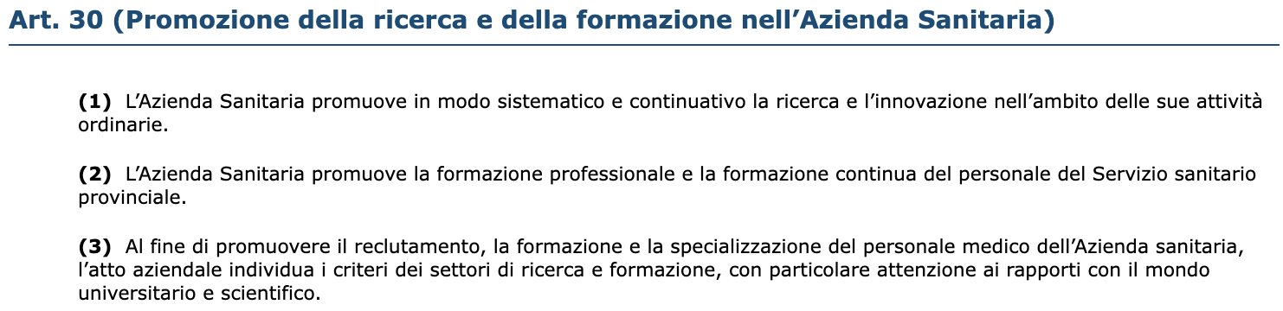
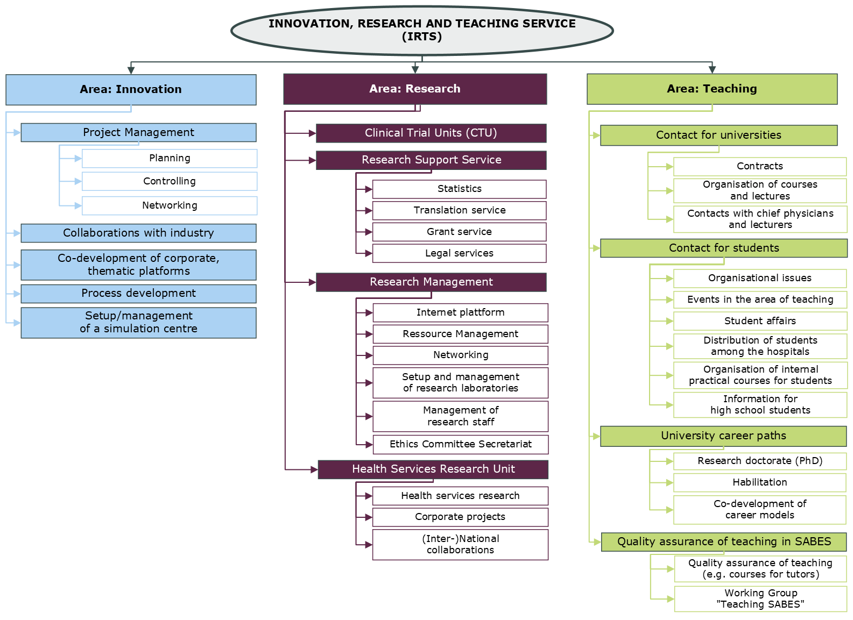
TIMES WERE CHANGING
PROVINCIAL LAW APRIL 21st, 2017, NO. 3

Slide 3
CLINICAL TRIALS APPROVED BY THE EC IN 2021-2022

Slide 4
CLINICAL TRIALS APPROVED BY THE EC IN 2021-2022

Slide 5
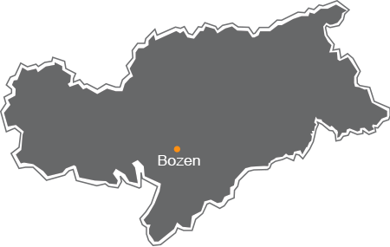






ORGANIZATION OF RESEARCH AFTER 2022
Single Researchers/Small Groups
KH Sterzing/Osp. Vipiteno
KH Bruneck/Osp. Brunico
Innovation, Research and Teaching Service (IRTS)
KH Brixen/Osp. Bressanone
Clinical Trial Unit
KH Schlanders/Osp. Silandro
KH Meran/Osp. Merano
KH Innichen/Osp. S. Candido
Pathological Anatomy Service
KH Bozen/Osp. Bolzano
Ethics committee
Claudiana
Collaboration with EURAC
Gesundheitsbezirk -Comprensorio
EURAC Biobank

Slide 6
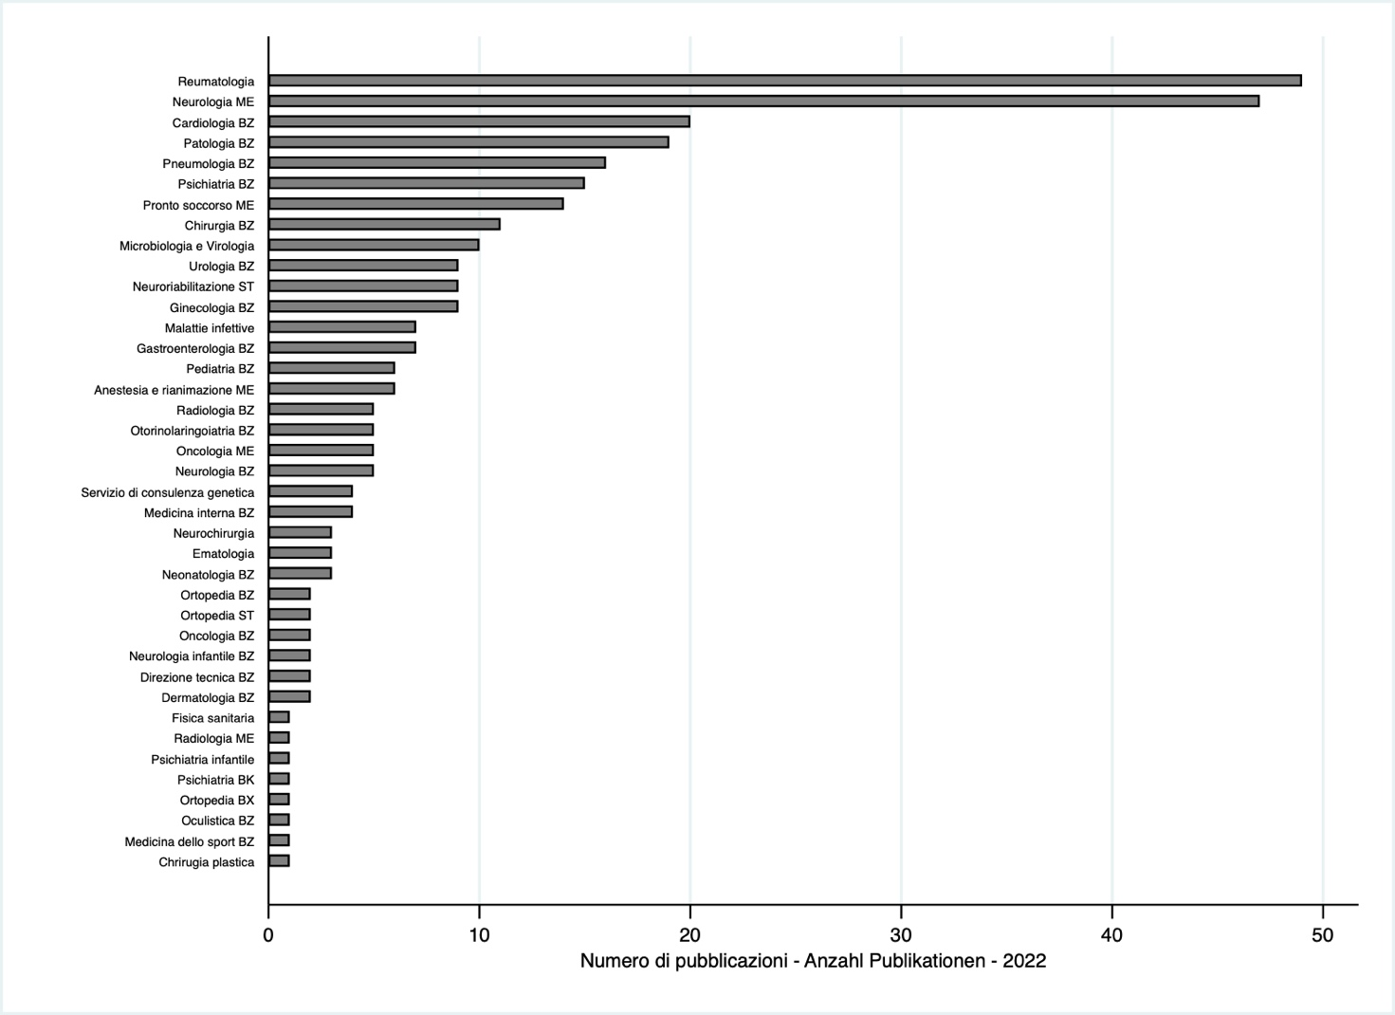
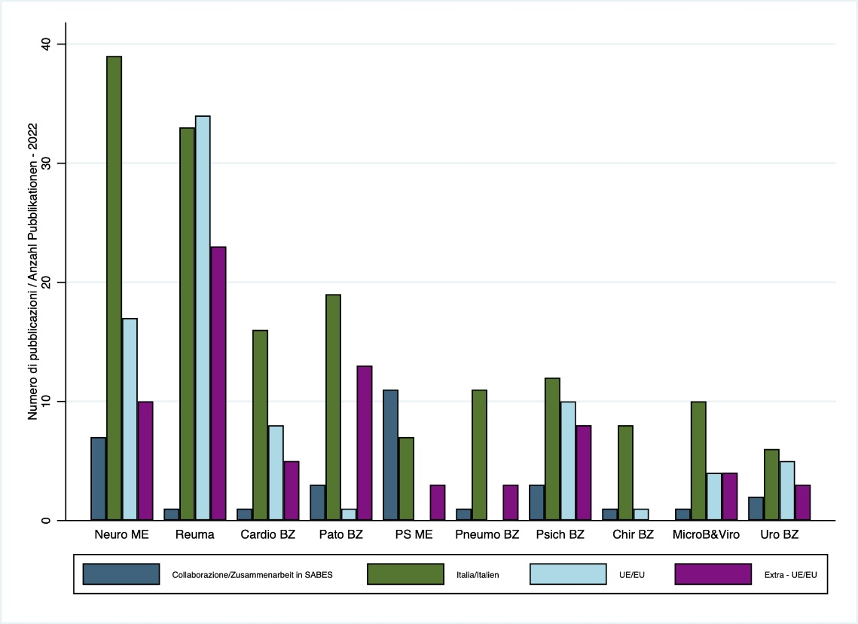
SABES PUBLICATIONS 2022
Timespan: 1.1.2022-31.12.2022
332 met the inclusion criteria and were considered for the present analysis
42 departments indicated at least one publication
Nearly 94% were published in PubMed listed journals
Publications are the fruit of both internal, national and international collaborations.
Analysis of the collaborators of the ten departments with the largest number of publications. Subdivision into SABES internal, rest of Italy, EU countries and non-EU countries.

Slide 7

