Slide 1
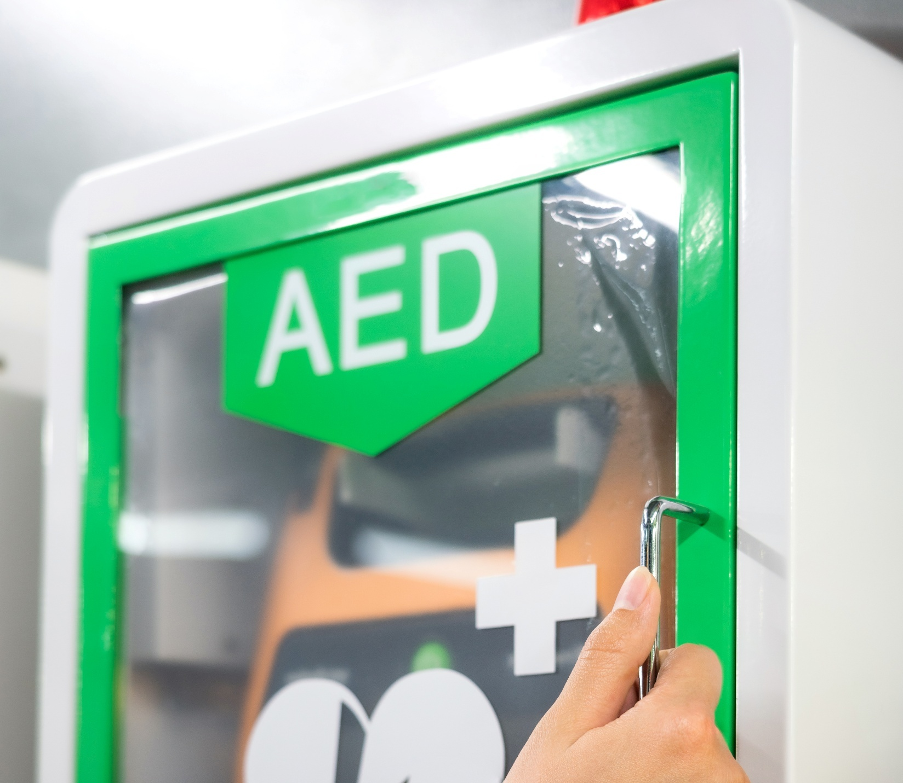

Basic Life Support and Automated External Defibrillation for Adults, Children and Infants
(includes clinical settings)
V1 August 2025
All rights reserved
© 2025 Highfield Products Limited
A global leader for qualifications, assessment, digital solutions, innovative products and customer service
Highfield Place Shaw Wood Business Park, Shaw Wood Way, Wheatley Hills Doncaster, DN2 5TB
01302 363277 | www.highfieldqualifications.com
Notes:
This training presentation can be used to support the delivery of learning outcomes 1 – 3 for the following qualifications:
Highfield Level 3 Award in Basic Life Support, Automated External Defibrillation for Adults, Children and Infants (RQF)
Highfield Level 3 Award in Basic Life Support, Automated External Defibrillation and Management of Anaphylaxis for Adults, Children and Infants (RQF)
Clinical practice
Highfield Level 3 Award in Basic Life Support for Adults, Children and Infants in Clinical Practice (RQF)
Highfield Level 3 Award in Basic Life Support and Management of Anaphylaxis for Adults, Children and Infants in Clinical Practice (RQF)

Slide 2


Ground rules
Fire escapes
Toilets
Smoking
Drinks
Breaks
Lunch
Questions
Talking over others
Respect others’ points of view
Timekeeping
As a courtesy to others,
please set your mobile phone
to SILENT MODE
Mobile phones must
be SWITCHED OFF
and removed from the desk
during the examination.
Notes:
Where possible, the health and safety briefing should be delivered by a local representative. If such a person is unavailable, the trainer should make themself familiar with the client’s protocols, procedures and facilities to complete this briefing themselves.
Point out the fire evacuation points and procedures as well as the location of the toilets and when/where people are allowed to smoke. Explain that breaks are provided in which people can smoke.
​
​

Slide 3







Key
Class
Question
Individual
Exercise
Key
Point
Definition
KEY POINT
Group
Exercise
Class
Exercise
Clinical
Practice
Navigation
CP
CE
Notes:
CP – clinical practice settings: this icon indicates where underpinning knowledge is provided specifically for clinical practice settings. Tutors can remove this content if they are not delivering qualifications in a clinical practice setting.

Slide 4


Learning outcomes
Module 1: Be able to assess an emergency situation safely
Module 2: Be able to provide first aid to an unresponsive casualty
who is not breathing normally
Module 3: Be able to provide first aid to an unresponsive casualty who is
breathing normally.

Slide 5


Module 1
Be able to assess an emergency situation safely
5
Notes:
Completion of this module will enable learners to meet the following learning outcome:
Be able to assess an emergency situation safely.
This includes the following assessment criteria:
conduct a scene survey
conduct a primary survey on:
an adult
a child
an infant
summon appropriate assistance when necessary
Activities in this module include:
GE: Primary survey – practical demonstration
CE: Two multiple-choice questions (MCQ’s) (formative assessment)

Slide 6
Conduct a scene survey
Always check the scene is safe before approaching a casualty
Protect yourself, the casualty and bystanders
Use the acronym CLAP to stay calm and in control
Control the situation
Look for potential hazards
Assess the situation
Protect and prioritise.
Notes:
Reinforce with a class question: ‘What could make a scene unsafe?’
Discuss common hazards (for example, electricity, fire, traffic and biohazards).
C - Control the situation – stop, take a deep breath and take charge of people and vehicular traffic.
L - Look for potential hazards – look for anything that could cause further danger/harm to the casualty, bystanders or more importantly yourself within the immediate area.
A - Assess the situation – evaluate what has happened from the casualty and, from bystanders, gather as much information as possible and try to make a diagnosis (history, signs and symptoms).
P - Protect and prioritise – ensure PPE is worn (gloves) and that casualties are prioritised (breathing, bleeding, bones/burns and other conditions). Delegate tasks. Try to gain assistance from bystanders and contact the emergency services.

Slide 7
Conduct a scene survey (cont.)
When carrying out a scene survey, always follow these steps to keep yourself and others safe:
check for ongoing/further dangers to you, the casualty or bystanders
wear appropriate personal protective equipment (PPE)
(gloves, mask and a face shield)
if there is more than 1 casualty, place them in an order of priority (breathing, bleeding, bones/burns, other conditions)
clear the area of unnecessary people
delegate tasks: ask someone to call 999 or fetch an automated external defibrillator (AED).
Notes:
Explain the importance of personal safety - you can’t help others if you become a casualty
Emphasise PPE use, especially gloves and masks – link this to infection prevention
Talk through scene hazards: traffic, electricity, aggression, sharp objects and body fluids
Introduce the idea of delegating tasks to bystanders (for example, ‘you, call 999’ or ‘you, get the AED’)

Slide 8
Calling for help 999
Getting help quickly is vital. Knowing what to say and staying calm can save time and lives
For a simple way to remember what to tell the emergency services, think ‘LINE’
  Location
  Incident
  Number of casualties
  Extent of their injuries
Use the speakerphone or ask a bystander if available.
Notes:
Calling for an ambulance
First-aiders will either call for an ambulance themselves on loudspeaker or instruct a bystander to do so.
Calling for an ambulance earliest opportunity is paramount. When calling on either 999, it is important that the information given is clear, concise and sufficient. This can be achieved by remembering the acronym ‘LINE’.

Slide 9
The 2222 protocol in a medical setting
CP
A universal hospital emergency number in the UK
Used to summon the resuscitation or medical emergency team
Ensures an immediate response to critical situation.

Slide 10
Primary survey
The primary survey is a systematic process of approaching, identifying and dealing with immediate and/or life-threatening conditions
You have confirmed the area is safe during the scene survey. You should now carry out an initial casualty assessment – this is the primary survey.
Notes:
Having conducted a scene survey and established that the immediate area is safe from any dangers, you can now approach the casualty. When approaching the casualty, an initial casualty assessment should be conducted – this initial assessment is called a primary survey.

Slide 11





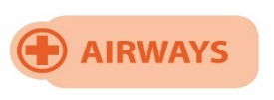

Primary survey steps – DRABCD
The primary survey can be remembered by the acronym ‘DRABCD’
(You can also remember this as Doctor ABCD).
Notes:
Having conducted a scene survey and established that the immediate area is safe from any dangers, you can now approach the casualty. When approaching the casualty, an initial casualty assessment should be conducted – this initial assessment is called a primary survey.
The primary survey is a systematic process of approaching, identifying and dealing with immediate and/or life-threatening conditions.
The primary survey can be remembered by the acronym DRABCD (or the easy way to remember, Doctor ABCD).

Slide 12
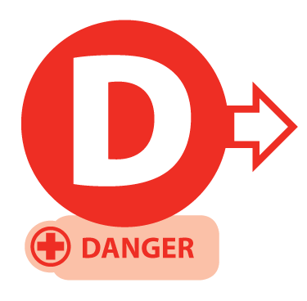
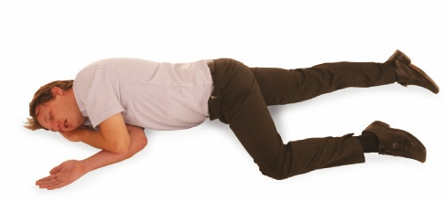
Primary survey
Prior to approaching the casualty, ensure the safety of the casualty, yourself and any bystanders.
Notes:
D – Danger
The same for all ages:
check for danger to yourself, the casualty and bystanders

Slide 13

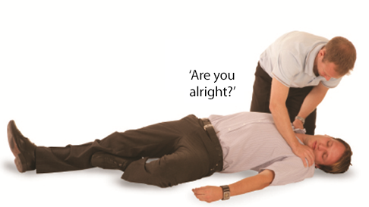
Primary survey – adult
If possible, approach the casualty from their feet as this prevents hyperextension of the neck from a responsive casualty. Use the AVPU scale when checking for a response
(If the casualty responds and providing there is no further danger, leave them in the position found and try to find out what is wrong. Get help if needed).
Notes:
R – Response
Same check for all ages, but:
adults/children: speak clearly, gently shake shoulders.
infants: tap the foot or flick the sole. Do not shake them.

Slide 14
Response – child or infant
Infant
Talk to the infant – is the infant alert, can you see them breathing or moving?
Gently stimulate the infant
If a response is gained, check for further injuries (secondary survey) and call for an ambulance (999) if required
Child
Talk to the child
Gently stimulate the child and ask loudly ‘Are you all right?’
If a response is gained, check for further injuries (secondary survey) and call for an ambulance (999) if required.
Notes:
R – Response
Same check for all ages, but:
children: speak clearly, gently shake shoulders.
infants: tap the foot or flick the sole. Do not shake them.

Slide 15
AVPU scale
A
ALERT – are they moving/talking? → No → Proceed to V
V
VOICE – do they respond to speech? → No → Proceed to P
P
PLACE – place your hand on their shoulders and gently shake them asking, ‘Are you alright?’ → No response → Proceed to U
U
UNRESPONSIVE – assume the casualty is unresponsive
The ‘P’ in the acronym AVPU is sometimes also referred to as ‘Pain’, meaning to cause a minor pain to see if the person responds. Examples include pinching the ear lobes or fingertips.

Slide 16
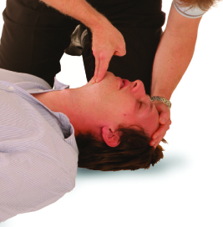
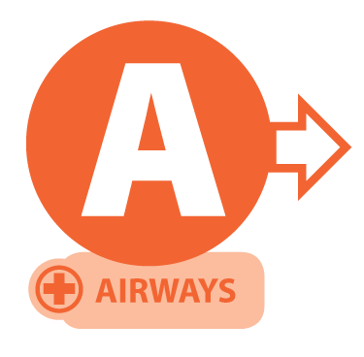
Primary survey
Open the airway
using the head-tilt/ chin-lift method.
Notes:
A – Airway
The same technique for all ages:
use the head tilt–chin lift
take extra care with infants: use a gentler tilt and keep the head in a neutral position, not tilted too far back

Slide 17
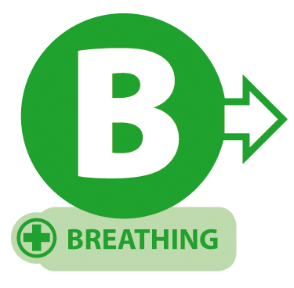
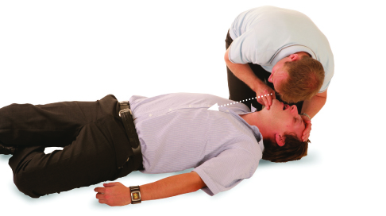
Primary survey
After opening the airway look, listen and feel for normal breathing for no more than 10 seconds
casualty breathing normally – check for further injuries and if safe to do so, place into the recovery position
casualty not breathing normally – commence CPR
Agonal breathing
In the first few minutes after a cardiac arrest, a casualty may be barely breathing or taking infrequent, slow noisy gasps. Do not confuse this with normal breathing. If in any doubt that breathing is normal, act as if not breathing normally and prepare to start CPR.
Notes:
B – Breathing
The same method for all ages:
look, listen and feel for breathing (no more than 10 seconds)
be alert to agonal breathing
infant chest movements are more subtle, so watch closely

Slide 18
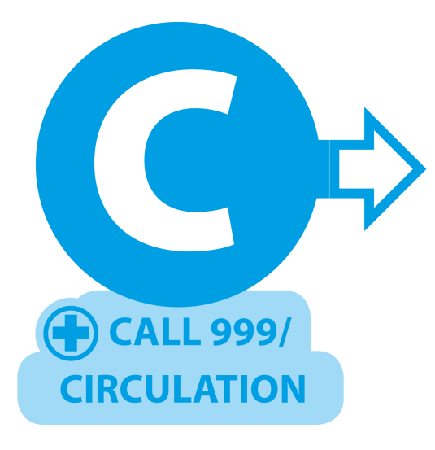
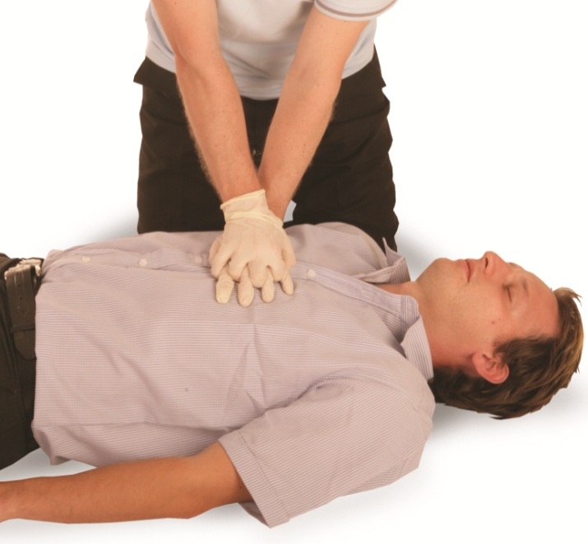
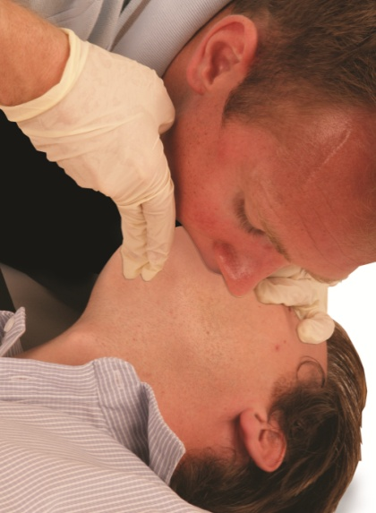
Primary survey
Call an ambulance (999). Ask a helper to call, otherwise call yourself. Stay with the casualty when making the call if possible, and activate the speaker function on the phone to aid communication with the ambulance service, send someone to get an AED. Commence CPR (30 compressions 2 breaths)
Compression-only CPR
If you are untrained or unable to do rescue breaths for a casualty who is not breathing, give chest compression-only CPR. These should be continuous at a rate 100-120 per minute and to a depth of 5-6 cm.
Notes:
C – CPR (if needed) – cardiopulmonary resuscitation
The next slide provides a breakdown of the CPR differences depending on the age of the casualty.

Slide 19
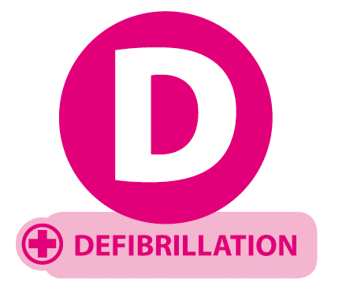
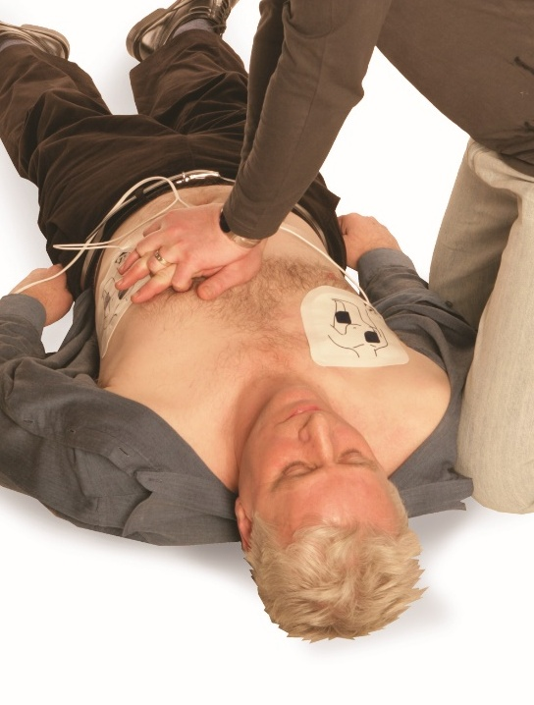
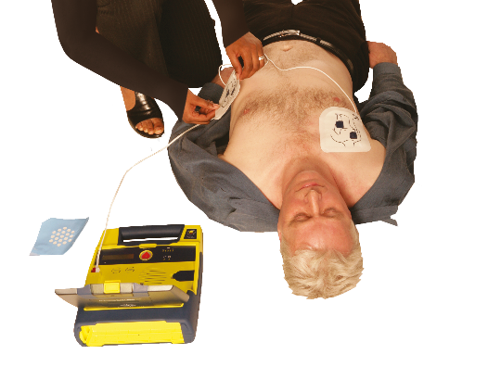
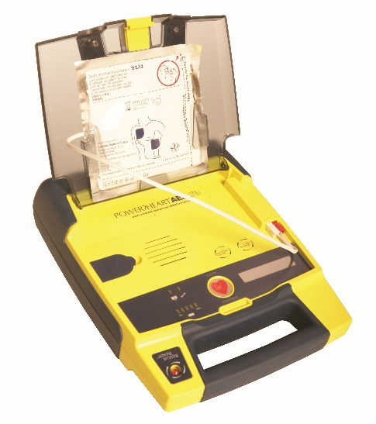
Primary survey
If an AED arrives, switch it on and follow the spoken or visual prompts. An AED is used in conjunction with CPR.
Notes:
D – Defibrillation (AED)
Adult pads: Ages 8+ (size dependent)
Paediatric pads: Ages 1-8
Infants (<1 year): Use manual defibrillator with attenuator if available, with pads placed front and back

Slide 20




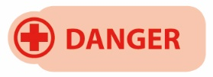


Primary survey – practical demonstration
Notes:
Group exercise: Primary survey – practical demonstration
Learners should work in groups to demonstrate the primary survey using the correct methods.
This is a hands-on assessment. Observation and participation are essential.

Slide 21




How much do you know?
CE
How should you check for a response in a casualty during the primary survey?
Shake the casualty firmly and shout loudly
C
Slap the casualty's face gently to provoke a response
Talk to the casualty and see if they are breathing or moving
Place them in the recovery position
Notes:
Class exercise: How much do you know?
The correct answer is C.

Slide 22
How much do you know?​
CE
When approaching a casualty, what is the correct way to check for responsiveness?
Shake them and wait for movement
D
Shout their name and blow in their face
Begin chest compressions immediately
Gently shake their shoulders and ask loudly ‘Are you all right?’
Notes:
Class exercise: How much do you know?
The correct answer is D.

Slide 23
Module 2
Be able to provide first aid to an unresponsive casualty who is not breathing normally
23
Notes:
Completion of this module will enable learners to meet the following learning outcome:
Be able to provide first aid to an unresponsive casualty who is not breathing normally.
This includes the following assessment criteria:
identify when to administer Cardiopulmonary Resuscitation (CPR)
demonstrate CPR using:
an adult
a child
an infant
identify other considerations when administering CPR and using an AED
Activities in this module include:
CQ: What is cardiopulmonary resuscitation?
GE: CPR - chest compressions
GE: CPR – practical demonstration
CE: Two multiple-choice questions (MCQ’s) (formative assessment)

Slide 24
What is cardiopulmonary resuscitation (CPR)?
CPR
CPR is a method of combining chest compressions with effective rescue breaths in order to artificially circulate blood and to put air into the lungs.
Cardio = heart
Pulmonary = lungs
Resuscitation = revive
Notes:
Class question: What is cardiopulmonary resuscitation (CPR)?

Slide 25
When you should administer CPR
First, assess the casualty quickly and calmly to decide if CPR is needed
CPR should be administered when the casualty is unresponsive and:
is not breathing
OR not breathing normally (agonal breathing)
KEY POINT
Starting CPR at the right time can be the difference between
life and death!
Notes:
Start CPR if someone is unresponsive and:
not breathing at all
or is making gasping, irregular or snorting sounds (agonal breathing) – this is not effective breathing.

Slide 26
Recognising an unresponsive casualty
A casualty is considered unresponsive if they:
do not respond to voice or touch
show no purposeful movement
have eyes that are closed or staring.
Notes:
Unresponsiveness means the person is unconscious. Try shouting, gently shaking their shoulders and checking for any response. If they don’t respond, proceed to assessing the breathing.

Slide 27
Recognising agonal breathing
Recognising abnormal breathing
Not all breathing is normal, especially in cardiac arrest
Agonal breathing can sound like gasping, snorting or choking
If in doubt about whether breathing is normal, assume it’s not
Start CPR immediately if breathing seems abnormal.
Notes:
Agonal breathing often happens shortly after the heart stops. It can look or sound dramatic, but it’s ineffective. Don’t mistake it for normal breathing. If in doubt, treat as not breathing.

Slide 28
Normal vs. agonal breathing the key differences
Breathing normally:
Agonal breathing:
regular rise and fall
quiet, steady breathing
effective air exchange
gasping, snorting and irregular
may sound like choking
not enough to sustain life.

Slide 29
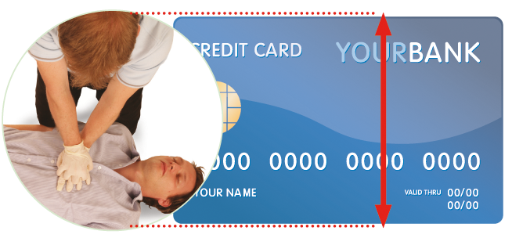
CPR - chest compressions
Chest compressions must only be administered to a casualty who is not breathing normally
Depth of compression should be 5-6 cm
Rate of compression should be 100-120 compressions per minute
30 chest compressions should be administered prior to moving onto rescue breaths (expired air ventilations).
Notes:
Demonstration
Ensure that all members of the group can see and demonstrate in full, using a manikin, administering chest compressions. Emphasise the importance of hand positioning, depth and rate of compression.
Group exercise: CPR – chest compressions
Once explained, split the class down into groups. Each group should have access to a manikin. Ask the learners to practise chest compressions, ensuring they follow correct technique and receive feedback where needed.

Slide 30
CP
CPR age-related changes
 | Adult | Child | Infant
Breaths | 30 compressions: 2 breaths | 5 initial breaths, then 30:2 | 5 initial breaths, then 30:2
Compression depth | 5-6cm | 4-5cm depending on size | 1/3 chest depth
Hand position | 2 hands, centre of chest | 1 or 2 hands depending on size | 2 fingers or thumbs in the centre of the chest
Compression rate | 100-120 per minute | Same as adult | Same as adult
KEY POINT
Paediatric resuscitation practice
Clinical settings may anticipate paediatric cardiac arrests
In such cases, a 15:2 compression-to-breath ratio may be used
This ratio is specific to paediatric basic life support protocols (30:2).
Notes:
Tutor to highlight the CPR differences between adults, children and infants.

Slide 31
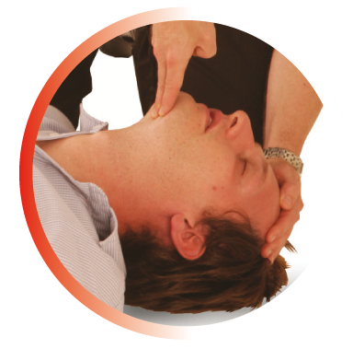
Airway maintenance
It is important that the casualty’s airway is opened and remains open (maintained).
Notes:
If the casualty is breathing, it is essential to keep the airway open at all times. This can be maintained by regularly checking the airway, even when the casualty is in the recovery position.

Slide 32
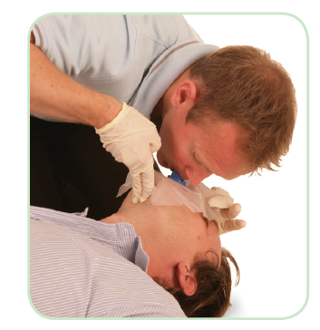
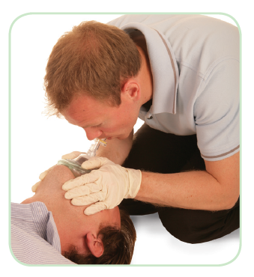
Barrier devices
Barrier devices are essential equipment and help to eradicate
the spread of infection and cross-contamination. Barrier devices, as
their name suggests, place a barrier between the first-aider and the casualty
Barrier devices include:
nitrile powder-free gloves
face shields
pocket masks
non-surgical face mask/clean fabric material.
Notes:
Explain that using a barrier device, such as a face shield, is important to prevent cross-infection. If the casualty has a serious mouth injury, mouth-to-nose ventilations can be performed. If the casualty has a stoma fitted, ‘mouth-to-stoma’ ventilation should be used.

Slide 33
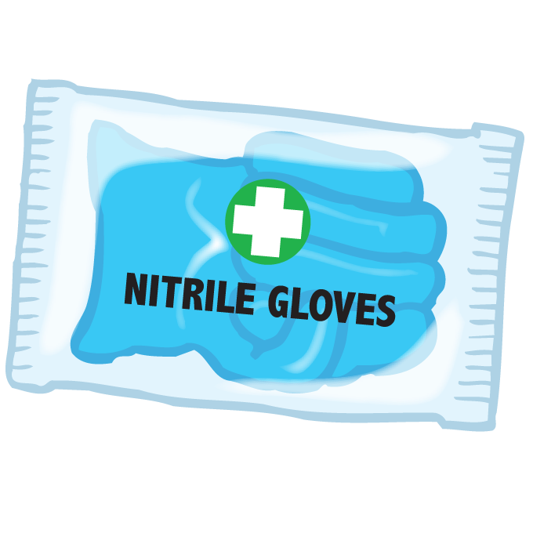
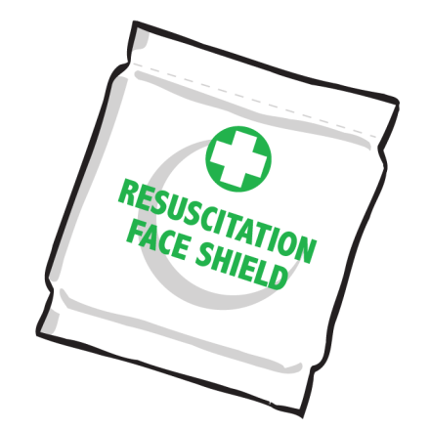
Minimising infection
To assist in minimising the risk of infection and cross-contamination
there are various precautions that can be taken, such as:
maintaining good personal hygiene
using barrier devices
covering open cuts or sores
minimising contact with blood or bodily fluids
changing gloves between casualties
washing hands thoroughly after removing gloves.
Notes:
Tutors should explain to learners that, as a first-aider, it is important not to transmit infections to the casualty, colleagues or others in the workplace and vice versa.
This can be achieved by:
maintaining good personal hygiene – always ensure your personal hygiene is of a high standard
using barrier devices – wear disposable gloves and use a face shield when dealing with any casualty
covering open cuts or sores – ensure any cuts or sores are covered with a suitable dressing
minimising contact with blood or bodily fluids – avoid direct contact wherever possible
changing gloves between casualties – if possible, change gloves between casualties to prevent cross-contamination
washing hands thoroughly after removing gloves – even when gloves are used, hands must be washed thoroughly after treatment

Slide 34
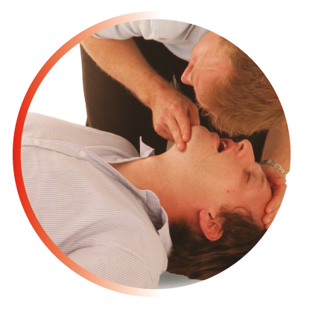
CPR – adult
After completing 30 chest compressions, the emergency first-aider must then administer 2 effective rescue breaths
Each breath should take 1 second to complete and the casualty’s chest should rise as in normal breathing. This is known as an effective rescue breath
Administering the 2 breaths should take no longer than 10 seconds to complete in total
  Once the first breath is administered, remove your mouth from the casualty’s mouth, turn your head and watch the chest rise and fall, then administer the second breath.
Notes:
Important note: Do not remain off the chest for longer than 10 seconds. Each breath should take 1 second to administer, which totals approximately 5 seconds for 5 breaths. This leaves 5 seconds to return to chest compressions.

Slide 35
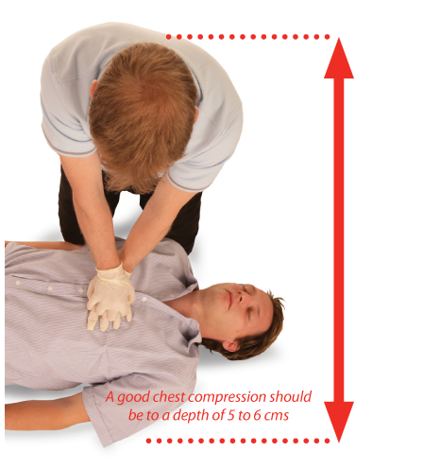
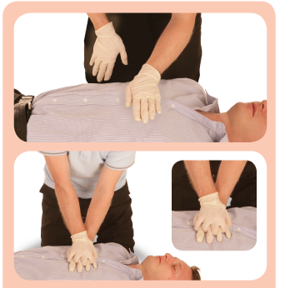
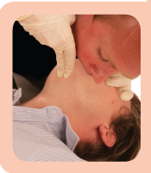
Demonstrate CPR – adult
Notes:
Group activity: Demonstrate CPR - adult
Gather the group and demonstrate CPR using a manikin.
Show them how to perform CPR both with and without a barrier device (such as a face shield).
After the demonstration, explain and demonstrate how to clean the manikin thoroughly and safely.
Explain that once you commence CPR, you should not stop until:
A health professional tells you to stop
You become exhausted
The casualty is definitely waking up, moving, opening their eyes and breathing normally
Prompted by the AED

Slide 36
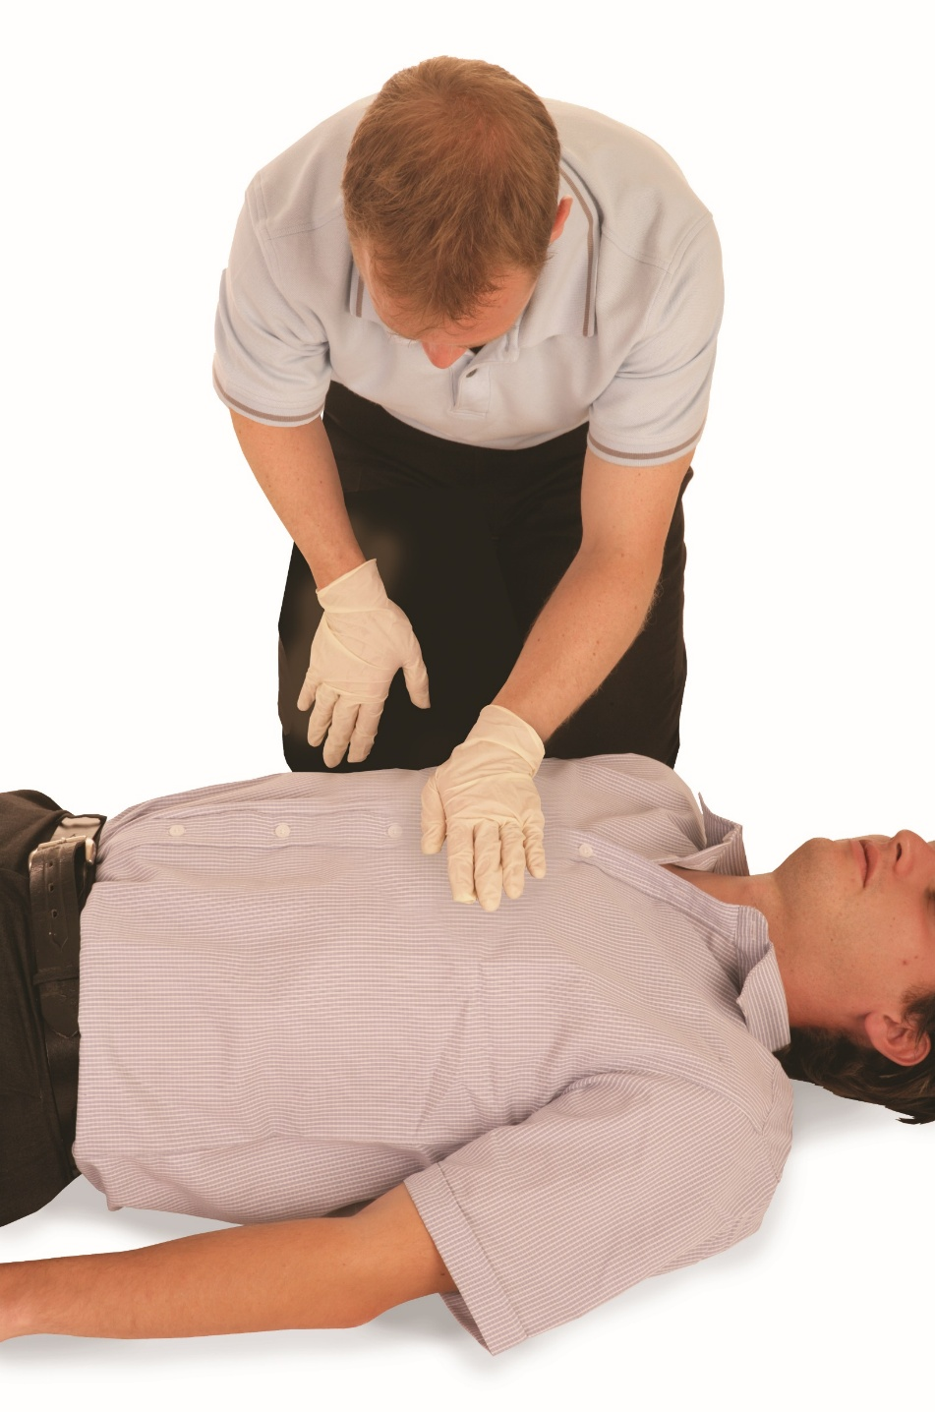
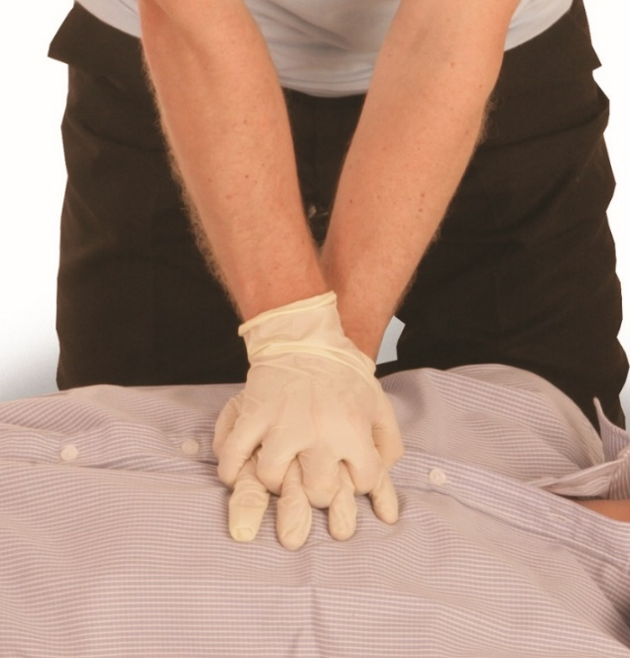
CPR – adult
Kneel by the side of the casualty. Place the heel of 1 hand in the centre of the casualty’s chest
Place the heel of your other hand on top of the first hand. Interlock the fingers of your hands.

Slide 37
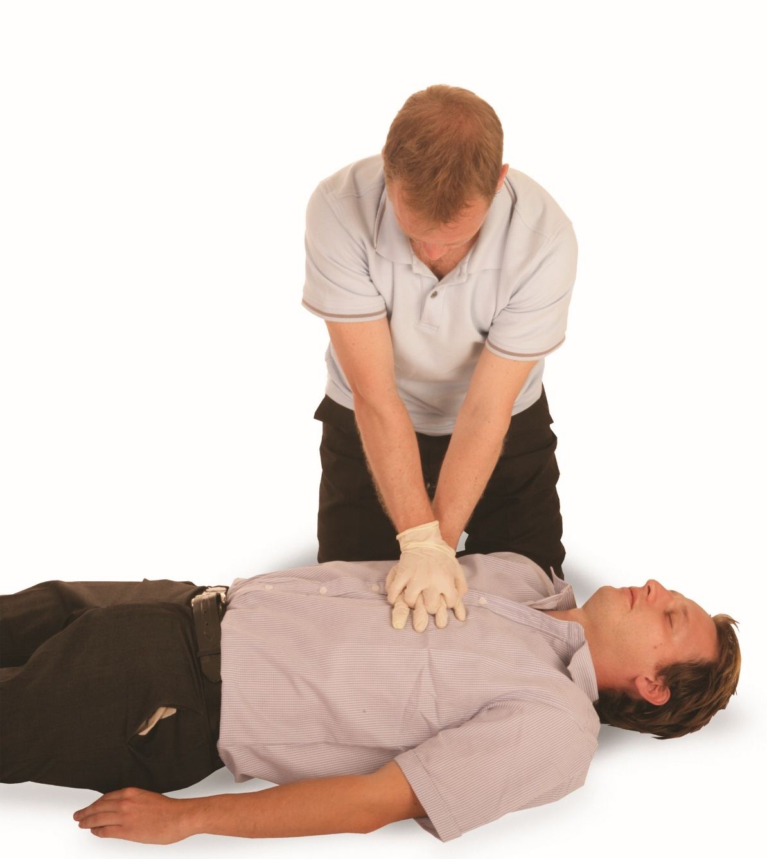
CPR – adult (cont.)
Position yourself vertically above the casualty’s chest and with your arms straight, press down on the sternum 5-6cm
After each compression, release all of the pressure on the chest without losing contact between your hands and the sternum. Repeat at a rate of 100-120 compressions per minute 30 times.

Slide 38
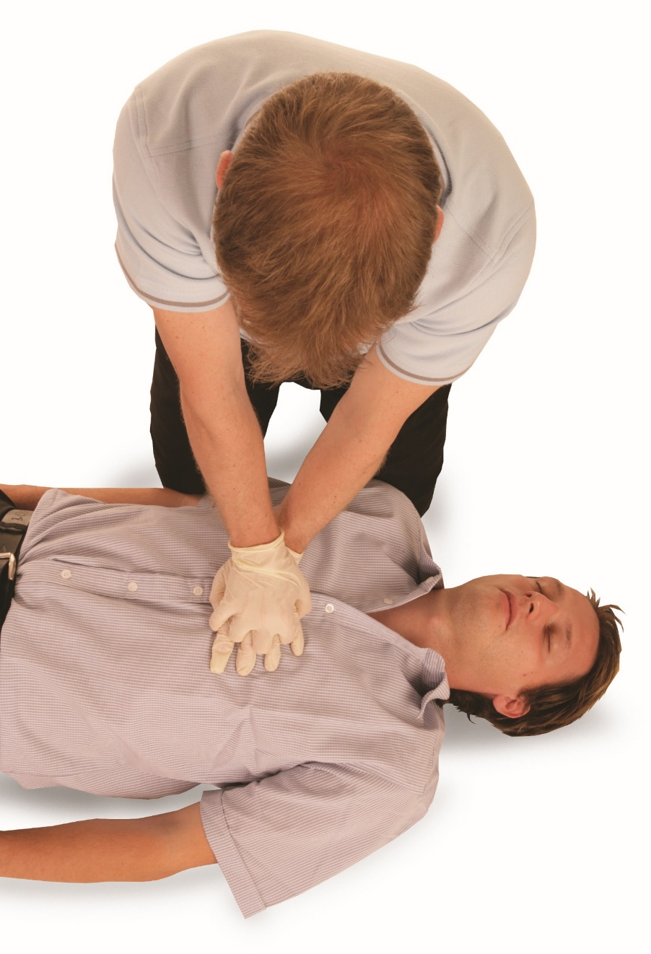
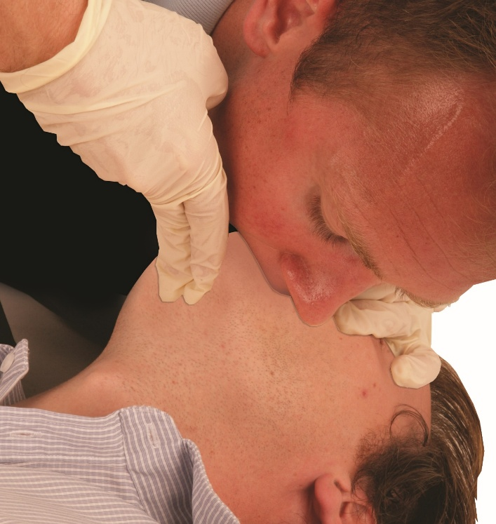
CPR – adult (cont.)
Administer 2 effective rescue breaths
KEY POINT
A good chest compression should be at a depth of 5 to 6cm.

Slide 39
Administering CPR (cont.)
Complete 30 compressions and 2 rescue breaths until:
1. A health professional tells you to stop
2. You become exhausted
3. The casualty is definitely waking up, moving, opening their eyes and breathing normally
4. Prompted by the AED
If there is assistance available when administering CPR, you should change
over every 1-2 minutes.

Slide 40
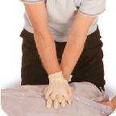
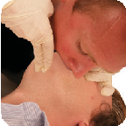
Adult basic life support and automated external defibrillation (AED)
Check for DANGER
If responsive, leave in the position found. Provided there is no further danger, try to find out what is wrong, get help if needed and reassess regularly
Yes
Check for a RESPONSE (AVPU)
Yes
Open the AIRWAY
Use the head-tilt/chin-lift method
Look, listen and feel for normal breathing for no more than 10 seconds
If breathing normally, check for injuries. Place into the recovery position, call an ambulance (999) and monitor
Yes
Call an ambulance (999), ask a helper or call yourself,
activate speaker function on phone to aid communication
with the ambulance, send someone to get an AED
Administer CPR - start with 30 chest compressions
x30
x2
For lifeguards only for drowning casualties. Give 5 initial
breaths and resuscitate for 1 minute before calling 999.
Upon your return, continue with CPR (30:2)
Give 2 effective rescue breaths
Continue with CPR until a health professional tells you to stop, you become exhausted or the casualty is definitely waking up, moving, opening eyes and breathing normally
If AED pads have been attached to the casualty,
continue as directed by the AED’s voice and
visual prompts.

Slide 41
Infant and child CPR
Check for DANGER
If responsive by answering or moving, leave in the position found, provided there is no further danger, check their condition and get help if needed. Reassess regularly
Check for a RESPONSE by gently stimulating
the infant or child
Yes
Open the airway
Yes
Use the head-tilt/chin-lift method
Look, listen and feel for normal breathing for
no longer than 10 seconds
Place into the recovery position, call an ambulance (999), only leave the infant/child if there is no other way of obtaining help and check for continued normal breathing
Yes
Call an ambulance (999), ask a helper or call yourself, activate speaker function on phone to aid communication with the ambulance, send someone to get an AED
Yes
If you are on your own, call for help (999) as soon as you recognise cardiac arrest. If possible, use a speakerphone so you can continue with care while alerting the emergency services. Give 5 initial rescue breaths, then begin CPR immediately. If you need to fetch help or a phone, take the infant/child with you if safe and practical
Remove any obvious airway obstruction
and give 5 initial rescue breaths
Continue with CPR until a health professional tells you to stop, you become exhausted or the infant/child shows signs of life (moving, breathing normally or coughing).
Give 30 chest compressions followed by
2 effective rescue breaths
Yes
Notes:
Infant and child CPR
The age definition of an infant is under the age of 1 year. A child is between 1 year and 18 years of age.

Slide 42
CPR – practical demonstration
You must be able to carry out a practical demonstration of CPR on the following:
an adult manikin
a child manikin
an infant manikin
This demonstration must show correct technique, positioning, compression depth and rate, effective rescue breaths and use of an AED where appropriate.
Notes:
Group exercise: CPR – practical demonstration
Learners should work in groups to practise on adult and child manakins using the correct methods.
This is a hands-on assessment. Observation and participation are essential.
Important note
To be deemed competent, a learner must perform CPR effectively and continuously for at least 2 minutes at floor level. This includes combining chest compressions and rescue breaths at the recommended ratio of 30 chest compressions and 2 rescue breaths.
You must be able to carry out a practical demonstration of CPR on the following:
an adult manikin
a child manikin
This demonstration must show correct technique, positioning, compression depth and rate, effective rescue breaths and use of an AED where appropriate.

Slide 43
Automated external defibrillator (AED)
An automated external defibrillator (AED) is used in conjunction
with CPR
Follow the adult basic life support sequence. If the AED is not available immediately, commence CPR prior to it arriving.
Notes:
Explain that an automated external defibrillator (AED) is used alongside CPR to help restore a normal heart rhythm in someone who is unresponsive and not breathing.
For children who are 8 years of age and older, depending on their size, standard adult AED pads are suitable. For children aged between 1 and 8 years, specific paediatric pads should be used as these attenuate the current delivered during defibrillation.

Slide 44
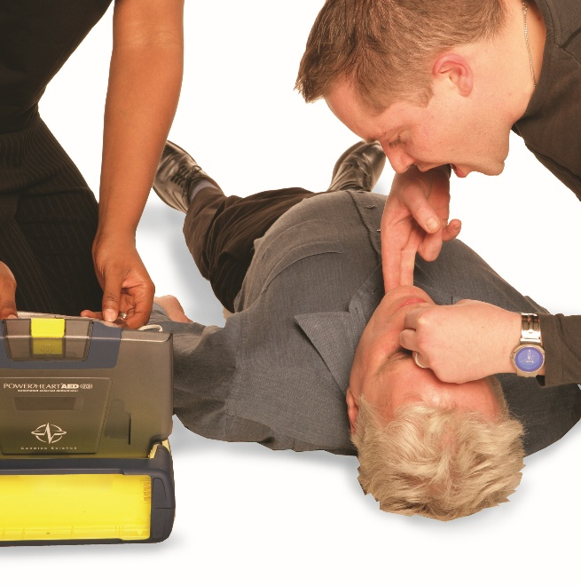
Automated external defibrillator (AED) (cont.)
Once the AED arrives:
if more than one rescuer is present, continue CPR while the AED is switched on. If you are alone, stop CPR and switch on the AED
follow the voice and or visual prompts
attach the electrode pads to the casualty’s bare
chest, ensuring the positioning of the pads as per
the instructions given
ensure that nobody touches the casualty while
the AED is analysing the heart rhythm
There is no need to
shave the chest unless it will affect the pads sticking to the skin.
Look for signs of a pacemaker or piercings. If visible, ensure that the pads are kept clear of them. Medication patches should be removed and skin wiped dry before pads are placed

Slide 45
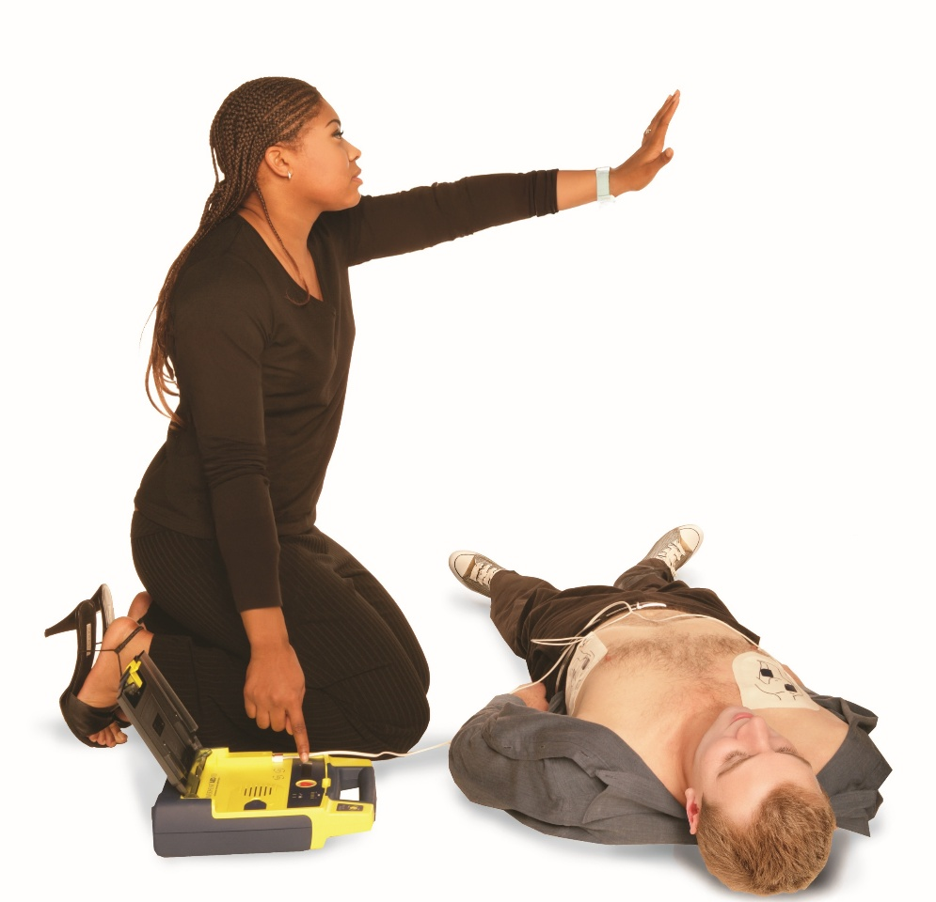
Automated external defibrillator (AED) (cont.)
3(a). If a shock is indicated
Ensure that nobody is in contact with the casualty and give clear instructions for everyone to ‘stand clear’
Press the shock button as directed (fully-automatic AEDs will
deliver the shock automatically)
Continue as directed by the AED’s voice and visual prompts
The AED will inform you to continue with CPR. Continue
with CPR until the voice prompt informs you to stop
Resume CPR immediately using a ration of 30 chest
compressions to 2 rescue breaths
Continue as directed by the voice/visual prompts.
3(b). If no shock is indicated

Slide 46
Automated external defibrillator (AED) (cont.)
4. Continue to follow the AED prompts until:
qualified help arrives and takes over or
the casualty starts to show signs of regaining consciousness, such as coughing, opening their eyes, speaking or moving purposefully and starts to breathe normally or
you become exhausted
If AED pads have been attached to the casualty continue as directed
by the AED’s voice and visual prompts
KEY POINT
Leave the pads attached when placing the casualty into the recovery position.

Slide 47
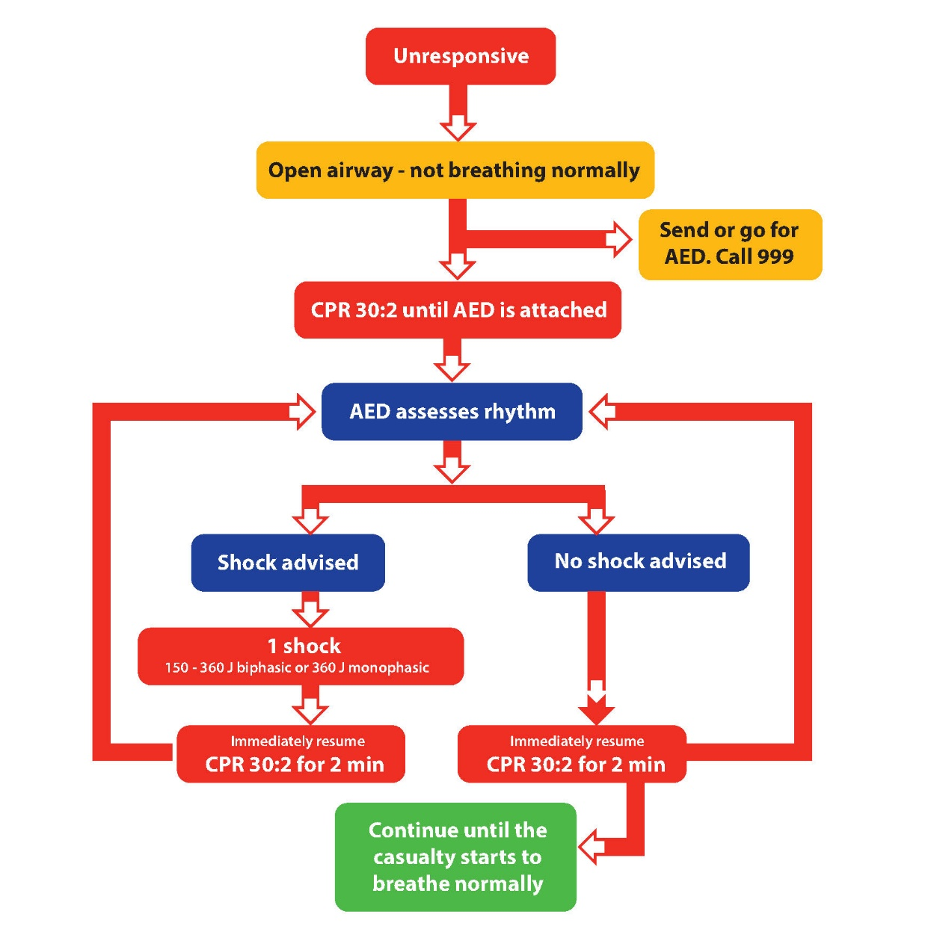
Defibrillation algorithm

Slide 48
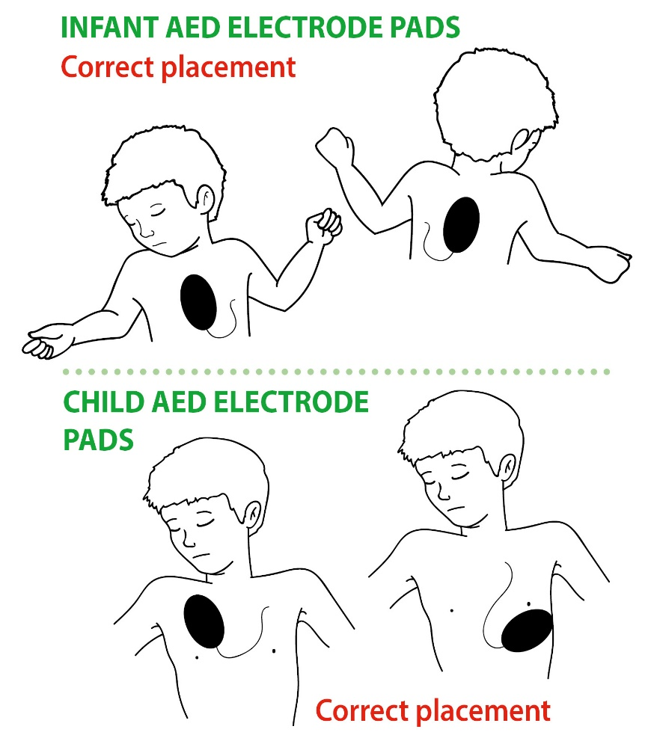
Key factors to consider during CPR and AED use – children and infants
Modifications to adult CPR for children and infants
  5 initial rescue breaths
  30 compressions to 2 breaths use gentler compression technique
    1 hand for smaller children
    2 thumbs for infants
Adjust depth and force based on child’s size
Pad placement on children and infants.
Notes:
Tutor to explain difference in DNACPR and a DNR form.
DNACPR stands for Do Not Attempt Cardiopulmonary Resuscitation. It is a medical decision made in advance indicating that CPR should not be performed if a person's heart stops beating or they stop breathing. DNACPR decisions are made based on clinical judgement, patient wishes, and best interests, often documented on a specific form used in healthcare settings.
ReSPECT stands for Recommended Summary Plan for Emergency Care and Treatment.
When is it appropriate to stop CPR?
Guidance for First Aiders and Clinical Practitioners.
Signs of life (ROSC – Return of Spontaneous Circulation)
Stop CPR when the casualty:
begins breathing normally
shows purposeful movement (e.g. moving limbs, blinking)
regains consciousness or
you are physically unable to continue
If you're the sole rescuer and become:
exhausted and unable to maintain effective compressions
alone with no help available, it is acceptable to stop to preserve your own wellbeing or
a trained healthcare professional takes over
CPR should be stopped when:
a paramedic, doctor or other appropriately trained professional arrives and assumes responsibility or
a valid DNACPR or advance decision is in place
If there is a:
do not attempt CPR (DNACPR) order
advance decision legally refusing CPR. Then do not start or stop CPR immediately if already underway.
Danger to rescuer
If the scene becomes:
unsafe due to environmental threats (e.g. fire, gas leak, aggression)
you should safely withdraw and stop CPR to protect yourself
Important note
Stopping CPR is a serious decision. Always consider:
the circumstances
your level of training
local policies or protocols if you're in a clinical environment

Slide 49
Key factors to consider during CPR and AED use – children and infants (cont.)
Infant and child AED settings/variances
If possible, use an AED with a paediatric attenuator in infants and children below 8 years (energy reduced to 50-75J). If this is not available, use the standard AED (for all ages)
There have been continuing reports of safe and successful use of AEDs in children less than 8 years, demonstrating that AEDs can identify arrhythmias accurately in children and are extremely unlikely to advise a shock inappropriately.
Notes:
Although there is limited data available, evidence from case reports now favours the use of a manual AED (preferably with an attenuator) on infants with shockable rhythms. However, the main focus should still be on the provision of high-quality CPR.
For children who are 8 years of age and older, depending on their size, standard adult AED pads are suitable. For children aged between 1 and 8 years, specific paediatric pads should be used as these attenuate the current delivered during defibrillation.

Slide 50
Key factors to consider during CPR and AED use
When administering CPR and using an AED, consider the following:
The scope of practice and personal limitations
Anticipatory care decisions recommended summary plan for emergency care and treatment (ReSPECT)/do not attempt cardiopulmonary resuscitation (DNACPR).
Notes:
Tutor to explain difference in DNACPR and a DNR form.
DNACPR stands for Do Not Attempt Cardiopulmonary Resuscitation. It is a medical decision made in advance indicating that CPR should not be performed if a person's heart stops beating or they stop breathing. DNACPR decisions are made based on clinical judgement, patient wishes, and best interests, often documented on a specific form used in healthcare settings.
ReSPECT stands for Recommended Summary Plan for Emergency Care and Treatment.
When is it appropriate to stop CPR?
Guidance for First Aiders and Clinical Practitioners.
Signs of life (ROSC – Return of Spontaneous Circulation)
Stop CPR when the casualty:
begins breathing normally
shows purposeful movement (e.g. moving limbs, blinking)
regains consciousness or
you are physically unable to continue
If you're the sole rescuer and become:
exhausted and unable to maintain effective compressions
alone with no help available, it is acceptable to stop to preserve your own wellbeing or
a trained healthcare professional takes over
CPR should be stopped when:
a paramedic, doctor or other appropriately trained professional arrives and assumes responsibility or
a valid DNACPR or advance decision is in place
If there is a:
do not attempt CPR (DNACPR) order
advance decision legally refusing CPR. Then do not start or stop CPR immediately if already underway.
Danger to rescuer
If the scene becomes:
unsafe due to environmental threats (e.g. fire, gas leak, aggression)
you should safely withdraw and stop CPR to protect yourself
Important note
Stopping CPR is a serious decision. Always consider:
the circumstances
your level of training
local policies or protocols if you're in a clinical environment

Slide 51
Key factors to consider during CPR and AED use (cont.)
Ensuring that no one is touching the casualty during analysis and shock
Recognition and actions to take for regurgitation
Circumstances when it is acceptable to pause/stop CPR
Clothing removal
Excessive chest hair.
Notes:
Tutor to explain difference in DNACPR and a DNR form.
DNACPR stands for do not attempt cardiopulmonary resuscitation. It is a medical decision made in advance indicating that CPR should not be performed if a person's heart stops beating or they stop breathing. DNACPR decisions are made based on clinical judgement, patient wishes and best interests, often documented on a specific form used in healthcare settings.
ReSPECT stands for recommended summary plan for emergency care and treatment.
When is it appropriate to stop CPR?
See guidance for first-aiders and clinical practitioners.
Signs of life (ROSC – return of spontaneous circulation)
Stop CPR when the casualty:
begins breathing normally
shows purposeful movement (for example, moving limbs or blinking)
regains consciousness
you are physically unable to continue
Stop CPR if you're the sole rescuer and:
become exhausted and unable to maintain effective compressions.
are alone with no help available. It is acceptable to stop to preserve your own wellbeing.
a trained healthcare professional takes over.
CPR should be stopped when:
a paramedic, doctor or other appropriately trained professional arrives and assumes responsibility
a valid DNACPR or advance decision is in place
It should also be stopped if there is a:
do not attempt CPR (DNACPR) order.
advance decision legally refusing CPR. If so, do not start or stop CPR immediately if already underway.
Danger to the rescuer
If the scene becomes unsafe due to environmental threats (for example, a fire, gas leak or aggression), you should safely withdraw and stop CPR to protect yourself
Important note:
Stopping CPR is a serious decision. Always consider:
the circumstances
your level of training
local policies or protocols if you're in a clinical environment

Slide 52
Other considerations when administering CPR (cont.)
Pregnancy
Tracheostomy patient
AED prep kit/rescue ready kit (razor, scissors, towel and PPE)
Oxygen therapy
Oxygen safety
Implanted pacemaker or defibrillator.
Notes:
Tracheostomy patient – a tracheostomy patient is someone who has undergone a tracheostomy, a surgical procedure where an opening (called a stoma) is created in the front of the neck into the trachea (windpipe).
Oxygen therapy – oxygen therapy is a medical treatment that provides supplemental oxygen to individuals who cannot get enough oxygen naturally through breathing. It is used to treat or manage various respiratory and cardiovascular conditions where blood oxygen levels fall below normal.
Oxygen safety – while oxygen therapy can be life-saving, oxygen is a highly flammable gas and it must be handled with great care.
Implanted pacemaker – a pacemaker is used to treat slow heart rhythms (bradycardia). It sends small electrical impulses to the heart to keep it beating at a normal rate and rhythm.
Defibrillator – an implantable cardioverter defibrillator (ICD) is used for patients at risk of dangerously fast heart rhythms (tachycardia or fibrillation) that could lead to cardiac arrest.

Slide 53
Other considerations when administering CPR (cont.)
Wet chest or wet surface: a shock can be delivered on wet or metal surfaces if no water links the casualty to the rescuer
Medical patches (for example, a GTN patch)
Jewellery
Moving machinery/vibrations
Explosive atmosphere
Post ROSC procedures
Accurate event reporting and recording.
Notes:
Explosive atmosphere – an explosive atmosphere is a mixture of air with flammable gases, vapours, mists or dusts under certain atmospheric conditions which, if ignited, can cause an explosion. These environments are common in various industries and require strict safety controls to prevent fires and explosions, protect workers and comply with legal standards.
Post-ROSC procedures – after a person regains a spontaneous heartbeat following cardiac arrest, immediate and ongoing care – known as post-ROSC (return of spontaneous circulation) care – is critical. The goal is to stabilise the patient, prevent further injury and optimise the chances of recovery.
A GTN patch is a transdermal (through the skin) medication patch that delivers glyceryl trinitrate (GTN) continuously into the bloodstream to help manage chronic angina (chest pain) or other heart-related conditions.

Slide 54
How much do you know?​
CE
Which of the following is a sign of agonal breathing?
Rhythmic breathing pattern
B
Gasping and choking sounds
Quiet and steady breathing
Regular rise and fall of the chest
Notes:
Class exercise: How much do you know?
The correct answer is B.

Slide 55
How much do you know?​
CE
When should you begin CPR on an unresponsive casualty?
If they do not respond and are breathing normally
C
If they respond to verbal commands but have shallow breathing
If they are unresponsive and breathing abnormally
If they are coughing and turning pale
Notes:
Class exercise: How much do you know?
The correct answer is C.

Slide 56
Module 3
Be able to provide first aid to an unresponsive casualty who is breathing normally
56
Notes:
Completion of this module will enable learners to meet the following learning outcome:
Be able to provide first aid to an unresponsive casualty who is breathing normally.
This includes the following assessment criteria:
identify when to place a casualty into the recovery position
demonstrate how to place:
an adult/child into the recovery position
an infant into the recovery position
demonstrate continual monitoring of breathing whilst the casualty is in the recovery position
Activities in this module include:
GE: The recovery position (adult) – practical demonstration
GE: The recovery position (infant) – practical demonstration
GE: The recovery position (child) – practical demonstration
CE: Two multiple-choice questions (MCQ’s) (formative assessment)

Slide 57
When to use the recovery position
Place a casualty in the recovery position when they have a lowered
level of response and:
do not need CPR
are breathing normally
are uninjured
If injured, only use the recovery position if their airway is at risk, such as:
• fluids in the airway (blood or vomit)
• you need to leave them to get help.
Notes:
Reinforce the difference between breathing normally vs. agonal breathing. Highlight risks of leaving someone flat who has a partially blocked airway.

Slide 58
Monitoring breathing continuously
Ongoing safety of the casualty
You must continue to monitor closely for any signs of deterioration
You should continue to:
look, listen and feel for breathing
reassess if there is any change in responsiveness
be alert for signs of deterioration into cardiac arrest
KEY POINT
If breathing stops or becomes irregular, start CPR immediately.
Notes:
Explain that sudden deterioration is common. Encourage learners to remain close and alert and be ready to begin CPR if needed.
Even when a casualty is in the recovery position and appears stable, things can change very quickly.

Slide 59
Monitoring casualty breathing
Prompt action if the condition changes
The recovery position keeps the airway open and helps fluids drain, but breathing complications can still occur
Monitoring ensures the casualty gets enough oxygen and warns of problems like irregular breathing, choking or signs of shock.
Notes:
Learners must be able to demonstrate how the continue to monitor breathing while the casualty is in the recovery position.

Slide 60
Monitoring casualty breathing (cont.)
Supports prompt action if the condition changes
If a casualty in the recovery position stops breathing normally, then act quickly
Roll the casualty onto their back and commence CPR
KEY POINT
Continuous monitoring allows immediate escalation if needed, which can significantly improve the chances of survival.

Slide 61
Monitoring casualty breathing (cont.)
Duty of care obligations
In both clinical practice and community settings, the first-aider has a duty of care to continue supporting the casualty until help arrives
This includes:
checking for normal breathing at regular intervals
looking, listening and feeling for breath sounds or chest movement
being prepared to re-assess the casualty's airway and responsiveness.

Slide 62
Additional considerations – recovery position
While the casualty is in the recovery position:
• continue to monitor airway and breathing at all times
• be alert for any changes in responsiveness
• turn the casualty onto the opposite side every 30 minutes
• if pregnant, place and keep them on their left side.
Notes:
Explain that prolonged pressure on 1 side can cause complications. Discuss how placing a pregnant casualty on the left side reduces pressure on major blood vessels and improves circulation.
When placing a pregnant woman into the recovery position she should be placed onto her left-hand side, as this prevents compression of the inferior vena cava.

Slide 63
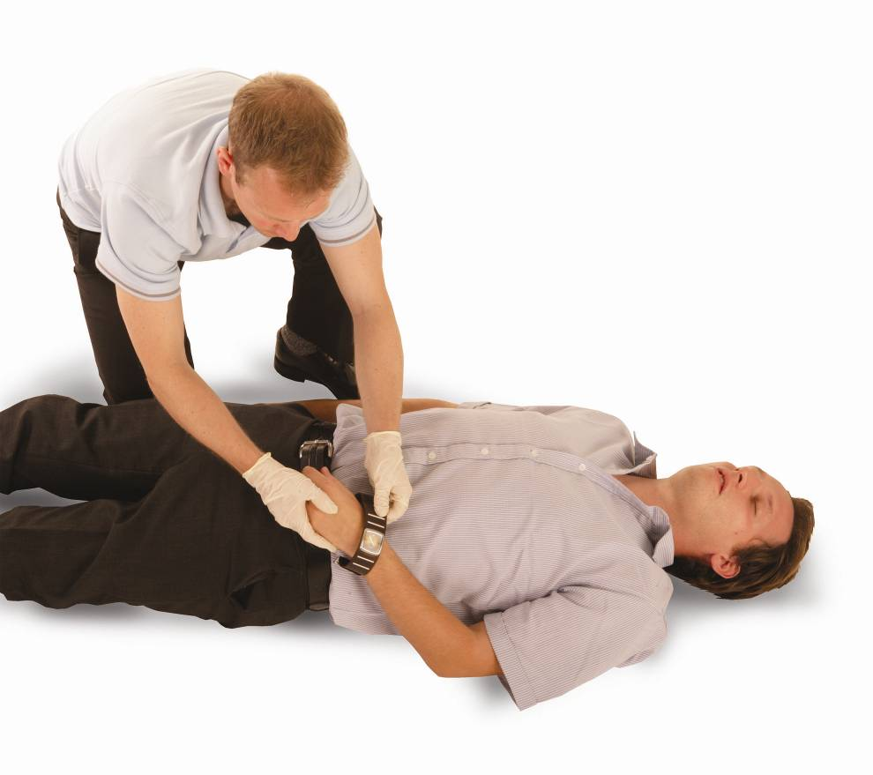
The recovery position – adult
Kneel to the side of the casualty. Remove glasses, watches and any large objects from side pockets.
Notes:
The recovery position
The recovery position is used to maintain a clear airway and assist with normal breathing when a casualty is unresponsive but breathing. It also assists when the casualty vomits or excretes saliva as it allows it to drain naturally from the mouth or nose. However, if you suspect that a casualty has had a spinal or head injury, you must carefully consider the movement of the casualty.

Slide 64
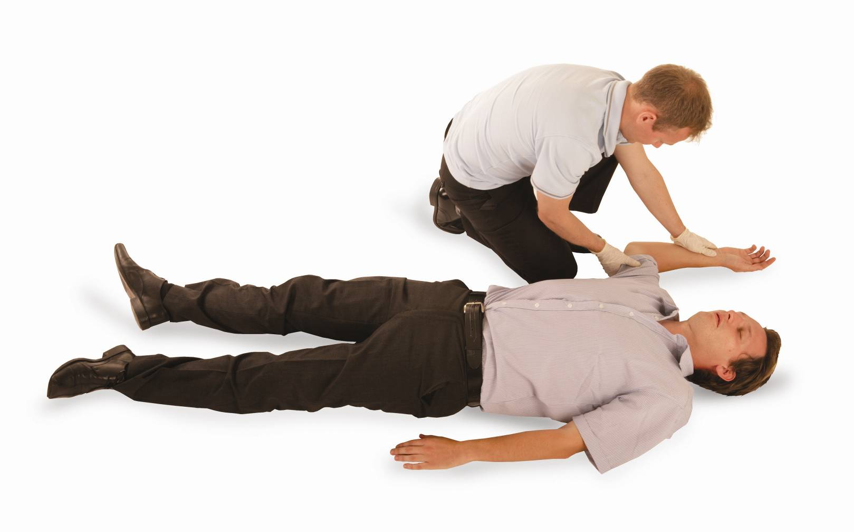
The recovery position
Place the arm nearest to you at a right angle to the casualty’s body (allow it to rest
in a natural position).

Slide 65
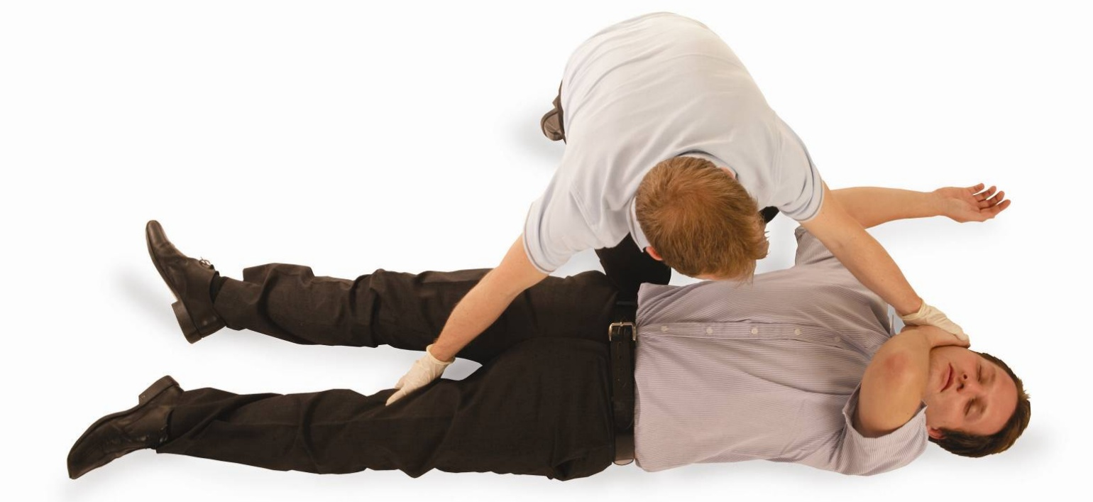
The recovery position
Bring the other arm across the casualty’s chest and secure the back of the hand onto
their nearest cheek with your hand.

Slide 66
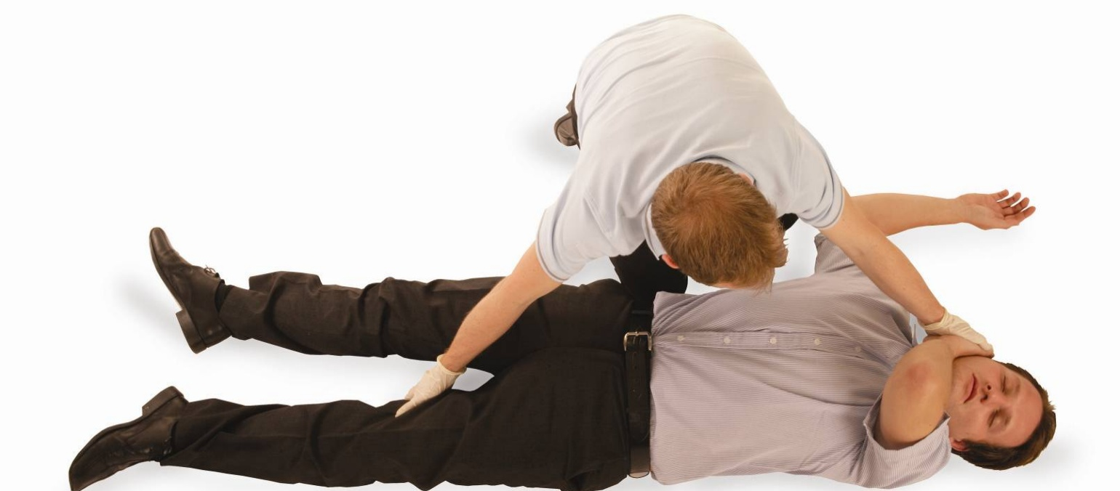
The recovery position
With your free hand, grasp the casualty’s clothing around the knee and draw the leg up,
ensuring the foot remains on
the ground.

Slide 67
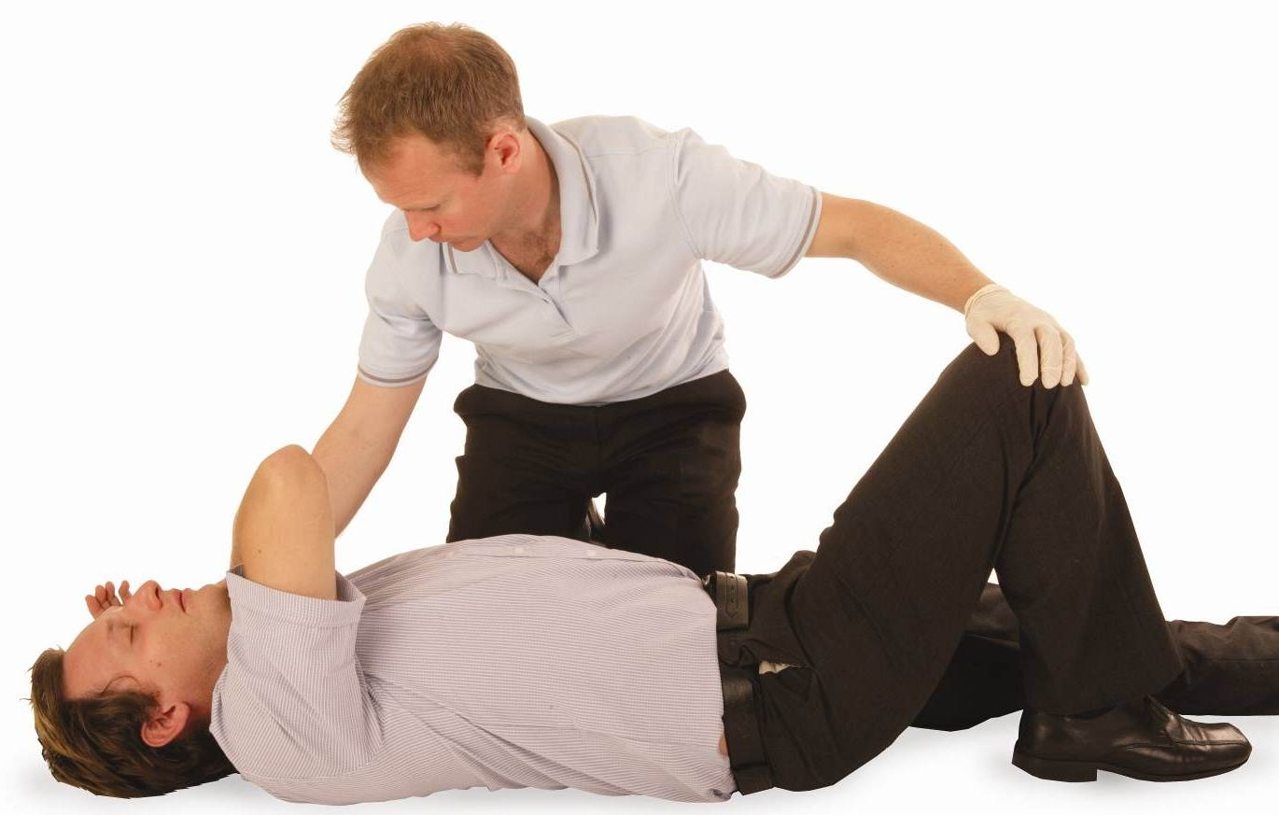
The recovery position
Keeping the casualty’s hand
on their cheek to control the
head movement, pull their leg towards you so the casualty turns onto their side.

Slide 68
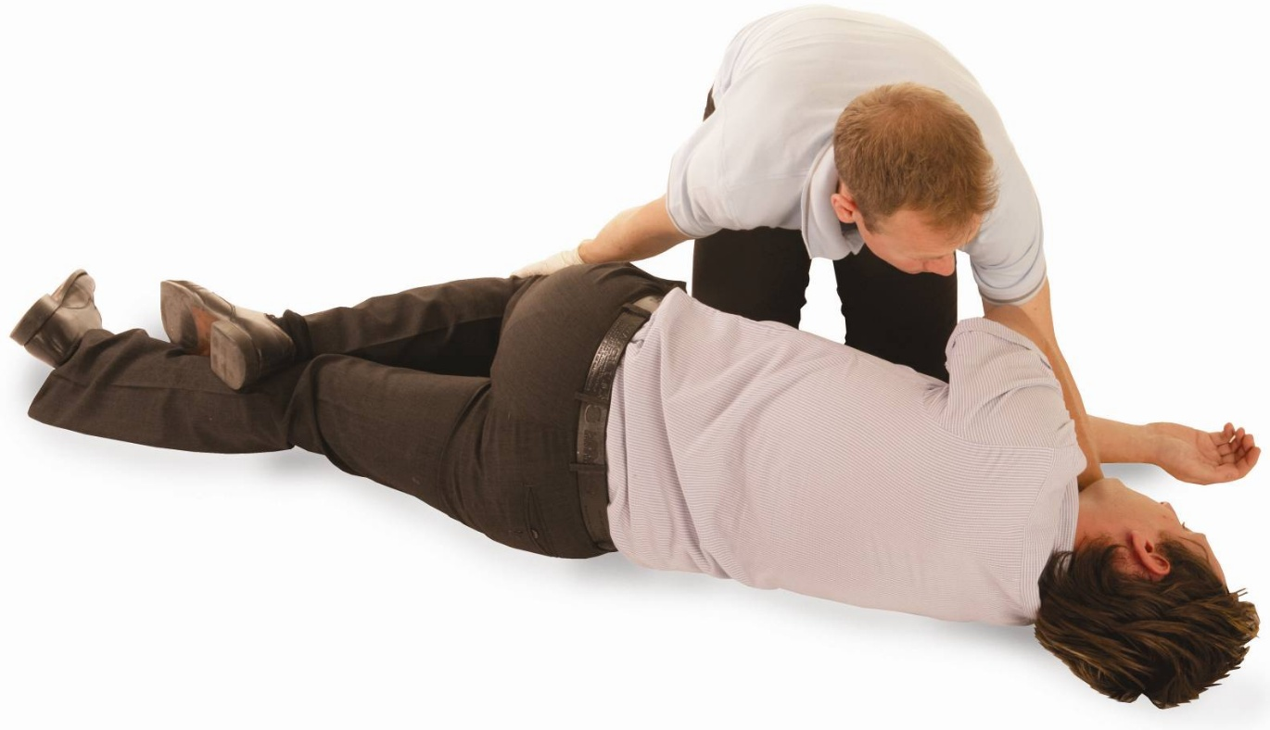
The recovery position
Adjust the casualty’s upper leg so that the knee and lower leg are at right angles to the
hip, making a stable base. Check that the airway is open and adjust the hand under the cheek to maintain the airway.

Slide 69
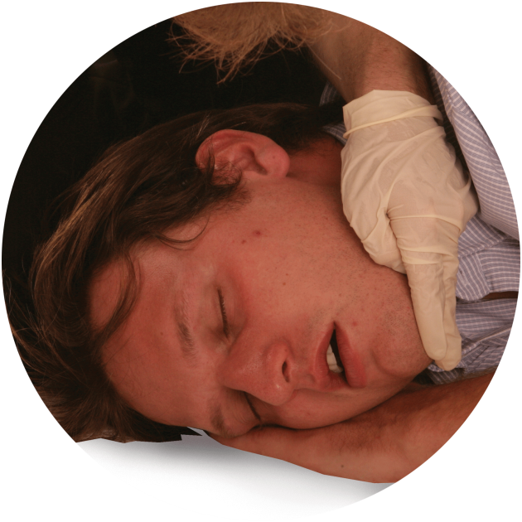
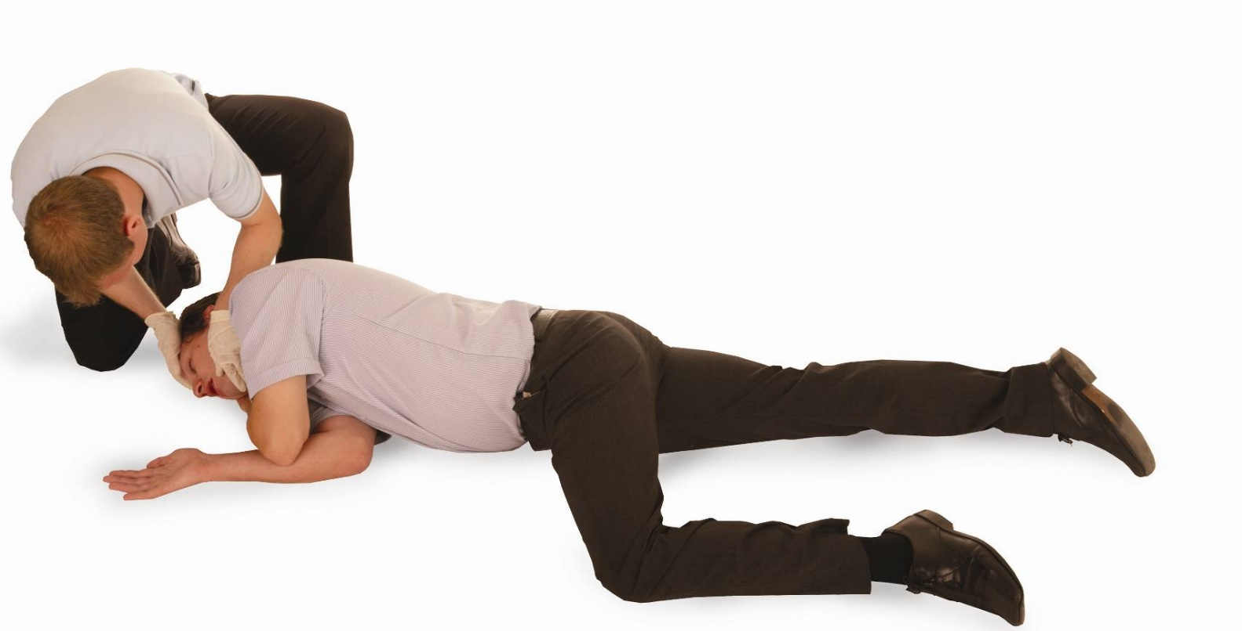
The recovery position
The casualty is now in the recovery position.
Continually monitor normal breathing, and be prepared to carry out CPR.

Slide 70
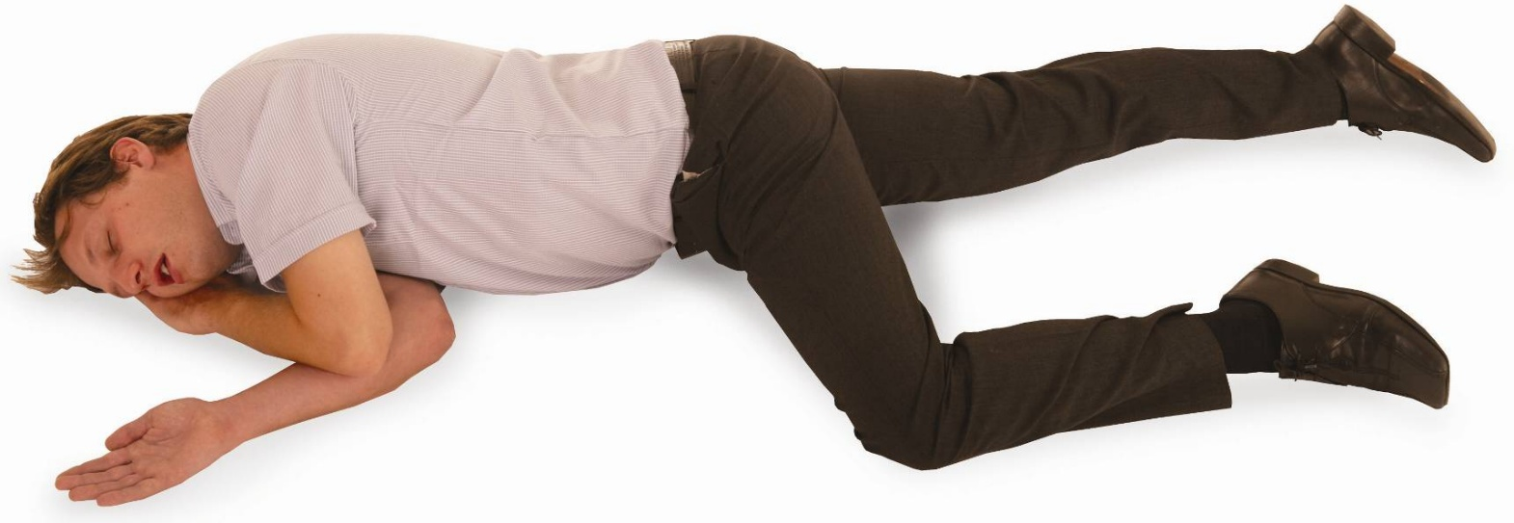
The casualty is now in the recovery position
Only place a casualty into the recovery position if there are no further injuries, once in the recovery position turn onto the opposite side every 30 minutes. When placing a pregnant woman into the recovery position she should be placed onto her left-hand side, as this prevents compression of
the inferior vena cava.

Slide 71
The recovery position (adult) – practical demonstration
You must be able to carry out a practical demonstration of how to place an adult into the recovery position
This demonstration must show the correct techniques, including:
monitoring the airway and breathing
turning the casualty on to the opposite side every 30 minutes
placing a pregnant casualty on their left side.
Notes:
Group exercise: The recovery position (adult) – practical demonstration
With the delegates working in pairs, ask them to demonstrate the procedure for placing a casualty into the recovery position and perform the action for a vomiting casualty.
Casualties should be placed injured side down if possible.
Pregnant women should be placed on their left-hand side, if injuries allow, as this prevents compression of the inferior vena cava (the large vein that carries deoxygenated blood from the lower half of the body into the right atrium (chamber) of the heart).

Slide 72
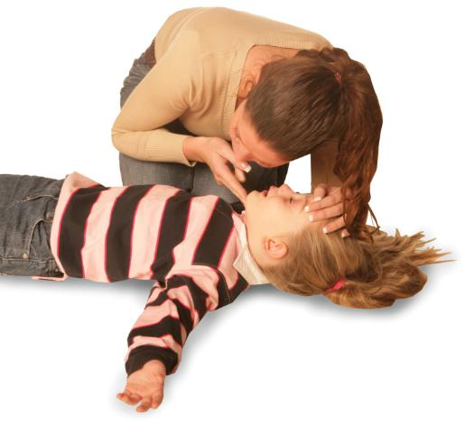
The recovery position – infant or child
Placing an infant or child in the
recovery position helps to:
1
Ensure that the airway is accessible and easily viewed
2
Assist with natural breathing
3
Enable the drainage of fluid from the mouth.
Notes:
The recovery position
Placing an infant or child in the recovery position helps to:
ensure that the airway is accessible and easily viewed
assist with natural breathing
enable the drainage of fluid from the mouth

Slide 73
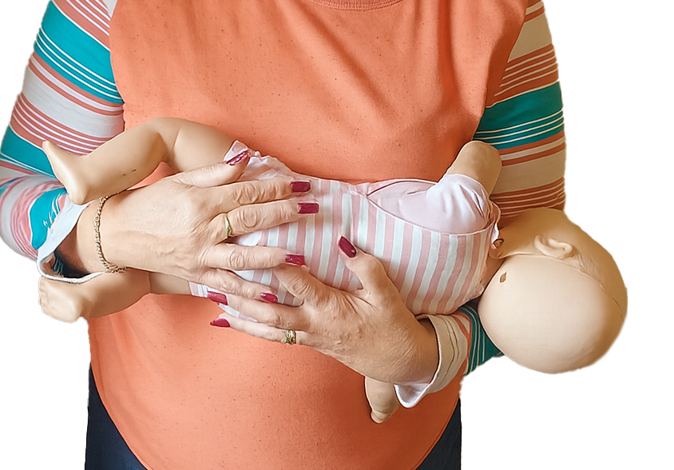
The recovery position (infant) – practical demonstration
Hold the infant facing towards you with
the head tilted down. This will allow fluids
to freely flow away from the infant and will
also allow you to monitor their breathing
and levels of responsiveness.
Notes:
If you have confirmed that the infant is breathing normally but is unresponsive, call for an ambulance on 999. If help is available, ask them to make the call. If no help is available, call for an ambulance yourself, ensuring that you take the infant with you, held in the recovery position (1).
Group exercise: The recovery position (infant) – practical demonstration
Gather the class around in a semicircle and demonstrate the recovery position using an infant manikin. Split the class into groups and get them to practise using the infant manikins. Walk around each group offering advice and assistance and assessing the competency of each individual delegate.

Slide 74
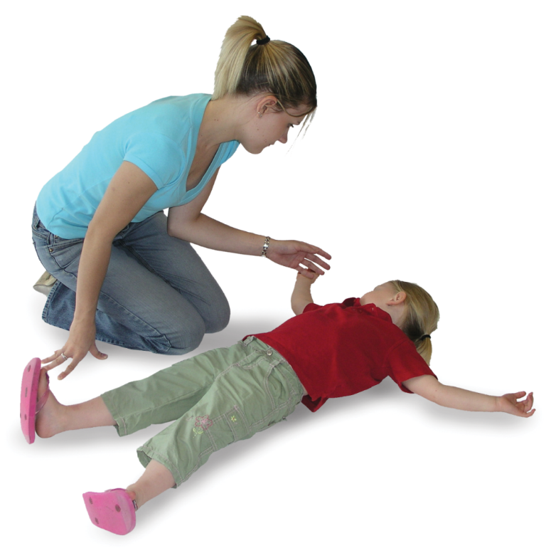

The recovery position – child
Kneel beside the child and remove
any hazards, such as spectacles
and objects in their pockets.
Notes:
When a child is breathing normally but is unresponsive/unconscious, and if injuries allow, the next procedure would be to place them into the recovery position, injured side down. This can be achieved even when the child is on their front or their side.

Slide 75

The recovery position – child
Place the arm nearest to
you at a right angle to the
child’s body (allow it to
rest in a natural position).

Slide 76

The recovery position – child
Bring the other arm across the child’s chest and secure the back of the hand on to their nearest cheek with your hand.

Slide 77

The recovery position – child
With your free, hand grasp the child’s clothing around the knee and draw the leg up, ensuring the foot remains on the ground.

Slide 78


The recovery position – child
Keeping the casualty’s hand on their cheek to control the head movement, pull their leg towards you so the casualty turns on to their side.

Slide 79

The recovery position (child) – practical demonstration
The child is now in the recovery position and either you or a member of staff can contact the emergency services if they haven’t already been contacted. Continually monitor breathing and levels of responsiveness while the child is in the recovery position
If the ambulance takes longer than 30 minutes to arrive and if injuries permit, turn the child on to their opposite side.
Notes:
Group exercise: The recovery position (child) – practical demonstration
Ask for a volunteer from the class. Gather the class round in a semicircle and demonstrate placing the volunteer into the recovery position.

Slide 80
How much do you know?​
CE
When is it appropriate to place a casualty in the recovery position?
When the casualty is breathing normally and has a suspected spinal injury
B
When the casualty is unresponsive and breathing normally
Only if the casualty is responsive but vomiting
When the casualty is having a seizure
Notes:
Class exercise: How much do you know?
The correct answer is B.

Slide 81
How much do you know?​
CE
Why should a pregnant casualty be placed on her left side in the recovery position?
To prevent compression of the inferior vena cava
A
To ensure they remain conscious
To allow for better observation
To improve spinal alignment
Notes:
Class exercise: How much do you know?
The correct answer is A.

Slide 82

Basic Life Support –
Choking for Adults,
Children and Infants
V1 August 2025
All rights reserved
© 2025 Highfield Products Limited
A global leader for qualifications, assessment, digital solutions, innovative products and customer service
Highfield Place Shaw Wood Business Park, Shaw Wood Way, Wheatley Hills Doncaster, DN2 5TB
01302 363277 | www.highfieldqualifications.com
Notes:
This training presentation can be used to support the delivery of the learning outcomes on choking for the following qualifications:
Clinical practice – learning outcome 4
Highfield Level 3 Award in Basic Life Support for Adults, Children and Infants in Clinical Practice (RQF)
Clinical practice - learning outcome 5
Highfield Level 3 Award in Basic Life Support and Management of Anaphylaxis for Adults, Children and Infants in Clinical Practice (RQF)

Slide 83
Be able to provide first aid to a casualty who is choking
83
Notes:
Completion of this module will enable learners to meet the following learning outcome:
Be able to provide first aid to a casualty who is choking
This includes the following assessment criteria:
identify when a casualty is choking
demonstrate how to administer first aid to:
an adult/child who is choking
an infant who is choking
Activities in this module include:
GE: Dealing with a conscious casualty
GE: Dealing with an unconscious casualty
CE: Two multiple-choice questions (MCQ’s) (formative assessment)

Slide 84

Obstructed airway
An obstructed airway is the partial or complete blockage of the upper airway (larynx and trachea), which leads to the lungs.

Slide 85
Obstructed airway (cont.)
The obstruction of the airway can be due to different causes, such as:
foreign bodies (foods)
allergic reactions
asthma
blood
vomit
infection
KEY POINT
An obstruction can cause minor or major breathing difficulties and, in
severe circumstances, may cause the casualty to become unconscious
and unresponsive.

Slide 86

Identifying a choking casualty – mild
Someone who is choking will have either a mild or severe airway obstruction. The severity of the blockage will determine the difficulty
in breathing
Identifying a choking casualty – mild
Coughing
Difficulty breathing and speaking
Redness of the face
Eyes enlarged and watering
Displaying distress.
Notes:
Dealing with a choking casualty can be a distressing and traumatic experience. However, to administer effective first aid, you must try to remain calm and act promptly to stop the situation escalating.

Slide 87
Identifying a choking casualty – severe
Identifying a choking casualty – severe
Grasping at the throat
Displaying distress
Unable to breathe or speak
Skin colour may develop a blue/grey tinge
Progressively getting weaker
Eventually, they will become unconscious.
Notes:
Dealing with a choking casualty can be a distressing and traumatic experience. However, to administer effective first aid you must try to remain calm and act promptly to stop the situation escalating.

Slide 88

Back blows
Treatment
Stand to the side and slightly behind the casualty
Support the chest with 1 hand, lean the casualty forward and administer a maximum of 5 sharp back blows between the shoulder blades with the heel of your other hand
If the back blows are ineffective, then give up to 5 abdominal thrusts.

Slide 89

Abdominal thrusts
Treatment
Stand behind the casualty and put both arms round the upper part of the abdomen. Lean the casualty forward
With one hand, clench your fist and place it between the navel and the ribcage
Grasp this hand with your other hand and pull sharply inwards and upwards. Repeat this process up to a maximum of 5 times.

Slide 90
Repeat
Assess the casualty’s condition. If the obstruction is still not relieved, call for an ambulance (999) and continue with cycles of up to 5 back blows and up to 5 abdominal thrusts until qualified medical assistance takes over
If the casualty becomes unresponsive, commence CPR
Casualties should seek medical attention if they:
have received abdominal thrusts
have difficulty swallowing or still feel as though they have an object stuck in their throat.

Slide 91


Dealing with a conscious casualty – practical demonstration
Encourage the casualty to cough. If ineffective, shout for help
If coughing is effective, continuously monitor
Give up to 5
BACK BLOWS
Is this SUCCESSFUL?
YES
If the casualty is or becomes unconscious, call an ambulance (999) and commence CPR
NO
Reassure and seek medical assistance if in any doubt
Give up to 5
ABDOMINAL THRUSTS
Assess. Is this SUCCESSFUL?
YES
NO
Call an ambulance (999). Continue with back blows and abdominal thrusts until qualified medical assistance takes over.
Notes:
Group exercise: Dealing with a conscious casualty –practical demonstration
In groups, ask the learners to work through the procedures for a conscious choking adult using a manikin.
If the casualty becomes unconscious or is found unconscious, then go to the next slide.
Fully demonstrate dealing with a conscious choking adult on a manikin. Fully explain:
encourage the casualty to cough
checking the casualty’s mouth (visually) for any obvious obstruction
bend the casualty forward and give up to 5 back blows
from behind the casualty give up to 5 abdominal thrusts
NB: if you have performed abdominal thrusts on a casualty, they must be sent to hospital to be examined for any internal injuries.
If the obstruction is still present after 3 cycles, call 999.

Slide 92
Dealing with an unconscious casualty – practical demonstration
Support the casualty to the ground
Give 2 effective breaths.
If they are not effective check the airway and remove any obstruction before your next attempt.
Do NOT interrupt CPR
Dial 999 and check on the availability
of an AED
Continue CPR
30 COMPRESSIONS – 2 BREATHS
Continue until a health professional tells you to stop, you become exhausted or the casualty is definitely waking up and moving.
Start CPR immediately with 30 chest compressions
Notes:
Group exercise: Dealing with an unconscious casualty – practical demonstration
With a manikin, allow the group time to practise this procedure.
Demonstrate
The tutor should demonstrate how to deal with an unconscious choking adult.

Slide 93















Actions for a choking child
START
Encourage the child to cough. If ineffective, shout for help
If coughing is effective, continuously monitor
x5
Give up to 5 sharp back blows
Is this successful?
YES
NO
Reassure and seek urgent medical assistance if in
any doubt
If you are on your own, call for help (999) as soon as you recognise cardiac arrest. If possible, use a speakerphone so you can continue with care while alerting the emergency services. Give 5 initial rescue breaths, then begin CPR immediately. If you need to fetch help or a phone, take the infant/child with you if safe and practical.
Give up to 5 abdominal thrusts
Assess. Is this successful?
YES
NO
Call an ambulance (999). Continue with
back blows and abdominal thrusts

Slide 94

Actions for a choking infant
START
If coughing is ineffective, shout for help
If coughing is effective, continuously monitor
x
Give up to 5 sharp back blows
x5
Is this successful?
YES
NO
Reassure and seek urgent medical assistance if in
any doubt
If you are on your own, call for help (999) as soon as you recognise cardiac arrest. If possible, use a speakerphone so you can continue with care while alerting the emergency services. Give 5 initial rescue breaths, then begin CPR immediately. If you need to fetch help or a phone, take the infant/child with you if safe and practical.
Give up to 5 chest thrusts (use the 2 thumbs encircling technique)
Assess. Is this successful?
YES
NO
Call an ambulance (999). Continue with
back blows and chest thrusts

Slide 95
How much do you know?​
CE
What is the most appropriate action to take if an adult/child is showing signs of severe choking (for example, unable to speak or breathe, skin turning blue).
Encourage them to drink water slowly
C
Ask them to lie down and breathe deeply
Perform up to 5 back blows followed by up to 5 abdominal thrusts
Begin CPR immediately without attempting back blows
Notes:
Class exercise: How much do you know?
The correct answer is C.

Slide 96
How much do you know?​
CE
What should you do if a choking adult becomes unresponsive after initial treatment attempts.
Roll the casualty into the recovery position and wait for help
D
Continue with back blows until help arrives
Begin abdominal thrusts again
Contact the emergency services and administer CPR
Notes:
Class exercise: How much do you know?
The correct answer is D.

Slide 97

Basic Life Support – Anaphylaxis for Adults, Children and Infants
V1 August 2025
All rights reserved
© 2025 Highfield Products Limited
A global leader for qualifications, assessment, digital solutions, innovative products and customer service
Highfield Place Shaw Wood Business Park, Shaw Wood Way, Wheatley Hills Doncaster, DN2 5TB
01302 363277 | www.highfieldqualifications.com
Notes:
This training presentation can be used to support the delivery of the learning outcomes on anaphylaxis for the following qualifications (learning outcome 4):
Highfield Level 3 Award in Basic Life Support, Automated External Defibrillation and Management of Anaphylaxis for Adults, Children and Infants (RQF)
Clinical practice
Highfield Level 3 Award in Basic Life Support and Management of Anaphylaxis for Adults, Children and Infants in Clinical Practice (RQF)

Slide 98
Be able to provide first aid to a casualty with anaphylaxis
98
Notes:
Completion of this module will enable learners to meet the following learning outcome:
Be able to provide first aid to a casualty with anaphylaxis
This includes the following assessment criteria:
recognise suspected anaphylaxis
Identify how to administer first aid for a casualty with suspected anaphylaxis
Demonstrate the use of a training device adrenaline auto-injector
Activities in this module include:
GE: Using an auto-injector
CE: Two multiple-choice questions (MCQ’s) (formative assessment)

Slide 99
What is anaphylaxis?
Anaphylaxis
Anaphylaxis is an extreme and potentially life-threatening allergic ​reaction, which results in rapid chemical changes in the body that is caused by a ‘trigger’, such as:
insect stings
foods (for example,
nuts and shellfish)
medicines, such as penicillin.
Notes:
Class question: What is anaphylaxis?

Slide 100
Recognition
Anaphylaxis may include the rapid onset and rapid recognition of a
life-threatening airway, breathing and/or circulation problems
Airway – swelling of the tongue, lips or throat ​
Breathing – difficult, wheezy breathing or a tight chest
Circulation:
  dizziness, feeling faint or passing out
  pale, cold, clammy skin and fast pulse
  nausea, vomiting, stomach cramps or diarrhoea
KEY POINT
There may also be skin rash, swelling and/or flushing.
Notes:
Discuss each ABC (airway, breathing, circulation) symptom with real-life examples.

Slide 101
Treatment
If you think the person has anaphylaxis, encourage the casualty to use their medication if applicable (antihistamine or adrenaline auto-injector)*​
Call 999
Sit/lay the casualty down (if responsive)​
Remove the trigger if possible​
Monitor the casualty ​(airway and breathing)​
Be prepared to carry out basic ​life support
KEY POINT
It is important that the casualty is seen by a qualified medical practitioner.
Notes:
The first-aider must be able to recognise an anaphylactic reaction and be trained to use an auto-injector.
*There is no legal problem with any person administering adrenaline using an adrenaline auto-injector if it could save someone’s life. The first-aider must be able to recognise an anaphylactic reaction and be trained to use an adrenaline auto-injector.

Slide 102
Adrenaline auto-injector (AAI)
A device designed to deliver a measured dose of adrenaline quickly into the outer thigh muscle
It is used as an emergency treatment for anaphylaxis, helping to reduce airway swelling, maintain blood pressure and support breathing.

Slide 103
Using an auto-injector – practical demonstration
1. Check
Undamaged
In date
Adrenaline is clear (not cloudy)
2. Remove the safety cap
Follow the device instructions
3. Position the injector – outer thigh
Right angle
Clothing (you don’t need to remove clothing)
4. Push and hold
Click and hold in place for 3 to 10 seconds (dependant on the make
of AAI)
KEY POINT
A second dose must be administered, after 5 minutes, if there is no improvement or symptoms worsen.
Notes:
Group exercise: Using an auto-injector
Split the learners into groups for a hands-on demonstration where each learner uses a training pen on each other.
Important: the demonstration must be with a training device only.
Show safe handling, remove the safety cap, press against thigh for 3 seconds
Hold in place, then massage the area lightly
Be aware of the need to administer a second dose if there is no improvement after 5 minutes
Simulated practise of drawing up a 1:1000 IM dose (if in scope)
Emphasise the safe disposal of sharps
Ensure every learner gets a turn with a training pen. Reinforce the 3-second rule and leg placement. Use visuals for drawing adrenaline if it is within the learner's scope.

Slide 104
Using an auto-injector – practical demonstration (cont.)
5. Remove and massage
Gently rub the injection site
6. Call 999 immediately
Even if symptoms improve
7. Reassure and monitor
Lay the casualty down with their legs raised unless breathing is difficult (in which case, let them sit up slightly).
Notes:
Group exercise: Using an auto-injector
Split the learners into groups for a hands-on demonstration where each learner uses a training pen on each other.
Important: the demonstration must be with a training device only.
show safe handling, remove the safety cap, press against thigh for three seconds
hold in place, then massage the area lightly
be aware of the need to administer a second dose if there is no improvement after five minutes
simulated practice of drawing up a 1:1000 IM dose (if in scope)
emphasise the safe disposal of sharps
Ensure every learner gets a turn with a training pen. Reinforce the three-second rule and leg placement. Use visuals for drawing adrenaline if it is within the learner's scope.

Slide 105
How much do you know?​
CE
Which of the following is a key symptom that may indicate a casualty is experiencing anaphylaxis?
Swelling of the tongue and lips with difficulty breathing
A
Mild skin itching with no other symptoms
Sneezing and watery eyes
Gradual onset of joint pain
Notes:
Class exercise: How much do you know?
The correct answer is A.

Slide 106
How much do you know?​
CE
What is the correct first step to take when a person shows signs of anaphylaxis and has their medication available.
Massage their arms to calm them
C
Ask them to lie down and take a deep breath
Encourage them to use their adrenaline auto-injector
Give them a glass of water and monitor them for changes
Notes:
Class exercise: How much do you know?
The correct answer is C.

Slide 107

Thank you for listening

