Slide 1
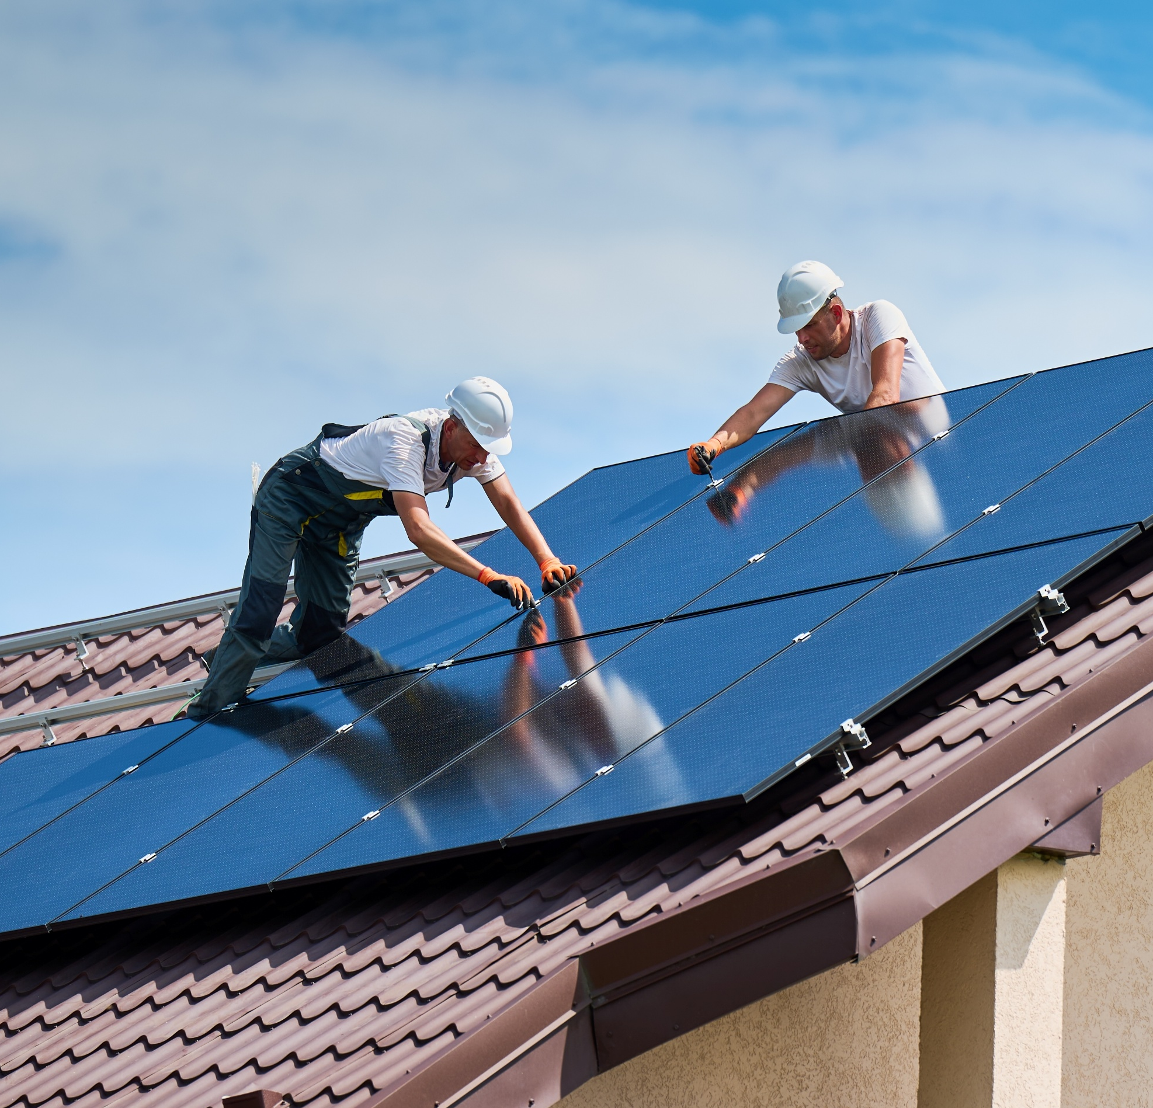

Level 2 Award in Retrofit Principles (RQF)​
V1 April 2025
All rights reserved
© 2025 Highfield Products Limited
A global leader for qualifications, assessment, digital solutions, innovative products and customer service
Highfield Place Shaw Wood Business Park, Shaw Wood Way, Wheatley Hills Doncaster, DN2 5TB
01302 363277 | www.highfieldqualifications.com
Notes:
All rights reserved. No part of this product may be reproduced, stored in a retrieval system, or transmitted in any form or by any means, including electronic, photocopying, recording or other commissioner wise, without the prior permission of Highfield Products Ltd. The of any unauthorised act may result in civil or criminal actions.
The publisher of this product has made every effort to ensure the accuracy of the information contained in this product. However, neither the author, nor Highfield Products Ltd nor anyone involved in the creation of this publication accepts any responsibility for any inaccuracies or failure to implement correctly, however caused.

Slide 2


Ground rules
Fire escapes
Toilets
Smoking
Drinks
Breaks
Lunch
Questions
Talking over others
Respect others’ points of view
Timekeeping
As a courtesy to others, please set your mobile phone to SILENT MODE
Mobile phones must be SWITCHED OFF and removed from the desk during the examination.
Notes:
Introduction​
The objective of this section is to outline the content and flow of the course and to introduce course activities and assessment methods. ​
​
Welcome learners – introduce yourself. Explain domestic arrangements, emergency evacuation procedures, refreshments, security and toilet location.​
Ask learners to switch off mobile phones.​
Provide a short overview of the course and its purpose.​
Encourage participation by asking learners to write their names on badges/stickers or display in front of them. ​
It is important that learners are made aware of general housekeeping and safety matters. ​
This is also an ideal time to establish any ground rules with regards to learners and your own expectations, expected involvement and information regarding home study.​
You could also take this opportunity to briefly outline the examination procedures relating to the awarding body being used.​
​
​
​

Slide 3


Learning outcomes
Module 1: Understand environmental sustainability, energy efficiency and retrofit​
Module 2: Understand the basic principles of the PAS 2035 standard
Module 3: Understand the basic principles of domestic retrofit installation
Module 4: Understand the principles of sustainable waste management.

Slide 4



Module 1
Understand environmental sustainability, energy efficiency and retrofit
4

Slide 5
Defining key terms​
Our use of energy and resources impacts the planet, driving climate change and global warming through the greenhouse effect, making sustainability crucial​
Below are the key terms used:
environmental sustainability – reducing environmental impact through efficient resource use​
climate change – long-term shifts in temperature and weather patterns
global warming – the Earth's temperature rising due to greenhouse gas emissions​.
Notes:
Explain how sustainability and energy efficiency impact everyday life. Ask learners how they reduce energy consumption at home or work.​

Slide 6
Defining key terms (cont.)​​
greenhouse effect – the trapping of heat in the atmosphere by gases, like carbon dioxide (CO₂)​
deforestation – the large-scale removal of forests, impacting CO₂ absorption
emissions – the release of pollutants into the atmosphere​
energy efficiency – using less energy to perform the same task​
retrofit – upgrading buildings to improve energy efficiency and sustainability.
Notes:
Explain how sustainability and energy efficiency impact everyday life. Ask learners how they reduce energy consumption at home or work.​

Slide 7


What is retrofit? ​
Retrofit involves upgrading buildings – both homes and commercial spaces
Aims to improve energy efficiency
Helps reduce carbon emissions
Lowers energy costs
Supports PAS 2035.
Notes:
Class question: What is retrofit?
Possible answers:
retrofit involves upgrading buildings – both homes and commercial spaces
aims to improve energy efficiency
helps reduce carbon emissions
lowers energy costs
supports PAS 2035

Slide 8
Examples of retrofit​
Domestic retrofit – modifying homes to improve energy efficiency, for example:​
insulation​
heating systems​
Non-domestic retrofit – upgrading commercial and industrial buildings for sustainability.
Notes:
Class question: What is retrofit?​
Show real-world examples of domestic and commercial retrofit projects, highlighting their impact on energy bills and CO₂ reduction.​

Slide 9
The domestic retrofit industry ​
Successful retrofitting relies on skilled professionals from various trades, each playing a crucial role in improving a building’s energy efficiency and performance
Businesses involved:
sole traders​
partnerships​
private businesses​
public limited companies
Key retrofit installers: ​
plumbers​
electricians​
carpenters/joiners​
plasterers​
bricklayers​
roofers.​
​
Notes:
Discuss the range of trades involved in retrofit projects. Ask learners to identify which professions they are familiar with or aspire to work in.​

Slide 10
The domestic retrofit industry (cont.)​
Retrofit activities focus on improving energy efficiency and sustainability through key upgrades to:​
insulation installation​
ventilation improvements​
energy-efficient heating and hot water systems​
sustainable energy solutions.

Slide 11
Retrofit vs. repair, refurbishment and maintenance
It’s important to distinguish retrofit from repair, refurbishment and maintenance, as retrofitting specifically aims to improve energy efficiency and sustainability
Retrofit – upgrading buildings for energy efficiency and sustainability​
Repair – fixing faults or damage in existing structures.
Notes:
Use case studies to show how retrofit differs from standard home improvements. Encourage discussion on the long-term cost benefits of retrofit.​

Slide 12
Retrofit vs. repair, refurbishment and maintenance (cont.)​
Refurbishment – improving aesthetics or usability without enhancing efficiency​
Maintenance – regular servicing to keep buildings in good condition
Key Point
Retrofit focuses on reducing the building’s carbon footprint and energy consumption.
Notes:
Use case studies to show how retrofit differs from standard home improvements. Encourage discussion on the long-term cost benefits of retrofit.​

Slide 13
Sustainability in domestic retrofit ​
Every stage of the retrofit process, from material selection to installation and waste disposal, plays a key role in maximising sustainability benefits
Material production – using sustainable, low-impact materials​
Waste disposal – reducing landfill waste through recycling​
Installation activities – ensuring energy-efficient processes during implementation.

Slide 14
Sustainability in domestic retrofit (cont.)
Key sustainability benefits include:​
lower carbon emissions​
reduced energy consumption​
long-term cost savings for homeowners​
improved indoor air quality and living conditions.
Notes:
Explain how material selection, waste reduction, and energy-efficient installation methods contribute to sustainability. Ask learners to think about how these principles apply to their homes.​

Slide 15

How much do you know?​
CE
What is the primary goal of retrofitting a building?​
A
To improve its energy efficiency and sustainability
A
B
To repair damage caused by wear and tear
C
To enhance the appearance of the building
Notes:
Class exercise: How much do you know?
The correct answer is A.

Slide 16
How much do you know?​
CE
Which of the following is NOT considered a retrofit activity?
A
Installing insulation
C
B
Upgrading heating systems
C
Painting walls to refresh the look
Notes:
Class exercise: How much do you know?
The correct answer is C.

Slide 17
How much do you know?​
CE
Why is sustainability important in retrofit projects?
A
It ensures the project costs more
B
B
It helps reduce energy consumption and the environmental impact
C
It only applies to new buildings, not existing ones
Notes:
Class exercise: How much do you know?
The correct answer is B.

Slide 18
Module 2
Understand the basic principles of the PAS 2035 standard
18

Slide 19
The purpose of the PAS 2035 standard​
​PAS 2035 is the overarching standard for domestic retrofit projects​
Ensures a consistent, high-quality approach to retrofit works​
Aims to improve energy efficiency, reduce carbon emissions and enhance building performance​
Focuses on a 'whole house or building' retrofit approach​
Helps meet the UK's net-zero targets by ensuring long-term sustainability.​
Notes:
Explain why a standardised approach is needed in retrofit projects. Discuss how PAS 2035 ensures consistency, quality and compliance across different projects.​

Slide 20
Why was PAS 2035 introduced?​
In 2019, PAS 2035 was introduced to:​
address previous issues in retrofit projects, such as poor design and inefficiencies​
ensure quality assurance and compliance with best practices​
support government initiatives on climate change and energy efficiency​
enhance consumer confidence in retrofit solutions​
encourage a structured approach to risk management and assessment.​
Notes:
Class question: Why was PAS 2025 introduced?​
In 2019, PAS 2035 was introduced to:​
address previous issues in retrofit projects, such as poor design and inefficiencies​
ensure quality assurance and compliance with best practices​
support government initiatives on climate change and energy efficiency​
enhance consumer confidence in retrofit solutions​
encourage a structured approach to risk management and assessment.​

Slide 21
Roles and responsibilities in PAS 2035 ​
PAS 2035 outlines key roles to ensure successful and compliant retrofit projects, such as:​
retrofit advisor – provides initial guidance to homeowners​
retrofit assessor – assesses property conditions before work begins​
retrofit co-ordinator – manages the entire retrofit process​
retrofit designer – develops tailored retrofit solutions​
retrofit installer (PAS 2035) – carries out retrofit work to meet standards​
retrofit evaluator – ensures retrofit effectiveness post-installation.
Notes:
Encourage discussion on the various job roles and how they work together in a retrofit project. Ask learners which roles interest them the most.​

Slide 22
Key PAS 2035 terms​
There are several key terms used when discussing PAS 2035. These include: ​
PAS 2035 process – structured steps from assessment to evaluation​
Risk assessment – evaluates project complexity and potential issues​
Fabric-first approach – prioritises insulation and airtightness before heating upgrades
Single energy efficiency measures (SEEMs) – individual improvements, such as loft insulation.
Notes:
Explain the key terms with real-life applications. For example, discuss the fabric-first approach by explaining why insulation should be prioritised before heating system upgrades.​

Slide 23
Key PAS 2035 terms ​(cont.)
Measures interaction matrix – assesses compatibility between different upgrades​
Medium-term improvement plan (MTIP) – a phased approach to retrofit over time​
Whole house retrofit – considers the building as an integrated system for efficiency.
Notes:
Explain the key terms with real-life applications. For example, discuss the fabric-first approach by explaining why insulation should be prioritised before heating system upgrades.​

Slide 24
How much do you know?​
CE
What is the main purpose of PAS 2035?​
A
To regulate construction site safety
B
B
To ensure a structured and high-quality approach to domestic retrofit projects
C
To improve building aesthetics
Notes:
Class exercise: How much do you know?
The correct answer is B.

Slide 25
How much do you know?​
CE
Which of the following is NOT a role outlined in PAS 2035?​
A
Retrofit assessor
C
B
Retrofit co-ordinator
C
Interior designer
Notes:
Class exercise: How much do you know?
The correct answer is C.

Slide 26
How much do you know?​
CE
What does the fabric-first approach prioritise?
A
Upgrading the heating system before adding insulation
B
B
Ensuring insulation and airtightness before beginning heating upgrades
C
Installing solar panels first in all retrofit projects
Notes:
Class exercise: How much do you know?
The correct answer is B.

Slide 27
Module 3
Understand the basic principles of domestic retrofit installation
27

Slide 28
Existing UK housing stock
The UK housing stock includes a range of property types and construction methods, ranging from historic buildings to modern homes built in line with current regulations​
The age range of properties​
Some homes in the UK are over 100 years old, while newer builds comply with modern construction regulations.
Notes:
Discuss the challenges of retrofitting older homes vs. modern buildings. Encourage learners to consider what types of properties they work with or live in.​

Slide 29
Existing UK housing stock (cont.)
Protected buildings​
Listed buildings and conservation areas have additional restrictions on modifications to maintain heritage value​
Traditional construction – many older homes feature solid
brick walls, single glazing and poor insulation, leading to
higher energy loss.​

Slide 30
Existing UK housing stock (cont.)
Basic construction types:​
foundations​
walls (solid or cavity)​
floors (solid or suspended timber)​
roofs (pitched or flat)​
windows and doors​
heating and hot water systems.
Notes:
Discuss the challenges of retrofitting older homes vs. modern buildings. Encourage learners to consider what types of properties they work with or live in.​

Slide 31
Why is it important to assess a property before retrofitting?
A thorough assessment of a property is crucial before implementing retrofit measures. Identifying existing defects and weaknesses helps prevent future failures and ensures the most effective solutions are applied​
Factors considered in assessments include:​
structural integrity – checking for weaknesses in walls, floors and roofs​
damp and moisture issues – identifying rising damp, penetrating damp and condensation risks.​
Notes:
Class question: Why is it important to assess a property before retrofitting?​
Explain how proper assessments prevent long-term issues. Discuss how defects, like damp and poor insulation, can affect a building’s energy performance.​

Slide 32
Why is it important to assess a property before retrofitting? (cont.)
ventilation and air movement – ensuring proper airflow to prevent mould growth and air quality issues​
current energy efficiency performance – assessing insulation levels, heat retention and energy use​
the condition of heating and insulation systems – evaluating boilers, radiators and existing insulation materials for efficiency and compliance.
Notes:
Class question: Why is it important to assess a property before retrofitting?​

Slide 33
Common defects before retrofitting​
Identifying common defects before retrofitting is essential to ensure that energy efficiency improvements are not compromised by underlying structural or environmental issues
Rising damp – moisture moving up from the ground​
Penetrating damp – water entering through walls, roofs or windows​
Condensation – moisture buildup inside properties, leading to mould growth.
Notes:
Show examples of real-life housing defects. Discuss how each issue impacts energy efficiency, costs and safety.​

Slide 34
Common defects before retrofitting (cont.)​
Defective services – outdated or poorly installed heating, plumbing or electrical systems​
Structural defects – weak or failing walls, floors or roofs​
Salt contamination – water damage leaving salt deposits in the brickwork and plaster.
Notes:
Show examples of real-life housing defects. Discuss how each issue impacts energy efficiency, costs and safety.​

Slide 35
Heat transfer and heat loss​
Heat loss occurs through conduction, convection and radiation​
Key principles:​
conduction – heat moves through solid materials (for example, walls, floors and roofs)​
convection – heat transfer via air movement, creating draughts​
radiation – heat lost from surfaces to colder surroundings​
thermal transmittance (U-values) – measures how well a material prevents heat loss​
thermal resistance (R-values) – the ability of a material to resist heat flow.​
Notes:
Use everyday examples to explain heat transfer (for example, how metal feels cold due to conduction). Ask learners to suggest ways to reduce heat loss in homes.​

Slide 36
The importance of ventilation in retrofit​
Proper ventilation is essential in retrofit projects to prevent moisture buildup, improve air quality and maintain energy efficiency​
Ventilation: ​
prevents moisture build-up, condensation and mould growth​
ensures fresh air exchange for healthy indoor air quality.

Slide 37
The importance of ventilation in retrofit (cont.)​
Types of ventilation:​
natural ventilation – airflow through windows, vents and chimneys​
mechanical ventilation – fans and mechanical ventilation with heat recovery (MVHR) systems to control air movement​
passive ventilation – incorporates design features, such as air bricks or roof vents, to allow airflow​
A balanced approach ensures energy efficiency while maintaining air quality.​
Notes:
Explain why ventilation must be balanced with insulation. Use case studies of poor ventilation leading to damp and mould growth.​

Slide 38
Insulation materials and installation ​
Proper insulation is essential in retrofit projects to reduce heat loss, improve energy efficiency and enhance comfort in buildings
Walls​
Cavity wall insulation (injected foam or fibre)​
Internal wall insulation (solid walls)​
External wall insulation (cladding or render)​
Floors​
Solid floor insulation (rigid boards)​
Suspended floor insulation (underfloor).​
Notes:
Compare insulation types, highlighting the cost, effectiveness and best-use cases. Encourage learners to consider insulation options for different building types.​

Slide 39
Insulation materials and installation (cont.)​
Roofs and lofts​
Pitched roof insulation (between or above rafters)​
Flat roof insulation (warm or cold deck systems)​
​
Windows and doors​
Double or triple glazing​
Draught-proofing and thermal doors.

Slide 40
Renewable energy options in retrofit ​
Integrating renewable energy into retrofit projects can significantly reduce carbon emissions, lower energy costs and enhance sustainability
Solar thermal – uses sunlight to heat water for domestic use, reducing reliance on gas or electricity​
Solar photovoltaic (PV) – converts sunlight into electricity, providing renewable power for homes.
Notes:
Discuss how solar panels, heat pumps and wind turbines contribute to net-zero goals. Ask learners what renewable technologies they have seen in practice.​

Slide 41
Renewable energy options in retrofit (cont.) ​
Air and ground source heat pumps – extract heat from the air or ground to provide energy-efficient space heating​
Domestic wind turbines – generate renewable electricity, especially for off-grid homes​
Combined heat and power (CHP) – produces both electricity and heating from a single fuel source, improving overall efficiency.​

Slide 42
Problems from poor retrofit installations​
Inadequately installed retrofit measures can lead to performance failures, structural issues and energy inefficiencies. Addressing these risks is essential for long-term success
Inadequate measures can include:​
thermal bridging – weak points allowing heat loss​
thermal bypass – air gaps reducing insulation performance​
condensation and mould growth – poor insulation and ventilation balance.
air tightness issues – unintended gaps increasing heat loss​
water ingress and damp – incorrect installation causing leaks​
structural risks – overloading walls or ceilings with insulation or panels.
Notes:
Show real-world examples of failed retrofits, explaining why they failed. Encourage learners to suggest solutions for preventing these issues.​

Slide 43
How much do you know?​
CE
Why is a thorough property assessment important before retrofitting?​
A
To check if the building needs repainting
B
B
To identify defects and weaknesses that could affect energy efficiency
C
To determine the number of people living in the house
Notes:
Class exercise: How much do you know?
The correct answer is B.

Slide 44
How much do you know?​
CE
Which of the following is NOT a cause of heat loss in a building?
A
Thermal bridging
B
B
High-quality insulation
C
Convection
Notes:
Class exercise: How much do you know?
The correct answer is B.

Slide 45
How much do you know?​
CE
Which of the following is NOT a cause of heat loss in a building?
A
Increased energy savings​
B
B
Condensation and mould growth
C
Faster heating of the building
Notes:
Class exercise: How much do you know?
The correct answer is B.

Slide 46
Module 4
Understand the principles of sustainable waste management
46

Slide 47
Key areas of waste management regulations
Waste management in retrofit projects must comply with UK regulations to ensure safe disposal, environmental protection and legal compliance​
Key areas include:​
hazardous waste – proper handling of asbestos, chemicals and contaminated materials​
producer responsibility – businesses must minimise waste production and ensure responsible disposal​
separate collection – waste must be sorted for recycling, recovery or disposal​
landfill regulations – restrictions on certain materials and taxes to reduce landfill waste.​
​
Notes:
Explain why waste regulations exist and their role in protecting public health and the environment. Provide examples of materials that require special disposal procedures.​

Slide 48
Main stages in a waste management process ​
A structured waste management process ensures efficient disposal, recycling and resource recovery​
Key stages are:​
collection – gathering waste from retrofit projects​
sorting or segregation – separating recyclable and hazardous materials​
storage – safely storing waste before disposal or recycling​
recycling – converting materials into new products to reduce waste​
disposal – sending non-recyclable waste to landfills or incineration​
energy recovery – using waste to generate electricity or heat.​
Notes:
Walk through each stage of the waste process, using real-world examples (for example, construction site waste sorting and recycling).​

Slide 49
Managing waste correctly and safely ​
Proper waste management minimises risks, protects the environment and improves sustainability
Best practices include:​
reduce – minimise waste generation at the source​
reuse – repurpose materials where possible to avoid disposal​
recycle – follow segregation guidelines to ensure materials are recycled correctly​
safe handling – ensure hazardous waste is disposed of according to regulations​
proper storage – use secure containers to prevent spills or contamination.​
Notes:
Discuss practical waste management strategies that businesses and individuals can implement. Ask learners to suggest ways they manage waste in their workplaces or homes.​

Slide 50
Benefits of proper waste management​
Sustainable waste management has far-reaching benefits for businesses, communities and the environment​
Key benefits:​
reduces environmental impact – less landfill waste and lower carbon emissions​
cost savings – efficient waste management reduces disposal fees and material costs
compliance with regulations – avoids fines and legal consequences​
improves sustainability – supports resource conservation and circular economy practices​
enhances company reputation – businesses adopting sustainable practices gain public trust.​
Notes:
Highlight how effective waste management can reduce costs, improve company reputation and benefit the environment. Encourage learners to think about long-term sustainability benefits.​

Slide 51
Consequences of waste mismanagement ​
Failure to manage waste correctly can lead to serious consequences for the environment, public health and the economy
The consequences are:​
environmental damage – pollution, habitat destruction and increased landfill waste​
health risks – exposure to hazardous materials can cause respiratory and skin conditions​
legal penalties – businesses face fines and prosecution for improper waste disposal​
economic impact – high costs of clean-up, fines and inefficiencies affect businesses and communities.​
Notes:
Use case studies of businesses that failed to manage waste properly and faced legal and financial repercussions. Ask learners what steps could have been taken to prevent these consequences.​

Slide 52
How much do you know?​
CE
Which of the following is NOT a stage in the waste management process?​
A
Waste collection
C
B
Recycling
C
Increasing energy use
Notes:
Class exercise: How much do you know?
The correct answer is C.

Slide 53
How much do you know?​
CE
What is the main reason for waste management regulations in retrofit projects?
A
To reduce project costs
B
B
To ensure safe disposal, environmental protection and legal compliance
C
To increase the number of waste management jobs
Notes:
Class exercise: How much do you know?
The correct answer is B.

Slide 54
How much do you know?​
CE
What is a potential consequence of failing to manage waste properly?​
A
Legal penalties and environmental damage
A
B
Reduced landfill waste​
C
Increased business profits​
Notes:
Class exercise: How much do you know?
The correct answer is A.

Slide 55

Thank you for listening

