Slide 1
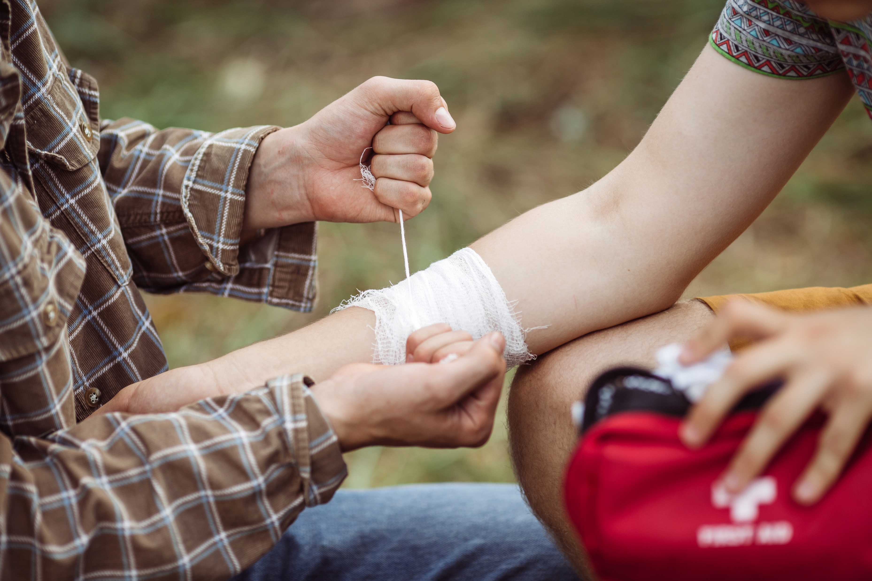

Level 3 Award in
Emergency Outdoor First Aid
V1 September 2025
All rights reserved
© 2025 Highfield Products Limited
A global leader for qualifications, assessment, digital solutions, innovative products and customer service
Highfield Place Shaw Wood Business Park, Shaw Wood Way, Wheatley Hills Doncaster, DN2 5TB
01302 363277 | www.highfieldqualifications.com
Notes:
This training presentation can be used to deliver the following qualifications:
Highfield Level 3 Award in Emergency first aid (RQF)
Highfield Level 3 Award in Outdoor First Aid (Unit 1)

Slide 2


Ground rules
Fire escapes
Toilets
Smoking
Drinks
Breaks
Lunch
Questions
Talking over others
Respect others’ points of view
Timekeeping.
As a courtesy to others,
please set your mobile phone
to SILENT MODE
Mobile phones must
be SWITCHED OFF
and removed from the desk
during the examination.
Notes:
Where possible, the health and safety briefing should be delivered by a local representative. If such a person is unavailable, the trainer should make themself familiar with the client’s protocols, procedures and facilities to complete this briefing themselves.
Point out the fire evacuation points and procedures as well as the location of the toilets and when/where people are allowed to smoke. Explain that breaks are provided in which people can smoke.
​
​

Slide 3






Key
Class
Question
Individual
Exercise
Key
Point
Definition
KEY POINT
Group
Exercise
Class
Exercise
Navigation
CE

Slide 4


Leaning outcomes
Module 1: Understand the scope of first aid in the outdoors
Module 2: Be able to assess an emergency situation safely
in the outdoors
Module 3: Be able to interpret vital sign information whilst
responding to an emergency incident in the outdoors
Module 4: Be able to respond to an incident involving an
unresponsive casualty with normal breathing in the outdoors.

Slide 5
Leaning outcomes
Module 5: Be able to respond to an incident involving an
unresponsive casualty who is not breathing normally in
the outdoors
Module 6: Be able to respond to an incident involving a choking
casualty in the outdoors
Module 7: Be able to respond to an incident involving blood loss in
the outdoors.

Slide 6


Module 1
Understand the scope of first aid in the outdoors
6
Notes:
Completion of this module will enable learners to meet the following learning outcome:
1. Understand the scope of first aid in the outdoors
This includes the following assessment criteria:
1.1 Describe key characteristics of outdoor first aid
1.2 Identify appropriate first aid equipment for emergency outdoor incidents
1.3 Summon assistance during emergency incidents in the outdoors
Activities in this module include:
CQ: What are the key characteristics of outdoor first aid?
CQ: How can you summon assistance?
CE: Three multiple-choice questions (MCQs) (formative assessment)

Slide 7
What are the key characteristics of outdoor first aid?
Outdoor first aid differs from standard first aid due to the following key characteristics:
remote context – delays in access to emergency services and professional medical help
extended care timeframes – there may be a need to monitor and manage casualties for a prolonged period
environmental influences – challenges such as cold, heat, wind, rain, altitude or uneven terrain
limited resources – restricted availability of equipment and communication methods.
Notes:
Class question: What are the key characteristics of outdoor first aid?
Encourage the group to share personal or known scenarios where these factors have affected first-aid delivery. For example, hiking injuries, climbing falls or prolonged weather exposure.
Additional class question: Which of these factors would be most challenging in your outdoor environment?

Slide 8
What are the key characteristics of outdoor first aid? (Cont.)
dynamic risk factors – potential for environmental hazards to change rapidly
personal safety and group care – need to consider safety of rescuer and others in group settings
improvisation and adaptability – using available materials and making decisions with limited support
communication methods – understanding how to summon help and relay key information in remote areas.
Notes:
Class question: What are the key characteristics of outdoor first aid? (Cont.)
Encourage the group to share personal or known scenarios where these factors have affected first-aid delivery. For example, hiking injuries, climbing falls or prolonged weather exposure.
Additional class question: Which of these factors would be most challenging in your outdoor environment?

Slide 9
Appropriate first-aid equipment
Outdoor first aid requires standard items plus additional equipment tailored to remote and environmental challenges.
Standard first-aid items:
Outdoor specific items:
dressings
bandages
gloves
plasters
antiseptic wipes
resuscitation face shield
thermal blankets
foil survival bags
shelter or bivvy bag
tick remover
burn gel.
Notes:
Show the group examples of each type of equipment. If possible, let them handle the kit to become familiar with contents.
Optional class question: Which outdoor-specific item would be most important in your environment?

Slide 10
Appropriate first-aid equipment (cont.)
Tools and support items:
Environmental protection:
waterproof bag
sun protection
insect repellent
trauma shears
whistle
torch/headlamp
notebook.
Notes:
Show the group examples of each type of equipment. If possible, let them handle the kit to become familiar with contents.
Optional class question: Which item in each category would be most essential in your outdoor role?

Slide 11
Appropriate first-aid equipment (cont.)
Communication aids:
Improvised equipment:
mobile phone
global positioning system
(GPS) device
emergency contact cards
triangular bandages for slings
walking poles for splinting
clothing layers for padding or insulation.
Notes:
Show the group examples of each type of equipment. If possible, let them handle the kit to become familiar with contents.
Optional class question: Which communication aid might fail in remote environments and what’s the backup plan?

Slide 12
How can you summon assistance?
Summoning assistance may include:
using a mobile phone to call emergency services with accurate location information
using text messaging or emergency SMS when voice signal is unavailable
using location-sharing tools, such as:
  GPS coordinates
  Ordnance Survey (OS) grid references
  Apps such as ‘what3words’.
Notes:
Class question: How can you summon assistance?
Ask the group to identify the different methods that can be used to summon assistance.
Optional class question: If you’re in a remote valley with no mobile signal, which of these methods would be most reliable?

Slide 13
How can you summon assistance?
(Cont.)
using emergency communication devices, such as:
  satellite phones
  personal locator beacons (PLBs)
  GPS messenger devices
dispatching someone to get help when electronic communication is unavailable.
Notes:
Class question: How can you summon assistance? (Cont.)
Ask the group to identify the different methods that can be used to summon assistance.

Slide 14
How can you summon assistance?
(Cont.)
using visual and audible signals, such as:
  whistle blasts
  mirror flashes
  hand signals
  ground markers
recording and convey information, ensuring clear communication of casualty condition, location and any hazards.
Notes:
Class question: How can you summon assistance? (Cont.)
Ask the group to identify the different methods that can be used to summon assistance.

Slide 15




How much do you know?​
CE
Which of the following is a key characteristic of outdoor first aid?
Immediate access to emergency services
C
Abundant medical equipment and resources
Delays in access to professional medical help
No need to adapt to environmental conditions
Notes:
Class exercise: How much do you know?
The correct answer is C.

Slide 16
How much do you know?​
CE
Which of the following items is classed as outdoor-specific first-aid equipment?
Adhesive plasters
B
Thermal blanket
Gauze dressing
Alcohol wipes
Notes:
Class exercise: How much do you know?
The correct answer is B.

Slide 17
How much do you know?​
CE
Which of the following is the most appropriate way to summon assistance when there is no mobile phone signal in a remote outdoor location?
Wait until you reach an area with mobile signal before contacting help
B
Use a whistle, mirror flashes, hand signals or ground markers to attract attention
Light a large fire regardless of environmental risks
Write a note and leave it at the scene for rescuers to find
Notes:
Class exercise: How much do you know?
The correct answer is B.

Slide 18
Module 2
Be able to assess an emergency situation safely in the outdoors
18
Notes:
Completion of this module will enable learners to meet the following learning outcome:
2. Be able to assess an emergency situation safely in the outdoors
This includes the following assessment criteria:
2.1 Conduct a scene survey
2.2 Minimise the risk of infection to self and others
2.3 Conduct a primary survey of a casualty
2.4 Conduct a secondary survey on a casualty wearing outdoor activity equipment
Activities in this module include:
GE: Primary survey – practical demonstration
CE: Four multiple-choice questions (MCQs) (formative assessment)

Slide 19
Conduct a scene survey
Always check the scene is safe before approaching a casualty
Protect yourself, the casualty and bystanders
Use the acronym CLAP to stay calm and in control
Control the situation
Look for potential hazards
Assess the situation
Protect and prioritise.
Notes:
C – control the situation – stop, take a deep breath and take charge of people and vehicular traffic.
L – look for potential hazards – look for anything that could cause further danger/harm to the casualty, bystanders or more importantly yourself within the immediate area.
A – assess the situation – evaluate what has happened from the casualty and from bystanders, gather as much information as possible and try to make a diagnosis (history, signs and symptoms).
P – protect and prioritise – ensure personal protective equipment (PPE) is worn (gloves) and that casualties are prioritised (breathing, bleeding, bones/burns and other conditions). Delegate tasks. Try to gain assistance from bystanders and contact the emergency services.

Slide 20
Conduct a scene survey (cont.)
When carrying out a scene survey, always follow these steps to keep yourself and others safe:
ensuring potential safety by checking for hazards, such as:
  unstable ground
  weather conditions
  animals
  fire
  water
  falling objects
KEY POINT
You can’t help others if you become a casualty.
Notes:
Explain the importance of personal safety - you can’t help others if you become a casualty.

Slide 21
Conduct a scene survey (cont.)
When carrying out a scene survey, always follow these steps to keep yourself and others safe:
identifying the number of casualties, checking for both visible and hidden individuals who may need help
assessing the nature and cause of the incident
recognising ongoing dangers, such as changing weather or hypothermia risk.

Slide 22
Conduct a scene survey (cont.)
using dynamic risk assessment, continuously reassessing the environment for changes
planning the approach to casualties, including safe access and egress routes
protecting the scene to prevent further harm to self, casualty or bystanders
A dynamic risk assessment is the process of evaluating risks in real
time as a situation unfolds and adjusting actions or safety measures accordingly.

Slide 23
Calling for help (999)
Getting help quickly is vital. Knowing what to say and staying calm can save time and lives
For a simple way to remember what to tell the emergency services, think ‘LINE’
  Location
  Incident
  Number of casualties
  Extent of their injuries
Use the speakerphone or ask a bystander if available.
Notes:
Calling for an ambulance
First-aiders will either call for an ambulance themselves on loudspeaker or instruct a bystander to do so.
Calling for an ambulance at the earliest opportunity is paramount. When calling on 999, it is important that the information given is clear, concise and sufficient. This can be achieved by remembering the acronym ‘LINE’.

Slide 24
Minimising infection
To assist in minimising the risk of infection and cross-contamination, there are various precautions that can be taken, such as:
wearing personal protective equipment (PPE), such as gloves and face coverings, especially when dealing with bodily fluids
using hand hygiene practices, washing hands with soap and water or using hand sanitiser before and after providing first aid
avoiding direct contact by using barriers (for example, gauze, clothing or face shields) when treating open wounds or giving rescue breaths.

Slide 25
Minimising infection (cont.)
cleaning and disposing of waste correctly, safely handling contaminated items like dressings or gloves
covering personal cuts or abrasions to reduce the risk of entry points for infection
maintaining a clean working area as far as reasonably practicable in outdoor conditions
avoiding coughing or sneezing over the casualty
following current infection control guidance, including any protocols related to notifiable diseases or public health alerts.
Notes:
Tutors should explain to learners that, as a first-aider, it is important not to transmit infections to the casualty, colleagues or others in the workplace and vice versa.
This can be achieved by:
maintaining good personal hygiene – always ensure your personal hygiene is of a high standard
using barrier devices – wear disposable gloves and use a face shield when dealing with any casualty
covering open cuts or sores – ensure any cuts or sores are covered with a suitable dressing
minimising contact with blood or bodily fluids – avoid direct contact wherever possible
changing gloves between casualties – if possible, change gloves between casualties to prevent cross-contamination
washing hands thoroughly after removing gloves – even when gloves are used, hands must be washed thoroughly after treatment

Slide 26
Primary survey
The primary survey is a systematic process of approaching, identifying and dealing with immediate and/or life-threatening conditions
You have confirmed the area is safe during the scene survey. You should now carry out an initial casualty assessment – this is the primary survey.
Notes:
Having conducted a scene survey and established that the immediate area is safe from any dangers, you can now approach the casualty. When approaching the casualty, an initial casualty assessment should be conducted – this initial assessment is called a primary survey.

Slide 27




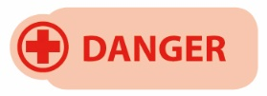

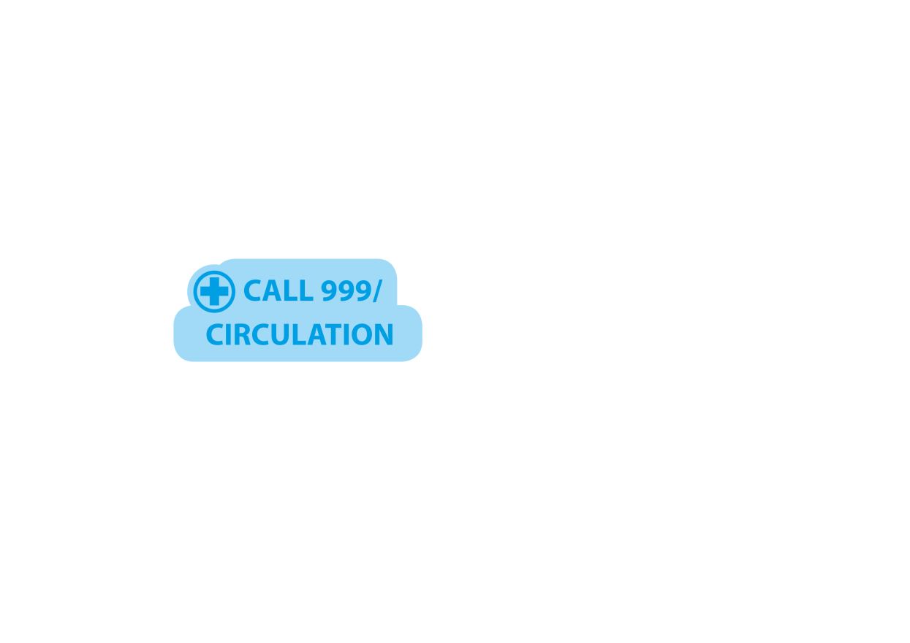
Primary survey steps – DRABCD
The primary survey can be remembered by the acronym ‘DRABCD’
You can also remember this as Doctor ABCD.
Notes:
Having conducted a scene survey and established that the immediate area is safe from any dangers, you can now approach the casualty. When approaching the casualty, an initial casualty assessment should be conducted – this initial assessment is called a primary survey.
The primary survey is a systematic process of approaching, identifying and dealing with immediate and/or life-threatening conditions.
The primary survey can be remembered by the acronym DRABCD (or the easy way to remember, Doctor ABCD).

Slide 28
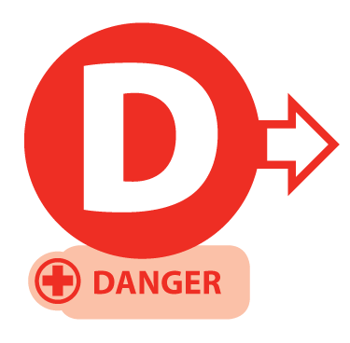
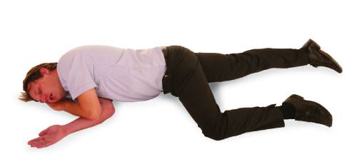
Primary survey
Prior to approaching the casualty, ensure the safety of the casualty, yourself and any bystanders.
Notes:
D – Danger
The same for all ages:
check for danger to yourself, the casualty and bystanders

Slide 29

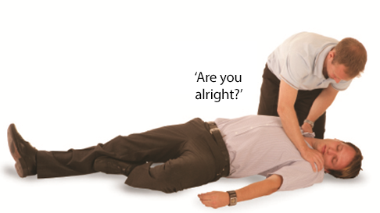
Primary survey
If possible, approach the casualty from their feet as this prevents hyperextension of the neck from a responsive casualty. Use the AVPU scale when checking for a response
(If the casualty responds and providing there is no further danger, leave them in the position found and try to find out what is wrong. Get help if needed.)
Notes:
R – Response
Same check for all ages, but:
adults/children: speak clearly, gently shake shoulders.
infants: tap the foot or flick the sole. Do not shake them.

Slide 30
AVPU scale
A
ALERT – are they moving/talking? → No → Proceed to V
V
VOICE – do they respond to speech? → No → Proceed to P
P
PLACE – place your hand on their shoulders and gently shake them asking ‘Are you alright?’ → No response → Proceed to U
U
UNRESPONSIVE – assume the casualty is unresponsive
The ‘P’ in the acronym AVPU is sometimes also referred to as ‘Pain’, meaning to cause a minor pain to see if the person responds. Examples include pinching the ear lobes or fingertips.

Slide 31
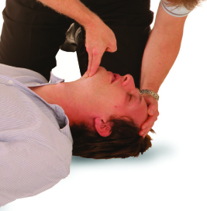
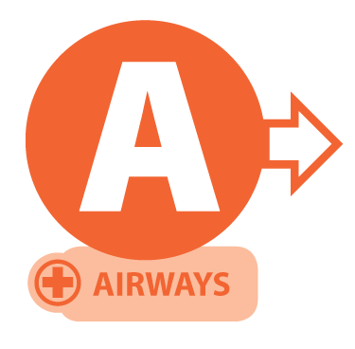
Primary survey
Open the airway
using the head-tilt/ chin-lift method.
Notes:
A – Airway
The same technique for all ages:
use the head-tilt/chin-lift
take extra care with infants: use a gentler tilt and keep the head in a neutral position, not tilted too far back

Slide 32

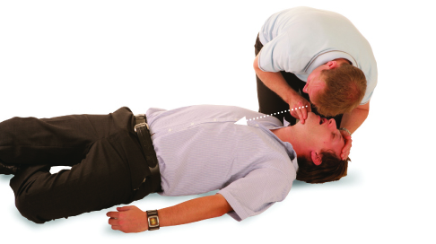
Primary survey
After opening the airway, look, listen and feel for normal breathing for no more than 10 seconds
casualty breathing normally – check for further injuries and, if safe to do so, place into the recovery position
casualty not breathing normally – commence CPR
Agonal breathing
In the first few minutes after a cardiac arrest, a casualty may be barely breathing or taking infrequent, slow, noisy gasps. Do not confuse this with normal breathing. If in any doubt that breathing is normal, act as if not breathing normally and prepare to start CPR.
Notes:
B – Breathing
The same method for all ages:
look, listen and feel for breathing (no more than 10 seconds)
be alert to agonal breathing
infant chest movements are more subtle, so watch closely

Slide 33
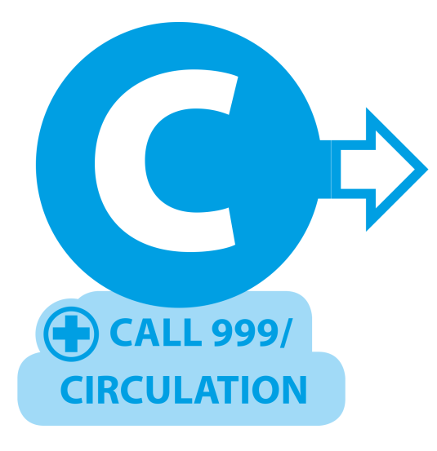
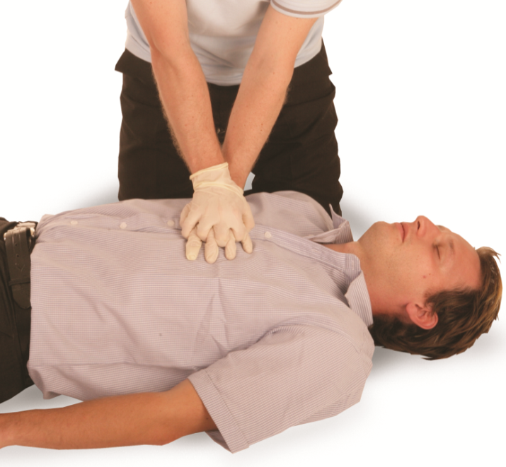
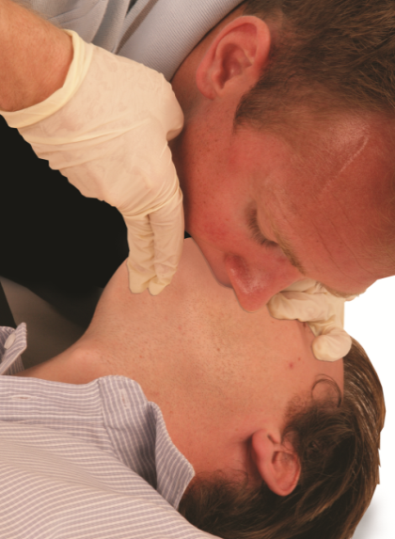
Primary survey
Call an ambulance (999). Ask a helper to call, otherwise call yourself. Stay with the casualty when making the call, if possible, and activate the speaker function on the phone to aid communication with the ambulance service. Commence CPR
(30 compressions to 2 breaths)
Compression-only CPR
If you are untrained or unable to do rescue breaths for a casualty who is not breathing, give chest compression-only CPR. These should be continuous at a rate 100-120 per minute and to a depth of 5-6 cm.
Notes:
C – CPR (if needed) – cardiopulmonary resuscitation
The next slide provides a breakdown of the CPR differences depending on the age of the casualty.

Slide 34
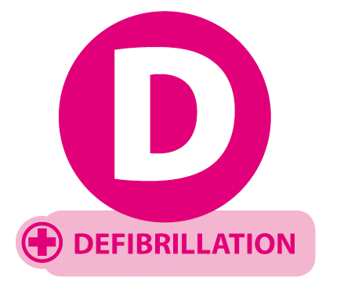
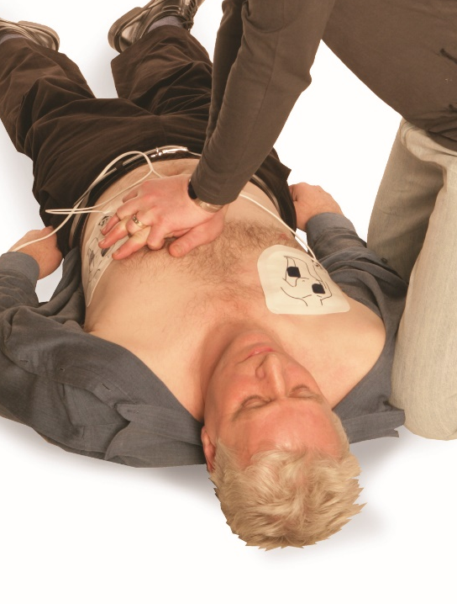
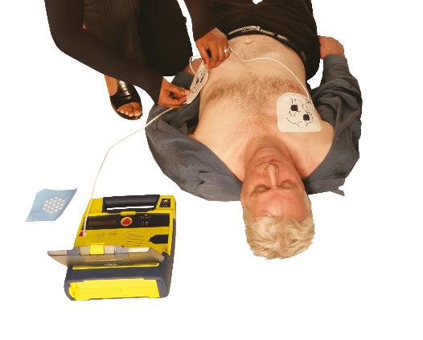
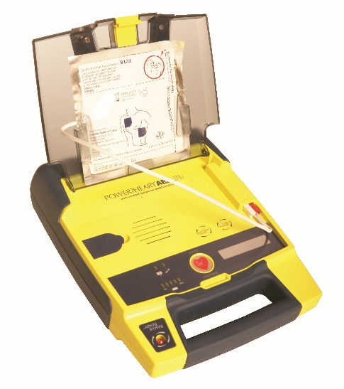
Primary survey
If an AED arrives, switch it on and follow the spoken or visual prompts. An AED is used in conjunction with CPR.
Notes:
D – Defibrillation (AED)
Adult pads: ages 8+ (size dependent)
Paediatric pads: ages 1-8
Infants (<1 year): use manual defibrillator with attenuator, if available, with pads placed front and back

Slide 35
Primary survey – practical demonstration
Notes:
Group exercise: Demonstrate the primary survey
Learners should work in groups to demonstrate the primary survey using the correct methods.
This is a hands-on assessment. Observation and participation are essential.

Slide 36
Secondary survey – outdoor activity equipment
A secondary survey on a casualty wearing outdoor activity
equipment may include:
• a head-to-toe examination carried out after the primary survey, used to identify less obvious injuries or medical issues, including:
  talking the casualty throughout the process to tell them what you are doing
  checking the head and neck for bleeding, swelling or deformity
  examining limbs and joints for injury.
Notes:
Tutor note: explain to the group that, after the primary survey, a secondary survey helps identify less obvious injuries, especially when outdoor gear may conceal them.

Slide 37
Secondary survey – outdoor activity equipment (cont.)
looking for signs of injury beneath or around equipment, such as:
  rucksacks
  harnesses
  helmets
being prepared to remove or adjust outdoor activity equipment, if necessary, safely and without causing further harm
recording and monitoring findings to identify developing issues and inform future care
KEY POINT
It is important to maintain casualty dignity and warmth throughout the process.

Slide 38
How much do you know?​
CE
When conducting a scene survey in the outdoors, what should you do first?
Check the casualty’s breathing
D
Look for signs of bleeding
Remove any outdoor activity equipment
Ensure the area is safe from hazards
Notes:
Class exercise: How much do you know?
The correct answer is D.

Slide 39
How much do you know?​
CE
Which of the following best minimises the risk of infection when providing outdoor first aid?
Giving rescue breaths without a face shield to save time
B
Wearing gloves and practising good hand hygiene
Washing the wound with untreated river water
Removing gloves between every treatment step
Notes:
Class exercise: How much do you know?
The correct answer is B.

Slide 40
How much do you know?​
CE
Which of the following best describes the correct order of
the DRABC approach during a primary survey?
Danger, response, airway, breathing, circulation
A
Response, danger, breathing, airway, circulation
Danger, airway, response, breathing, circulation
Danger, response, breathing, circulation, airway
Notes:
Class exercise: How much do you know?
The correct answer is A.

Slide 41
How much do you know?​
CE
When carrying out a secondary survey on a casualty wearing outdoor activity equipment, which action is MOST appropriate?
Remove all equipment immediately to look for hidden injuries
B
Examine the casualty from head to toe, checking beneath or around equipment as necessary
Focus only on the area where the casualty reports pain
Delay the survey until after evacuation to a warmer location
Notes:
Class exercise: How much do you know?
The correct answer is B.

Slide 42
Module 3
Be able to interpret vital sign information whilst responding to an emergency incident in
the outdoors
42
Notes:
Completion of this module will enable learners to meet the following learning outcome:
3. Be able to interpret vital sign information whilst responding to an emergency incident in the outdoors
This includes the following assessment criteria:
3.1 Describe the principles of casualty monitoring
3.2 Demonstrate monitoring of a casualty whilst they are in the recovery position
3.3 Demonstrate appropriate responses to changes in a casualty’s vital signs
3.4 Respond to signs commonly shown by a casualty suffering from hypothermia
3.5 Prioritise first aid to a casualty who requires more than one emergency first aid intervention
Activities in this module include:
CQ: What actions would you take if you noticed a casualty’s vital signs change?
CQ: What are the common signs if hypothermia?
GE: Responding to hypothermia
CQ GE: How would you prioritise the treatment of a casualty with multiple injuries?
CE: Five multiple-choice questions (MCQ’s) (formative assessment)

Slide 43
The principles of casualty monitoring
Casualty monitoring means checking, recording and responding to changes in the casualty’s condition.
Check regularly
Assess the casualty’s condition at frequent intervals
Track vital signs
Monitor:
level of consciousness
breathing rate and quality
skin colour and temperature
KEY POINT
Changes in these indicators may signal deterioration – act immediately if they worsen.
Notes:
Tutor note: emphasise outdoor-specific challenges (for example, equipment failure in cold, reduced dexterity with gloves, limited light).
Suggested activity: 1 learner plays the casualty, the other tracks the 3 vital signs at one-minute intervals, noting any changes.

Slide 44
The principles of casualty monitoring (cont.)
3. Record changes
Note improvements or deterioration in the casualty’s condition
4. Maintain ABC
Keep the airway, breathing and circulation prioritised and reassessed
5. Minimise movement
Keep the casualty still unless movement is essential for safety.
Notes:
Tutor note: emphasise outdoor-specific challenges (for example, equipment failure in cold, reduced dexterity with gloves, limited light).

Slide 45
The principles of casualty monitoring (cont.)
6. Maintain communication
Offer clear communication and emotional support
7. Adapt to the environment
Consider cold, heat, wet conditions and elevation changes
8. Prepare to pass on information
Be ready to pass on clear observations to the emergency services
or other first-aiders.
Notes:
Tutor note: emphasise outdoor-specific challenges (for example, equipment failure in cold, reduced dexterity with gloves, limited light).
Suggested activity: you’re in a mountain rescue scenario – split into small teams and decide which of the 8 principles would be most challenging to follow in this situation, and why.

Slide 46
AVPU scale
A
ALERT – are they moving/talking? → No → Proceed to V
V
VOICE – do they respond to speech? → No → Proceed to P
P
PLACE – place your hand on their shoulders and gently shake them asking ‘Are you alright?’ → No response → Proceed to U
U
UNRESPONSIVE – assume the casualty is unresponsive
The ‘P’ in the acronym AVPU is sometimes also referred to as ‘Pain’, meaning to cause a minor pain to see if the person responds. Examples include pinching the ear lobes or fingertips.

Slide 47
Monitoring a casualty in the recovery position
observing breathing, including the rate, depth and any irregularities
checking skin condition for colour, temperature and signs of shock
maintaining an open airway, ensuring the head is tilted and the airway is clear
listening and observing for changes, including gurgling, vomiting or laboured breathing
protecting from environmental factors, using insulation or shelter as needed
reassessing regularly, repeating checks at appropriate intervals and noting any deterioration
recording observations, noting times and changes for handover to emergency services.

Slide 48
What actions would you take if you noticed a casualty’s vital signs change?
1. Deterioration in consciousness:
  adjust positioning
  maintain the airway
  prepare for possible unconsciousness or CPR
2. Breathing rate or quality changes:
  monitor closely
  remove any obstructions
  reassure casualty
  prepare to escalate care.
Notes:
Class question: What actions would you take if you noticed a casualty’s vital signs change?
Discuss the appropriate responses to change with the group.

Slide 49
What actions would you take if you noticed a casualty’s vital signs change? (Cont.)
3. Weak or rapid pulse:
  treat for shock
  maintain warmth
  monitor closely
4. Cold, clammy or pale skin:
  manage for shock or hypothermia
  insulate casualty
  avoid heat loss
5. Signs of serious bleeding or internal injury:
  apply appropriate first aid
  control bleeding
  summon help immediately.
Notes:
Class question: What actions would you take if you noticed a casualty’s vital signs change? (Cont.)
Discuss the appropriate responses to change with the group.

Slide 50
What actions would you take if you noticed a casualty’s vital signs change? (Cont.)
6. Vomiting or airway obstruction risks:
  place in recovery position
  clear the airway
  monitor breathing
7. Escalation of care:
  recognise when to call for urgent help or prepare for prolonged casualty management.
Notes:
Class question: What actions would you take if you noticed a casualty’s vital signs change? (Cont.)
Discuss the appropriate responses to change with the group.
Group exercise
Learners to demonstrate recognising changes in a casualty’s vital signs and showing the correct responses.
Setup
Place learners in pairs or small groups
1 person is the casualty, 1 the first-aider, and the remainder of the group should be observers and provide feedback
Give the casualty a card describing a change in vital signs
The casualty acts out the signs
The first-aider:
says what they notice
demonstrates the correct actions from the training
Swap roles and use a new card each round
Equipment
Training first-aid kit
Blankets
Bandages/dressings
Space for recovery position

Slide 51
Hypothermia
Hypothermia occurs when the body loses heat faster than it produces it, causing a dangerous drop in core temperature
Causes
Prolonged exposure to cold, wet or windy conditions
immersion in cold water
KEY POINT
If the body’s core temperature drops below 35⁰C, then the onset of hypothermia will occur.
Notes:
Explain that hypothermia can develop gradually and may be overlooked in mild cases
Emphasise the importance of gentle handling to avoid triggering cardiac complications
Highlight environmental factors (wind, wetness, exhaustion) that increase risk
Use practical examples or scenarios to help learners identify early signs
Reinforce the need for ongoing monitoring and the possibility of prolonged care in remote settings

Slide 52
What are the common signs of hypothermia?
Physical signs:
shivering
cold, pale skin
bluish extremities
Vital signs:
slow breathing or pulse
unresponsiveness
Behavioural changes:
confusion or unusual behaviour
slurred speech
clumsiness (loss of co-ordination)
fatigue.
Notes:
Class question: What are the common signs if hypothermia?

Slide 53
Responding to hypothermia
Remove the casualty from the cold environment if safe to do so
Insulate the casualty using dry clothing, foil blankets, sleeping bags or other available materials
Prevent further heat loss using windproof layers, ground insulation and shelter
Provide warmth gradually using body heat, warm (not hot) drinks if the casualty is conscious. Avoid direct heat sources.
Notes:
Group exercise: Responding to hypothermia
Learners will demonstrate the correct sequence of actions for treating a casualty with hypothermia, following the 7 steps from the following slides.
Split learners into pairs or small groups
Assign one person as the casualty and the other(s) as first-aider(s)
Rotate roles so everyone practises both
Explain that each group will be given a hypothermia scenario to act out.
Example scenario prompt:
You are in a remote field during a winter hike. One member of your group starts shivering, has pale skin and is becoming confused. You have blankets, a sleeping bag and warm drinks in a flask. Demonstrate how you would respond.
Remind learners to talk through their actions so the tutor can assess their reasoning as well as their technique.
The casualty will show realistic signs of hypothermia (for example, shivering, pale skin and slurred speech).
The first-aider(s) must:
Remove the casualty from a ‘cold’ environment
insulate with available materials
prevent further heat loss
provide warmth gradually
monitor vital signs
avoid unnecessary movement
summon emergency help if needed
Equipment (suggestions)
Training first-aid kit
Blankets or foil survival blankets
Sleeping bag or large coat
Ground insulation (mat, tarp or spare clothing)
Cups and (pretend) warm drink bottles
Scenario prompt cards

Slide 54
Responding to hypothermia (cont.)
Monitor vital signs regularly, including breathing and responsiveness
Avoid unnecessary movement to reduce the risk of cardiac complications
Summon emergency help, if the casualty is unresponsive, deteriorating or not breathing.
Notes:
Group exercise: Responding to hypothermia (cont.)
Learners will demonstrate the correct sequence of actions for treating a casualty with hypothermia, following the 7 steps from the following slides.
Split learners into pairs or small groups
Assign one person as the casualty and the other(s) as first-aider(s)
Rotate roles so everyone practises both
Explain that each group will be given a hypothermia scenario to act out.
Example scenario prompt:
You are in a remote field during a winter hike. One member of your group starts shivering, has pale skin and is becoming confused. You have blankets, a sleeping bag and warm drinks in a flask. Demonstrate how you would respond.
Remind learners to talk through their actions so the tutor can assess their reasoning as well as their technique.
The casualty will show realistic signs of hypothermia (for example, shivering, pale skin and slurred speech).
The first-aider(s) must:
Remove the casualty from a ‘cold’ environment
insulate with available materials
prevent further heat loss
provide warmth gradually
monitor vital signs
avoid unnecessary movement
summon emergency help if needed
Equipment (suggestions)
Training first-aid kit
Blankets or foil survival blankets
Sleeping bag or large coat
Ground insulation (mat, tarp or spare clothing)
Cups and (pretend) warm drink bottles
Scenario prompt cards

Slide 55
How would you prioritise the treatment of a casualty with multiple injuries?
Prioritise first aid to a casualty who requires multiple first-aid treatments, for example, not breathing, arm bleeding and broken leg
primary survey
severity of injuries or conditions – treat the most urgent and potentially fatal issues first.
Notes:
Class question: How would you prioritise the treatment of a casualty with multiple injuries? (Cont.)
Tutor to ask learners for/or provide examples of times when multiple interventions are needed. Examples may include:
performing CPR before addressing other injuries
managing life-threatening bleeding before placing a casualty in the recovery position
treating hypothermia after ensuring breathing and the airway are maintained
Tutor to also link this to module 2 – conducting a scene survey, primary and secondary survey, ensuring environmental context.
Group exercise: casualty prioritisation scenarios
Set-up
Split learners into small groups (3-4 people). Give each group a short written scenario involving a casualty with multiple issues. For example:
a casualty who is not breathing normally and has a severe leg wound
a casualty who is breathing but has heavy bleeding and is showing early signs of shock
a casualty who is responsive but hypothermic and has a minor bleed
Task
Ask each group to:
carry out a quick scene survey (link back to Module 2)
decide in what order they would treat the casualty’s conditions
justify their prioritisation using the primary survey (airway, breathing, circulation) and environmental context
Debrief
Groups present their decisions. Tutor leads a discussion comparing answers, reinforcing that life-threatening conditions (airway, breathing, severe bleeding) must always take priority, with reassessment as the casualty’s condition changes.

Slide 56
How would you prioritise the treatment of a casualty with multiple injuries? (Cont.)
environment and context – account for external risks
availability of equipment and assistance – make decisions based on what can be managed effectively in the circumstances
monitoring and reassessing – be prepared to adjust priorities if the casualty’s condition changes.
Notes:
Class question: How would you prioritise the treatment of a casualty with multiple injuries?
Tutor to ask learners for/or provide examples of times when multiple interventions are needed.
Examples may include:
managing life-threatening bleeding before placing a casualty in the recovery position
performing CPR before addressing other injuries
treating hypothermia after ensuring breathing and the airway are maintained
Tutor to link this to module 2 – conducting a scene survey, primary and secondary survey, ensuring environmental context.

Slide 57
How much do you know?​
CE
Which of the following is a key principle of casualty monitoring in an outdoor environment?
Only check the casualty’s vital signs once to avoid disturbing them
B
Track vital signs regularly, record any changes and be prepared to pass information to emergency services
Avoid touching the casualty to reduce infection risk
Keep the casualty awake at all times to prevent unconsciousness
Notes:
Class exercise: How much do you know?
The correct answer is B.

Slide 58
How much do you know?​
CE
When monitoring a casualty in the recovery position, what is the MOST important action?
Check breathing and responsiveness at regular intervals
A
Leave them unattended to fetch equipment
Give them food and drink to maintain energy
Keep them lying flat on their back to avoid movement
Notes:
Class exercise: How much do you know?
The correct answer is A.

Slide 59
How much do you know?​
CE
If a casualty’s breathing rate becomes irregular and they appear distressed, what is the MOST appropriate first action?
Monitor closely, remove any obstructions, reassure the casualty and prepare to escalate care
A
Immediately move the casualty to a standing position to improve breathing
Begin CPR without checking for responsiveness
Provide warm drinks to improve oxygenation
Notes:
Class exercise: How much do you know?
The correct answer is A.

Slide 60
How much do you know?​
CE
Which of the following is the MOST appropriate first-aid action for a casualty with suspected hypothermia?
Give them hot drinks and place them directly in front of a fire
C
Encourage vigorous exercise to raise body temperature quickly
Remove them from the cold environment, insulate with dry clothing or blankets and provide warmth gradually
Rub their arms and legs vigorously to restore circulation
Notes:
Class exercise: How much do you know?
The correct answer is C.

Slide 61
How much do you know?​
CE
When a casualty has both severe bleeding and is unresponsive but breathing, which intervention should be carried out FIRST?
Place them in the recovery position before treating the bleeding
B
Control the life-threatening bleeding before moving them into the recovery position
Check their temperature to rule out hypothermia before any treatment
Give them water to prevent shock before any other action
Notes:
Class exercise: How much do you know?
The correct answer is B.

Slide 62
Module 4
Be able to respond to an incident involving an unresponsive casualty with normal breathing in the outdoors
62
Notes:
Completion of this module will enable learners to meet the following learning outcome:
4. Be able to respond to an incident involving an unresponsive casualty with normal breathing in the outdoors
This includes the following assessment criteria:
4.1 Place an unresponsive casualty into a suitable position to maintain a safe airway
4.2 Describe environmental factors that affect the administration of first aid in outdoor settings
4.3 Demonstrate how to adapt first aid practices in response to environmental conditions
4.4 Demonstrate how to manage an unresponsive casualty when assistance is more than 30 minutes away
Activities in this module include:
GE: The recovery position – practical demonstration
GE: Managing an unresponsive casualty when assistance is more than 30 minutes away
CE: Four multiple-choice questions (MCQ’s) (formative assessment)

Slide 63
When to use the recovery position
Place a casualty in the recovery position when they have a lowered
level of response or are unresponsive and:
do not need CPR
are breathing normally
have no suspected spinal injury
If injured, only use the recovery position if their airway is at risk, such as:
• fluids in the airway (blood or vomit)
• you need to leave them to get help.
Notes:
Reinforce the difference between breathing normally vs. agonal breathing. Highlight risks of leaving someone flat who has a partially blocked airway.

Slide 64
Monitoring breathing continuously
Ongoing safety of the casualty
You must continue to monitor closely for any signs of deterioration
You should continue to:
look, listen and feel for breathing
reassess if there is any change in responsiveness
be alert for signs of deterioration into cardiac arrest
KEY POINT
If breathing stops or becomes irregular, start CPR immediately.
Notes:
Explain that sudden deterioration is common. Encourage learners to remain close and alert and be ready to begin CPR if needed.
Even when a casualty is in the recovery position and appears stable, things can change very quickly.

Slide 65
Monitoring casualty breathing
Prompt action if the condition changes
The recovery position keeps the airway open and helps fluids drain, but breathing complications can still occur
Monitoring ensures the casualty gets enough oxygen and warns of problems like irregular breathing, choking or signs of shock.
Notes:
learners must be able to demonstrate how they continue to monitor breathing while the casualty is in the recovery position.

Slide 66
Monitoring casualty breathing (cont.)
Supports prompt action if the condition changes
If a casualty in the recovery position stops breathing normally, then act quickly
Roll the casualty onto their back and commence CPR
KEY POINT
Continuous monitoring allows immediate escalation if needed, which can significantly improve the chances of survival.

Slide 67
Monitoring casualty breathing (cont.)
Duty of care obligations
The first-aider has a duty of care to continue supporting the casualty until help arrives
This includes:
checking for normal breathing at regular intervals
looking, listening and feeling for breath sounds or chest movement
being prepared to re-assess the casualty's airway and responsiveness.

Slide 68
Additional considerations – recovery position
While the casualty is in the recovery position:
• continue to monitor airway and breathing at all times
• be alert for any changes in responsiveness
• turn the casualty onto the opposite side every 30 minutes
• if pregnant, place and keep them on their left side.
Notes:
Explain that prolonged pressure on 1 side can cause complications. Discuss how placing a pregnant casualty on the left side reduces pressure on major blood vessels and improves circulation.

Slide 69
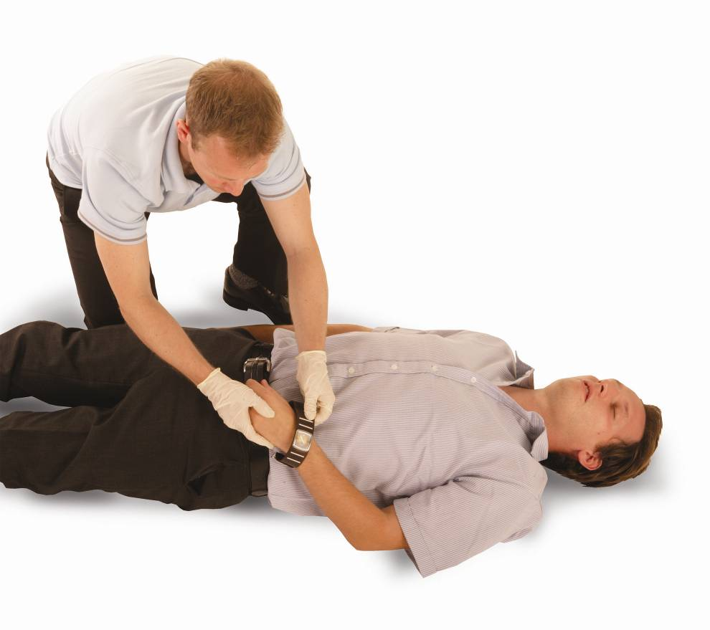
The recovery position – adult
Kneel to the side of the casualty. Remove glasses, watches and any large objects from side pockets.
Notes:
The recovery position
The recovery position is used to maintain a clear airway and assist with normal breathing when a casualty is unresponsive but breathing. It also assists when the casualty vomits or excretes saliva as it allows it to drain naturally from the mouth or nose. However, if you suspect that a casualty has had a spinal or head injury, you must carefully consider the movement of the casualty.

Slide 70
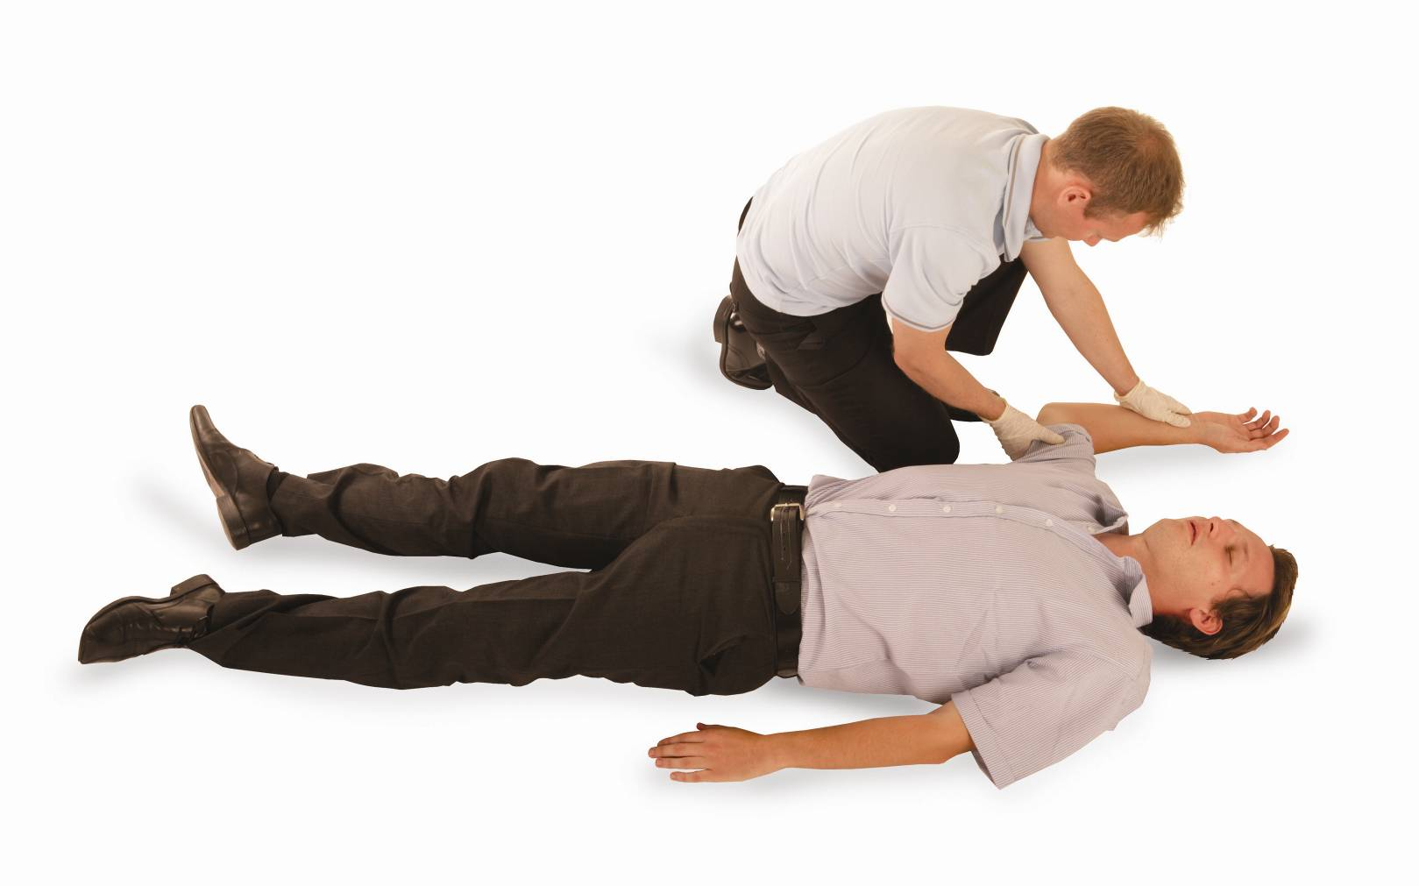
The recovery position
Place the arm nearest to you at a right angle to the casualty’s body (allow it to rest
in a natural position).

Slide 71
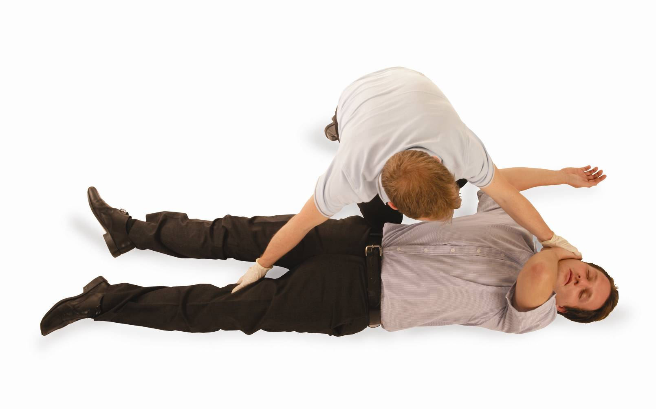
The recovery position
Bring the other arm across the casualty’s chest and secure the back of the hand onto
their nearest cheek with your hand.

Slide 72
The recovery position
With your free hand, grasp the casualty’s clothing around the knee and draw the leg up,
ensuring the foot remains on
the ground.

Slide 73
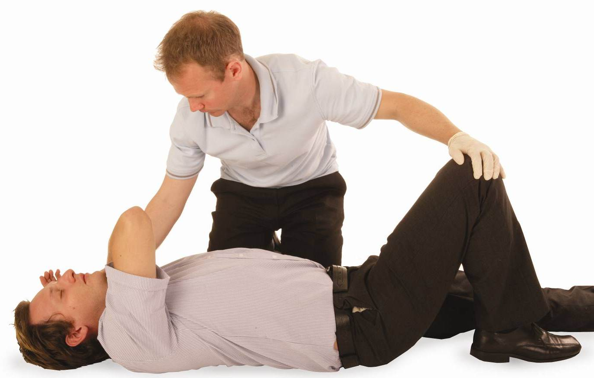
The recovery position
Keeping the casualty’s hand
on their cheek to control the
head movement, pull their leg towards you so the casualty turns onto their side.

Slide 74
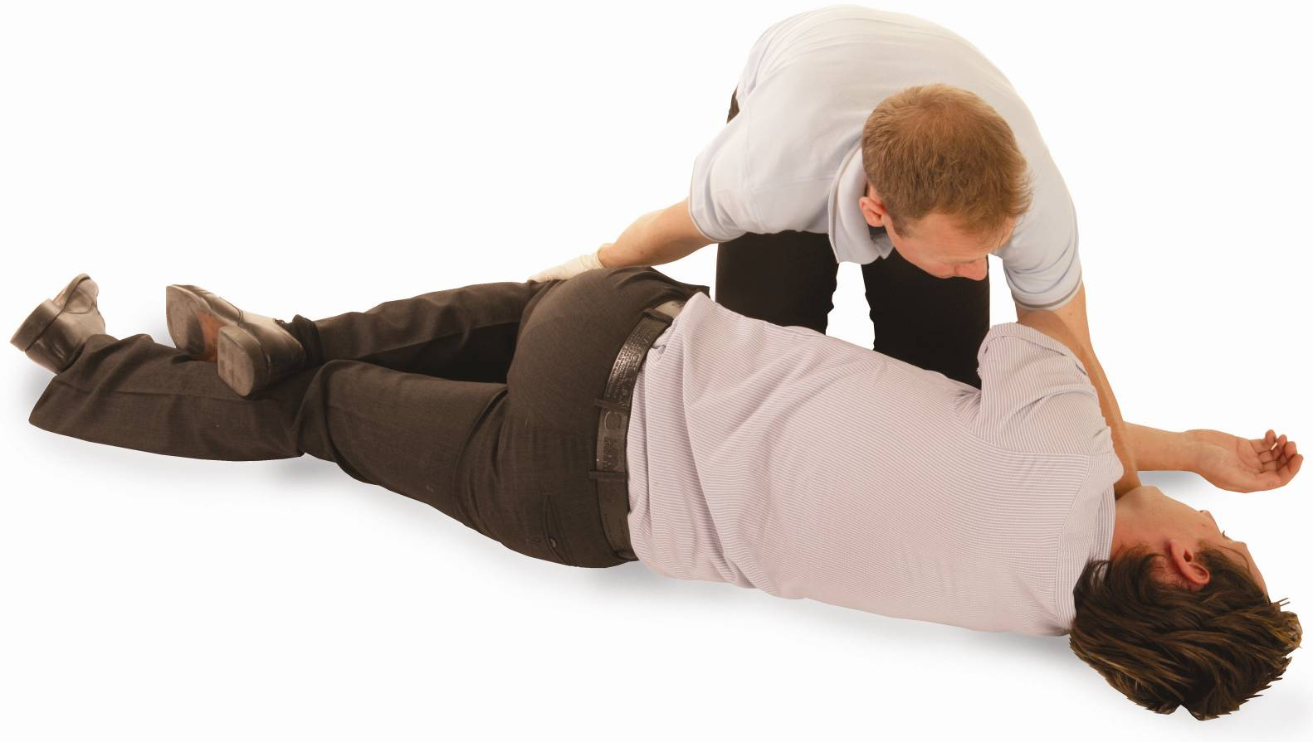
The recovery position
Adjust the casualty’s upper leg so that the knee and lower leg are at right angles to the
hip, making a stable base. Check that the airway is open and adjust the hand under the cheek to maintain the airway.

Slide 75
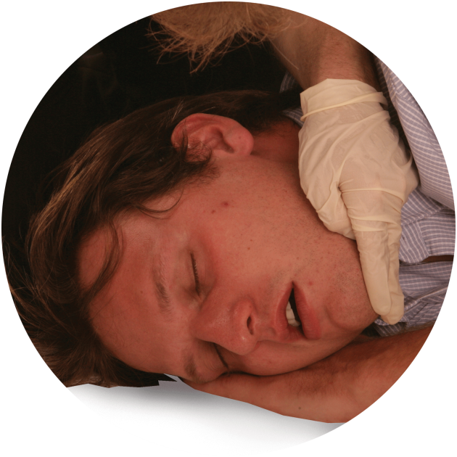
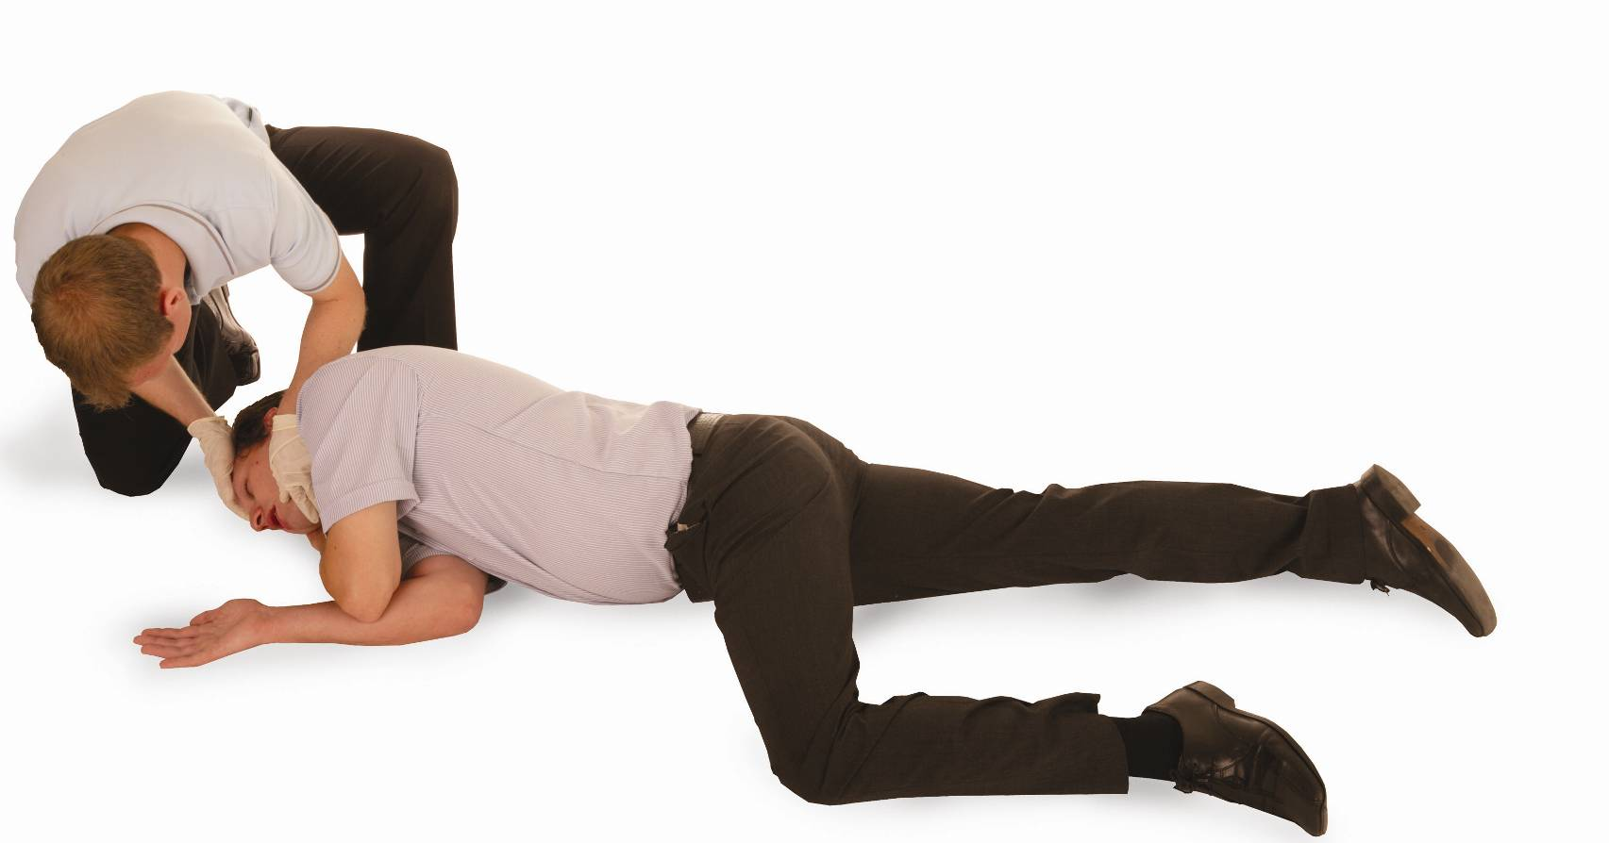
The recovery position
The casualty is now in the recovery position.
Continually monitor normal breathing and be prepared to carry out CPR.

Slide 76
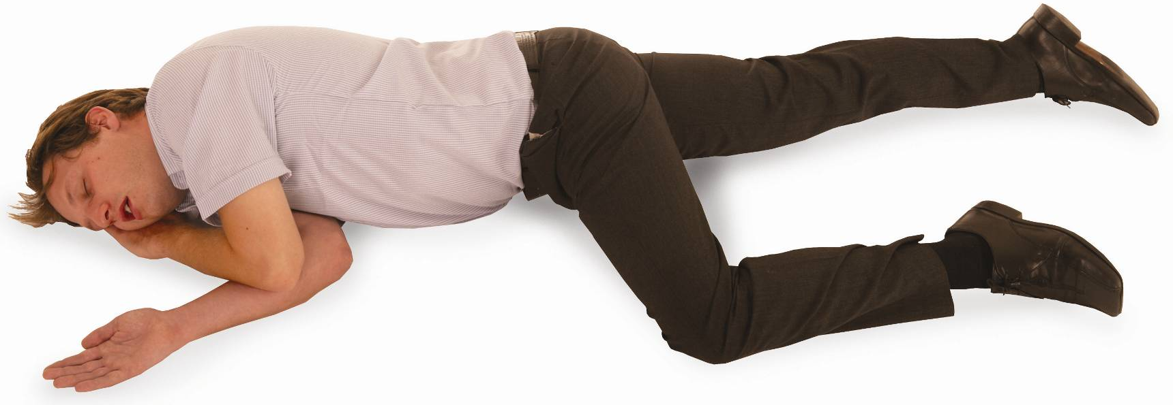
The casualty is now in the recovery position
Only place a casualty into the recovery position if there are no further injuries. Once in the recovery position, turn onto the opposite side every 30 minutes. When placing a pregnant woman into the recovery position, she should be placed onto her left-hand side, as this prevents compression of
the inferior vena cava.

Slide 77
Alternative recovery positions
Modified recovery positions are
used when the standard recovery
position is not appropriate or
safe due to:
suspected spinal injury
limb injury
confined space
uneven terrain
Adjustments may include:
altering limb placement
supporting the head with available clothing
limiting body roll
maintaining airway protection.
Notes:
Tutor to explain
Modified recovery positions may be used when the standard recovery position is not appropriate due to suspected spinal injury, limb injury, confined space or uneven terrain.
Adjustments may include altering limb placement, supporting the head with available clothing or limiting body roll, while still maintaining airway protection.

Slide 78
Alternative recovery positions (cont.)
A semi-sitting position
Is useful if the casualty has chest injuries, breathing difficulties or is more comfortable upright
Supports easier breathing when lying flat may worsen their condition
Casualty can be supported against a rucksack, tree or improvised backrest
KEY POINT
Choose the safest position that maintains an open airway and protect the casualty from environmental hazards.
Notes:
Semi-sitting position
This may be appropriate where the casualty has chest injuries, breathing difficulties or finds it more comfortable to remain partly upright. Support should be provided using natural features, such as trees or rocks or improvised items, such as a rucksack or folded clothing. The position must enable the airway to remain open and allow effective monitoring.
Key principle
The overriding principle is to select the safest position that maintains a clear airway, while adapting to the casualty’s injuries and the environmental conditions. Learners should recognise the importance of continuous monitoring of breathing and responsiveness, whichever position is used.
Where possible, tutors should demonstrate these alternative positions and encourage learners to practise adapting the recovery position to different scenarios.

Slide 79
The recovery position – practical demonstration
You must be able to carry out a practical demonstration of how to place an adult into the recovery position
This demonstration must show the correct techniques, including:
monitoring the airway and breathing
turning the casualty on to the opposite side every 30 minutes
placing a pregnant casualty on their left side.
Notes:
Group exercise: The recovery position – practical demonstration
With the delegates working in pairs, ask them to demonstrate the procedure for placing a casualty into the recovery position and perform the action for a vomiting casualty.
Casualties should be placed injured side down if possible.
Pregnant women should be placed on their left-hand side, if injuries allow, as this prevents compression of the inferior vena cava (the large vein that carries deoxygenated blood from the lower half of the body into the right atrium (chamber) of the heart).

Slide 80
Environmental factors and how to adapt first aid practices
Environmental conditions have a significant impact on how first aid is provided.
Understanding these factors and knowing how to adapt your approach improves safety for both the casualty and the rescuer
KEY POINT
As you review the tables in the next slides, think about how each environmental factor and adaptation could apply in your own outdoor environments.
Notes:
Discussion suggestion or class question.
Tutor to ask learners
What environmental challenges have you faced in your outdoor activities and how did they affect the way you provided, or would provide, first aid?

Slide 81
Environmental factors and how to adapt first-aid practices – slope, uneven ground, terrain
Environmental factor | Adapted first-aid practice
Slope or uneven ground affects: casualty position rescuer stability safe access Terrain type: may limit access may affect extraction introduces specific hazards | Position the casualty to prevent rolling or further injury Stabilise with: clothing packs natural features Maintain rescue balance during treatment.

Slide 82
Environmental factors and how to adapt first-aid practices – cold, wet and hot/sunny weather
Environmental factor | Adapted first-aid practice cold or wet weather | Adapted first-aid practice hot, sunny weather
Temperature extremes: risk of heat exhaustion dehydration hypothermia frostbite | insulate the casualty from the ground and elements minimise exposure time – use windbreaks or shelters where possible prioritise warmth and drying for hypothermic casualties | move the casualty to shade or create shade with tarpaulin or clothing hydrate and cool the casualty gradually avoid excessive handling of heat-sensitive equipment
Also impacts equipment function and casualty response.
Notes:
Tutor note: highlight how the environment can affect both the casualty and the rescuer, including stability, equipment performance and communication.
Link the discussion back to casualty safety, rescuer safety and the prioritisation of treatment.

Slide 83
Environmental factors and how to adapt first-aid practices – strong sunlight
Environmental factor | Adapted first-aid practice
Strong sunlight: can lead to heat-related conditions affects visibility requires protection of both casualty and rescuer | In strong sunlight: move the casualty to shade or create shade with tarpaulin or clothing hydrate and cool the casualty gradually avoid excessive handling of heat-sensitive equipment.
Notes:
Tutor note: highlight how the environment can affect both the casualty and the rescuer, including stability, equipment performance and communication.
Link the discussion back to casualty safety, rescuer safety and the prioritisation of treatment.

Slide 84
Environmental factors and how to adapt first-aid practices – wind direction and speed
Environmental factor | Adapted first-aid practice
Wind direction and speed: can cause rapid heat loss may affect communication increases fire or smoke hazards | In high wind: shelter the casualty using: natural barriers group bodies tents protect dressings and equipment from being blown away communicate clearly and assertively over wind noise.
Notes:
Tutor note: highlight how the environment can affect both the casualty and the rescuer, including stability, equipment performance and communication.
Link the discussion back to casualty safety, rescuer safety and the prioritisation of treatment.

Slide 85
Environmental factors and how to adapt first-aid practices – rain, snow or sleet
Environmental factor | Adapted first-aid practice
Precipitation (rain, snow or sleet): reduces visibility reduces heat on contact creates slippery surfaces complicates treatment | In low visibility or darkness: use head torches or signal lights mark the scene clearly to avoid trip hazards keep communication clear and maintain contact with team members.
Notes:
Tutor note: highlight how the environment can affect both the casualty and the rescuer, including stability, equipment performance and communication.
Link the discussion back to casualty safety, rescuer safety and the prioritisation of treatment.

Slide 86
Environmental factors and how to adapt first-aid practices – altitude
Environmental factor | Adapted first-aid practice
Altitude May reduce oxygen availability Could impact both casualty and rescuer performance | In remote locations: prepare for extended monitoring and delayed evacuation prioritise: comfort warmth psychological reassurance converse resources and document care over time.
Notes:
Tutor note: highlight how the environment can affect both the casualty and the rescuer, including stability, equipment performance and communication.
Link the discussion back to casualty safety, rescuer safety and the prioritisation of treatment.

Slide 87
Environmental factors and how to adapt first-aid practices – time of day and visibility
Environmental factor | Adapted first aid-practice
Time of day and visibility Darkness or low light can hinder assessment and treatment | In low visibility or darkness: use head torches or signal lights mark the scene clearly to avoid trip hazards keep communication clear and maintain contact with team members.
Notes:
Tutor note: highlight how the environment can affect both the casualty and the rescuer, including stability, equipment performance and communication.
Link the discussion back to casualty safety, rescuer safety and the prioritisation of treatment.

Slide 88
Environmental factors and how to adapt first-aid practices – distance from help
Environmental factor | Adapted first-aid practice
Distance from help Delays in emergency response May require extended casualty care | In remote locations: prepare for extended monitoring and delayed evacuation prioritise: comfort warmth psychological reassurance converse resources and document care over time.
Notes:
Tutor note: highlight how the environment can affect both the casualty and the rescuer, including stability, equipment performance and communication.
Link the discussion back to casualty safety, rescuer safety and the prioritisation of treatment.

Slide 89
Managing an unresponsive casualty when assistance is more than 30 minutes away
When help is over 30 minutes away, focus on maintaining life, preventing deterioration and providing environmental protection.
Steps to follow:
Maintain airway and breathing using the recovery position. Monitor and reassess regularly
Protect from environmental exposure (insulate from cold, shade from heat)
Monitor vital signs over time, record changes and respond to changes in breathing responsiveness and skin condition
Manage fluids and vomiting by turning the casualty to drain and clear the airway if needed.
Notes:
Group exercise: Managing an unresponsive casualty when assistance is more than 30 minutes away
Learners will need to demonstrate how to manage an unresponsive but breathing casualty, simulating extended care while awaiting delayed rescue.
Set-up
Place a volunteer or manikin as the casualty in a realistic outdoor or indoor ‘field’ environment
Provide minimal equipment (basic first-aid kit, foil blanket, spare clothing, notebook and pen)
Give each group an ‘environment brief’ (for example, cold and wet conditions, high wind or hot and sunny)
Instructions
Initial assessment – conduct a primary survey, place casualty in the recovery position, if appropriate.
Ongoing care – assign team members to:
continually monitor vital signs
maintain airway and breathing
protect from environmental exposure
reassure casualty
document all actions and observations
Complication injects – Every 5-10 minutes, the trainer introduces a change (for example, the casualty vomits, temperature drops, rescuer must leave briefly or rain starts). Teams must adapt care.
Handover – at the end of the exercise, teams give a full verbal and written handover to ‘rescue services’ (tutor).
Debrief
Discuss what adaptations were made and why
Highlight the challenges of prolonged care in limited-resource environments
Reinforce the importance of continuous monitoring and record-keeping
Equipment
Manakin
Training first-aid kit
Blankets
Bandages/dressings
Coat
Hat

Slide 90
Managing an unresponsive casualty when assistance is more than
30 minutes away (cont.)
Prevent secondary complications, such as:
  pressure sores
  hypothermia
  shock
Reassure the casualty (even if unconscious) using calm tone and body language
Use clothing or soft items to pad and maintain a safe posture
Keep accurate records for handover to emergency services
Keep the casualty ready to move while reducing unnecessary movement.
Notes:
Group exercise: Managing an unresponsive casualty when assistance is more than 30 minutes away (cont.)
Learners will need to demonstrate how to manage an unresponsive but breathing casualty, simulating extended care while awaiting delayed rescue.
Set-up
Place a volunteer or manikin as the casualty in a realistic outdoor or indoor ‘field’ environment
Provide minimal equipment (basic first-aid kit, foil blanket, spare clothing, notebook and pen)
Give each group an ‘environment brief’ (for example, cold and wet conditions, high wind or hot and sunny)
Instructions
Initial assessment – conduct a primary survey, place casualty in the recovery position, if appropriate.
Ongoing care – assign team members to:
continually monitor vital signs
maintain airway and breathing
protect from environmental exposure
reassure casualty
document all actions and observations
Complication injects – Every 5-10 minutes, the trainer introduces a change (for example, the casualty vomits, temperature drops, rescuer must leave briefly or rain starts). Teams must adapt care.
Handover – at the end of the exercise, teams give a full verbal and written handover to ‘rescue services’ (tutor).
Debrief
Discuss what adaptations were made and why
Highlight the challenges of prolonged care in limited-resource environments
Reinforce the importance of continuous monitoring and record-keeping
Equipment
Manakin
Training first-aid kit
Blankets
Bandages/dressings
Coat
Hat

Slide 91
How much do you know?​
CE
Which position is MOST suitable for an unresponsive casualty who is breathing normally and has no suspected spinal injury?
Sitting upright with head tilted forward
B
Recovery position with head tilted back
Lying flat on their back with legs elevated
Semi-sitting position regardless of injuries
Notes:
Class exercise: How much do you know?
The correct answer is B.

Slide 92
How much do you know?​
CE
Which of the following is an environmental factor that could directly impact first-aid delivery outdoors?
The casualty’s favourite type of outdoor activity
D
Whether the casualty prefers hot or cold drinks
The number of people in the rescue team
Strong wind reducing body temperature and affecting communication
Notes:
Class exercise: How much do you know?
The correct answer is D.

Slide 93
How much do you know?​
CE
When treating a casualty on a steep slope, which adaptation is MOST appropriate?
Stabilise the casualty using clothing or natural features to prevent rolling
A
Move the casualty downhill immediately without assessment
Place the casualty in the recovery position without considering slope stability
Wait for emergency services before taking any action
Notes:
Class exercise: How much do you know?
The correct answer is A.

Slide 94
How much do you know?​
CE
Which action is MOST appropriate when managing an unresponsive casualty and help is over 30 minutes away?
Keep the casualty seated upright to prevent pressure sores
C
Focus solely on keeping the casualty awake until help arrives
Maintain airway and breathing, insulate from environmental conditions and monitor vital signs
Avoid repositioning the casualty even if they vomit
Notes:
Class exercise: How much do you know?
The correct answer is C.

Slide 95
Module 5
Be able to respond to an incident involving an unresponsive casualty who is not breathing normally in the outdoors
95
Notes:
Completion of this module will enable learners to meet the following learning outcome:
5. Be able to respond to an incident involving an unresponsive casualty who is not breathing normally in the outdoors
This includes the following assessment criteria:
5.1 Demonstrate cardiopulmonary resuscitation (CPR) on an adult manikin
5.2 Describe the accepted modifications to CPR protocols for different outdoor scenarios, including:
a near-drowning incident
a child casualty
a casualty who is remote from immediate medical help
a lightning strike casualty
5.3 Demonstrate when and how to remove outdoor activity equipment from an unresponsive non-breathing casualty
5.4 Demonstrate how to manage an unresponsive casualty who is vomiting
Activities in this module include:
CQ: What is cardiopulmonary resuscitation (CRP)?
GE: CPR – chest compressions
GE: CPR – practical demonstration
CQ GE: How would you manage an unresponsive casualty who is vomiting? Practical demonstration
CE: Four multiple-choice questions (MCQs) (formative assessment)

Slide 96
What is cardiopulmonary resuscitation (CPR)?
CPR
CPR is a method of combining chest compressions with effective rescue breaths in order to artificially circulate blood and to put air into the lungs.
Cardio = heart
Pulmonary = lungs
Resuscitation = revive
Notes:
Class question: What is cardiopulmonary resuscitation (CPR)?

Slide 97
When you should administer CPR
First, assess the casualty quickly and calmly to decide if CPR is needed
CPR should be administered when the casualty is unresponsive and:
is not breathing
OR not breathing normally (agonal breathing)
KEY POINT
Starting CPR at the right time can be the difference between
life and death!
Notes:
Start CPR if someone is unresponsive and:
not breathing at all
or is making gasping, irregular or snorting sounds (agonal breathing) – this is not effective breathing

Slide 98
Recognising an unresponsive casualty
A casualty is considered unresponsive if they:
do not respond to voice or touch
show no purposeful movement
have eyes that are closed or staring.
Notes:
Unresponsiveness means the person is unconscious. Try shouting, gently shaking their shoulders and checking for any response. If they don’t respond, proceed to assessing the breathing.

Slide 99
Recognising agonal breathing
Recognising abnormal breathing
Not all breathing is normal, especially in cardiac arrest
Agonal breathing can sound like gasping, snorting or choking
If in doubt about whether breathing is normal, assume it’s not
Start CPR immediately if breathing seems abnormal.
Notes:
Agonal breathing often happens shortly after the heart stops. It can look or sound dramatic, but it’s ineffective. Don’t mistake it for normal breathing. If in doubt, treat as not breathing.

Slide 100
Normal vs. agonal breathing – the key differences
Breathing normally:
Agonal breathing:
regular rise and fall
quiet, steady breathing
effective air exchange
gasping, snorting and irregular
may sound like choking
not enough to sustain life.

Slide 101
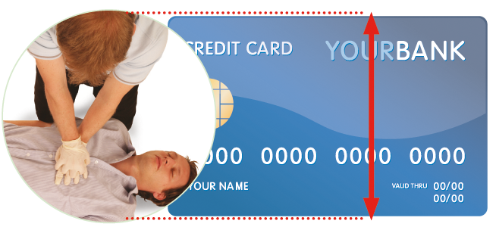
CPR – chest compressions
Chest compressions must only be administered to a casualty who is not breathing normally
Depth of compression should be 5-6 cm
Rate of compression should be 100-120 compressions per minute
30 chest compressions should be administered prior to moving onto rescue breaths (expired air ventilations).
Notes:
Demonstration
Ensure that all members of the group can see and demonstrate in full, using a manikin, administering chest compressions. Emphasise the importance of hand positioning, depth and rate of compression.
Group exercise: CPR – chest compressions
Once explained, split the class down into groups. Each group should have access to a manikin. Ask the learners to practise chest compressions, ensuring they follow correct technique and receive feedback where needed.

Slide 102
CPR age-related changes
 | Adult | Child | Infant
Breaths | 30 compressions: 2 breaths | 5 initial breaths, then 30:2 | 5 initial breaths, then 30:2
Compression depth | 5-6cm | 4-5cm depending on size | 1/3 chest depth
Hand position | 2 hands, centre of chest | 1 or 2 hands depending on size | 2 fingers or thumbs in the centre of the chest
Compression rate | 100-120 per minute | Same as adult | Same as adult
KEY POINT
Paediatric resuscitation practice
This ratio is specific to paediatric basic life support protocols (30:2).
Notes:
Tutor to highlight the CPR differences between adults, children and infants.

Slide 103
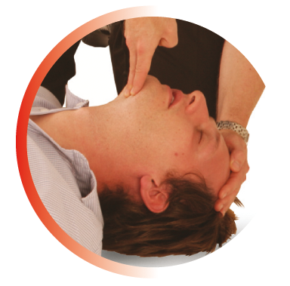
Airway maintenance
It is important that the casualty’s airway is opened and remains open (maintained).
Notes:
If the casualty is breathing, it is essential to keep the airway open at all times. This can be maintained by regularly checking the airway, even when the casualty is in the recovery position.

Slide 104
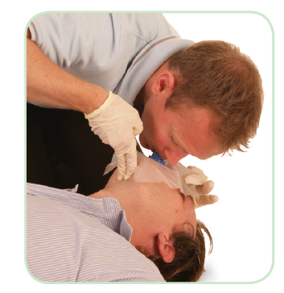
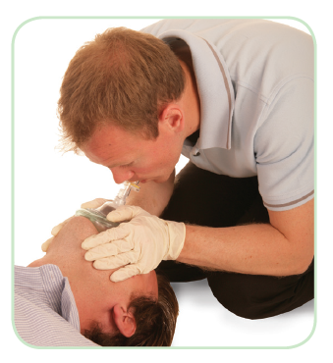
Barrier devices
Barrier devices are essential equipment and help to eradicate
the spread of infection and cross-contamination. Barrier devices, as
their name suggests, place a barrier between the first-aider and the casualty
Barrier devices include:
nitrile powder-free gloves
face shields
pocket masks
non-surgical face mask/clean fabric material.
Notes:
Explain that using a barrier device, such as a face shield, is important to prevent cross-infection. If the casualty has a serious mouth injury, mouth-to-nose ventilations can be performed. If the casualty has a stoma fitted, ‘mouth-to-stoma’ ventilation should be used.

Slide 105
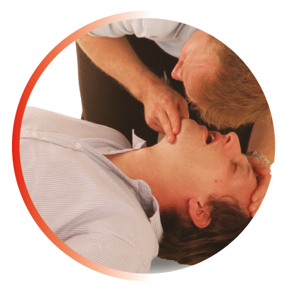
CPR – adult
After completing 30 chest compressions, the emergency first-aider must then administer 2 effective rescue breaths
Each breath should take 1 second to complete and the casualty’s chest should rise as in normal breathing. This is known as an effective rescue breath.
Administering the 2 breaths should take no longer than 10 seconds to complete in total.
  Once the first breath is administered, remove your mouth from the casualty’s mouth, turn your head and watch the chest rise and fall, then administer the second breath.
Notes:
Important note: Do not remain off the chest for longer than 10 seconds. Each breath should take 1 second to administer, which totals approximately 5 seconds for 5 breaths. This leaves 5 seconds to return to chest compressions.

Slide 106
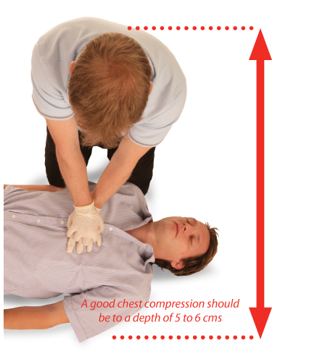
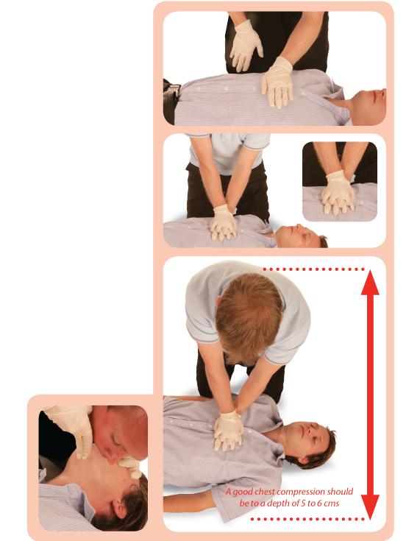
Demonstrate and practise CPR – adult
Notes:
Group activity: Demonstrate and practise CPR – adult
Gather the group and demonstrate CPR using a manikin.
Show them how to perform CPR both with and without a barrier device (such as a face shield).
After the demonstration, explain and demonstrate how to clean the manikin thoroughly and safely.
Explain that, once you commence CPR, you should not stop until:
A health professional tells you to stop
You become exhausted
The casualty is definitely waking up, moving, opening their eyes and breathing normally
Prompted by the AED

Slide 107
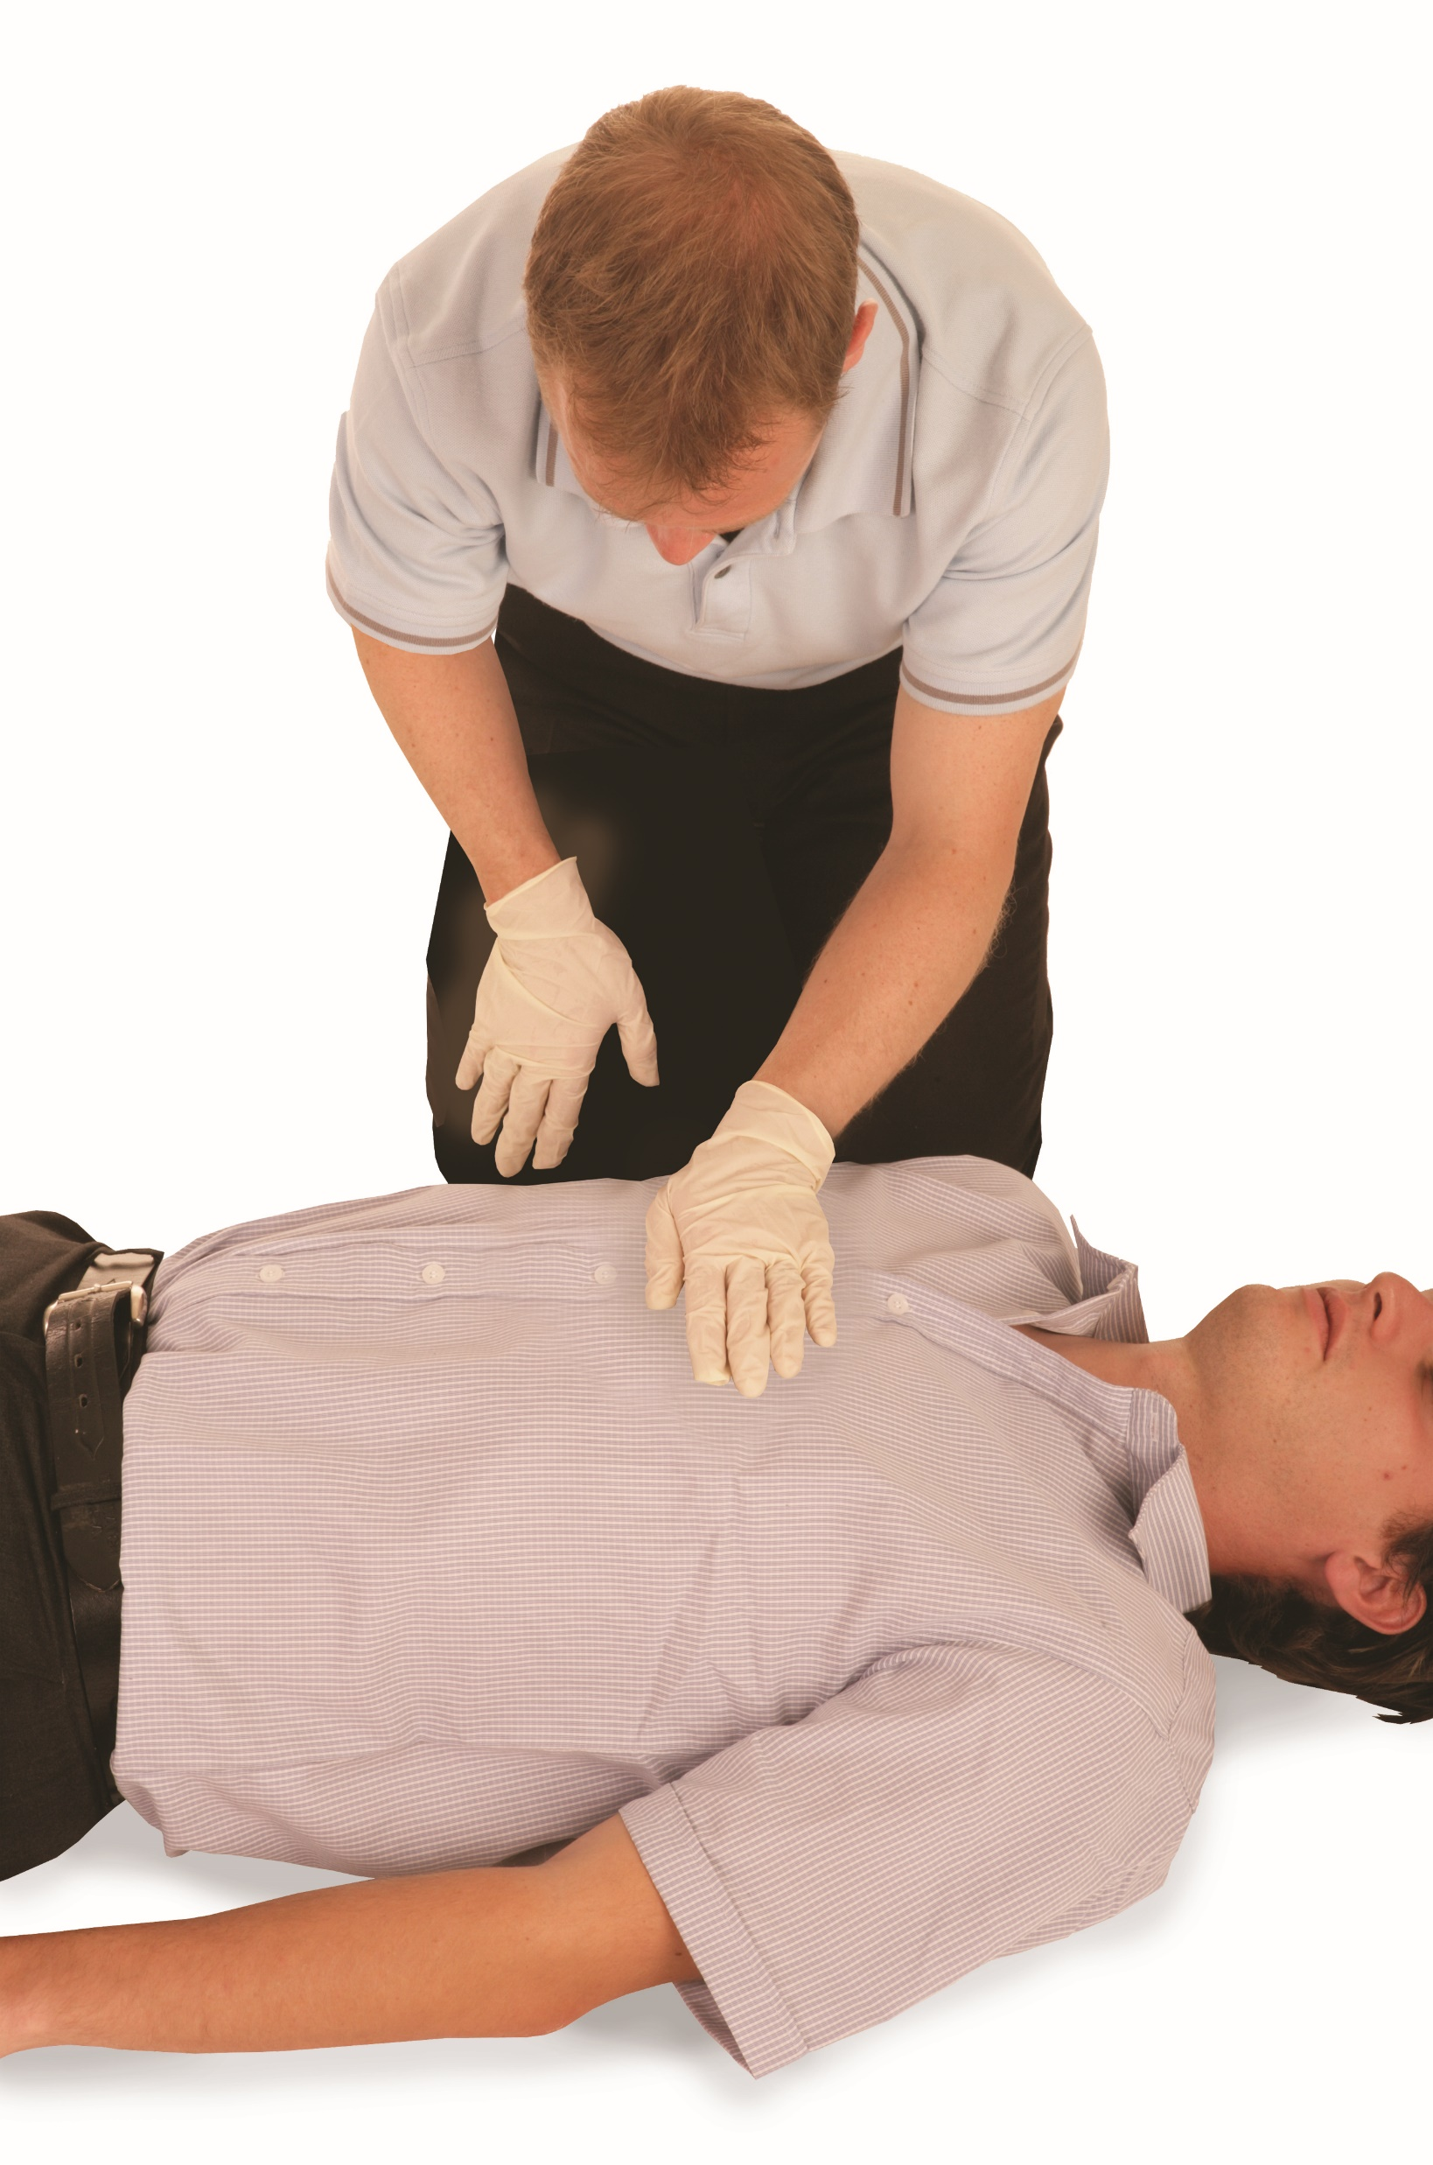
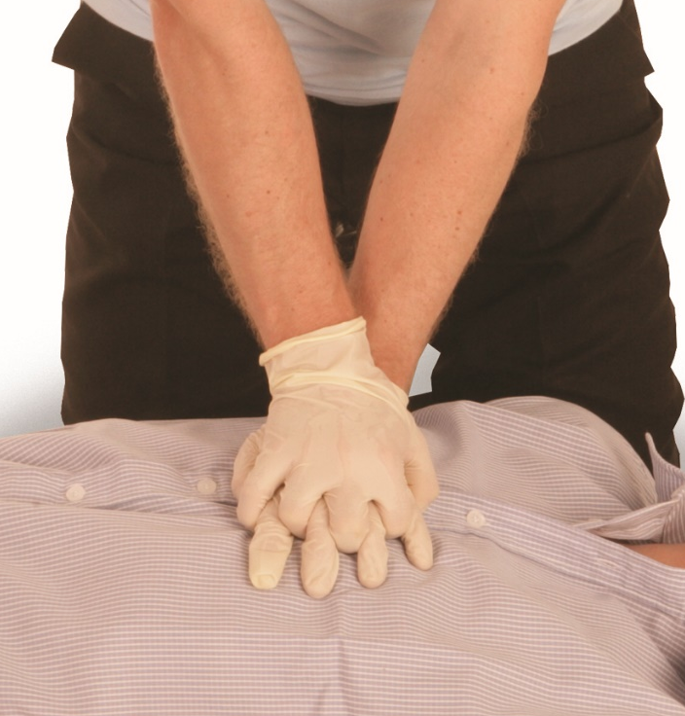
CPR – adult
Kneel by the side of the casualty. Place the heel of 1 hand in the centre of the casualty’s chest
Place the heel of your other hand on top of the first hand. Interlock the fingers of your hands.

Slide 108

CPR – adult (cont.)
Position yourself vertically above the casualty’s chest and with your arms straight, press down on the sternum 5-6cm
After each compression, release all of the pressure on the chest without losing contact between your hands and the sternum. Repeat at a rate of 100-120 compressions per minute 30 times.

Slide 109
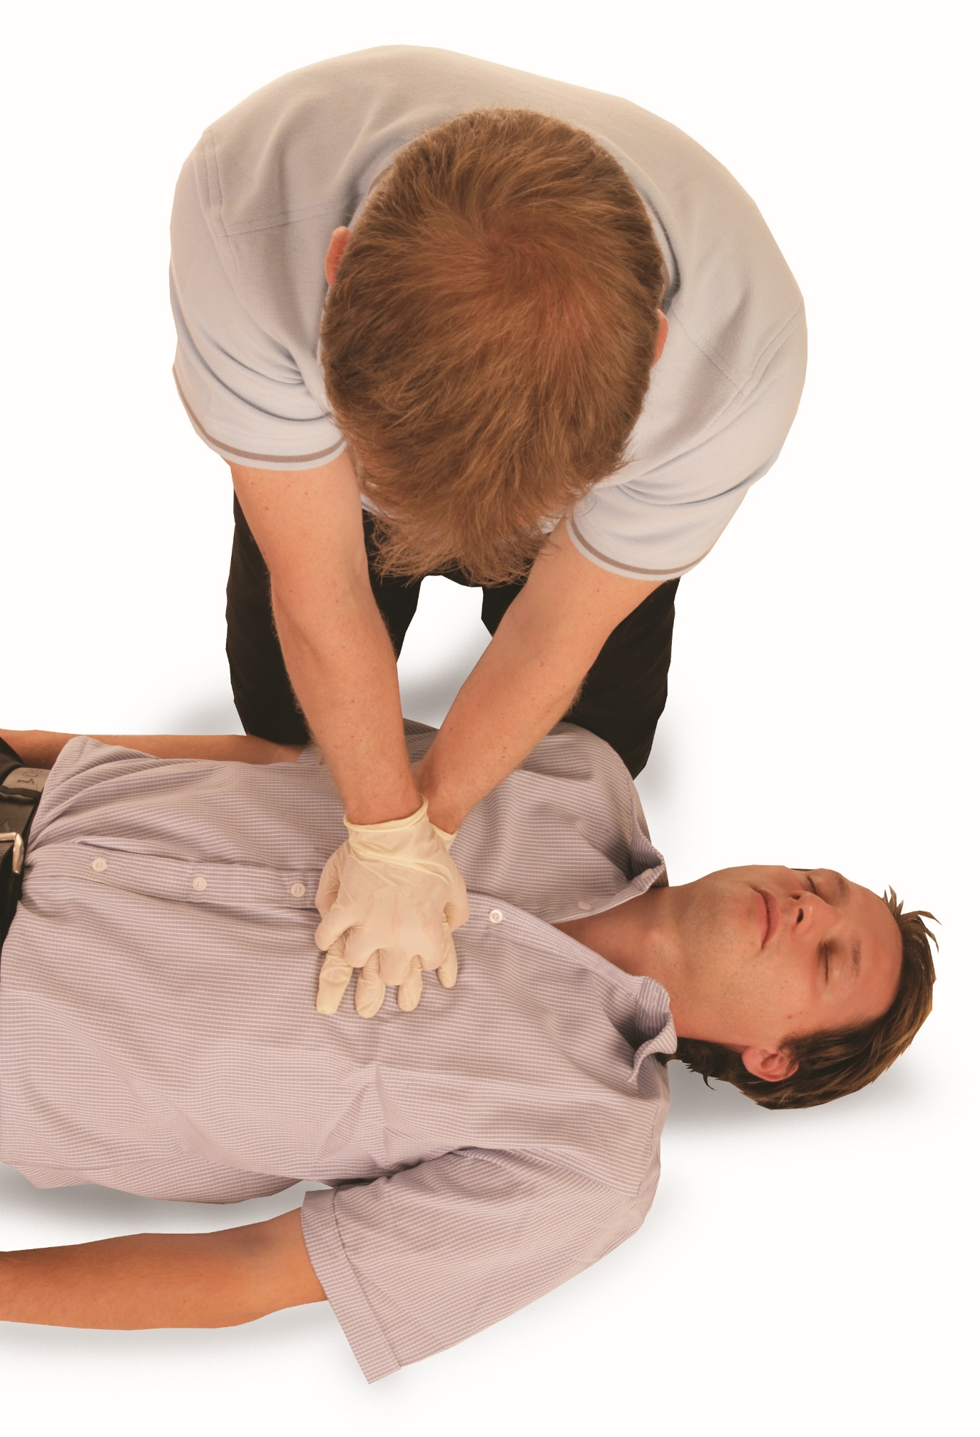

CPR – adult (cont.)
Administer 2 effective rescue breaths
KEY POINT
A good chest compression should be at a depth of 5 to 6cm.

Slide 110
Administering CPR (cont.)
Complete 30 compressions and 2 rescue breaths until:
1. A health professional tells you to stop
2. You become exhausted
3. The casualty is definitely waking up, moving, opening their eyes and breathing normally
4. Prompted by the AED
If there is assistance available when administering CPR, you should change
over every 1-2 minutes.

Slide 111
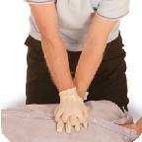
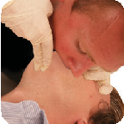
Adult basic life support
Adult basic life support and automated external defibrillation (AED)
Check for DANGER
If responsive, leave in the position found. Provided there is no further danger, try to find out what is wrong, get help if needed and reassess regularly
Yes
Check for a RESPONSE (AVPU)
Yes
Open the AIRWAY
Use the head-tilt/chin-lift method
Look, listen and feel for normal breathing for no more than 10 seconds
If breathing normally, check for injuries. Place into the recovery position, call an ambulance (999) and monitor
Yes
Call an ambulance (999), ask a helper or call yourself,
activate speaker function on phone to aid communication
with the ambulance, send someone to get an AED
Administer CPR – start with 30 chest compressions
x30
x2
For lifeguards only for drowning casualties. Give 5 initial
breaths and resuscitate for 1 minute before calling 999.
Upon your return, continue with CPR (30:2)
Give 2 effective rescue breaths
Continue with CPR until a health professional tells you to stop, you become exhausted or the casualty is definitely waking up, moving, opening eyes and breathing normally
If AED pads have been attached to the casualty,
continue as directed by the AED’s voice and
visual prompts.

Slide 112
CPR – practical demonstration
You must be able to carry out a practical demonstration of CPR on the following:
an adult manikin
This demonstration must show correct technique, positioning, compression depth and rate, effective rescue breaths and use of an AED where appropriate.
Notes:
Group exercise: CPR – practical demonstration
Learners should work in groups to practise on an adult using the correct methods.
This is a hands-on assessment. Observation and participation are essential.
Important note: learners must demonstrate CPR for a minimum of 2 minutes in the assessment.
You must be able to carry out a practical demonstration of CPR on the following:
an adult manikin
This demonstration must show correct technique, positioning, compression depth and rate, effective rescue breaths and use of an AED where appropriate.

Slide 113
Modifications to CPR
Modifications for a child casualty
Use child-specific CPR protocols:
  5 initial rescue breaths
  30 compressions to 2 breaths – use gentler compression technique
    1 hand for smaller children
    2 thumbs for infants (encircling technique)
Adjust depth and force based on child’s size.
Notes:
Breaths: 5 initial breaths, then 30:2
Compression depth: 4-5cm depending on size
Hands: 1 or 2 hands depending on size
Compression rate: same as adult

Slide 114
Modifications to CPR (cont.)
A near-drowning incident:
deliver 5 initial rescue breaths before starting chest compressions
emphasis on effective ventilations to address oxygen deprivation
minimise interruptions between breaths and compressions
prioritise removal from water and ensuring the safety of the rescuer.
Notes:
Class question: When might modifications to CPR be needed?

Slide 115
Modifications to CPR (cont.)
A casualty who is remote from immediate medical help:
be prepared for prolonged CPR. It may need to continue for significantly longer than urban settings
consider rotating rescuers if available to prevent fatigue
focus on quality over speed. Effective compressions and ventilations are critical
use available tools to protect against environmental exposure during prolonged resuscitation.
Notes:
Class question: When might modifications to CPR be needed?

Slide 116
Modifications to CPR (cont.)
Lightning strike casualties:
treat all casualties as potentially viable – even if initially unresponsive or showing no signs of life
reverse triage may apply. Prioritise those who appear most seriously affected first
begin CPR immediately. Success rates are higher than in other cardiac arrest scenarios
be aware of the potential for multiple casualties and the need for rapid prioritisation.
Notes:
Class question: When might modifications to CPR be needed?

Slide 117
Removing outdoor activity equipment
When and how to remove outdoor activity equipment from an unresponsive non-breathing casualty
When to remove equipment:
when it obstructs access to the airway, chest or abdomen and prevents effective CPR
if the equipment poses a risk to the airway, such as a helmet restricting head tilt or jaw thrust
when it is safe to do so without causing further harm or delay to life-saving treatment
in drowning and immersion scenarios, when wet clothing may interfere with breathing or CPR.

Slide 118
Removing outdoor activity equipment (cont.)
How to remove equipment:
act quickly but carefully, ensuring spinal alignment is maintained where injury is suspected
cut away clothing or equipment if removing it conventionally would delay CPR
remove helmets only if they prevent airway management or chest compressions, and only if trained to do so safely.

Slide 119
Removing outdoor activity equipment (cont.)
ensure minimal movement of the head, neck and spine if spinal injury is suspected
use teamwork where possible – 1 person stabilising the head while another removes equipment
prioritise exposing the chest for compressions and defibrillator pad placement.

Slide 120
How would you manage an unresponsive casualty who is vomiting? Practical demonstration
Immediate airway management, turning the casualty onto their side (recovery position) to allow vomit to drain
Supporting the head, keeping the airway open using the head-tilt/chin-lift technique while in a side-lying position
Monitoring breathing and responsiveness, ensuring the casualty continues to breathe normally after repositioning
Avoiding supine positioning unless CPR is required.
Notes:
Class question: How would you manage an unresponsive casualty who is vomiting?
Once the class question has been asked, carry out the practical demonstration:
split into groups of 3-4
assign one person as the casualty, one or two as first-aiders and one observer/assessor
rotate roles after each run-through
Practical task – the first-aiders must:
quickly check the scene for safety (rocks, tripping hazards and weather conditions)
assess responsiveness and breathing
recognise vomiting and immediately manage the airway by rolling the casualty onto their side into the recovery position
support the head and keep the airway open using head-tilt/chin-lift while in side-lying position
ensure vomit drains away from the airway and monitor breathing continuously
keep the casualty off cold/wet ground by placing a tarp, blanket or jacket under them (without delaying airway management)
be prepared to turn the casualty again if they vomit more or their condition changes
if the casualty becomes responsive, explain what happened to reduce confusion or distress
Time limit – give each group 3-4 minutes to complete the exercise, simulating a real-time emergency response.
Observer/assessor checklist
observers should note if the first-aiders:
checked for hazards before approaching
acted immediately to protect the airway
correctly rolled casualty into recovery position
maintained airway with head-tilt/chin-lift while on their side
allowed vomit to drain
monitored breathing and responsiveness throughout
considered environmental factors (cold/wet ground) without delaying airway management
gave reassurance and explanation if casualty regained consciousness
Discuss the following after the activity
What went well?
What could have been done faster or more effectively?
How would this differ if the casualty was in a tent, on uneven ground or in snow?

Slide 121
How would you manage an unresponsive casualty who is vomiting? Practical demonstration (cont.)
maintaining environmental safety by turning the casualty away from cold or wet ground, if possible, while still prioritising the drainage of vomit
being prepared to reassess and move the casualty again if condition changes
explaining actions if the casualty regains consciousness to reduce distress.
Notes:
Class question: How would you manage an unresponsive casualty who is vomiting?
Once the class question has been asked, carry out the practical demonstration:
split into groups of 3-4
assign one person as the casualty, one or two as first-aiders and one observer/assessor
rotate roles after each run-through
Practical task – the first-aiders must:
quickly check the scene for safety (rocks, tripping hazards and weather conditions)
assess responsiveness and breathing
recognise vomiting and immediately manage the airway by rolling the casualty onto their side into the recovery position
support the head and keep the airway open using head-tilt/chin-lift while in side-lying position
ensure vomit drains away from the airway and monitor breathing continuously
keep the casualty off cold/wet ground by placing a tarp, blanket or jacket under them (without delaying airway management)
be prepared to turn the casualty again if they vomit more or their condition changes
if the casualty becomes responsive, explain what happened to reduce confusion or distress
Time limit – give each group 3-4 minutes to complete the exercise, simulating a real-time emergency response.
Observer/assessor checklist
observers should note if the first-aiders:
checked for hazards before approaching
acted immediately to protect the airway
correctly rolled casualty into recovery position
maintained airway with head-tilt/chin-lift while on their side
allowed vomit to drain
monitored breathing and responsiveness throughout
considered environmental factors (cold/wet ground) without delaying airway management
gave reassurance and explanation if casualty regained consciousness
Discuss the following after the activity
What went well?
What could have been done faster or more effectively?
How would this differ if the casualty was in a tent, on uneven ground or in snow?

Slide 122
How much do you know?​
CE
When giving CPR to an adult in the outdoors, what is the correct compression depth?
3-4cm
C
4-5cm
5-6cm
6-7cm
Notes:
Class exercise: How much do you know?
The correct answer is C.

Slide 123
How much do you know?​
CE
In a near-drowning incident, what is the correct initial CPR approach?
Begin with chest compressions
B
Deliver 5 initial rescue breaths before chest compressions
Give abdominal thrusts before starting CPR
Start with back blows followed by compressions
Notes:
Class exercise: How much do you know?
The correct answer is B.

Slide 124
How much do you know?​
CE
When should you remove a helmet from an unresponsive non-breathing casualty in the outdoors?
Only after CPR is complete
D
Never remove a helmet outdoors
Only if the casualty is conscious
If it obstructs airway management or CPR
Notes:
Class exercise: How much do you know?
The correct answer is D.

Slide 125
How much do you know?​
CE
What is the first action if an unresponsive casualty begins to vomit?
Sit them upright
B
Place them into the recovery position
Start chest compressions
Give small sips of water
Notes:
Class exercise: How much do you know?
The correct answer is B.

Slide 126
Module 6
Be able to respond to an incident involving a choking casualty in the outdoors
126
Notes:
Completion of this module will enable learners to meet the following learning outcome:
6. Be able to respond to an incident involving a choking casualty in the outdoors
This includes the following assessment criteria:
6.1 Identify when a casualty is choking
6.2 Demonstrate how to administer first aid to a casualty who is choking
Activities in this module include:
GE: Primary survey – practical application
CE: Two multiple-choice questions (MCQ’s) (formative assessment)

Slide 127
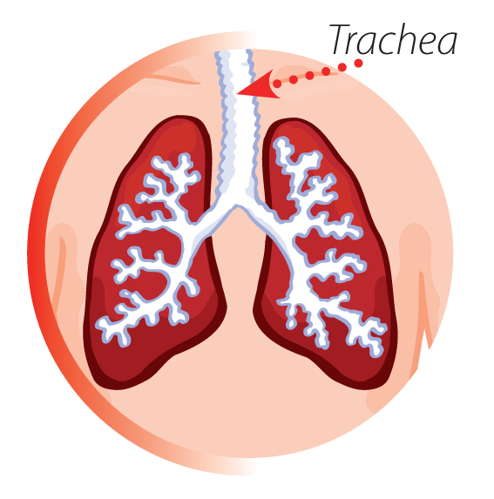
Obstructed airway
An obstructed airway is the partial or complete blockage of the upper airway (larynx and trachea), which leads to the lungs.

Slide 128
Obstructed airway (cont.)
The obstruction of the airway can be due to different causes, such as:
foreign bodies (foods)
allergic reactions
asthma
blood
vomit
infection
KEY POINT
An obstruction can cause minor or major breathing difficulties and, in
severe circumstances, may cause the casualty to become unconscious
and unresponsive.

Slide 129
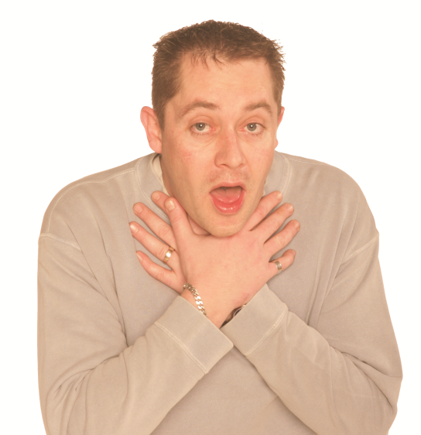
Identifying a choking casualty – mild
Someone who is choking will have either a mild or severe airway obstruction. The severity of the blockage will determine the difficulty
in breathing
Identifying a choking casualty – mild
Coughing
Difficulty breathing and speaking
Redness of the face
Eyes enlarged and watering
Displaying distress.
Notes:
Dealing with a choking casualty can be a distressing and traumatic experience. However, to administer effective first aid, you must try to remain calm and act promptly to stop the situation escalating.

Slide 130
Identifying a choking casualty – severe
Identifying a choking casualty – severe
Grasping at the throat
Displaying distress
Unable to breathe or speak
Skin colour may develop a blue/grey tinge
Progressively getting weaker
Eventually, they will become unconscious.
Notes:
Dealing with a choking casualty can be a distressing and traumatic experience. However, to administer effective first aid you must try to remain calm and act promptly to stop the situation escalating.

Slide 131
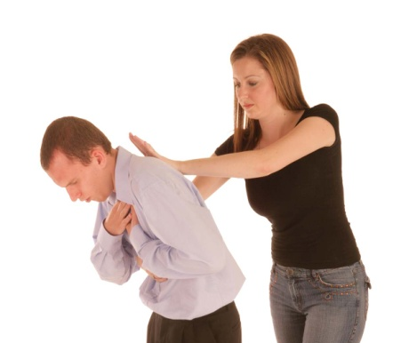
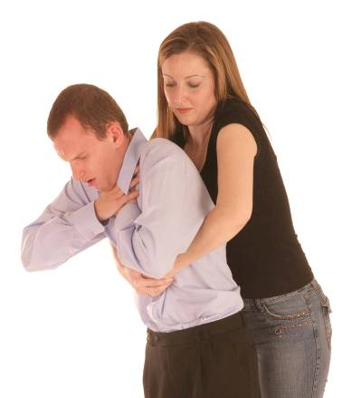
Dealing with a conscious choking casualty
Encourage the casualty to cough. If ineffective, shout for help
If coughing is effective, continuously monitor
Give up to 5
BACK BLOWS
Is this SUCCESSFUL?
YES
If the casualty is or becomes unconscious, call an ambulance (999) and commence CPR
NO
Reassure and seek medical assistance if in any doubt
Give up to 5
ABDOMINAL THRUSTS
Assess. Is this SUCCESSFUL?
YES
NO
Call an ambulance (999). Continue with back blows and abdominal thrusts until qualified medical assistance takes over.

Slide 132
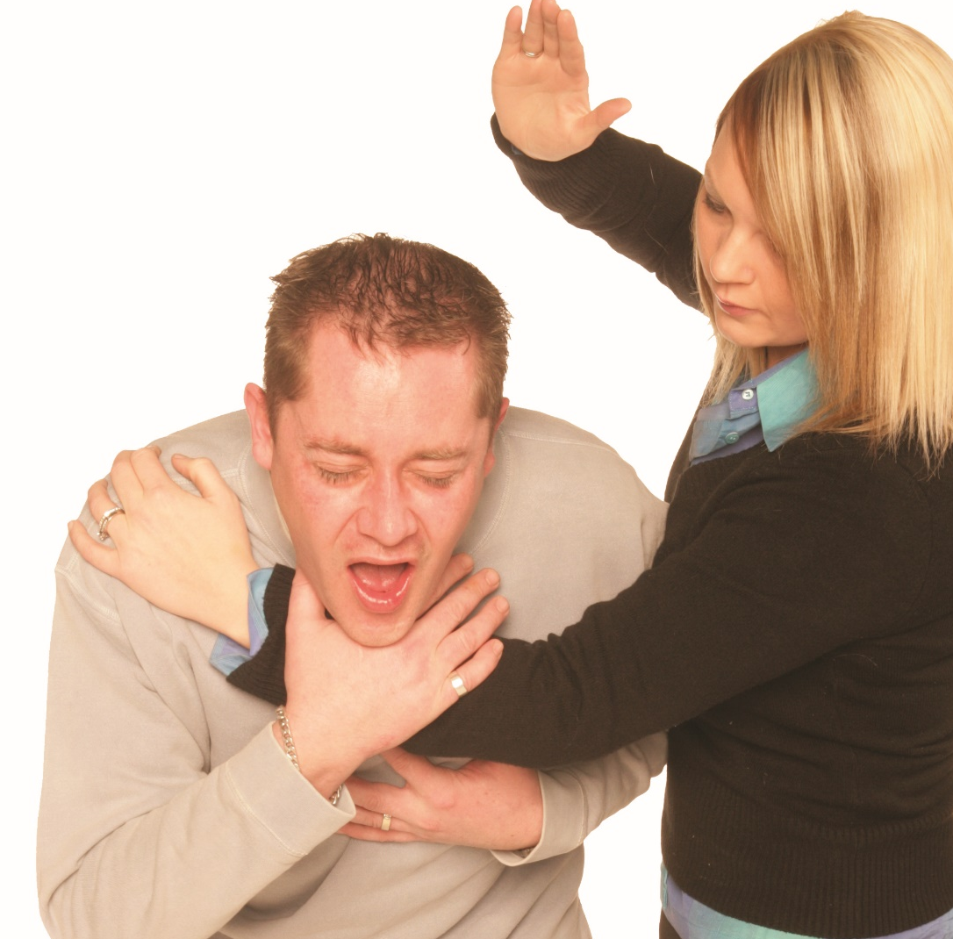
Back blows
Treatment
Stand to the side and slightly behind the casualty
Support the chest with 1 hand, lean the casualty forward and administer a maximum of 5 sharp back blows between the shoulder blades with the heel of your other hand
If the back blows are ineffective, then give up to 5 abdominal thrusts.

Slide 133
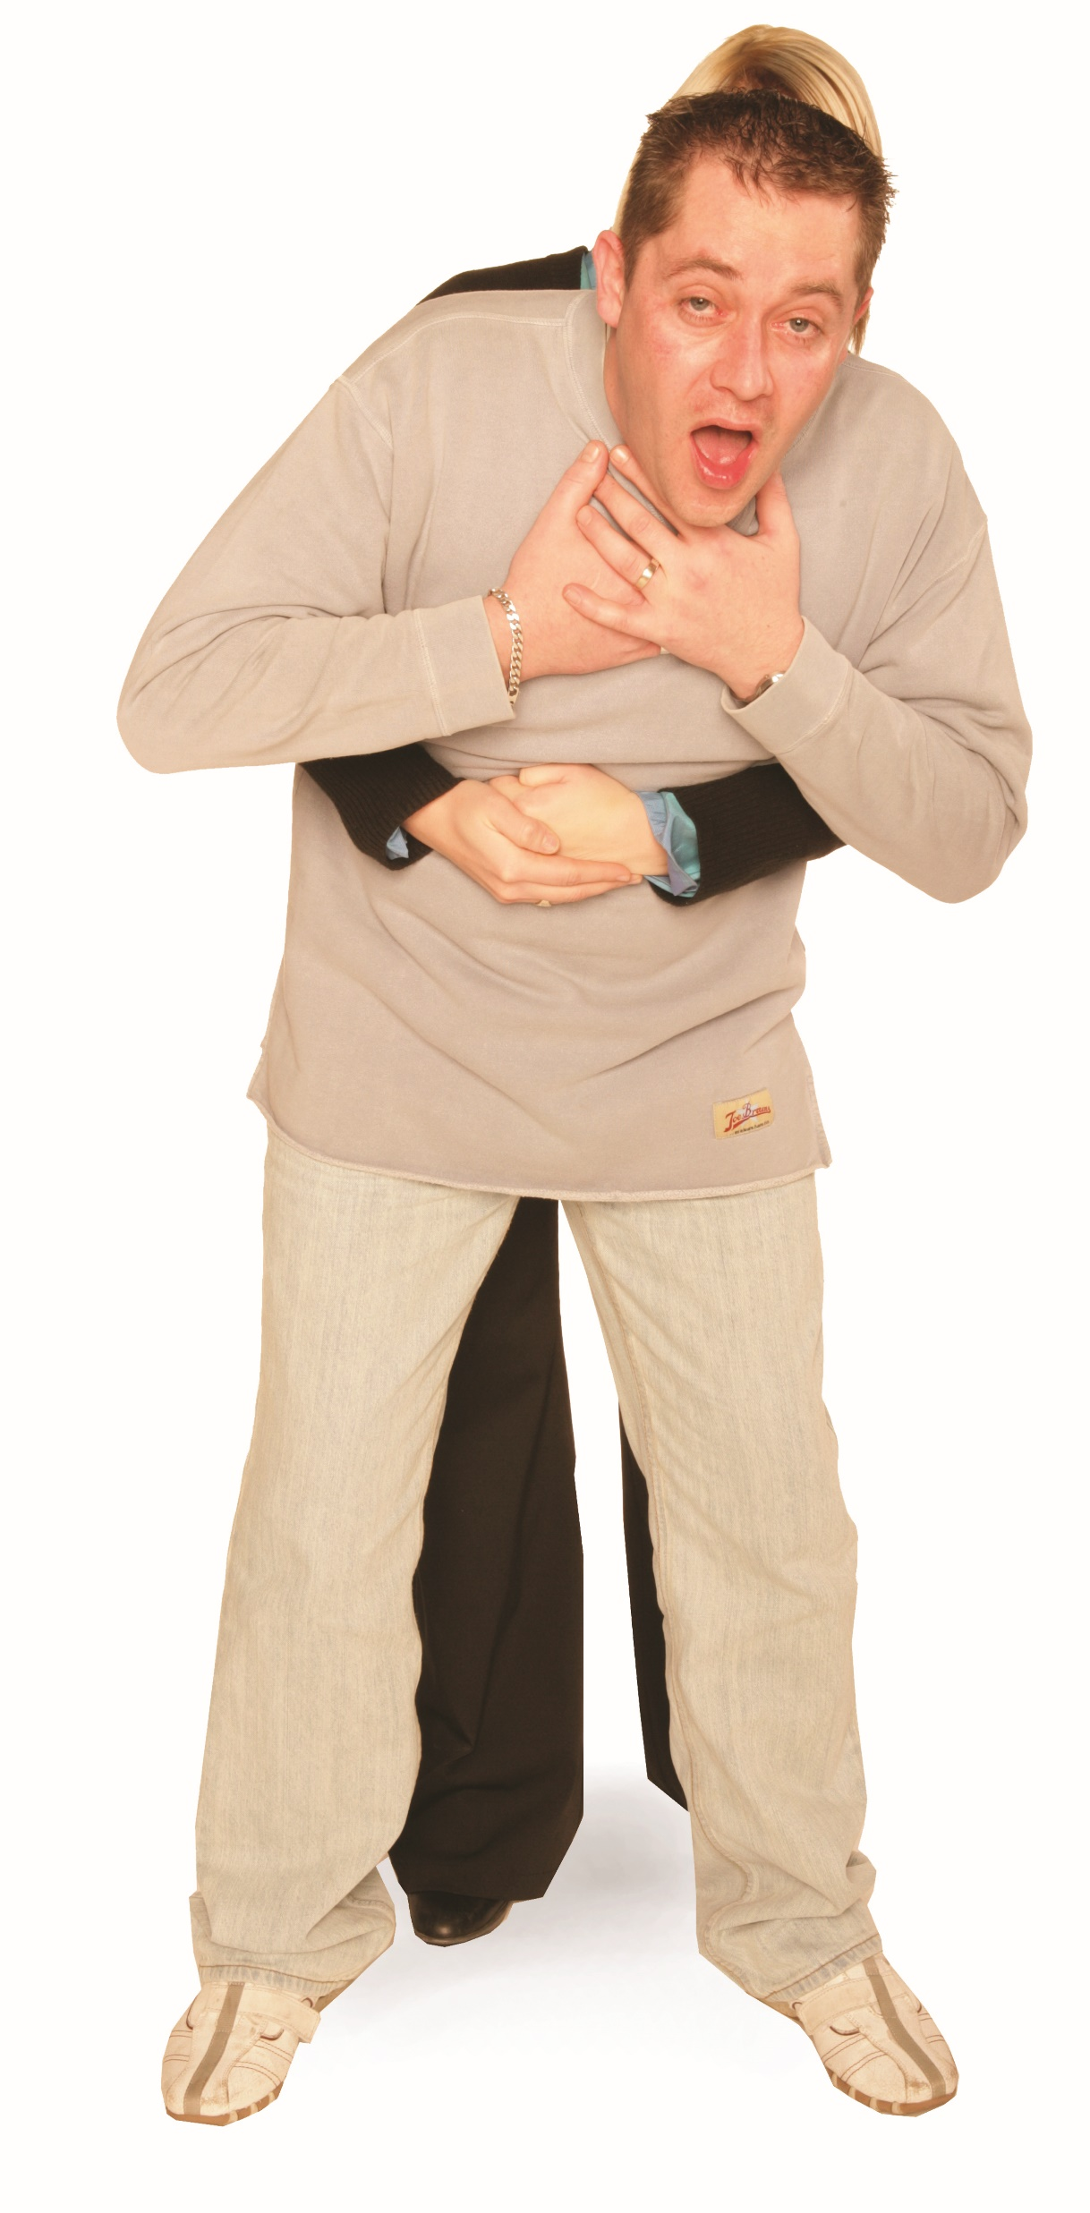
Abdominal thrusts
Treatment
Stand behind the casualty and put both arms round the upper part of the abdomen. Lean the casualty forward
With one hand, clench your fist and place it between the navel and the ribcage
Grasp this hand with your other hand and pull sharply inwards and upwards. Repeat this process up to a maximum of 5 times.

Slide 134
Repeat
Assess the casualty’s condition. If the obstruction is still not relieved, call for an ambulance (999) and continue with cycles of up to 5 back blows and up to 5 abdominal thrusts until qualified medical assistance takes over
If the casualty becomes unresponsive, commence CPR
Casualties should seek medical attention if they:
have received abdominal thrusts
have difficulty swallowing or still feel as though they have an object stuck in their throat.

Slide 135
Dealing with a conscious casualty – practical demonstration
Encourage the casualty to cough. If ineffective, shout for help
If coughing is effective, continuously monitor
Give up to 5
BACK BLOWS
Is this SUCCESSFUL?
YES
If the casualty is or becomes unconscious, call an ambulance (999) and commence CPR
NO
Reassure and seek medical assistance if in any doubt
Give up to 5
ABDOMINAL THRUSTS
Assess. Is this SUCCESSFUL?
YES
NO
Call an ambulance (999). Continue with back blows and abdominal thrusts until qualified medical assistance takes over.
Notes:
Group exercise: Dealing with a conscious casualty –practical demonstration
In groups, ask the learners to work through the procedures for a conscious choking adult using a manikin.
If the casualty becomes unconscious or is found unconscious, then go to the next slide.
Fully demonstrate dealing with a conscious choking adult on a manikin. Fully explain:
encourage the casualty to cough
checking the casualty’s mouth (visually) for any obvious obstruction
bend the casualty forward and give up to 5 back blows
from behind the casualty give up to 5 abdominal thrusts
NB: if you have performed abdominal thrusts on a casualty, they must be sent to hospital to be examined for any internal injuries.
If the obstruction is still present after 3 cycles, call 999.

Slide 136
Dealing with an unconscious casualty – practical demonstration
Support the casualty to the ground
Give 2 effective breaths.
If they are not effective check the airway and remove any obstruction before your next attempt.
Do NOT interrupt CPR
Dial 999 and check on the availability
of an AED
Continue CPR
30 COMPRESSIONS – 2 BREATHS
Continue until a health professional tells you to stop, you become exhausted or the casualty is definitely waking up and moving.
Start CPR immediately with 30 chest compressions
Notes:
Group exercise: Dealing with an unconscious casualty – practical demonstration
With a manikin, allow the group time to practise this procedure.
Demonstrate
The tutor should demonstrate how to deal with an unconscious choking adult.

Slide 137

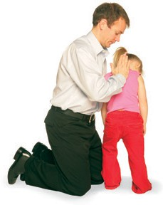





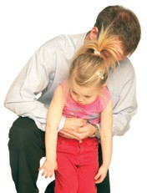







Actions for a choking child
START
Encourage the child to cough. If ineffective, shout for help
If coughing is effective, continuously monitor
x5
Give up to 5 sharp back blows
Is this successful?
YES
NO
Reassure and seek urgent medical assistance if in
any doubt
If you are on your own, call for help (999) as soon as you recognise cardiac arrest. If possible, use a speakerphone so you can continue with care while alerting the emergency services. Give 5 initial rescue breaths, then begin CPR immediately. If you need to fetch help or a phone, take the infant/child with you if safe and practical.
Give up to 5 abdominal thrusts
Assess. Is this successful?
YES
NO
Call an ambulance (999). Continue with
back blows and abdominal thrusts

Slide 138
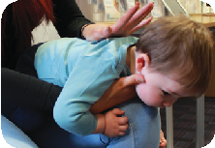
Actions for a choking infant
START
If coughing is ineffective, shout for help
If coughing is effective, continuously monitor
x
Give up to 5 sharp back blows
x5
Is this successful?
YES
NO
Reassure and seek urgent medical assistance if in
any doubt
If you are on your own, call for help (999) as soon as you recognise cardiac arrest. If possible, use a speakerphone so you can continue with care while alerting the emergency services. Give 5 initial rescue breaths, then begin CPR immediately. If you need to fetch help or a phone, take the infant/child with you if safe and practical.
Give up to 5 chest thrusts (use the 2 thumbs encircling technique)
Assess. Is this successful?
YES
NO
Call an ambulance (999). Continue with
back blows and chest thrusts

Slide 139
How much do you know?​
CE
What is the most appropriate action to take if a casualty is showing signs of severe choking (for example, unable to speak or breathe, skin turning blue).
Encourage them to drink water slowly
C
Ask them to lie down and breathe deeply
Perform up to 5 back blows followed by up to 5 abdominal thrusts
Begin CPR immediately without attempting back blows
Notes:
Class exercise: How much do you know?
The correct answer is C.

Slide 140
How much do you know?​
CE
What should you do if a choking casualty becomes unresponsive after initial treatment attempts.
Roll the casualty into the recovery position and wait for help
D
Continue with back blows until help arrives
Begin abdominal thrusts again
Contact the emergency services and administer CPR
Notes:
Class exercise: How much do you know?
The correct answer is D.

Slide 141
Module 7
Be able to respond to an incident involving blood loss in the outdoors
141
Notes:
Completion of this module will enable learners to meet the following learning outcome:
7. Be able to respond to an incident involving blood loss in the outdoors
This includes the following assessment criteria:
7.1 Identify whether external bleeding is life-threatening
7.2 Demonstrate how to administer first aid to a casualty with external bleeding
7.3 Recognise when a casualty is suffering from shock
7.4 Identify how to administer first aid to a casualty who is suffering from shock
Activities in this module include:
CQ: What are the signs of shock?
GE: First aid for shock – practical demonstration
CE: Four multiple-choice questions (MCQs) (formative assessment)

Slide 142
Life-threatening external bleeding
When responding to an incident involving blood loss, the first step is to quickly assess the situation and determine if the external bleeding poses a life-threatening risk.
Life-threatening external bleeding may include:
profuse, uncontrollable bleeding – large amounts of blood flowing or spurting from a wound
arterial bleeding – often bright red and spurting in time with the heartbeat
rapid blood loss – signs of hypovolaemic shock may develop quickly
bleeding from major vessels or deep wounds – especially to the neck, groin or thigh.
Notes:
The tutor must note that learners must:
be able to assess the severity of bleeding and identify when it constitutes a life-threatening emergency
also recognise that smaller wounds can become life-threatening if bleeding is not managed properly

Slide 143
Life-threatening external bleeding (cont.)
bleeding that soaks through multiple dressings or cannot be controlled with direct pressure
amputation or partial amputation with significant blood loss
casualty shows signs of shock, such as:
  pale, cold clammy skin
  fast pulse and shallow breathing
  dizziness, confusion or collapse
KEY POINT
Assess bleeding quickly – recognise life-threatening cases and understand that even small wounds can become serious if not controlled.
Notes:
The tutor must note that learners must:
be able to assess the severity of bleeding and identify when it constitutes a life-threatening emergency
also recognise that smaller wounds can become life-threatening if bleeding is not managed properly

Slide 144
First aid for external bleeding
Control external bleeding quickly to prevent further blood loss and reduce the risk of shock.
Ensure scene safety and apply personal protective equipment (PPE) – use gloves where possible
Expose the wound, remove or cut away clothing to assess the injury
Examine the wound for embedded objects
Apply direct pressure using a sterile dressing, clean cloth or gloved hand
Maintain pressure until bleeding is controlled, reinforce or replace dressings if they become soaked.
Notes:
Tutor to remind learners the importance of minimising the risk of infection by wearing gloves and barrier devices where possible.

Slide 145
First aid for external bleeding (cont.)
Apply a bandage over the dressing firmly, but not so tight as to cut off circulation
Check circulation beyond the wound, including skin colour and temperature
Monitor for signs of shock and treat accordingly if the casualty deteriorates
Use of tourniquet or haemostatic dressing only if trained and when direct pressure fails or in cases of life-threatening bleeding
Reassure and monitor the casualty, maintain warmth and observe for changes.

Slide 146
What are the signs of shock?
pale, cold, clammy skin, particularly around the lips, face and extremities
a fast, weak pulse that is often difficult to detect at the wrist
rapid, shallow breathing
nausea or vomiting
dizziness or fainting
restlessness or anxiety
thirst
deteriorating consciousness
blue or grey lips and fingertips (cyanosis).
Notes:
Class question: What signs tell you a casualty is in shock?
Tutor to ensure that learners can distinguish shock from less serious conditions and recognise signs early to initiate treatment and prevent deterioration.

Slide 147
First aid for shock – practical demonstration
Shock is life-threatening – recognise it early and take prompt action to prevent deterioration.
Action may include:
identify and treat the cause, such as controlling bleeding, managing burns or treating an allergic reaction
lay the casualty down on their back with legs elevated (unless injury prevents this) to improve circulation
maintain an open airway and monitor breathing
keep the casualty warm using insulating layers, foil blankets, ground insulation or body heat in cold environments.
Notes:
Tutor note: the following group exercise combines the required demonstrations for 7.1,7.2,7.3 and 7.4.
Demonstration
Show the group how to assess a severe bleed, control it, recognise shock and treat shock using a manikin. Highlight key bleeding signs, bandaging, airway, warmth and reassurance.
Group exercise: First aid for shock – practical demonstration
In small groups with a manikin, dressings and blankets:
identify life-threatening bleeding
control bleeding
recognise shock
treat shock
Give feedback on technique and communication.

Slide 148
First aid for shock – practical demonstration (cont.)
loosen tight clothing, especially around the neck, chest and waist
reassure the casualty, remain calm and use clear communication
do not give them food or drink
record and monitor vital signs
prepare for delayed help, adapting care for extended periods
call for emergency help early, providing clear information about signs of shock and underlying causes.
Notes:
Tutor note: the following group exercise combines the required demonstrations for 7.1, 7.2, 7.3 and 7.4.
Demonstration
Show the group how to assess a severe bleed, control it, recognise shock and treat for shock using a manikin. Highlight key bleeding signs, bandaging, airway, warmth and reassurance.
Group exercise: First aid for shock – practical demonstration
In small groups with a manikin, dressings and blankets:
identify life-threatening bleeding
control bleeding
recognise shock
treat shock
Give feedback on technique and communication.

Slide 149
How much do you know?​
CE
Which of the following is a sign of life-threatening external bleeding?
Small cut with slow oozing of blood
C
Bruising without broken skin
Bright red blood spurting in time with the heartbeat
Grazed knee with minor bleeding
Notes:
Class exercise: How much do you know?
The correct answer is C.

Slide 150
How much do you know?​
CE
What is one of the first actions when treating severe external bleeding?
Elevate the injured limb
D
Cover the casualty with a blanket
Offer the casualty a drink
Apply direct pressure to the wound
Notes:
Class exercise: How much do you know?
The correct answer is D.

Slide 151
How much do you know?​
CE
Which of the following is a common sign of shock?
Flushed skin and rapid breathing
B
Pale, cold, clammy skin and a weak pulse
High fever and shivering
Persistent coughing
Notes:
Class exercise: How much do you know?
The correct answer is B.

Slide 152
How much do you know?​
CE
When treating a casualty for shock, you should:
give them water to drink
C
keep them sitting upright
lay them down, elevate their legs if safe and keep them warm
leave them unattended to rest
Notes:
Class exercise: How much do you know?
The correct answer is C.

Slide 153
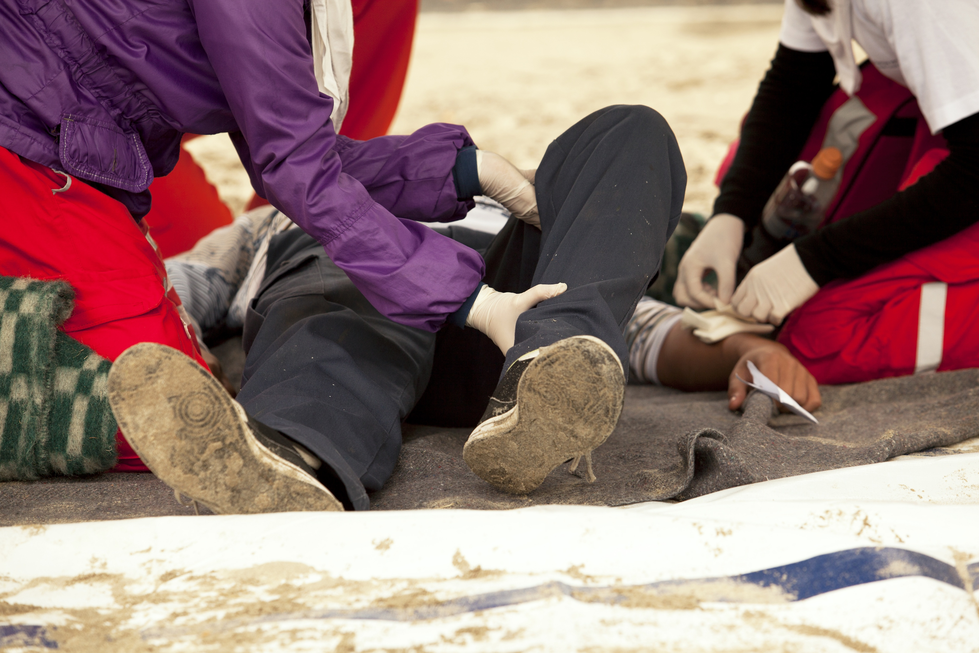

Outdoor Incident Management
V1 September 2025
All rights reserved
© 2025 Highfield Products Limited
A global leader for qualifications, assessment, digital solutions, innovative products and customer service
Highfield Place Shaw Wood Business Park, Shaw Wood Way, Wheatley Hills Doncaster, DN2 5TB
01302 363277 | www.highfieldqualifications.com
Notes:
This training presentation supports the delivery of Unit 2: Outdoor Incident Management, for the Highfield Level 3 Award in Outdoor First Aid (RQF).

Slide 154
Ground rules
Fire escapes
Toilets
Smoking
Drinks
Breaks
Lunch
Questions
Talking over others
Respect others’ points of view
Timekeeping
As a courtesy to others,
please set your mobile phone
to SILENT MODE
Mobile phones must
be SWITCHED OFF
and removed from the desk
during the examination.
Notes:
Where possible, the health and safety briefing should be delivered by a local representative. If such a person is unavailable, the trainer should make themself familiar with the client’s protocols, procedures and facilities to complete this briefing themselves.
Point out the fire evacuation points and procedures as well as the location of the toilets and when/where people are allowed to smoke. Explain that breaks are provided in which people can smoke.
​
​

Slide 155
Key
Class
Question
Individual
Exercise
Key
Point
Definition
KEY POINT
Group
Exercise
Class
Exercise
Navigation
CE

Slide 156
Learning outcomes
Module 1: Be able to apply incident management and casualty assessment
principles in the outdoors
Module 2: Be able to respond to an incident involving limb injury in the outdoors
Module 3: Be able to respond to an incident involving a casualty with a head,
neck or torso injury in the outdoors
Module 4: Know how to provide first aid to a casualty with suspected major
illness
Module 5: Be able to respond to an incident involving the effects of cold and
heat outdoors
Module 6: Know how to provide first aid to a casualty with minor injuries.

Slide 157
Module 1
Be able to apply incident management and casualty assessment principles in the outdoors
157
Notes:
Completion of this module will enable learners to meet the following learning outcome:
1. Be able to apply incident management and casualty assessment principles in the outdoors
This includes the following assessment criteria:
1.1 Identify the information to be collected when gathering a casualty history
1.2 Provide emotional support to a casualty
1.3 Manage a casualty who is wearing outdoor activity clothing or equipment
1.4 Justify when and how to move a casualty
1.5 Demonstrate incident management actions when accompanied by others
Activities in this module include:
CQ: What information do you need to collect when assessing a casualty?
CQ: When should you move a casualty?
CQ: How should you move a casualty?
GE: Working as a team in outdoor emergencies – practical demonstration
CE: Five multiple-choice questions (MCQs) (formative assessment)

Slide 158
What information do you need to collect when assessing a casualty?
When gathering a casualty history, use the SAMPLE framework:
S | signs and symptoms – what you see and what they feel
A | allergies – medication, food, stings, environment
M | medications – prescribed, over-the-counter, herbal, last dose
P | past medical history – conditions, illnesses, surgery
L | last oral intake – food, drink, medication
E | events leading up to the incident – what happened before, cause of injury/illness
KEY POINT
A structured history helps identify risks, guide treatment and support handover to emergency services.
Notes:
Class question: What information do you need to collect when assessing a casualty?
(S) Signs and symptoms
What the casualty is experiencing for example, pain or discomfort
What can be observed for example, swelling or bleeding
(A) Allergies
Any known allergies to food, medication, insect stings or environment triggers
(M) Medications
Any prescribed, over-the-counter or herbal medicines the casualty is taking
The time of the casualty’s last dose
(P) Past medical history
Existing conditions
Recent illness
Surgeries
Relevant hospitalisations
(L) Last oral intake
Time and content of the last food and drink (what they had to eat and drink)
Last medication or fluid intake
(E) Events leading up to the incident
What the casualty was doing before the incident occurred
Mechanism/cause of the injury or onset of illness

Slide 159
How to support a casualty emotionally
Effective emotional support includes:
staying calm and confident – a steady voice and body language
reassuring the casualty – explain clearly what is happening
establishing rapport – use the casualty’s name and maintain eye contact
listening actively – allow them to speak.

Slide 160
How to support a casualty emotionally (cont.)
avoiding false reassurance – be honest, but give hope
staying with them – don’t leave unless necessary
respecting personal space – ask the casualty for consent before administering first aid
adapting support – depending on their needs and emotional state
KEY POINT
Clear communication reduces fear and builds trust.

Slide 161
Managing outdoor clothing or equipment during care
Treating a casualty with outdoor equipment may include:
assessing whether to adjust or remove equipment, but only if it obstructs airway, CPR or bleeding control
minimising unnecessary movement – protect the spine if injury is suspected
safely removing helmets, rucksacks or harnesses only if trained and safe
preserving warmth and dignity – replace layers when removed.
Notes:
Explain that removing or adjusting equipment should only be done when it improves safety or treatment.
Explain why outdoor equipment (helmets, rucksacks, harnesses, thick layers) can complicate assessment and treatment
Stress that airway, breathing and bleeding control come first
Reinforce that unnecessary removal can worsen injuries or expose the casualty to cold
Highlight the value of improvisation – for example, using rucksacks as padding, jackets for insulation and poles as splints

Slide 162
Managing outdoor clothing or equipment during care (cont.)
using equipment to support care – for example, walking poles as splints
checking beneath clothing/equipment for hidden injuries
reassessing continuously to monitor for shock or deterioration.
Notes:
Explain that removing or adjusting equipment should only be done when it improves safety or treatment.
Explain why outdoor gear (helmets, rucksacks, harnesses, thick layers) can complicate assessment and treatment
Stress that airway, breathing and bleeding control come first
Reinforce that unnecessary removal can worsen injuries or expose the casualty to cold
Highlight the value of improvisation - for example, using rucksacks as padding, jackets for insulation and poles as splints

Slide 163
When should you move a casualty?
Move a casualty only when:
there is immediate danger (fire, flooding, falling rocks, weather exposure)
you need access for airway, CPR or bleeding control
evacuation is required if professional help is delayed or cannot reach the scene quickly
multiple casualties require triage or prioritisation.
Notes:
Class question: When should you move a casualty?

Slide 164
How should you move a casualty?
How to move a casualty safely:
use the safest method and minimise movement
protect the head, neck and spine if injury is suspected
use manual handling techniques and get help if possible
improvise with available kit – use clothing, poles, tarpaulin
communicate continually with the casualty during the move
continuously monitor the casualty – stop moving them if their condition worsens
KEY POINT
Move only if the benefits outweigh the risks.
Notes:
Class question: How should you move a casualty?

Slide 165
Working as a team in outdoor emergencies – practical demonstration
Effective incident management requires you to:
delegate roles – call for help, monitor the casualty and fetch kit
communicate clearly – calm, assertive instructions
maintain control – ensure scene safety and avoid confusion
prioritise actions – use DRABC to focus on life-saving care.
Notes:
The practical demonstrations covers 1.2, 1.3, 1.4 and 1.5
Group exercise: Working as a team in outdoor emergencies – practical demonstration
Set-up
Learners are divided into small groups
Each group is given a casualty scenario (for example, a hiker with a head injury wearing a rucksack and helmet, a climber with a suspected spinal injury, a walker collapsed in bad weather)
Task
Assess the casualty while considering their clothing/equipment.
Decide if the casualty should be moved or kept still, justifying when and how movement would be safe. Work together to assign roles and responsibilities (1 monitors casualty, 1 calls for help, 1 prepares kit, 1 supports environment control) to demonstrate incident management with others.
Debrief
Each group explains their decision-making.
Tutor highlights good practice:
only remove/adjust kit if it aids airway/breathing/bleeding control
move casualties only when essential and with spinal precautions
clear delegation, calm communication and safety-first approach when working with others

Slide 166
Working as a team in outdoor emergencies – practical demonstration (cont.)
coordinate monitoring – regular checks, share updates
support the group – provide reassurance and keep morale high
plan together – prepare for evacuation or long-term care if help is delayed
document actions – record care provided and casualty’s condition
KEY POINT
Clear teamwork ensures safety, effective care and confidence in an outdoor emergency.
Notes:
The practical demonstrations covers 1.2, 1.3, 1.4 and 1.5
Group exercise: Working as a team in outdoor emergencies – practical demonstration
Set-up
Learners are divided into small groups
Each group is given a casualty scenario (for example, a hiker with a head injury wearing a rucksack and helmet, a climber with a suspected spinal injury, a walker collapsed in bad weather)
Task
Assess the casualty while considering their clothing/equipment.
Decide if the casualty should be moved or kept still, justifying when and how movement would be safe. Work together to assign roles and responsibilities (1 monitors casualty, 1 calls for help, 1 prepares kit, 1 supports environment control) to demonstrate incident management with others.
Debrief
Each group explains their decision-making.
Tutor highlights good practice:
only remove/adjust kit if it aids airway/breathing/bleeding control
move casualties only when essential and with spinal precautions
clear delegation, calm communication and safety-first approach when working with others

Slide 167
How much do you know?​
CE
A casualty tells you they use an inhaler twice daily for their asthma. In the SAMPLE framework, where should this information be recorded?
Signs and symptoms
C
Allergies
Medications
Last oral intake
Notes:
Class exercise: How much do you know?
The correct answer is C.

Slide 168
How much do you know?​
CE
Which of the following best describes effective emotional support for a casualty?
Giving false reassurance to keep them calm
C
Speaking quickly to distract them
Remaining calm, explaining clearly and listening actively
Leaving the casualty alone to reduce stress
Notes:
Class exercise: How much do you know?
The correct answer is C.

Slide 169
How much do you know?​
CE
When should outdoor equipment, such as a rucksack or helmet, be removed?
Always remove it immediately for comfort
B
Only if it obstructs airway access, CPR or bleeding control
As soon as the casualty asks
Only once emergency services arrive
Notes:
Class exercise: How much do you know?
The correct answer is B.

Slide 170
How much do you know?​
CE
Which is the most appropriate reason to move a casualty?
To make them more comfortable
D
To allow bystanders to see better
To check their past medical history
To protect them from immediate danger, such as a fire or flooding
Notes:
Class exercise: How much do you know?
The correct answer is D.

Slide 171
How much do you know?​
CE
What is the priority when managing an incident with others?
Clear communication and delegation of roles
A
Writing down casualty details immediately
Retrieving equipment before checking the scene
Asking the group who wants to help first
Notes:
Class exercise: How much do you know?
The correct answer is A.

Slide 172
Module 2
Be able to respond to an incident involving limb injury in the outdoors
172
Notes:
Completion of this module will enable learners to meet the following learning outcome:
2. Be able to respond to an incident involving limb injury in the outdoors
This includes the following assessment criteria:
2.1 Recognise a suspected:
fracture or dislocation
sprain or strain
2.2 Identify how to administer first aid for a casualty with a suspected:
fracture or dislocation
sprain or strain
2.3 Demonstrate how to apply:
a support sling
an elevated sling
Activities in this module include:
CQ: What is a fracture?
GE: Applying a sling – practical demonstration
CQ: What is a dislocation?
CQ: What are sprains and strains?
CE: Three multiple-choice questions (MCQs) (formative assessment)

Slide 173
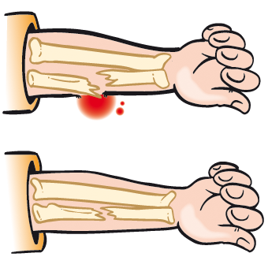
What is a fracture?
A fracture is a chip, crack or break in the bone
Closed (no associated wound)
Open (the fracture has broken the skin)
Complicated (the fracture is causing a further injury
to vessels or organs, for example).
Notes:
Class question: What is a fracture?

Slide 174
Fractures – symptoms
Symptoms may include:
pain, tenderness, bruising and swelling at the site of the injury, especially with movement or pressure
in the case of an open wound with protruding bone, associated bleeding
loss of mobility or inability to weight-bear
deformity
grating sensation or sound (crepitus)
shortening or bending of the limb or unnatural limb position
nausea, pale and cold, clammy skin (shock).

Slide 175
Fractures – treatment
Do:
put on gloves
treat bleeding if required
immobilise in the position found (most comfortable for the casualty)
apply cold packs directly to reduce swelling
monitor for signs of shock
call the emergency services (999) if required.

Slide 176
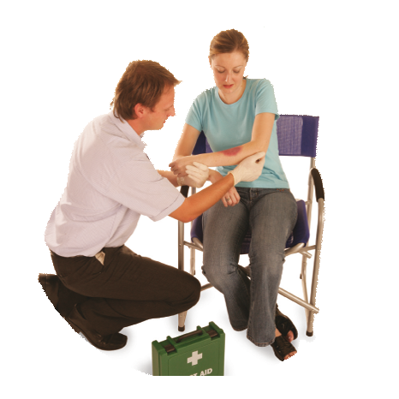
Applying a support sling
Gently support the arm. Ask
the casualty to assist
if possible.

Slide 177
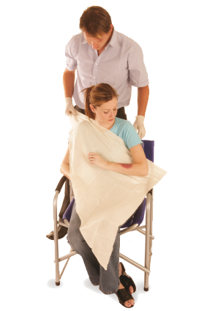
Applying a support sling (cont.)
Place a triangular bandage
with its base parallel
to the casualty’s body.

Slide 178
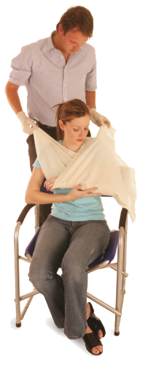
Applying a support sling (cont.)
Bring the lower end of the bandage up to meet the upper end at the shoulder. Secure with a reef knot.

Slide 179

Applying a support sling (cont.)
Use a safety pin to secure
at the elbow, or twist the bandage and tuck into
the sling at the back
of the arm.

Slide 180

Applying a support sling – practical demonstration
With the arm safely supported
in a sling, you can transport
the casualty.
Notes:
Group exercise: Applying a support sling – practical demonstration
Once you have gone through this slide, gather the learners around and ask for a volunteer to fully demonstrate applying a support sling.
Split the class into groups and ask them to practise. Move round each group, offering feedback, advice and guidance.
An elevated sling is another method for a support sling, and it is worth researching this technique.

Slide 181
Applying an elevated sling
Ask the casualty to support their injured arm across their chest with their fingers resting on the opposite shoulder
Lay a triangular bandage over their chest, on top of the injured arm, and hold the point of the bandage just below the elbow on the injured side
Tuck the lower part of the bandage underneath the injured arm. Bring it diagonally across their back to meet the other end of the bandage
Check circulation. Once the sling is in place, check the fingers for warmth, colour and feeling to ensure the bandage is not too tight.

Slide 182
What is a dislocation?
A dislocation happens when bones in a joint become misaligned or displaced, often due to sudden impact. It may also damage surrounding ligaments
Severe pain
Restricted movement
Obvious deformity at a joint
Swelling or bruising
Numbness or tingling if nerves are affected.
Notes:
Class question: What is a dislocation?

Slide 183
Dislocation – treatment
Do:
support the joint in the position found
immobilise using slings or padding
apply a cold compress to reduce swelling and pain
seek urgent medical attention
Do not:
attempt to relocate the joint.

Slide 184
What are sprains and strains?
A sprain or strain is often referred to as a soft tissue injury – this is often attributed to activity or sports-related events
Sprain (ligament damage)
Pain, especially with movement
Swelling and bruising around a joint
Limited range of motion
No bone deformity
Usually follows a twisting injury
Strain (muscle/tendon damage)
Pain, especially in the muscle area
Muscle spasm or weakness
Swelling or bruising
Stiffness or limited movement
Often caused by overuse or overstretching.
Notes:
Class question: What are sprains and strains?

Slide 185

Sprains and strains – treatment
Sprain:
avoid heat and massage in the early stages
monitor and reassess for signs of worsening
Strain:
gentle movement after the pain subsides
monitor for persistent pain, bruising or swelling.
REST the injured limb
Apply ICE
(over a covering)
COMPRESS the area
ELEVATE if possible
Notes:
Rest the injured limb
Ice (wrapped with material) applied for short periods of time
Compression with an elastic bandage
Elevation above ear level, if possible

Slide 186
How much do you know?​
CE
What is a fracture?
A sprain in the muscle
B
A chip, crack or break in the bone
A dislocation of the joint
A strain in the tendon
Notes:
Class exercise: How much do you know?
The correct answer is B.

Slide 187
How much do you know?​
CE
What is the primary characteristic of a dislocation?
A break in the bone
C
A sprain in the ligament
A misalignment or displacement of bones in a joint
A strain in the muscle
Notes:
Class exercise: How much do you know?
The correct answer is C.

Slide 188
How much do you know?​
CE
Which of the following is most accurate description of a sprain?
Muscle damage
B
Ligament damage
Bone fracture
Tendon damage
Notes:
Class exercise: How much do you know?
The correct answer is B.

Slide 189
Module 3
Be able to respond to an incident involving a casualty with a head, neck or torso injury in the outdoors
189
Notes:
Completion of this module will enable learners to meet the following learning outcome:
3. Be able to apply incident management and casualty assessment principles in the outdoors
This includes the following assessment criteria:
3.1 Identify the signs and symptoms of a:
a head injury
a spinal injury
a chest injury
an abdominal injury
a pelvic injury
3.2 Demonstrate how to administer first aid for a responsive casualty with a suspected:
a head injury
a spinal injury
a chest injury
an abdominal injury
a pelvic injury
3.3 Demonstrate how to administer first aid for an unresponsive casualty with a suspected:
a head injury
a spinal injury
a chest injury
an abdominal injury
a pelvic injury
Activities in this module include:
CQ: What is a head injury?
CQ: What is a spinal injury and how are they caused?
CQ: What is a chest injury?
CQ: What is abdominal trauma?
CE: Three multiple-choice questions (MCQs) (formative assessment)

Slide 190

What is a head injury?
All head injuries can be life-threatening. Always seek medical assistance where a major head injury is suspected
Types of major head injuries include:
concussion
cerebral compression
skull fracture.
Notes:
Class question: What is a head injury?

Slide 191
Concussion – symptoms
A concussion is caused by shaking of the brain, usually after a blow to the head. This results in a temporary disturbance of normal brain activity
Concussion may include:
possible brief loss of consciousness
bleeding or swelling
dizziness and nausea
headache
brief loss of memory
slurred speech or delayed responses
blurred vision.

Slide 192

Cerebral compression – symptoms
A build-up of pressure on the brain caused by brain tissue swelling or an accumulation of blood
A cerebral compression may include:
an intense headache
drowsiness
unequal pupil sizes
a slow, strong pulse
weakness or paralysis down one side of the body
noisy breathing.

Slide 193

Skull fracture – symptoms
A skull fracture may be open or closed, and is caused by a direct or indirect blow to the head
Depressed fracture
A fractured skull may include:
an associated wound
tenderness and pain
depression/deformity of the skull
bruising and swelling at the site of injury
presence of cerebral spinal fluid (CSF) from the ears and nose.
Base of skull fracture

Slide 194
Head injuries – treatment of a responsive casualty
Do:
control bleeding and/or CSF loss
reassure the casualty, keeping them calm and still
place the casualty in a comfortable position, preferably on a flat surface with the head and shoulders raised
monitor the casualty and be ready to begin basic life support if needed
call the emergency services (999)
Do not:
move the head if you suspect a skull fracture – this could worsen a neck or spinal injury.

Slide 195
Head injuries – treatment of an unresponsive casualty
Do:
maintain the airway and breathing
consider spinal precautions
monitor the casualty and be ready to begin basic life support if needed
call the emergency services (999).

Slide 196
What is a spinal injury and how are they caused?
Spinal injuries are serious because damage to the spinal cord can lead to paralysis or even death
The main causes of spinal injury may be:
car accidents
diving into shallow water
slips, trips or falls from height
high-impact trauma – falls or collisions
KEY POINT
Spinal injuries should always be treated as a medical emergency.
Notes:
Class question: What is a spinal injury and how are they caused?

Slide 197
Spinal injury – symptoms
A spinal injury may include:
pain in the neck or back
numbness, tingling or weakness in the limbs
difficulty moving parts of the body
sensation changes or unusual posture
an unresponsive casualty with a history of back or neck trauma.

Slide 198
Spinal injury – treatment of a responsive casualty
Do:
call the emergency services (999)
keep the casualty in the position found
stabilise the head and neck in a neutral position
reassure the casualty and ask them to stay still
keep the casualty warm
monitor for any changes in condition.
Notes:
Movement of a casualty with spinal injuries is a last resort. Leave them stabilised in the position found unless:
you are on your own and have to leave the casualty to call an ambulance
the casualty’s airway is obstructed or they are vomiting
to maintain the airway and breathing

Slide 199
Spinal injury – treatment of a responsive casualty (cont.)
Do not:
move the casualty (unless absolutely necessary)
ask questions that require head movement (nodding or shaking head)
KEY POINT
Never move the casualty – unless you have to.
Notes:
Movement of a casualty with spinal injuries is a last resort. Leave them stabilised in the position found unless:
you are on your own and have to leave the casualty to call an ambulance
the casualty’s airway is obstructed or they are vomiting
to maintain the airway and breathing

Slide 200
Spinal injury – treatment of an unresponsive casualty
Do:
determine if the casualty is breathing – if not, commence basic life support
if breathing, do not move them unless they are in danger or choking on blood or vomit
  Keep the head gently tilted back to maintain the airway
call the emergency services (999)
keep the casualty warm and monitor
keep the head and spine in line where possible
Do not:
move the casualty – unless you have to.
Notes:
Only consider the log roll technique by using multiple people if movement is unavoidable.

Slide 201

What is a chest injury?
Chest injuries or chest trauma (thoracic trauma) are serious. They can lead to disability or, in the worst cases, death
There are two main types of chest injuries, such
as the following:
rib fracture
penetrating chest wounds.
Notes:
Class question: What is a chest injury?

Slide 202
Rib fracture – symptoms and treatment
A break or fracture in one or more of the ribs
(middle ribs are most commonly affected)
Symptoms may include:
pain when breathing or moving
a grating or crunching sound when moving or breathing
Treatment
Help the casualty find the most comfortable position
Seek medical attention immediately.

Slide 203
Rib fracture – treatment of a responsive casualty
Do:
assist the casualty into a
half-sitting position, leaning
slightly toward the injured side
support the injured side with
padding (if needed)
encourage slow, shallow breaths
monitor breathing and watch for changes in condition
seek medical help immediately
Do not:
give the casualty food or drink.

Slide 204
Rib fracture – treatment of an unresponsive casualty
Do:
maintain an open airway and assist breathing if needed
place in a position that supports breathing
call emergency services (999)
Do not:
place pressure over the injured area.

Slide 205
Penetrating chest wounds – symptoms
A penetrating chest wound may be caused by a gunshot, knife or any sharp object that punctures the chest wall. This is often referred to as a sucking chest wound
Symptoms may include:
a visible open wound
a sucking sound as air enters the wound
difficulty in breathing
blood bubbling from the wound
coughing up blood
KEY POINT
If untreated, this pressure can collapse a lung and affect both the heart and breathing function.

Slide 206
Penetrating chest wounds – treatment for a responsive casualty
Do:
call the emergency services (999)
wear gloves if available (to reduce infection risk)
assist the casualty into a half-sitting position, leaning slightly towards the injured side
control localised bleeding with direct pressure
treat for shock
monitor the casualty’s airway and be prepared to carry out basic life support.

Slide 207
Penetrating chest wounds – treatment for a responsive casualty (cont.)
Do not:
remove any embedded objects
apply a dressing – leave the open chest wound
exposed to freely communicate with the external environment,
or cover the wound with a non-occlusive dressing if necessary.

Slide 208
Penetrating chest wounds – treatment for an unresponsive casualty
Do:
maintain an open airway
assist breathing if needed
apply an occlusive dressing to an open wound (if appropriate)
place in a position that supports breathing
Do not:
place pressure over the injured area.
Notes:
An occlusive dressing is a special type of bandage that seals the wound completely, preventing air and moisture from passing through.

Slide 209
What is abdominal trauma?
Abdominal trauma refers to any injury to the abdomen caused by an external force
These injuries fall into two main categories:
blunt abdominal trauma (BAT)
penetrating abdominal trauma (PAT).
Notes:
Class question: What is abdominal trauma?

Slide 210
Blunt abdominal trauma (BAT) – symptoms
Blunt abdominal trauma can be caused by a punch, kick or object striking the abdomen
Symptoms may include:
abdominal pain
bruising and swelling
abrasions
nausea and vomiting
possible blood in the urine
associated signs of symptoms of shock.

Slide 211
Blunt abdominal trauma (BAT) – treatment for a responsive casualty
Do:
call the emergency services (999) immediately
place on disposable gloves
gather as much information as possible
ensure that the airway is maintained
try and lay the casualty down with their knees drawn up – if this is not possible, adopt the most comfortable position
monitor the casualty
treat for shock if necessary
be prepared to carry out basic life support.

Slide 212

Penetrating abdominal trauma
(PAT) – symptoms
Penetrating abdominal trauma occurs when a foreign object pierces the skin and enters the abdomen
Symptoms may include:
a visible associated wound
abdominal pain
guarding of the abdominal muscles
nausea and vomiting
a distressed state
possible blood in the urine
signs and symptoms of shock.

Slide 213
Penetrating abdominal trauma
(PAT) – treatment for a responsive casualty
Do:
call the emergency services (999) immediately
wear gloves if available
(to reduce infection risk)
ensure that the airway is maintained
control and treat any associated bleeding
try position the casualty laying down with the knees slightly bent (if comfortable)
monitor the casualty for signs of shock
be prepared to carry out basic life support
Do not:
apply direct pressure to protruding organs.

Slide 214
Penetrating abdominal trauma
(PAT) – treatment for an unresponsive casualty
Do:
open the airway and monitor breathing
place in the recovery position (if safe)
if there are protruding organs, cover with a moist sterile dressing
monitor for signs of shock
Do not:
apply pressure to the abdomen
give the casualty food or drink.

Slide 215
Pelvic injury – symptoms
A pelvic injury is damage to the bones, ligaments or muscles in the pelvic region that can be caused by trauma, falls or accidents
Symptoms may include:
pain in hips, groin or lower back
difficulty standing, walking or moving legs
bruising or swelling around the pelvis
altered sensation or limb positioning
a casualty found unresponsive with suspected pelvic trauma.

Slide 216
Pelvic injury – treatment for a responsive casualty
Do:
help the casualty lie flat with legs straight and still
pad between knees and ankles to prevent movement
reassure and keep warm
monitor for signs of shock
call the emergency services (999)
Do not:
attempt to realign or reposition limbs.

Slide 217
Pelvic injury – treatment for an unresponsive casualty
Do:
call the emergency services (999) immediately
place padding between the knees and ankles if limbs are in contact
continue to monitor the airway, breathing and signs of shock
Do not:
avoid movement of the hips or legs and keep the casualty on their back if possible
only move if absolutely necessary.

Slide 218
How much do you know?​
CE
Which of the following is a potential sign of a spinal injury?
Headache and dizziness
B
Numbness or tingling in the limbs
Pain when moving the chest
Bruising around the pelvis
Notes:
Class exercise: How much do you know?
The correct answer is B.

Slide 219
How much do you know?​
CE
When caring for a responsive casualty with a suspected spinal injury, what is the most appropriate first-aid action?
Encourage them to walk to a more comfortable position
D
Place them immediately into the recovery position
Give them food and water for comfort
Manually stabilise the head and neck and keep them still
Notes:
Class exercise: How much do you know?
The correct answer is D.

Slide 220
How much do you know?​
CE
What should be the first priority when managing an unresponsive casualty with a suspected abdominal injury?
Open the airway and monitor breathing
A
Apply pressure directly to the abdomen
Sit them upright with knees raised
Offer small sips of water
Notes:
Class exercise: How much do you know?
The correct answer is A.

Slide 221
Module 4
Know how to provide first aid to a casualty with suspected major illness
221
Notes:
Completion of this module will enable learners to meet the following learning outcome:
4. Know how to provide first aid to a casualty with suspected major illness
This includes the following assessment criteria:
4.1 Identify signs and symptoms of the following life-threatening conditions:
heart attack
stroke
diabetic hypoglycaemic emergency
asthma
epileptic seizure
anaphylaxis
4.2 Demonstrate how to administer first aid to a casualty with one of the following life-threatening conditions:
heart attack
stroke
diabetic hypoglycaemic emergency
asthma
epileptic seizure
anaphylaxis
4.3 Demonstrate the use of a training device adrenaline auto-injector
Activities in this module include:
CQ: What is a heart attack?
CQ: What is angina?
CQ: What is a stroke?
CQ: What is diabetes?
CQ: What is asthma?
CQ: What is an epileptic seizure?
CQ: What is anaphylaxis?
GE: Anaphylaxis – treatment
GE: Using an auto-injector – practical demonstration
CE: Three multiple-choice questions (MCQs) (formative assessment)

Slide 222

What is a heart attack?
A heart attack occurs when the coronary arteries, which supply the heart with oxygen-enriched blood, become blocked
Symptoms may include:
tightness and/or pain in the chest (mild or severe)
pain to the arms, neck and back
dizziness or a light-headed feeling
shortness of breath
nausea or vomiting
pale, clammy skin.
Notes:
Class question: What is a heart attack?
Explain that a heart attack occurs when the coronary arteries, which supply the heart with oxygen-enriched blood, become blocked.

Slide 223
Heart attack – treatment
Call the emergency services (999) immediately
Sit the casualty down with the legs drawn up or in a position which is comfortable
Loosen restrictive clothing
Keep the casualty warm and comfortable
Monitor the casualty’s airway and breathing
If casualty becomes unresponsive, then carry out basic life support
KEY POINT
Give 150-300mg of chewable aspirin to a casualty with chest pain due to a suspected heart attack (if available).

Slide 224
What is angina?
Angina (angina pectoris) is caused by a build-up of fatty deposits inside the coronary arteries, causing them to narrow. This narrowing impedes the flow of blood to the heart and causes pain similar to that of a heart attack
Symptoms may include:
tightening or squeezing of the chest
pain radiating in the chest often spreading to the jaw, neck, arms and back
shortness of breath
anxiety and weakness.
Notes:
Class question: What is angina?

Slide 225
Angina – treatment
Ascertain if this is the first attack or if they have previously been diagnosed
Allow the casualty to rest
Encourage them to take their medication if applicable – usually GTN spray (Glyceryl trinitrate)
Seek medical attention if it’s the casualty’s first attack or if you are unsure of the condition
KEY POINT
An angina attack is similar to a heart attack, however, an angina sufferer will recover with rest and the attack should only last between 1-15 minutes.

Slide 226
What is a stroke?
A stroke causes either short-term or permanent damage to the brain and/or body
If you suspect a stroke, act FAST. Call 999.
Notes:
Class question: What is a stroke?

Slide 227

Stroke – symptoms
Facial weakness
  Can the person smile?
  Has the face dropped on one side?
Arm weakness
  Can the person raise both arms?
Speech problems
  Can the person speak clearly and understand what you say?
By calling 999, early treatment can be given, which can prevent further damage.

Slide 228
Stroke – treatment
Call for an ambulance (999) immediately
If responsive, lay the casualty down with the head and shoulders raised or assist into a comfortable position
If unconscious, place into the recovery position, affected side down
Loosen any restrictive clothing
If there are any secretions, then wipe them away
Monitor the airway and breathing
Be prepared to carry out basic life support
KEY POINT
Call for an ambulance as soon as possible. The speed of treatment can have a major impact on the casualty’s recovery.

Slide 229
What is diabetes?
Diabetes is a condition caused by the body’s failure to regulate blood sugar levels – this regulation is controlled by insulin
Hypoglycaemia – blood sugar too low
Hyperglycaemia – blood sugar too high.
Notes:
Class question: What is diabetes?
Explain that there are over 40 different types of diabetes so, to keep both symptoms and treatment simple, we have placed the different types of diabetes into two groups: hypoglycaemia and hyperglycaemia.
Hypoglycaemia is when the blood sugar content is too low, and Hyperglycaemia is when the blood sugar content is too high.

Slide 230
Hypoglycaemia – symptoms
Symptoms may include:
blurred vision
hunger
tiredness or lethargy
lack of concentration
increased heart rate
headaches
tingling sensations
noticeable changes in personality
feeling faint.
Notes:
Explain that there are over 40 different types of diabetes so, to keep both recognition and treatment simple, we have placed the different types of diabetes into two groups: hypoglycaemia and hyperglycaemia.
Hypoglycaemia is when the blood sugar content is too low, and Hyperglycaemia is when the blood sugar content is too high.

Slide 231
Hypoglycaemia – treatment
Sit the casualty down, calm and reassure
For suspected hypoglycaemia, ask the casualty to take their glucose tablets, equating to 15-20g of glucose. If glucose tablets are not available, use another dietary form of sugar (jelly babies/non-diet fizzy drink)
If there is no improvement in the casualty’s condition, call for the emergency services (999)
Monitor the condition. If the casualty becomes unconscious, carry out basic life support.

Slide 232
Hyperglycaemia – symptoms
Symptoms may include:
sweet, fruity-smelling breath
an increased need to urinate
increased thirst
dry mouth
loss of appetite
tiredness and lethargy.

Slide 233
Hyperglycaemia – treatment
Sit the casualty down
Encourage the casualty to use their medication
If they have not been previously diagnosed, then call the emergency services (999)
Monitor the condition. If the casualty becomes unconscious, carry out basic life support.

Slide 234
What is asthma?
Asthma is a condition that affects and inflames the airways, making it difficult to manage normal breathing
There are many ‘asthma triggers’, such as:
dust
pet fur
house dirt.
Notes:
Class question: What is asthma?

Slide 235

Asthma – symptoms
Symptoms may include:
breathlessness (gasping for breath)
wheezing
tightness of the chest
bouts of coughing
cyanosis (grey/blue lips and skin)
may become unconscious.

Slide 236
Asthma
Asthma – treatment
Assist the casualty to sit down
Ensure use of medication (reliever inhaler) and get the casualty to follow own personal action plan
Reassure the casualty
If the attack is prolonged, call the emergency services (999)
Be prepared to carry out basic life support.

Slide 237
What is an epileptic seizure?
An epileptic seizure happens when a sudden burst of excessive electrical activity in the brain temporarily disrupts the signals passing between brain cells
To keep the symptoms and treatment at a general level, we group these into two main forms:
partial seizures
generalised seizures.
Notes:
Class question: What is an epileptic seizure?
There are more than 40 different types of epilepsy, so to keep both recognition and treatment easy for the emergency first-aider, we have placed the differing forms of epilepsy into two main groups:
partial seizures
generalised seizures

Slide 238

Partial seizures – symptoms
A partial seizure is a brief loss of responsiveness
for a few seconds or minutes
Symptoms may include:
staring blankly
mood swings
the feeling of déjà vu
tingling sensations (pins and needles)
twitching of the face or body.

Slide 239
Partial seizures – treatment
Ensure the casualty’s safety (make sure people or objects are kept away)
See if the casualty can be seated
Stay with the casualty and time the episode
Refer the casualty to a doctor if this is the first seizure.

Slide 240
Generalised seizures
The most common and widely recognised, a generalised seizure is called a tonic-clonic seizure. This affects the body in progressive ways
A tonic-clonic seizure is sometimes referred to as a grand mal and occurs in stages
Before a tonic-clonic seizure, a casualty may experience confusing thoughts, headaches or unusual tastes and smells. This is called an aura.

Slide 241
Generalised seizures – symptoms
Tonic phase (after ‘aura’ phase) – symptoms may include:
convulsions
muscles become rigid
arching back
blue or purple colouration
to the skin (cyanosis)
.
Clonic phase – symptoms may include:
the limbs make violent jerking movements
rolling eyes and crying out
clenched teeth
possible loss of bladder and bowel control
lack of consciousness.
.

Slide 242
Generalised seizures – treatment
Ensure the casualty’s safety by removing dangerous items from within the vicinity where possible
Remove any spectacles and loosen clothing around the neck
Do not restrain the casualty
Record the time and duration of the seizure
If the seizure continues (timings dependent on local policy), or there are multiple seizures, then contact the emergency services (999).

Slide 243
Generalised seizures – treatment (cont.)
When the seizure stops, clear any excess saliva and check airways and breathing
Place the casualty into the recovery position
Be conscious of the casualty’s embarrassment
Reassure the casualty
If it is their first seizure, call for an ambulance (999)
KEY POINT
Do not place objects in the casualty’s mouth.

Slide 244
What is anaphylaxis?
Anaphylaxis is an extreme and potentially life-threatening allergic reaction, which results in rapid chemical changes in the body
Anaphylaxis can be caused by a ‘trigger’, such as insect stings, foods (for example, nuts and shellfish) and medicines, such as penicillin.
Notes:
Class question: What is anaphylaxis?
Tutor note
The tutor is to demonstrate the use of a training device adrenaline auto-injector. Where possible, allow learners the chance to practise with a training device.

Slide 245
Anaphylaxis – symptoms
Symptoms may include:
swelling of the mouth, tongue, face and neck
difficulty in breathing
red, blotchy and itchy skin
nausea
anxiety.
Notes:
Tutor note
The tutor is to demonstrate the use of a training device adrenaline auto-injector.

Slide 246
Anaphylaxis – treatment
If you think the person has anaphylaxis, encourage the casualty to use their medication if applicable (antihistamine or auto injector)*
Call the emergency services (999)
Sit the casualty down (if responsive)
Remove the trigger if possible
Monitor the casualty (airway and breathing)
Be prepared to carry out basic life support
KEY POINT
It is important that the casualty is seen by a qualified medical practitioner.
Notes:
Group exercise: Anaphylaxis – treatment
Split the learners into groups for a hands-on demonstration where each learner uses a training pen on each other.
Important: the demonstration must be with a training device only.
show safe handling, remove the safety cap and press against thigh for three seconds
hold in place, then massage the area lightly
be aware of the need to administer a second dose if there is no improvement after five minutes
simulated practise of drawing up a 1:1000IM dose (if in scope)
emphasise the safe disposal of sharps
Ensure every learner gets a turn with a training pen. Reinforce the three-second rule and leg placement. Use visuals for drawing adrenaline if it is within the learner's scope.
*There is no legal problem with any person administering adrenaline using an auto-injector if it could save someone’s life. The first-aider must be able to recognise an anaphylactic reaction, use an auto-injector and ensure they work to their employer’s guidelines and also those of the training organisation that issued their first-aid qualification.

Slide 247
How much do you know?​
CE
Which of the following is a common sign of a heart attack?
Sudden stiffening of the body and jerking movements
B
Chest pain spreading to the arm, neck or jaw
Difficulty breathing with wheezing sounds
Swelling of the lips, tongue and throat
Notes:
Class exercise: How much do you know?
The correct answer is B.

Slide 248
How much do you know?​
CE
A casualty is experiencing a hypoglycaemic emergency but is still responsive. What is the correct first-aid action?
Encourage them to take deep breaths and rest quietly
D
Place them into the recovery position immediately
Ask them to avoid eating or drinking until help arrives
Give them a fast-acting sugar, such as glucose gel or a sugary drink
Notes:
Class exercise: How much do you know?
The correct answer is D.

Slide 249
How much do you know?​
CE
When using an adrenaline auto-injector, where should it be applied?
Into the upper arm muscle
C
Into the abdomen, just above the navel
Firmly against the outer mid-thigh
Into the buttock muscle
Notes:
Class exercise: How much do you know?
The correct answer is C.

Slide 250
Module 5
Be able to respond to an incident involving the effects of cold and heat outdoors
250
Notes:
Completion of this module will enable learners to meet the following learning outcome:
5. Be able to respond to an incident involving the effects of cold and heat in the outdoors
This includes the following assessment criteria:
5.1 Identify the signs and symptoms of:
hypothermia
frostbite
dehydration
heat exhaustion
5.2 Demonstrate how to administer first aid to a casualty with the signs of:
hypothermia
frostbite
dehydration
heat exhaustion
Activities in this module include:
CQ: What is extreme cold?
CQ: What are the effects of extreme cold?
CQ: What are the symptoms of hypothermia?
CQ: What are the symptoms of frostbite?
CQ: What is extreme heat?
CQ: What are the effects of extreme heat?
CQ: What are the symptoms of heat exhaustion?
CQ: What are the symptoms of dehydration?
CE: Two multiple-choice questions (MCQs) (formative assessment)

Slide 251
What is extreme cold?
Extreme cold is prolonged exposure to very low temperatures
(below 0°C/32°F), made worse by wind chill or moisture
Key characteristics:
common in winter, high altitudes and snowy environments
increases heat loss from the body, especially with wet or inadequate clothing
risk is higher with immobility, poor shelter or wind or water exposure.
Notes:
Class question: What is extreme cold?

Slide 252
What are the effects of extreme cold?
Hypothermia – affects the whole body, causing a drop in core temperature (life-threatening)
Frostbite – tissue freezing, usually on the fingers, toes, nose and ears
Chilblains – repeated or prolonged exposure to cold/damp conditions on the fingers, toes, nose and ears (not life-threatening)
Cold water shock – occurs when the body is abruptly immersed in water, generally below 15°C.
Notes:
Class question: What are the effects of extreme cold?
Cold water shock exposure – occurs when the body is abruptly immersed in water, generally below 15°C. This sudden immersion triggers involuntary physical reactions, even in healthy individuals.

Slide 253
What are the symptoms of hypothermia?
Hypothermia symptoms progress from mild to life-threatening if untreated
Early symptoms
Shivering
Cold or pale skin
Confusion or irrational behaviour
Slurred speech
Lack of or poor co-ordination
Severe symptoms
Drowsiness
Slow pulse
Shallow breathing
Collapse or unconsciousness.
Notes:
Class question: What are the symptoms of hypothermia?

Slide 254
Hypothermia – treatment
Do:
move the casualty to shelter to reduce heat loss
remove wet clothing and replace with dry, insulated layers
wrap in a survival blanket or insulating materials
offer warm drinks (if fully conscious)
monitor breathing and be prepared to resuscitate
call for emergency services/evacuation immediately (999).
Notes:
Sudden or rough rewarming can cause dangerous complications. Rewarm gradually.

Slide 255
Hypothermia – treatment (cont.)
Do not:
rub limbs
use direct heat sources
KEY POINT
Rewarm gradually. Sudden or rough rewarming can cause dangerous complications.
Notes:
Sudden or rough rewarming can cause dangerous complications. Rewarm gradually.

Slide 256
What are the symptoms of frostbite?
Knowing the symptoms of frostbite helps you act quickly and reduce the risk of long-term damage
Skin changes
Cold, numb skin that turns white, blue or grey
Skin feels hard or waxy
Damage changes
Blisters
Loss of sensation.
Notes:
Class question: What are the symptoms of frostbite?

Slide 257
Frostbite – treatment
Do:
warm affected areas gradually, using body heat
protect the area with a dry, non-stick dressing
immobilise and elevate affected limb if possible
evacuate for medical treatment
Do not:
allow further exposure to the cold
rub the skin or use open flames or stoves
rewarm if there is a risk of refreezing
KEY POINT
Frostbite can cause permanent tissue damage if not treated quickly.

Slide 258
What is extreme heat?
Extreme heat is sustained high temperatures, often above 30°C (86°F), especially with high humidity or poor ventilation
Key characteristics:
occurs during heatwaves, in hot climates or enclosed poorly ventilated spaces
the body struggles to cool itself, especially through sweating
risk increases with dehydration, physical exertion or lack of shade.
Notes:
Class question: What is extreme heat?

Slide 259
What are the effects of extreme heat?
Heat exhaustion – caused by the body’s core temperature rising above 37°C. It usually happens after prolonged exposure to high temperatures or strenuous activity in hot, humid conditions
Heat stroke – caused by the body’s core temperature rising to 40°C or higher (life-threatening).
Notes:
Class question: What are the effects of extreme heat?

Slide 260
What are the effects of extreme heat? (cont.)
Dehydration – occurs when the body loses more fluids than it takes in
Sunburn – skin damage caused by overexposure to ultraviolet (UV) radiation, most commonly from the sun
Heat rash – a skin irritation that develops when sweat ducts become blocked and sweat becomes trapped under the skin.
Notes:
Class question: What are the effects of extreme heat?

Slide 261
What are the symptoms of heat exhaustion?
Heat exhaustion may cause:
headache and dizziness
nausea or vomiting
sweating
pale, clammy skin
a rapid pulse
shallow breathing
muscle cramps
feeling weak, tired or faint
an elevated body temperature.
Notes:
Class question: What are the symptoms of heat exhaustion?

Slide 262
Heat exhaustion – treatment
Do:
move the casualty to a shaded, cool area
remove excess clothing and personal protective equipment (PPE)
encourage the casualty to lie down with legs raised
give the casualty cool water to drink (small sips, frequently)
use cool, wet clothes or fanning to aid cooling
monitor closely. If symptoms persist or worsen, call the emergency services (999).

Slide 263
Heat exhaustion – treatment (cont.)
Do not:
give them alcohol or caffeine
allow them to continue physical activity
leave them unattended while symptoms are present
KEY POINT
Heat exhaustion can develop into heat stroke if untreated.

Slide 264
What are the symptoms of dehydration?
Dehydration may cause:
dark urine or reduced urination
dry mouth and lips
headache and dizziness
tiredness or confusion
poor co-ordination.
Notes:
Class question: What are the symptoms of dehydration?

Slide 265
Dehydration – treatment
Do:
encourage small, frequent sips of water or an oral rehydration solution
rest in a cool, shaded area
monitor and advise medical attention if symptoms persist or worsen
Do not:
give large amounts of fluid quickly
give caffeine or alcohol
ignore ongoing symptoms
KEY POINT
Untreated dehydration can worsen rapidly.

Slide 266
How much do you know?​
CE
Which of the following is an early symptom of hypothermia?
Hot, dry skin
D
Severe thirst
Rapid pulse
Shivering
Notes:
Class exercise: How much do you know?
The correct answer is D.

Slide 267
How much do you know?​
CE
Which of these is the correct treatment for frostbite?
Warm affected areas gradually, using body heat
A
Rub the skin to restore circulation
Use open flames or stoves to warm quickly
Rewarm if there is a risk of freezing
Notes:
Class exercise: How much do you know?
The correct answer is A.

Slide 268
Module 6
Know how to provide first aid to a casualty with minor injuries
268
Notes:
Completion of this module will enable learners to meet the following learning outcome:
6. Know how to provide first aid to a casualty with minor injuries
This includes the following assessment criteria:
6.1 Identify the signs and symptoms of:
splinters
blisters
minor burns/scalds
animal bites
stings
poisoning
dust in eyes
bright light eye injury
6.2 Demonstrate how to deliver first aid to a casualty with the signs of:
splinters
blisters
minor burns/scalds
animal bites
stings
poisoning
dust in eyes
bright light eye injury
Activities in this module include:
CQ: What are splinters?
CQ: What are the causes of burns and scalds?
CQ: What is poison?
CQ: What are blisters?
GE: Animal bites – treatment
CQ: What is bright light eye injury?
CE: Two multiple-choice questions (MCQs) (formative assessment)

Slide 269
Minor injuries
Minor injuries are not life-threatening, however, if untreated, they may lead to infection or other complications.

Slide 270
What are splinters?
Splinters are foreign objects that embed themselves into the skin, either fully or partially
Splinter injuries are often painful and commonly caused by materials such as:
glass
wood
plastic
metal.
Notes:
Class question: What are splinters?

Slide 271
Splinters – symptoms
Symptoms may include:
pain at the site of the injury
visibility of the splinter
swelling at the site of the injury
associated bleeding.
Notes:
For larger splinters and fully embedded splinters that cannot be drawn out, please seek qualified medical attention – the drawing technique is the method of using a plaster to try and draw the splinter out overnight.
If the splinter is under a fingernail or toenail, then seek medical attention as the extraction may become complicated.

Slide 272
Splinters – treatment
Clean the skin area of the splinter
Use clean tweezers to remove any visible splinters
Wash the area again and apply a dressing if needed
KEY POINT
Do not dig deeply for the splinter. If it is embedded, do not attempt to remove it – instead, use the drawing technique.

Slide 273


Burns and scalds
The severity of the injury depends on the classification of the burn. There are three recognised types
KEY POINT
Human skin is
made up of three layers: the outer
layer (epidermis), the middle layer (dermis) and the innermost layer (subcutaneous tissue).

Slide 274
What are the causes of burns and scalds?
A burn or a scald can be caused by:
radiation – sunburn, ultraviolet lamps, overexposure to X-rays
dry heat – hot surfaces, fire, friction
electricity – domestic low-voltage appliances, lighting, high voltage, cables
extreme cold – freezing temperatures, frozen foreign objects, refrigerants
chemicals – acids and alkalis, domestic cleaning products, industrial chemicals
toxic fumes – inhalation from a fire
wet heat – hot water, steam, fat/oil.
Notes:
Class question: What are the causes of burns and scalds?

Slide 275

Minor burns – symptoms
Symptoms may include:
pain at the site of the injury
redness, tenderness and swelling
blistering.

Slide 276
Minor burns – treatment
Remove the source of the burn if possible
Put on your disposable gloves
Remove clothing if it is not stuck to the burnt skin. Flush the wound with water for at least 20 minutes
Dress the burn with a loose sterile dressing. If unavailable, place a layer of clingfilm over the burn and continue cooling.**

Slide 277
Minor burns – treatment (cont.)
Remove restrictive clothing or jewellery as swelling may occur
Do not try to remove anything stuck to the burnt skin
Seek medical attention immediately
** Cling film is sterile if the first few inches are
discarded. It does not stick to the skin, and the
condition of the burn can clearly be seen through it.

Slide 278
What is poison?
A poison can be defined as a foreign substance that enters by means of:
ingestion
inhalation
absorption
injection.
Notes:
Class question: What is poison?

Slide 279
Poisons – symptoms
Symptoms may include:
pains in the stomach
impaired vision
confusion
seizures
unconsciousness
increased/decreased heart rate
the smell of fumes or chemicals
burns, burning sensations and rashes
nausea and vomiting
difficulty in breathing.

Slide 280
Poisons – treatment
Call for the emergency services (999)
Ensure the scene is safe
Remove the cause or remove the casualty from the scene
Identify the poison
Be prepared to carry out basic life support
Do not encourage vomiting or moving around
KEY POINT
If you suspect poisoning, use a face shield if you need to give rescue breaths.
Notes:
Explain the general treatment of poisonings before going into the specifics.

Slide 281
What are blisters?
Blisters are small pockets of fluid that form on or under the skin. They usually develop as the body’s way of protecting and healing itself after damage
Causes may include:
friction – for example, from tight shoes rubbing against your heel
burns or scalds – including sunburn
extreme cold – such as frostbite
allergic reactions or skin conditions – such as eczema or contact dermatitis
infections – such as chickenpox, cold sores or impetigo.
Notes:
Class question: What are blisters?

Slide 282
Blisters – symptoms
Symptoms may include:
a painful, fluid-filled bubble under the skin
redness or swelling.

Slide 283
Blisters – treatment
Do:
clean and cover with a sterile dressing or blister pad
if the blister bursts, clean it with mild antiseptic and cover it to prevent infection
monitor for signs of infection, such as redness, pus or spreading pain
KEY POINT
Do not burst the blister. Burst blisters increase the risk of infection.

Slide 284
Animal bites
Animal bites are wounds that occur when an animal’s teeth break through the skin
Bites can range from small punctures to deep lacerations. They carry a high risk of infection because bacteria from the animal’s mouth can enter the wound.

Slide 285
Animal bites – symptoms
Symptoms may include:
breaks in the skin, puncture wounds or tears
bleeding, swelling and bruising
a risk of infection (such as redness, pus or fever) and possible tetanus or rabies, depending on the animal.
Notes:
Additional class question: What animals could present bite risks in outdoor settings?
Examples include: dogs, snakes, horses, farm animals and rodents

Slide 286
Animal bites – treatment
Wash the wound thoroughly with clean running water
Control the bleeding with direct pressure and a sterile dressing
Seek urgent medical attention for antibiotics, tetanus or rabies vaccinations as required.
Notes:
Tutors are to stress the danger of infection and the importance of washing thoroughly with water. Highlight the need for medical help for antibiotics, tetanus or rabies prophylaxis, depending on the situation.
Group exercise: scenario role-play – casualty with a bleeding bite
Learners are to practise controlling bleeding, dressing the wound and discussing when to escalate for medical support.

Slide 287
Dust in the eyes
Dust in the eyes happens when small particles, such as soil, sand or grit get onto the surface of the eye
This can cause:
irritation
redness
watering
discomfort.

Slide 288
Dust in eyes – symptoms
Symptoms may include:
irritation
redness
watery eyes
pain or discomfort when blinking
blurred vision.
Notes:
Class question: What situations outdoors could cause dust or grit in the eyes?
Examples include: wind, campfires, grit from paths and sand.
Tutor note: stress the importance of flushing with clean water and avoiding rubbing. If removal fails or vision is impaired, cover both eyes and seek medical help.

Slide 289
Dust in eyes – treatment
Do:
wash the eye with clean water or sterile eyewash solution while tilting the head to the side
if the particle does not wash out or if vision is affected, seek medical help
cover both eyes to prevent movement if medical evacuation is needed
Do not:
allow the casualty to rub the eye.
Notes:
Additional class question: What situations outdoors could cause dust or grit in the eyes?
Examples include: wind, campfires, grit from paths and sand.
The tutor is to stress the importance of flushing with clean water and avoiding rubbing. If removal fails or vision is impaired, cover both eyes and seek medical help.

Slide 290
What is bright light eye injury?
Bright light eye injury, sometimes called flash burn or photokeratitis, occurs when the eye is exposed to very strong light, such as:
sunlight reflected off snow or water
welding arcs
bright torches
Notes:
Class question: What is bright light eye injury?

Slide 291
Bright light eye injury – symptoms
Symptoms may include:
pain
watering and redness of the eyes
sensitivity to light (photophobia)
blurred vision or temporary loss of vision.
Notes:
Additional class question: What sources of bright light might cause eye injury outdoors?
Examples include: snow glare, welding, lasers and looking at the sun.
Explain that this is sometimes called 'snow blindness' or 'flash burn'. Resting in darkness is the most effective immediate aid. Stress not to rub the eyes and to seek medical help if vision does not recover.

Slide 292
Bright light eye injury – treatment
Do:
move the casualty out of direct light to a shaded area
ask the casualty to rest with eyes closed if possible
cover the eyes lightly with a clean dressing if needed for comfort
seek medical attention if symptoms persist or vision is impaired
Do not:
allow the casualty to rub the eye.

Slide 293
How much do you know?​
CE
Which of the following is the most common sign of a bright light eye injury?
Persistent coughing and a sore throat
B
Pain, watering eyes and sensitivity to light
Localised redness and swelling at the site of a sting
Blistering of the skin after heat exposure
Notes:
Class exercise: How much do you know?
The correct answer is B.

Slide 294
How much do you know?​
CE
What is the most appropriate first-aid action for a casualty with a splinter?
Push the splinter deeper to stop bleeding
C
Squeeze the skin around the splinter to expel it
Remove the splinter carefully with clean tweezers, clean the area and cover with a plaster if needed
Leave the splinter in place and bandage it tightly to prevent infection
Notes:
Class exercise: How much do you know?
The correct answer is C.

Slide 295

Thank you for listening

