Slide 1
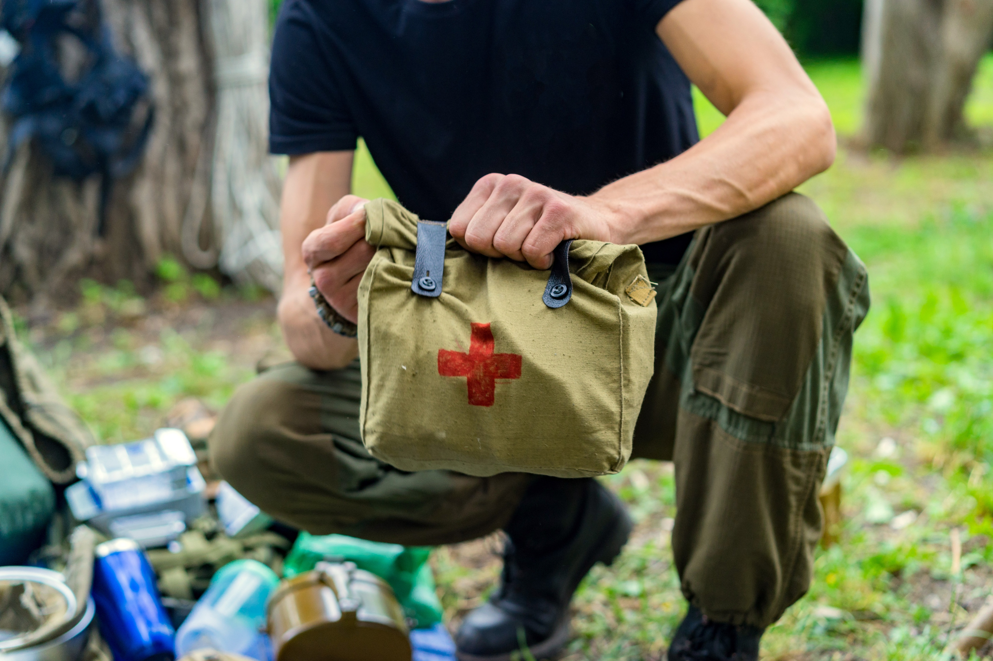

Level 3 Award in
Forestry First Aid
V1 September 2025
All rights reserved
© 2025 Highfield Products Limited
A global leader for qualifications, assessment, digital solutions, innovative products and customer service
Highfield Place Shaw Wood Business Park, Shaw Wood Way, Wheatley Hills Doncaster, DN2 5TB
01302 363277 | www.highfieldqualifications.com
Notes:
This training presentation can be used to deliver the Highfield Level 3 Award in Forestry First Aid (RQF).

Slide 2


Ground rules
Fire escapes
Toilets
Smoking
Drinks
Breaks
Lunch
Questions
Talking over others
Respect others’ points of view
Timekeeping
As a courtesy to others,
please set your mobile phone
to SILENT MODE
Mobile phones must
be SWITCHED OFF
and removed from the desk
during the examination.
Notes:
Where possible, the health and safety briefing should be delivered by a local representative. If such a person is unavailable, the trainer should make themself familiar with the client’s protocols, procedures and facilities to complete this briefing themselves.
Point out the fire evacuation points and procedures as well as the location of the toilets and when/where people are allowed to smoke. Explain that breaks are provided in which people can smoke.
​
​

Slide 3






Key
Class
Question
Individual
Exercise
Key
Point
Definition
KEY POINT
Group
Exercise
Class
Exercise
Navigation
CE

Slide 4


Learning outcomes
Module 1: Know how to manage casualties affected by extreme cold
and extreme heat
Module 2: Be able to manage life-threatening bleeding
Module 3: Know how to manage casualties with crush injuries
Module 4: Know how to manage casualties with Lyme disease
Module 5: Know how to manage casualties with adder snake bites.

Slide 5


Module 1
Know how to manage casualties affected by extreme cold and extreme heat
5
Notes:
Completion of this module will enable learners to meet the following learning outcome:
1. Know how to manage casualties affected by extreme cold and extreme heat
This includes the following assessment criteria:
1.1 Identify the effects of:
extreme cold
extreme heat
1.2 State how to treat the effects of:
extreme cold
extreme heat
Activities in this module include:
CQ: What is extreme cold?
CQ: What are the effects of extreme cold?
CQ: What are the symptoms of hypothermia?
CQ: What are the symptoms of frostbite?
CQ: What are the symptoms of chilblains?
CQ: What are the symptoms of cold-water shock?
CQ: What is extreme heat?
CQ: What are the effects of extreme heat?
CQ: What are the symptoms of head exhaustion?
CQ: What are the symptoms of heat stroke?
CQ: What are the symptoms of dehydration?
CQ: What are the symptoms of sunburn?
CQ: What are the symptoms of head rash?
CE: Four multiple-choice questions (MCQs) (formative assessment)

Slide 6
What is extreme cold?
Extreme cold is prolonged exposure to very low temperatures (below 0°C/32°F), made worse by wind chill or moisture
Key characteristics:
common in winter, high altitudes, snowy environments
increases heat loss from the body, especially with wet or inadequate clothing
risk is higher with immobility, poor shelter or wind or water exposure.
Notes:
Class question: What is extreme cold?

Slide 7
What are the effects of extreme cold?
Hypothermia – affects the whole body, causing a drop in core temperature (life-threatening)
Frostbite – tissue freezing usually on fingers, toes, nose and ears
Chilblains – repeated or prolonged exposure to cold/damp conditions on fingers, toes, nose and ears (not life-threatening)
Cold water shock – occurs when the body is abruptly immersed in water, generally below 15°C.
Notes:
Class question: What are the effects of extreme cold?
Cold water shock exposure – occurs when the body is abruptly immersed in water generally below 15°C. This sudden immersion triggers involuntary physical reactions, even in healthy individuals.

Slide 8
What are the symptoms of hypothermia
Hypothermia symptoms progress from mild to life-threatening if untreated
Early symptoms
Shivering
Cold or pale skin
Confusion or irrational behaviour
Slurred speech
Lack of, or poor, co-ordination
Severe symptoms
Drowsiness
Slow pulse
Shallow breathing
Collapse or unconsciousness.
Notes:
Class question: What are the symptoms of hypothermia?

Slide 9
Hypothermia – treatment
Do:
move the casualty to shelter to reduce heat loss
remove wet clothing and replace with dry, insulated layers
wrap in a survival blanket or insulating materials
offer warm drinks (if fully conscious)
monitor breathing and be prepared to resuscitate
call for emergency services/evacuation immediately (999).
Notes:
Sudden or rough rewarming can cause dangerous complications. Rewarm gradually.

Slide 10
Hypothermia – treatment (cont.)
Do not:
rub limbs
use direct heat sources
KEY POINT
Rewarm gradually. Sudden or rough rewarming can cause dangerous complications.
Notes:
Sudden or rough rewarming can cause dangerous complications. Rewarm gradually.

Slide 11
What are the symptoms of frostbite?
Knowing the symptoms of frostbite helps you act quickly and reduce the risk of long-term damage
Skin changes
Cold, numb skin that turns white, blue or grey
Skin feels hard or waxy
Damage changes
Blisters
Loss of sensation.
Notes:
Class question: What are the symptoms of frostbite?

Slide 12
Frostbite – treatment
Do:
warm affected areas gradually, using body heat
protect the area with a dry, non-stick dressing
immobilise and elevate affected limb if possible
evacuate for medical treatment
Do not:
allow further exposure to the cold
rub the skin or use open flames or stoves
rewarm if there is a risk of refreezing
KEY POINT
Frostbite can cause permanent tissue damage if not treated quickly.

Slide 13
What are the symptoms of chilblains?
Chilblains may cause:
red or purple swollen patches
an itching, burning or tingling sensation
possible blistering or ulcers in severe cases.
Notes:
Class question: What are the symptoms of chilblains?

Slide 14
Chilblains – treatment
Do:
warm the affected area slowly
apply dry dressings if the skin is broken
keep the area clean and dry
prevent recurrence by improving insulation and circulation
Do not:
scratch or rub the area
KEY POINT
Rewarm gently – avoid sudden or direct heat.

Slide 15
What are the symptoms of cold-water shock?
Cold-water shock triggers a sudden, dangerous response in the body
Immediate responses
Gasping and hyperventilation
Panic
Rapid heartbeat
Severe responses
Immediate loss of motor control
Cardiac arrest.
Notes:
Class question: What are the symptoms of cold-water shock?
Tutors should explain that even strong swimmers are at risk – focus on staying clam and keeping the airway clear.

Slide 16
Cold-water shock – treatment
Do:
remove the casualty from the water quickly and safely
remove wet clothing and rewarm gradually
treat for hypothermia
monitor vital signs and be prepared to give CPR
Call the emergency services (999) urgently due to a high risk of complications.

Slide 17
Cold-water shock – treatment (cont.)
Do not:
rewarm too quickly with direct heat
assume recovery is complete – complications can still develop
KEY POINT
Act fast and continue monitoring even after the casualty seems stable.

Slide 18
What is extreme heat?
Extreme heat is sustained high temperatures, often above 30°C (86°F), especially with high humidity or poor ventilation
Key characteristics:
occurs during heatwaves, in hot climates or in enclosed, poorly ventilated spaces
the body struggles to cool itself, especially through sweating
risk increases with dehydration, physical exertion or lack of shade.
Notes:
Class question: What is extreme heat?

Slide 19
What are the effects of extreme heat?
Heat exhaustion – caused by the body’s core temperature rising above 37°C. It usually happens after prolonged exposure to high temperatures or strenuous activity in hot, humid conditions
Heat stroke – caused by the body’s core temperature rising to 40°C or higher (life-threatening).
Notes:
Class question: What are the effects of extreme heat?

Slide 20
What are the effects of extreme heat? (cont.)
Dehydration – occurs when the body loses more fluids than it takes in
Sunburn – skin damage caused by overexposure to ultraviolet (UV) radiation, most commonly from the sun
Heat rash – a skin irritation that develops when sweat ducts become blocked and sweat becomes trapped under the skin.
Notes:
Class question: What are the effects of extreme heat?

Slide 21
What are the symptoms of heat exhaustion?
Heat exhaustion may cause:
headache and dizziness
nausea or vomiting
sweating
pale, clammy skin
a rapid pulse
shallow breathing
muscle cramps
feeling weak, tired or faint
an elevated body temperature.
Notes:
Class question: What are the symptoms of heat exhaustion?

Slide 22
Heat exhaustion – treatment
Do:
move the casualty to a shaded, cool area
remove excess clothing and personal protective equipment (PPE)
encourage the casualty to lie down with legs raised
give the casualty cool water to drink (small sips, frequently)
use cool, wet clothes or fanning to aid cooling
monitor closely – if symptoms persist or worsen, call emergency services (999).

Slide 23
Heat exhaustion – treatment (cont.)
Do not:
give them alcohol or caffeine
allow them to continue physical activity
leave them unattended while symptoms are present
KEY POINT
Heat exhaustion can develop into heat stroke if untreated.

Slide 24
What are the symptoms of heat stroke?
Heat stroke may cause:
hot, dry skin
a rapid pulse
confusion or irrational behaviour
headache and dizziness
seizures
nausea and vomiting
loss of consciousness
a core body temperature above 40°C.
Notes:
Class question: What are the symptoms of heat stroke?

Slide 25
Heat stroke – treatment
Do:
call the emergency services (999) immediately
move the casualty to a cool, shaded area
remove outer clothing and personal protective equipment (PPE)
actively cool the body using:
  cold, wet cloths
  immersion in cool water, if safe
  fanning and misting with water.

Slide 26
Heat stroke – treatment (cont.)
Do:
position the casualty appropriately:
  on their back with legs raised, if conscious
  in the recovery position if unconscious but breathing
monitor breathing and prepare to give CPR if needed.

Slide 27
Heat stroke – treatment (cont.)
Do not:
give the casualty anything to eat or drink
use ice directly on the skin
delay cooling while waiting for emergency services
leave the casualty unattended
KEY POINT
Heat stroke is a life-threatening emergency – call the emergency services (999) immediately.

Slide 28
What are the symptoms of dehydration?
Dehydration may cause:
dark urine or reduced urination
a dry mouth and lips
headaches and dizziness
tiredness or confusion
poor co-ordination.
Notes:
Class question: What are the symptoms of dehydration?

Slide 29
Dehydration – treatment
Do:
encourage small, frequent sips of water or oral rehydration solution
rest in a cool, shaded area
monitor and advise medical attention if symptoms persist or worsen
Do not:
give large amounts of fluid quickly
give caffeine or alcohol
ignore ongoing symptoms
KEY POINT
Untreated dehydration can worsen rapidly.

Slide 30
What are the symptoms of sunburn?
Sunburn may cause:
red, sore or tender skin that feels hot
pain or discomfort in the affected area
blistering (in more severe cases)
KEY POINT
Sunburn can increase the risk of heat stroke.
Notes:
Class question: What are the symptoms of sunburn?

Slide 31
Sunburn – treatment
Do:
cool the skin with cool or tepid water or after-sun lotion
avoid further sun exposure
keep the skin dry and wear loose clothing
Do not:
burst blisters
apply ice to the skin
use greasy or oil-based creams as these can trap heat
KEY POINT
Severe sunburn increases the risk of dehydration and heat-related illness.

Slide 32
What are the symptoms of heat rash?
Heat rash may cause:
small red spots or tiny clear blisters
an itchy, prickly or stinging sensation on the skin
a rash
KEY POINT
Skin is irritated but not typically blistered in the same way as sunburn.
Notes:
Class question: What are the symptoms of heat rash?

Slide 33
Heat rash – treatment
Do:
cool the skin with tepid water or allow the skin to air
avoid further sun exposure
keep the skin dry and wear loose clothing
Do not:
use oily or greasy creams
scratch the rash, as this may worsen
cover the skin with tight clothing
KEY POINT
Heat rash is usually mild and improves once the skin is cooled and kept dry.

Slide 34




How much do you know?​
CE
Which of the following is an early symptom of hypothermia?
Hot, dry skin
D
Severe thirst
Rapid pulse
Shivering
Notes:
Class exercise: How much do you know?
The correct answer is D.

Slide 35
How much do you know?​
CE
Which of these is the correct treatment for frostbite?
Warm affected areas gradually, using body heat
A
Rub the skin to restore circulation
Use open flames or stoves to warm quickly
Rewarm if there is a risk of freezing
Notes:
Class exercise: How much do you know?
The correct answer is A.

Slide 36
How much do you know?​
CE
Which of the following is caused by the body’s core temperature rising to 40°C or higher?
Dehydration
C
Sunburn
Heat stroke
Cold-water shock
Notes:
Class exercise: How much do you know?
The correct answer is C.

Slide 37
How much do you know?​
CE
Which of these is an immediate response to cold-water shock?
Muscle cramps
D
Shivering
Rash and itching
Gasping and hyperventilation
Notes:
Class exercise: How much do you know?
The correct answer is D.

Slide 38
Module 2
Be able to manage life-threatening bleeding
38
Notes:
Completion of this module will enable learners to meet the following learning outcome:
2. Be able to manage life-threatening bleeding
This includes the following assessment criteria:
2.1 Recognise the signs of life-threatening bleeding
2.2 Demonstrate the treatment of life-threatening bleeding using:
direct pressure
a tourniquet
haemostatic agents
Activities in this module include:
CQ: What are the signs of life-threatening bleeding?
GE: Primary survey – practical demonstration
CQ GE: How can you treat life-threatening bleeding – direct pressure?
CQ GE: How can you treat life-threatening bleeding – haemostatic agents?
CQ GE: How can you treat life-threatening bleeding – tourniquet?
CE: Two multiple-choice questions (MCQs) (formative assessment)

Slide 39
What are the signs of life-threatening bleeding?
Uncontrollable, massive external bleeding from a limb or major vessel
Pumping or spurting blood, often in sync with the heartbeat (indicative of an arterial bleed)
Rapid and continuous blood loss that cannot be managed with pressure alone
Bleeding that soaks through dressings within seconds or pools quickly around the casualty
Wounds involving traumatic amputations, deep lacerations or crush injuries.
Notes:
Class question: What are the signs of life-threatening bleeding?

Slide 40
What are the signs of life-threatening bleeding? (Cont.)
Associated signs may include:
casualty becomes pale, cold and clammy
rapid pulse and breathing
signs of shock (for example, confusion, restlessness or reduced consciousness)
visual evidence of significant blood volume loss.
Notes:
Class question: What are the signs of life-threatening bleeding? (Cont.)

Slide 41
Conduct a scene survey
Always check the scene is safe before approaching a casualty
Protect yourself, the casualty and bystanders
Use the acronym CLAP to stay calm and in control
Control the situation
Look for potential hazards
Assess the situation
Protect and prioritise.
Notes:
Reinforce with a class question: ‘What could make a scene unsafe?’
Discuss common hazards (for example, electricity, fire, traffic and biohazards).
C – control the situation – stop, take a deep breath and take charge of people and vehicular traffic.
L – look for potential hazards – look for anything that could cause further danger/harm to the casualty, bystanders, or more importantly yourself, within the immediate area.
A – assess the situation – evaluate what has happened from the casualty and, from bystanders, gather as much information as possible and try to make a diagnosis (history, signs and symptoms).
P – protect and prioritise – ensure personal protective equipment (PPE) is worn (gloves) and that casualties are prioritised (breathing, bleeding, bones/burns and other conditions). Delegate tasks. Try to gain assistance from bystanders and contact the emergency services.

Slide 42
Conduct a scene survey (cont.)
When carrying out a scene survey, always follow these steps to keep yourself and others safe:
check for ongoing/further dangers to you, the casualty or bystanders
wear appropriate personal protective equipment (PPE) (gloves, mask and a face shield)
if there is more than one casualty, place them in an order of priority (breathing, bleeding, bones/burns and other conditions)
clear the area of unnecessary people
delegate tasks: ask someone to call 999 or fetch an automated external defibrillator (AED).
Notes:
Explain the importance of personal safety – you can’t help others if you become a casualty
Emphasise PPE use, especially gloves and masks – link this to infection prevention
Talk through scene hazards – traffic, electricity, aggression, sharp objects and body fluids
Introduce the idea of delegating tasks to bystanders (for example, ‘you, call 999’ or ‘you, get the AED’)

Slide 43
Calling for help (999)
Getting help quickly is vital. Knowing what to say and staying calm can save time and lives
For a simple way to remember what to tell the emergency services, think ‘LINE’
  Location
  Incident
  Number of casualties
  Extent of their injuries
Use the speakerphone or ask a bystander if available.
Notes:
Calling for an ambulance
First-aiders will either call for an ambulance themselves on loudspeaker or instruct a bystander to do so.
Calling for an ambulance earliest opportunity is paramount. When calling on 999, it is important that the information given is clear, concise and sufficient. This can be achieved by remembering the acronym ‘LINE’.

Slide 44


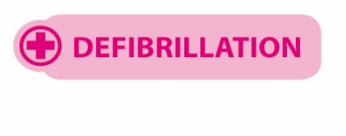
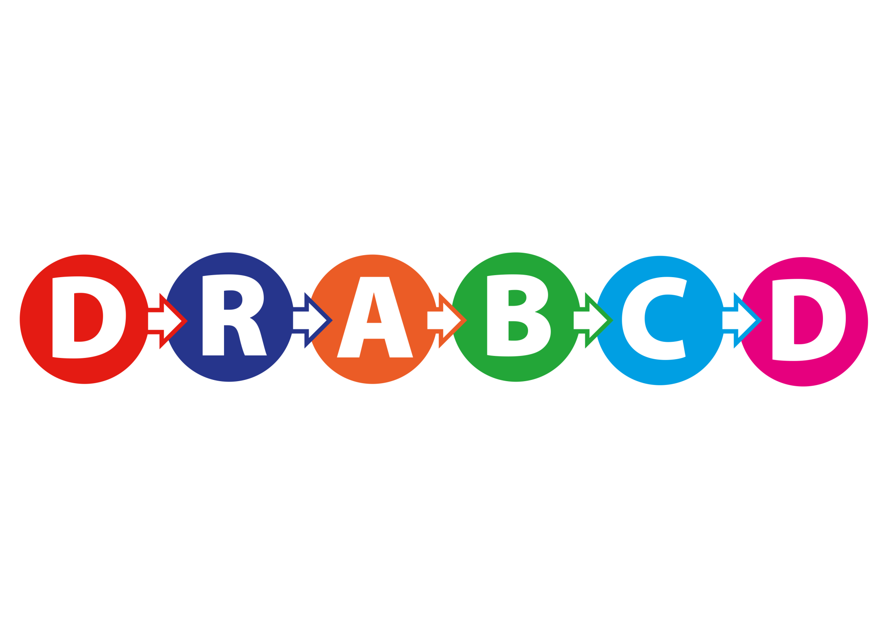
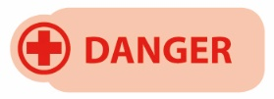
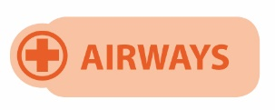
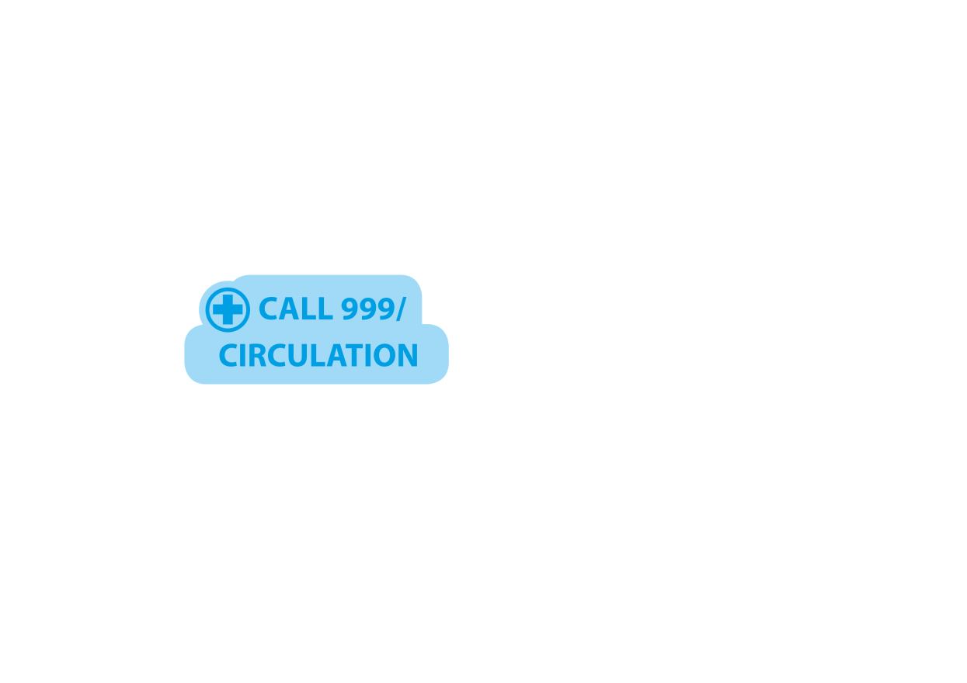
Primary survey steps – DRABCD
The primary survey can be remembered by the acronym ‘DRABCD’
(You can also remember this as Doctor ABCD).
Notes:
Having conducted a scene survey and established that the immediate area is safe from any dangers, you can now approach the casualty. When approaching the casualty, an initial casualty assessment should be conducted – this initial assessment is called a primary survey.
The primary survey is a systematic process of approaching, identifying and dealing with immediate and/or life-threatening conditions.
The primary survey can be remembered by the acronym DRABCD (or the easy way to remember, Doctor ABCD).

Slide 45
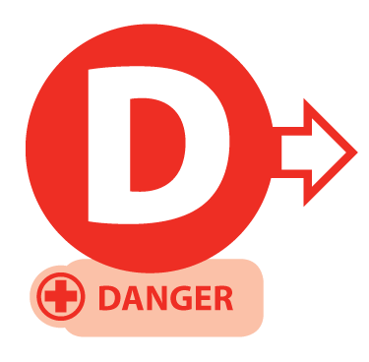
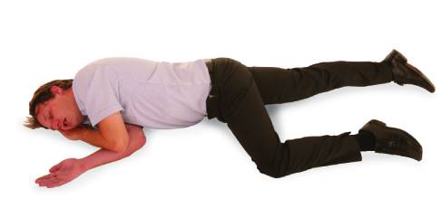
Primary survey – adult
Prior to approaching the casualty, ensure the safety of the casualty, yourself and any bystanders.
Notes:
D – Danger
The same for all ages:
check for danger to yourself, the casualty and bystanders

Slide 46
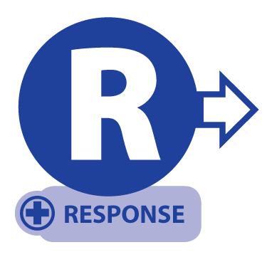
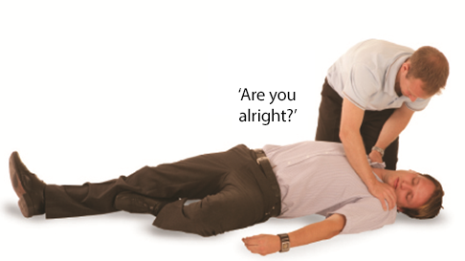
Primary survey – adult
If possible, approach the casualty from their feet as this prevents hyperextension of the neck from a responsive casualty. Use the AVPU scale when checking for a response
(If the casualty responds, and providing there is no further danger, leave them in the position found and try to find out what is wrong. Get help if needed.)
Notes:
R – Response
Same check for all ages, but:
adults/children: speak clearly, gently shake shoulders.
infants: tap the foot or flick the sole. Do not shake them.

Slide 47
Response – child or infant
Infant
Talk to the infant – is the infant alert, can you see them breathing or moving?
Gently stimulate the infant
If a response is gained, check for further injuries (secondary survey) and call for an ambulance (999) if required
Child
Talk to the child
Gently stimulate the child and ask loudly ‘Are you all right?’
If a response is gained, check for further injuries (secondary survey) and call for an ambulance (999) if required.
Notes:
R – Response
Same check for all ages, but:
children: speak clearly, gently shake shoulders.
infants: tap the foot or flick the sole. Do not shake them.

Slide 48
AVPU scale
A
ALERT – are they moving/talking? → No → Proceed to V
V
VOICE – do they respond to speech? → No → Proceed to P
P
PLACE – place your hand on their shoulders and gently shake them asking ‘Are you alright?’ → No response → Proceed to U
U
UNRESPONSIVE – assume the casualty is unresponsive
The ‘P’ in the acronym AVPU is sometimes also referred to as ‘Pain’, meaning to cause a minor pain to see if the person responds. Examples include pinching the ear lobes or fingertips.

Slide 49
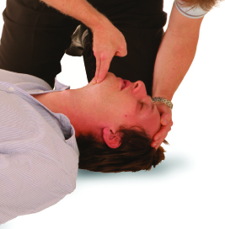
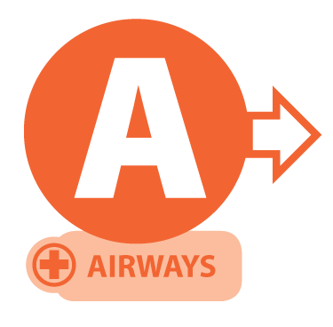
Primary survey
Open the airway
using the head-tilt/ chin-lift method
KEY POINT
Control life-threatening bleeding first before airway and breathing.
Notes:
A – Airway
The same technique for all ages:
use the head-tilt/chin-lift
take extra care with infants: use a gentler tilt and keep the head in a neutral position, not tilted too far back

Slide 50

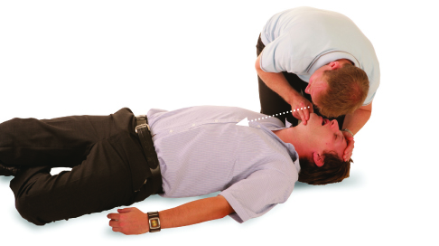
Primary survey (cont.)
After opening the airway, look, listen and feel for normal breathing for no more than 10 seconds
Casualty breathing normally – check for further injuries and, if safe to do so, place into the recovery position
Casualty not breathing normally – commence CPR
Agonal breathing
In the first few minutes after a cardiac arrest, a casualty may be barely breathing or taking infrequent, slow, noisy gasps. Do not confuse this with normal breathing. If in any doubt that breathing is normal, act as if not breathing normally and prepare to start CPR.
Notes:
B – Breathing
The same method for all ages:
look, listen and feel for breathing (no more than 10 seconds)
be alert to agonal breathing
infant chest movements are more subtle, so watch closely

Slide 51
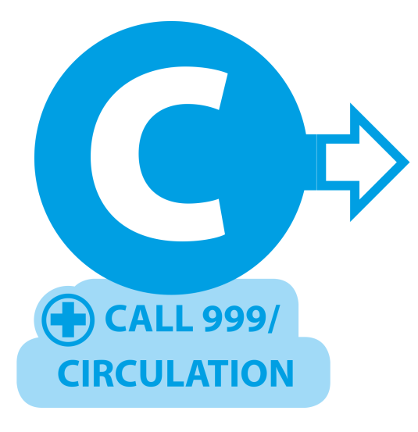
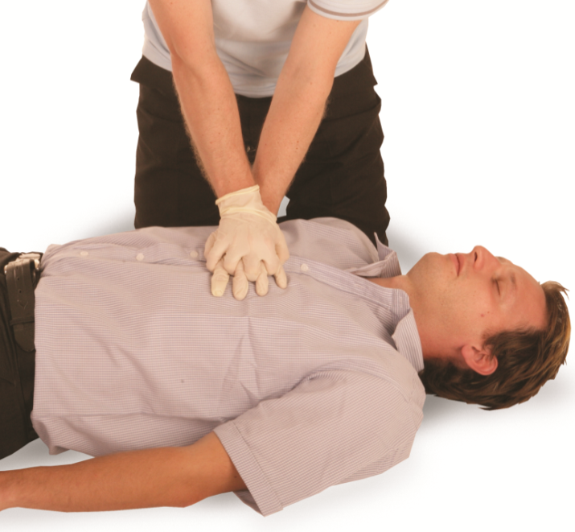
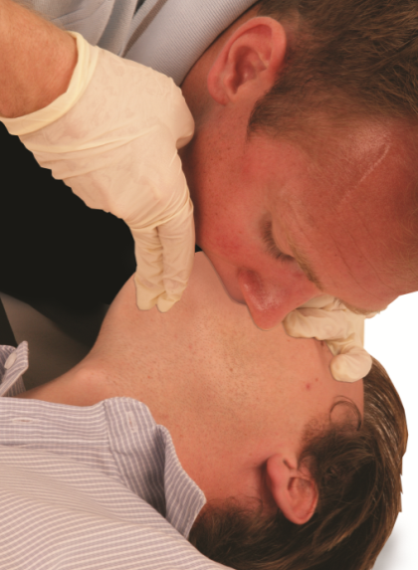
Primary survey (cont.)
Call an ambulance (999). Ask a helper to call, otherwise call yourself. Stay with the casualty when making the call, if possible, and activate the speaker function on the phone to aid communication with the ambulance service, send someone to get an AED. Commence CPR (30 compressions 2 breaths)
Compression-only CPR
If you are untrained or unable to do rescue breaths for a casualty who is not breathing, give chest compression-only CPR. These should be continuous at a rate of 100-120 per minute and to a depth of 5-6cm.
Notes:
C – CPR (if needed) – cardiopulmonary resuscitation.

Slide 52
Primary survey – practical demonstration
Notes:
Group exercise: Primary survey – practical demonstration
Learners should work in groups to demonstrate the primary survey using the correct methods.
This is a hands-on assessment. Observation and participation are essential.

Slide 53
Signs of shock
Signs of shock may include:
pale
cold
clammy skin
rapid pulse and breathing
confusion
restlessness
reduced consciousness.

Slide 54
Signs and treatment of shock
Signs of shock may include:
pale, cold, clammy skin
a rapid pulse and breathing
confusion
restlessness
reduced consciousness
Treatment:
lay the casualty down
keep them warm
provide assurance
continue to monitor the following (until emergency help arrives):
  responsiveness
  breathing
  circulation.

Slide 55
How can you treat life-threatening bleeding – direct pressure?
When bleeding is life-threatening, quick and decisive action is vital
Check the wound and apply direct pressure (primary method) – this is the first line method, where practical, especially if the wound is accessible and bleeding is not from a limb requiring a tourniquet
Apply continuous pressure directly over the source of the bleeding using a sterile dressing, gloved hand or cloth if needed.
Notes:
Class question: How can you treating life-threatening bleeding – direct pressure?
The tutor is to demonstrate how to secure the dressing with a bandage or manual hold.
Show how to:
locate the wound quickly
apply firm pressure using dressings, cloth or a gloved hand
maintain pressure without lifting to ‘check’ the wound
Contextual examples
Use scenarios, for example, a limb wound on a hike or fall with arterial bleeding, to help learners visualise applying pressure in an outdoor environment.
Safety note:
Always use gloves or barriers where possible to protect both the casualty and rescuer from infection.
Group exercise (suggested)
Learners are to practise applying direct pressure to control life-threatening bleeding.
Instructions:
pair up in twos
take turns acting as the casualty and the first-aider
use the following steps:
identify a simulated wound site (use manikins or each others’ arms/legs with fake wound dressings if available)
apply direct pressure using a sterile dressing, gloved hand or cloth
maintain firm, continuous pressure
talk through your actions as if in a real incident
switch roles after 2-3 minutes
The tutor is to observe and give feedback on:
correct placement of pressure
technique (firm, continuous, no unnecessary checking)
communication and reassurance during the response

Slide 56
How can you treat life-threatening bleeding – haemostatic agents?
Haemostatic agents are recommended for forestry first-aid kits due to the risk of deep, inaccessible wounds
Identify when haemostatic dressings are appropriate, including deep, heavily bleeding wounds and locations where tourniquets cannot be applied
Pack the wound firmly with the haemostatic gauze, filling all spaces
Apply and maintain firm direct pressure for at least three minutes (or as directed by product instructions)
Cover the wound with an appropriate pressure dressing to secure it
KEY POINT
Ensure the haemostatic dressing packaging is sent with the casualty to hospital so medical staff are aware of what has been used.
Notes:
Class question: How can you treating life-threatening bleeding – haemostatic agents?
The tutor is to demonstrate how to use a haemostatic agent.
Group exercise
Learners are to practise using a haemostatic agent to control life-threatening bleeding.
Instructions:
pair up with another learner
one person will play the casualty, and the other the first-aider
Scenario: the casualty has a deep, heavily bleeding wound on the upper thigh where a tourniquet cannot be applied.
Using a training haemostatic gauze (or substitute if not available)
Identify when haemostatic packing is appropriate
Pack the wound thoroughly, simulating filling all wound spaces
Apply firm, direct pressure for at least 3 minutes (simulate with pressure)
Cover with a dressing to secure it
Switch roles after the first run-through
Time: 10-12 minutes per pair
Simulation tips
Use a folded towel or sponge to mimic a wound cavity
Practise giving calm, clear instructions
Emphasise communication, safety and cleanliness
Additional class questions
When would this be more appropriate than a tourniquet?
What’s the importance of sending the gauze to hospital?

Slide 57
How can you treat life-threatening bleeding – tourniquet?
Tourniquet is a vital method in remote forestry environments where evacuation delays are likely, and uncontrolled bleeding from limbs is common due to high-risk tools and machinery
Place the tourniquet 5-7cm above the wound, but not over a joint
Tighten the device until the bleeding stops and there is no distal pulse
Secure the device to prevent loosening
Record the time the tourniquet was applied (on the tourniquet)
Important:
You must be able to use both commercial tourniquets, such as a combat application tourniquet (CAT) or a special operations forces tactical tourniquet (SOFTT), and improvised options.
Notes:
Class question: How can you treating life-threatening bleeding – tourniquet?
Tutor to demonstrate how to secure a tourniquet.
Group exercise
Learners are to practise applying a tourniquet to control life-threatening bleeding.
Instructions:
pair up with another learner
one person will play the casualty, and the other the first-aider
Using a training tourniquet:
identify a limb injury scenario
apply the tourniquet 5-7cm above the wound, avoiding joints
tighten until the bleeding would stop (simulate checking for a distal pulse)
secure the device to prevent loosening
record the time of application on a label or note
Switch roles and repeat the exercise
The tutor is to observe and give feedback on:
correct placement and tightening
confidence and clarity in communication during the process
giving and receiving constructive feedback (allow 10 minutes (5 per person))
Additional information - improvised tourniquet
Use available materials for example, a triangular bandage and stick or belt to simulate an improvised tourniquet.

Slide 58
How much do you know?​
CE
When carrying out a scene survey in the outdoors, what should you do first?
Check the casualty’s airway
C
Begin chest compressions immediately
Ensure the area is safe from hazards
Ask the casualty what happened
Notes:
Class exercise: How much do you know?
The correct answer is C.

Slide 59
How much do you know?​
CE
What is the primary method for treating life-threatening external bleeding?
Applying firm direct pressure to the wound
A
Applying a tourniquet straight away
Packing the wound with haemostatic agents
Elevating the injured limb without pressure
Notes:
Class exercise: How much do you know?
The correct answer is A.

Slide 60
Module 3
Know how to manage casualties with crush injuries
60
Notes:
Completion of this module will enable learners to meet the following learning outcome:
3. Know how to manage casualties with crush injuries
This includes the following assessment criteria:
3.1 Describe the effects of crush injurie.
3.2 Identify the critical time factors in managing crush injuries
3.3 State how to manage a casualty with crush injuries
Activities in this module include:
CQ: What is a crush injury?
CE: Three multiple-choice questions (MCQs) (formative assessment)

Slide 61
What is a crush injury?
Crush injury
A crush injury occurs when a body part is subjected to high force or pressure, typically after being pressed between two solid objects
They can cause:
muscle swelling
disrupted blood flow
damage to organs (organ damage)
KEY POINT
Often linked to heavy machinery, falling trees or remote forestry work environments.
Notes:
Class question: What is a crush injury?

Slide 62
What is a crush injury? (Cont.)
Crush injuries may lead to 2 serious medical conditions:
Compartment syndrome – the compression of nerves, blood vessels and muscles. Pressure builds up within a closed muscle compartment, cutting off blood supply and damaging tissue
Crush syndrome (Bywaters’ syndrome) – occurs when the pressure on muscles is relieved. Toxins are released from the crushed muscle tissue, entering the bloodstream, potentially causing:
  shock
  kidney failure
  irregular heartbeat
  death.
Notes:
Class question: What is a crush injury? (Cont.)

Slide 63
The effects of crush injuries – local effects
  Local effects at the site of injury may include:
  pain and tenderness
  swelling and extensive bruising
  bleeding (internal or external)
  open or closed fractures
  damage to the body’s structure,
  such as:
    skin
    tissue
    blood vessels
    muscles or bones
  loss of sensation or movement due to nerve damage
  compartment syndrome.

Slide 64
The effects of crush injuries – systemic effects
Systemic effects throughout the body may include:
crush syndrome:
  shock
  dark or tea-coloured urine
  nausea and vomiting
  confusion
  kidney failure
  irregular heart rhythms or cardiac arrest
multi-organ failure in severe cases.

Slide 65
Other possible effects of crush injuries
Additional effects may include:
hypovolaemic shock – a life-threatening condition that occurs when the body loses 20% (one fifth) or more of its blood or bodily fluids
infection
amputation
psychological trauma.

Slide 66
Critical time factors – duration of compression
Critical time factors are vital when dealing with crush injuries. These are:
below 15 minutes – safe to release with standard precautions
beyond 15 minutes – increased risk of crush syndrome – do not release
KEY POINT
Releasing pressure after prolonged compression can lead to sudden toxic shock caused by the release of toxins.

Slide 67
Remote settings and time to emergency support – golden hour
Delays in professional help are more likely in remote forestry settings
This increases the need for:
early recognition of injury severity
appropriate decision-making about pressure release (if and when)
prompt communication with emergency services
The first 60 minutes after a major trauma is critical for survival. This is known as ‘the golden hour’
KEY POINT
For crush injuries, outcomes are significantly better if advanced care
and fluid resuscitation begin before release when entrapment is prolonged.

Slide 68
Managing crush injuries
Managing a casualty with crush injuries involves:
scene safety – check for dangers or hazards for example, unstable trees, machinery or collapse risk
call emergency services (999) – provide entrapment duration and details and injury details
assess the casualty:
  level of consciousness
  breathing and signs of shock
  location and severity/extent of the injuries
KEY POINT
Do not put yourself or others at risk. If the casualty is responsive, reassure and keep them still.

Slide 69
Emergency services – key information
When contacting emergency services, provide:
duration of entrapment/compression
location and severity of injuries
casualty’s condition
  consciousness
  breathing
  circulation
first aid given.

Slide 70
Managing the entrapment
If trapped for less than 15 minutes:
it’s generally safe to release the pressure
provide first aid for:
  bleeding
  fractures
  shock
If trapped for more than 15 minutes:
do not release pressure unless directed by the emergency services or the scene becomes unsafe
sudden release may cause crush syndrome – this is a potentially fatal systemic reaction
continue to monitor and support the casualty until advanced help arrives.

Slide 71
First-aid treatment
Treat visible injuries by:
controlling the bleeding – direct pressure or dressings
elevating the injured area if possible
Prevent and treat shock as follows:
lay the casualty down and, if able, raise their legs
keep them warm
monitor vital signs and prepare to begin CPR if necessary
do not give them food or drink.

Slide 72
How much do you know?​
CE
Which of the following is a systemic effect of a crush injury that may indicate crush syndrome?
Localised swelling and bruising
C
Pain and tenderness at the site
Irregular heart rhythm
Loss of sensation in the fingers
Notes:
Class exercise: How much do you know?
The correct answer is C.

Slide 73
How much do you know?​
CE
After how many minutes of compression does the risk of crush syndrome become significant, requiring medical supervision before release?
5 minutes
D
10 minutes
47 minutes
15 minutes
Notes:
Class exercise: How much do you know?
The correct answer is D.

Slide 74
How much do you know?​
CE
What is the first action you should take when attending a casualty with a suspected crush injury in a remote forestry location?
Ensure scene safety and call emergency services
A
Begin fluid resuscitation
Immediately release the pressure
Begin CPR
Notes:
Class exercise: How much do you know?
The correct answer is A.

Slide 75
Module 4
Know how to manage casualties with Lyme disease
75
Notes:
Completion of this module will enable learners to meet the following learning outcome:
4. Know how to manage casualties with Lyme disease
This includes the following assessment criteria:
4.1 Identify the signs and symptoms of Lyme disease
4.2 State how to provide first aid and seek further treatment for Lyme disease
Activities in this module include:
CQ: What is Lyme disease?
CE: Three multiple-choice questions (MCQs) (formative assessment)

Slide 76
What is Lyme disease?
Lyme disease is an infectious illness caused by Borrelia bacteria and spread through tick bites
caused by the bite of infected Ixodes (black-legged or deer) ticks
common in woodlands and grassy areas
can affect the skin and joints and may spread to the nervous system or heart if untreated.
Notes:
Class question: What is Lyme disease?
Explain how ticks transmit Borrelia. Emphasize the types of environments where ticks are likely.
Optional: share a recent local case to show relevance.

Slide 77
Signs and symptoms of Lyme disease
Early localised signs and symptoms include:
erythema migrans (EM)
  a distinctive bull’s-eye rash with central clearing with and a red outer ring
  develops at the site of the bite
  usually painless and not itchy
  appears in about 70-80% of cases.
Notes:
The tutor is to mention that not everyone gets a rash. Flu-like symptoms can be mistaken for other illnesses.

Slide 78
Signs and symptoms of Lyme disease (cont.)
flu-like symptoms:
  fatigue
  fever and chills
  headache
  muscle and joint aches
  swollen lymph nodes.
Notes:
Tutor to mention that not everyone gets a rash. Flu-like symptoms can be mistaken for other illnesses.

Slide 79
Signs and symptoms of Lyme disease (cont.)
Early-stage symptoms:
multiple rashes on different parts of the body
migrating joint pain
facial palsy or nerve pain/ numbness
visual disturbances
palpitations or an irregular heartbeat
Late-stage symptoms:
chronic joint inflammation
memory issues or difficulty concentrating
tingling in hands or feet
extreme fatigue.

Slide 80
First aid and treatment for Lyme disease – tick removal
Do:
remove the tick promptly (ideally within 24 hours)
use fine-tipped tweezers or a tick tool to grasp the tick close to the skin
pull upward slowly and steadily – avoid twisting or crushing
clean the bite area and hands with soap and water or antiseptic
record the date and location of the bite for medical reference
Do not:
use heat, petroleum jelly or chemicals.
Notes:
If possible, show a pair of fine-tipped tweezers and a tick removal tool and demonstrate the motion using a dummy or image.

Slide 81
First aid and treatment for Lyme disease
Monitor and seek medical advice if:
symptoms change over several days or weeks
a bull’s-eye rash develops
flu-like symptoms appear
KEY POINT
Early, late and advanced stage treatment should be given by a medical professional.
Notes:
If possible, show a pair of fine-tipped tweezers and a tick removal tool and demonstrate the motion using a dummy or image.

Slide 82
How much do you know?​
CE
What is a key early symptom of Lyme disease?
Bull’s-eye rash
A
Palpitations
Tingling fingers
Cold sweats
Notes:
Class exercise: How much do you know?
The correct answer is A.

Slide 83
How much do you know?​
CE
What is the correct way to remove a tick?
Burn the tick off with a match
B
Use fine-tipped tweezers close to the skin
Cover with petroleum jelly
Twist the tick while pulling
Notes:
Class exercise: How much do you know?
The correct answer is B.

Slide 84
How much do you know?​
CE
When should you seek medical help after a tick bite?
After 48 hours no matter what
D
Only if fever exceeds 38°C
After the tick is removed
If rash or flu-like symptoms develop
Notes:
Class exercise: How much do you know?
The correct answer is D.

Slide 85
Module 5
Know how to manage casualties with adder snake bites
85
Notes:
Completion of this module will enable learners to meet the following learning outcome:
5. Know how to manage casualties with adder snake bites
This includes the following assessment criteria:
5.1 Identify the signs and symptoms of adder snake bites
5.2 State how to manage a casualty with an adder snake bite
Activities in this module include:
CQ: What is an adder bite?
CQ: What should you avoid dong when treating an adder bite?
CE: Two multiple-choice questions (MCQs) (formative assessment)

Slide 86
What is an adder bite?
A bite from the UK’s only native venomous snake – the adder
Found in grassy, sunny areas, such as heathland and forests
Venom may cause local or systemic reactions
KEY POINT
Most bites are not life-threatening but always require medical attention.
Notes:
Class question: What is an adder bite?

Slide 87
Signs and symptoms of adder bites
Local signs:
two puncture marks (may not always be visible)
immediate or delayed pain at the site
redness, swelling and warmth
tenderness or bruising
possible blistering in severe cases.
Notes:
Tutors should explain the need to look for swelling, puncture marks and systemic symptoms, like dizziness.
Systemic symptoms may occur minutes to hours later.

Slide 88
Signs and symptoms of adder bites (cont.)
Systemic symptoms:
nausea and vomiting
dizziness or fainting
sweating and chills
abdominal pain
a headache
a rapid heartbeat or low blood pressure
breathing difficulty
an allergic reaction or anaphylaxis.
Notes:
Tutors should explain the need to look for swelling, puncture marks and systemic symptoms, like dizziness.
Systemic symptoms may occur from minutes to hours later.

Slide 89
First-aid treatment for adder bites – immediate action
call the emergency services immediately (999)
reassure and keep the casualty calm
keep the person still and seated or lying down
immobilise the affected limb – keeping the limb below heart level if possible
remove constrictive items (rings, watches) near the bite.

Slide 90
First-aid treatment for adder bites – ongoing care
monitor for shock, breathing difficulties or allergic reaction
check consciousness, pulse and breathing regularly
keep the casualty warm and dry
record time of the bite, symptoms and snake appearance (if safe)
KEY POINT
Be prepared to give CPR.

Slide 91
What should you avoid doing when treating an adder bite?
Do not:
suck or cut the wound
use a tourniquet or restrict blood flow
use ice or attempt to neutralise the venom
give food, drink or medication unless advised by a medical professional
KEY POINT
These actions can worsen the injury or delay effective treatment.
Notes:
Class question: What should you avoid doing when treating an adder bite?

Slide 92
How much do you know?​
CE
What is a common local sign of an adder snake bite?
Itchy rash
B
Two puncture marks
Cold and dry skin
Blurred vision
Notes:
Class exercise: How much do you know?
The correct answer is B.

Slide 93
How much do you know?​
CE
What should you do first if someone is bitten by an adder?
Apply ice
D
Cut the wound open
Suck out the venom
Call emergency services
Notes:
Class exercise: How much do you know?
The correct answer is D.

Slide 94

Thank you for listening

