Slide 1
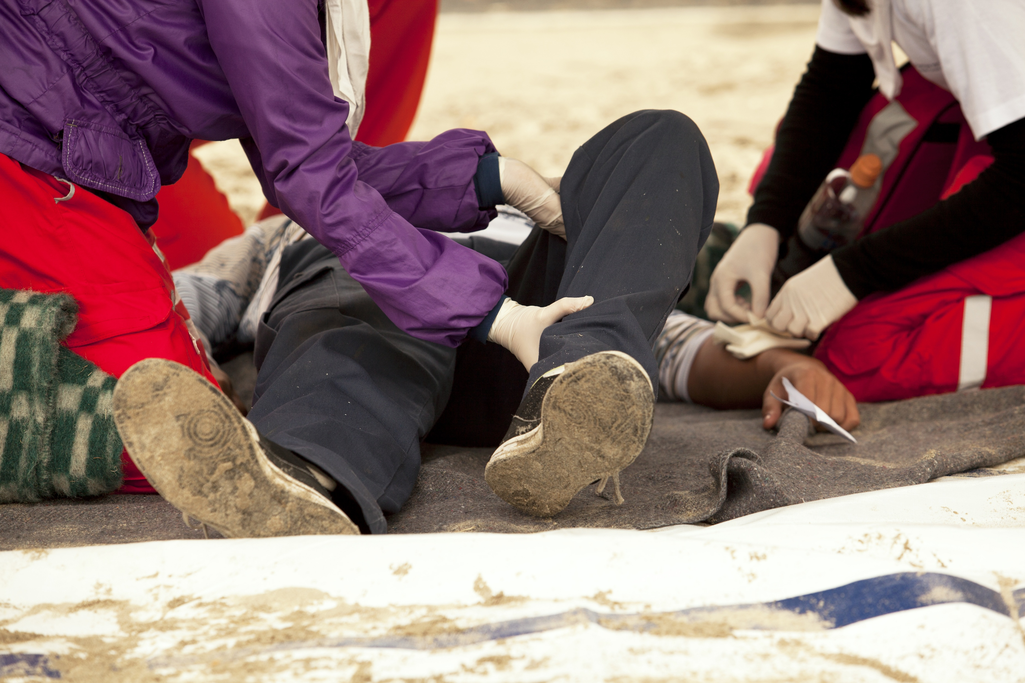

Outdoor Incident Management
V1 September 2025
All rights reserved
© 2025 Highfield Products Limited
A global leader for qualifications, assessment, digital solutions, innovative products and customer service
Highfield Place Shaw Wood Business Park, Shaw Wood Way, Wheatley Hills Doncaster, DN2 5TB
01302 363277 | www.highfieldqualifications.com
Notes:
This training presentation supports the delivery of Unit 2: Outdoor Incident Management, for the Highfield Level 3 Award in Outdoor First Aid (RQF).

Slide 2


Ground rules
Fire escapes
Toilets
Smoking
Drinks
Breaks
Lunch
Questions
Talking over others
Respect others’ points of view
Timekeeping
As a courtesy to others, please set your mobile phone to SILENT MODE
Mobile phones must be SWITCHED OFF and removed from the desk during the examination.
Notes:
Where possible, the health and safety briefing should be delivered by a local representative. If such a person is unavailable, the trainer should make themself familiar with the client’s protocols, procedures and facilities to complete this briefing themselves.
Point out the fire evacuation points and procedures as well as the location of the toilets and when/where people are allowed to smoke. Explain that breaks are provided in which people can smoke.
​
​

Slide 3






Key
Class Question
Individual Exercise
Key Point
Definition
KEY POINT
Group Exercise
Class Exercise
Navigation
CE

Slide 4


Learning outcomes
Module 1: Be able to apply incident management and casualty assessment
principles in the outdoors
Module 2: Be able to respond to an incident involving limb injury in the outdoors
Module 3: Be able to respond to an incident involving a casualty with a head,
neck or torso injury in the outdoors
Module 4: Know how to provide first aid to a casualty with suspected major
illness
Module 5: Be able to respond to an incident involving the effects of cold and
heat outdoors
Module 6: Know how to provide first aid to a casualty with minor injuries.

Slide 5


Module 1
Be able to apply incident management and casualty assessment principles in the outdoors
5
Notes:
Completion of this module will enable learners to meet the following learning outcome:
1. Be able to apply incident management and casualty assessment principles in the outdoors
This includes the following assessment criteria:
1.1 Identify the information to be collected when gathering a casualty history
1.2 Provide emotional support to a casualty
1.3 Manage a casualty who is wearing outdoor activity clothing or equipment
1.4 Justify when and how to move a casualty
1.5 Demonstrate incident management actions when accompanied by others
Activities in this module include:
CQ: What information do you need to collect when assessing a casualty?
CQ: When should you move a casualty?
CQ: How should you move a casualty?
GE: Working as a team in outdoor emergencies – practical demonstration
CE: Five multiple-choice questions (MCQs) (formative assessment)

Slide 6
What information do you need to collect when assessing a casualty?
When gathering a casualty history, use the SAMPLE framework:
S | signs and symptoms – what you see and what they feel
A | allergies – medication, food, stings, environment
M | medications – prescribed, over-the-counter, herbal, last dose
P | past medical history – conditions, illnesses, surgery
L | last oral intake – food, drink, medication
E | events leading up to the incident – what happened before, cause of injury/illness
KEY POINT
A structured history helps identify risks, guide treatment and support handover to emergency services.
Notes:
Class question: What information do you need to collect when assessing a casualty?
(S) Signs and symptoms
What the casualty is experiencing for example, pain or discomfort
What can be observed for example, swelling or bleeding
(A) Allergies
Any known allergies to food, medication, insect stings or environment triggers
(M) Medications
Any prescribed, over-the-counter or herbal medicines the casualty is taking
The time of the casualty’s last dose
(P) Past medical history
Existing conditions
Recent illness
Surgeries
Relevant hospitalisations
(L) Last oral intake
Time and content of the last food and drink (what they had to eat and drink)
Last medication or fluid intake
(E) Events leading up to the incident
What the casualty was doing before the incident occurred
Mechanism/cause of the injury or onset of illness

Slide 7
How to support a casualty emotionally
Effective emotional support includes:
staying calm and confident – a steady voice and body language
reassuring the casualty – explain clearly what is happening
establishing rapport – use the casualty’s name and maintain eye contact
listening actively – allow them to speak.

Slide 8
How to support a casualty emotionally (cont.)
avoiding false reassurance – be honest, but give hope
staying with them – don’t leave unless necessary
respecting personal space – ask the casualty for consent before administering first aid
adapting support – depending on their needs and emotional state
KEY POINT
Clear communication reduces fear and builds trust.

Slide 9
Managing outdoor clothing or equipment during care
Treating a casualty with outdoor equipment may include:
assessing whether to adjust or remove equipment, but only if it obstructs airway, CPR or bleeding control
minimising unnecessary movement – protect the spine if injury is suspected
safely removing helmets, rucksacks or harnesses only if trained and safe
preserving warmth and dignity – replace layers when removed.
Notes:
Explain that removing or adjusting equipment should only be done when it improves safety or treatment.
Explain why outdoor equipment (helmets, rucksacks, harnesses, thick layers) can complicate assessment and treatment
Stress that airway, breathing and bleeding control come first
Reinforce that unnecessary removal can worsen injuries or expose the casualty to cold
Highlight the value of improvisation – for example, using rucksacks as padding, jackets for insulation and poles as splints

Slide 10
Managing outdoor clothing or equipment during care (cont.)
using equipment to support care – for example, walking poles as splints
checking beneath clothing/equipment for hidden injuries
reassessing continuously to monitor for shock or deterioration.
Notes:
Explain that removing or adjusting equipment should only be done when it improves safety or treatment.
Explain why outdoor gear (helmets, rucksacks, harnesses, thick layers) can complicate assessment and treatment
Stress that airway, breathing and bleeding control come first
Reinforce that unnecessary removal can worsen injuries or expose the casualty to cold
Highlight the value of improvisation - for example, using rucksacks as padding, jackets for insulation and poles as splints

Slide 11
When should you move a casualty?
Move a casualty only when:
there is immediate danger (fire, flooding, falling rocks, weather exposure)
you need access for airway, CPR or bleeding control
evacuation is required if professional help is delayed or cannot reach the scene quickly
multiple casualties require triage or prioritisation.
Notes:
Class question: When should you move a casualty?

Slide 12
How should you move a casualty?
How to move a casualty safely:
use the safest method and minimise movement
protect the head, neck and spine if injury is suspected
use manual handling techniques and get help if possible
improvise with available kit – use clothing, poles, tarpaulin
communicate continually with the casualty during the move
continuously monitor the casualty – stop moving them if their condition worsens
KEY POINT
Move only if the benefits outweigh the risks.
Notes:
Class question: How should you move a casualty?

Slide 13
Working as a team in outdoor emergencies – practical demonstration
Effective incident management requires you to:
delegate roles – call for help, monitor the casualty and fetch kit
communicate clearly – calm, assertive instructions
maintain control – ensure scene safety and avoid confusion
prioritise actions – use DRABC to focus on life-saving care.
Notes:
The practical demonstrations covers 1.2, 1.3, 1.4 and 1.5
Group exercise: Working as a team in outdoor emergencies – practical demonstration
Set-up
Learners are divided into small groups
Each group is given a casualty scenario (for example, a hiker with a head injury wearing a rucksack and helmet, a climber with a suspected spinal injury, a walker collapsed in bad weather)
Task
Assess the casualty while considering their clothing/equipment.
Decide if the casualty should be moved or kept still, justifying when and how movement would be safe. Work together to assign roles and responsibilities (1 monitors casualty, 1 calls for help, 1 prepares kit, 1 supports environment control) to demonstrate incident management with others.
Debrief
Each group explains their decision-making.
Tutor highlights good practice:
only remove/adjust kit if it aids airway/breathing/bleeding control
move casualties only when essential and with spinal precautions
clear delegation, calm communication and safety-first approach when working with others

Slide 14
Working as a team in outdoor emergencies – practical demonstration (cont.)
coordinate monitoring – regular checks, share updates
support the group – provide reassurance and keep morale high
plan together – prepare for evacuation or long-term care if help is delayed
document actions – record care provided and casualty’s condition
KEY POINT
Clear teamwork ensures safety, effective care and confidence in an outdoor emergency.
Notes:
The practical demonstrations covers 1.2, 1.3, 1.4 and 1.5
Group exercise: Working as a team in outdoor emergencies – practical demonstration
Set-up
Learners are divided into small groups
Each group is given a casualty scenario (for example, a hiker with a head injury wearing a rucksack and helmet, a climber with a suspected spinal injury, a walker collapsed in bad weather)
Task
Assess the casualty while considering their clothing/equipment.
Decide if the casualty should be moved or kept still, justifying when and how movement would be safe. Work together to assign roles and responsibilities (1 monitors casualty, 1 calls for help, 1 prepares kit, 1 supports environment control) to demonstrate incident management with others.
Debrief
Each group explains their decision-making.
Tutor highlights good practice:
only remove/adjust kit if it aids airway/breathing/bleeding control
move casualties only when essential and with spinal precautions
clear delegation, calm communication and safety-first approach when working with others

Slide 15




How much do you know?​
CE
A casualty tells you they use an inhaler twice daily for their asthma. In the SAMPLE framework, where should this information be recorded?
Signs and symptoms
C
Allergies
Medications
Last oral intake
Notes:
Class exercise: How much do you know?
The correct answer is C.

Slide 16
How much do you know?​
CE
Which of the following best describes effective emotional support for a casualty?
Giving false reassurance to keep them calm
C
Speaking quickly to distract them
Remaining calm, explaining clearly and listening actively
Leaving the casualty alone to reduce stress
Notes:
Class exercise: How much do you know?
The correct answer is C.

Slide 17
How much do you know?​
CE
When should outdoor equipment, such as a rucksack or helmet, be removed?
Always remove it immediately for comfort
B
Only if it obstructs airway access, CPR or bleeding control
As soon as the casualty asks
Only once emergency services arrive
Notes:
Class exercise: How much do you know?
The correct answer is B.

Slide 18
How much do you know?​
CE
Which is the most appropriate reason to move a casualty?
To make them more comfortable
D
To allow bystanders to see better
To check their past medical history
To protect them from immediate danger, such as a fire or flooding
Notes:
Class exercise: How much do you know?
The correct answer is D.

Slide 19
How much do you know?​
CE
What is the priority when managing an incident with others?
Clear communication and delegation of roles
A
Writing down casualty details immediately
Retrieving equipment before checking the scene
Asking the group who wants to help first
Notes:
Class exercise: How much do you know?
The correct answer is A.

Slide 20
Module 2
Be able to respond to an incident involving limb injury in the outdoors
20
Notes:
Completion of this module will enable learners to meet the following learning outcome:
2. Be able to respond to an incident involving limb injury in the outdoors
This includes the following assessment criteria:
2.1 Recognise a suspected:
fracture or dislocation
sprain or strain
2.2 Identify how to administer first aid for a casualty with a suspected:
fracture or dislocation
sprain or strain
2.3 Demonstrate how to apply:
a support sling
an elevated sling
Activities in this module include:
CQ: What is a fracture?
GE: Applying a sling – practical demonstration
CQ: What is a dislocation?
CQ: What are sprains and strains?
CE: Three multiple-choice questions (MCQs) (formative assessment)

Slide 21
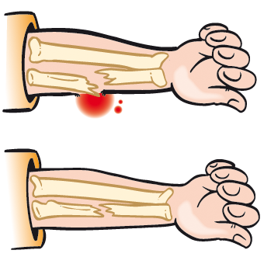
What is a fracture?
A fracture is a chip, crack or break in the bone
Closed (no associated wound)
Open (the fracture has broken the skin)
Complicated (the fracture is causing a further injury to vessels or organs, for example).
Notes:
Class question: What is a fracture?

Slide 22
Fractures – symptoms
Symptoms may include:
pain, tenderness, bruising and swelling at the site of the injury, especially with movement or pressure
in the case of an open wound with protruding bone, associated bleeding
loss of mobility or inability to weight-bear
deformity
grating sensation or sound (crepitus)
shortening or bending of the limb or unnatural limb position
nausea, pale and cold, clammy skin (shock).

Slide 23
Fractures – treatment
Do:
put on gloves
treat bleeding if required
immobilise in the position found (most comfortable for the casualty)
apply cold packs directly to reduce swelling
monitor for signs of shock
call the emergency services (999) if required.

Slide 24
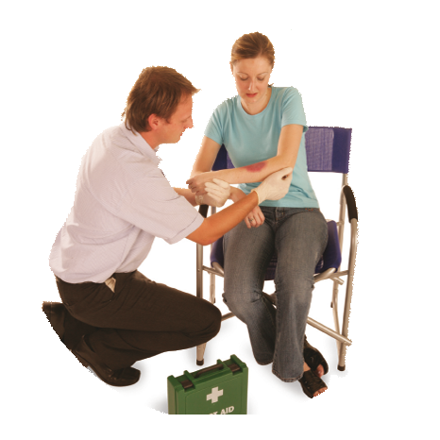
Applying a support sling
Gently support the arm. Ask
the casualty to assist
if possible.

Slide 25
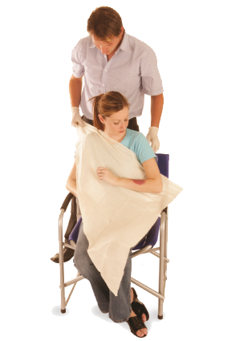
Applying a support sling (cont.)
Place a triangular bandage
with its base parallel
to the casualty’s body.

Slide 26
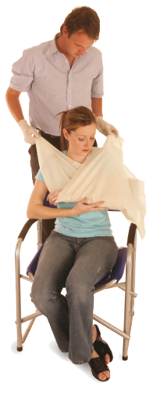
Applying a support sling (cont.)
Bring the lower end of the bandage up to meet the upper end at the shoulder. Secure with a reef knot.

Slide 27
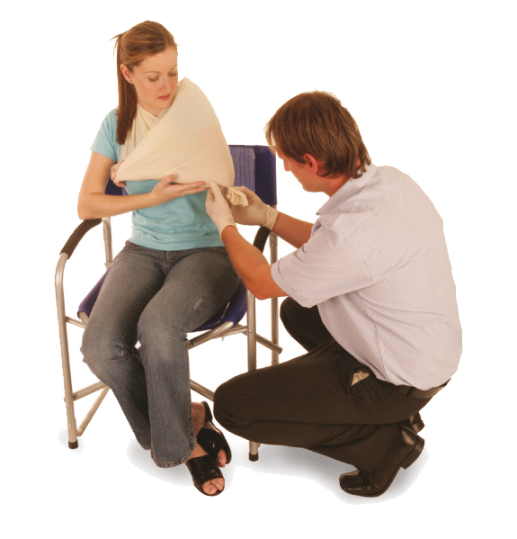
Applying a support sling (cont.)
Use a safety pin to secure at the elbow, or twist the bandage and tuck into
the sling at the back
of the arm.

Slide 28
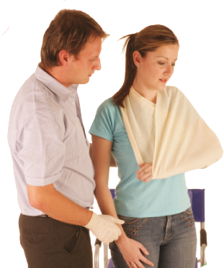
Applying a support sling – practical demonstration
With the arm safely supported in a sling, you can transport the casualty.
Notes:
Group exercise: Applying a support sling – practical demonstration
Once you have gone through this slide, gather the learners around and ask for a volunteer to fully demonstrate applying a support sling.
Split the class into groups and ask them to practise. Move round each group, offering feedback, advice and guidance.
An elevated sling is another method for a support sling, and it is worth researching this technique.

Slide 29
Applying an elevated sling
Ask the casualty to support their injured arm across their chest with their fingers resting on the opposite shoulder
Lay a triangular bandage over their chest, on top of the injured arm, and hold the point of the bandage just below the elbow on the injured side
Tuck the lower part of the bandage underneath the injured arm. Bring it diagonally across their back to meet the other end of the bandage
Check circulation. Once the sling is in place, check the fingers for warmth, colour and feeling to ensure the bandage is not too tight.

Slide 30
What is a dislocation?
A dislocation happens when bones in a joint become misaligned or displaced, often due to sudden impact. It may also damage surrounding ligaments
Severe pain
Restricted movement
Obvious deformity at a joint
Swelling or bruising
Numbness or tingling if nerves are affected.
Notes:
Class question: What is a dislocation?

Slide 31
Dislocation – treatment
Do:
support the joint in the position found
immobilise using slings or padding
apply a cold compress to reduce swelling and pain
seek urgent medical attention
Do not:
attempt to relocate the joint.

Slide 32
What are sprains and strains?
A sprain or strain is often referred to as a soft tissue injury – this is often attributed to activity or sports-related events
Sprain (ligament damage)
Pain, especially with movement
Swelling and bruising around a joint
Limited range of motion
No bone deformity
Usually follows a twisting injury
Strain (muscle/tendon damage)
Pain, especially in the muscle area
Muscle spasm or weakness
Swelling or bruising
Stiffness or limited movement
Often caused by overuse or overstretching.
Notes:
Class question: What are sprains and strains?

Slide 33
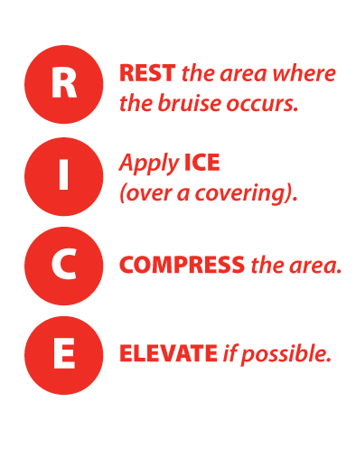
Sprains and strains – treatment
Sprain:
avoid heat and massage in the early stages
monitor and reassess for signs of worsening
Strain:
gentle movement after the pain subsides
monitor for persistent pain, bruising or swelling.
REST the injured limb
Apply ICE (over a covering)
COMPRESS the area
ELEVATE if possible
Notes:
Rest the injured limb
Ice (wrapped with material) applied for short periods of time
Compression with an elastic bandage
Elevation above ear level, if possible

Slide 34
How much do you know?​
CE
What is a fracture?
A sprain in the muscle
B
A chip, crack or break in the bone
A dislocation of the joint
A strain in the tendon
Notes:
Class exercise: How much do you know?
The correct answer is B.

Slide 35
How much do you know?​
CE
What is the primary characteristic of a dislocation?
A break in the bone
C
A sprain in the ligament
A misalignment or displacement of bones in a joint
A strain in the muscle
Notes:
Class exercise: How much do you know?
The correct answer is C.

Slide 36
How much do you know?​
CE
Which of the following is most accurate description of a sprain?
Muscle damage
B
Ligament damage
Bone fracture
Tendon damage
Notes:
Class exercise: How much do you know?
The correct answer is B.

Slide 37
Module 3
Be able to respond to an incident involving a casualty with a head, neck or torso injury in the outdoors
37
Notes:
Completion of this module will enable learners to meet the following learning outcome:
3. Be able to apply incident management and casualty assessment principles in the outdoors
This includes the following assessment criteria:
3.1 Identify the signs and symptoms of a:
a head injury
a spinal injury
a chest injury
an abdominal injury
a pelvic injury
3.2 Demonstrate how to administer first aid for a responsive casualty with a suspected:
a head injury
a spinal injury
a chest injury
an abdominal injury
a pelvic injury
3.3 Demonstrate how to administer first aid for an unresponsive casualty with a suspected:
a head injury
a spinal injury
a chest injury
an abdominal injury
a pelvic injury
Activities in this module include:
CQ: What is a head injury?
CQ: What is a spinal injury and how are they caused?
CQ: What is a chest injury?
CQ: What is abdominal trauma?
CE: Three multiple-choice questions (MCQs) (formative assessment)

Slide 38
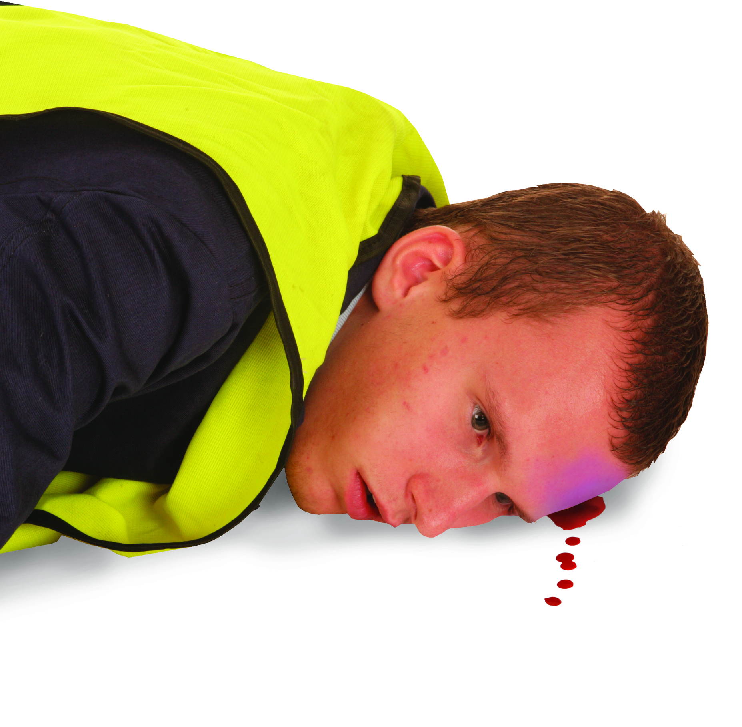
What is a head injury?
All head injuries can be life-threatening. Always seek medical assistance where a major head injury is suspected
Types of major head injuries include:
concussion
cerebral compression
skull fracture.
Notes:
Class question: What is a head injury?

Slide 39
Concussion – symptoms
A concussion is caused by shaking of the brain, usually after a blow to the head. This results in a temporary disturbance of normal brain activity
Concussion may include:
possible brief loss of consciousness
bleeding or swelling
dizziness and nausea
headache
brief loss of memory
slurred speech or delayed responses
blurred vision.

Slide 40
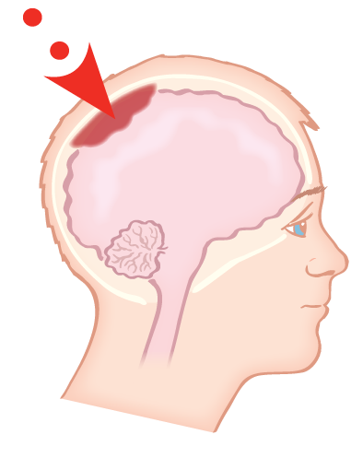
Cerebral compression – symptoms
A build-up of pressure on the brain caused by brain tissue swelling or an accumulation of blood
A cerebral compression may include:
an intense headache
drowsiness
unequal pupil sizes
a slow, strong pulse
weakness or paralysis down one side of the body
noisy breathing.

Slide 41
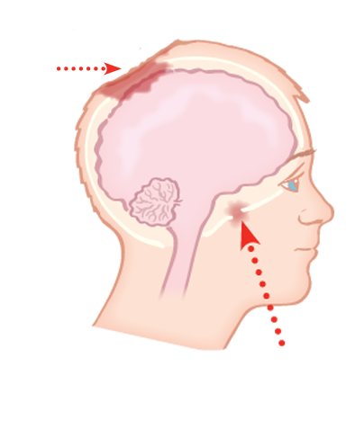
Skull fracture – symptoms
A skull fracture may be open or closed, and is caused by a direct or indirect blow to the head
Depressed fracture
A fractured skull may include:
an associated wound
tenderness and pain
depression/deformity of the skull
bruising and swelling at the site of injury
presence of cerebral spinal fluid (CSF) from the ears and nose.
Base of skull fracture

Slide 42
Head injuries – treatment of a responsive casualty
Do:
control bleeding and/or CSF loss
reassure the casualty, keeping them calm and still
place the casualty in a comfortable position, preferably on a flat surface with the head and shoulders raised
monitor the casualty and be ready to begin basic life support if needed
call the emergency services (999)
Do not:
move the head if you suspect a skull fracture – this could worsen a neck or spinal injury.

Slide 43
Head injuries – treatment of an unresponsive casualty
Do:
maintain the airway and breathing
consider spinal precautions
monitor the casualty and be ready to begin basic life support if needed
call the emergency services (999).

Slide 44
What is a spinal injury and how are they caused?
Spinal injuries are serious because damage to the spinal cord can lead to paralysis or even death
The main causes of spinal injury may be:
car accidents
diving into shallow water
slips, trips or falls from height
high-impact trauma – falls or collisions
KEY POINT
Spinal injuries should always be treated as a medical emergency.
Notes:
Class question: What is a spinal injury and how are they caused?

Slide 45
Spinal injury – symptoms
A spinal injury may include:
pain in the neck or back
numbness, tingling or weakness in the limbs
difficulty moving parts of the body
sensation changes or unusual posture
an unresponsive casualty with a history of back or neck trauma.

Slide 46
Spinal injury – treatment of a responsive casualty
Do:
call the emergency services (999)
keep the casualty in the position found
stabilise the head and neck in a neutral position
reassure the casualty and ask them to stay still
keep the casualty warm
monitor for any changes in condition.
Notes:
Movement of a casualty with spinal injuries is a last resort. Leave them stabilised in the position found unless:
you are on your own and have to leave the casualty to call an ambulance
the casualty’s airway is obstructed or they are vomiting
to maintain the airway and breathing

Slide 47
Spinal injury – treatment of a responsive casualty (cont.)
Do not:
move the casualty (unless absolutely necessary)
ask questions that require head movement (nodding or shaking head)
KEY POINT
Never move the casualty – unless you have to.
Notes:
Movement of a casualty with spinal injuries is a last resort. Leave them stabilised in the position found unless:
you are on your own and have to leave the casualty to call an ambulance
the casualty’s airway is obstructed or they are vomiting
to maintain the airway and breathing

Slide 48
Spinal injury – treatment of an unresponsive casualty
Do:
determine if the casualty is breathing – if not, commence basic life support
if breathing, do not move them unless they are in danger or choking on blood or vomit
Keep the head gently tilted back to maintain the airway
call the emergency services (999)
keep the casualty warm and monitor
keep the head and spine in line where possible
Do not:
move the casualty – unless you have to.
Notes:
Only consider the log roll technique by using multiple people if movement is unavoidable.

Slide 49
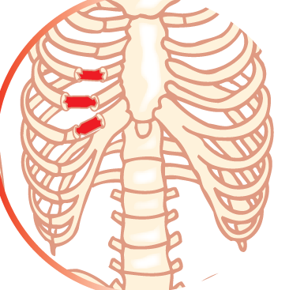
What is a chest injury?
Chest injuries or chest trauma (thoracic trauma) are serious. They can lead to disability or, in the worst cases, death
There are two main types of chest injuries, such as the following:
rib fracture
penetrating chest wounds.
Notes:
Class question: What is a chest injury?

Slide 50
Rib fracture – symptoms and treatment
A break or fracture in one or more of the ribs (middle ribs are most commonly affected)
Symptoms may include:
pain when breathing or moving
a grating or crunching sound when moving or breathing
Treatment
Help the casualty find the most comfortable position
Seek medical attention immediately.

Slide 51
Rib fracture – treatment of a responsive casualty
Do:
assist the casualty into a half-sitting position, leaning slightly toward the injured side
support the injured side with padding (if needed)
encourage slow, shallow breaths
monitor breathing and watch for changes in condition
seek medical help immediately
Do not:
give the casualty food or drink.

Slide 52
Rib fracture – treatment of an unresponsive casualty
Do:
maintain an open airway and assist breathing if needed
place in a position that supports breathing
call emergency services (999)
Do not:
place pressure over the injured area.

Slide 53
Penetrating chest wounds – symptoms
A penetrating chest wound may be caused by a gunshot, knife or any sharp object that punctures the chest wall. This is often referred to as a sucking chest wound
Symptoms may include:
a visible open wound
a sucking sound as air enters the wound
difficulty in breathing
blood bubbling from the wound
coughing up blood
KEY POINT
If untreated, this pressure can collapse a lung and affect both the heart and breathing function.

Slide 54
Penetrating chest wounds – treatment for a responsive casualty
Do:
call the emergency services (999)
wear gloves if available (to reduce infection risk)
assist the casualty into a half-sitting position, leaning slightly towards the injured side
control localised bleeding with direct pressure
treat for shock
monitor the casualty’s airway and be prepared to carry out basic life support.

Slide 55
Penetrating chest wounds – treatment for a responsive casualty (cont.)
Do not:
remove any embedded objects
apply a dressing – leave the open chest wound exposed to freely communicate with the external environment, or cover the wound with a non-occlusive dressing if necessary.

Slide 56
Penetrating chest wounds – treatment for an unresponsive casualty
Do:
maintain an open airway
assist breathing if needed
apply an occlusive dressing to an open wound (if appropriate)
place in a position that supports breathing
Do not:
place pressure over the injured area.
Notes:
An occlusive dressing is a special type of bandage that seals the wound completely, preventing air and moisture from passing through.

Slide 57
What is abdominal trauma?
Abdominal trauma refers to any injury to the abdomen caused by an external force
These injuries fall into two main categories:
blunt abdominal trauma (BAT)
penetrating abdominal trauma (PAT).
Notes:
Class question: What is abdominal trauma?

Slide 58
Blunt abdominal trauma (BAT) – symptoms
Blunt abdominal trauma can be caused by a punch, kick or object striking the abdomen
Symptoms may include:
abdominal pain
bruising and swelling
abrasions
nausea and vomiting
possible blood in the urine
associated signs of symptoms of shock.

Slide 59
Blunt abdominal trauma (BAT) – treatment for a responsive casualty
Do:
call the emergency services (999) immediately
place on disposable gloves
gather as much information as possible
ensure that the airway is maintained
try and lay the casualty down with their knees drawn up – if this is not possible, adopt the most comfortable position
monitor the casualty
treat for shock if necessary
be prepared to carry out basic life support.

Slide 60
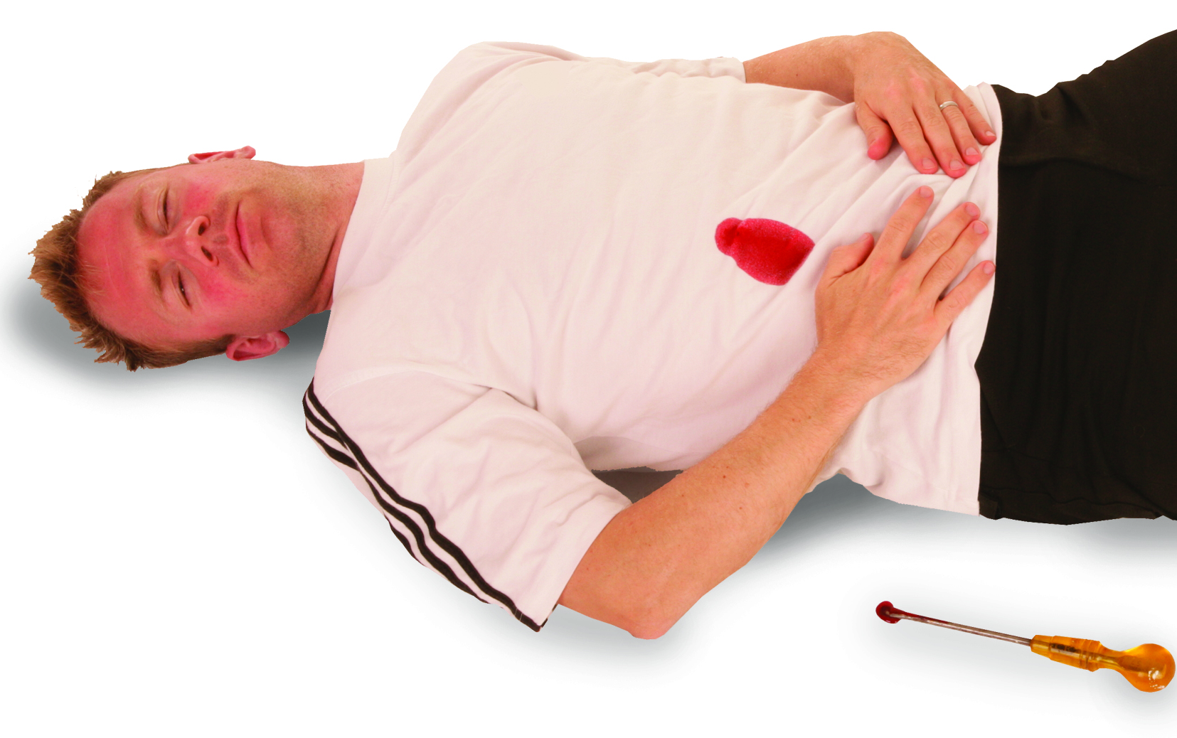
Penetrating abdominal trauma (PAT) – symptoms
Penetrating abdominal trauma occurs when a foreign object pierces the skin and enters the abdomen
Symptoms may include:
a visible associated wound
abdominal pain
guarding of the abdominal muscles
nausea and vomiting
a distressed state
possible blood in the urine
signs and symptoms of shock.

Slide 61
Penetrating abdominal trauma (PAT) – treatment for a responsive casualty
Do:
call the emergency services (999) immediately
wear gloves if available (to reduce infection risk)
ensure that the airway is maintained
control and treat any associated bleeding
try position the casualty laying down with the knees slightly bent (if comfortable)
monitor the casualty for signs of shock
be prepared to carry out basic life support
Do not:
apply direct pressure to protruding organs.

Slide 62
Penetrating abdominal trauma (PAT) – treatment for an unresponsive casualty
Do:
open the airway and monitor breathing
place in the recovery position (if safe)
if there are protruding organs, cover with a moist sterile dressing
monitor for signs of shock
Do not:
apply pressure to the abdomen
give the casualty food or drink.

Slide 63
Pelvic injury – symptoms
A pelvic injury is damage to the bones, ligaments or muscles in the pelvic region that can be caused by trauma, falls or accidents
Symptoms may include:
pain in hips, groin or lower back
difficulty standing, walking or moving legs
bruising or swelling around the pelvis
altered sensation or limb positioning
a casualty found unresponsive with suspected pelvic trauma.

Slide 64
Pelvic injury – treatment for a responsive casualty
Do:
help the casualty lie flat with legs straight and still
pad between knees and ankles to prevent movement
reassure and keep warm
monitor for signs of shock
call the emergency services (999)
Do not:
attempt to realign or reposition limbs.

Slide 65
Pelvic injury – treatment for an unresponsive casualty
Do:
call the emergency services (999) immediately
place padding between the knees and ankles if limbs are in contact
continue to monitor the airway, breathing and signs of shock
Do not:
avoid movement of the hips or legs and keep the casualty on their back if possible
only move if absolutely necessary.

Slide 66
How much do you know?​
CE
Which of the following is a potential sign of a spinal injury?
Headache and dizziness
B
Numbness or tingling in the limbs
Pain when moving the chest
Bruising around the pelvis
Notes:
Class exercise: How much do you know?
The correct answer is B.

Slide 67
How much do you know?​
CE
When caring for a responsive casualty with a suspected spinal injury, what is the most appropriate first-aid action?
Encourage them to walk to a more comfortable position
D
Place them immediately into the recovery position
Give them food and water for comfort
Manually stabilise the head and neck and keep them still
Notes:
Class exercise: How much do you know?
The correct answer is D.

Slide 68
How much do you know?​
CE
What should be the first priority when managing an unresponsive casualty with a suspected abdominal injury?
Open the airway and monitor breathing
A
Apply pressure directly to the abdomen
Sit them upright with knees raised
Offer small sips of water
Notes:
Class exercise: How much do you know?
The correct answer is A.

Slide 69
Module 4
Know how to provide first aid to a casualty with suspected major illness
69
Notes:
Completion of this module will enable learners to meet the following learning outcome:
4. Know how to provide first aid to a casualty with suspected major illness
This includes the following assessment criteria:
4.1 Identify signs and symptoms of the following life-threatening conditions:
heart attack
stroke
diabetic hypoglycaemic emergency
asthma
epileptic seizure
anaphylaxis
4.2 Demonstrate how to administer first aid to a casualty with one of the following life-threatening conditions:
heart attack
stroke
diabetic hypoglycaemic emergency
asthma
epileptic seizure
anaphylaxis
4.3 Demonstrate the use of a training device adrenaline auto-injector
Activities in this module include:
CQ: What is a heart attack?
CQ: What is angina?
CQ: What is a stroke?
CQ: What is diabetes?
CQ: What is asthma?
CQ: What is an epileptic seizure?
CQ: What is anaphylaxis?
GE: Anaphylaxis – treatment
GE: Using an auto-injector – practical demonstration
CE: Three multiple-choice questions (MCQs) (formative assessment)

Slide 70
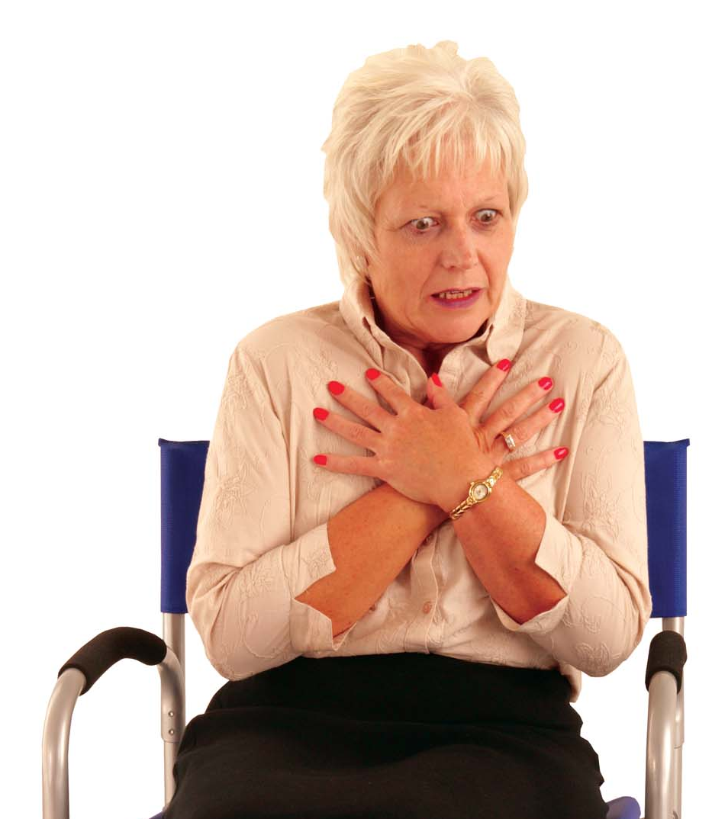
What is a heart attack?
A heart attack occurs when the coronary arteries, which supply the heart with oxygen-enriched blood, become blocked
Symptoms may include:
tightness and/or pain in the chest (mild or severe)
pain to the arms, neck and back
dizziness or a light-headed feeling
shortness of breath
nausea or vomiting
pale, clammy skin.
Notes:
Class question: What is a heart attack?
Explain that a heart attack occurs when the coronary arteries, which supply the heart with oxygen-enriched blood, become blocked.

Slide 71
Heart attack – treatment
Call the emergency services (999) immediately
Sit the casualty down with the legs drawn up or in a position which is comfortable
Loosen restrictive clothing
Keep the casualty warm and comfortable
Monitor the casualty’s airway and breathing
If casualty becomes unresponsive, then carry out basic life support
KEY POINT
Give 150-300mg of chewable aspirin to a casualty with chest pain due to a suspected heart attack (if available).

Slide 72
What is angina?
Angina (angina pectoris) is caused by a build-up of fatty deposits inside the coronary arteries, causing them to narrow. This narrowing impedes the flow of blood to the heart and causes pain similar to that of a heart attack
Symptoms may include:
tightening or squeezing of the chest
pain radiating in the chest often spreading to the jaw, neck, arms and back
shortness of breath
anxiety and weakness.
Notes:
Class question: What is angina?

Slide 73
Angina – treatment
Ascertain if this is the first attack or if they have previously been diagnosed
Allow the casualty to rest
Encourage them to take their medication if applicable – usually GTN spray (Glyceryl trinitrate)
Seek medical attention if it’s the casualty’s first attack or if you are unsure of the condition
KEY POINT
An angina attack is similar to a heart attack, however, an angina sufferer will recover with rest and the attack should only last between 1-15 minutes.

Slide 74
What is a stroke?
A stroke causes either short-term or permanent damage to the brain and/or body
If you suspect a stroke, act FAST. Call 999.
Notes:
Class question: What is a stroke?

Slide 75

Stroke – symptoms
Facial weakness
Can the person smile?
Has the face dropped on one side?
Arm weakness
Can the person raise both arms?
Speech problems
Can the person speak clearly and understand what you say?
By calling 999, early treatment can be given, which can prevent further damage.

Slide 76
Stroke – treatment
Call for an ambulance (999) immediately
If responsive, lay the casualty down with the head and shoulders raised or assist into a comfortable position
If unconscious, place into the recovery position, affected side down
Loosen any restrictive clothing
If there are any secretions, then wipe them away
Monitor the airway and breathing
Be prepared to carry out basic life support
KEY POINT
Call for an ambulance as soon as possible. The speed of treatment can have a major impact on the casualty’s recovery.

Slide 77
What is diabetes?
Diabetes is a condition caused by the body’s failure to regulate blood sugar levels – this regulation is controlled by insulin
Hypoglycaemia – blood sugar too low
Hyperglycaemia – blood sugar too high.
Notes:
Class question: What is diabetes?
Explain that there are over 40 different types of diabetes so, to keep both symptoms and treatment simple, we have placed the different types of diabetes into two groups: hypoglycaemia and hyperglycaemia.
Hypoglycaemia is when the blood sugar content is too low, and Hyperglycaemia is when the blood sugar content is too high.

Slide 78
Hypoglycaemia – symptoms
Symptoms may include:
blurred vision
hunger
tiredness or lethargy
lack of concentration
increased heart rate
headaches
tingling sensations
noticeable changes in personality
feeling faint.
Notes:
Explain that there are over 40 different types of diabetes so, to keep both recognition and treatment simple, we have placed the different types of diabetes into two groups: hypoglycaemia and hyperglycaemia.
Hypoglycaemia is when the blood sugar content is too low, and Hyperglycaemia is when the blood sugar content is too high.

Slide 79
Hypoglycaemia – treatment
Sit the casualty down, calm and reassure
For suspected hypoglycaemia, ask the casualty to take their glucose tablets, equating to 15-20g of glucose. If glucose tablets are not available, use another dietary form of sugar (jelly babies/non-diet fizzy drink)
If there is no improvement in the casualty’s condition, call for the emergency services (999)
Monitor the condition. If the casualty becomes unconscious, carry out basic life support.

Slide 80
Hyperglycaemia – symptoms
Symptoms may include:
sweet, fruity-smelling breath
an increased need to urinate
increased thirst
dry mouth
loss of appetite
tiredness and lethargy.

Slide 81
Hyperglycaemia – treatment
Sit the casualty down
Encourage the casualty to use their medication
If they have not been previously diagnosed, then call the emergency services (999)
Monitor the condition. If the casualty becomes unconscious, carry out basic life support.

Slide 82
What is asthma?
Asthma is a condition that affects and inflames the airways, making it difficult to manage normal breathing
There are many ‘asthma triggers’, such as:
dust
pet fur
house dirt.
Notes:
Class question: What is asthma?

Slide 83
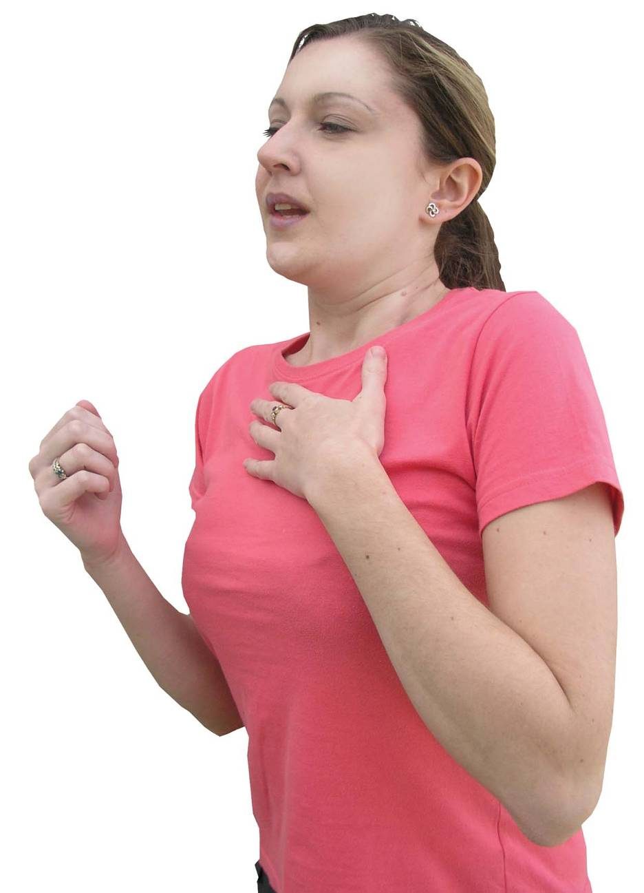
Asthma – symptoms
Symptoms may include:
breathlessness (gasping for breath)
wheezing
tightness of the chest
bouts of coughing
cyanosis (grey/blue lips and skin)
may become unconscious.

Slide 84
Asthma
Asthma – treatment
Assist the casualty to sit down
Ensure use of medication (reliever inhaler) and get the casualty to follow own personal action plan
Reassure the casualty
If the attack is prolonged, call the emergency services (999)
Be prepared to carry out basic life support.

Slide 85
What is an epileptic seizure?
An epileptic seizure happens when a sudden burst of excessive electrical activity in the brain temporarily disrupts the signals passing between brain cells
To keep the symptoms and treatment at a general level, we group these into two main forms:
partial seizures
generalised seizures.
Notes:
Class question: What is an epileptic seizure?
There are more than 40 different types of epilepsy, so to keep both recognition and treatment easy for the emergency first-aider, we have placed the differing forms of epilepsy into two main groups:
partial seizures
generalised seizures

Slide 86
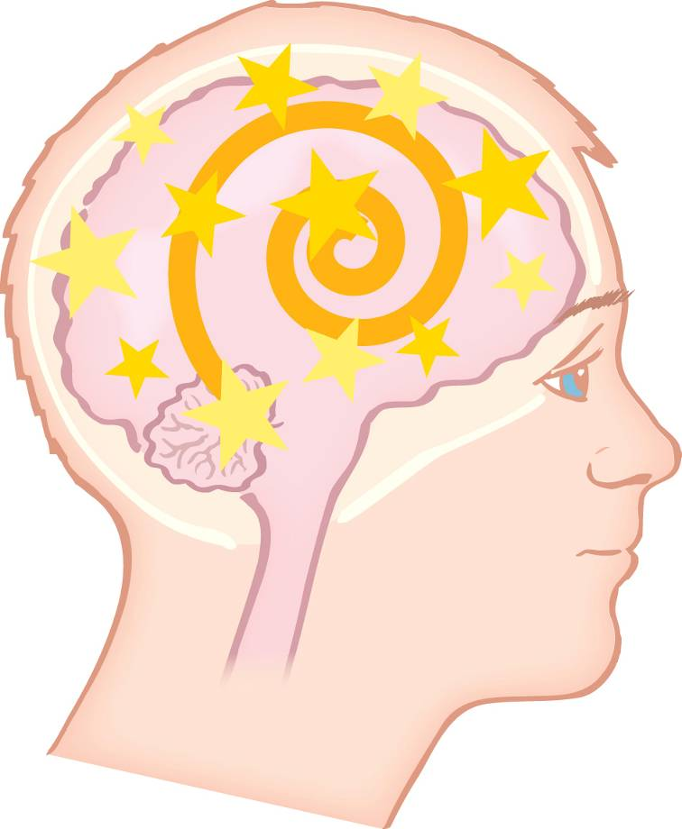
Partial seizures – symptoms
A partial seizure is a brief loss of responsiveness for a few seconds or minutes
Symptoms may include:
staring blankly
mood swings
the feeling of déjà vu
tingling sensations (pins and needles)
twitching of the face or body.

Slide 87
Partial seizures – treatment
Ensure the casualty’s safety (make sure people or objects are kept away)
See if the casualty can be seated
Stay with the casualty and time the episode
Refer the casualty to a doctor if this is the first seizure.

Slide 88
Generalised seizures
The most common and widely recognised, a generalised seizure is called a tonic-clonic seizure. This affects the body in progressive ways
A tonic-clonic seizure is sometimes referred to as a grand mal and occurs in stages
Before a tonic-clonic seizure, a casualty may experience confusing thoughts, headaches or unusual tastes and smells. This is called an aura.

Slide 89
Generalised seizures – symptoms
Tonic phase (after ‘aura’ phase) – symptoms may include:
convulsions
muscles become rigid
arching back
blue or purple colouration to the skin (cyanosis)
.
Clonic phase – symptoms may include:
the limbs make violent jerking movements
rolling eyes and crying out
clenched teeth
possible loss of bladder and bowel control
lack of consciousness.
.

Slide 90
Generalised seizures – treatment
Ensure the casualty’s safety by removing dangerous items from within the vicinity where possible
Remove any spectacles and loosen clothing around the neck
Do not restrain the casualty
Record the time and duration of the seizure
If the seizure continues (timings dependent on local policy), or there are multiple seizures, then contact the emergency services (999).

Slide 91
Generalised seizures – treatment (cont.)
When the seizure stops, clear any excess saliva and check airways and breathing
Place the casualty into the recovery position
Be conscious of the casualty’s embarrassment
Reassure the casualty
If it is their first seizure, call for an ambulance (999)
KEY POINT
Do not place objects in the casualty’s mouth.

Slide 92
What is anaphylaxis?
Anaphylaxis is an extreme and potentially life-threatening allergic reaction, which results in rapid chemical changes in the body
Anaphylaxis can be caused by a ‘trigger’, such as insect stings, foods (for example, nuts and shellfish) and medicines, such as penicillin.
Notes:
Class question: What is anaphylaxis?
Tutor note
The tutor is to demonstrate the use of a training device adrenaline auto-injector. Where possible, allow learners the chance to practise with a training device.

Slide 93
Anaphylaxis – symptoms
Symptoms may include:
swelling of the mouth, tongue, face and neck
difficulty in breathing
red, blotchy and itchy skin
nausea
anxiety.
Notes:
Tutor note
The tutor is to demonstrate the use of a training device adrenaline auto-injector.

Slide 94
Anaphylaxis – treatment
If you think the person has anaphylaxis, encourage the casualty to use their medication if applicable (antihistamine or auto injector)*
Call the emergency services (999)
Sit the casualty down (if responsive)
Remove the trigger if possible
Monitor the casualty (airway and breathing)
Be prepared to carry out basic life support
KEY POINT
It is important that the casualty is seen by a qualified medical practitioner.
Notes:
Group exercise: Anaphylaxis – treatment
Split the learners into groups for a hands-on demonstration where each learner uses a training pen on each other.
Important: the demonstration must be with a training device only.
show safe handling, remove the safety cap and press against thigh for three seconds
hold in place, then massage the area lightly
be aware of the need to administer a second dose if there is no improvement after five minutes
simulated practise of drawing up a 1:1000IM dose (if in scope)
emphasise the safe disposal of sharps
Ensure every learner gets a turn with a training pen. Reinforce the three-second rule and leg placement. Use visuals for drawing adrenaline if it is within the learner's scope.
*There is no legal problem with any person administering adrenaline using an auto-injector if it could save someone’s life. The first-aider must be able to recognise an anaphylactic reaction, use an auto-injector and ensure they work to their employer’s guidelines and also those of the training organisation that issued their first-aid qualification.

Slide 95
How much do you know?​
CE
Which of the following is a common sign of a heart attack?
Sudden stiffening of the body and jerking movements
B
Chest pain spreading to the arm, neck or jaw
Difficulty breathing with wheezing sounds
Swelling of the lips, tongue and throat
Notes:
Class exercise: How much do you know?
The correct answer is B.

Slide 96
How much do you know?​
CE
A casualty is experiencing a hypoglycaemic emergency but is still responsive. What is the correct first-aid action?
Encourage them to take deep breaths and rest quietly
D
Place them into the recovery position immediately
Ask them to avoid eating or drinking until help arrives
Give them a fast-acting sugar, such as glucose gel or a sugary drink
Notes:
Class exercise: How much do you know?
The correct answer is D.

Slide 97
How much do you know?​
CE
When using an adrenaline auto-injector, where should it be applied?
Into the upper arm muscle
C
Into the abdomen, just above the navel
Firmly against the outer mid-thigh
Into the buttock muscle
Notes:
Class exercise: How much do you know?
The correct answer is C.

Slide 98
Module 5
Be able to respond to an incident involving the effects of cold and heat outdoors
98
Notes:
Completion of this module will enable learners to meet the following learning outcome:
5. Be able to respond to an incident involving the effects of cold and heat in the outdoors
This includes the following assessment criteria:
5.1 Identify the signs and symptoms of:
hypothermia
frostbite
dehydration
heat exhaustion
5.2 Demonstrate how to administer first aid to a casualty with the signs of:
hypothermia
frostbite
dehydration
heat exhaustion
Activities in this module include:
CQ: What is extreme cold?
CQ: What are the effects of extreme cold?
CQ: What are the symptoms of hypothermia?
CQ: What are the symptoms of frostbite?
CQ: What is extreme heat?
CQ: What are the effects of extreme heat?
CQ: What are the symptoms of heat exhaustion?
CQ: What are the symptoms of dehydration?
CE: Two multiple-choice questions (MCQs) (formative assessment)

Slide 99
What is extreme cold?
Extreme cold is prolonged exposure to very low temperatures (below 0°C/32°F), made worse by wind chill or moisture
Key characteristics:
common in winter, high altitudes and snowy environments
increases heat loss from the body, especially with wet or inadequate clothing
risk is higher with immobility, poor shelter or wind or water exposure.
Notes:
Class question: What is extreme cold?

Slide 100
What are the effects of extreme cold?
Hypothermia – affects the whole body, causing a drop in core temperature (life-threatening)
Frostbite – tissue freezing, usually on the fingers, toes, nose and ears
Chilblains – repeated or prolonged exposure to cold/damp conditions on the fingers, toes, nose and ears (not life-threatening)
Cold water shock – occurs when the body is abruptly immersed in water, generally below 15°C.
Notes:
Class question: What are the effects of extreme cold?
Cold water shock exposure – occurs when the body is abruptly immersed in water, generally below 15°C. This sudden immersion triggers involuntary physical reactions, even in healthy individuals.

Slide 101
What are the symptoms of hypothermia?
Hypothermia symptoms progress from mild to life-threatening if untreated
Early symptoms
Shivering
Cold or pale skin
Confusion or irrational behaviour
Slurred speech
Lack of or poor co-ordination
Severe symptoms
Drowsiness
Slow pulse
Shallow breathing
Collapse or unconsciousness.
Notes:
Class question: What are the symptoms of hypothermia?

Slide 102
Hypothermia – treatment
Do:
move the casualty to shelter to reduce heat loss
remove wet clothing and replace with dry, insulated layers
wrap in a survival blanket or insulating materials
offer warm drinks (if fully conscious)
monitor breathing and be prepared to resuscitate
call for emergency services/evacuation immediately (999).
Notes:
Sudden or rough rewarming can cause dangerous complications. Rewarm gradually.

Slide 103
Hypothermia – treatment (cont.)
Do not:
rub limbs
use direct heat sources
KEY POINT
Rewarm gradually. Sudden or rough rewarming can cause dangerous complications.
Notes:
Sudden or rough rewarming can cause dangerous complications. Rewarm gradually.

Slide 104
What are the symptoms of frostbite?
Knowing the symptoms of frostbite helps you act quickly and reduce the risk of long-term damage
Skin changes
Cold, numb skin that turns white, blue or grey
Skin feels hard or waxy
Damage changes
Blisters
Loss of sensation.
Notes:
Class question: What are the symptoms of frostbite?

Slide 105
Frostbite – treatment
Do:
warm affected areas gradually, using body heat
protect the area with a dry, non-stick dressing
immobilise and elevate affected limb if possible
evacuate for medical treatment
Do not:
allow further exposure to the cold
rub the skin or use open flames or stoves
rewarm if there is a risk of refreezing
KEY POINT
Frostbite can cause permanent tissue damage if not treated quickly.

Slide 106
What is extreme heat?
Extreme heat is sustained high temperatures, often above 30°C (86°F), especially with high humidity or poor ventilation
Key characteristics:
occurs during heatwaves, in hot climates or enclosed poorly ventilated spaces
the body struggles to cool itself, especially through sweating
risk increases with dehydration, physical exertion or lack of shade.
Notes:
Class question: What is extreme heat?

Slide 107
What are the effects of extreme heat?
Heat exhaustion – caused by the body’s core temperature rising above 37°C. It usually happens after prolonged exposure to high temperatures or strenuous activity in hot, humid conditions
Heat stroke – caused by the body’s core temperature rising to 40°C or higher (life-threatening).
Notes:
Class question: What are the effects of extreme heat?

Slide 108
What are the effects of extreme heat? (cont.)
Dehydration – occurs when the body loses more fluids than it takes in
Sunburn – skin damage caused by overexposure to ultraviolet (UV) radiation, most commonly from the sun
Heat rash – a skin irritation that develops when sweat ducts become blocked and sweat becomes trapped under the skin.
Notes:
Class question: What are the effects of extreme heat?

Slide 109
What are the symptoms of heat exhaustion?
Heat exhaustion may cause:
headache and dizziness
nausea or vomiting
sweating
pale, clammy skin
a rapid pulse
shallow breathing
muscle cramps
feeling weak, tired or faint
an elevated body temperature.
Notes:
Class question: What are the symptoms of heat exhaustion?

Slide 110
Heat exhaustion – treatment
Do:
move the casualty to a shaded, cool area
remove excess clothing and personal protective equipment (PPE)
encourage the casualty to lie down with legs raised
give the casualty cool water to drink (small sips, frequently)
use cool, wet clothes or fanning to aid cooling
monitor closely. If symptoms persist or worsen, call the emergency services (999).

Slide 111
Heat exhaustion – treatment (cont.)
Do not:
give them alcohol or caffeine
allow them to continue physical activity
leave them unattended while symptoms are present
KEY POINT
Heat exhaustion can develop into heat stroke if untreated.

Slide 112
What are the symptoms of dehydration?
Dehydration may cause:
dark urine or reduced urination
dry mouth and lips
headache and dizziness
tiredness or confusion
poor co-ordination.
Notes:
Class question: What are the symptoms of dehydration?

Slide 113
Dehydration – treatment
Do:
encourage small, frequent sips of water or an oral rehydration solution
rest in a cool, shaded area
monitor and advise medical attention if symptoms persist or worsen
Do not:
give large amounts of fluid quickly
give caffeine or alcohol
ignore ongoing symptoms
KEY POINT
Untreated dehydration can worsen rapidly.

Slide 114
How much do you know?​
CE
Which of the following is an early symptom of hypothermia?
Hot, dry skin
D
Severe thirst
Rapid pulse
Shivering
Notes:
Class exercise: How much do you know?
The correct answer is D.

Slide 115
How much do you know?​
CE
Which of these is the correct treatment for frostbite?
Warm affected areas gradually, using body heat
A
Rub the skin to restore circulation
Use open flames or stoves to warm quickly
Rewarm if there is a risk of freezing
Notes:
Class exercise: How much do you know?
The correct answer is A.

Slide 116
Module 6
Know how to provide first aid to a casualty with minor injuries
116
Notes:
Completion of this module will enable learners to meet the following learning outcome:
6. Know how to provide first aid to a casualty with minor injuries
This includes the following assessment criteria:
6.1 Identify the signs and symptoms of:
splinters
blisters
minor burns/scalds
animal bites
stings
poisoning
dust in eyes
bright light eye injury
6.2 Demonstrate how to deliver first aid to a casualty with the signs of:
splinters
blisters
minor burns/scalds
animal bites
stings
poisoning
dust in eyes
bright light eye injury
Activities in this module include:
CQ: What are splinters?
CQ: What are the causes of burns and scalds?
CQ: What is poison?
CQ: What are blisters?
GE: Animal bites – treatment
CQ: What is bright light eye injury?
CE: Two multiple-choice questions (MCQs) (formative assessment)

Slide 117
Minor injuries
Minor injuries are not life-threatening, however, if untreated, they may lead to infection or other complications.

Slide 118
What are splinters?
Splinters are foreign objects that embed themselves into the skin, either fully or partially
Splinter injuries are often painful and commonly caused by materials such as:
glass
wood
plastic
metal.
Notes:
Class question: What are splinters?

Slide 119
Splinters – symptoms
Symptoms may include:
pain at the site of the injury
visibility of the splinter
swelling at the site of the injury
associated bleeding.
Notes:
For larger splinters and fully embedded splinters that cannot be drawn out, please seek qualified medical attention – the drawing technique is the method of using a plaster to try and draw the splinter out overnight.
If the splinter is under a fingernail or toenail, then seek medical attention as the extraction may become complicated.

Slide 120
Splinters – treatment
Clean the skin area of the splinter
Use clean tweezers to remove any visible splinters
Wash the area again and apply a dressing if needed
KEY POINT
Do not dig deeply for the splinter. If it is embedded, do not attempt to remove it – instead, use the drawing technique.

Slide 121
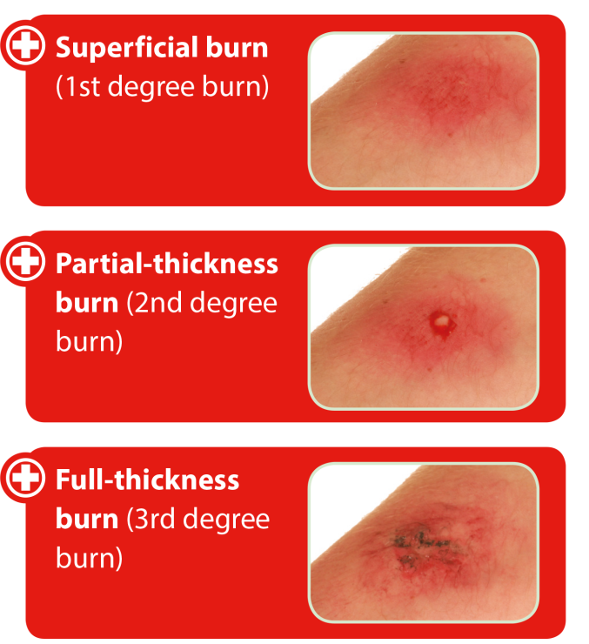

Burns and scalds
The severity of the injury depends on the classification of the burn. There are three recognised types
KEY POINT
Human skin is made up of three layers: the outer layer (epidermis), the middle layer (dermis) and the innermost layer (subcutaneous tissue).

Slide 122
What are the causes of burns and scalds?
A burn or a scald can be caused by:
radiation – sunburn, ultraviolet lamps, overexposure to X-rays
dry heat – hot surfaces, fire, friction
electricity – domestic low-voltage appliances, lighting, high voltage, cables
extreme cold – freezing temperatures, frozen foreign objects, refrigerants
chemicals – acids and alkalis, domestic cleaning products, industrial chemicals
toxic fumes – inhalation from a fire
wet heat – hot water, steam, fat/oil.
Notes:
Class question: What are the causes of burns and scalds?

Slide 123
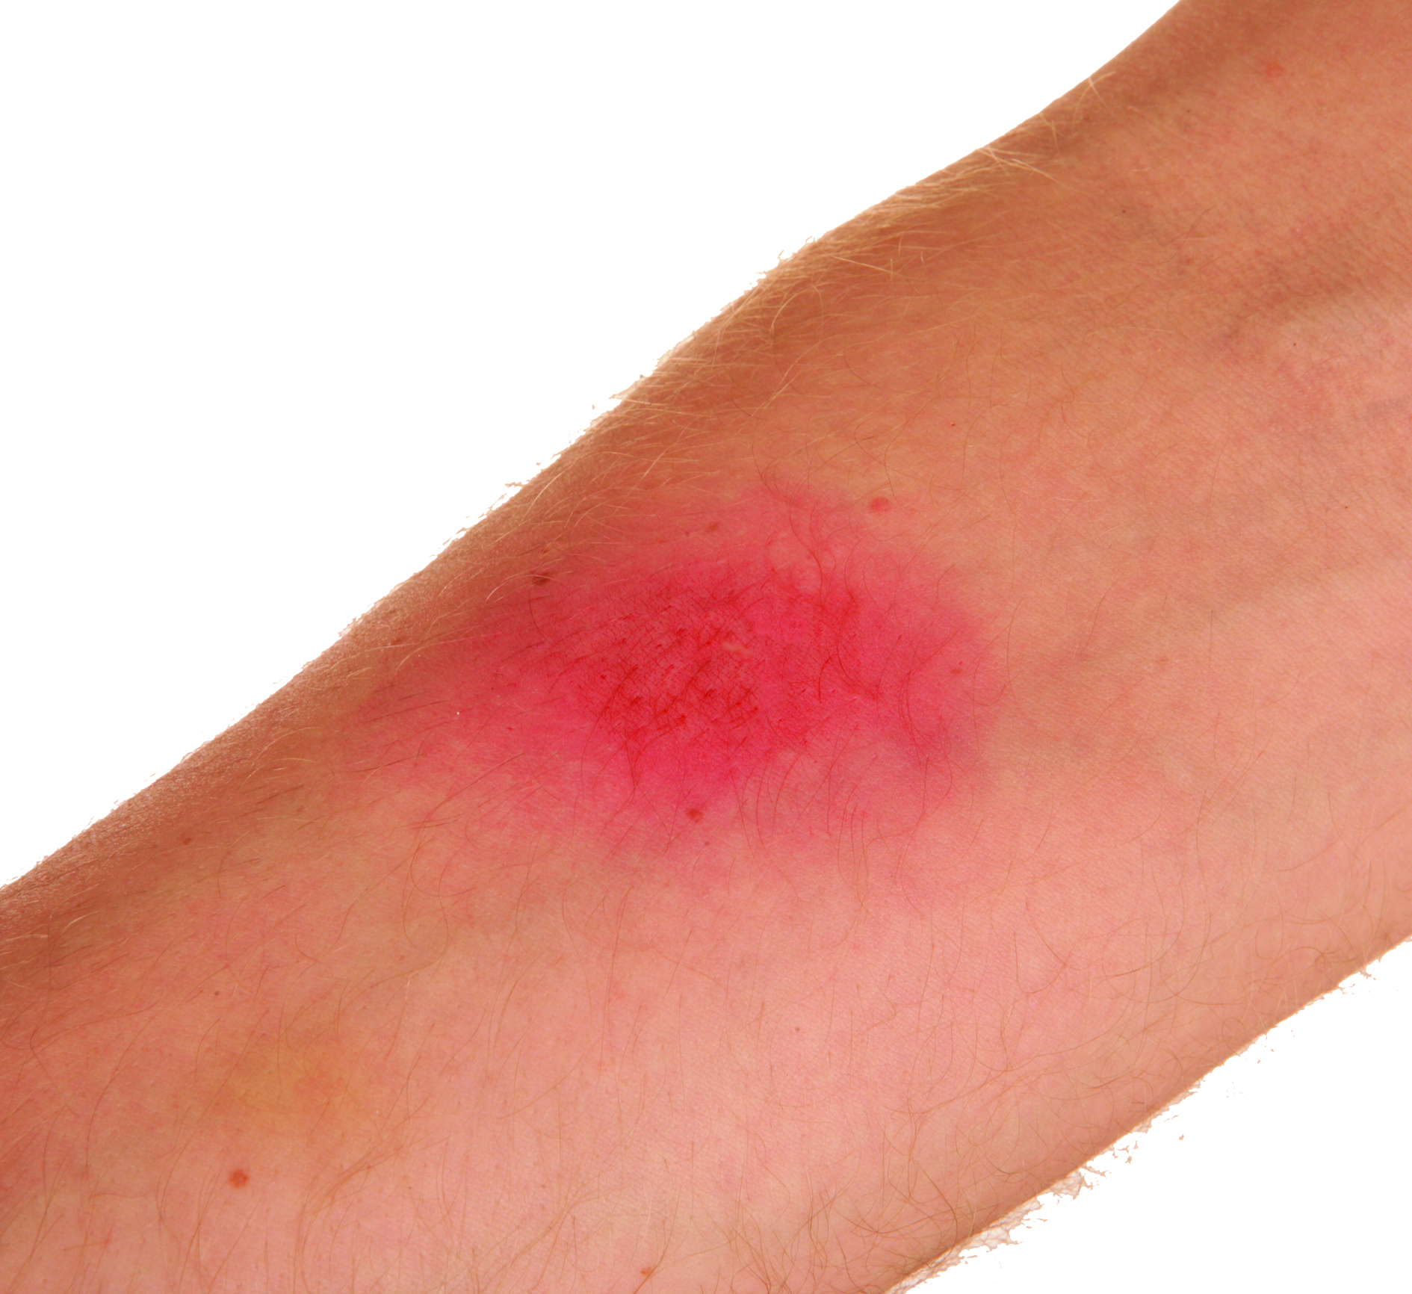
Minor burns – symptoms
Symptoms may include:
pain at the site of the injury
redness, tenderness and swelling
blistering.

Slide 124
Minor burns – treatment
Remove the source of the burn if possible
Put on your disposable gloves
Remove clothing if it is not stuck to the burnt skin. Flush the wound with water for at least 20 minutes
Dress the burn with a loose sterile dressing. If unavailable, place a layer of clingfilm over the burn and continue cooling.**

Slide 125
Minor burns – treatment (cont.)
Remove restrictive clothing or jewellery as swelling may occur
Do not try to remove anything stuck to the burnt skin
Seek medical attention immediately
** Cling film is sterile if the first few inches are discarded. It does not stick to the skin, and the condition of the burn can clearly be seen through it.

Slide 126
What is poison?
A poison can be defined as a foreign substance that enters by means of:
ingestion
inhalation
absorption
injection.
Notes:
Class question: What is poison?

Slide 127
Poisons – symptoms
Symptoms may include:
pains in the stomach
impaired vision
confusion
seizures
unconsciousness
increased/decreased heart rate
the smell of fumes or chemicals
burns, burning sensations and rashes
nausea and vomiting
difficulty in breathing.

Slide 128
Poisons – treatment
Call for the emergency services (999)
Ensure the scene is safe
Remove the cause or remove the casualty from the scene
Identify the poison
Be prepared to carry out basic life support
Do not encourage vomiting or moving around
KEY POINT
If you suspect poisoning, use a face shield if you need to give rescue breaths.
Notes:
Explain the general treatment of poisonings before going into the specifics.

Slide 129
What are blisters?
Blisters are small pockets of fluid that form on or under the skin. They usually develop as the body’s way of protecting and healing itself after damage
Causes may include:
friction – for example, from tight shoes rubbing against your heel
burns or scalds – including sunburn
extreme cold – such as frostbite
allergic reactions or skin conditions – such as eczema or contact dermatitis
infections – such as chickenpox, cold sores or impetigo.
Notes:
Class question: What are blisters?

Slide 130
Blisters – symptoms
Symptoms may include:
a painful, fluid-filled bubble under the skin
redness or swelling.

Slide 131
Blisters – treatment
Do:
clean and cover with a sterile dressing or blister pad
if the blister bursts, clean it with mild antiseptic and cover it to prevent infection
monitor for signs of infection, such as redness, pus or spreading pain
KEY POINT
Do not burst the blister. Burst blisters increase the risk of infection.

Slide 132
Animal bites
Animal bites are wounds that occur when an animal’s teeth break through the skin
Bites can range from small punctures to deep lacerations. They carry a high risk of infection because bacteria from the animal’s mouth can enter the wound.

Slide 133
Animal bites – symptoms
Symptoms may include:
breaks in the skin, puncture wounds or tears
bleeding, swelling and bruising
a risk of infection (such as redness, pus or fever) and possible tetanus or rabies, depending on the animal.
Notes:
Additional class question: What animals could present bite risks in outdoor settings?
Examples include: dogs, snakes, horses, farm animals and rodents

Slide 134
Animal bites – treatment
Wash the wound thoroughly with clean running water
Control the bleeding with direct pressure and a sterile dressing
Seek urgent medical attention for antibiotics, tetanus or rabies vaccinations as required.
Notes:
Tutors are to stress the danger of infection and the importance of washing thoroughly with water. Highlight the need for medical help for antibiotics, tetanus or rabies prophylaxis, depending on the situation.
Group exercise: scenario role-play – casualty with a bleeding bite
Learners are to practise controlling bleeding, dressing the wound and discussing when to escalate for medical support.

Slide 135
Dust in the eyes
Dust in the eyes happens when small particles, such as soil, sand or grit get onto the surface of the eye
This can cause:
irritation
redness
watering
discomfort.

Slide 136
Dust in eyes – symptoms
Symptoms may include:
irritation
redness
watery eyes
pain or discomfort when blinking
blurred vision.
Notes:
Class question: What situations outdoors could cause dust or grit in the eyes?
Examples include: wind, campfires, grit from paths and sand.
Tutor note: stress the importance of flushing with clean water and avoiding rubbing. If removal fails or vision is impaired, cover both eyes and seek medical help.

Slide 137
Dust in eyes – treatment
Do:
wash the eye with clean water or sterile eyewash solution while tilting the head to the side
if the particle does not wash out or if vision is affected, seek medical help
cover both eyes to prevent movement if medical evacuation is needed
Do not:
allow the casualty to rub the eye.
Notes:
Additional class question: What situations outdoors could cause dust or grit in the eyes?
Examples include: wind, campfires, grit from paths and sand.
The tutor is to stress the importance of flushing with clean water and avoiding rubbing. If removal fails or vision is impaired, cover both eyes and seek medical help.

Slide 138
What is bright light eye injury?
Bright light eye injury, sometimes called flash burn or photokeratitis, occurs when the eye is exposed to very strong light, such as:
sunlight reflected off snow or water
welding arcs
bright torches
Notes:
Class question: What is bright light eye injury?

Slide 139
Bright light eye injury – symptoms
Symptoms may include:
pain
watering and redness of the eyes
sensitivity to light (photophobia)
blurred vision or temporary loss of vision.
Notes:
Additional class question: What sources of bright light might cause eye injury outdoors?
Examples include: snow glare, welding, lasers and looking at the sun.
Explain that this is sometimes called 'snow blindness' or 'flash burn'. Resting in darkness is the most effective immediate aid. Stress not to rub the eyes and to seek medical help if vision does not recover.

Slide 140
Bright light eye injury – treatment
Do:
move the casualty out of direct light to a shaded area
ask the casualty to rest with eyes closed if possible
cover the eyes lightly with a clean dressing if needed for comfort
seek medical attention if symptoms persist or vision is impaired
Do not:
allow the casualty to rub the eye.

Slide 141
How much do you know?​
CE
Which of the following is the most common sign of a bright light eye injury?
Persistent coughing and a sore throat
B
Pain, watering eyes and sensitivity to light
Localised redness and swelling at the site of a sting
Blistering of the skin after heat exposure
Notes:
Class exercise: How much do you know?
The correct answer is B.

Slide 142
How much do you know?​
CE
What is the most appropriate first-aid action for a casualty with a splinter?
Push the splinter deeper to stop bleeding
C
Squeeze the skin around the splinter to expel it
Remove the splinter carefully with clean tweezers, clean the area and cover with a plaster if needed
Leave the splinter in place and bandage it tightly to prevent infection
Notes:
Class exercise: How much do you know?
The correct answer is C.

Slide 143

Thank you for listening

