Slide 1
Gift of Life
Bone marrow & blood stem cells

Slide 2
Agenda
Bone marrow
Transplantation methods
01
04
Peripheral blood
Procedure
02
05
Diseases & treatment
Vocabulary and pronunciation challenge
03
06

Slide 3
Bone marrow

Slide 4

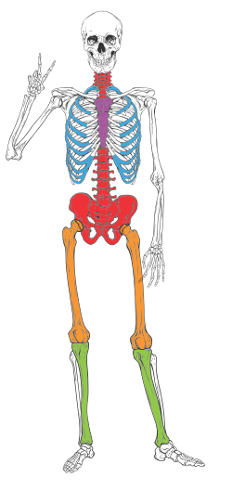

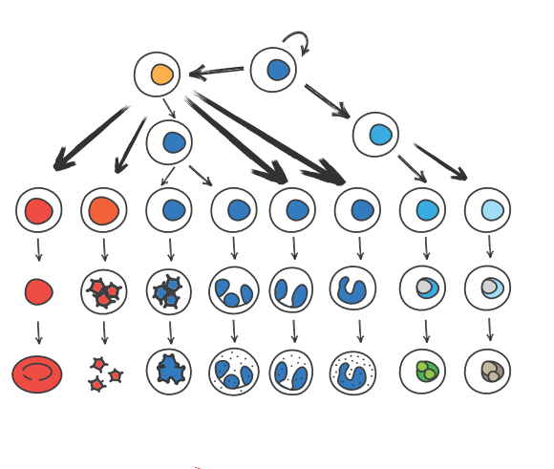
Bone marrow – the blood factory
Notes:
.

Slide 5
Peripheral blood

Slide 6
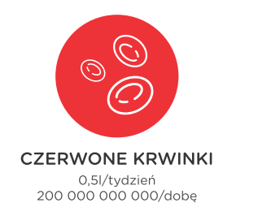
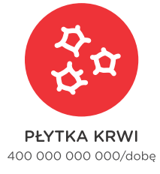
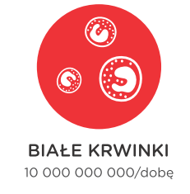






Peripheral blood
Red Blood Cells Erythrocytes
White Blood Cells Leucocytes
Platelets
Thrombocytes

Slide 7



Nobody is perfect, we all make mistakes…

Slide 8



… but mistakes cause problems
Army of mutants = cancer, blood errors

Slide 9
Diseases & treatment

Slide 10
Blood Cancers
Leucemias
Lymphomas
MDS
Polycythemia vera
Essential Thrombocytemia
OMF
Multiple myeloma
& many others

Slide 11
Non-cancer diseases
Hemoglobinopathy
Anemias
Immunodeficiency

Slide 12
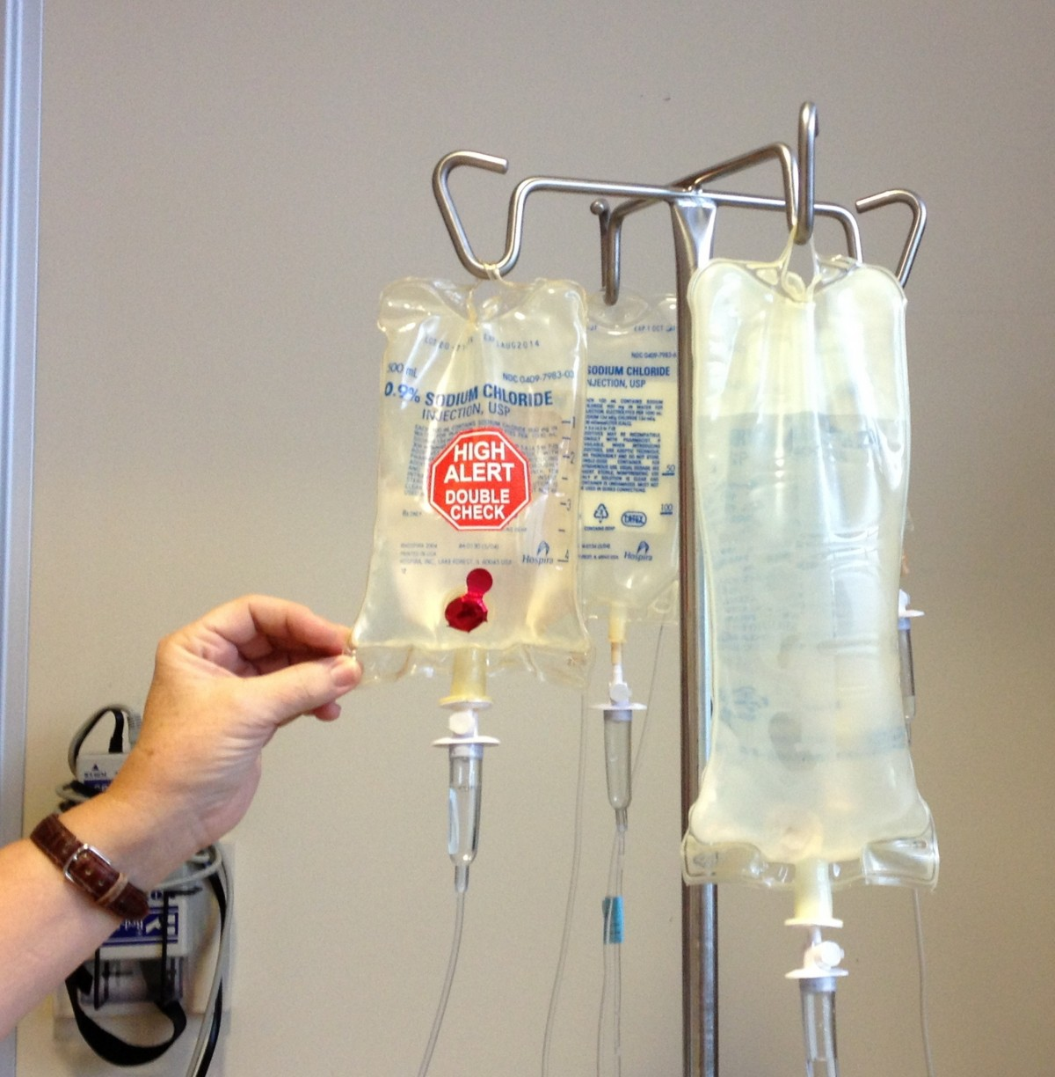
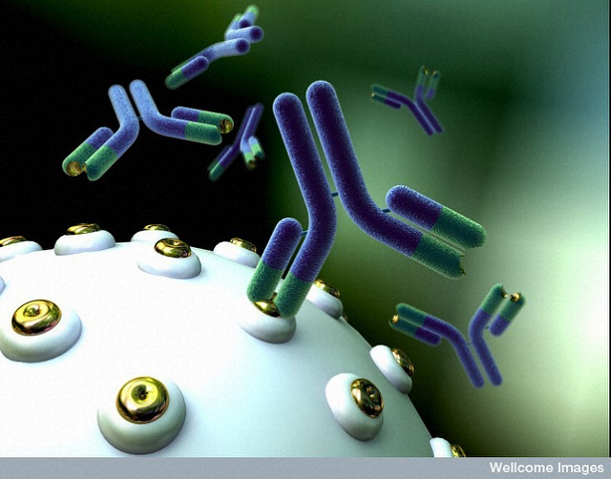
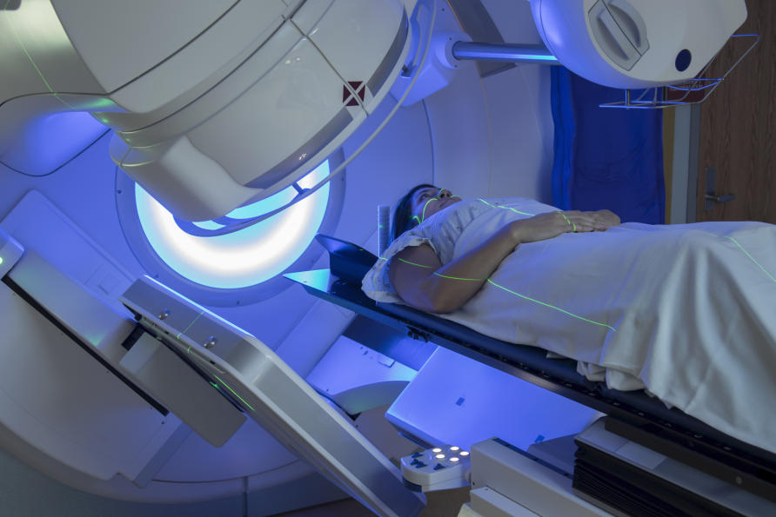



Treatment of blood cancers

Slide 13

HSC transplantation

Slide 14
Transplantation methods

Slide 15
Indications for bone marrow transplantation
Blood cancers
Non-malignant diseases

Slide 16

HLA– let’s be compatible

Slide 17
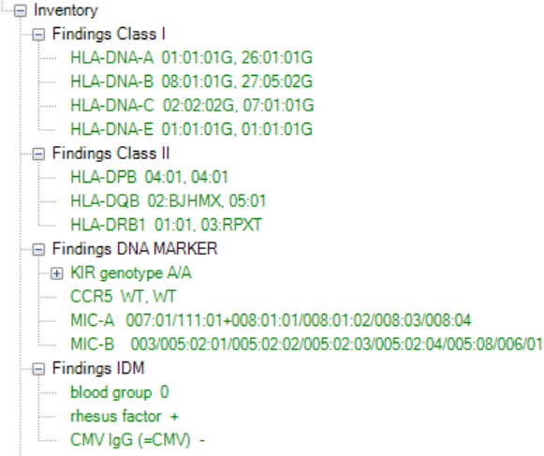




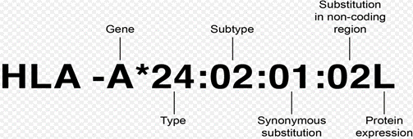
HLA– let’s be compatible

Slide 18
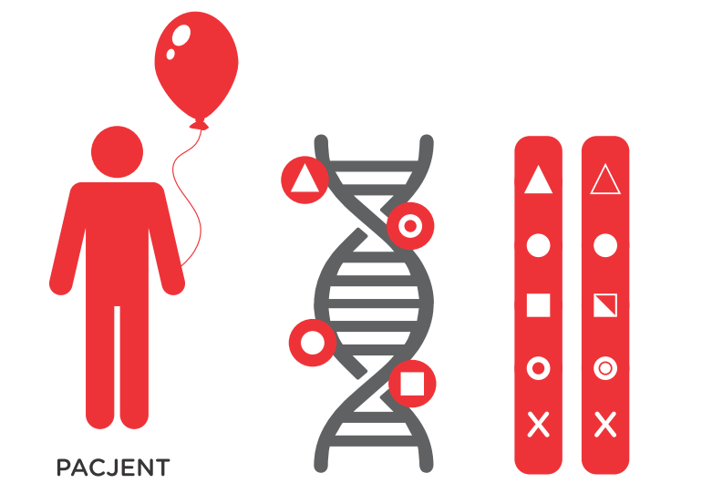


10/10 - Now that’s a match!
DONOR
PATIENT

Slide 19
Procedure

Slide 20
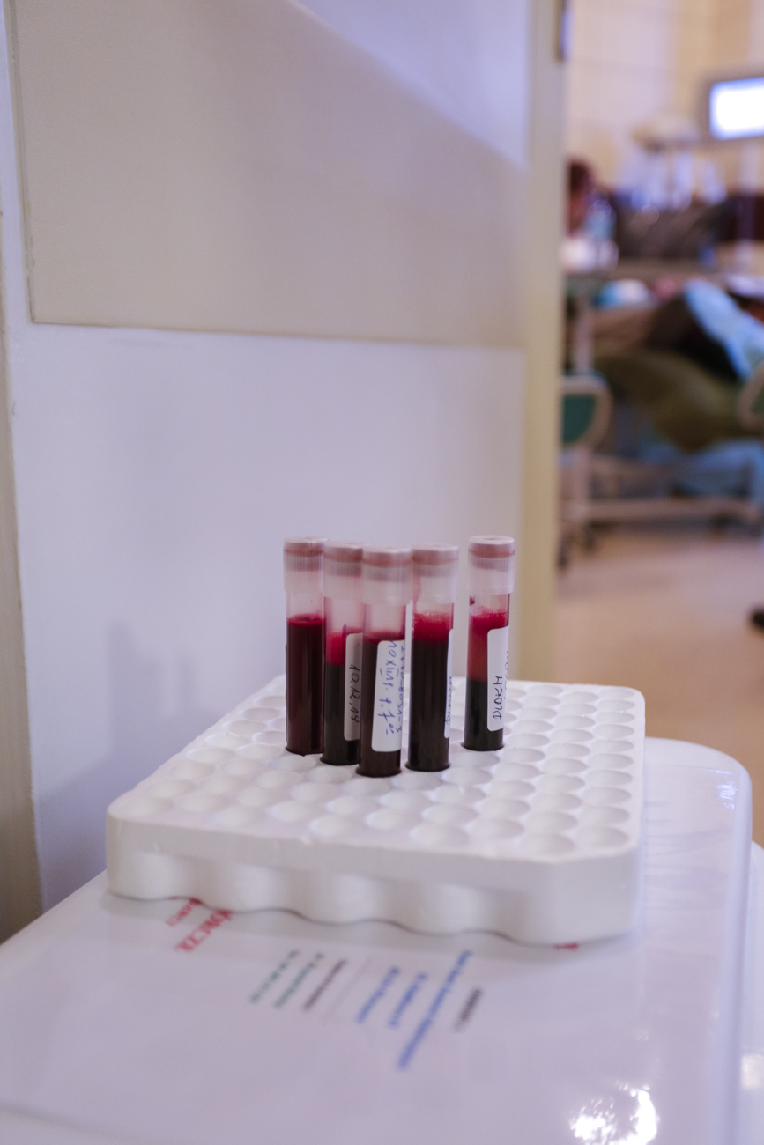






And when the time comes…

Slide 21


And when the time comes… WU
Physical Examination

Slide 22
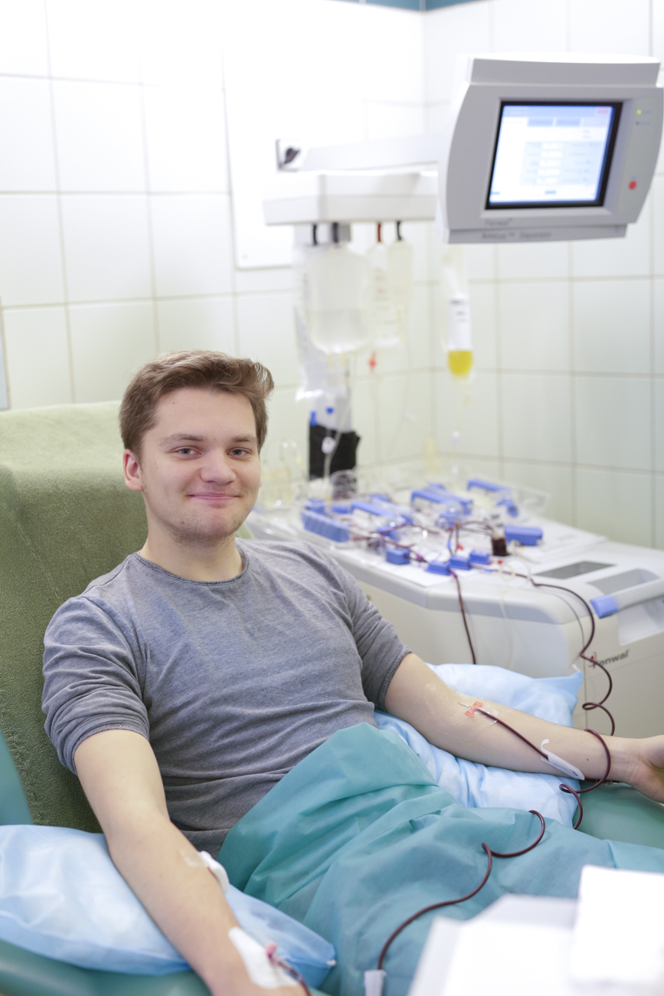

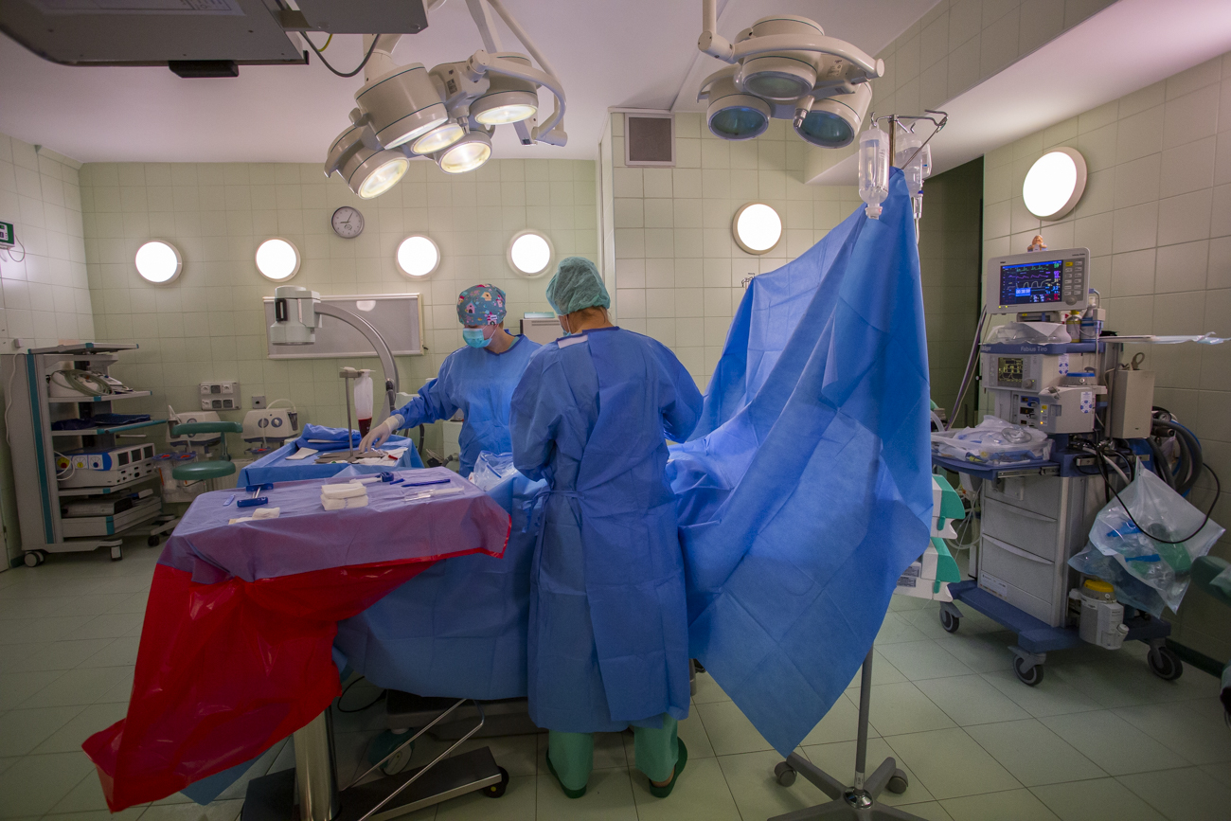
Two ways to become a Hero
This Photo by Unknown Author is licensed under CC BY-NC

Slide 23
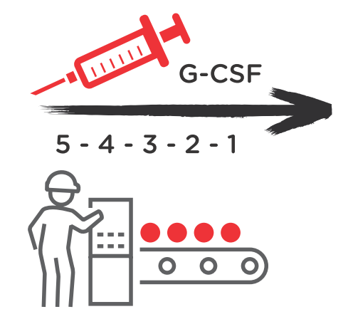
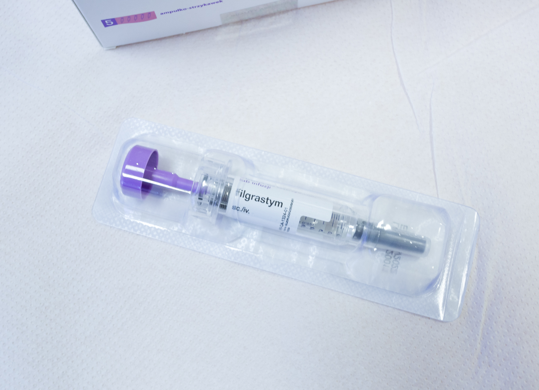
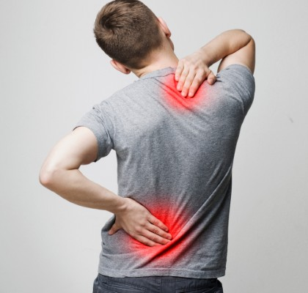
PBSC: mobilisation

Slide 24
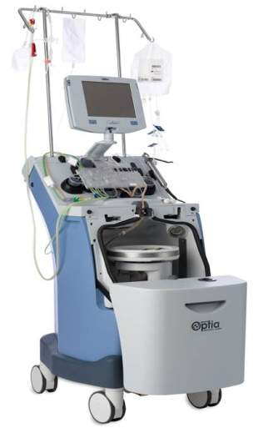

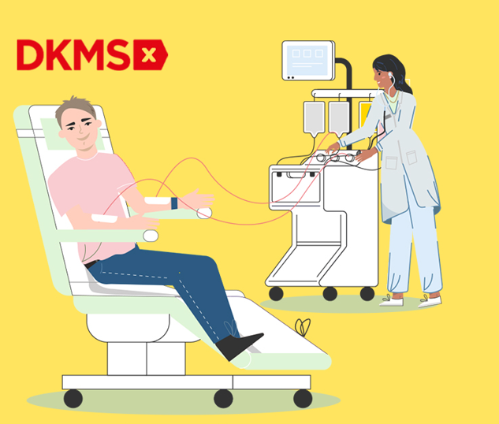
PBSC: apheresis = collection = harvest

Slide 25
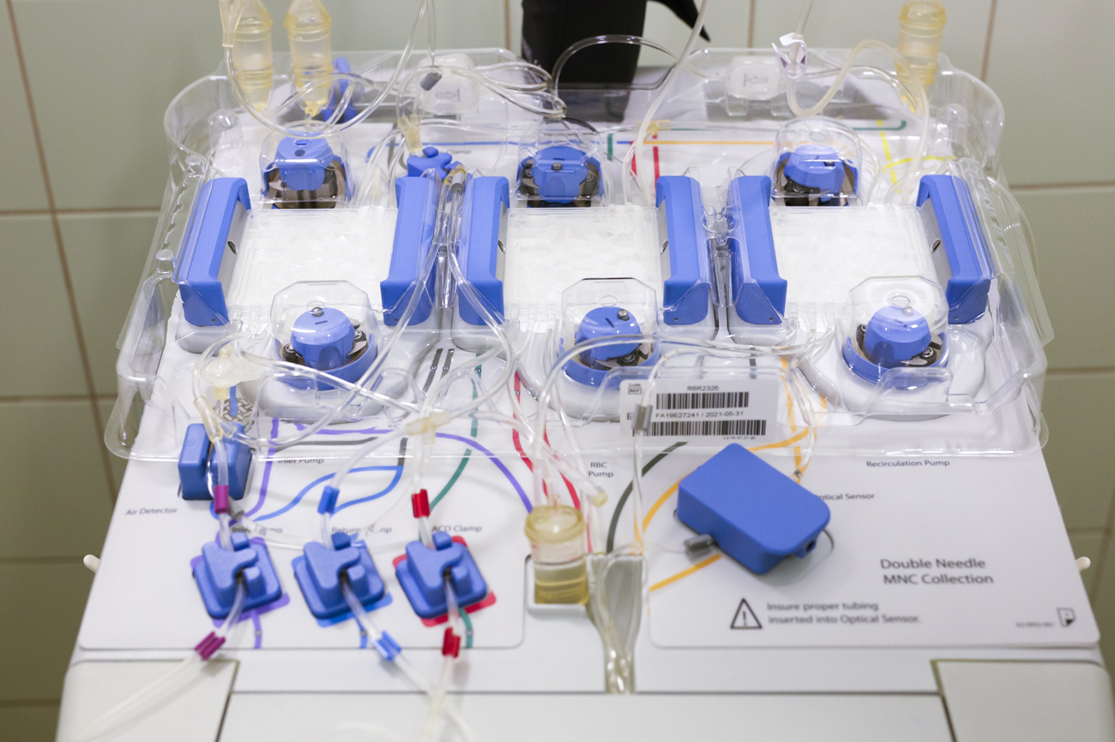
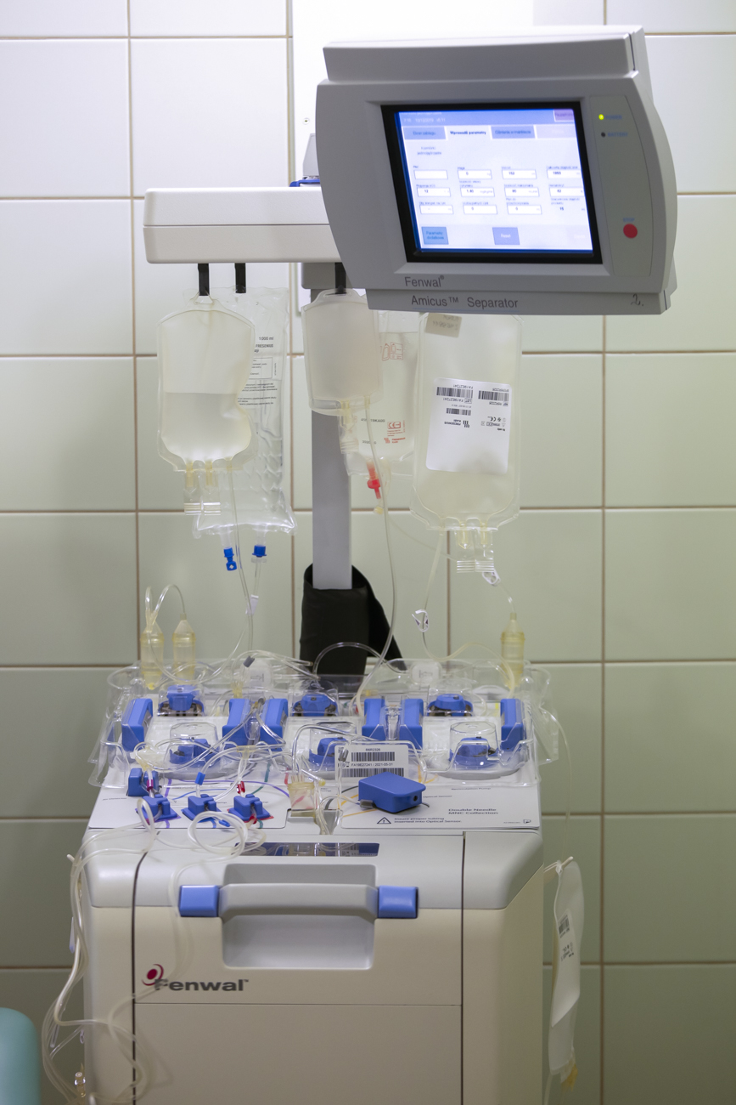
PBSC: apheresis = collection = harvest

Slide 26
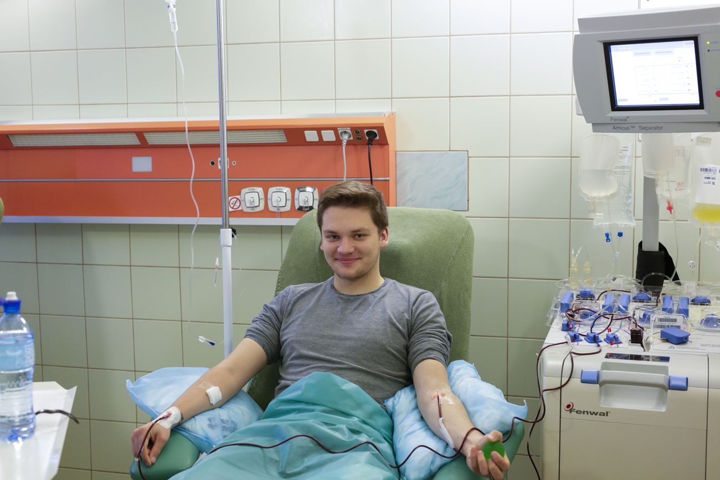
PBSC: apheresis = collection = harvest

Slide 27
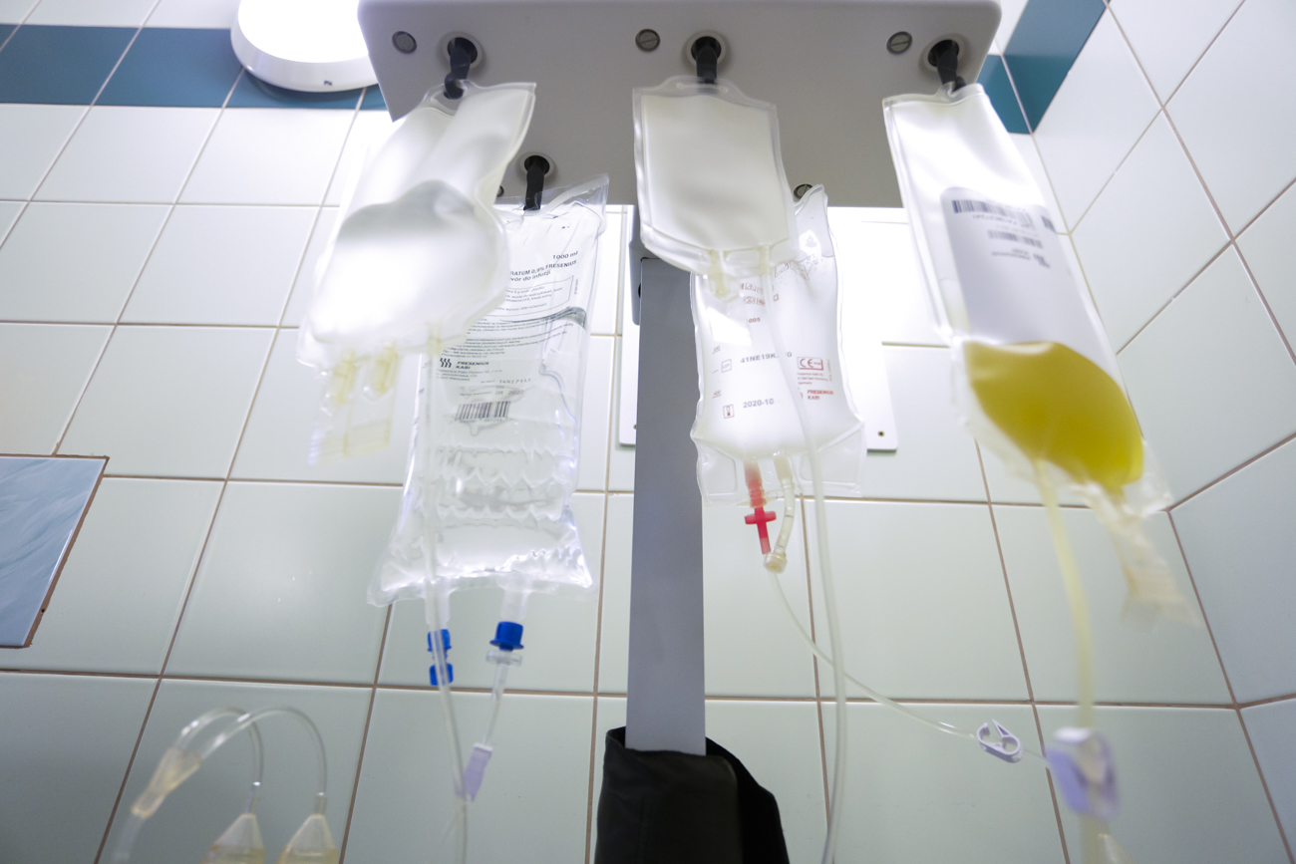
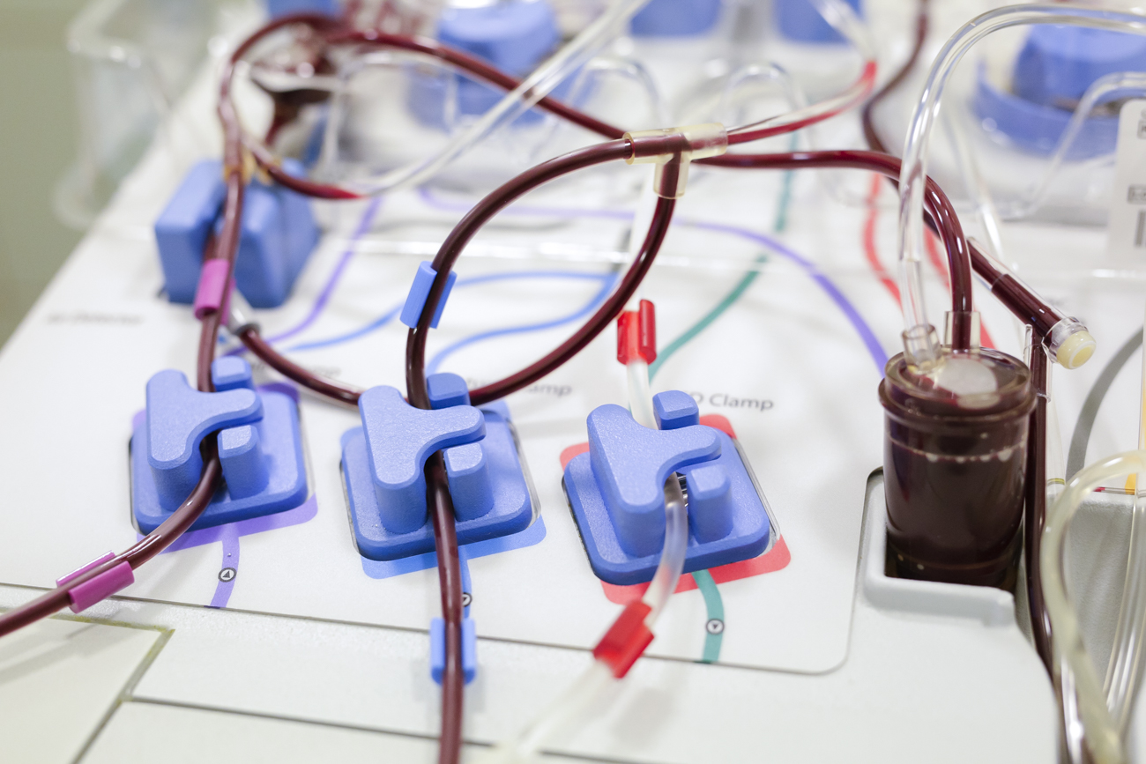
PBSC: apheresis = collection = harvest

Slide 28
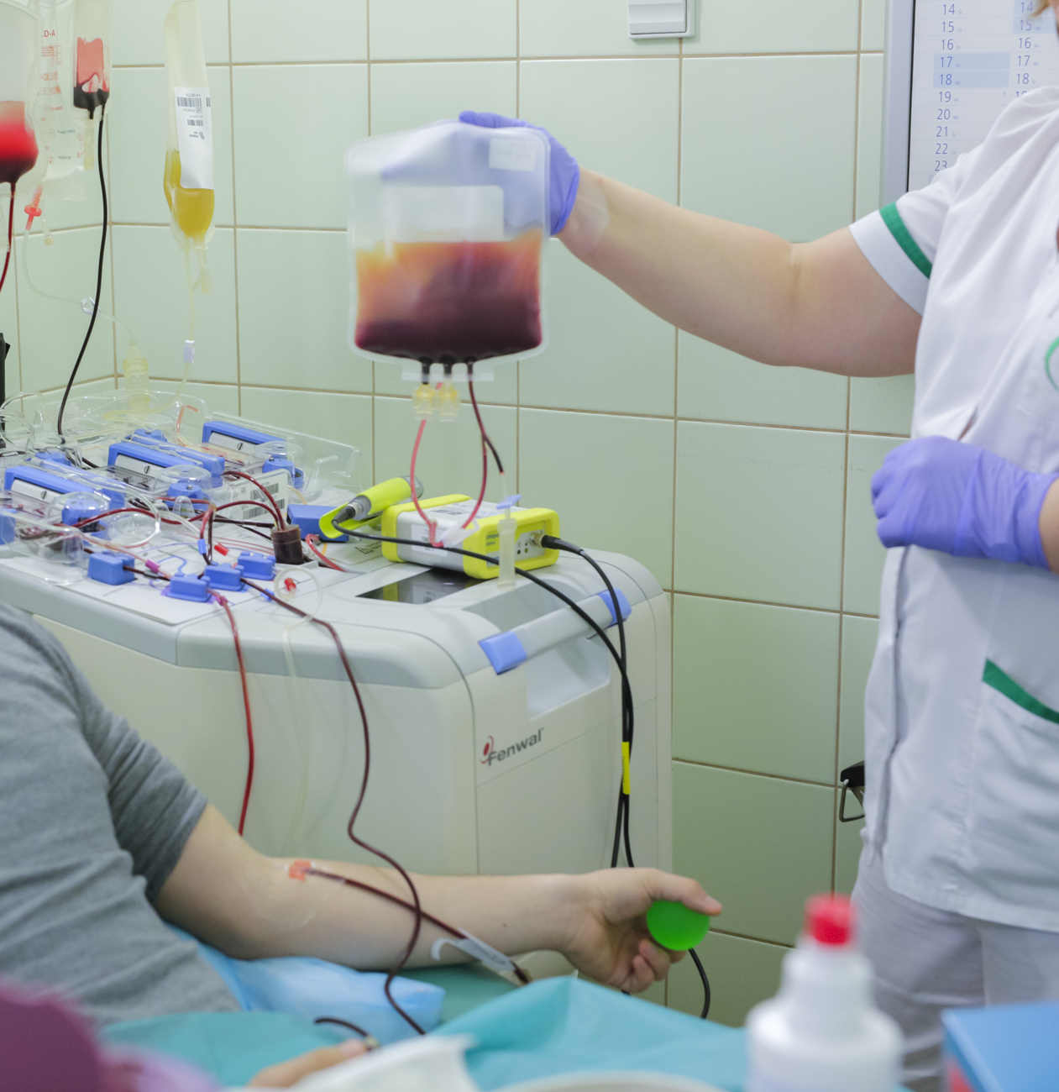
PBSC: the gift of life

Slide 29
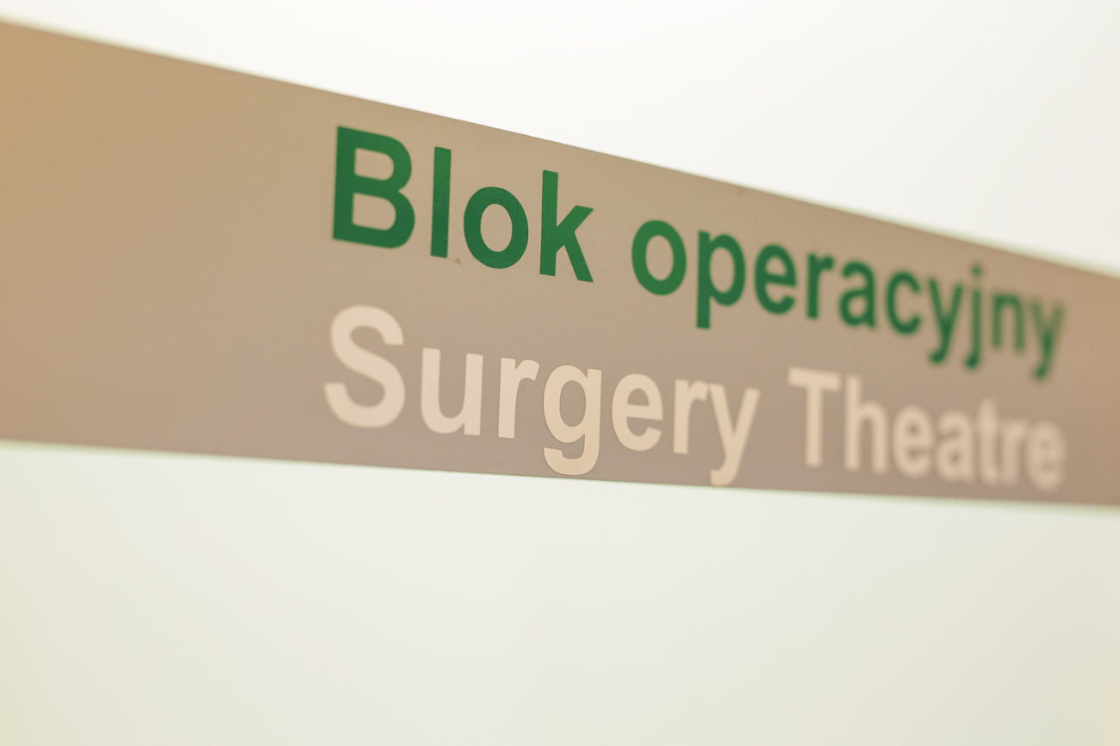
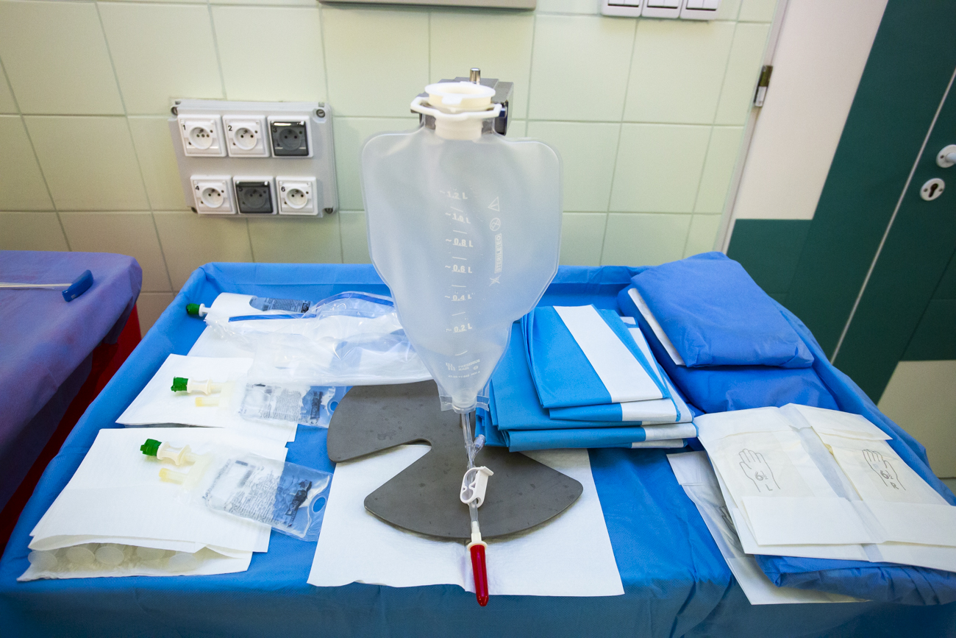
Bone marrow collection – BE SAFE!

Slide 30
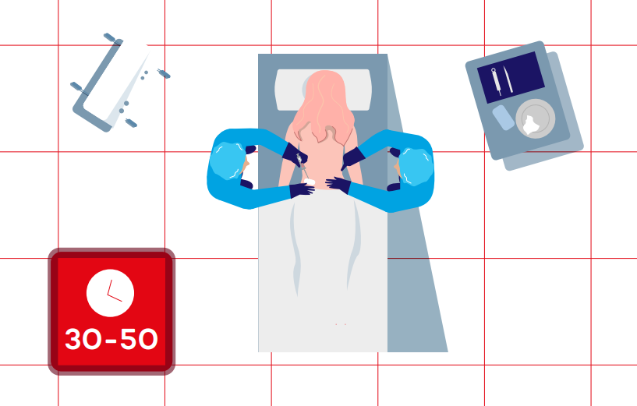
Bone marrow collection- It won’t hurt! I promise!

Slide 31
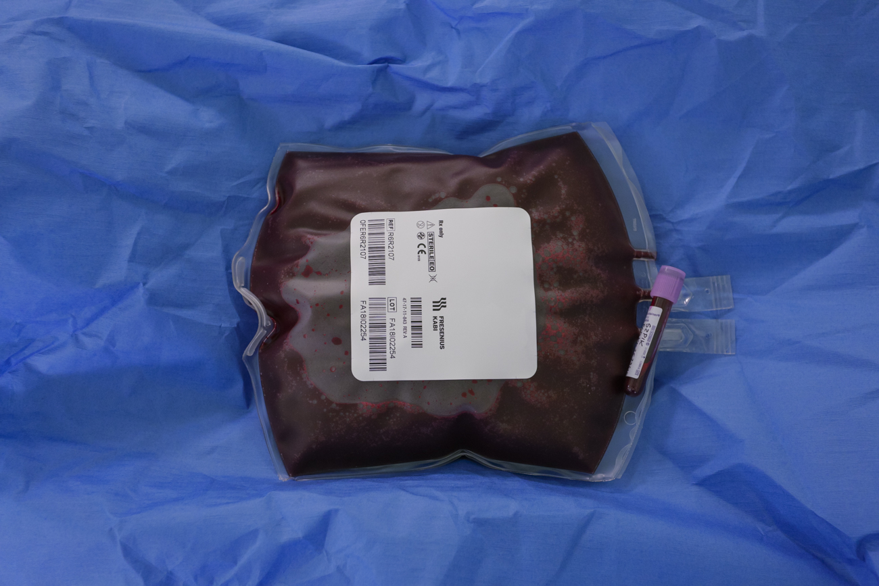
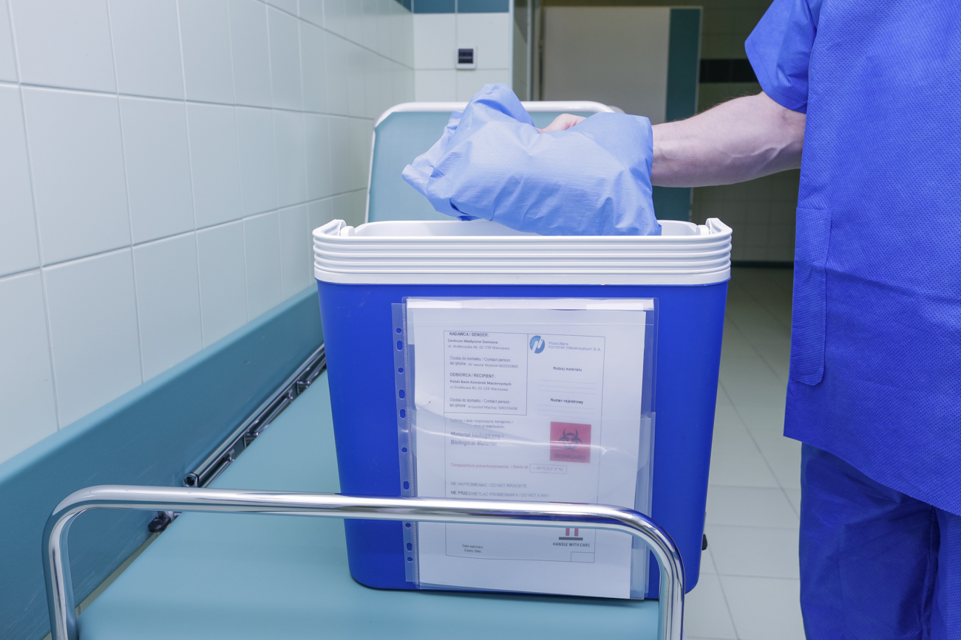
Bone marrow collection- the gift of life!

Slide 32
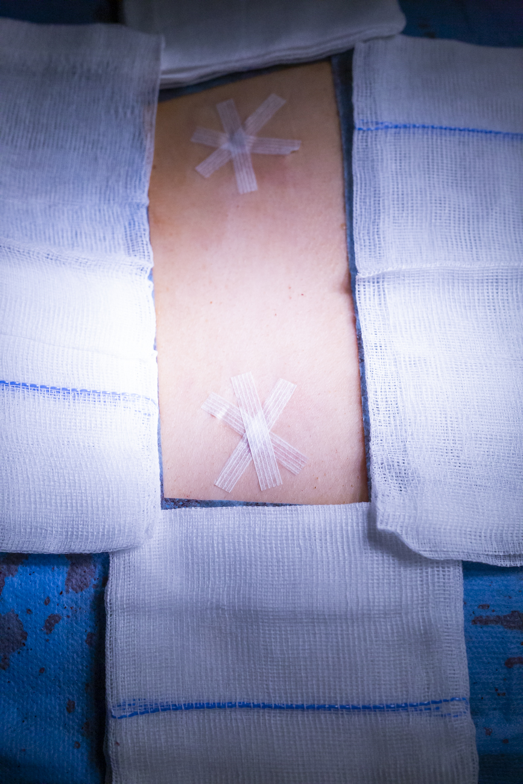
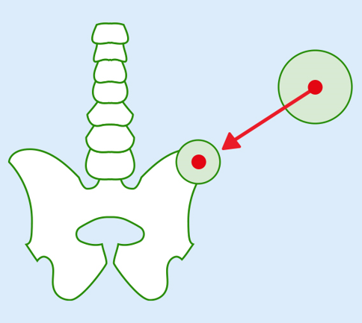
Bone marrow collection

Slide 33
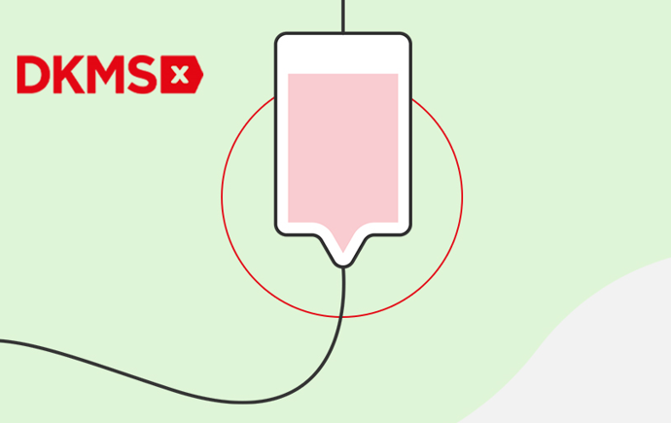

Way to go!

Slide 34

Follow Up*
Let’s stay in touch!

Slide 35
Questions:
When is bone marrow/blood stem cells transplantation necessary?
What happens to the blood of the Patient who suffers from blood cancer?
How do we know that we are a ’genetic twin’ of a person?
What’s the difference between apheresis and bone marrow harvesting?
What makes the process of bone marrow and stem cells collection safe?

Slide 36

Stronger together

Slide 37
Vocabulary and pronunciation challenge

Slide 38
Give it a go! Say the words with a little help from your friends ☺
/ˌhiːmatəʊpɔɪˈɛtɪk/
hematopoietic stem cell - krwiotwórcza komórka macierzysta
/saɪt/
erythrocytes – erytrocyty
leucocytes – leukocyty UK/ˈljuː.kə.saɪt/ US/ˈluː.kə.saɪt/
lymphocyte – limfocyt
thrombocyte – trombocyt
/əˈnɒnɪməs/
anonymous – anonimowy
/ˌeɪ.fə'ri.sɪs/ /ˌæ.fə'ri.sɪs/ /əˈfɪe.rə.sɪs/
apheresis – afereza

Slide 39
’’England and America are two countries separated by a common language.” - Bernard Shaw
British
american
data
/ˈdeɪtə/
to schedule a meeting/an appointment - umówić, ustalić termin
/ˈʃedʒ.uːl/
leucocytes – leukocyty
/ˈljuː.kə.saɪt/
data
/ˈdeɪ.t̬ə/ /dæt̬.ə/
to schedule a meeting/an appointment - umówić, ustalić termin
/ˈskedʒ.uːl/
leucocytes – leukocyty
/ˈluː.kə.saɪt/

Slide 40
‘G’ sounds easy…or it doesn’t sound at all😊
non-malignat / niezłośliwe
benign / łagodny
congenital /inborn / wrodzony
a lung / płuco

Slide 41
How many ways of pronouncing ‘ch’ do you know? Check this out:
a chest X-ray
prześwietlenie płuc
/tʃest/
01
        chemotherapy
        chemioterapia
        /ˌkiː.məʊˈθer.ə.pi/
02
to schedule
umówić/ustalić termin
UK/ˈʃedʒ.uːl/ US/ˈskedʒ.uːl/
03

Slide 42
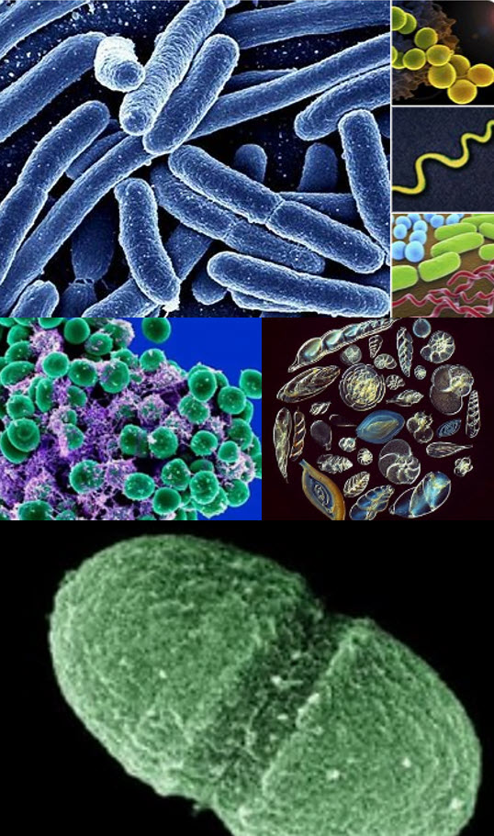
Tricky plural forms
Would you like more of the following?
It all depends on the type 😊
Mind the plural forms here:
fungus - fungi
bacterium - bacteria
protozoan - protozoans or protozoa

Slide 44
Fundacja DKMS
ul. Altowa 6/9
02-386 Warszawa
Polska
T +48 22 882 94 00
F +48 22 882 94 02
kontakt@dkms.pl
dkms.pl
© DKMS 2023

