Slide 1

WELCOME TO PPG’S Product Knowledge University 201: Application and Equipment

Slide 2



Welcome
Please mute your microphone.

Slide 3

Today’s agenda
Introductions
The three keys to proper application
Production methods
Substrates and impact on application
Problem-solving chart
Quality Cooperative Program (QCP)

Slide 4

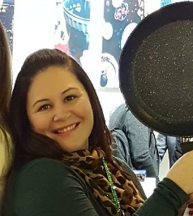



PKU Panel
Jim Gibian
Senior Business Development Manager and Global Key Account Manager USCA
Suzie Eberhardt
USCA Sales Manager, Kitchenware and Industrial Bakeware
Don Poitras
Global Strategic Account Manager
Kurt Mecray
Consumer Technical Marketing Manager
Genna Niemiec Deane
Marketing Communications Partner

Slide 5
The three keys to proper application
There are three very critical aspects to ensure the coating will perform as designed:
Surface preparation
Cure (temperature and time)
Dry film thickness
All information is listed on the product data sheet provided by PPG

Slide 6
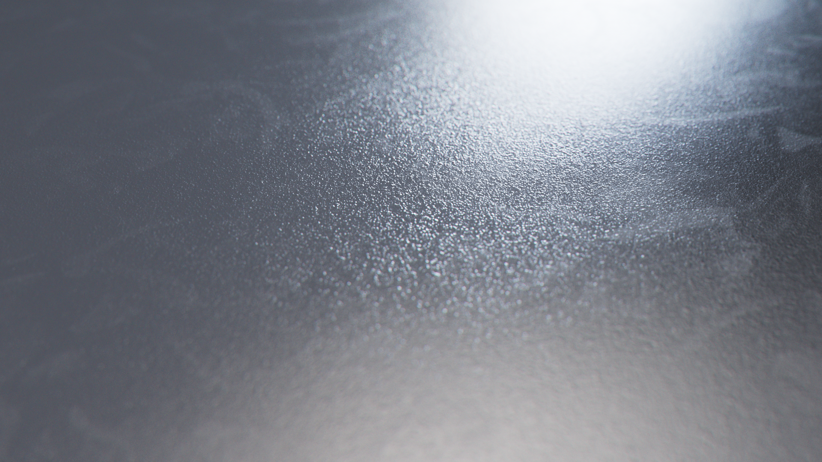
Surface preparation
Preparing a substrate properly is the first step toward a successful coating application. Proper preparation can vary depending on the substrate, the end use of the coating and the cost.
These are some examples of typical means to prepare the surface for non-stick coating application:
Alkaline wash
Mechanical roughening (grit blasting and linishing)
Chemical cleaning and/or etching
Zinc Phosphate (carbon steel bakeware)

Slide 7
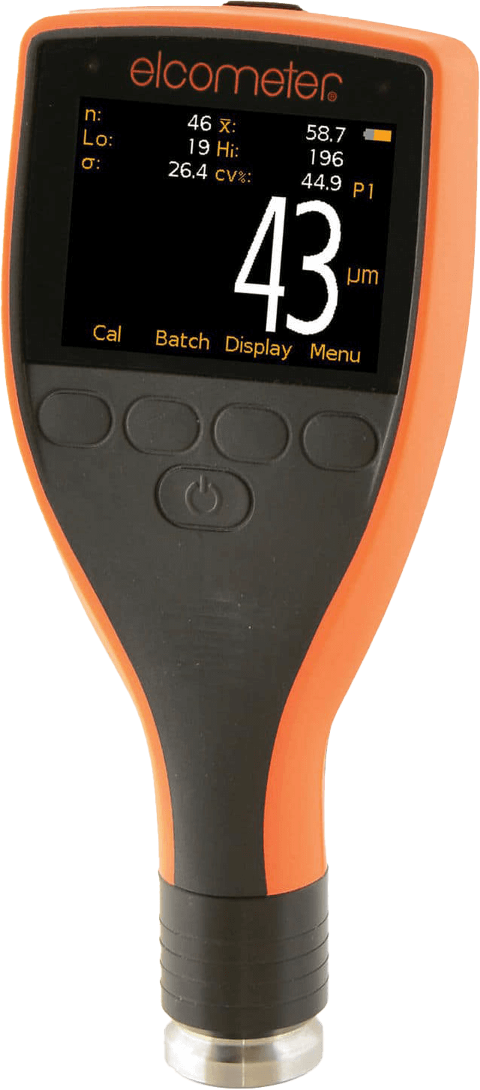
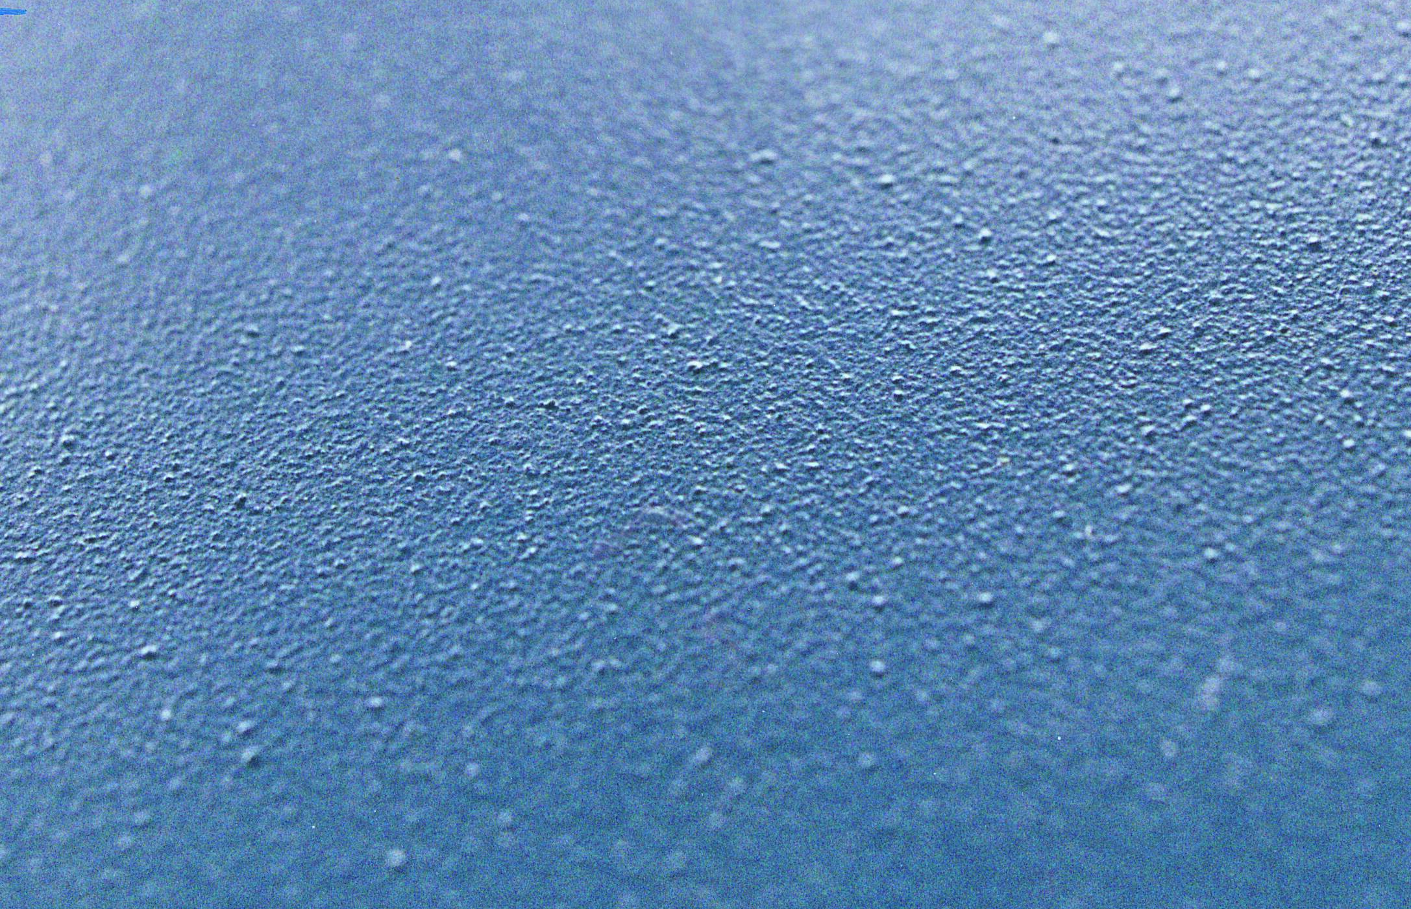
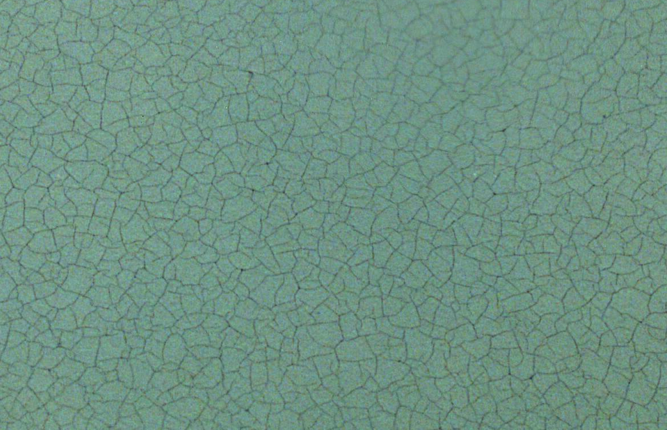
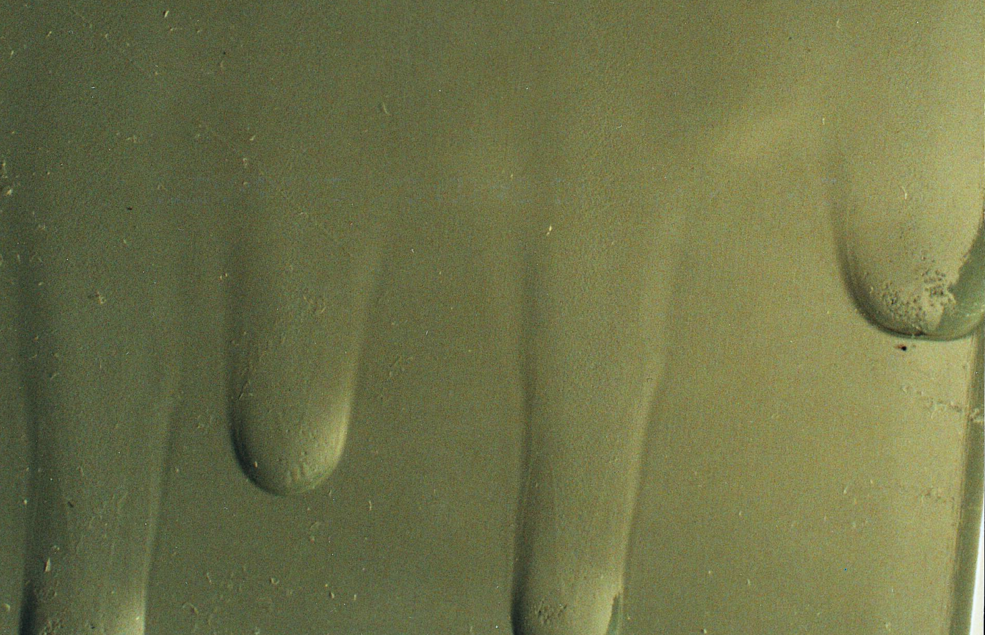
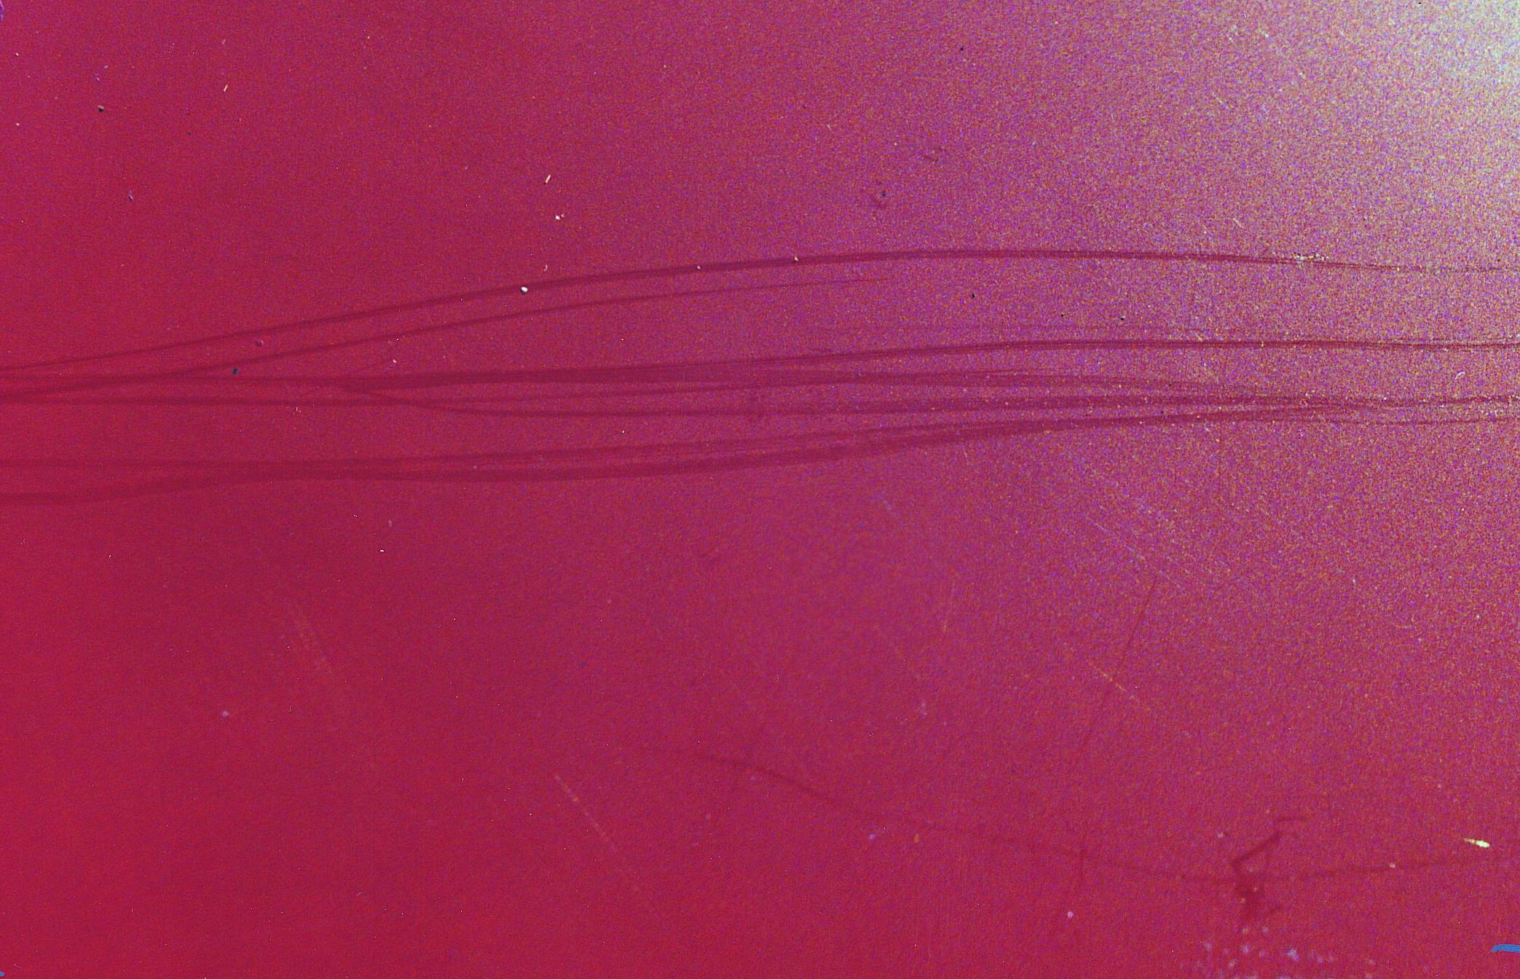
Dry film thickness (DFT)
It is important that the coating be applied according to the recommended dry film thickness measurement specified by the coating manufacturer. This identifies the amount of coating to be applied and can vary by coating type. It is most commonly measured in microns.
If too thick
If too thin
Blisters
Mud-cracking
Sagging
Hazing
…and low gloss will be apparent, as well as other performance issues, such as reduced life of the coating.
Notes:
Have them reference and feel a piece of paper as an example fo the thickness of a coating

Slide 8
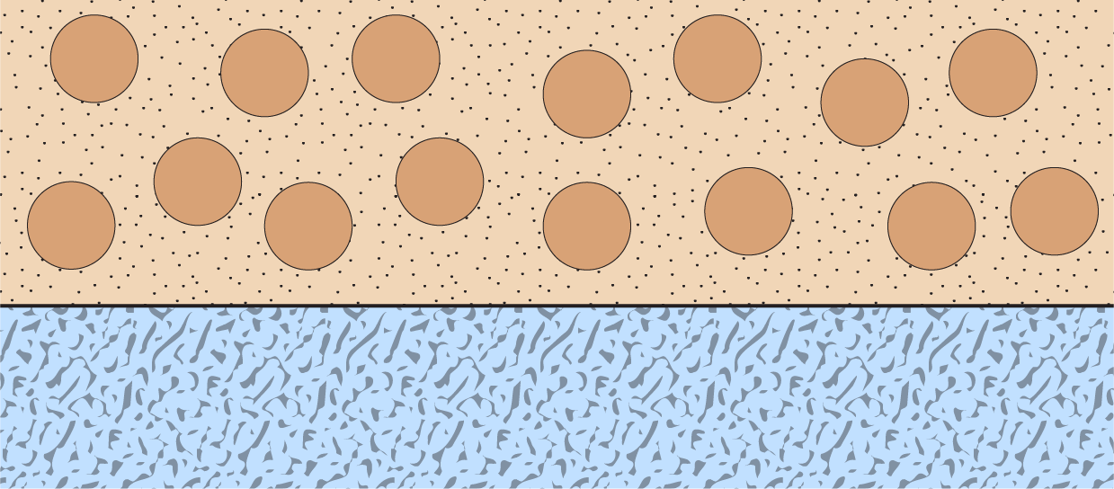
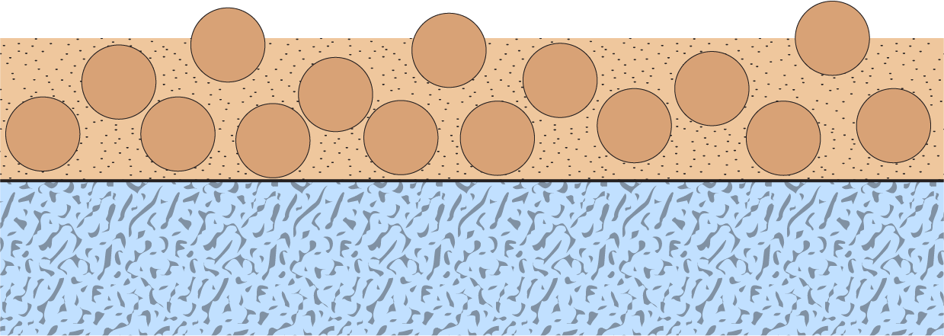
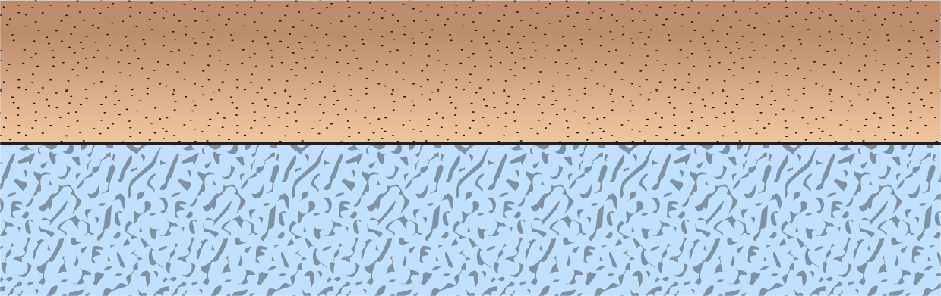
The curing step
Fluoropolymer
particles
Resin solution
The curing of the PTFE coatings is an important process:
1
The water evaporates leaving the dry-film uncured
Coating Applied
Coating Dried
FP melts, stratifies into gradient
2
Due to the high temperature, the additives begin to degrade and leave the film
500
4
5
3
The binder resins start to melt and crosslink
400
4
300
2
4
The fluoropolymers melt and sinter
Temperature (ºC)
3
200
3
5
The layers rearrange in the molten film; the fluoropolymers migrate to the top and the binders and fillers move to the bottom or rearrange within the layers.
2
100
1
1
Note: a similar cure profile occurs with silicone release coatings but with different times, temperatures and different polymer reactions.
0
5
10
15
Minutes
Notes:
Mention that they will see improper cure during the problem solving section

Slide 9
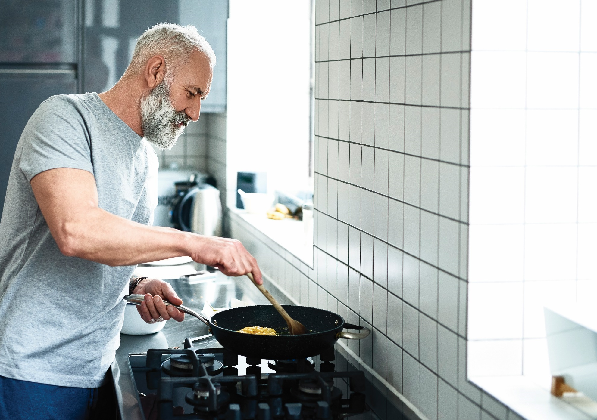
Production methods

Slide 10
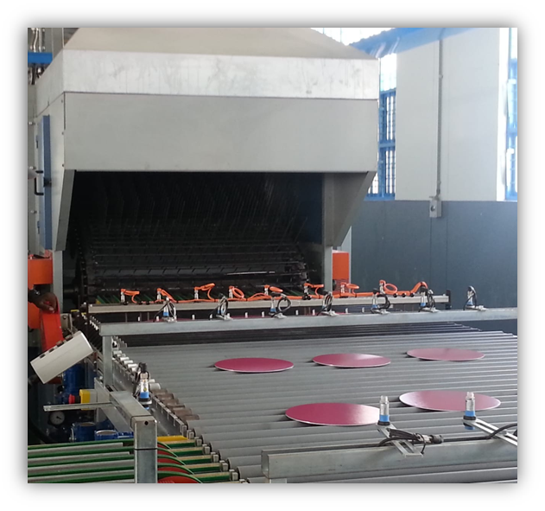
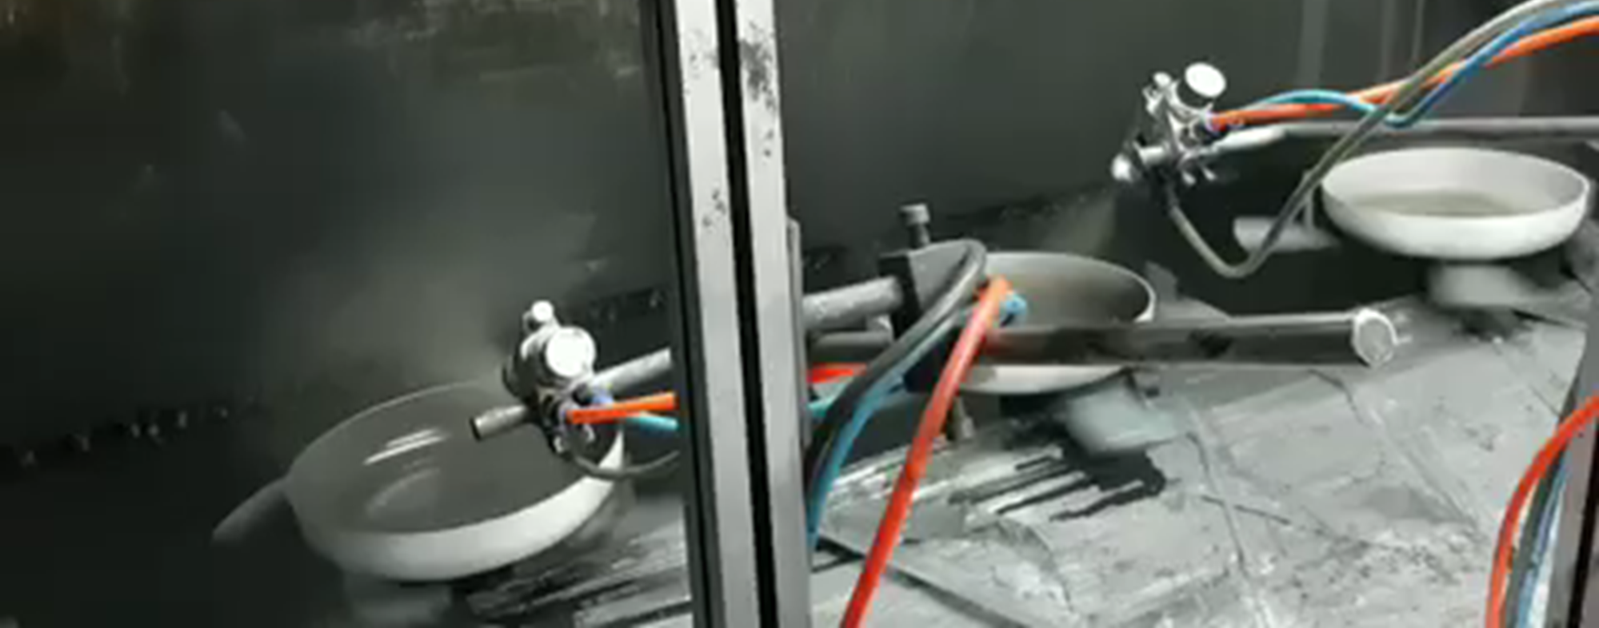
Production methods for cookware
Pre coating
vs
Post coating
Before forming the article
Coatings are a compromise of damage resistance and flexibility
Application is fast and efficient
After forming the article
Coatings focused on high performance
Application is less efficient
Roller coating for cookware
Spray coating for cookware
Notes:
Please define PTFE, PFOE and PFOA in simple terms. What does it mean when we say a coating is PTFE-free, PFOE-free and/or PFOA-free? How are the chemicals removed? What do you use in place of PFOA, PFOE or PTFE? Are the replacements safe?
Regarding PFOA, PTFE and PFOE: why do you decide to use one and not another? Why do you need to use chemicals in non-stick coatings?
PFOA is an important chemical, crucial to the manufacture of materials used to make a wide variety of products.
What little PFOA may have been in the dispersions used to make a coating is decomposed and incinerated by the curing (baking) process through which all non-stick-coated products pass — to the point at which it is virtually undetectable in the toughest migration tests. PFOA is destroyed in one second at 500° F (260° C), and high-quality non-stick coatings are all cured at very high temperatures, usually around 800°F/425°C for 10 minutes. So the conditions are such that the PFOA is destroyed in the curing process. In every study of non-stick-coated cookware by every regulatory agency worldwide, conducted under normal cooking conditions, the results have been the same: There is no detectable PFOA. It has been, is, and will always be safe to use non-stick cookware, bakeware and small appliances as intended.
Is there any chance fluoropolymers or non-stick coatings will be banned?
Absolutely not! Fluoropolymers and non-stick coatings are here to stay. Remember, PFOA is not the same as PTFE. It is not used to make non-stick-coated housewares products, it is just a component in the manufacturing process of fluoropolymers, such as PTFE. In addition, both fluoropolymers and non-stick coatings, for many years, have made significant contributions to human well-being in hundreds of industries, including cookware, bakeware and small appliances, and life would be far less easy, less comfortable, and less worry-free without them.
What is changing are the methods used to manufacture such products, which, as mentioned above, has already reduced the emissions of PFOA significantly, and will virtually eliminate emissions in the near future.
What can we expect in the future?
Overall, you can expect the virtual elimination of emissions of PFOA, with little or no harm done to the industries that manufacture and use fluoropolymers, and no inconvenience to the millions and millions of consumers around the world who depend on and benefit greatly from products that contain fluoropolymers.
What's the bottom line?
non-stick coatings were introduced into the housewares market about 50 years ago. Since then, billions of pieces of cookware, bakeware and small electrics with non-stick coatings have been used around the world — virtually problem-free.
All available information tells us that non-stick-coated housewares are indeed among the safest and most useful items ever introduced into commerce. So you can be confident when talking to your customers or addressing any concerns on this issue.

Slide 11
Spray application of a multi-coat system
1
2
3
4
5
Forming
Mechanical
roughening
Application of Primer
Drying of Primer
at ~95-150º C
Application of Midcoat
Flash Off
Wet on Wet
6
7
8
9
Application of
Topcoat
Curing of coating at 400-430º C for 4-5 minutes
Exterior coating
application, if required
Decoration,
Inspection, Assembly
Notes:
Speak to chemical etch process

Slide 12

Typical spray application

Slide 13
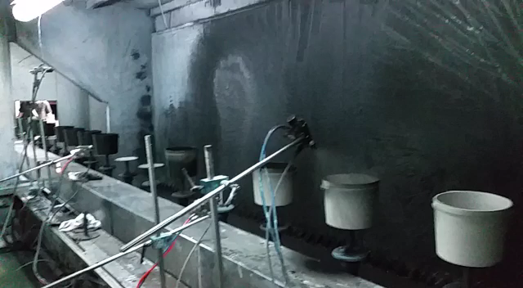
Spray application for interior and exterior

Slide 14
Roller coating application of a multi-coat system
1
2
3
4
5
Cleaning/drying
Roughening
Application of Primer
Application of Midcoat
Application of first Topcoat
Flash Off
Flash Off
Flash Off
6
7
8
9
Application of
second Topcoat
Application of third Topcoat
Curing of coating at 400-430º C for 4-5 minutes
Exterior coating application, if required
Flash Off
Notes:
Speak to chemical etch process

Slide 15
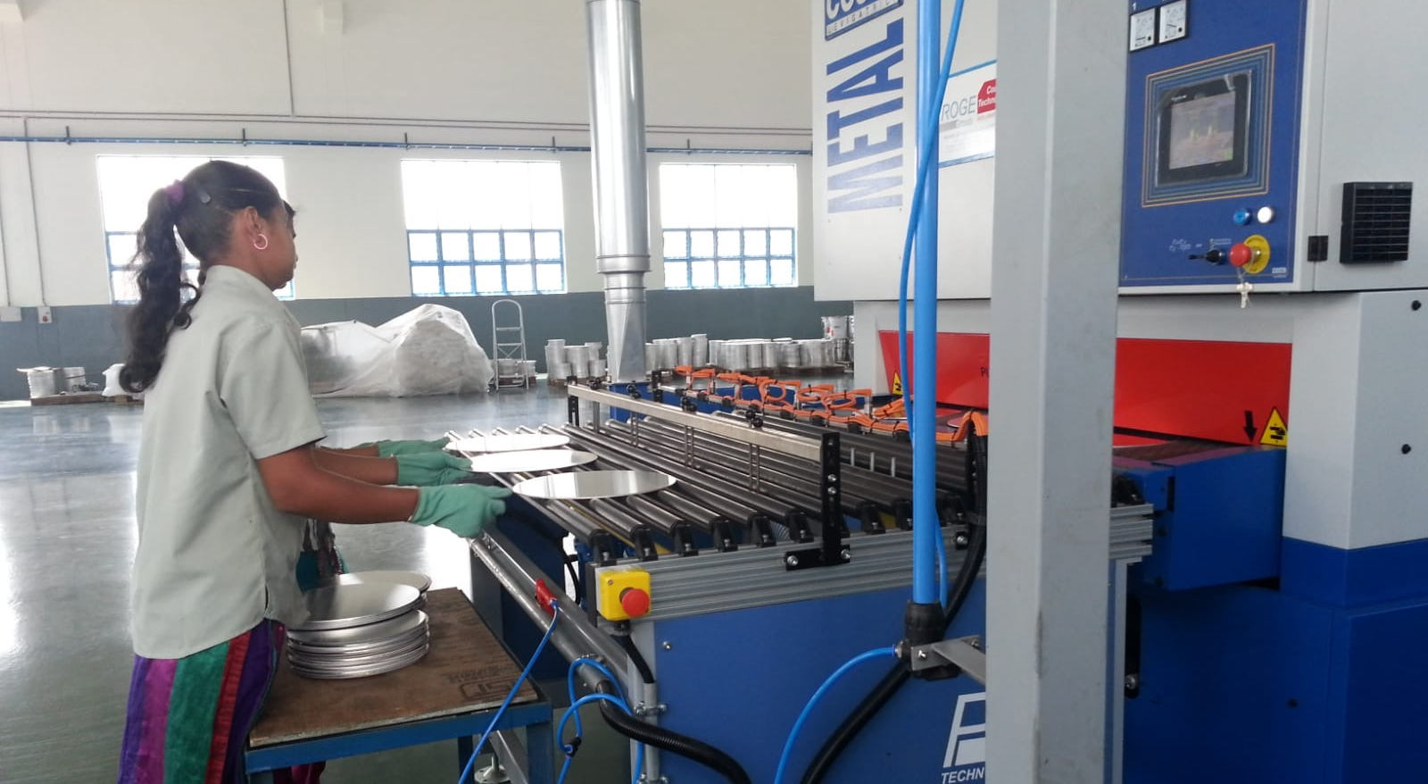
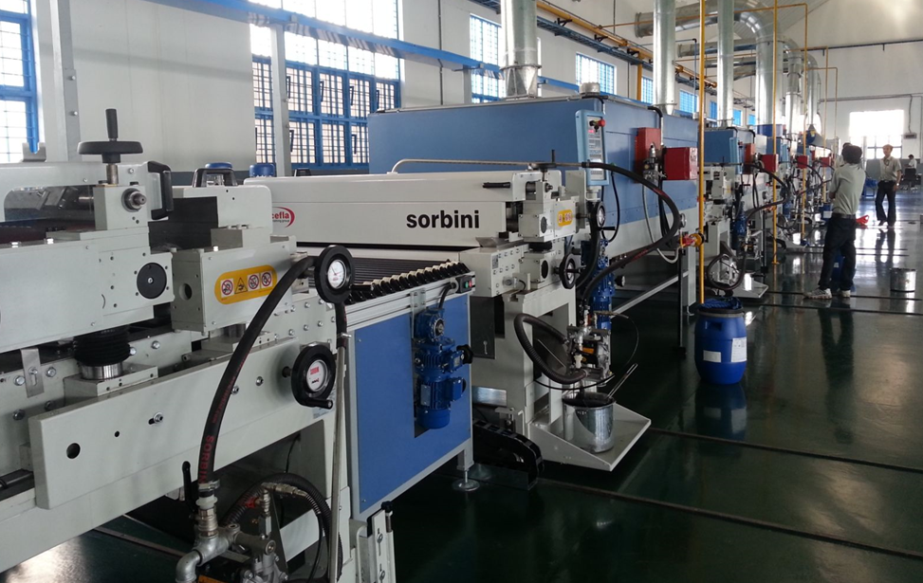
Roller coating production method

Slide 16
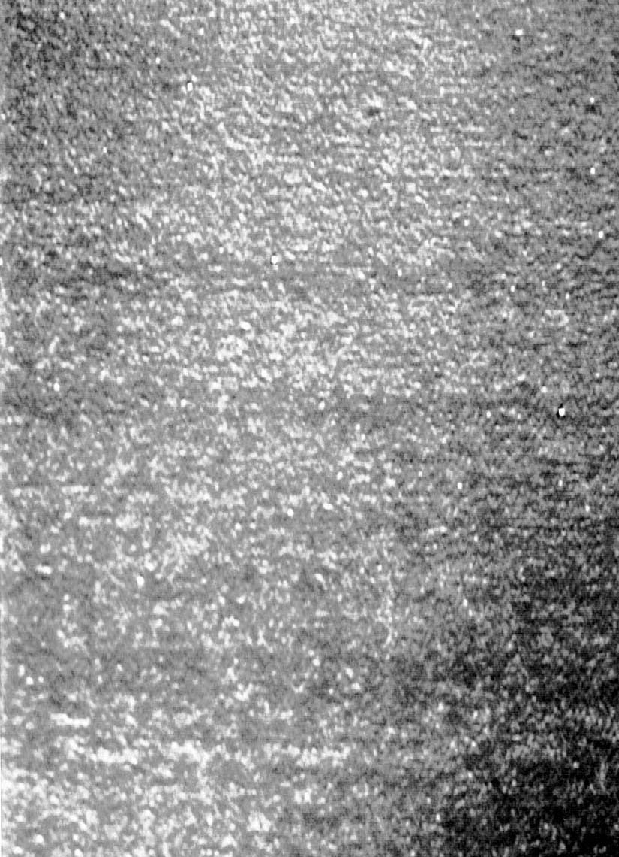
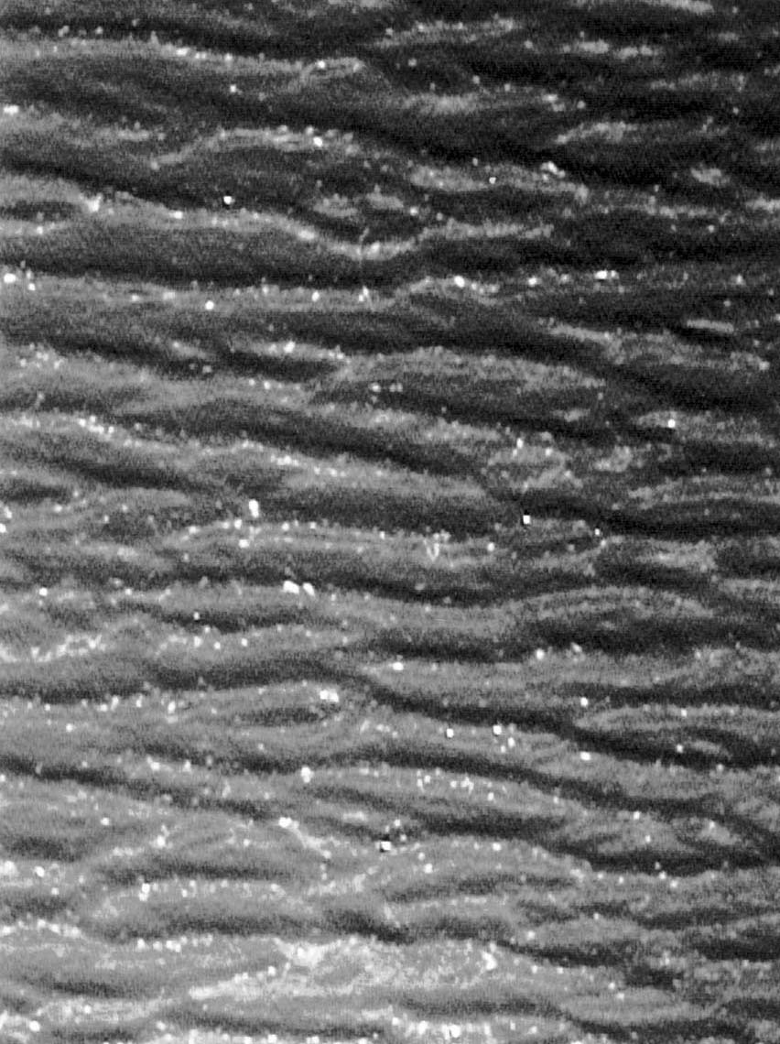

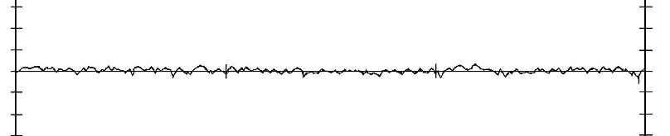
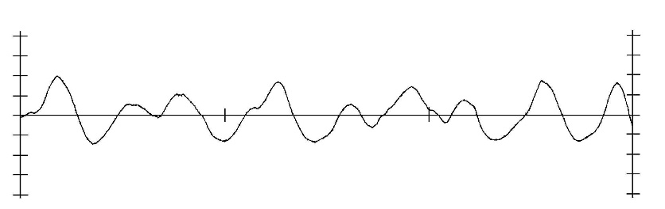
10X
Spray Coating
Surface Smoothness
Roller Coating
Surface Smoothness

Slide 17
Comparison of production methods
 | Spray | Roller
Number of coating layers | 2 - 3 | 4 - 5
Roughening process | Standard = Slow "No blast" = Fast | Fast
Coating speed (pieces/hour) | Under 1,000 | 3,000 - 4,000
Coating efficiency | 50 - 60% | 95%
Appearance | Smooth; higher gloss Rough can be achieved if desired | Many ridges; lower gloss
Performance | Good, better, best | Good
Scratch resistance | 4 - 5 | 2 - 3
Abrasion | 4 - 5 | 1 - 2
Release | 4 - 5 | 3 - 4

Slide 18
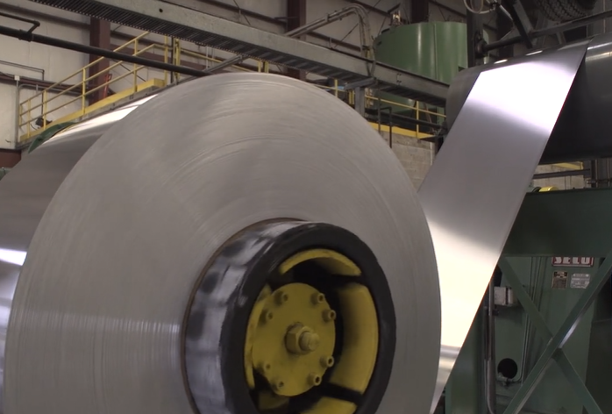
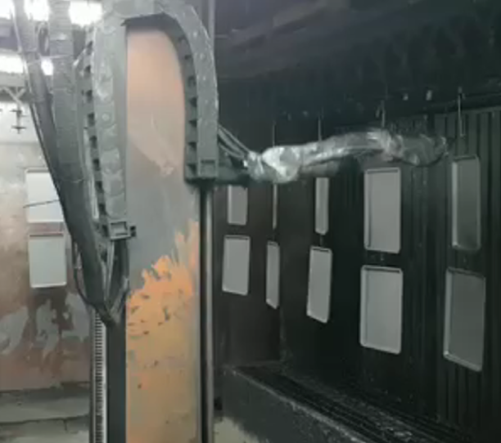
Production methods for bakeware
Pre coating
vs
Post coating
Before forming the article
Coatings are a compromise of damage resistance and flexibility
Application is fast and efficient
After forming the article
Coatings focused on a range of performance
Application is less efficient
Coil coating for bakeware
Spray coating for bakeware
Notes:
Please define PTFE, PFOE and PFOA in simple terms. What does it mean when we say a coating is PTFE-free, PFOE-free and/or PFOA-free? How are the chemicals removed? What do you use in place of PFOA, PFOE or PTFE? Are the replacements safe?
Regarding PFOA, PTFE and PFOE: why do you decide to use one and not another? Why do you need to use chemicals in non-stick coatings?
PFOA is an important chemical, crucial to the manufacture of materials used to make a wide variety of products.
What little PFOA may have been in the dispersions used to make a coating is decomposed and incinerated by the curing (baking) process through which all non-stick-coated products pass — to the point at which it is virtually undetectable in the toughest migration tests. PFOA is destroyed in one second at 500° F (260° C), and high-quality non-stick coatings are all cured at very high temperatures, usually around 800°F/425°C for 10 minutes. So the conditions are such that the PFOA is destroyed in the curing process. In every study of non-stick-coated cookware by every regulatory agency worldwide, conducted under normal cooking conditions, the results have been the same: There is no detectable PFOA. It has been, is, and will always be safe to use non-stick cookware, bakeware and small appliances as intended.
Is there any chance fluoropolymers or non-stick coatings will be banned?
Absolutely not! Fluoropolymers and non-stick coatings are here to stay. Remember, PFOA is not the same as PTFE. It is not used to make non-stick-coated housewares products, it is just a component in the manufacturing process of fluoropolymers, such as PTFE. In addition, both fluoropolymers and non-stick coatings, for many years, have made significant contributions to human well-being in hundreds of industries, including cookware, bakeware and small appliances, and life would be far less easy, less comfortable, and less worry-free without them.
What is changing are the methods used to manufacture such products, which, as mentioned above, has already reduced the emissions of PFOA significantly, and will virtually eliminate emissions in the near future.
What can we expect in the future?
Overall, you can expect the virtual elimination of emissions of PFOA, with little or no harm done to the industries that manufacture and use fluoropolymers, and no inconvenience to the millions and millions of consumers around the world who depend on and benefit greatly from products that contain fluoropolymers.
What's the bottom line?
non-stick coatings were introduced into the housewares market about 50 years ago. Since then, billions of pieces of cookware, bakeware and small electrics with non-stick coatings have been used around the world — virtually problem-free.
All available information tells us that non-stick-coated housewares are indeed among the safest and most useful items ever introduced into commerce. So you can be confident when talking to your customers or addressing any concerns on this issue.

Slide 19
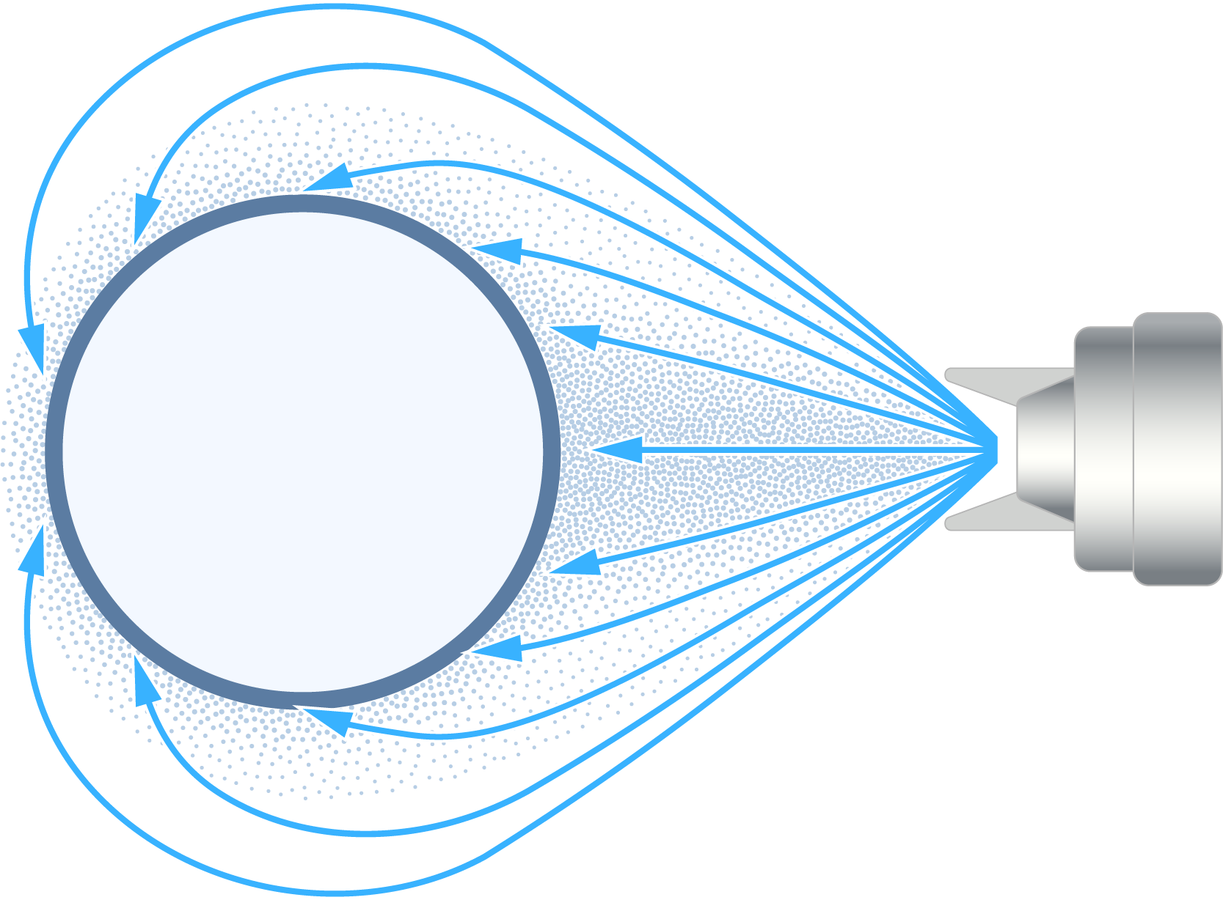
Electrostatic application
Spraying is typically air atomized, but other delivery methods, including rotary disk or bell can be used
Electrically charged paint droplets are attracted to grounded parts improving transfer efficiency
Proper conductivity of liquid coating is important for good transfer efficiency
Best for parts needing “wrap-around” (e.g., wire goods or coating both sides)
Difficulty in penetrating deep recesses, and can build up on edges, termed the Faraday Cage Effect
A similar method is used for powder coating application
Notes:
discuss during bakeware video

Slide 20
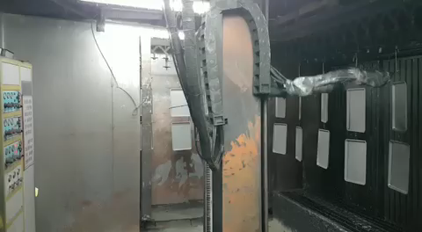
Electrostatic application

Slide 21
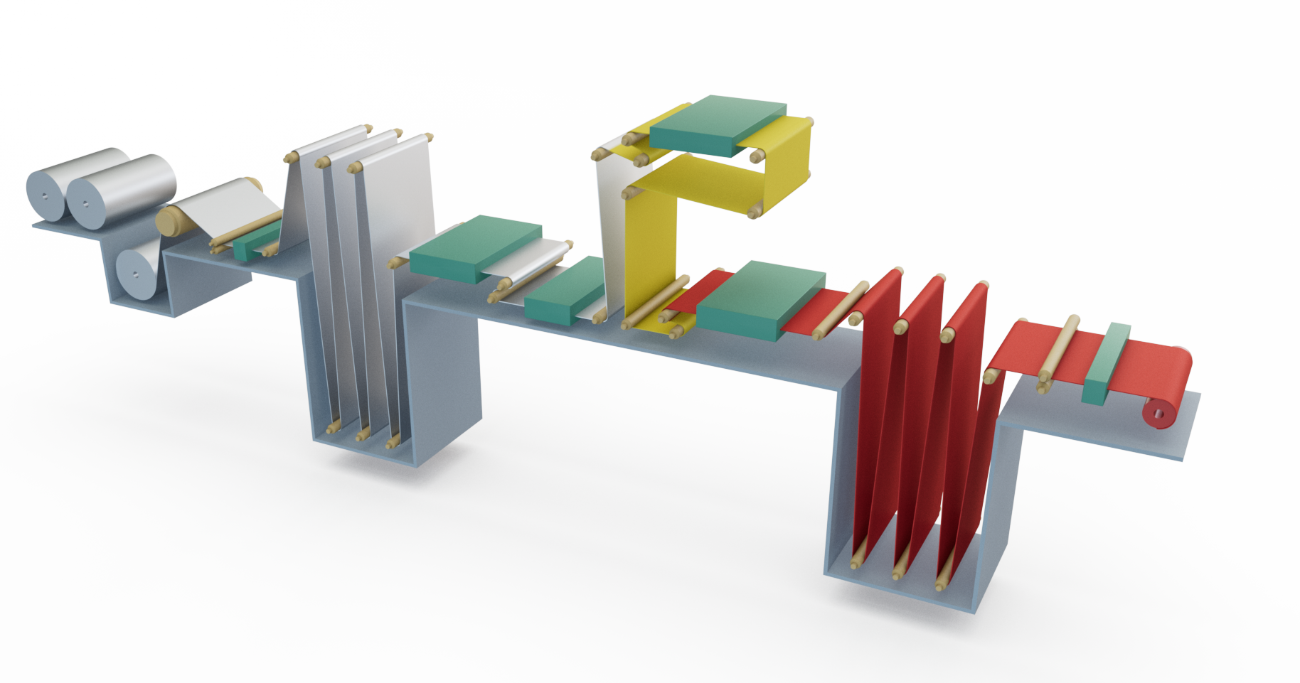
Coil coating production method
High speed, very efficient application process
Best suited to light-gauge metals
A continuous process
High transfer efficiency
Consistent quality
Curing oven
Entrance accumulator
Prime coater
Dry
Recoiler
Uncoiler
Top coater
Finish oven
Pretreatment (cleaning and conversion coating)
Cut-off
Water quench

Slide 22
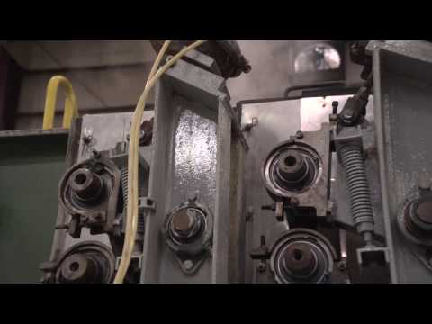
Coil Coating application

Slide 23
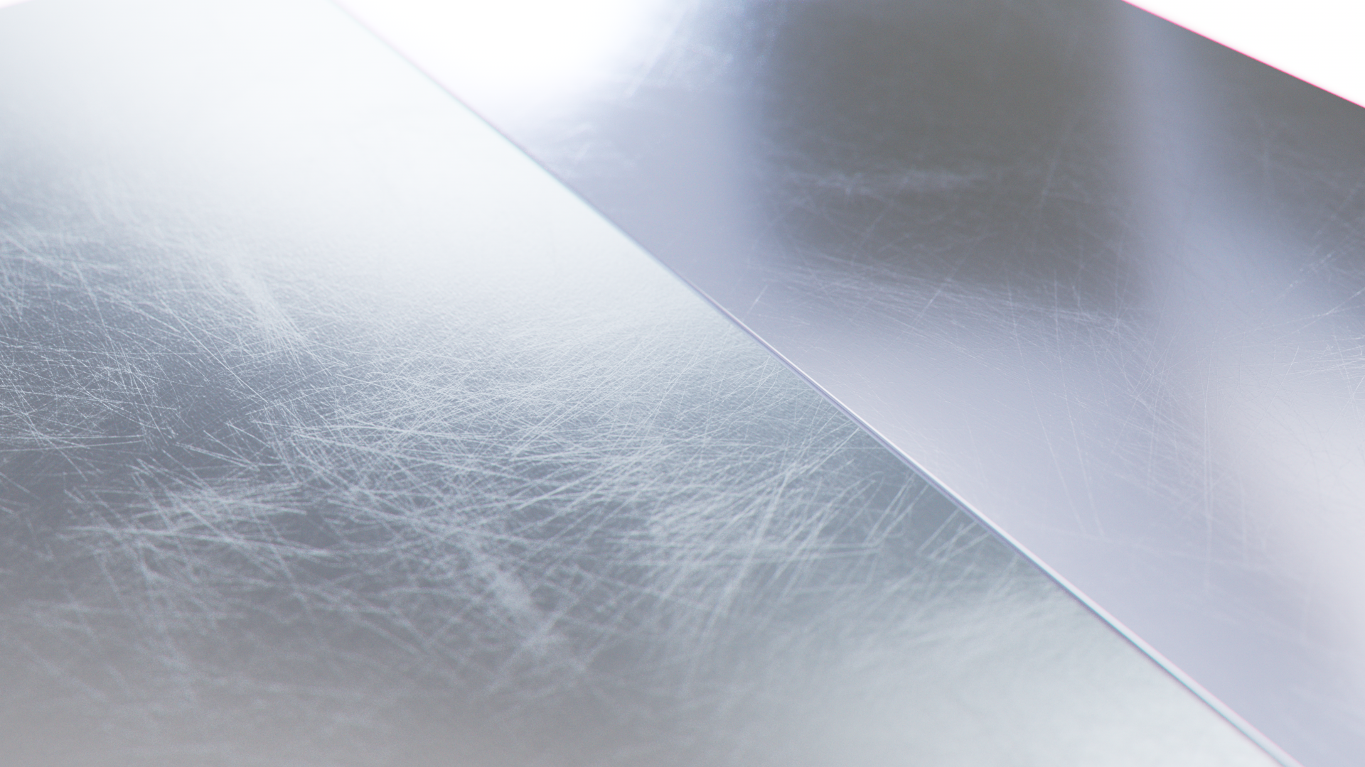
Substrates and impact on application

Slide 24
Main substrates for coated housewares
Aluminum
Pressed or Forged
Cast
Hard anodized
Steel
Stainless
Aluminized
Tin-Free Steel (TFS)/ECCS* (for coil coated products)
Carbon
*Electrolytic Chromium Coated Steel

Slide 25
Aluminum
Pressed or Forged
Cast
Hard anodized
Product knowledge facts
Aluminum is available in several different alloys, with only a few ideal for housewares.
The majority of aluminum cookware is manufactured by pressing or forging.
In these methods, flat sheets of rolled aluminum at the desired thickness are placed on a press. The press then forms the sheet metal into the desired shape.
The thickness can vary from 1.8 to 5.0mm.
Important details for non-stick coating application
Aluminum is a soft metal and will accept all surface preparation steps well.
Proper cleaning of the surface is important.

Slide 26
Aluminum
Pressed or Forged
Cast
Hard anodized
Product knowledge facts
Molten aluminum is poured or injected into molds specially designed for each different cookware utensil; can be gravity cast (permanent mold) or (pressure) die-cast aluminum.
Gravity casting is suitable for small productions and produces a purer substrate with no outgassing issues, but die casting is the most common process.
Die casting is commonly used for intricate designs due to the pressure and speed used to inject the molten metal.
Important details for non-stick coating application
The quality of the casting is critical to the selection and application of the non-stick coating.
Poor casting quality can result in air pockets within the casting that can erupt during the curing process of the coating, creating ruptures in the casting surface. This may result in very high and costly rejection rates.
For lower quality castings, if the quality cannot be improved, a low-cure coating can be used.
Alternatives include gravity casting and slower-speed die casting.
Notes:
Gravity Die Casting:
The equipment is less expensive than
In the cookware industry these are claimed as very high quality crafts.
Pressure Die Casting:
Liquid metal is injected at high speed and high pressure into a metal mold
The machine and its dies are very expensive, but it's a much faster process.
Special precautions must be taken to avoid too many gas inclusions which causes outgassing (blistering) during subsequent heat-treatment or welding of the casting product.
413.0-F and 5079 are the aluminum allow most commonly used.

Slide 27
Aluminum
Pressed or Forged
Cast
Hard anodized
Product knowledge facts
Hard anodized aluminum is a popular substrate for higher end aluminum cookware lines.
When anodizing aluminum, the metal is oxidized chemically and electrically, producing a very hard, smooth outer layer on the aluminum.
Important details for non-stick coating application
Hard anodized treatment quality has direct influence over the coating finish, especially adhesion, gloss and appearance.
Shallow anodizing and lesser porosity will lead to higher gloss of the coating, while deeper anodizing and higher porosity will lead to lower gloss.
Identifying when the anodizing process is done before or after the coating is applied is important to know for both coating selection and to identify potential QC issues.
If the coating is applied after anodizing, it is important that it is done within 24 hours, to avoid self-sealing of the anodized layer, which can result in poor coating adhesion. Note: for sol-gel 'ceramic' application, the anodizing must be done first over a gritblasted surface.
Notes:
Facts Follow Up:
Anodized aluminum has had the naturally occurring layer of aluminum oxide thickened by an electrolytic process to create a surface that is hard and non-reactive
Annealing is another oxidizing process, achieved by a heating and cooling cycle that strengthens the steel and makes it more resistant to corrosion.
Aluminum that has been hard anodized is twice as strong as stainless steel to increase lifespan of product.
The surface is inert; thus it does not react with food. It is naturally stick resistant and is resistant to scratches, and food odors.
Hard anodized aluminum forms a high quality aluminum core that is durable and corrosion resistant.

Slide 28
Steel
Stainless
Aluminized (Bakeware only)
TFS/ECCS(for coil coated products)
Carbon
Product knowledge facts
Stainless steel is available in several different alloys, with only a few ideal for housewares. Alloys containing at least 11% chromium are considered "stainless."
Stainless steel cookware is exceptionally durable. It's extremely hard to dent once pressed or formed into the final article.
If the proper alloy is selected, its attractive finish won't corrode or tarnish permanently, and the hard, tough, nonporous surface is resistant to wear.
It is recommended to use the ANSI grading system (301, 302, 304, 430), rather than 18/0, 18/8, 18/10.
Important details for non-stick coating application
The preparation of stainless steel for non-stick finishes can be a complicated process.
The very hard surface of the stainless steel is a poor substrate for anchoring coatings. Coatings may exhibit adhesion failure unless proper surface preparation is performed.
The design of the pan can also impact the coating adhesion.
Many stainless steel pans have a flared rim. If the surface preparation is not done properly to the full edge of the pan, chipping and peeling can occur in these areas.
Notes:
Facts Follow Up:
It may also contain other elements, such as nickel, molybdenum, columbium or titanium.
Chrome as an alloying element, provides a thin and stable oxide layer at the surface of the metal, that prevents further oxidation (rusting) of the material. This phenomenon is called “passivation”.
The oxide layer is however weak towards acids and chloride ions (like kitchen or dishwashing machine salt!): these substances can easily break it and cause pitting corrosion of the metal.
Stainless steels have Nickel and Chrome, with a low content of carbon (0.08%)
Sometimes you'll hear a shorthand way of describing stainless steel, such as "18/10" or "18/8". The first figure indicates the percentage of chromium contained within the stainless. The second number is the percentage of nickel. Nickel is an alloying element used in steel to increase its ability to be formed.
Top of range stainless steel utensils combine other metals into the body. Those are then named i.e. Two-ply up to nine-ply (depending on the manufacturer and the desired characteristics ). Advantages are mainly improved heat conductivity
Important Detail Follow Up:
Deep grit-blasting is required to attain good performances of the coatings on these substrates.
Additionally, it takes more time and energy to cure the non-stick finish in stainless steel due to its less-conductive nature.

Slide 29
Steel
Stainless
Aluminized (Bakeware only)
TFS/ECCS (for coil coated products)
Carbon
Product knowledge facts*
Aluminized steel is made by coating steel with a thin layer of aluminum at high temperatures that cause it to diffuse into the steel. The aluminum layer is then oxidized to provide corrosion protection.
This is commonly used for higher quality bakeware products.
Important details for non-stick coating application*
Aluminized steel can accept both a chemical etch and grit-blast surface preparation. This means that both PTFE and silicone-based coatings can be applied to this substrate.
Grit-blast preparations must be done carefully as it is possible to blast through the aluminized layer.
* Bakeware only

Slide 30
Steel
Stainless
Aluminized (Bakeware only)
TFS/ECCS (for coil coated products)
Carbon
Product knowledge facts
This steel-based material has a good weight-to-strength ratio needed to satisfy the coil coating application process.
This substrate provides the necessary protection that helps the steel resist rusting and staining.
There are a limited number of TFS/ECCS suppliers.
Important details for non-stick coating application
Specific gauge limitations due to the coil coating process.
There is a limited number of coil coaters capable of curing non-stick coatings.
A thoroughly cleaned substrate and a chemical pretreatment should be used to gain suitable coating adhesion.
Alternate metal would be aluminized steel.
Notes:
TFS = Tin Free Steel
Electrolytic Chromium Coated Steel (ECCS) = a sheet or strip of steel electrolytically coated with a layer of chrome.

Slide 31
Steel
Stainless
Aluminized (Bakeware only)
TFS/ECCS (for coil coated products)
Carbon
Product knowledge facts
The main alloying constituent is carbon in the range of 0.12 – 2.00%. It is priced much lower than stainless steel.
Due to its tendency to rust quickly, special precautions must be taken to protect the surface against rust (zinc phosphate).
Carbon steel bakeware may be produced by drawing or folding.
Important details for non-stick coating application
Carbon steel should only use silicone-based / solvent-borne coatings.
Waterborne coatings could cause flash rusting.

Slide 32
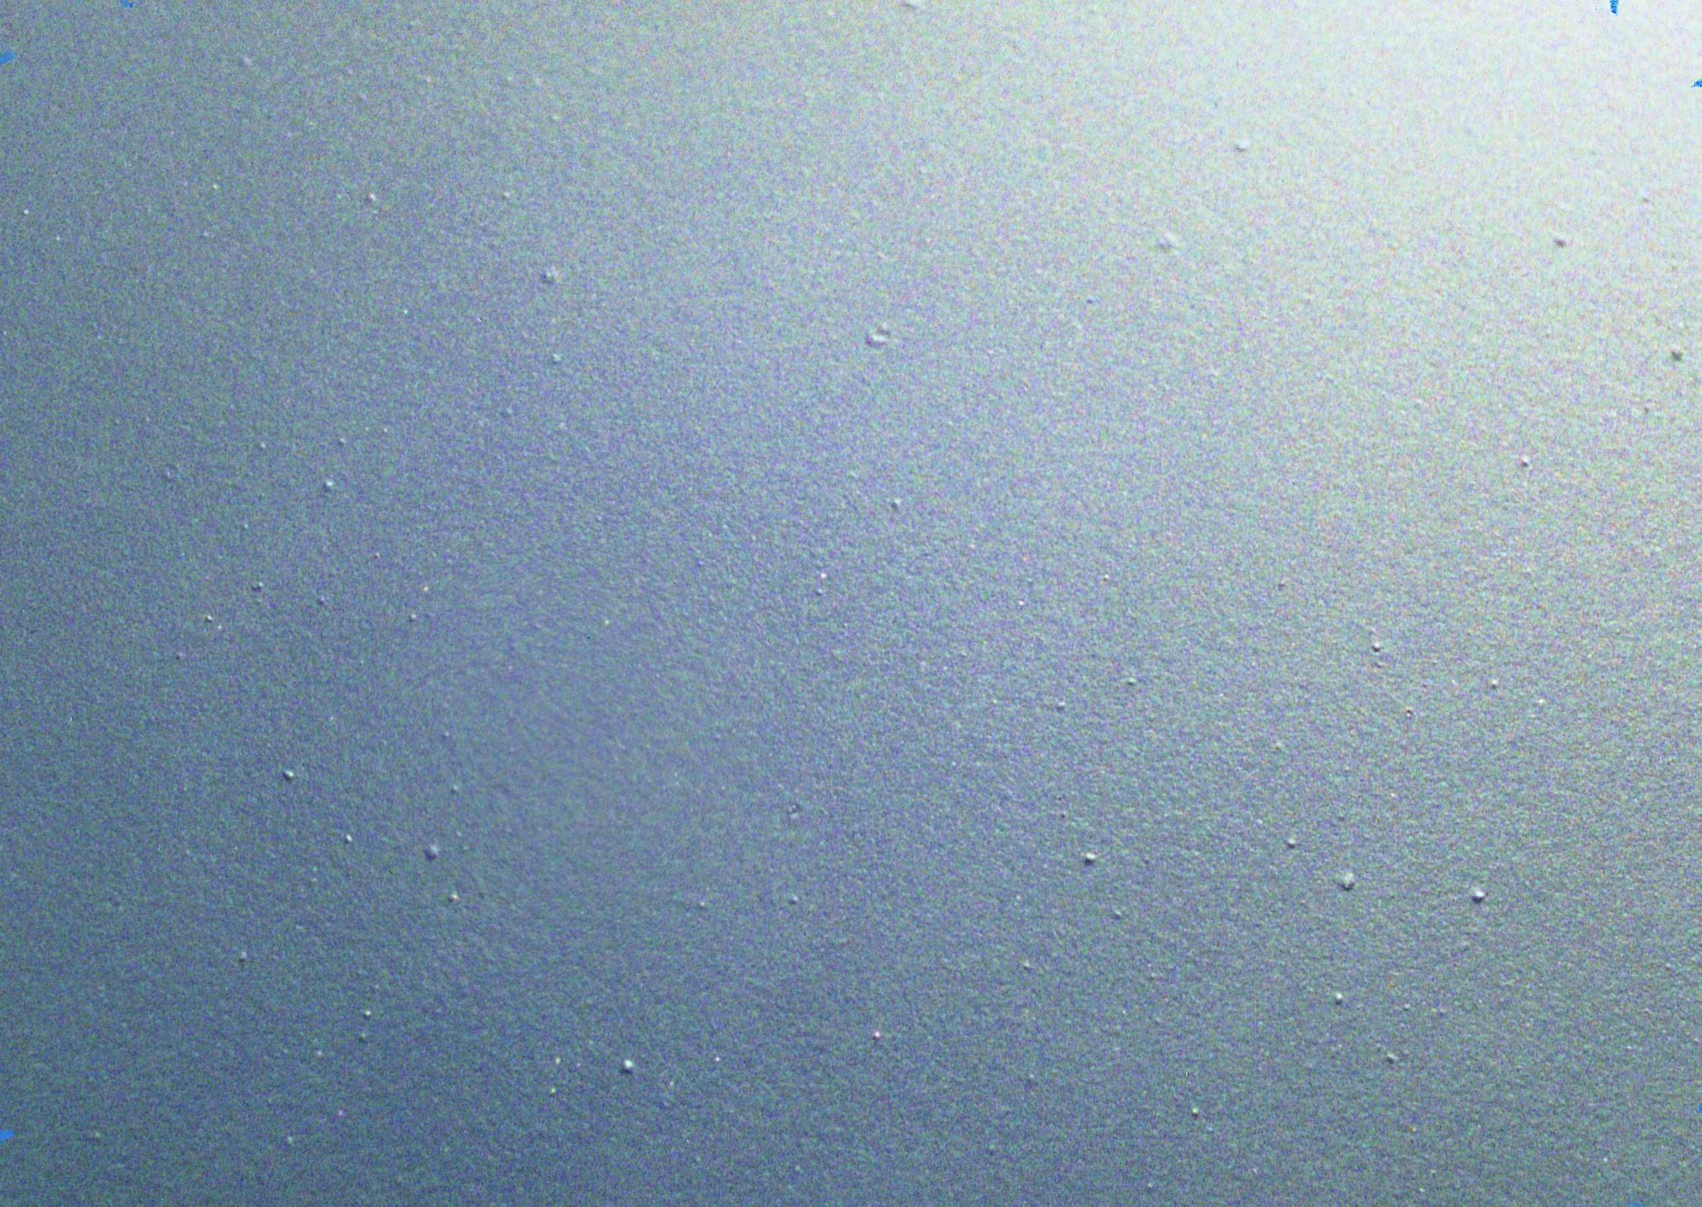
Problem- solving chart

Slide 33
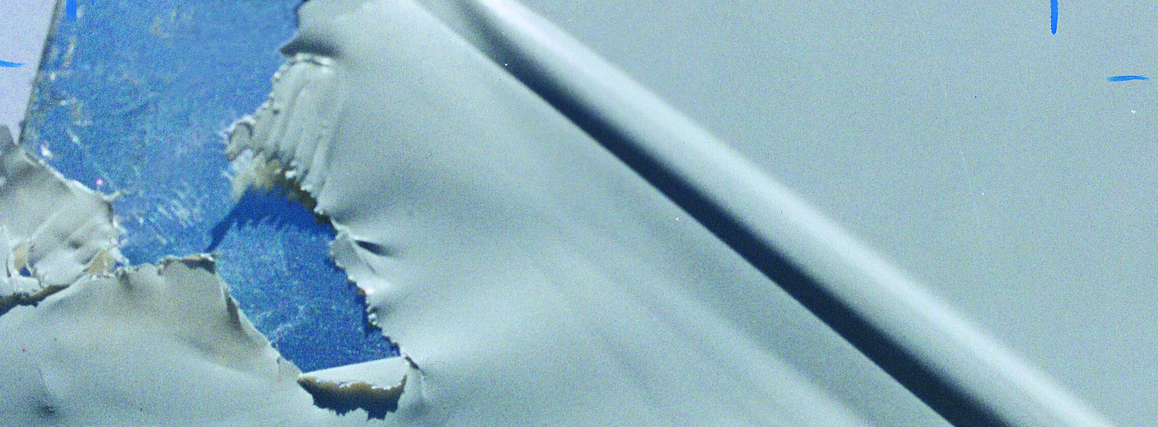
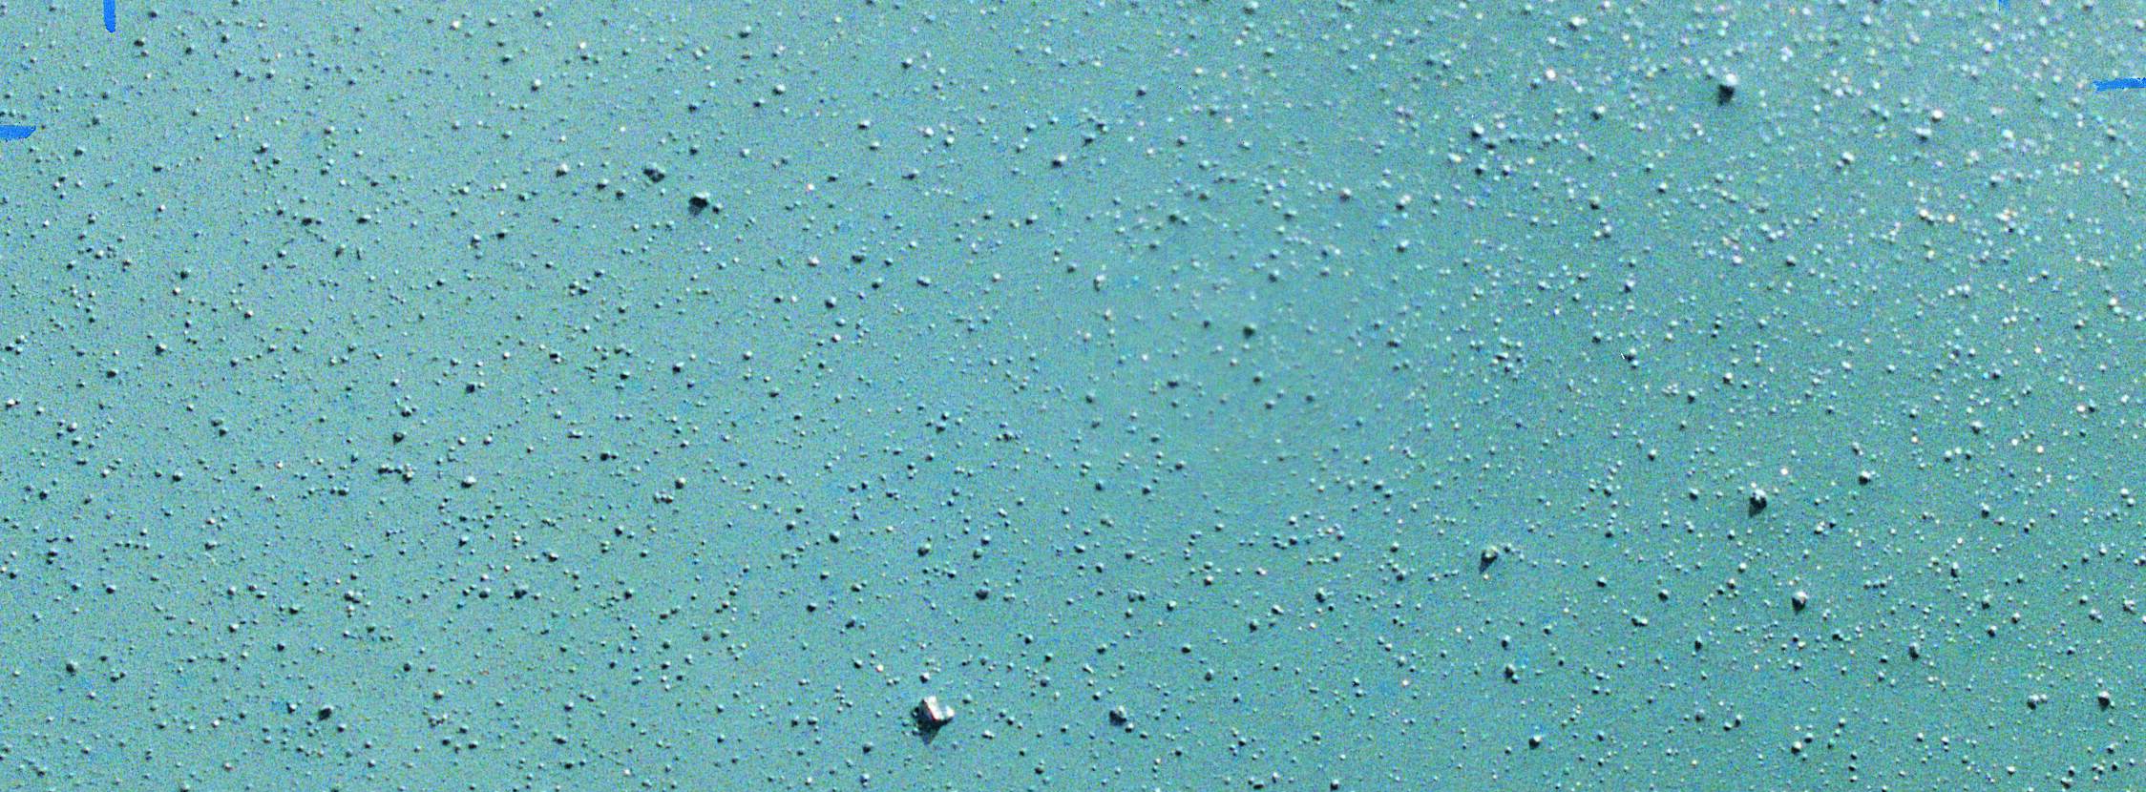
Common problems and possible solutions
Bubbles / pinholes
Peeling / flaking
Particulate contamination
Many small pock marks or tiny holes in the coating
Possible cause
Excessive agitation causing coating to foam and trap air
Excessive pumping or a leaking pump
Rapid evaporation of solvent
Insufficient substrate pre-heating / substrate issue
Section of coating easily lift off from substrate
Possible cause
Substrate contamination
Improper surface preparation
Insufficient mixing
Improper curing
Improper applied DFT
Particles on surface of coated substrate
Possible cause
Dried coating bits inside container falling back into coating
Airborne particles either in spray area or oven
improper activation of coating
Suggested solutions (fluoropolymer)
Reduce agitation in tank and check pumping process
Add slow-evaporating solvent
Warm more gradually, flash briefly before curing
Increase substrate pre-heating and spray gun atomization pressure with gradual DFT built up
Refer to PPG’s technical team for appropriate solution
Suggested solutions (fluoropolymer)
Improve process of cleaning to ensure no forming oil or previous coating residue mix according to Product Data Sheet (PDS)
Check PDS curing procedure apply appropriate DFT according to PDS
Suggested solutions (fluoropolymer/sol-gel)
Filter coating before use
Keep spray areas clean and dust-free ensure proper coating activation as per PDS
Consult PPG Technical for further information
Notes:
Remind audience of the curing process mentioned earlier slides

Slide 34
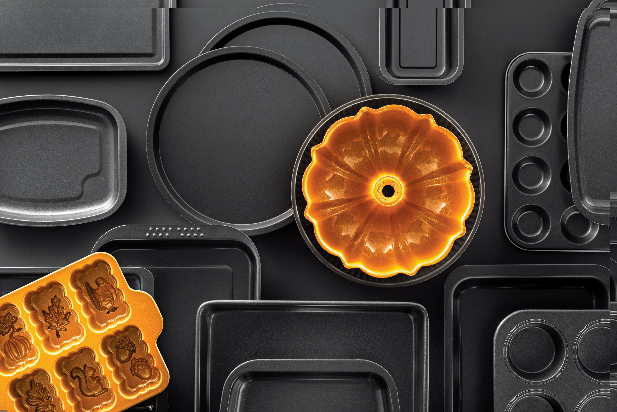
Quality Cooperative Program (QCP)

Slide 35

Quality Cooperative Program (QCP)
PPG publishes strict specifications for all our coatings. Adherence to these is crucial to achieving and maintaining maximum quality.
QCP Member Manufacturers who use our coatings must submit products on a regular basis for verification of the three main characteristics of all coatings:
Proper surface preparation
Film thickness
Proper cure
Important note: PPG is not the FINAL QC Check. Be sure your QC teams are checking products and production lines before the items ship.

Slide 36
Questions?
Jim Gibian Senior Business Development Manager and Global Key Account Manager USCA | jgibian@ppg.com
Suzie Eberhardt USCA Sales Manager, Kitchenware and Industrial Bakeware | seberhardt@ppg.com
Kurt Mecray Consumer Technical Marketing Manager | kmecray@ppg.com
Don Poitras Global Strategic Account Manager | dpoitras@ppg.com
Genna Niemiec Deane Marketing Communications Partner | gniemiec@ppg.com

Slide 37


