Slide 1
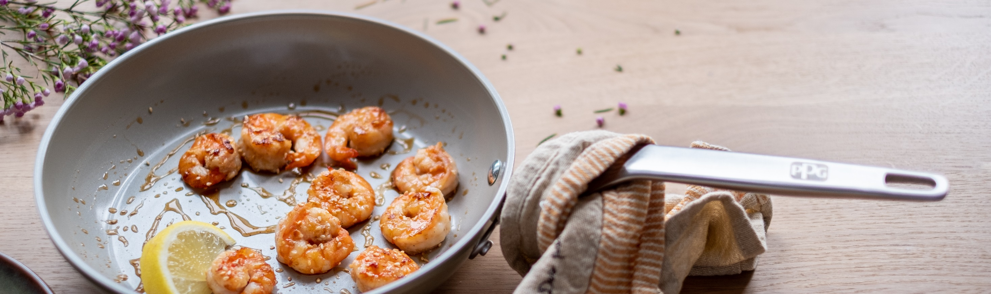
WELCOME TO PPG’S Product Knowledge University 101: Introduction to Non-Stick

Slide 2



Welcome
Please mute your microphone.

Slide 3

Today’s agenda
Introductions
PPG overview
Anatomy of a coating
Types of non-stick coatings
Internal and external reinforcements
How do the components work together?

Slide 4

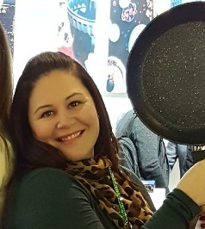



PKU Panel
Jim Gibian
Senior Business Development Manager and Global Key Account Manager USCA
Suzie Eberhardt
USCA Sales Manager, Kitchenware and Industrial Bakeware
Don Poitras
Global Strategic Account Manager
Kurt Mecray
Consumer Technical Marketing Manager
Genna Niemiec Deane
Marketing Communications Partner

Slide 5

PPG is a global maker of paints, coatings and specialty materials
Founded in 1883
Headquartered in Pittsburgh, PA
50,000+ employees
Facilities in 70+ countries

Slide 6
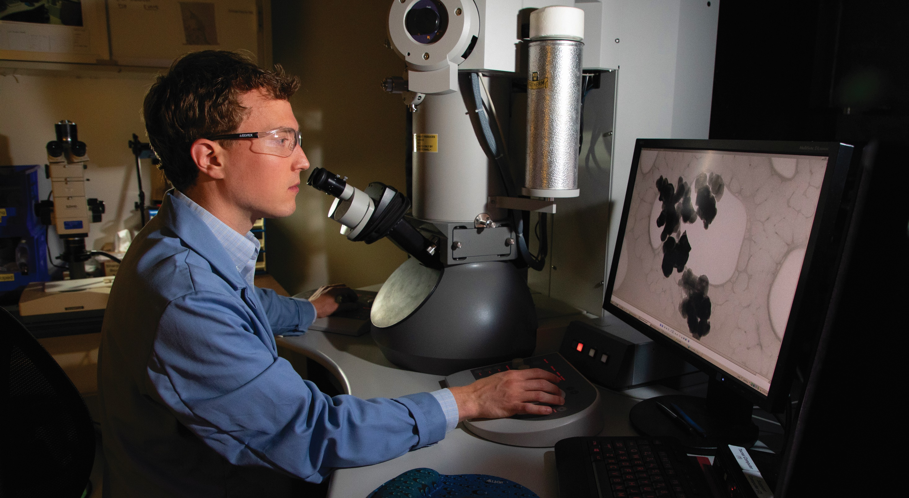
Capabilities
PPG’s 2019 acquisition of Whitford Worldwide expanded our consumer offering to include non-stick coatings. PPG now offers a complete range of consumer coatings.
Coatings combine high performance features with the most in-demand colors
Coatings are available in a range of formulations for all sectors of housewares.
PPG is driven by innovation with 3,500+ technical employees and $464 MM average annual R&D investment

Slide 7
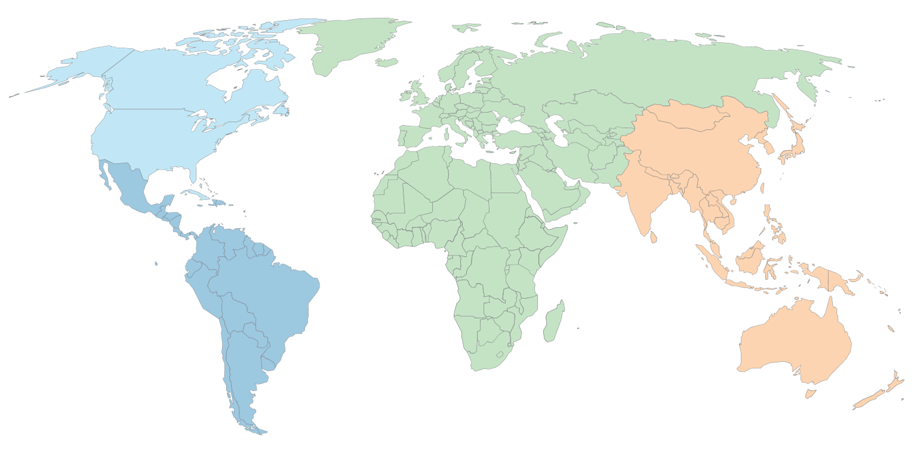
IC global laboratories by PPG region and lab type
Region
United States & Canada (USCA)
Latin America (LA)
Europe, Middle East & Africa (EMEA)
Asia Pacific (AP)
Lab Type
Research
42
Development
labs worldwide
Field

Slide 8

IC global manufacturing plants by PPG region
Region
United States & Canada (USCA)
Latin America (LA)
Europe, Middle East & Africa (EMEA)
Asia Pacific (AP)
43
facilities worldwide

Slide 9


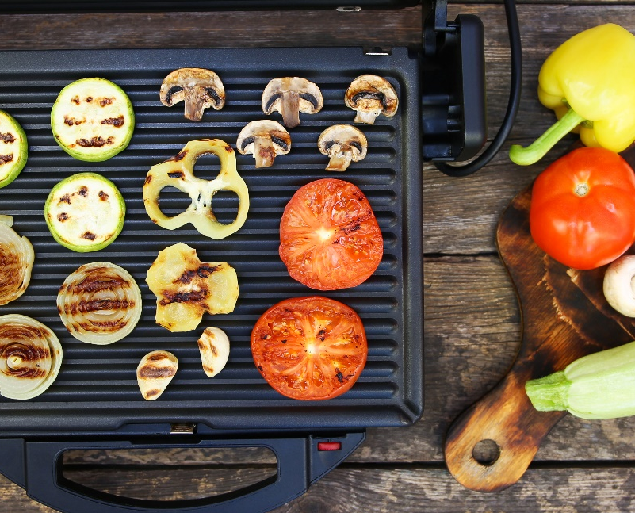
Cookware
Bakeware
Small Electrics
Hydration

Slide 10
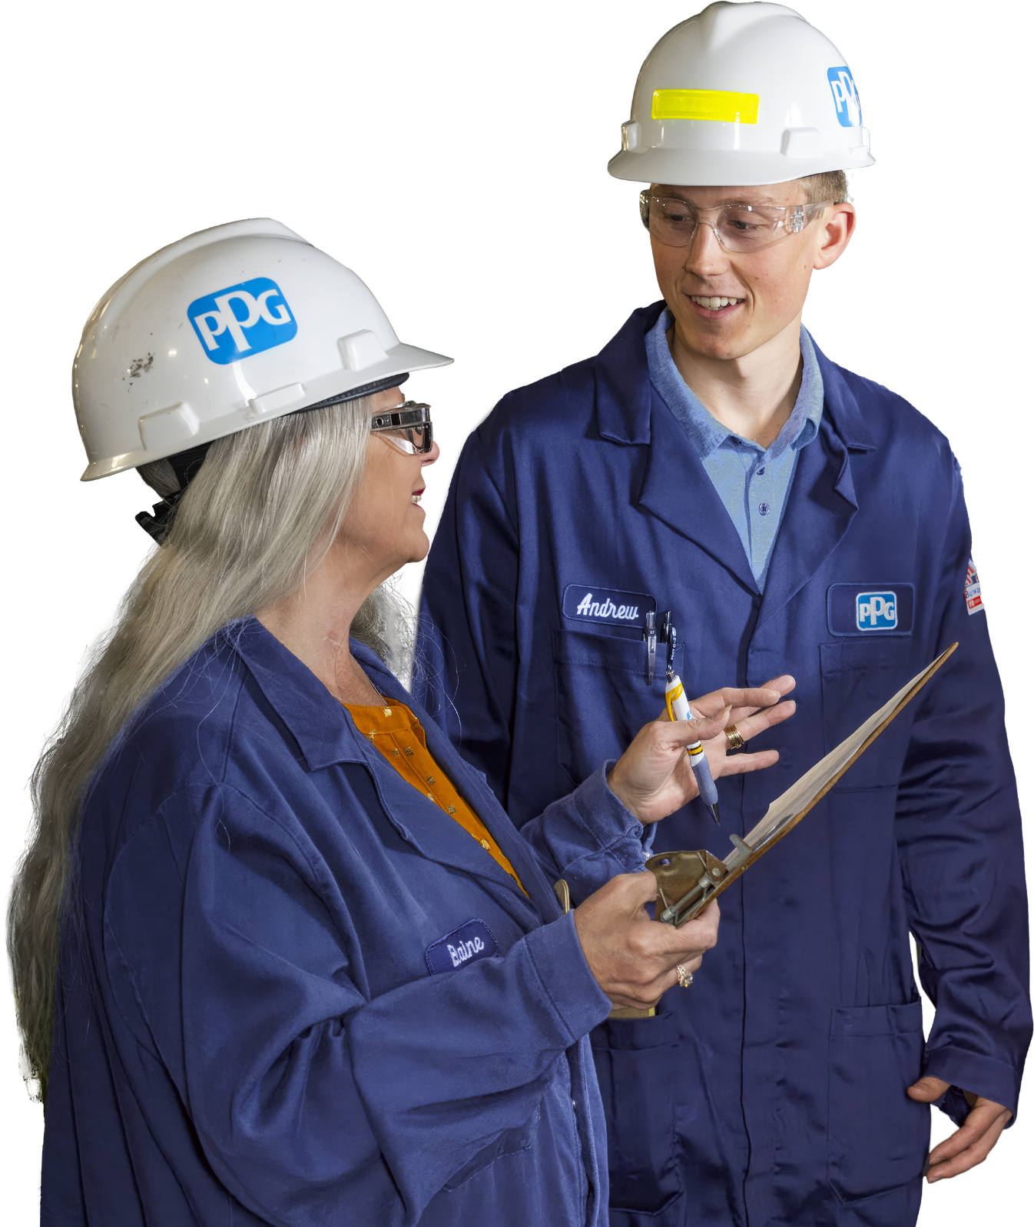
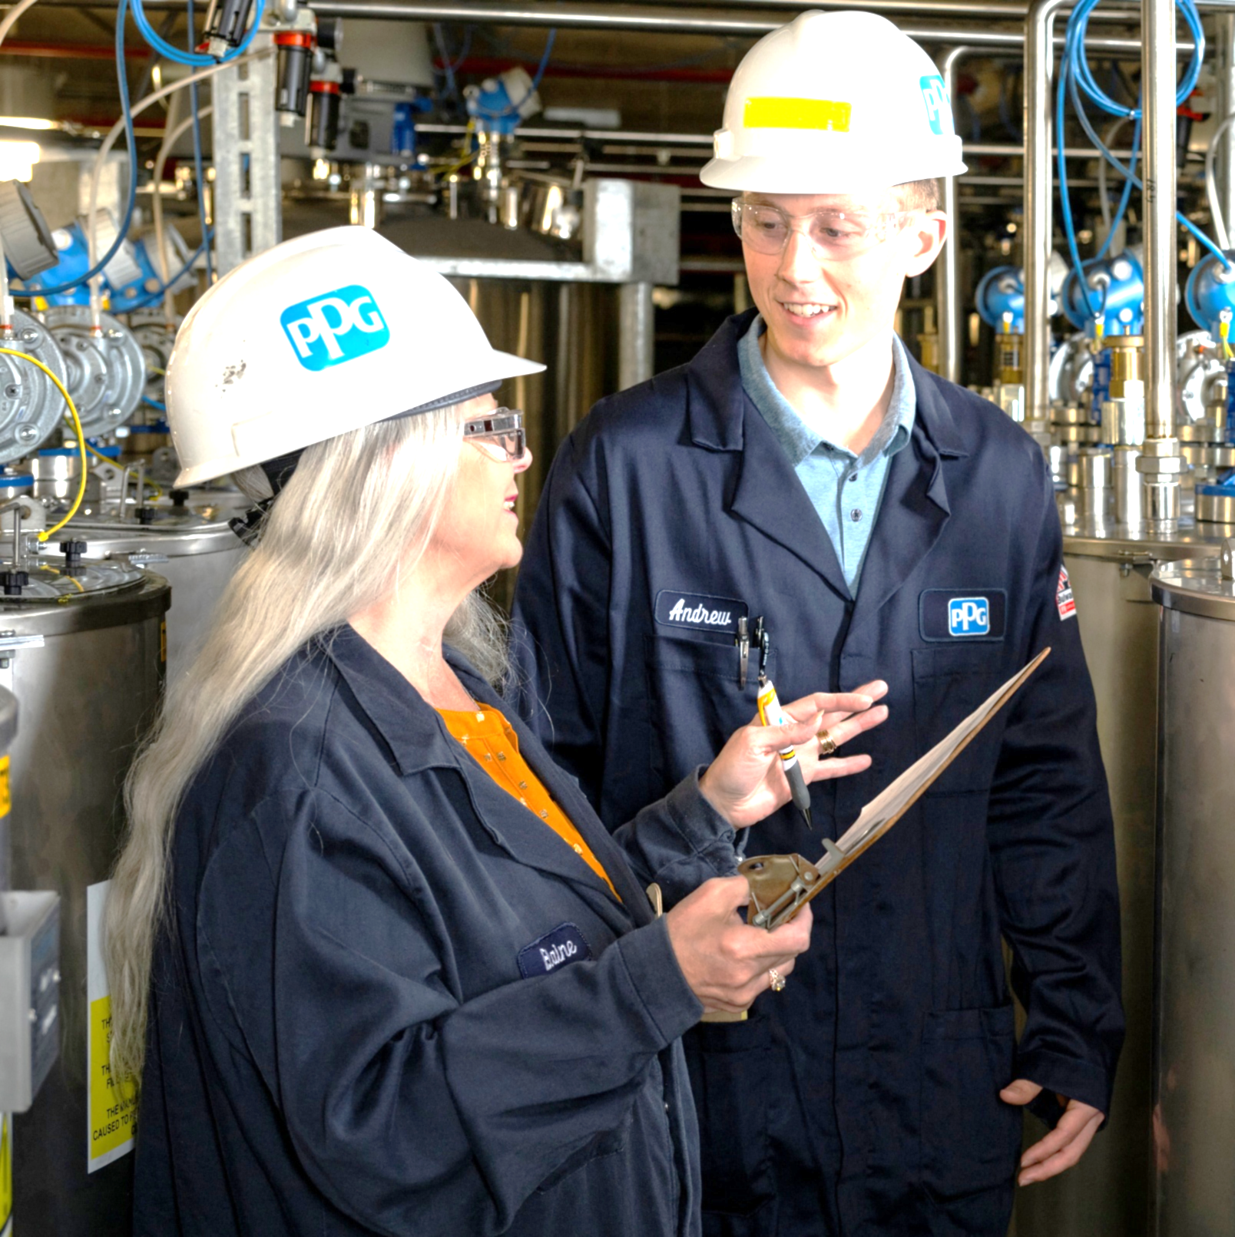




We are committed to sustainability
Sustainability
2030 sustainability goals*
50% of sales from sustainable products and processes by 2025
2023: 44%
50% reduction in GHG emissions from our own operations (scope 1 and 2 emissions)**
2023: 10%
30% reduction in GHG emissions in our value chain (scope 3 emissions)**
2023: 12%
100% process waste for reuse, recycling and recovery
2023: 45%
100% of key suppliers assessed to sustainability and social responsibility criteria
2023: 97%
* All goals are by 2030 with a 2019 baseline, unless otherwise noted ** Validated by SBTi and aligned with the emissions reductions required for a 1.5° C future or better

Slide 11
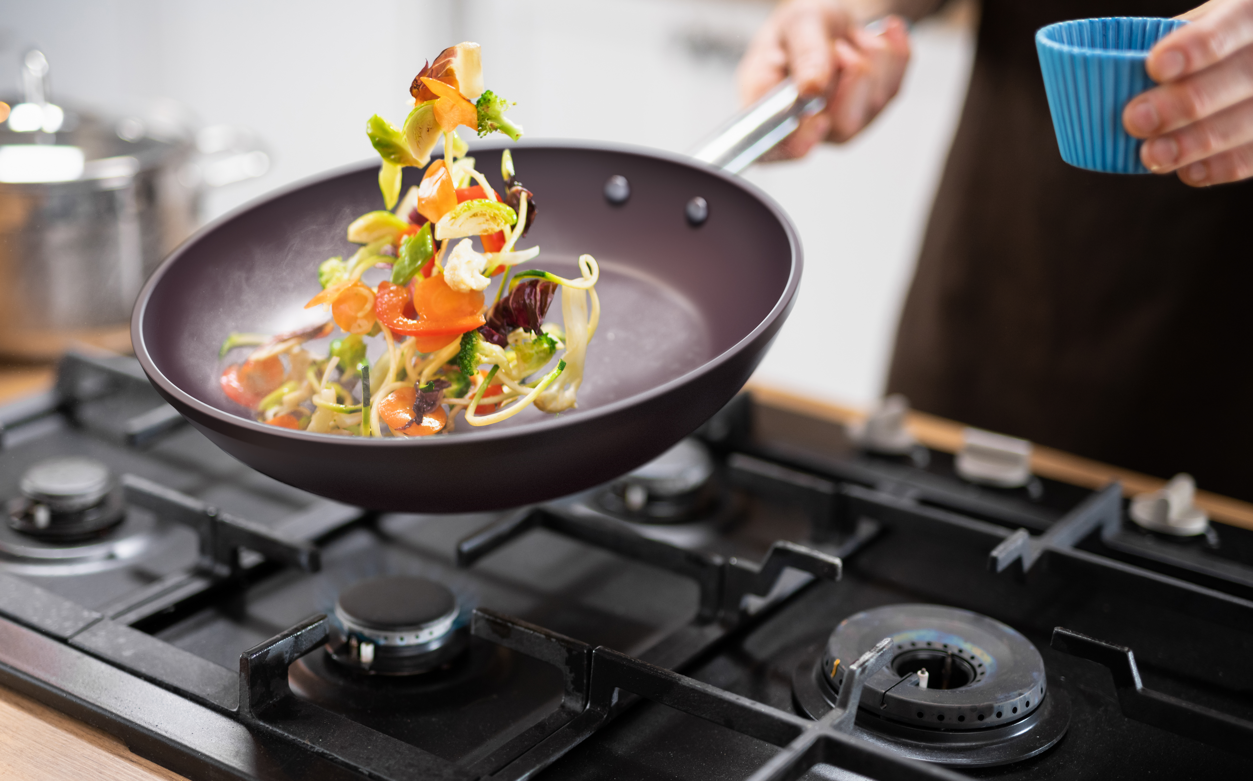
30 international color experts across five color-oriented businesses
Expert color styling and design studio access for customers at our Huntington Beach, CA studio and Zhangjiagang, China facilities
Curated standard color catalogue based on customer preference and demand
Custom annual color palette driven by trends in the home and housewares market
Precise color-matching capabilities for custom colors
Color expertise

Slide 12

PPG: more than just innovative products
A partner focused on quality
Consultative services to guide you from product development through manufacturing and beyond
Focused on the future and global compliance needs
Leveraging our relationships with manufacturers through our QCP program
Committed to going above and beyond

Slide 13
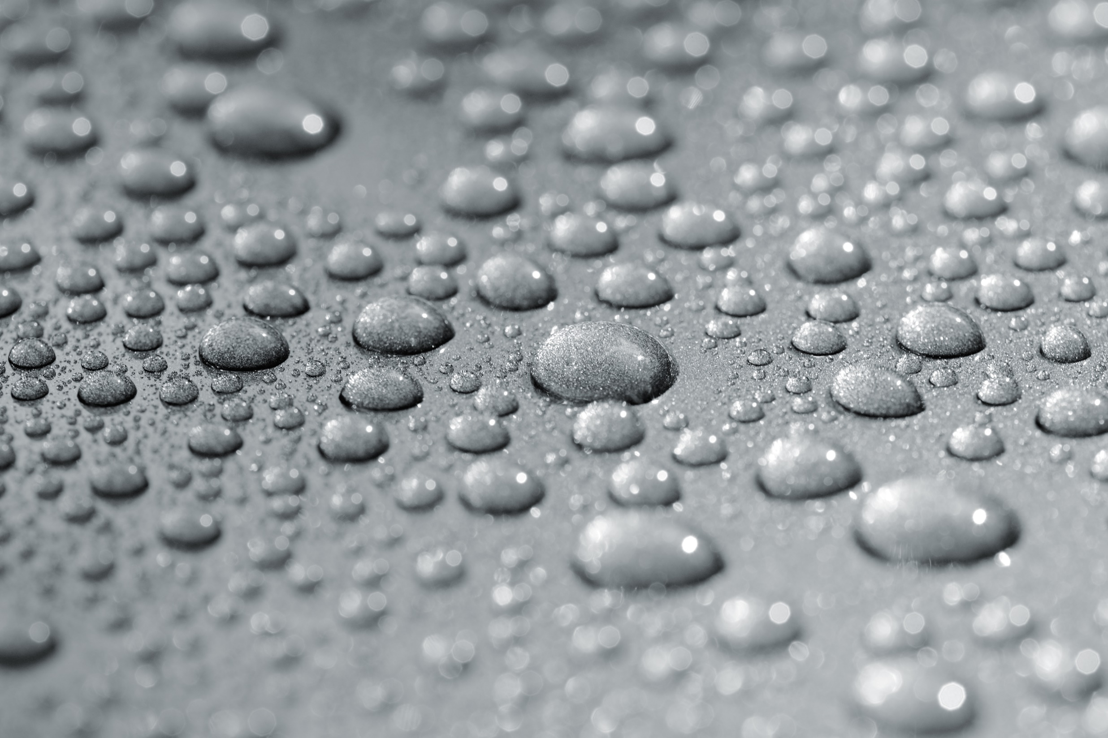
Anatomy of a coating

Slide 14
What is a coating?
An adherent and coherent layer of material formed upon the surface of another material and is different in composition than the surface of the other material.
Modifications can include changes to the:
Appearance
Mechanical / physical properties
Resistance properties (e.g., chemical, weathering, heat)
Other properties (e.g., electrical)

Slide 15
Anatomy of a coating
A non-stick coating is a blend of carefully chosen raw materials. The main components of a coating are:
Binder
Adheres and coheres to the surface of the pan, acting as the “glue”
Holds the rest of the ingredients together, also determining the fundamental properties of the coating
Pigment
Provides the color and metallic effect
Carrier
The component in which all other materials are suspended; evaporates when the coating is cured
Non-stick Component
PTFE or silicone, which provides the release
Reinforcing Agents
Strengthen the coating and resist wear
Additives
Processing and/or application aids
Materials to support marketing claims
Notes:
Considerations that go into creating a color match for your coating
When a color match for a coating is done, the first step is to advise the target color by using a standard color system such as Pantone or RAL. Then the parameters need to be defined, such as, is it for an interior or exterior application; will it come in contact with direct flame; and what are the performance requirements?
Once the important details are discussed with your coating supplier, the first things they consider are the regulatory requirements, such as FDA, Prop 65 and EU compliance. These requirements determine which pigments and ingredients can be used, as only food-contact safe pigments and ingredients can be used.
For a housewares coating, in addition to the performance and regulatory challenges, there are application considerations as well. The coating must be heat resistant, the color must be achieved in a relatively thin film, and it has to be able to be sprayed with good viscosity. And finally the target cost is weighed into the equation.
Working with a reputable coating manufacturer, providing all requirements and being aware of the impacting factors, will help you get the best coating for your project including the desired color.

Slide 16
More on binders
Binder
Generally, a resin or organic polymer that creates the “backbone” of the coating
Provides adhesion, cohesion and most of the mechanical, thermal and chemical properties of the coating
Binder resins can be solvent-borne, waterborne or dispersion/emulsion in water
Most of the fluorinated coating formulations for housewares are waterborne systems
Most of the bakeware coatings (spray or coil) are solvent-borne systems
Pigment
Carrier
Non-stick Component
Reinforcing Agents
Additives

Slide 17
Types of binders
Binder
There are usually 3 kinds of binders that find common use in the formulation of cookware products:
Polyamide imide resin (PAI)
Polyethersulfone resin (PES)
Polyphenilensulfide resin (PPS)
These resins provide the heat resistance, hardness, flexibility and chemical resistance necessary for fluoropolymer-based non-stick coatings
The main binders that find common use in the formulation of bakeware products include:
Siliconized Polyester (spray application)
Polyethersulfone resin (PES)
Pigment
Carrier
Non-stick Component
Reinforcing Agents
Additives

Slide 18
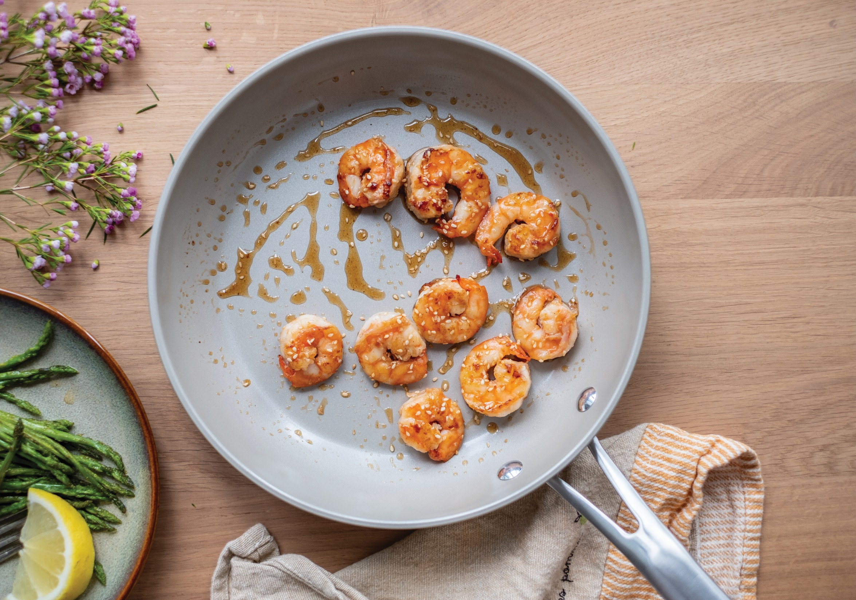
Types of non-stick coatings

Slide 19
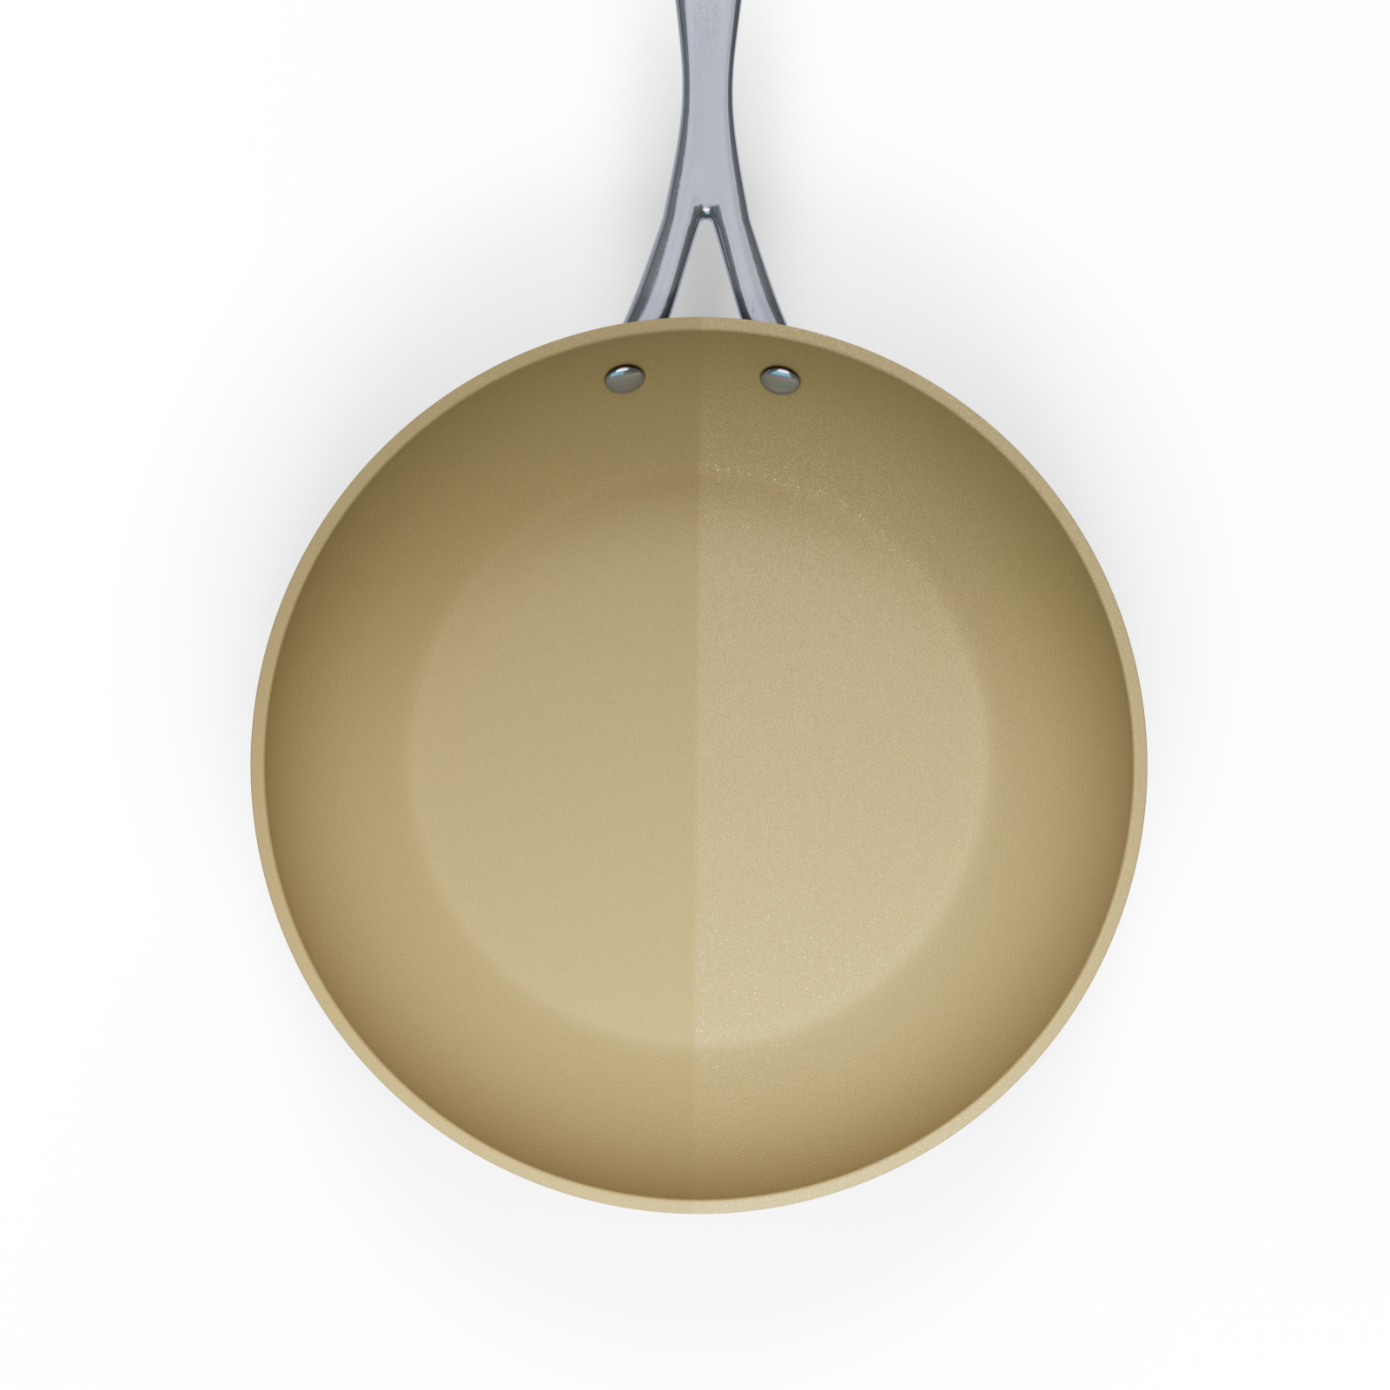
Main types of non-stick coatings
There are two main types of non-stick coatings: fluoropolymer coatings and silicone release coatings. They are differentiated by the ingredient used to provide the non-stick characteristic.
Silicone Release Coatings are coatings which use a safe synthetic resin that can be applied to specially prepared metal surfaces and bonded to the metal by baking. Unfortunately, they tend to lose their non-stick characteristic sooner than fluoropolymer coatings.
This category also includes sol-gel “ceramic” coatings.
Reasons for use Silicone release coatings are primarily used for bakeware, with the exception of sol-gel “ceramic” coatings that are used mostly for cookware and small electric appliances.
Fluoropolymer Coatings use a few fluoropolymer resin compounds (principally PTFE) that are solid, safe for use, plastic polymers having inherent non-stick properties.
Reasons for use Fluoropolymer coatings retain the
non-stick quality far longer and, with advances in coating technology, they are far more resistant to wear. Therefore, they are primarily used on cookware and small electric appliances.
Notes:
Where did it all begin?
non-stick coatings hit the selling floors in the early 1960s.
The first non-sticks were made primarily of polytetrafluoroethylene (PTFE). PTFE has the lowest coefficient of friction (CoF) of any known solid. In other words, the majority of materials (in this case foodstuffs) do not stick to it.
PTFE's low CoF "releases" the materials, making it easy to separate them from the coating. Therefore, on non-stick pans, most substances are easily removed from the surface.
Unfortunately, PTFE is also very soft and, if unprotected, wears quickly. While early non-sticks had good release, they were soft and wore out after little use. The result: non-stick-coated cookware earned the reputation of being "disposable".
What is a fluoropolymer?
A fluoropolymer is a polymer that contains molecules of carbon and fluorine. They are high-performance plastic materials used in harsh chemical and high-temperature environments, primarily where a critical performance specification must be met.
What are fluoropolymers used for?
Fluoropolymers are thermoplastics, which simply means that at some point energy (in most cases, heat, which is why the prefix "thermo") is used to achieve the final form.
Typical uses for fluoropolymers include:
wire insulation for computer networks
semi-conductor manufacturing equipment
automotive fuel hoses
About 85 percent of fluoropolymers are used in industrial applications like these.
The other 15 percent are used in consumer products such as non-stick cookware, bakeware, small electrics and weather- and chemical-protective fabrics.
How do you decide what coating to put on a specific metal? We offer non-stick items made from stainless-steel, tri-ply, aluminum, hard anodized aluminum and carbon steel.

Slide 20
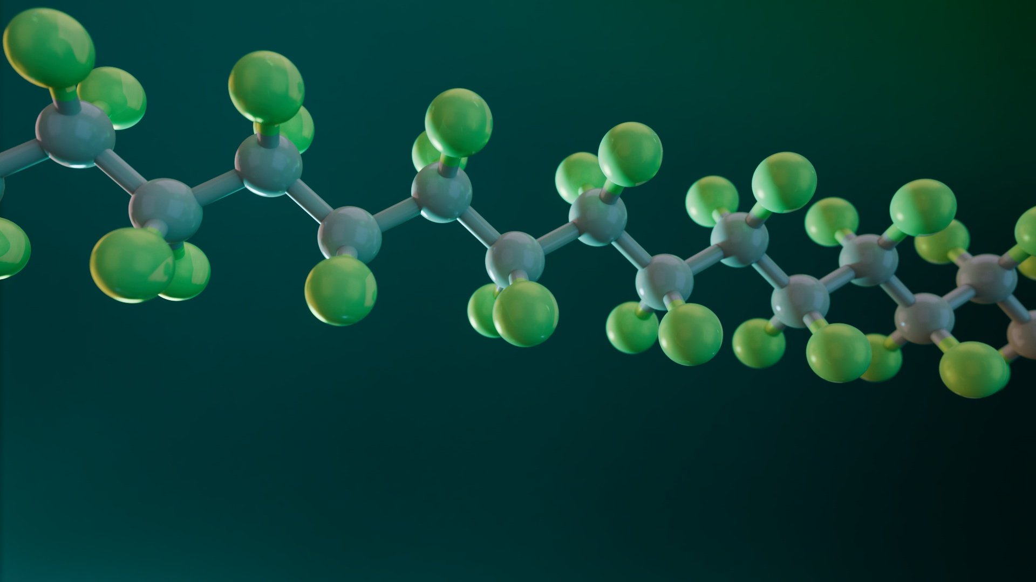
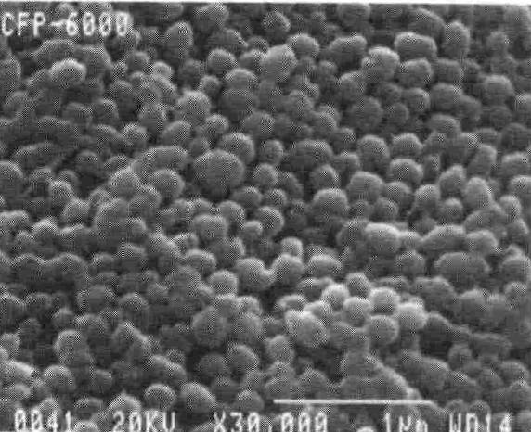
PTFE: Poly-Tetra-Fluoro-Ethylene
A polymer with a simple and linear crystalline structure. This makes it a chemically inert, refractory material, with low thermal and electrical conductivity.
PTFE used for the formulation of waterborne coatings is supplied in aqueous dispersions: these are milky white latex full of very small spheres of PTFE (the radius is about 200nm = 0.00002 cm).
Notes:
https://pslc.ws/macrog/ptfe.htm
A fluoropolymer is a polymer that contains atoms of carbon and fluorine
They are high-performance plastic materials used in harsh chemical and high-temperature environments
Used in more than cookware and bakeware:
Defense
Automotive
Telecom
Aerospace
Electronics
Consumer Products

Slide 21
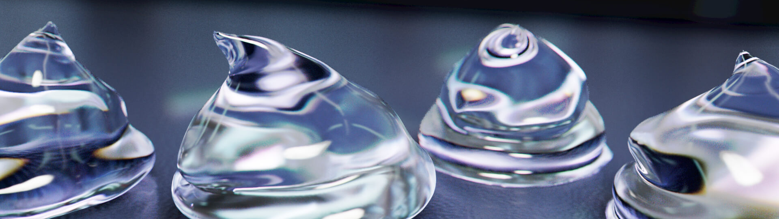
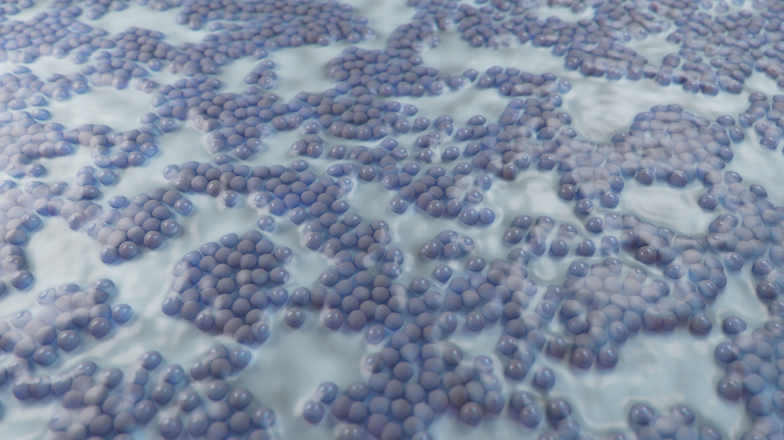
Sol-Gel
Sol (Solution):
A colloidal suspension of tiny particles in a liquid medium which undergoes hydrolysis and condensation polymerization to form a “gel”. This occurs in the activation phase.
Gel:
A solid, jelly-like material that has properties ranging from soft and weak to hard and tough. Gels are defined as a substantially dilute cross-linked system, which exhibits no flow when in the steady state. When the gel is applied as a coating and dried, a hard film is created, with a ceramic-like appearance.
Sol-gel technology is a hybrid of organic and inorganic chemistry. Coatings produced using sol-gel technology are more accurately described as ceramic-like; they feature many of the same characteristics as ceramic but to a lesser extent.

Slide 22
Pros and cons of coating types
A quick summary to consider when developing products:
PROS
CONS
Fluoropolymer coatings
Excellent release and abrasion performance
Wide variety of options
For all price and performance levels
Simple application
Great chemical inertness
Dishwasher safe
Soft Thermoplastic
Standard use temperature (500º F / 260º C)
High temperature cure (processing)
Poor stain resistance; limited to dark, matte finishes
Currently classified as PFAS
Non PFAS
High hardness
Higher use temperatures (550º F / 288º C)
Good non-stick performance and corrosion resistance
Lighter colors and higher gloss can be achieved (bright whites and creams)
Sol-Gel 'ceramic' coatings
Limited non-stick durability and longevity
More brittle
More steps in application
Traditional ceramic coatings dishwasher not recommended
Notes:
How does the performance of sol-gel coatings differ from PTFE coatings?

Slide 23

Internal and external reinforcements

Slide 24
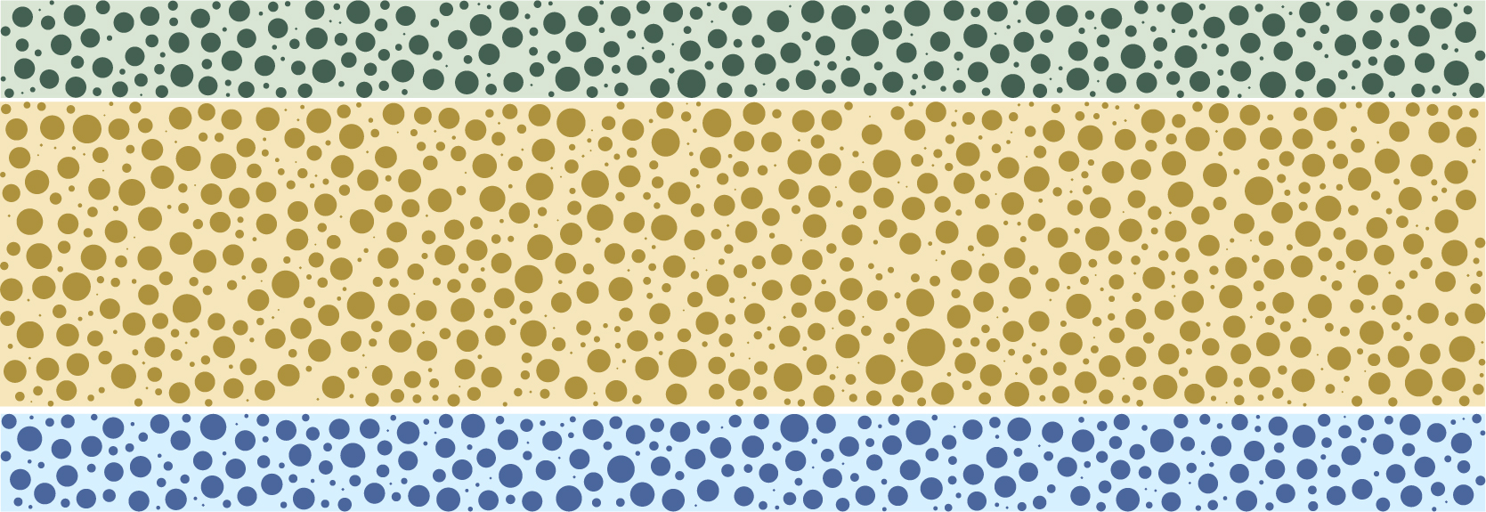
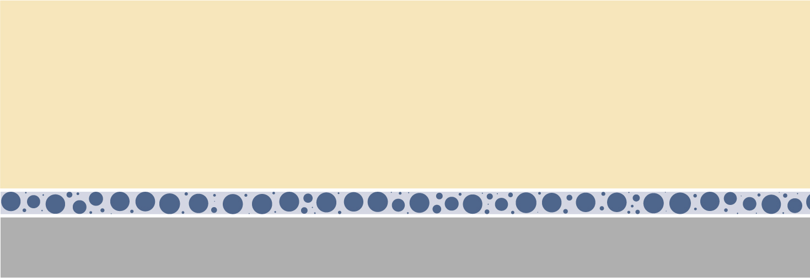
Internal and external reinforcements
A key factor in how a coating will perform, both in release life and abrasion resistance, is whether it contains any level or type of reinforcement.
Reinforcing agents can be added to the coating and/or the substrate to improve resistance to wear, extend the life of the coating, and further strengthen inter-coat adhesion. There are two types of reinforced non-stick coatings:
Internally reinforced coatings have small particles of varying sizes added directly into the different layers of the coating. The amount, size and type contribute to the quality level (durability) of the coating.
Externally reinforced coatings apply a foundation of small particles to the surface of the substrate to help lock in the coating. An example of external reinforcement is a plasma pretreatment.

Slide 25

How do the components work together?

Slide 26
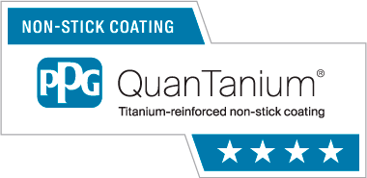
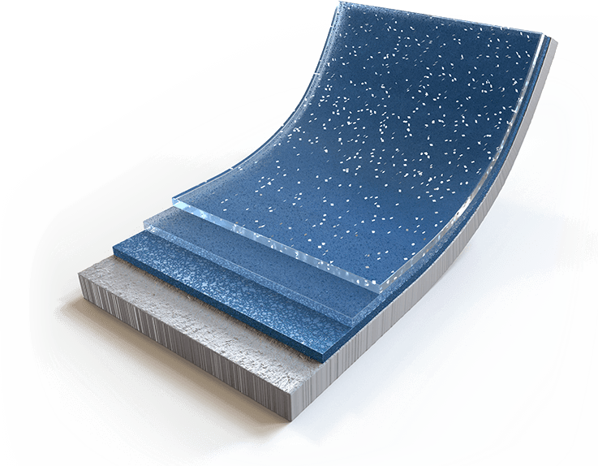
How do the components all work together?
PTFE coatings for consumer cookware are usually multi-coat systems, composed of two or three coats
Topcoat Provides the final appearance of the system and the main physical-chemical surface properties. This layer is mostly composed of fluoropolymers and pigments to provide the desired appearance and the necessary non-stick properties. It is usually not reinforced.
Midcoat Provides a bridging action between the primer and the topcoat. It may or may not contain a binder resin; the amount of fluoropolymer is high in this layer, and it can be reinforced. It is usually highly pigmented.
Basecoat (Primer) Provides adhesion to the substrate. A binder resin is always present; sometimes little or no fluoropolymer is in this layer.

Slide 27

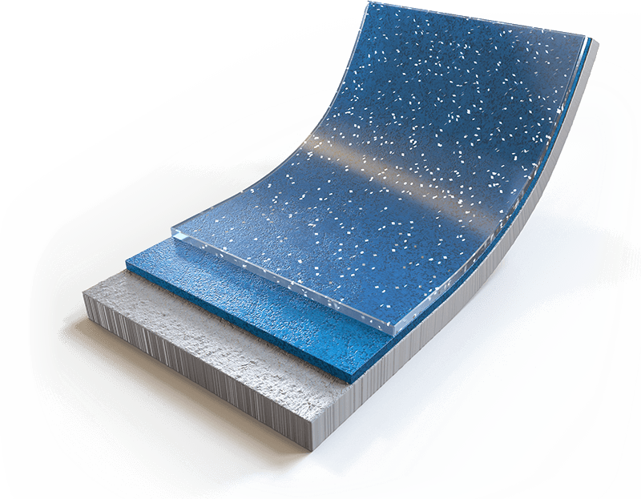
How do the components all work together?
Sol-gel “ceramic” coatings for consumer cookware are usually multi-coat systems, that consist of two coats
Sol-gel Topcoat
Provides the final appearance of the system and provides the main physical-chemical, and non-stick properties.
Sol-gel Basecoat (Primer)
Provides adhesion to the substrate. The application of the primer may require pre-heating of the parts before application begins. This allows for a more uniform application of the coating.

Slide 28
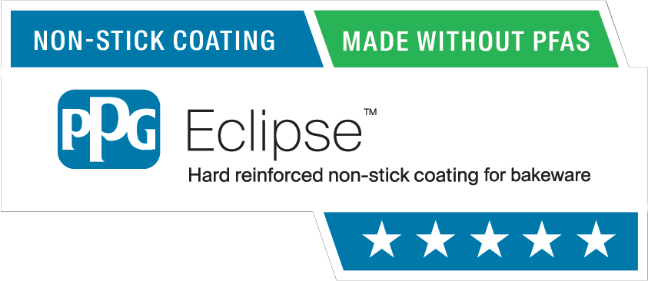
How do the components all work together?
Silicone release coatings for consumer bakeware are usually one or two coats
Topcoat
provides the final appearance of the system. This layer is mostly composed of silicone and pigments to provide the desired appearance and the necessary non-stick properties.
Basecoat (Primer)
provides adhesion to the substrate. There may be reinforcements in this layer as well (for both one and two coat systems). In a one coat system all functions must be performed by this layer including non-stick properties.
Notes:
In higher performing bakeware coatings, small amounts of PTFE powder may be contained in the formulation.

Slide 29
Questions?
Jim Gibian Senior Business Development Manager and Global Key Account Manager USCA | jgibian@ppg.com
Suzie Eberhardt USCA Sales Manager, Kitchenware and Industrial Bakeware (KIB) | seberhardt@ppg.com
Kurt Mecray Consumer Technical Marketing Manager | kmecray@ppg.com
Don Poitras Global Strategic Account Manager | dpoitras@ppg.com
Genna Niemiec Deane Marketing Communications Partner | gniemiec@ppg.com

Slide 30


