Slide 1
England Hockey 25/26

Slide 2
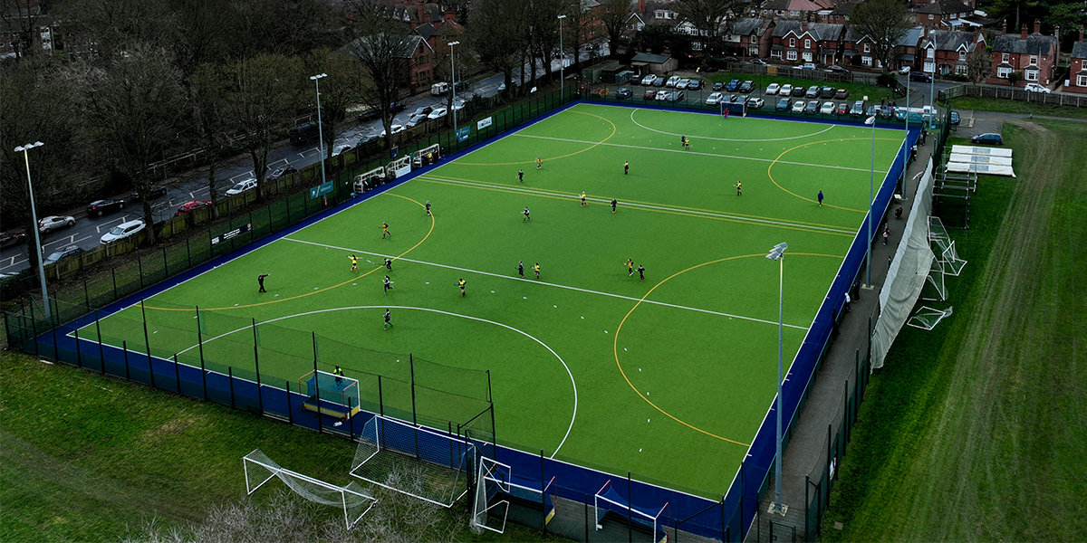
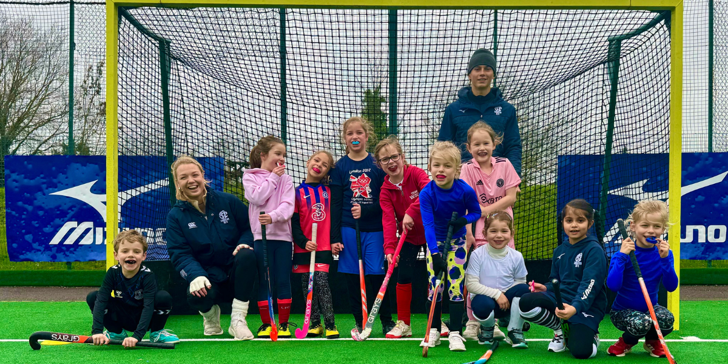
Pitch Together Fund:
£1.07 million invested in facility developments to date. Introduction Forums available to sign up to online.
https://www.englandhockey.co.uk/deliver/facilities
Junior Hockey Framework:
New coaching and game formats developed for Under 12 and below. Greater awareness of Under 12 and below competition taking place (100+ events registered).
https://www.englandhockey.co.uk/play/junior-hockey-framework
Structure Fit For The Future Review:
Review of governance changes across Areas and Counties completed. Review will be available online. Action plan developed to explore recommendations.
https://www.englandhockey.co.uk/governance/areas-and-counties/agm-resolution/governance-review

Slide 3

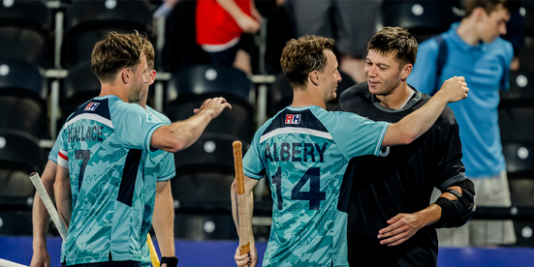
State School Fund:
18 Face to Face Teacher Training Workshops delivered. 174 Teachers trained. 96 Festivals delivered. 833 Young Leaders trained. 6259 participants.
State School Festivals:
32 state school festivals delivered by Counties, Areas and England Hockey (previously 21).
FIH Pro League:
24 international matches in London, delivered over 12 days of competition. Thank you to Hockey Makers for support over the competition.
https://www.englandhockey.co.uk/international/fih-hockey-pro-league-2025-26

Slide 4
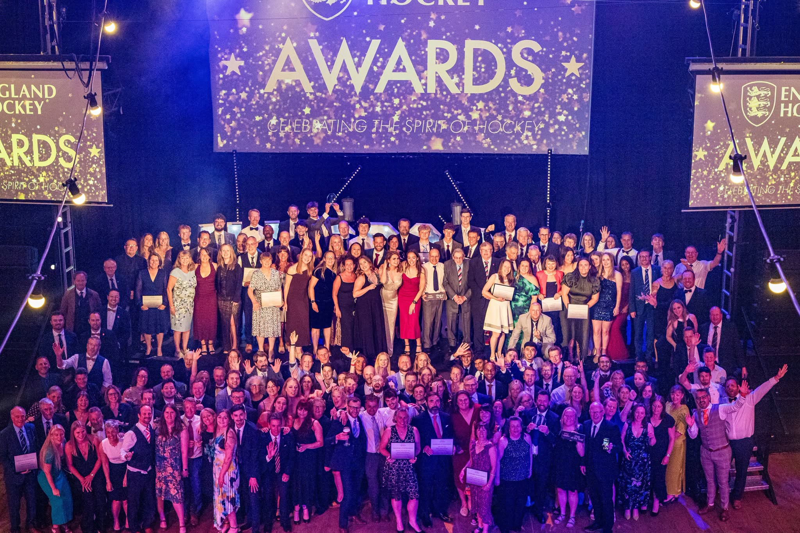

England Hockey Awards:
First time introduction of Area winners – recognising more people and organisations than ever (74 Area Winners). Highest number of nominations received (circa 210).
https://www.englandhockey.co.uk/competitions-and-events/england-hockey-awards/winners-2026
CPD:
3252 attendees of L1 Umpiring and Coaching workshops. 4680 safeguarding modules completed, plus 443 attendees at Safeguarding in Hockey and 168 Welfare Officers on Time To Listen.
EuroChamps27:
Tickets launched for EuroChamps27. Hockey Maker volunteer recruitment underway (500+ applications received). 27th July to 8th August 2027.
https://eurochamps27.com/

