Slide 1
Advocacy Academy
Refugee Academy (R.A.)– Vrije Universiteit Amsterdam
Elena Ponzoni, Halleh Ghorashi

Slide 2
Icebreaker
What is meaningful participation to you?
Share your answers with each other!

Slide 3
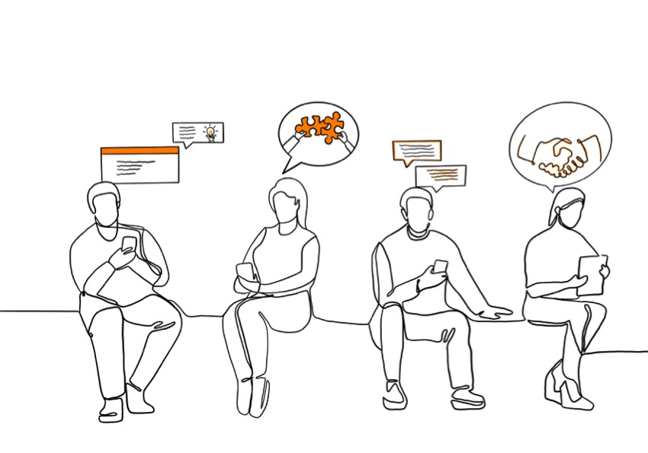
Starting points and
Assumptions
Policy is often detached from the experiences, whishes and perspectives of refugees
Experiences of refugee advocates are source of reflection for policy makers (reflecting on one’s position and actions)
How to create space for a variety of pespectives.

Slide 4
Structure of the advocacy academy
1 full day (offline)
  Morning: Discussing notions of ‘polivocal policymaking’ – lecture Halleh Ghorashi
Afternoon: Working in groups
  Mapping participatory spaces
  Diving into concrete cases
One come back session (online) after 3 weeks
Sharing and reflecting on the basis of the assingment and looking back on key notions

Slide 5
A case for refugee-led avocacy
Why is participation of refugee/migrant perspectives in policymaking important?
Theoretical notions:
  Deep democracy
  Politics of presence and politics of ideas

Slide 6
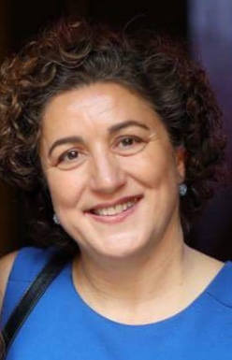
Lecture: Polyvocal policymaking
By Halleh Ghorashi
Professor of Diversity and Integration – Sociology
Vrije Universiteit Amstedam

Slide 7
Participatory governance
Inclusion of different perspectives to create ‘polivocality’ in policymaking
Deep democracy within deliberative structures: Making space for unusual and even disruptive voices in the process of decision making /policy making.

Slide 8
Different forms of power
Visible power – power of domination
Invisible power - discourses that reproduce certain taken for granted ways of thinking and acting

Slide 9
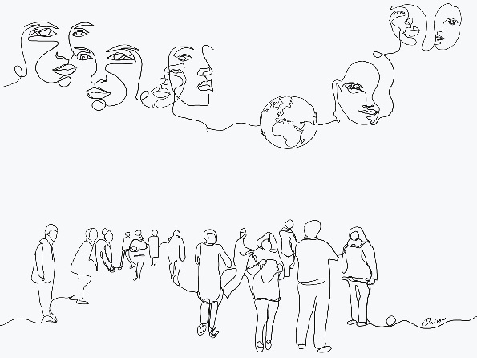
In-between instead of against
  In-between the lines
  In-between individuals
  In-between spaces

Slide 10
In-between instead of against
  In-between the lines
  “In a space that we cannot capture in rules and regulations, something extraordinary happens: something meaningful: a moment of consideration for the specific aspect of some one’s life situation; a moment of possible governmental and legal creativity ” (Hirsch Ballin)

Slide 11
In-between instead of against
  ‘In-between individuals’ having specific forms of consciousness
Practical consciousness (embedded enough to know how the new structure works)
Reflective consciousness (constant mirroring between the past and the present)
Relational consciousness (one’s narratives is situated within the general patterns of their network with other refugees/soulmates)

Slide 12
In-between instead of against
  ‘In-between spaces’ (or ‘interspaces’)
Slowing down – create space for multiplicity
Epoché (temporary suspension of one’s own judgement)
Alterity (approaching the other from the position of the other) –Emmanuel Levinas

Slide 13
Capacity building for all actors
Capacity building for people in decisionmaking
Capacity building for refugee advocates
Capacity sharing

Slide 14
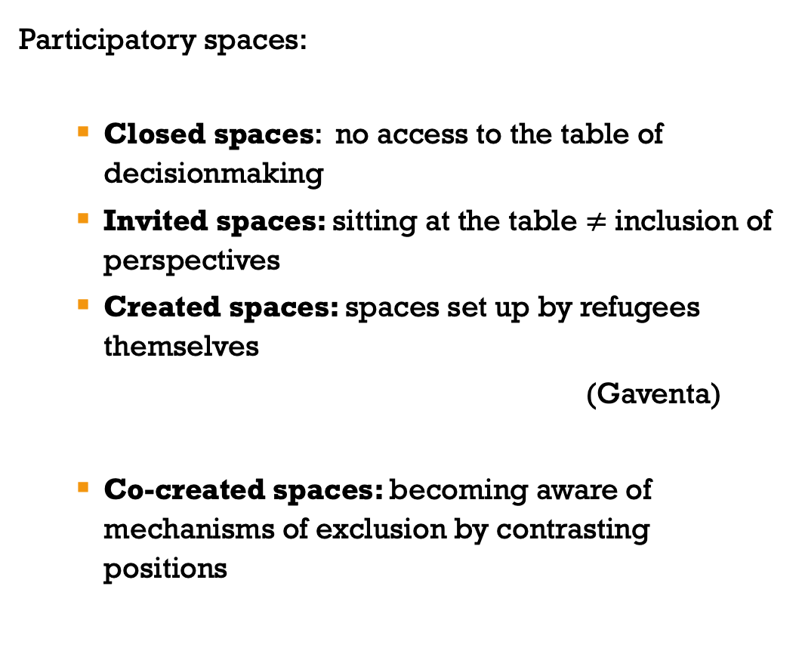
Participatory spaces
Participatory spaces:
  Closed spaces: no access to the table of decisionmaking
  Invited spaces: sitting at the table $≠$ inclusion of perspectives
  Created spaces: spaces set up by refugees themselves
  (Gaventa)
  Co-created spaces: becoming aware of mechanisms of exclusion by contrasting positions

Slide 15
Walking exercise
What did you hear in the lecture that is relevant for you/your work? Why is it relevant and how do you reflect on it?
Share an experience which you see as a good example of bringing refugee/migrant’s perspectives to policymaking and one example where that did not go so well.

Slide 16
Conditions for learning
Ryan en Markova (2006)
In the comfort zone, someone feels comfortable without anxiety or discomfort. There are no new challenges or reflections to start a learning process
The other extreme is the panic zone, a space that is overwhelming and far from comfortable. In this zone, people experience stress and anxiety. Learning is impossible because people are forced to expend all their energy on coping with stress and panic.
In between is the stretch zone. In this space, things can be unknown and can become uncomfortable, but there is room for a learning process.

Slide 17
Participatory spaces
What we mean with ‘Spaces’: Context and situations for decision making and consultation.
Also: “Opportunities, moments and channels where citizens can act to potentially affect policies, discourses, decisions and relationships that affect their lives and interests” (Gaventa)

Slide 18
Participatory spaces
Participatory spaces:
  Closed spaces: no access to the table of decisionmaking
  Invited spaces: sitting at the table $≠$ inclusion of perspectives
  Created spaces: spaces set up by refugees themselves
  (Gaventa)
  Co-created spaces: becoming aware of mechanisms of exclusion by contrasting positions

Slide 19
Thank you!

