Slide 1
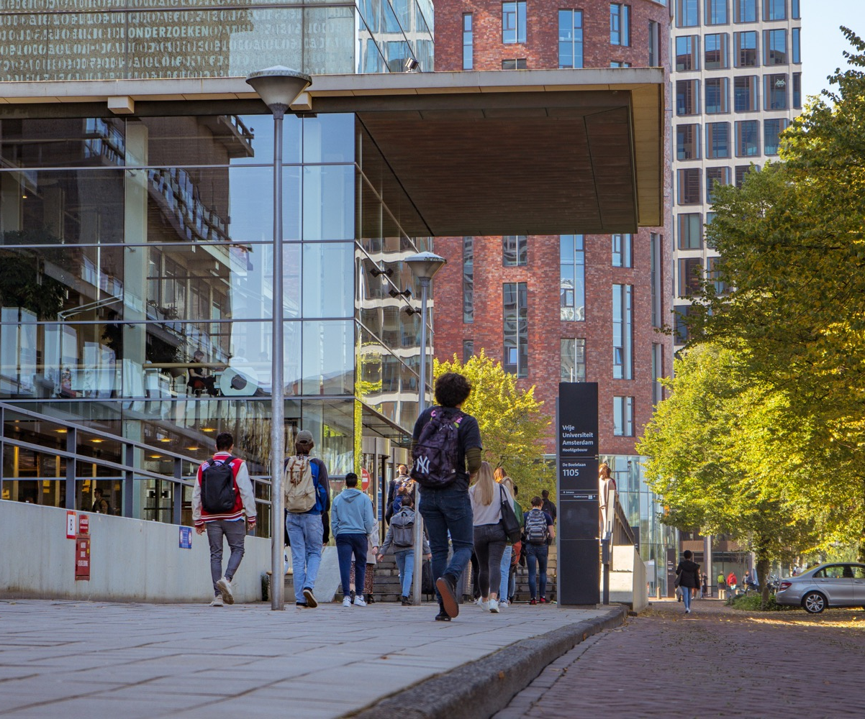
Welcome to Vrije Universiteit Amsterdam

Slide 2
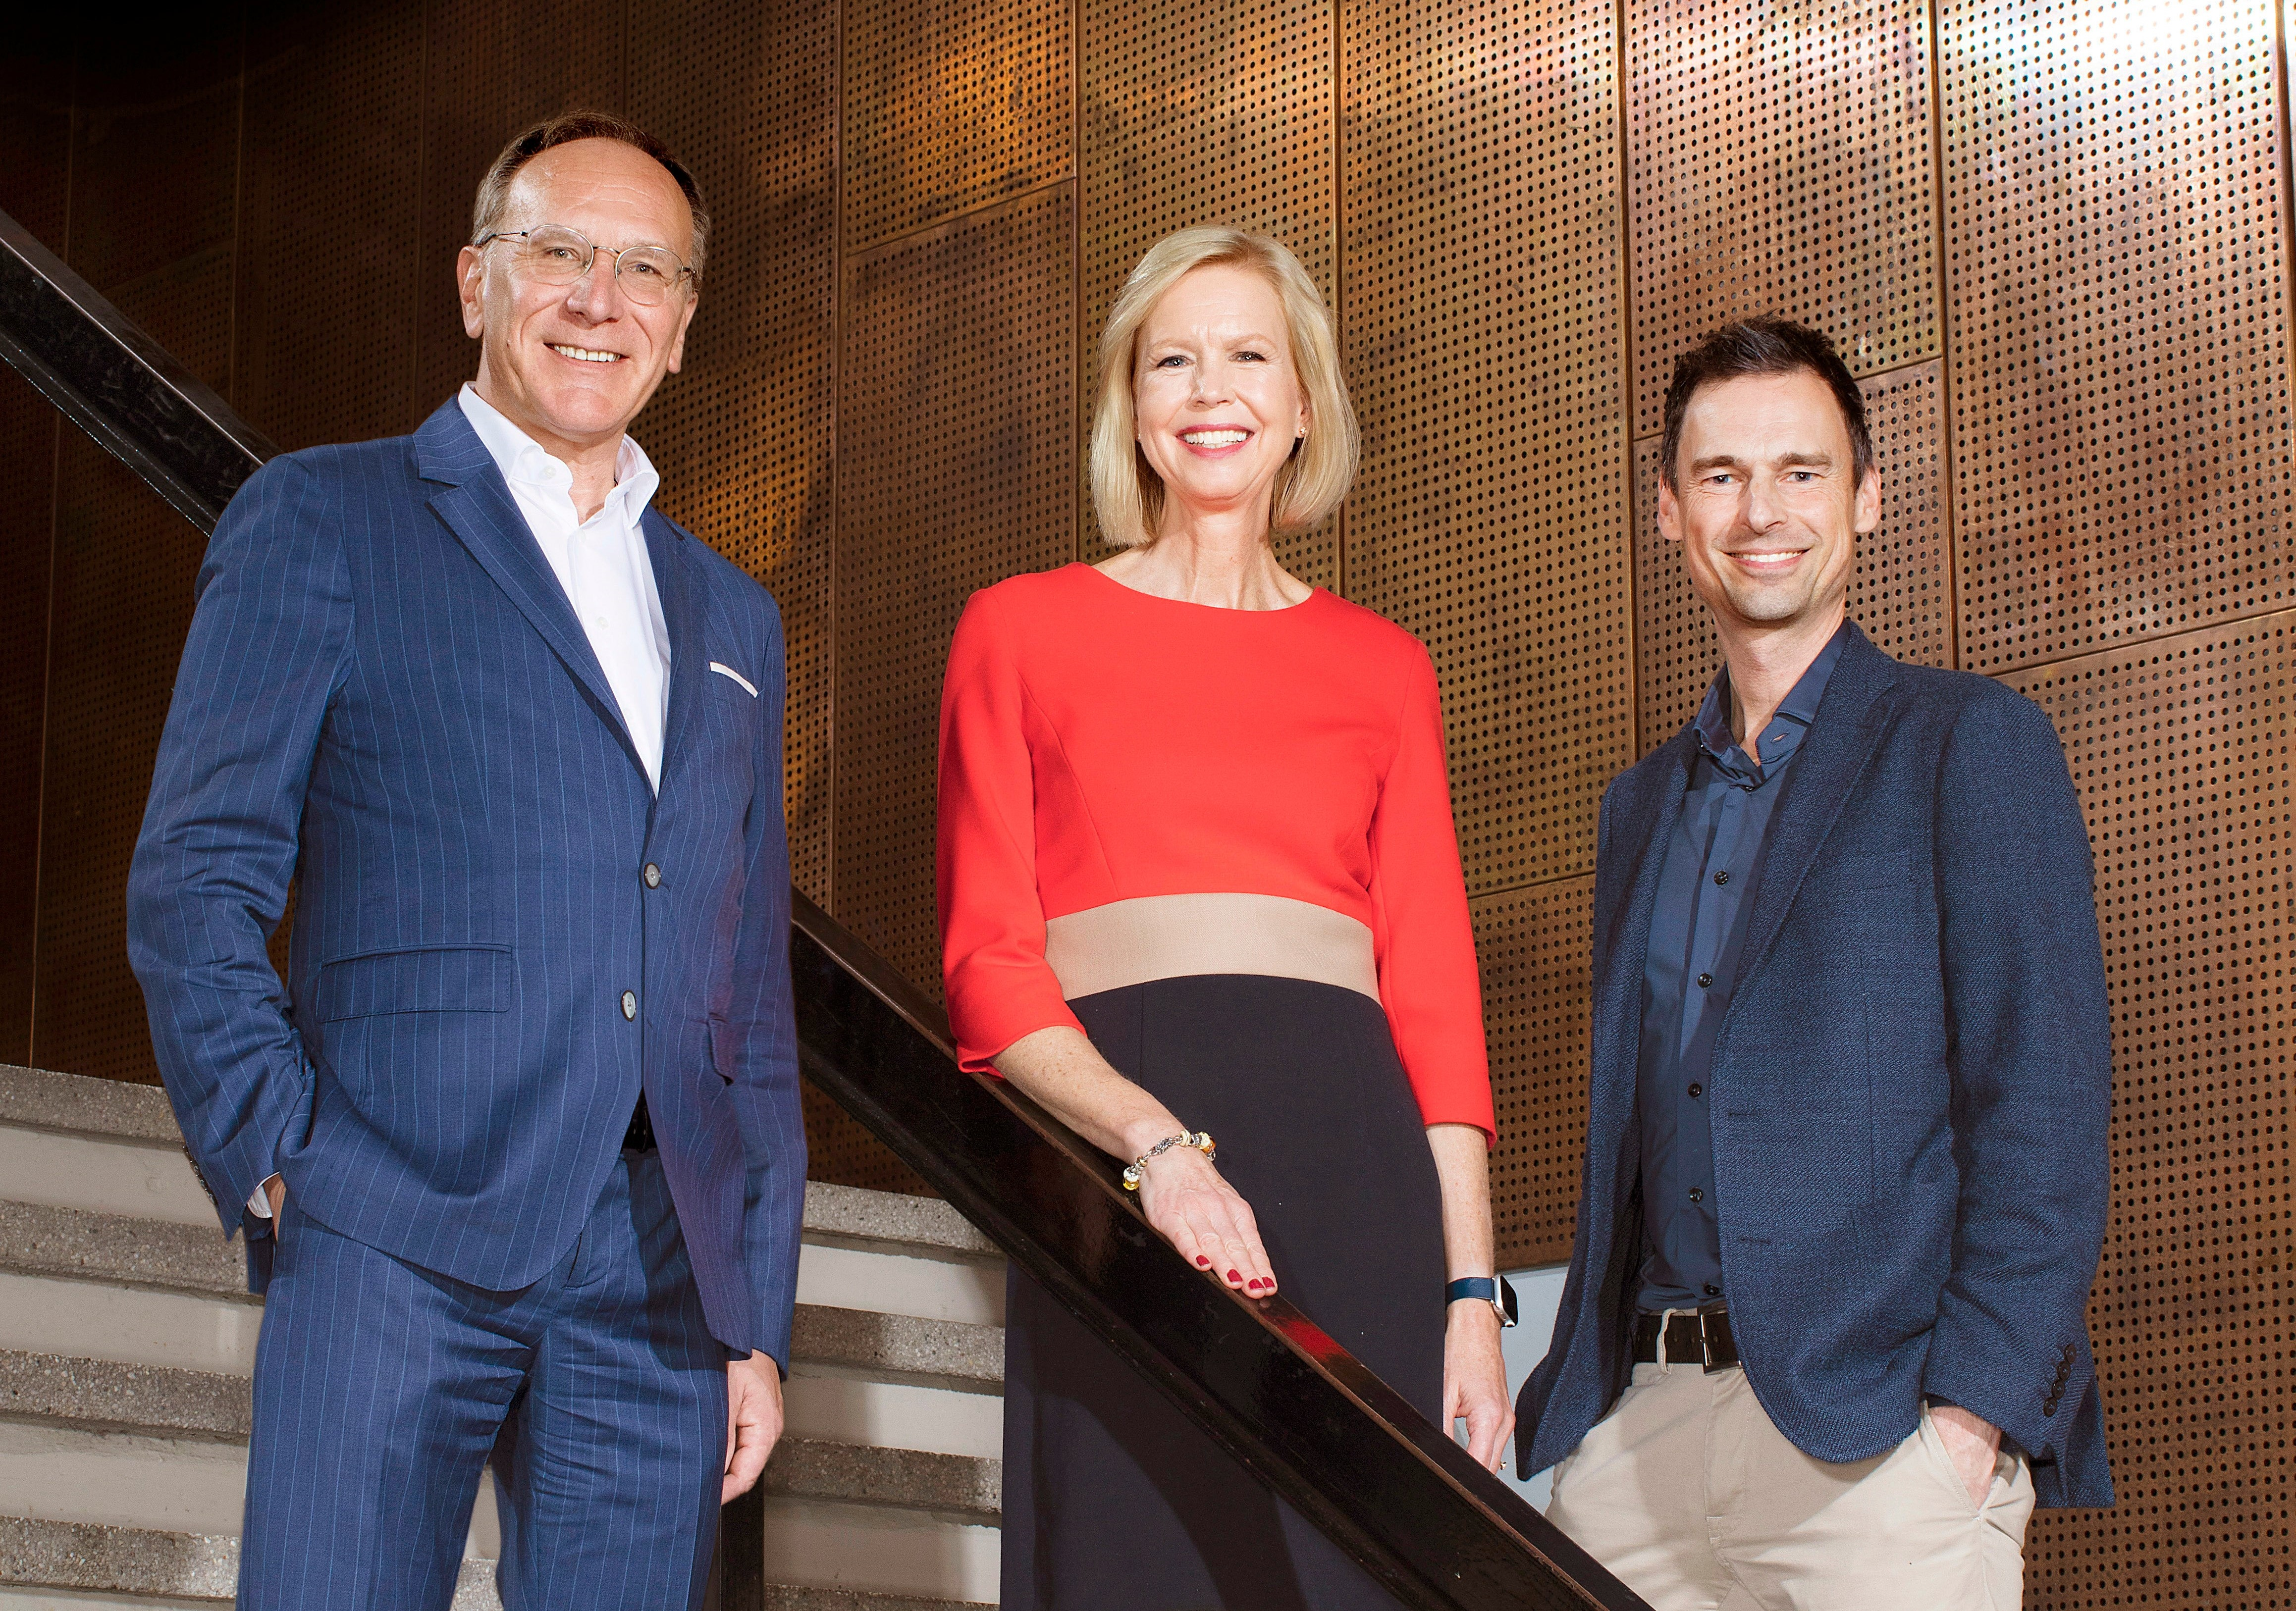
Executive Board
Margrethe Jonkman
Chair
Jeroen Geurts
Rector Magnificus
Marcel Nollen
Member

Slide 3
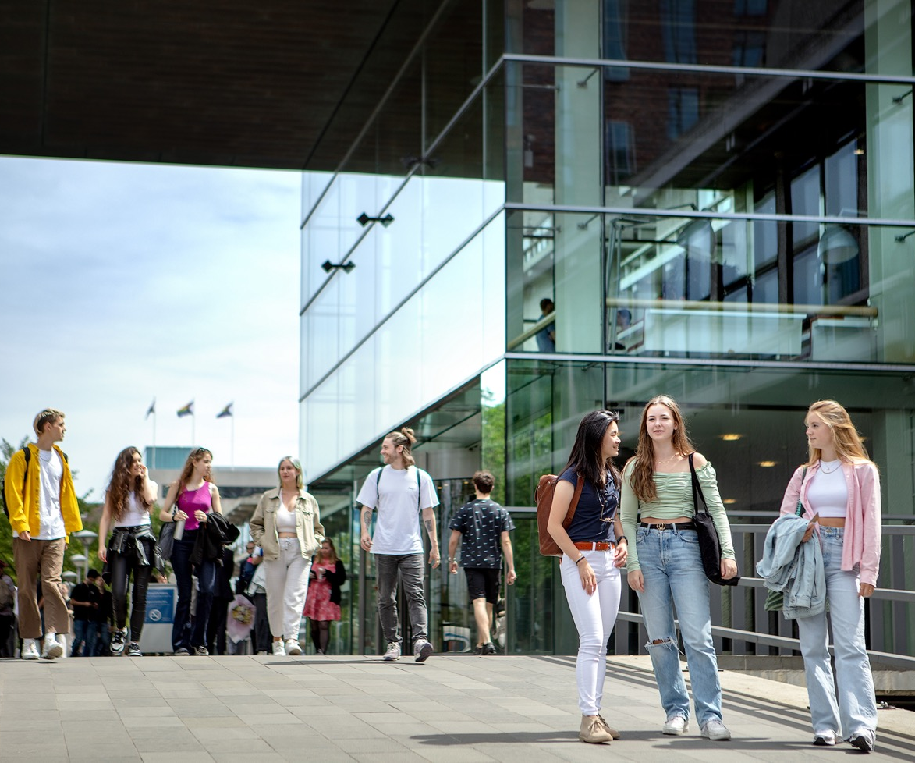
Official name: Vrije Universiteit Amsterdam
We have used one name nationally and internationally since 2015:
Vrije Universiteit Amsterdam
As an abbreviation of the name,
'VU Amsterdam' or 'VU' can be used.

Slide 4
Organisational chart
SUPERVISORY BOARD
EXECUTIVE BOARD
SERVICES
PARTICIPATORY BODIES
Administration Office (BZ)
Communication & Marketing (C&M)
University Relations and Fundraising
Service (DURF)
Corporate Real Estate and Facilities (FCO)
Finance (FIN)
Human Resources, Health Safety
and Environment (HR & HSE)
Information Technology (IT)
Student & Educational Affairs (SOZ)
University Library (UB)
FACULTIES
Faculty of Science (BETA)
Faculty of Behavioural and Movement Sciences (FBMS)
Faculty of Humanities (HUM)
Faculty of Medicine (MED)
Faculty of Law (LAW)
Faculty of Social Sciences (FSS)
Faculty of Religion and Theology (FRT)
School of Business and Economics (SBE)
Academisch Centrum Tandheelkunde Amsterdam (ACTA)
INTERDISCIPLINARY
RESEARCH INSTITUTES

Slide 5
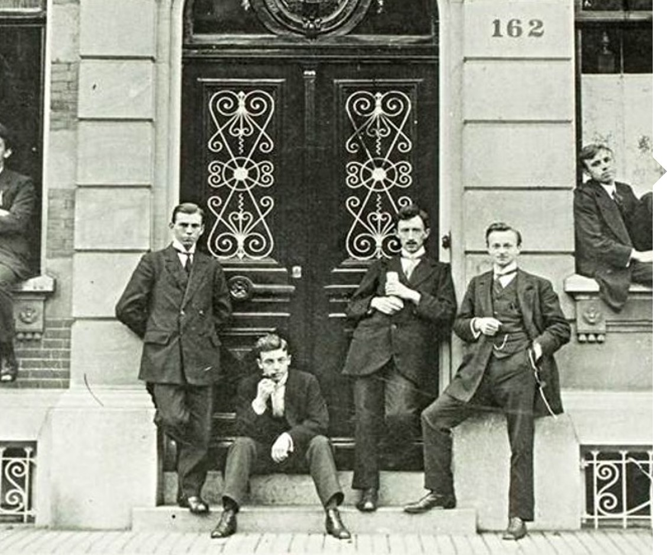
History
Vrije Universiteit Amsterdam
Established by Abraham Kuyper in 1880
1st location main building: Keizersgracht
1973 official opening main building De Boelelaan
Vrije Universiteit stands for: freedom from church, state, and commercial interests.
The motives of the time are still leading today.
Freedom and responsibility
Pluralism
Room for diversity of beliefs
Intellectual education and citizenship
www.geheugenvandevu.nl

Slide 6
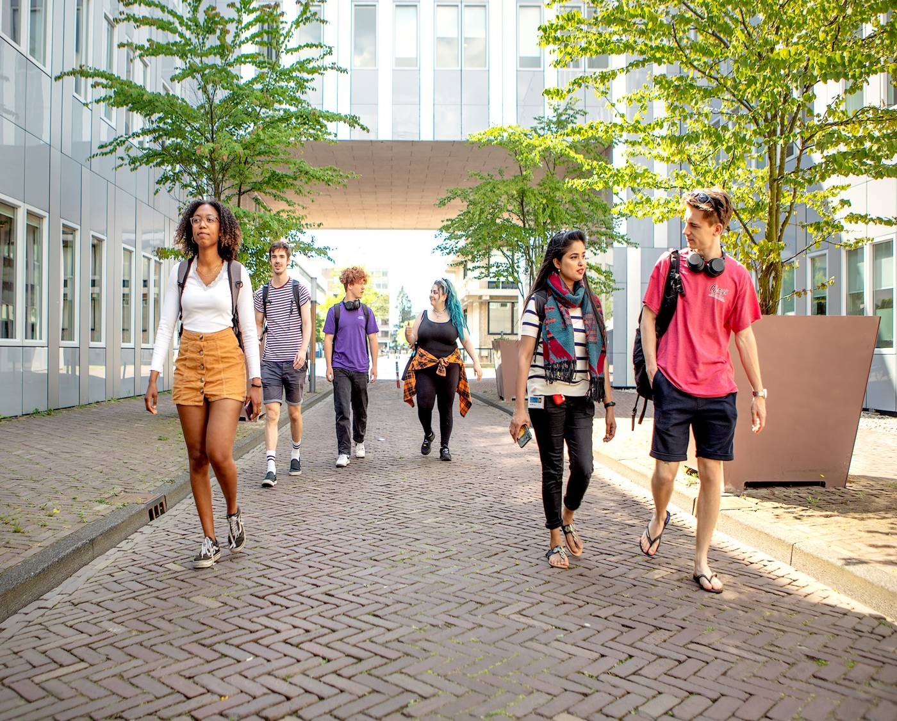
Core values of VU Amsterdam
  VU Amsterdam's basic philosophy guides the work and actions of staff and students.
  Responsible
  We are committed to being of service to people and society.
  Open
  We are accessible and receptive to diversity in disciplines, cultures, ideas, nationalities and beliefs.
  Personal
  We pay attention to and respect each individual.

Slide 7

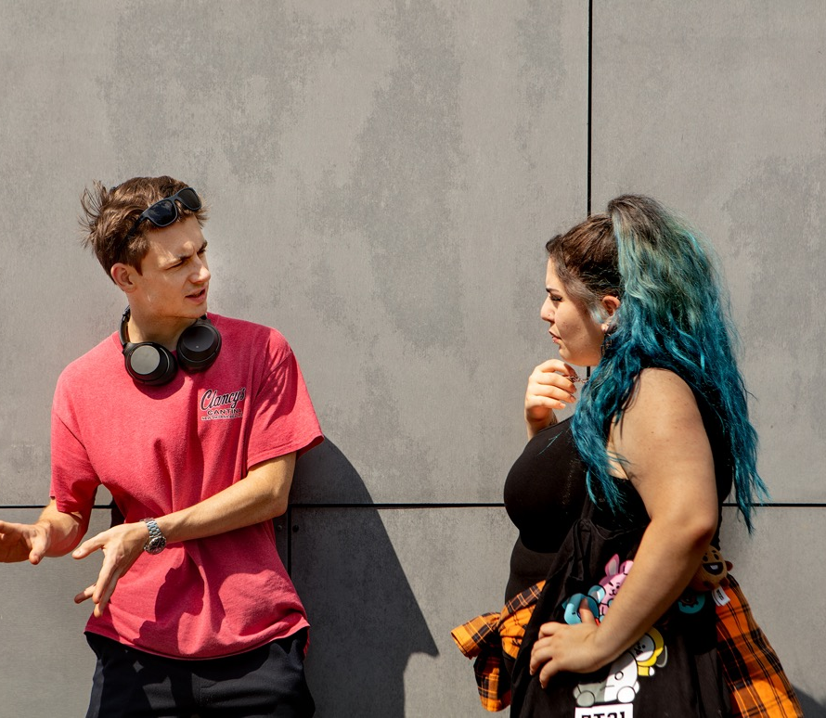
Art of Engagement
  Working together for a better world is easier in a work environment that inspires, develops and engages.
  To achieve this, we formulated 4 principles:
  Contribute to the greater good;
  Be brave and decisive;
  Be transparent and clear;
  Listen and give room for growth.

Slide 8
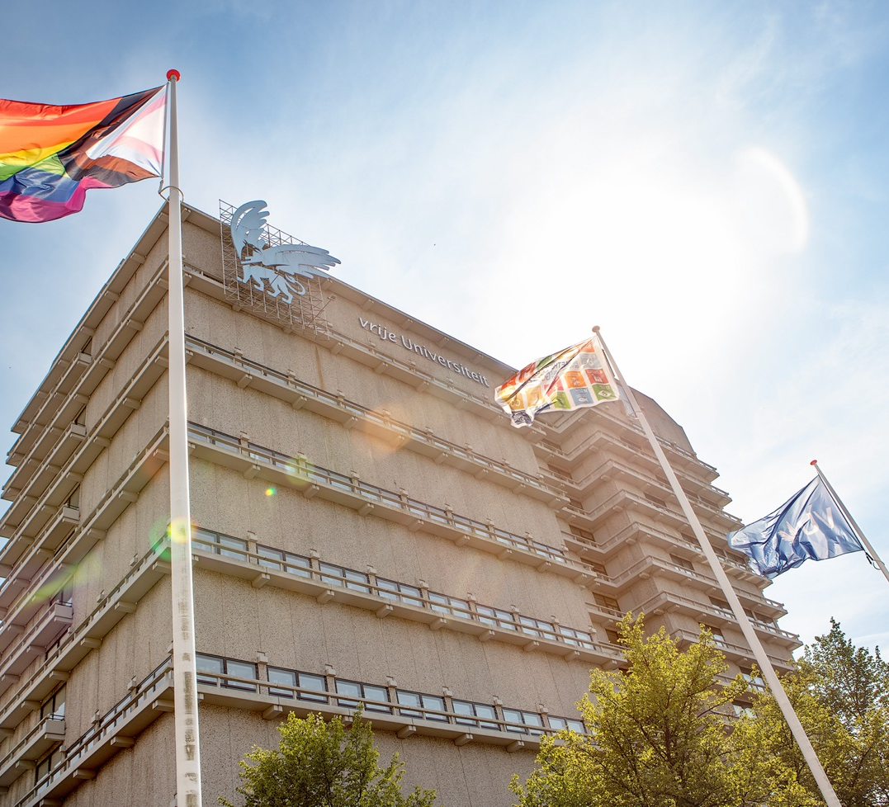
Diverse
VU Amsterdam aims to provide an environment that promotes diversity and inclusion, where people feel comfortable and encouraged to share their unique perspectives.
Diversity Office
Networks
    VU Pride
    Wo/men Network @VU
    Young.VU
    International Academic staff network
  vu.nl/diversity

Slide 9

VU Strategy 2020-2025

Slide 10
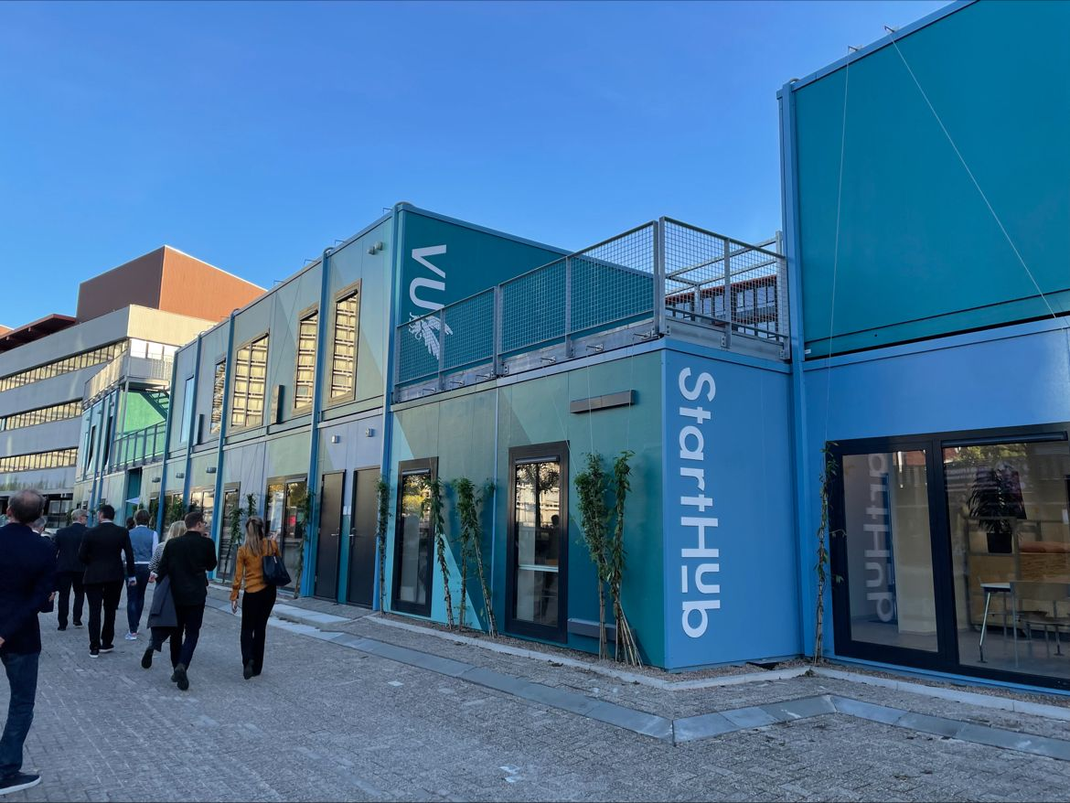
Entrepreneurial
Collaborate, Innovate & Accelerate
VU Amsterdam encourages and facilitates an enterprising attitude among our students and staff to create added value for our society.
VU Starthub Community
Demonstrator Lab
Startup ACE Incubator
Innovation Exchange Amsterdam (IXA-GO)
  vu.nl/enterprising

Slide 11
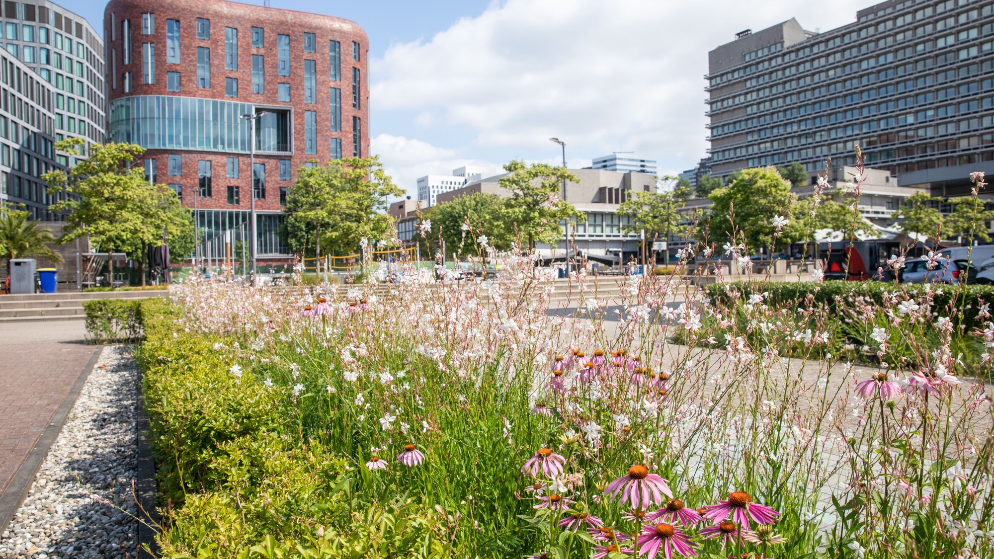
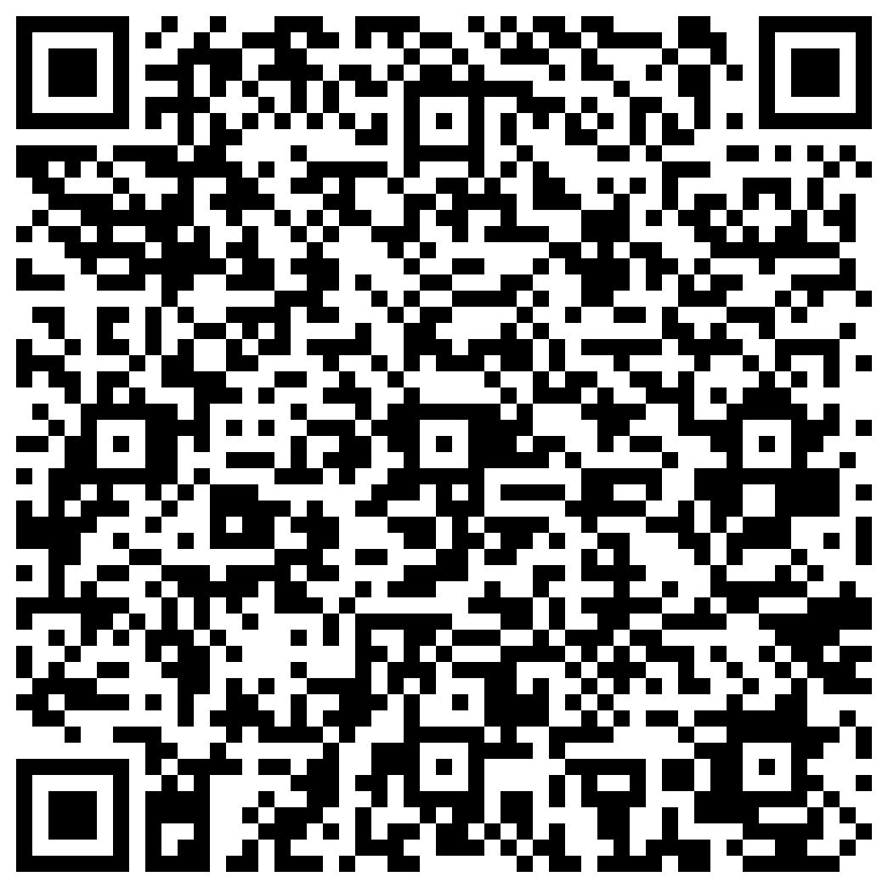


Sustainability
As the VU community, we contribute to the transition towards a sustainable campus, university, and society – every day.
We do this by implementing our sustainability ambition in operations, education, research, and valorisation.
Questions? Ideas? Contact Sustainability Office VU! sustainability@vu.nl
vu.nl/sustainable

Slide 12
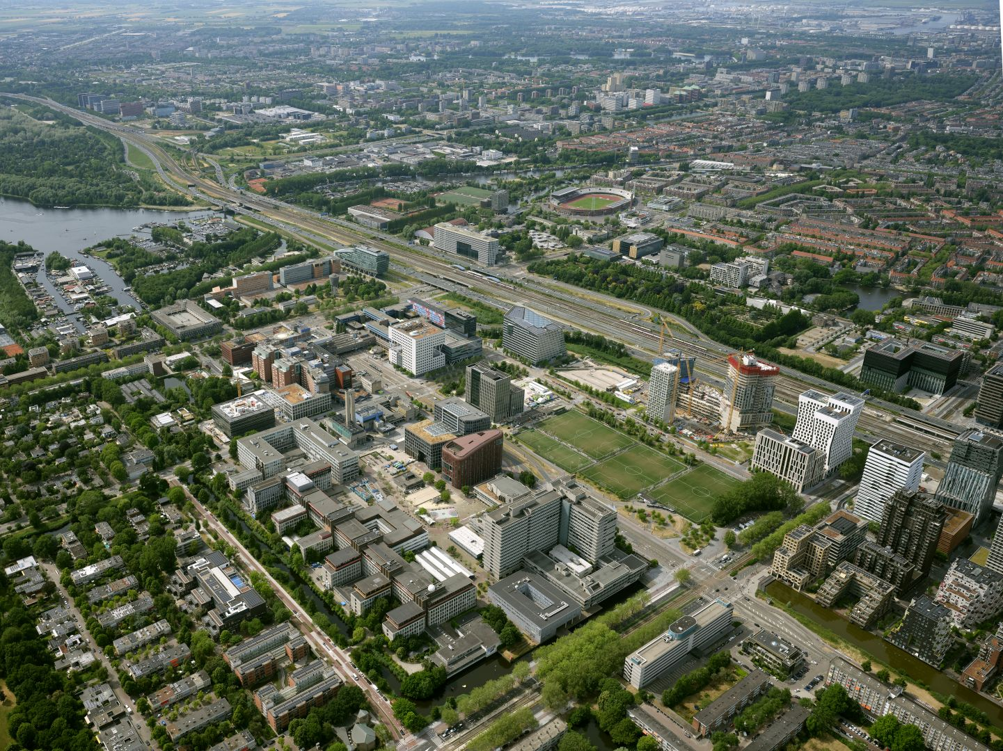
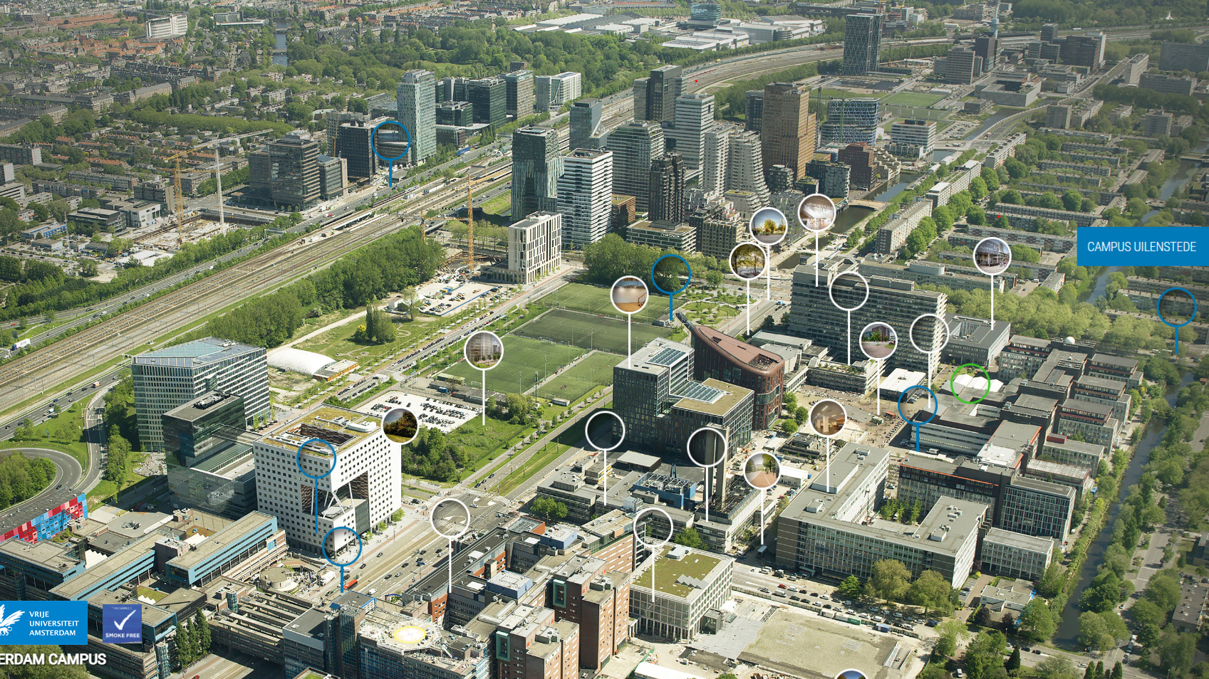
VU Amsterdam Campus
  The VU Amsterdam campus now consists of 14 buildings. Our campus is a close-knit community.
  We think it’s important that you feel at home!
  vu.nl/campus (+ virtual tour)

Slide 13
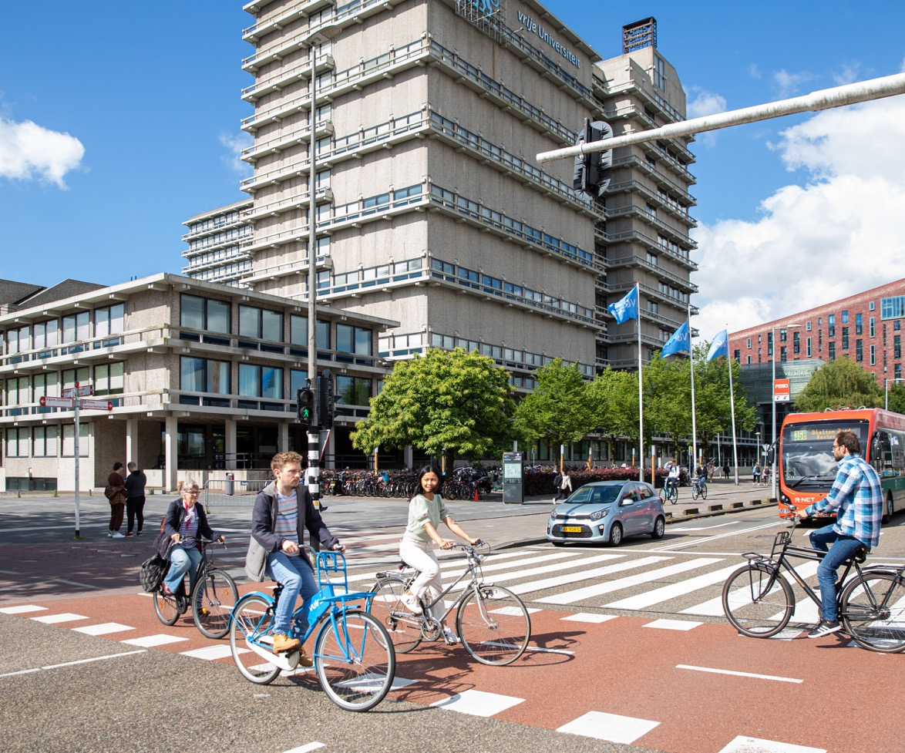
Questions?

