Slide 1
Being confident and assertive

Slide 2
Objectives
To learn what it means to be confident and assertive
To learn why negative thoughts can affect how we think about ourselves
To learn how positive actions can help us to feel good about ourselves
To talk about the 4 sources of being confident

Slide 3
Activity 1
What is confidence?

Slide 4
Four sources of confidence
Knowing that we have succeeded in the past. This can help us to feel confident about ourselves.
Seeing people we know doing well can reassure us that if they can do well, we can too.
Positive feedback from others about a specific task or skill.
Feeling positive about ourselves, having positive thoughts and acting positively around other people.

Slide 5
Activity 2
What is feedback?

Slide 6
Activity 3
What is it about me?

Slide 7
Behaving confidently
Underpinning self-confidence is the ability to be assertive.
People who feel, think and act with confidence have good assertiveness skills.
People who lack confidence tend not to be assertive or they may be aggressive.

Slide 8
Things that affect confidence
There are times when other factors can affect your confidence or self-belief.
Negative thoughts
Jumping to conclusions
Over-sensitivity
Getting things out of proportion

Slide 9
Activity 4
Self-confidence

Slide 10
What’s the difference?
Aggressive
Assertive
Not assertive

Slide 11
Skills to make you assertive
Know exactly what it is you want.
Be clear and specific.
Make ‘I’ statements and take ownership of your request.
Listen to the other person’s point of view.
Understand what you do not want but, if necessary, what you would settle for.
Keep control over your emotions. Asking does not always mean getting…
Aim for a solution where both sides ‘win’.

Slide 12
Activity 5
Tips to be assertive

Slide 13
Broken record technique
Broken record (repetition of assertive refusal).
This technique is useful when you are under pressure to agree or buy something you do not want.
Be clear about what you want to say. Avoid getting angry, uncomfortable, irritated or loud.

Slide 14
“No... but”
“No... but” leaves room for negotiation.
This is a way of saying ‘no’ to the request.
The word 'but' leaves room for negotiation.

Slide 15
Asking for time
When people make requests, give orders or ask a favour and you are not clear about how you wish to respond.
Give yourself time to think about what is being asked and then respond.

Slide 16
Think, feel and act positively
Use positive thoughts, feelings and actions to stop negative and unhelpful beliefs.
You'll also feel more confident.

Slide 17
Activity 6
Assertive skills practice

Slide 18
Optional follow-up activity
Assertiveness quiz

Slide 19
Reviewing your actions
It's important to review your action plans regularly.
Ask yourself the following questions:
Has the goal been achieved or changed?
Which steps were achieved and why?
Which steps were not met and why?
If you were doing it again, what would you change?

Slide 20
Learn at Scope

Slide 21
What is Learn at Scope?
Learn at Scope is Scope’s eLearning platform.
It is exclusively for Scope customers and offers further support to achieve your goals.
As it’s a digital resource you can use it on your home computer, tablet or smartphone.
It is available 24 hours a day.

Slide 22
Scope job board

Slide 23
What is the Scope job board?
The Scope job board is exclusive for Scope customers.
It advertises job vacancies with Disability Confident employers.
It has a range of job sectors and job types.
It is available 24 hours a day and is updated regularly.

Slide 24
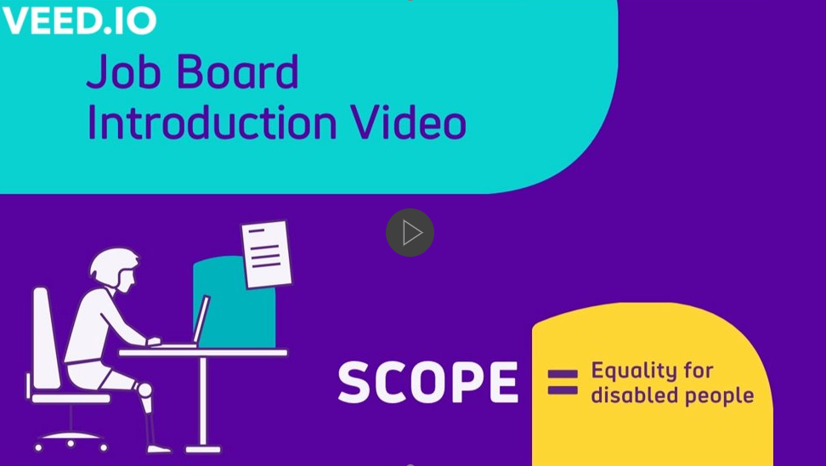
How to use the Scope job board
Notes:
Play from https://www.scope.org.uk/advice-and-support/jobs-board-video/

Slide 25
Feedback Let us know what you think so far

Slide 26
Thank you

