Slide 1
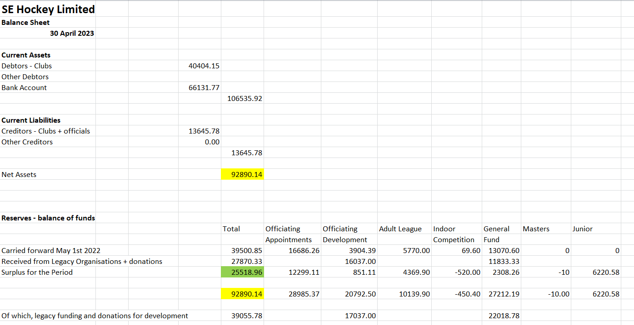
SE Hockey Financial Overview – 2023-24
Part 1 – final filed accounts YE April 30th 2023 – Balance Sheet and Reserves

Slide 2
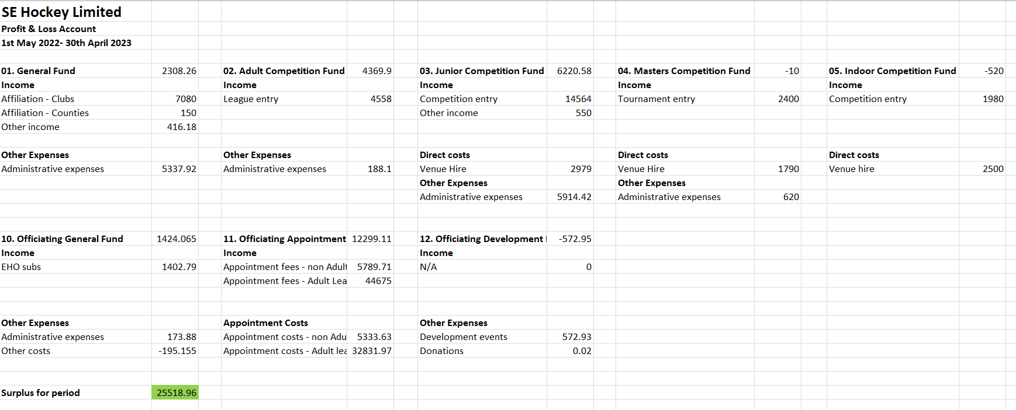
SE Hockey Financial Overview – 2023-24
Part 1 – Accounts YE April 30th 2023 - Profit and Loss
2022-23 Accounts filed in January 2024, attested to by Scrutineer. Surplus for the period £25K spread predominantly across umpire appointments, adult leagues and junior competitions where two years of income were recorded in 2022-23. In addition £38K was received in donations from legacy organisations.

Slide 3
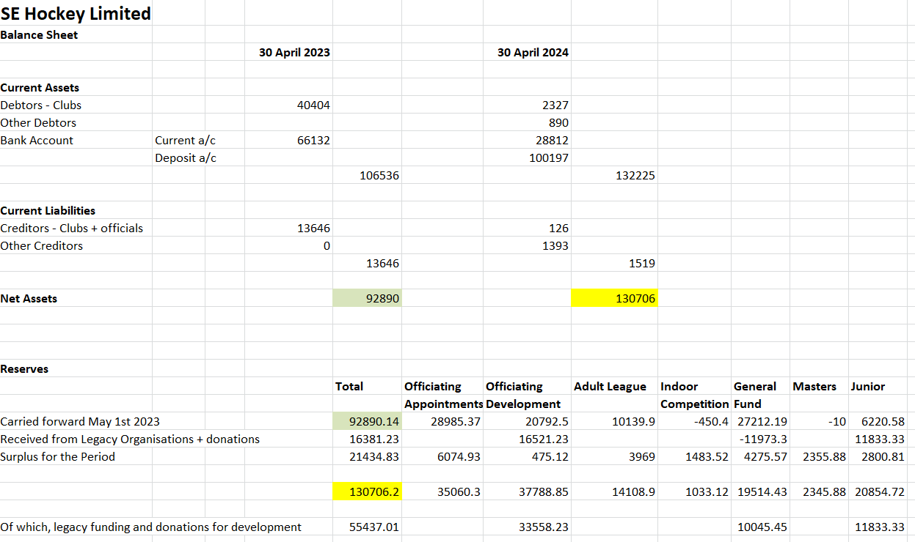
SE Hockey Financial Overview – 2023-24
Part 2 – Draft accounts for 2023-24 – Balance sheet and reserves
Increase in fund balance of £38K: £21.5K spread across cost centres and further £16.5K in donations from legacy HUAs. Significantly reduced debtors and creditors vs 22-23.

Slide 4
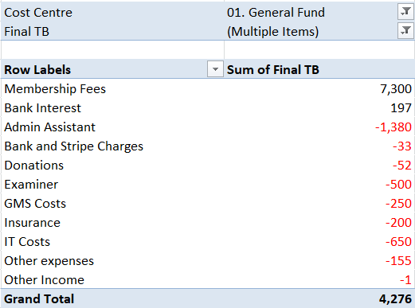
SE Hockey Financial Overview – 2023-24
Part 2 – Draft accounts 2023-24 Profit and Loss – General fund
Income from membership fees paid by clubs @£15 per adult team (~480), and small amount of bank interest.
Most significant cost has been the Admin Assistant who has been invaluable in helping with invoicing and collection of payments from clubs and schools.
Examiner has been paid for two sets of accounts.
IT costs have included email account and Zoom account provision.
Directors’ liability insurance obtained via the EH Membership+ scheme.

Slide 5
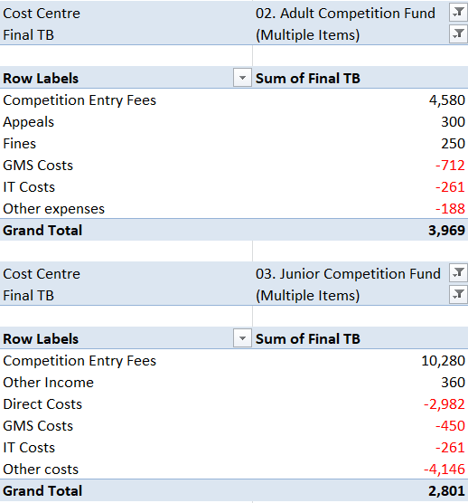
SE Hockey Financial Overview – 2023-24
Part 2 – Draft accounts 2023-24 Profit and Loss – Adult and Junior Competition
Adult league entry remained @ £10 per team and will continue at that level. Minimal fines and a small number of appeals.
Costs include trophies for Premier Division winners and a share of email and GMS costs. No outstanding entry fees. Looking to contribute towards umpire development from reserves.
Junior competition fees spread across clubs and schools. Costs have been predominantly for provision of pitches for club In2H competitions and medals for all competitions with a contribution towards email and GMS. Fees vary for schools and clubs. Some schools yet to pay entry fees.

Slide 6
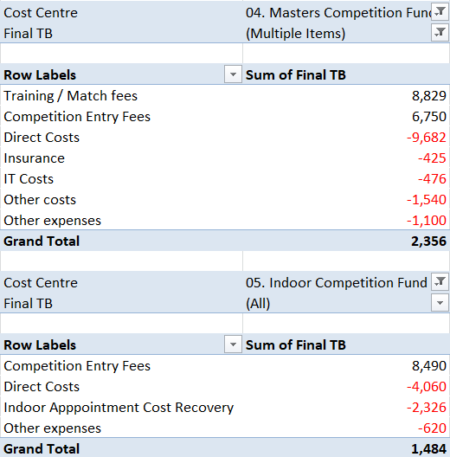
SE Hockey Financial Overview – 2023-24
Part 2 – Draft accounts 2023-24 Profit and Loss – Masters and Indoor
Masters includes 2023 tournaments and 2023-24 assessments and training with all fees for the latter being collected via Pitchero, for which we pay £400+ per annum and is shown in IT costs (with email provision). This has allowed proper accountability and also removed fee collection responsibility from coaches and managers. Insurance covers each age group team.
Indoor covers clubs adult and junior competitions held at Polo Farm, and schools’ competitions for which we are grateful to a number of schools for hosting at no cost. Umpire costs are absorbed into the fees paid by entrants which were reduced from £220 to £175 per adult team this season.

Slide 7
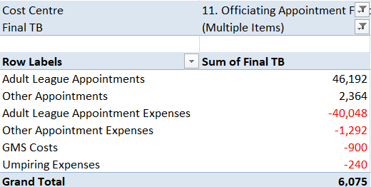
SE Hockey Financial Overview – 2023-24
Part 2 – Draft accounts 2023-24 Profit and Loss – Umpire Appointments
Umpire appointment fees for Adult league fixtures were reduced once more to £30 per Premier appointment, £22 for East/West and £17 for sub-area divisions. In addition, ~£13K was returned to clubs in recognition of the surplus made in 2022-23.
The appointment fees this season have pretty much reflected umpire expenses and there is no plan to change them or the umpire reimbursement rate in 2024-25.
Any surplus will be transferred to the Umpire Development fund to support initiatives being put forward for club and appointment taking umpires.
There are a number of umpires yet to put in claims but this will not materially impact the reported accounts.

Slide 8
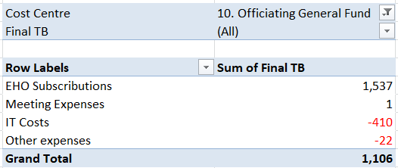
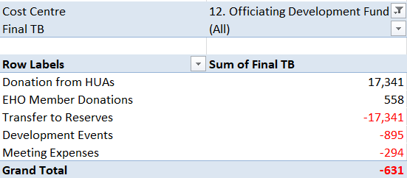
SE Hockey Financial Overview – 2023-24
Part 2 – Draft accounts 2023-24 Profit and Loss – Officitaing General and Development
Umpire general fund relies on income from EHO subscriptions which were very similar to the two previous years. Only costs are email and meeting hosting software.
Umpire development receives no income as such however donations from both Surrey and Sussex HUAs were received with thanks and transferred to reserves. There were a number of Development events and meetings for which costs were incurred. There is planned to be a significant increase in umpire development activities in 2024-25 that will be funded by donations received previously and reserves from other cost centres.

Slide 9
SE Hockey Financial Overview – 2023-24
Part 2 – Draft Accounts 2023-24 Summary
Another very healthy year in financial terms for South East Hockey with a surplus of £21.5K on operations and further donations of £16.5K from Surrey and Sussex HUAs.
A balance has now been found in appointment costs vs fees charged to clubs with the surplus being set aside for umpire development.
South East Hockey is not proposing to change fee levels for any competition entry or appointments.
With the funds South East Hockey does have we are looking for support from clubs via volunteers to join our management structure to help with initiatives to return these funds to clubs in support of promoting hockey to all throughout the South East.

