Slide 1
ENGLAND HOCKEY LIGHTING PARTNER TENDER
COMMERCIAL PARTNERSHIP OPPORTUNITY – 2025 TO 2028

Slide 2
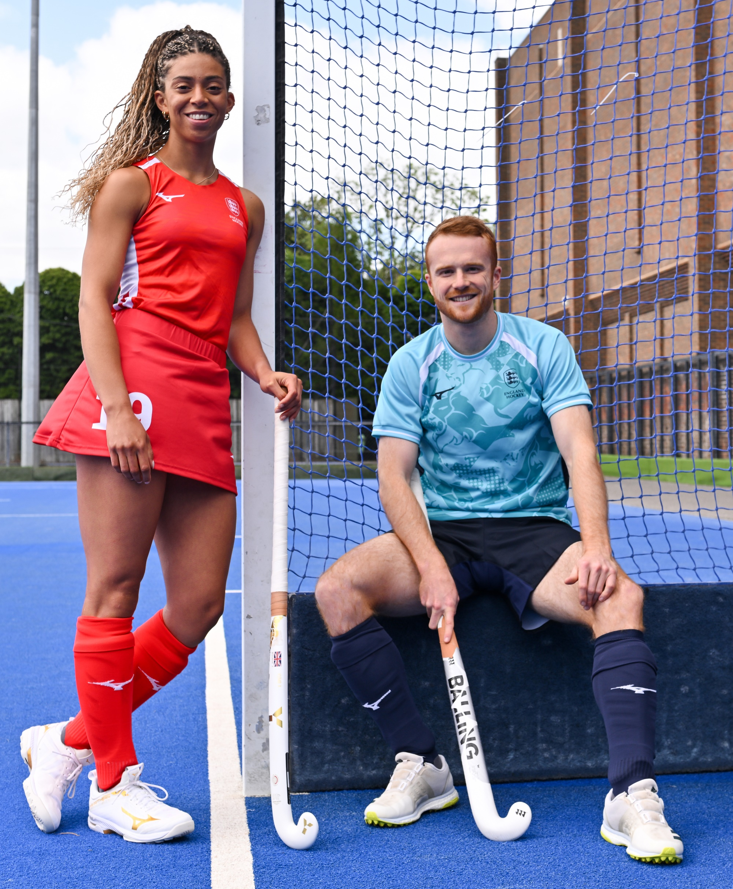
LIGHTING PARTNER OPPORTUNITY
England Hockey is the national governing body for the sport, representing a vibrant and growing community of over 700 clubs, schools, and facilities. With year-round participation at all levels - from grassroots to international - high-quality lighting is vital to our game.
By partnering with England Hockey, a lighting company will gain unparalleled access to a loyal, engaged, and diverse audience, as well as the opportunity to positively impact the infrastructure and experience of hockey clubs and facilities across the country.
Our collaborative, community-focused approach ensures that the chosen partner will not only drive brand visibility but also help shape the future of sport facility lighting in England.
Together, we can elevate environments where players, coaches, and fans come together, under the lights.

Slide 3





HOCKEY IS UNIQUE
We’re on a mission to make hockey more visible, relevant, and accessible.
50:50 GENDER SPLIT
TOP 10 GLOBAL PARTICIPATION SPORT
ACCESSIBLE TO ALL
A SPORT NEVER STANDING STILL
AN INSPIRING OLYMPIAN
Hockey is equally amazing – the most equal gender team sport in the UK
Irrespective of social background, race, gender, age, or sexual orientation
1M+ pick up a stick every year helping the nation stay fit & healthy
Played across 6 continents and in all major markets
Is 3 times more likely to inspire than the average sports star

Slide 4
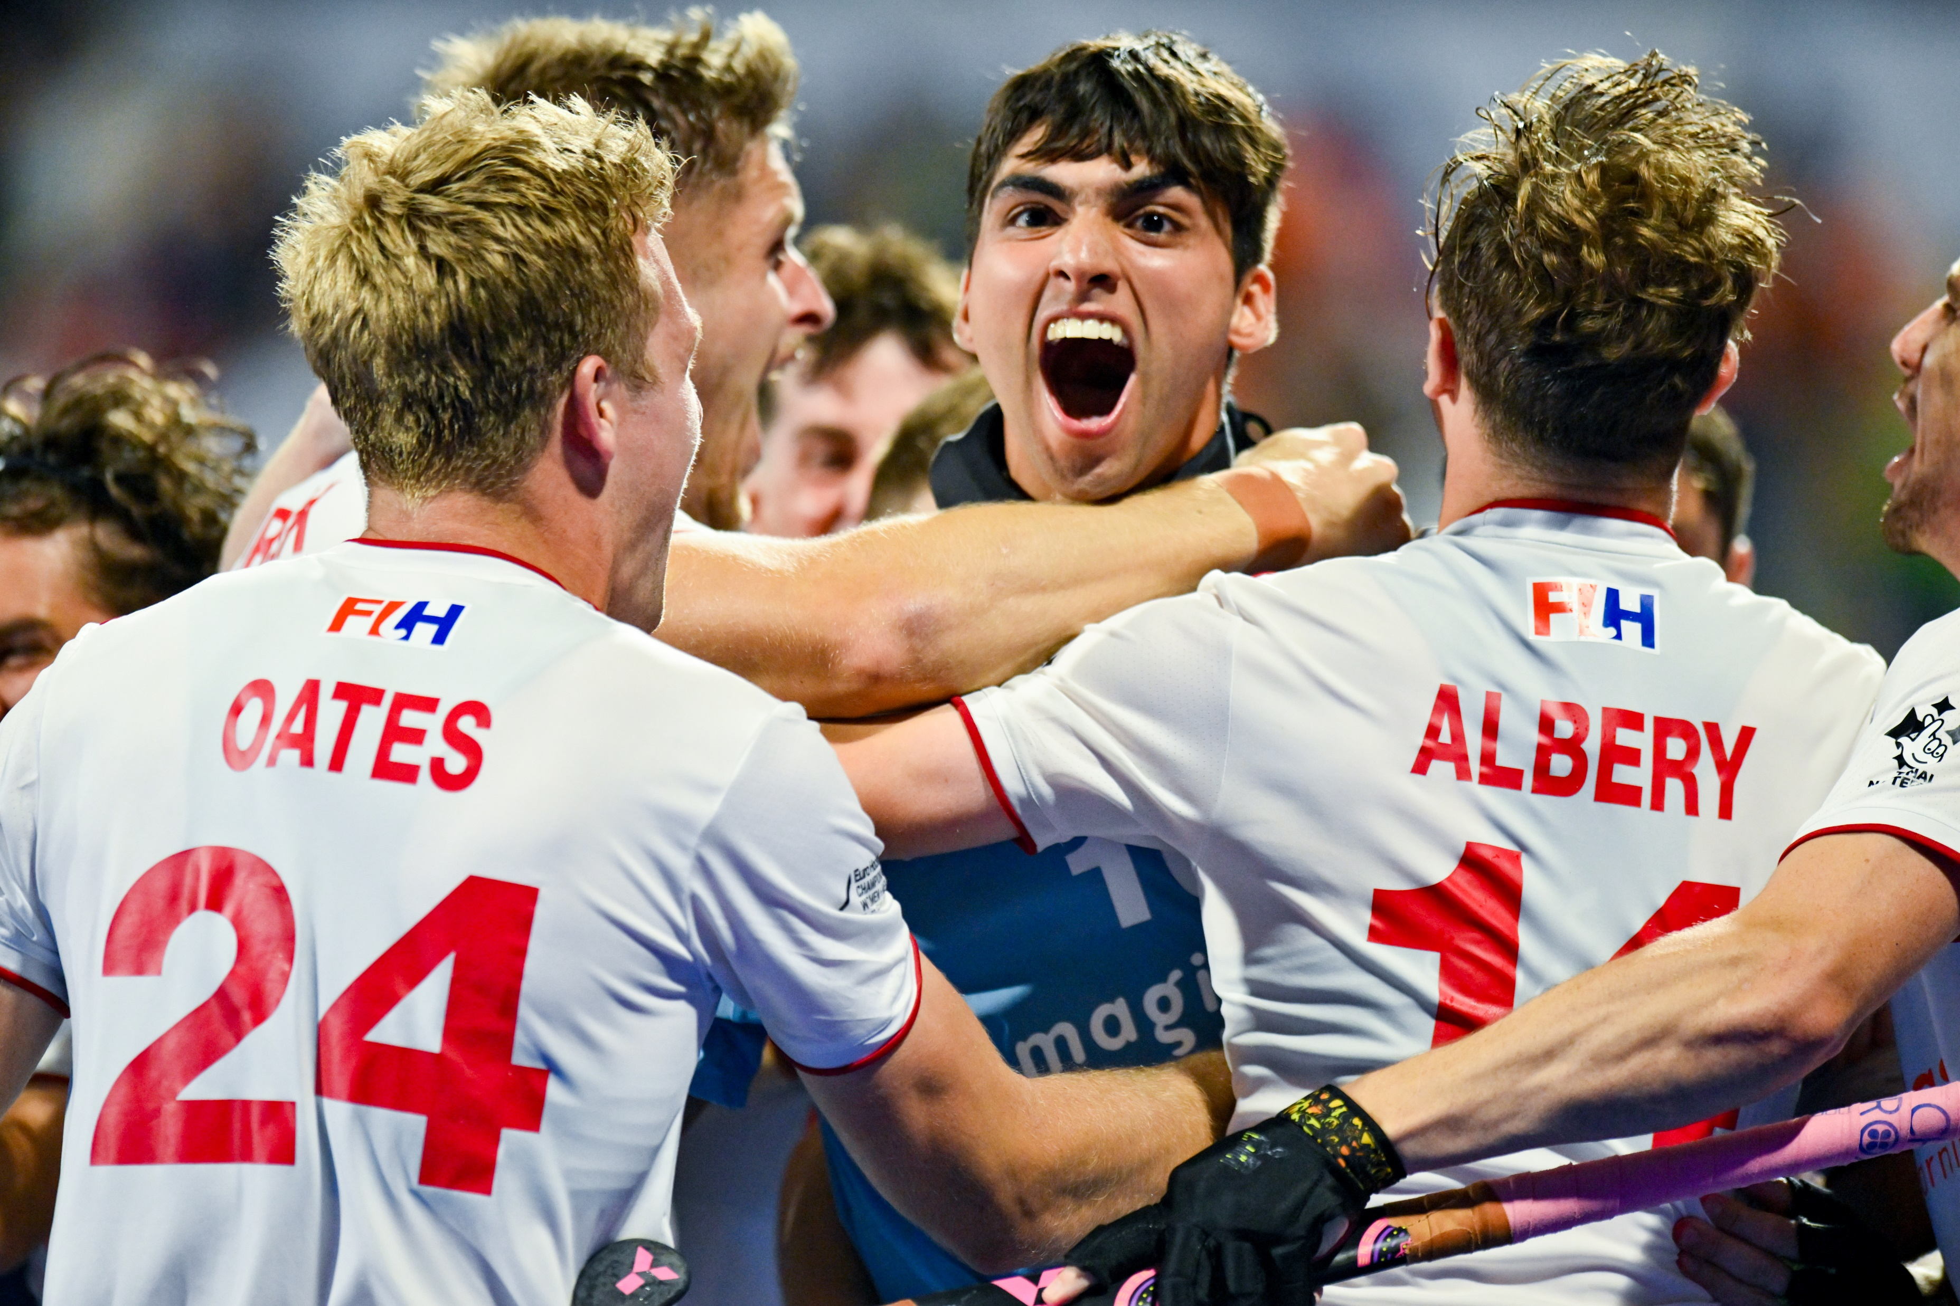
WE’RE ENGLAND HOCKEY
England Hockey is responsible for the management and development of the sport from grassroots to elite activities.
England Hockey has a membership comprising 750 Clubs / 40 Counties / 8 Areas
+150,000 individuals play adult hockey regularly in the club system
+100,000 children (age 5-16) play in the club environment
+15,000 playing at university/college
+2,500 schools (800,000 school pupils) participating in our competitions and events.
+15,000 coaches, umpires and officials are supported and developed by England Hockey

Slide 5
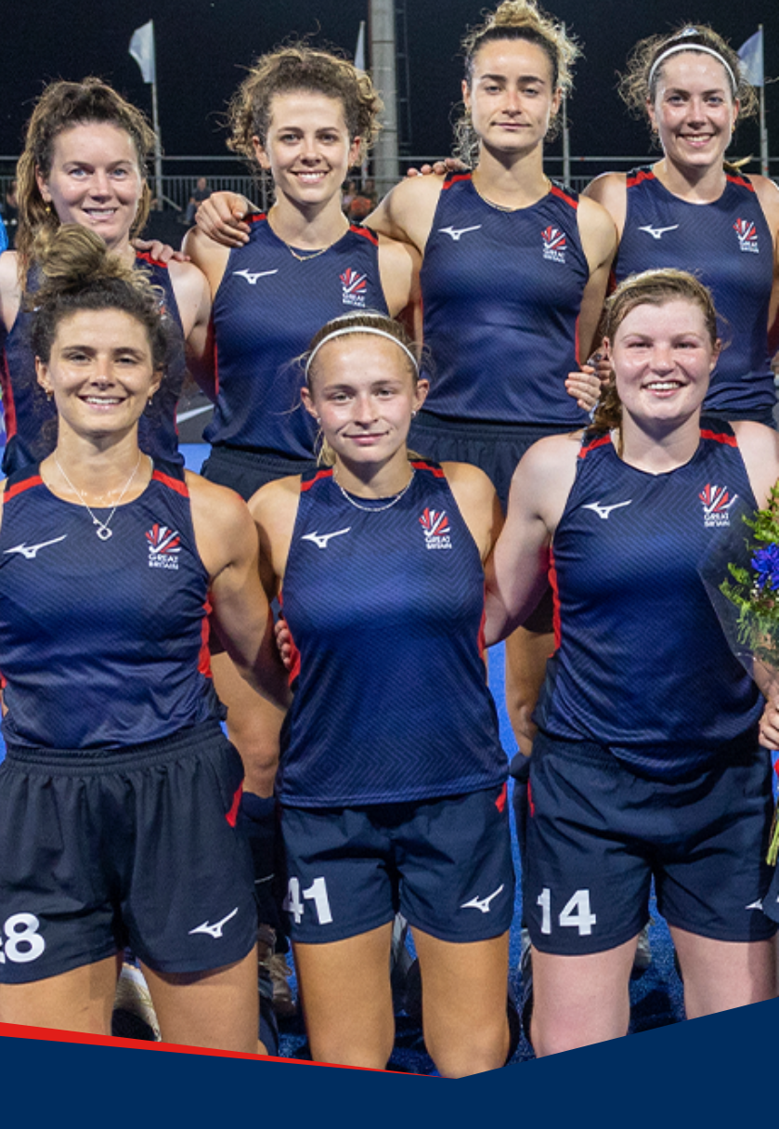
INTRODUCTION TO TENDER
England Hockey is seeking an exclusive Official Lighting Partner to support the lighting needs of our network of over 700+ affiliated clubs and facilities across England. We invite expressions of interest from experienced, innovative, and committed lighting companies to enter into a three-year commercial partnership starting in 2025.
This opportunity represents a unique platform to connect directly with the national hockey and schools’ community, drive awareness and engagement, and contribute meaningfully to the grassroots game.
Notes:
Slide hid

Slide 6
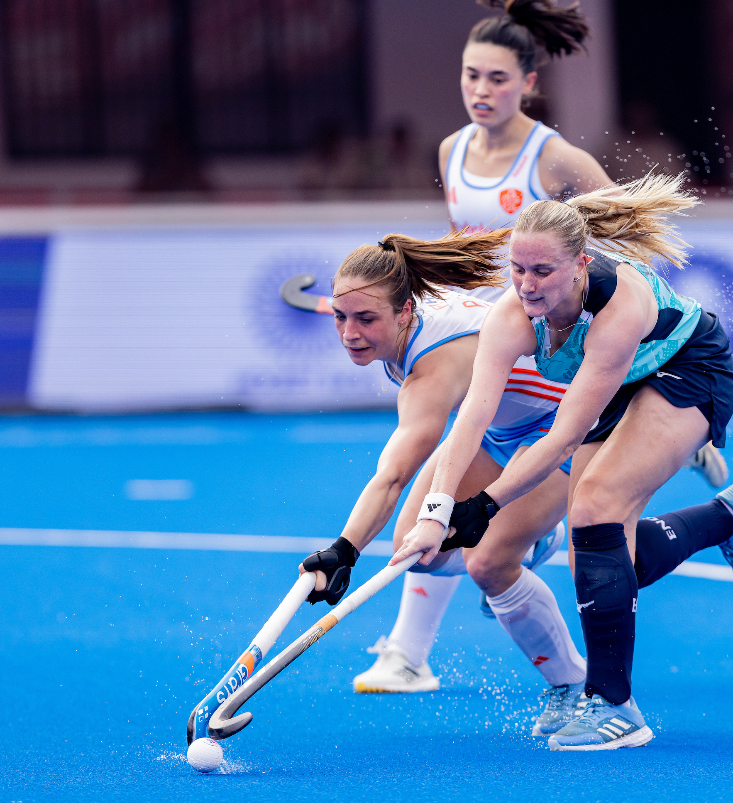
SCOPE OF PARTNERSHIP
Scope of Partnership
Be designated as the Official Lighting Partner of England Hockey with full category exclusivity.
Receive endorsement and recommendation to all England Hockey Member clubs and schools considering lighting renovation, installation, or maintenance.
Support England Hockey’s strategic goal of enhancing the infrastructure and experience at hockey facilities nationwide.
Commercial Terms
This will be an exclusive three-year partnership, subject to mutual performance reviews.
A commercial fee will be required from the chosen partner.
Rights, benefits, and activations will be customised but aligned to the framework outlined on the next slide.

Slide 7

ILLUSTRATIVE RIGHTS PACKAGE
Designation & Branding
Exclusive use of the ‘Official Lighting Partner of England Hockey designation.
Access to England Hockey logos, branding and image assets for promotional use.
Events & On-Site Presence
Branding opportunities at major domestic events (perimeter boards, big screen ads, event marketing).
Opportunities for on-site activations, presence at end of season England Hockey Awards, and sponsorship of individual awards.
Access to VIP and general admission tickets.
Digital & Media Exposure
Regular social media posts and engagement via England Hockey channels.
Dedicated England Hockey website partner page
Co-branded or sponsored digital content opportunities (e.g., live Q&As, Team of the Week, etc.).
Inclusion in email newsletters, website features, and digital event programme advertising.
Community Engagement
Dedicated support from our Facilities Development Managers to assist with lead generation and club/ facilities relationships.
Annual training workshop and opportunities for case studies with Member clubs.
Invitations to club events and a role in educating clubs and schools on lighting solutions and innovations.

Slide 8
SUBMISSION REQUIREMENTS
Interested parties are requested to submit an EOI including:
Company overview and relevant experience in sports facility lighting.
Details of your proposed commercial fee and any value-in-kind offerings.
Vision for activation of the partnership and community engagement.
Examples of past partnerships in sport or similar sectors.
Key contacts for follow-up discussions.
Timeline
EOI Submission Deadline: Friday 23 May 5pm
Shortlist Notification: Wednesday 28 May
Follow-up Presentations / Discussions: w/c 2 June
Final Selection, Negotiation & Due Diligence: w/c 9 June
Partnership Commencement: June/July 2025

Slide 9
SUBMISSION & CONTACT
Please send your Expression of Interest to:
Charlie Wells – Commercial Director
Email: Charlie.Wells@EnglandHockey.co.uk
For an informal conversation on our facilities and lighting opportunities, please contract Jo Hawley – Facilities Development Manager (Joanna.Hawley@EnglandHockey.co.uk)
We look forward to exploring this exciting opportunity with you.

Slide 10
Charlie Wells
Commercial Director
E: Charlie.Wells@EnglandHockey.co.uk

