Slide 1
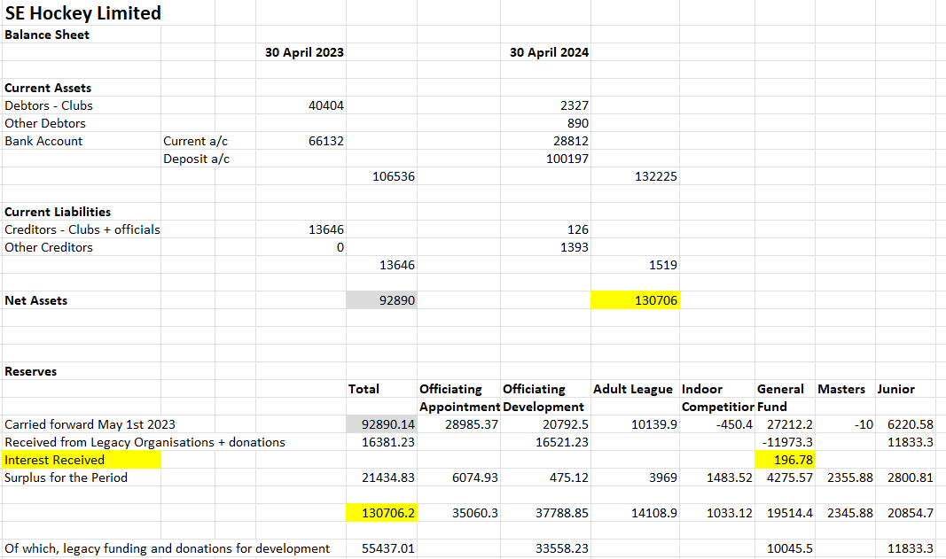
SE Hockey Financial Overview – 2024-25
Part 1 – final filed accounts YE April 30th 2024 – Balance Sheet and Reserves

Slide 2
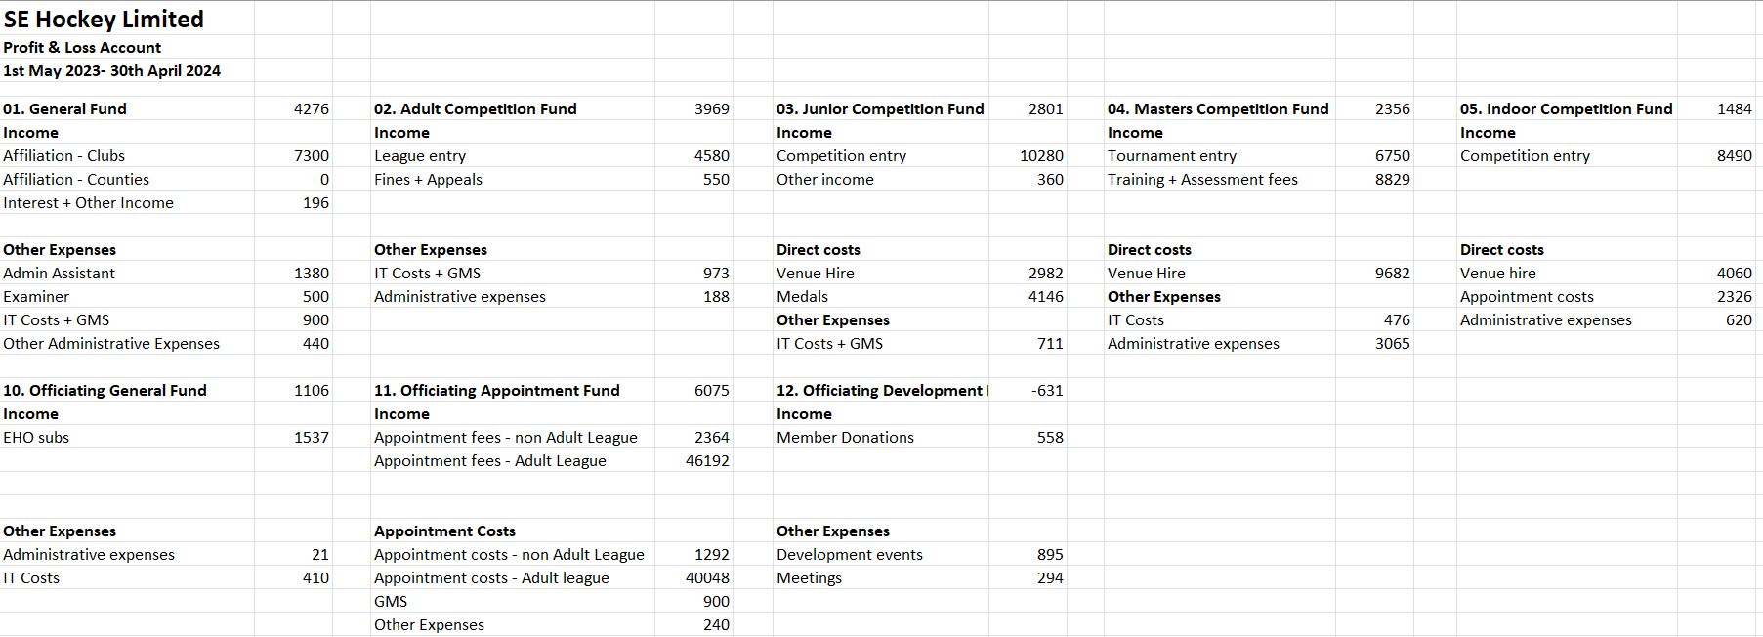
SE Hockey Financial Overview – 2023-24
Part 1 – Accounts YE April 30th 2024 - Profit and Loss
2023-24 Accounts filed in January 2025, attested to by Scrutineer. Surplus for the period £21K spread predominantly across umpire appointments, adult leagues and junior competitions and masters where full accounting took place for the first time. In addition £16.4K was received in donations from legacy organisations.

Slide 3
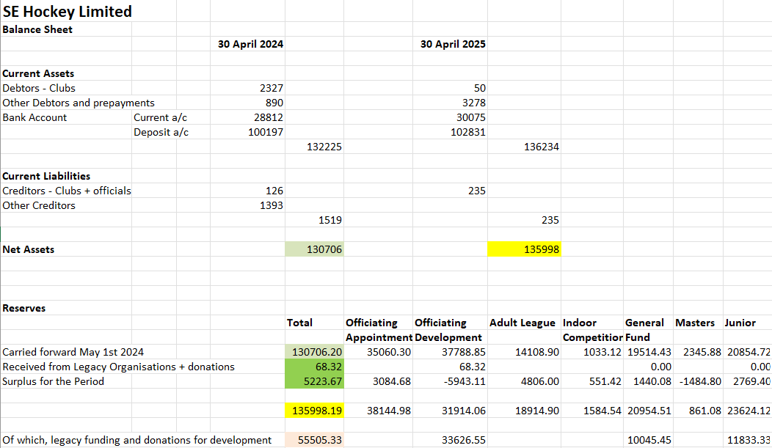
SE Hockey Financial Overview – 2024-25
Part 2 – Draft accounts for 2024-25 – Balance sheet and reserves
Increase in fund balance of £5K: small deficit from Masters, offset by surpluses in Adult and Junior. Appointment surplus offsets Officiating Development costs. Debtors and Creditor level is minimal with the majority from accruals and pre-payment of email costs.

Slide 4
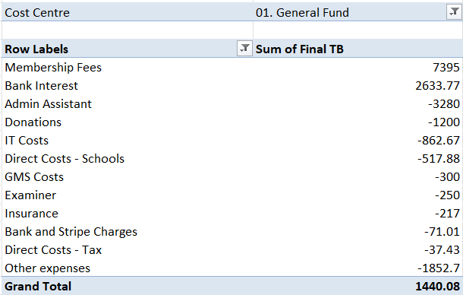
SE Hockey Financial Overview – 2024-25
Part 2 – Draft accounts 2024-25 Profit and Loss – General fund
Income from membership fees paid by clubs @£15 per adult team (~490), and significant amount of bank interest.
First full year of Admin Assistant who remains invaluable in helping with invoicing and collection of payments from clubs and schools.
Examiner has been paid for one set of accounts.
IT costs have included email account and Zoom account provision.
Donation made to support South East / London entry into ED participation in event at EHL finals in April. Funded State Schools Festivals in three counties.
£1140 paid for pin badges to be awarded to Masters Tournament representatives.

Slide 5
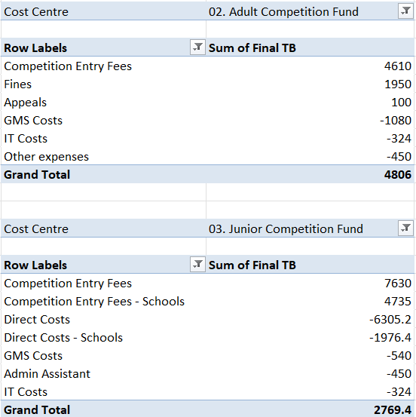
SE Hockey Financial Overview – 2024-25
Part 2 – Draft accounts 2024-25 Profit and Loss – Adult and Junior Competition
Adult league entry remained @ £10 per team and will continue at that level. More significant fines, set aside to support South East Hockey Futures.
Costs include trophies for Premier Division winners and a share of email and GMS costs, plus generation of fixtures. No outstanding entry fees. Looking to contribute towards umpire development from reserves.
Junior competition fees now split between clubs and schools. Costs have been predominantly for provision of pitches for club In2H competitions and medals for all competitions with a contribution towards email and GMS. Fees vary for schools and clubs. Some schools yet to pay entry fees.

Slide 6
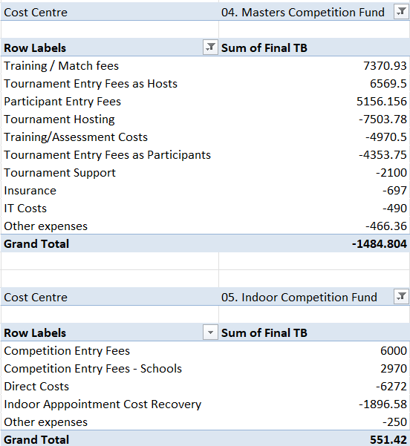
SE Hockey Financial Overview – 2024-25
Part 2 – Draft accounts 2024-25 Profit and Loss – Masters and Indoor
Masters includes 2024 tournaments and 2024-25 assessments and training. Training income affected by poor weather and clashes with England Masters training. Further income from tournaments we hosted (3). Insurance covers each age group team.
Support for Team Managers/Coaches plus one-off acquisition of promotional material has resulted in an in-period deficit.
Indoor covers clubs’ adult & junior events held at Polo Farm, and schools’ events for which we are grateful to a number of schools for hosting at no cost. Umpire costs are absorbed into the fees paid by entrants which remained at £175 per adult team / £150 per junior team this season despite Polo Farm reverting to a single pitch venue.

Slide 7
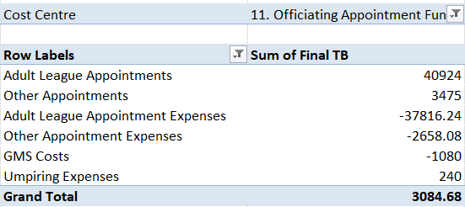
SE Hockey Financial Overview – 2024-25
Part 2 – Draft accounts 2024-25 Profit and Loss – Umpire Appointments
Umpire appointment fees for Adult league fixtures were kept at £30 per Premier appointment, £22 for East/West and £17 for sub-area divisions. The appointment fees this season have pretty much reflected umpire expenses and there is no plan to change them or the umpire reimbursement rate in 2025-26.
Any surplus will be transferred to the Umpire Development fund to support initiatives being put forward for club and appointment taking umpires.
There are a number of umpires yet to put in claims but this will not materially impact the reported accounts. “Umpiring Expenses” showing as income is reversal of 2023-24 accrual of unclaimed items shown in appropriate accounts this year.

Slide 8
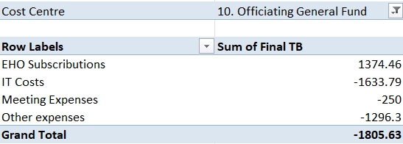
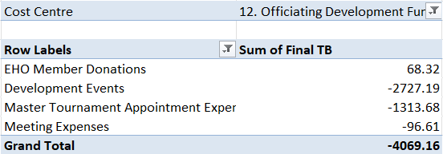
SE Hockey Financial Overview – 2024-25
Part 2 – Draft accounts 2023-24 Profit and Loss – Officiating General and Development
Umpire general fund relies on income from EHO subscriptions which were very similar to the two previous years. New IT equipment has been obtained for the EHO Committee’s use, with ownership retained by SE Hockey.
Umpire development receives no income aside from minimal donations from EHO members. There were a number of Development events, including officiating at Masters Tournaments, and meetings for which costs were incurred. There is planned to be a significant increase in umpire development activities in 2025-26 that will be funded by donations received previously and reserves from other cost centres.

Slide 9
SE Hockey Financial Overview – 2024-25
Part 2 – Draft Accounts 2024-25 Summary
As hoped, South East Hockey has essentially broken even this year from operations with the surplus coming predominantly from Fines, the generosity of Schools in hosting Indoor events at no cost and Bank Interest.
As a result, once again, South East Hockey is not proposing to change fee levels for any competition entry or appointments.
South East Hockey have appointed JD O’Brien to run South East Hockey Futures with expectation of using substantial parts of our reserves to promote State School hockey over the next three years. Clubs will shortly be asked to express interest in receipt of these funds for programmes they are running.
South East Hockey is also discussing supporting financially some of the volunteers who taken on the most arduous roles from the funds already accumulated.
As Companies House is planning to change how Annual Accounts are filed, I will be investigating transferring all current surpluses to ‘Reserves’ in FY 2025-26.

